Slide 1
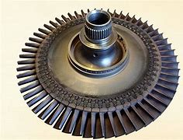
From Open Source
Notes:
This Joint Venture is targeted for Aero Engine Fabrication part families.

Slide 2
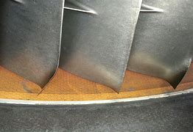
From Open Source

Slide 3
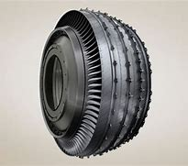
From Open Source

