Slide 1
Project 5: Sentiment analysis for marketing
Phase 1: Problem Definition and Design Thinking
Problem Definition:
The problem is to perform sentiment analysis on customer feedback to gain insights into competitor products. By understanding customer sentiments, companies can identify strengths and weaknesses in competing products, thereby improving their own offerings. This project requires utilizing various NLP methods to extract valuable insights from customer feedback.

Slide 2
Example problem
A company wants to understand customer sentiment regarding their newly launched smart phone. They have collected a large dataset of customer reviews and social media comments about the phone. The company aims to analyze this data to gain insights into how customers perceive their product. Specifically, they want to:
Sentiment Classification: Classify each customer comment or review into one of three categories: Positive, Negative, or Neutral sentiment
Key Insights: Identify the key features or aspects of the smart phone that customers are praising or criticizing the most.
Trend Analysis: Determine if sentiment towards the smart phone has changed over time, especially after certain marketing campaigns or product updates.

Slide 3
Design Thinking
Data collection
Identify a dataset containing customer reviews and sentiments about competitor products.
2. Data preprocessing
We will use NumPy and pandas library for manipulating the dataset
TensorFlow for creating and training the machine learning model
Import the necessary libraries that u will use to preprocess the data and create the model

Slide 4
import numpy as np
import pandas as pd
import tensorflow as tf
from sklearn.model_selection
import train_test_split
from sklearn.metrics
import accuracy_score
from tensorflow.keras.preprocessing.text
import Tokenizer
from tensorflow.keras.preprocessing.sequence
import pad_sequences
from tensorflow.keras.models
import Sequential
from tensorflow.keras.layers
import Embedding, Conv1D, GlobalMaxPooling1D, Dense, Dropout
import pickle5 as pickle

Slide 5
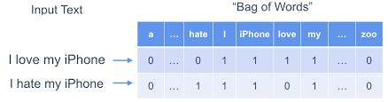
3. Sentiment analysis techniques:
Employ different NLP techniques like Bag of Words, Word Embeddings, or Transformer models for sentiment analysis.

Slide 6
4. Feature Extraction: Extract features and sentiments from the text data
An automatic keyword extraction algorithm identifies the most frequently mentioned features or aspects of the iPhone 12S Pro in these tweets.
Example Tweet Stream:
User A tweets: "Just got my hands on the new #iPhone12SPro, and the camera quality is mind-blowing! #TechGizmo #Impressed" Sentiment: Positive
Key Feature: Camera quality
User B tweets: "Battery life on the #TechGizmo iPhone 12S Pro is terrible! I expected better. #Disappointed"
Sentiment: Negative
Key Feature: Battery life
3. User C tweets: "The design of the #iPhone12SPro is sleek and stylish. Loving it! #TechGizmo #HappyCustomer"
Sentiment: Positive
Key Feature: Design

Slide 7
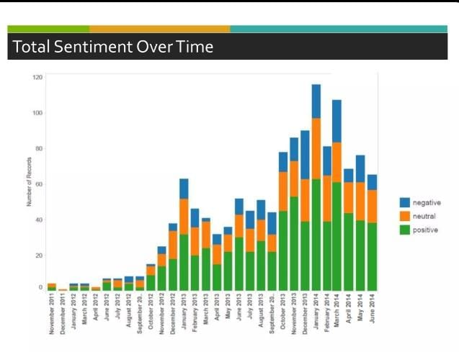
5. Visualisation: Create visualizations to depict the sentiment distribution and analyze trends.

Slide 8
6. Insights Generation: Extract meaningful insights from the sentiment analysis results to guide business decisions.
Due to their secrecy, innovation, branding and product to product connectivity and compatibility, Iphone is the most sought after mobile device and is the market leader in the mobile market.

