Slide 1
[SMART JOB RECOMMENDATION SYSTEM AND SMART RESUME SCREENING]
Final Project Review |Department of Computer Science and Engineering] | [K L (Deemed to be) University]
TEAM MEMBERS
[2420030289] – [P. Sri Durga]
[2420030304] – [K. Dharani Harika]
[2420030311] – [G. Usha Sai Bhavani]
Guide: [B. Prathusha, Assitant Professor] | Academic Year: [2026–27]
Notes:
Title slide. Replace all bracketed text. Use the full project title, list every team member with registration number, and name your guide. Insert the institution logo in the dashed box.

Slide 2



Introduction & Problem Statement
Background
Candidates often struggle to find job opportunities that match their skills and qualifications.
A job recommendation system helps users discover relevant openings based on their resume and skills.
Problem Statement
candidates often struggle to find relevant job opportunities matching their skills and qualifications. Therefore, a system is needed to simplify resume screening and recommend suitable job opportunities based on resume content and skills.
Motivation / Need
Helps candidates discover relevant job openings based on their resume and skills.
Saves time by reducing the effort required to search for suitable job opportunities.
Notes:
State the domain, the exact problem and why it matters. Keep it to about 2 minutes. Add one real-world statistic if you can, with a citation.

Slide 3


Objectives & Scope
Objectives
1
Develop a resume-based job recommendation system.
2
Extract skills and qualifications from resumes.
3
Recommend relevant job opportunities based on candidate profiles.
4
Display job details, company information and application links.
Notes:
Objectives should be measurable and start with action verbs. The scope slide tells the panel what you did and did not attempt.

Slide 4

Literature Survey
S.No | Author(s) & Year | Method / Technique | Key Findings | Limitation / Gap
1 | Gugnani & Misra (2020) | Skill extraction, Doc2Vec | Improved resume–job matching through skill extraction. | Limited understanding of job context and experience.
2 | Tejaswini et al. (2022) | TF-IDF, Cosine Similarity, KNN | Ranked resumes based on job description similarity. | Mainly depends on keyword similarity.
3 | ICSSAS Study (2023) | NLP, GNN, TF-IDF | Combined resume analysis with job recommendations. | Requires complex models and computational resources.
4 | AIMS Study (2024) | Word2Vec, TF-IDF, Distance algorithm | Compared different techniques for recommending suitable jobs. | Recommendation quality depends on available job data.
Research Gap
Existing systems use different matching techniques, but there is a need for a simple integrated platform that provides resume-based job recommendations and live job listings.
Notes:
Summarise four to six relevant papers or existing systems. End with the research gap, because that gap justifies your project.

Slide 5





Proposed System & Methodology
STEP 1
STEP 2
STEP 3
STEP 4
STEP 5
Define Problem
Collect Data
Design
Implement
Test & Evaluate
Difficulty in finding suitable job opportunities based on candidates' skills, qualifications, and experience.
Collect resumes and job listings using the Himalayas Jobs API.
Architecture of the system, including resume parsing, skill extraction, job matching and recommendation.
Divides the application into resume processing, job matching and recommendation modules.
Test resume processing, job recommendations, matching scores and skill gap analysis.
Key Novelty / Contribution
Combines automated resume analysis, skill-based job recommendations and skill gap analysis to help candidates find relevant job opportunities and improve their skills.
Notes:
Walk through the five steps left to right. Rename the steps to match your project (for example, Requirement Analysis, Design, Coding, Testing, Deployment). End with your novelty.

Slide 6
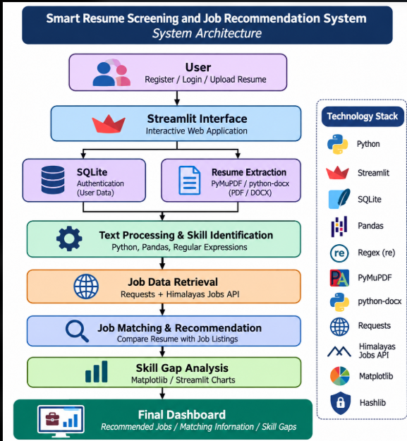
System Architecture
Components
[Insert system architecture / block diagram
(Input → Processing → Output)]
1
[User Management
Handles user registration, login and resume uploading through the application
Resume Processing
Extracts text from PDF/DOCX resumes and identifies candidate skills and qualifications.
2
3
Job Recommendation
Retrieves job listings from the Himalayas Jobs API and matches them with candidate skills.
4
Skill Gap Analysis & Dashboard
Identifies missing skills and displays recommended jobs, matching scores and skill analysis .
Notes:
Insert a clear block diagram: input, processing, storage, output. Number each block and explain them on the right. Redraw the figure yourself rather than copying it.

Slide 7


Hardware & Software Requirements
Hardware
Software & Tools
Libraries / Frameworks
Operating System: Windows 10/11
Programming Language: Python 3.x
IDE: VS Code / Jupyter Notebook
Version Control: Git and GitHub
Processor: Intel Core i3 or above
RAM: 4 GB minimum (8 GB recommended)
Storage: 256 GB HDD/SSD
Network: Internet connection
Pandas – Data processing
PyMuPDF – PDF text extraction
python-docx – DOCX text extraction
Requests – API integration
SQLite – Database management
Matplotlib / Seaborn – Data visualization
Deployment / Platform: python streamlit
Notes:
List only what you actually used, with versions. For a pure software project, shorten the hardware list and add cloud or deployment resources.

Slide 8
Module-wise Description
1
User Management & Resume Upload
2
Resume Extraction & Preprocessing
Purpose: Handles user registration, login and resume uploading.
Input → Output: User details and PDF/DOCX resume → Uploaded resume and user account.
Purpose: Extracts resume text and identifies technical skills.
Input → Output:PDF/DOCX resume → Cleaned text and identified skills.
3
Job Retrieval & Recommendation
4
Skill Gap Analysis & Dashboard
Purpose: Retrieves job listings and recommends suitable jobs based on candidate skills.
Input → Output:Candidate skills and job requirements → Recommended jobs and matching percentage.
Purpose: Identifies missing skills and displays job recommendations and skill analysis.
Input → Output: Candidate skills and job requirements → Matched skills, missing skills and dashboard insights.
Notes:
Divide the project into three to five modules. For each, state its purpose, inputs, outputs and who built it. Duplicate a card if you have more modules.

Slide 9
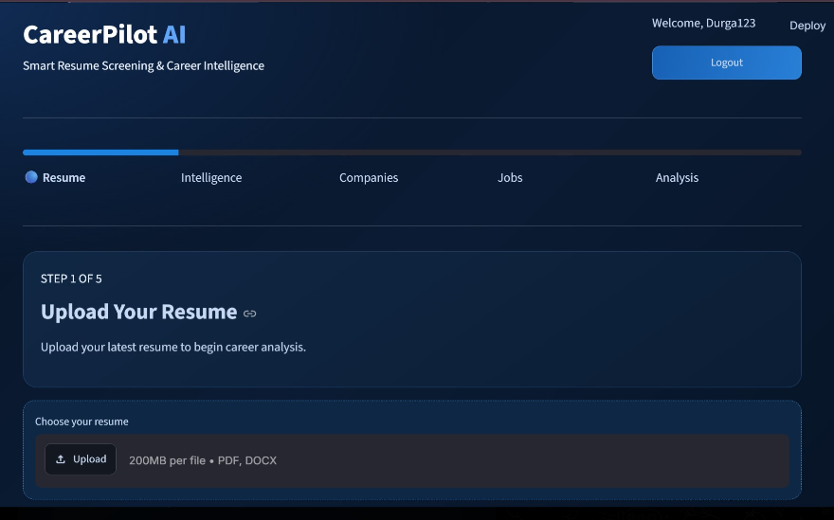
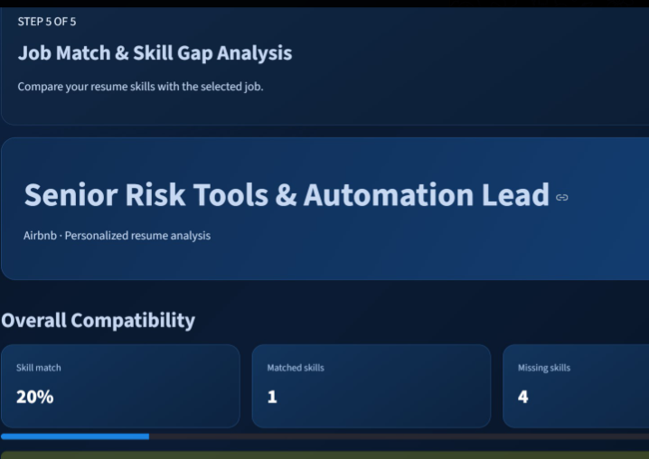
Working Prototype / Output Screens
[Screenshot / photo 1]
[Screenshot / photo 3]
Notes:
Show real screenshots, photos of the hardware or a short demo video link. Caption each one with what the viewer should notice.

Slide 10


Challenges & Limitations
Challenges Faced
Limitations
Resume Format Variations → Used PyMuPDF and python-docx to extract text from PDF and DOCX files.
Unstructured Resume Text → Applied Python Regex and text preprocessing to clean content and identify technical skills.
Job Data Retrieval → Integrated the Himalayas Jobs API using the Requests library to retrieve job listings and descriptions.
Limited File Support – Currently supports PDF and DOCX formats only.
Scanned Resume Limitation – Scanned documents may require OCR for text extraction.
Skill Identification – The predefined skill list may not recognize every technical skill.
Notes:
Be candid. Pair every challenge with how you solved it, and list limitations that the panel would otherwise spot themselves.

Slide 11

Conclusion
Developed a Smart Job Recommendation and Resume Screening System using Python and Streamlit. It extracts information from PDF/DOCX resumes and retrieves job listings through the Himalayas Jobs API.
1
Final Outcome
The system identifies candidate skills, compares them with job requirements, calculates a matching percentage and recommends relevant job opportunities.
[XX%]
2
[Headline metric or achievement]
Objectives achieved: [x of y]
The system provides resume uploading, text extraction, skill identification, job recommendations and skill gap analysis through an interactive dashboard.
3
Notes:
Revisit each objective and say whether you met it. Quote your headline result with numbers. Do not introduce new material here.

Slide 12




Future Scope & Applications
Enhance skill-matching algorithms using advanced AI and NLP techniques to improve recommendation relevance.
Applications
Job Seekers – Find suitable jobs based on resume skills.
Recruitment Teams – Assist in initial resume screening.
Career Guidance – Identify missing skills and improvement areas.
Educational Institutions – Help students understand industry skill requirements.
Add more job sources, support additional resume formats and expand the technical skill database.
Deploy the Streamlit application online and develop a more user-friendly web or mobile interface.
Implement cloud deployment, improve data security and support more users with reliable performance.
Notes:
Give concrete next steps, ideally tied to the limitations. Then name two or three real-world uses.

Slide 13
THANK YOU
Questions & Discussion
TEAM-22
Notes:
Leave this slide up during questions. Make sure every team member can answer questions about their own module.

