Slide 1


BLUESTOCK Mutual Fund Analytics Project
Bluestock Internship Project Submitted By: Sri Gouri Sundara Tools Used: Python | Pandas | SQLite | Power BI | JUPYTER Notebook

Slide 2
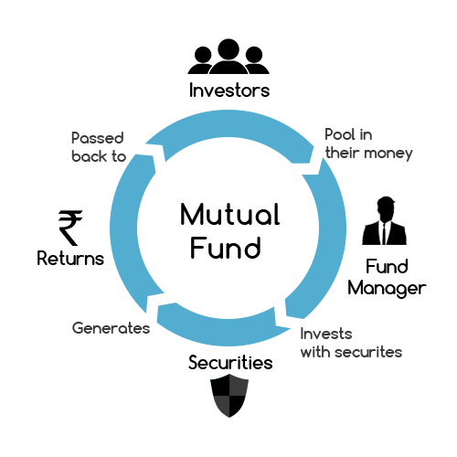
Problem Statement
The Indian Mutual Fund industry has experienced rapid growth in assets under management (AUM), SIP inflows, and investor participation.
However, investors face challenges in:
• Comparing fund performance
• Understanding risk
• Tracking market trends
• Selecting suitable funds
The objective of this project is to build a complete analytics solution that transforms mutual fund data into actionable insights.

Slide 3

Project Objectives
• Build an ETL pipeline for mutual fund datasets
• Design a structured SQLite database
• Perform Exploratory Data Analysis (EDA)
• Calculate performance metrics such as:
- CAGR
- Sharpe Ratio
- Sortino Ratio
- Alpha & Beta
• Develop advanced risk analytics:
- VaR
- CVaR
- Rolling Sharpe
• Build an interactive Power BI dashboard
• Generate fund recommendations

Slide 4
Data Sources
Datasets:
Fund Master
NAV History
AUM by Fund House
Monthly SIP Inflows
Category Inflows
Industry Folio Count
Scheme Performance
Investor Transactions
Portfolio Holdings
Benchmark Indices
Total Datasets Used: 10
Total Mutual Fund Schemes: 40

Slide 5
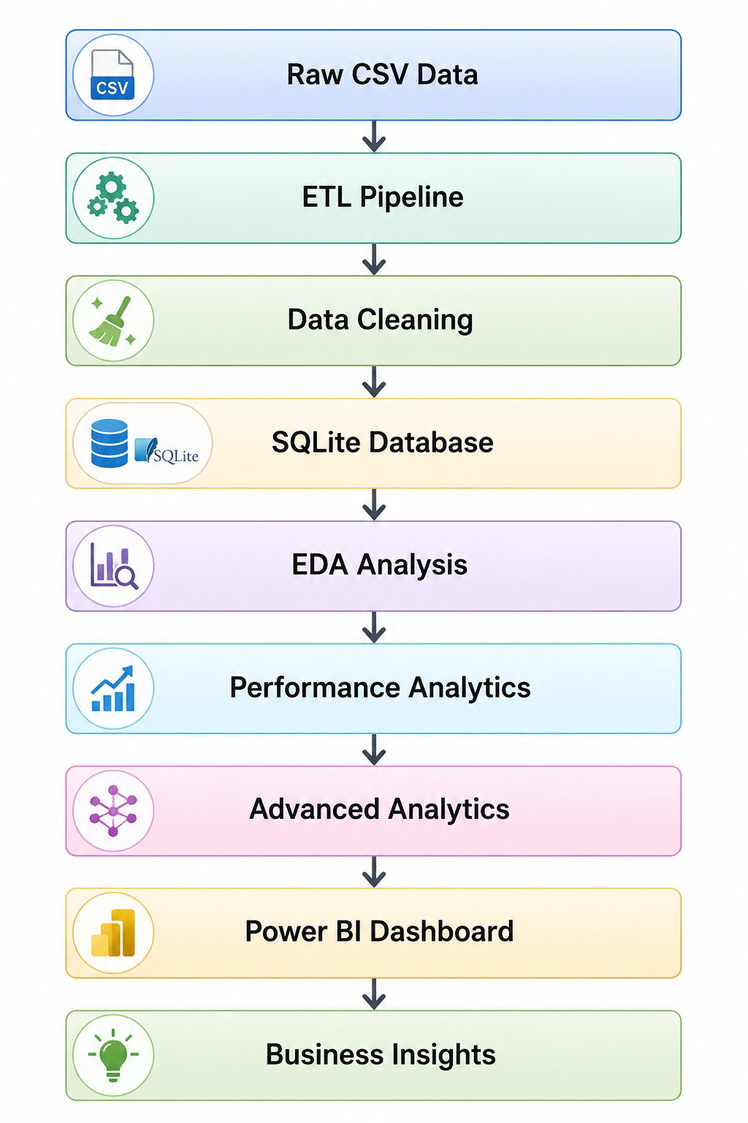
Project Architecture

Slide 6
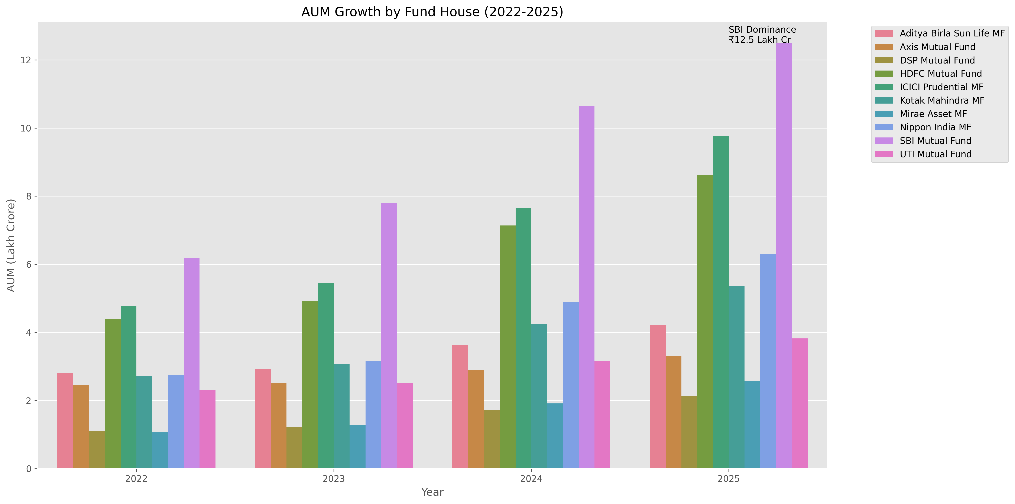
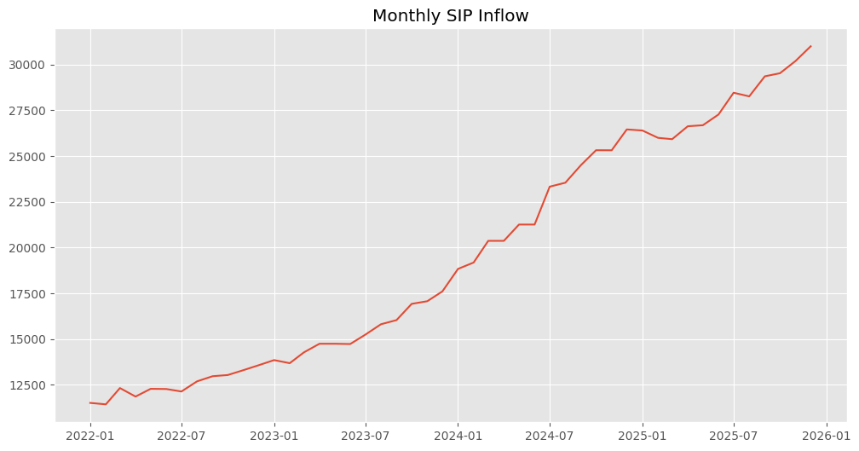
EDA Highlights
• SIP inflows increased steadily between 2022 and 2025
• AUM growth shows strong expansion of the mutual fund industry
• Equity-oriented schemes dominate investor interest
• Industry folio counts nearly doubled during the study period

Slide 7
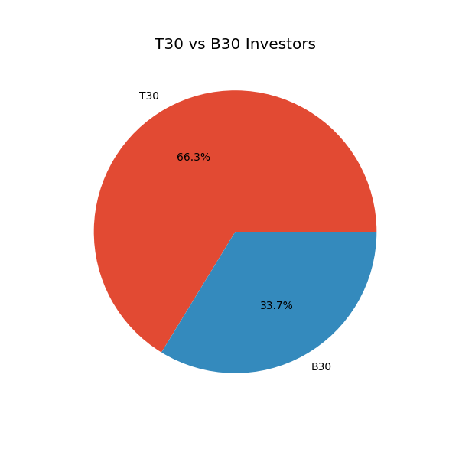
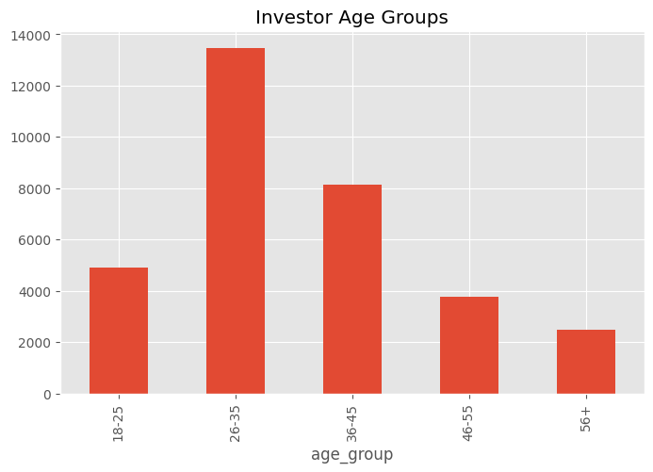
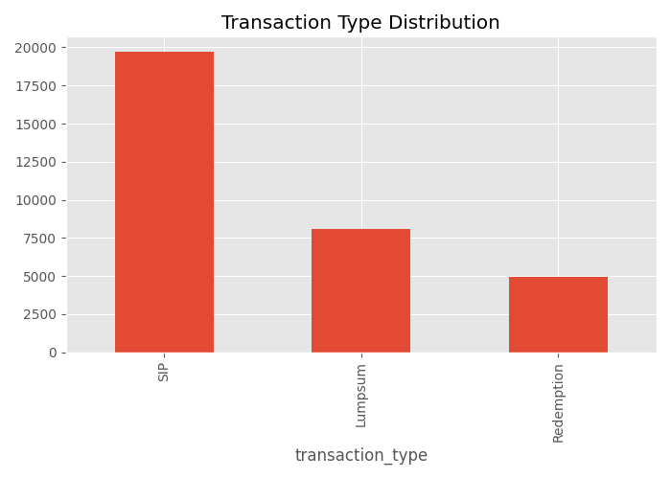
Investor Analytics
• Investors are concentrated in major states
• T30 cities contribute significant investment volume
• SIP is the most preferred investment mode
• Younger investors show increasing participation

Slide 8
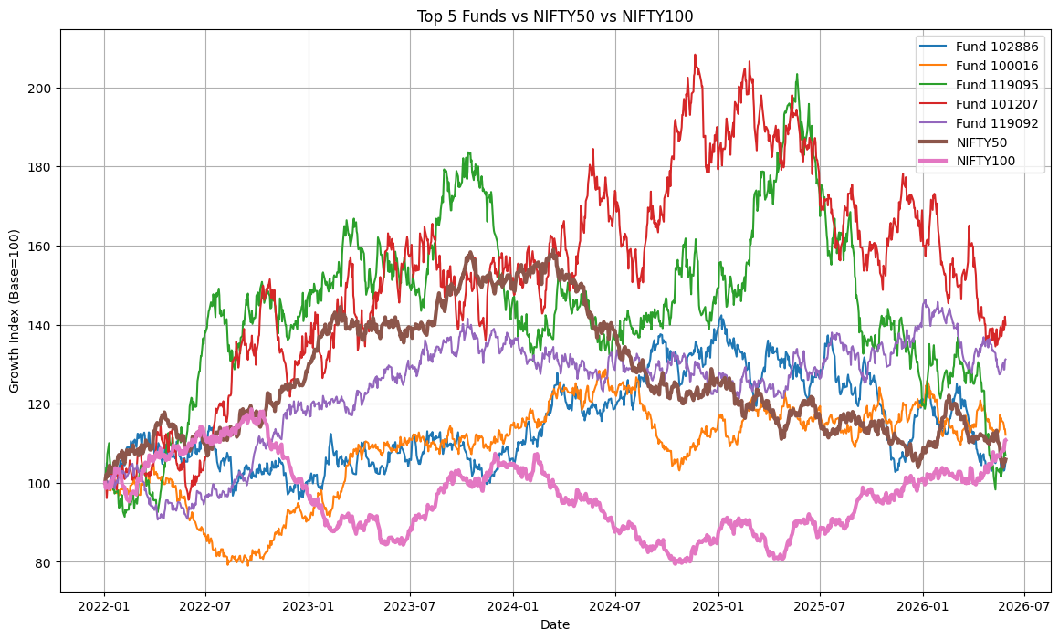
Fund Performance Analytics
Metrics Calculated:
• CAGR (1Y, 3Y, 5Y)
• Sharpe Ratio
• Sortino Ratio
• Alpha
• Beta
• Maximum Drawdown
• Tracking Error
• Composite Fund Score
Fund 101207 delivered the strongest overall performance, peaking above 200 (Base = 100) during 2024–2025 and finishing well above most other funds, indicating superior long-term growth.
Fund 119095 showed high growth but also high volatility, reaching levels above 180–200 before experiencing significant drawdowns, suggesting higher return potential with greater risk.
Most top funds outperformed NIFTY50 and NIFTY100 over the analysis period, particularly Funds 101207, 119095, and 119092, demonstrating stronger wealth creation than the benchmark indices.

Slide 9
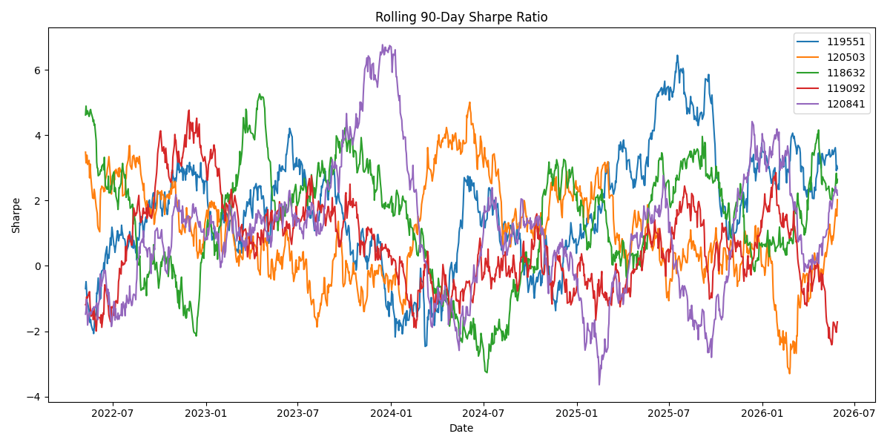
Advanced Risk Analytics
Risk Metrics Implemented:
• Historical VaR , Rolling 90-Day Sharpe Ratio , HHI Portfolio Concentration Index
• Conditional VaR (CVaR) , SIP Continuity Analysis , Investor Cohort Analysis

Slide 10

Dashboard Overview
Industry Overview
Investor Analytics
Fund Performance
Sip & Market Trends
Features:
• Interactive slicers
• KPI cards
• Fund drill-through
• Trend analysis
• Investor analytics

Slide 11
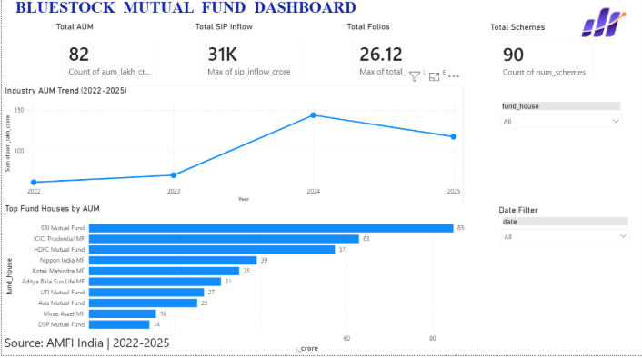
Power BI Dashboard [Industry overview]
Industry AUM grew strongly between 2022 and 2024, indicating rising investor participation and expanding opportunities for asset management companies.
Market share is concentrated among a few large fund houses, with SBI Mutual Fund, ICICI Prudential, and HDFC Mutual Fund leading in AUM, highlighting a highly competitive but concentrated industry structure.
Strong SIP inflows and a large scheme base suggest sustained retail investor interest, supporting long-term growth potential for the mutual fund industry.

Slide 12
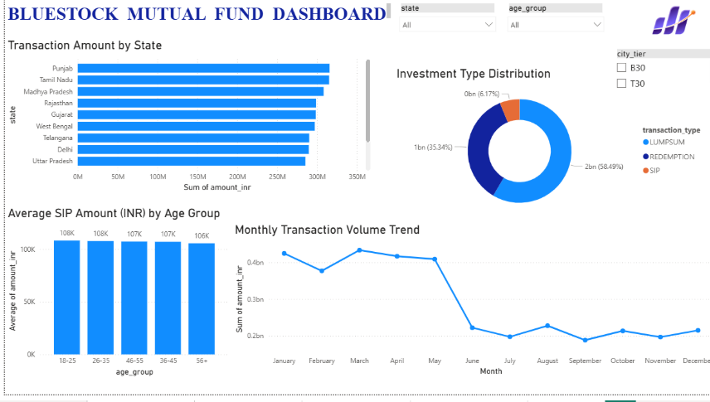
Power BI Dashboard [investor analytics]
Investment participation is geographically diversified, with states such as Punjab, Tamil Nadu, and Madhya Pradesh contributing the highest transaction volumes, indicating broad retail investor engagement across regions.
Lumpsum investments dominate transaction value (≈58%), significantly exceeding SIP and redemption volumes, suggesting investors are allocating larger one-time investments during the analysis period.
Average SIP amounts are consistent across age groups (~₹106K–₹108K), showing that mutual fund adoption and investment capacity are relatively balanced among different generations of investors.

Slide 13
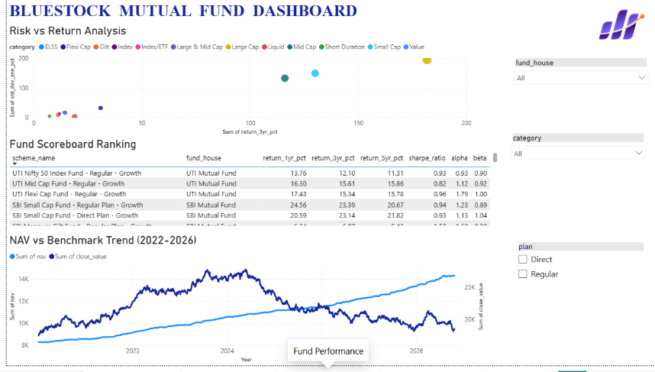
Power BI Dashboard [fund performance]
Higher-risk fund categories generally delivered higher returns, as shown in the Risk vs Return analysis, indicating a positive risk–reward relationship for investors seeking long-term growth.
Several UTI and SBI schemes rank among the top-performing funds, demonstrating strong consistency across return metrics, Sharpe Ratio, Alpha, and Beta scores.
Benchmark indices showed steady long-term growth from 2022–2026, while individual fund NAVs experienced greater fluctuations, highlighting the importance of diversification and active fund selection.

Slide 14
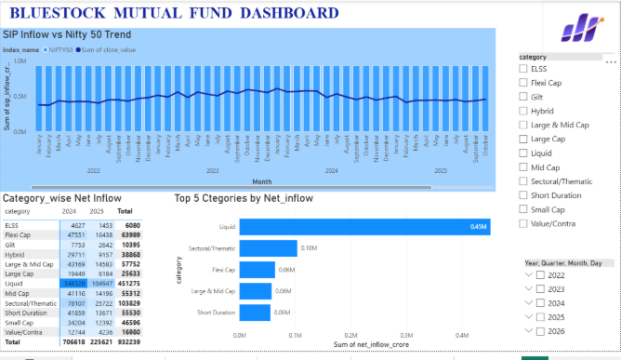
Power BI Dashboard [sip & market trends]
SIP inflows remained relatively stable from 2022–2025, indicating consistent retail investor participation despite fluctuations in the NIFTY 50 index.
Liquid Funds attracted the highest net inflows (≈0.45M crore), significantly outperforming other categories, suggesting investors prioritized liquidity and lower-risk investment options.
Sectoral/Thematic and Flexi Cap categories emerged as strong growth segments, reflecting increasing investor interest in diversified and theme-driven investment strategies.

Slide 15
Key Findings & Recommendations
FINDINGS:
• Several funds achieved superior Sharpe Ratios indicating better risk-adjusted returns.
• SIP inflows showed consistent growth over the analysis period.
• High HHI funds demonstrate greater portfolio concentration risk.
• Investor cohorts entering in recent years contributed larger investment amounts.
• Funds with high VaR values carry greater downside risk.
RECOMMENDATIONS:
• Prefer funds with strong Sharpe Ratios.
• Monitor concentration risk using HHI.
• Improve SIP continuity among at-risk investors.
• Use risk-grade based fund recommendations.
• Track rolling Sharpe ratios for performance monitoring.

Slide 16
THANK YOU

