Slide 1
SURVEY DATA ANALYSIS TOOL
Student Social Media Usage, Digital Dependency & Well-being
TEAM MEMBERS
Team Member 1: SriHansika Saraf-2420030556
Team Member 2: R.Jahnavi-2420030173
Team Member 3: T.Mounitha-2420030330
Notes:
Introduce the project title, domain (Data Science and Student Behaviour Analysis) and the team. Mention the guide and department.

Slide 2
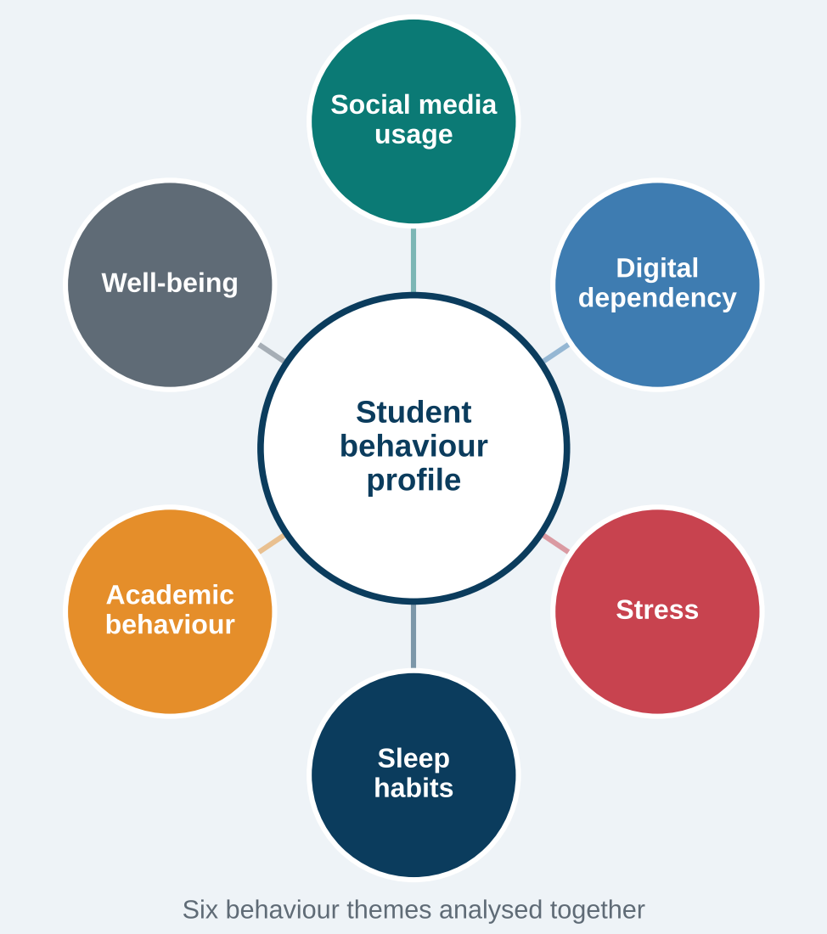



Introduction & Problem Statement
Background
Students spend ever more time online. Heavy social media use is linked in published studies to stress, poor sleep and lower well-being.
Problem Statement
Student habits (usage, dependency, stress, sleep, academics) sit scattered in raw survey data. We need a tool that cleans, analyses and classifies usage level.
Motivation / Need
Helps students, educators and counsellors spot usage patterns early. The tool describes behaviour; it does not diagnose addiction.
Notes:
Domain: student social media behaviour. Problem: raw survey data is hard to interpret; we built a Python tool to analyse and classify usage level. Emphasise that this is behavioural analysis, not clinical diagnosis.

Slide 3


Objectives & Scope
Objectives
In Scope
1
Collect, inspect and integrate three datasets using documented variable mapping.
Student social media behaviour survey (1 genuine + 399 simulated responses)
Two supplementary datasets, analysed separately
Classifying usage level: Low / Moderate / Heavy
Local Streamlit dashboard
2
Clean the survey and engineer behavioural scores (stress, sleep, dependency, well-being).
3
Analyse usage patterns with exploratory and statistical analysis.
Out of Scope
Clinical diagnosis of addiction or mental-health conditions
Claims about the whole student population
Online deployment of the dashboard
4
Build and compare five classifiers for usage level; present results in a local Streamlit dashboard.
Notes:
Four objectives on the left; scope on the right. Be explicit about what the project does not claim: no diagnosis, no population-level generalisation, no hosted deployment.

Slide 4

Literature Survey
S.No | Author(s) & Year | Method / Technique | Key Findings | Limitation / Gap
1 | Andreassen et al., 2012 [1] | Bergen Facebook Addiction Scale; survey of 423 students | Reliable, valid scale for measuring Facebook addiction | Self-report scale only; no ML prediction
2 | Kuss & Griffiths, 2017 [2] | Review: ten lessons on social networking addiction | Excessive use can be problematic for some users; definitions need care | Review only; no predictive modelling
3 | Hunt et al., 2018 [3] | Experiment: 143 students limited use for 3 weeks | Limiting use reduced loneliness and depression | Small, single-university sample
4 | Keles et al., 2020 [4] | Systematic review of 13 studies on adolescents | Social media use linked to depression, anxiety and distress | Mostly cross-sectional; cause unclear
5 | Fauziah et al., 2026 [5] | Random Forest vs XGBoost on 705 student responses | Very high accuracy (about 98.6% test) classifying addiction level | One public dataset; no independent validation
Research Gap
The works reviewed focus on addiction scales, reviews, interventions or a single dataset. This project adds an end-to-end pipeline combining usage, stress, sleep and well-being scores, with transparent disclosure of data limits.
Notes:
Five published works (references [1]-[5]) set the context. These are published research; our own findings appear from slide 8 onward. The gap: few works combine multiple behaviour dimensions into engineered features with honest data-quality reporting.

Slide 5





Proposed System & Methodology
STEP 1
STEP 2
STEP 3
STEP 4
STEP 5
Collect
Preprocess
Analyse
Model
Evaluate
Three datasets: a 400-row survey plus two supplementary sets.
Clean, integrate via variable mapping, engineer scores.
EDA, statistical analysis, then select 12 features.
Train five classifiers on a stratified 80/20 split.
Compare accuracy and weighted F1; show in Streamlit.
Key Novelty / Contribution
An end-to-end, reproducible Python workflow that turns survey answers into engineered behaviour scores and compares five classifiers, with honest disclosure of data limits.
Notes:
Walk the five steps left to right. Full workflow: Data Collection, Inspection, Integration, Preprocessing, EDA, Statistical Analysis, Feature Engineering, Feature Selection, Machine Learning, Evaluation, Insights, Streamlit Dashboard.

Slide 6
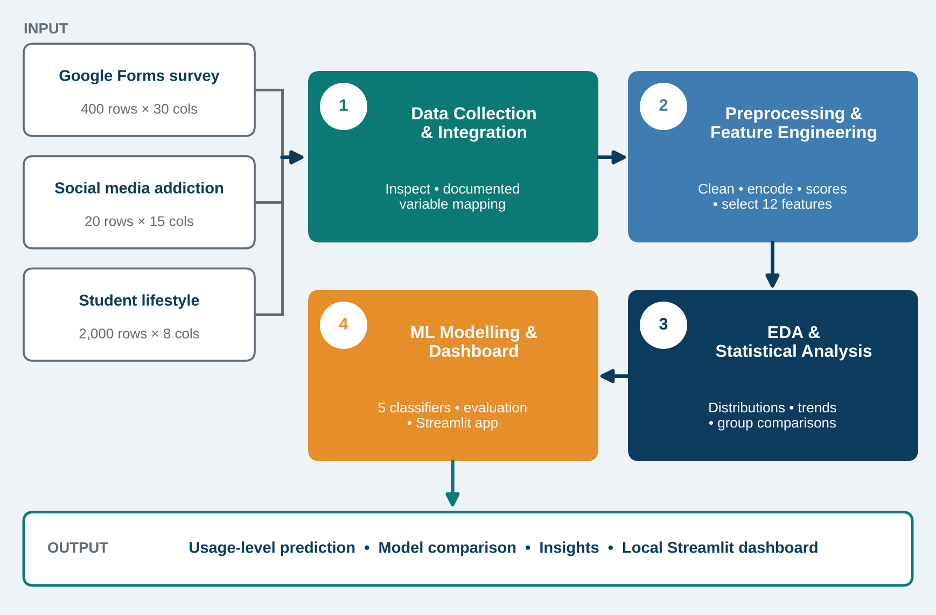
System Architecture
Components
1
Data Collection & Integration
3 datasets, variable mapping
2
Preprocessing & Features
Cleaning, 9 scores, 12 features
3
EDA & Statistics
Distributions, patterns, comparisons
4
ML Modelling & Dashboard
5 classifiers; local Streamlit app
Notes:
Input: three datasets. Processing: integration, preprocessing, feature engineering, EDA and statistics. Output: model results and a local Streamlit dashboard. Numbers match the four components on the right.

Slide 7


Hardware & Software Requirements
Hardware
Software & Tools
Libraries / Frameworks
Windows laptop / desktop
Local execution, no GPU required
Local disk for CSV / Excel data
Internet for Google Forms survey
Windows (local development)
Python 3.13
Visual Studio Code
Microsoft Excel
pandas, NumPy
Matplotlib, Seaborn
scikit-learn
joblib
Streamlit 1.65.0
Deployment / Platform: Developed and run locally on Windows; the Streamlit dashboard runs locally (not hosted online).
Notes:
Everything was developed and executed locally on Windows. Streamlit runs locally; there is no online deployment yet.

Slide 8
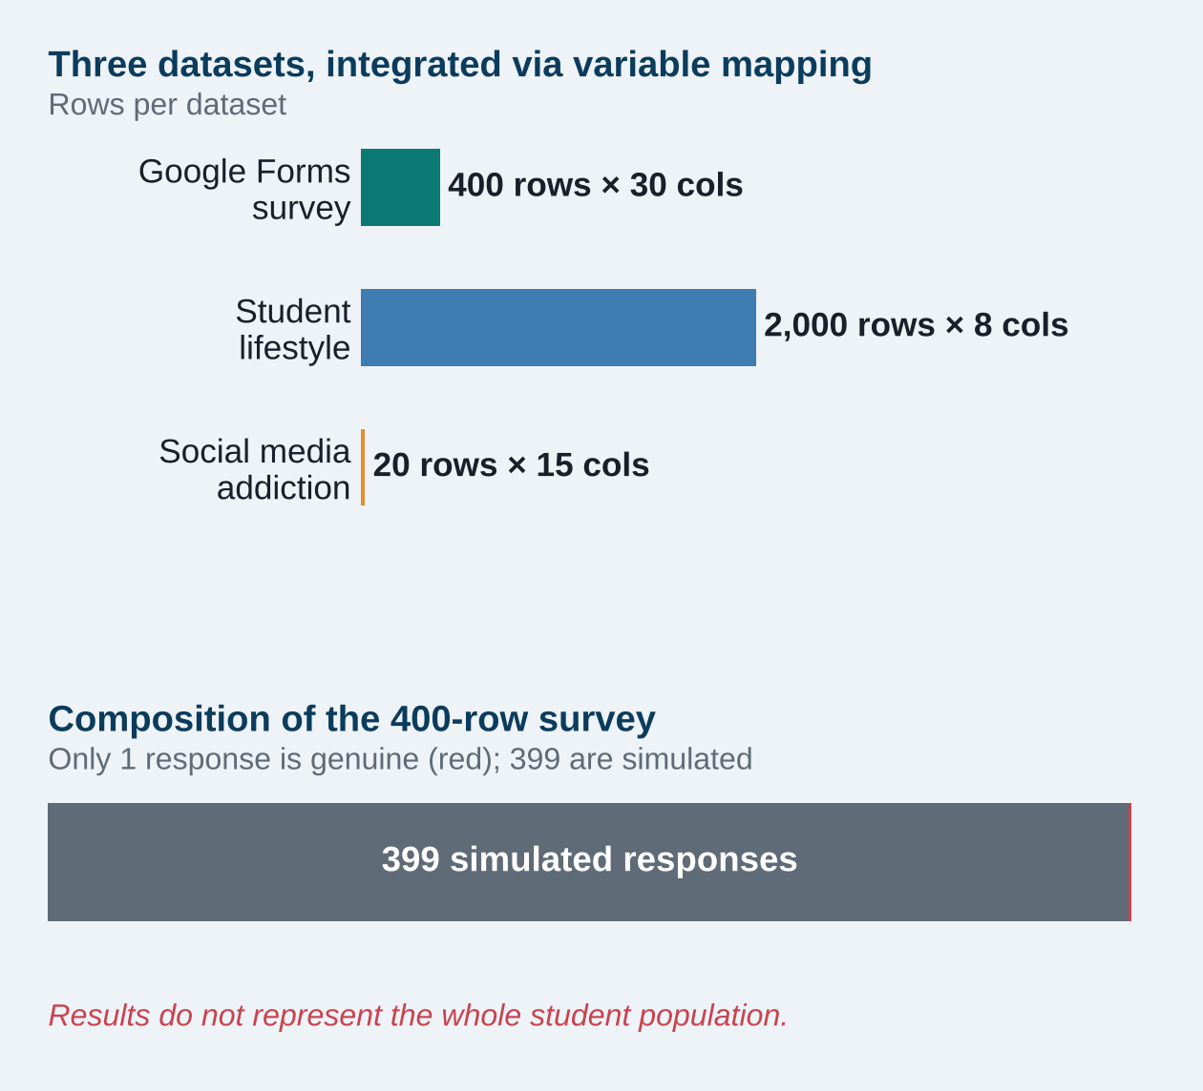
Dataset / Data Understanding
400
30
Survey records (rows)
Original columns
0
3
Missing values (cleaned)
Target classes
Survey: Google Forms; 1 genuine + 399 simulated responses
Supplementary: 20 × 15 and 2,000 × 8 datasets
Quality: 0 duplicates; Heavy class small (39)
Notes:
Disclose clearly: only one of the 400 survey responses is genuine; 399 are simulated. The two supplementary datasets were analysed separately and linked through documented variable mapping, not blindly concatenated.

Slide 9
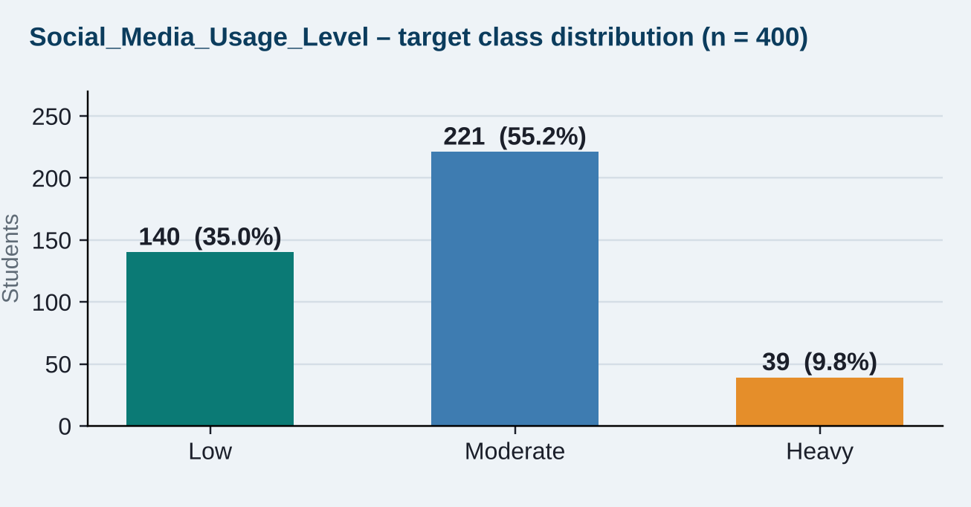
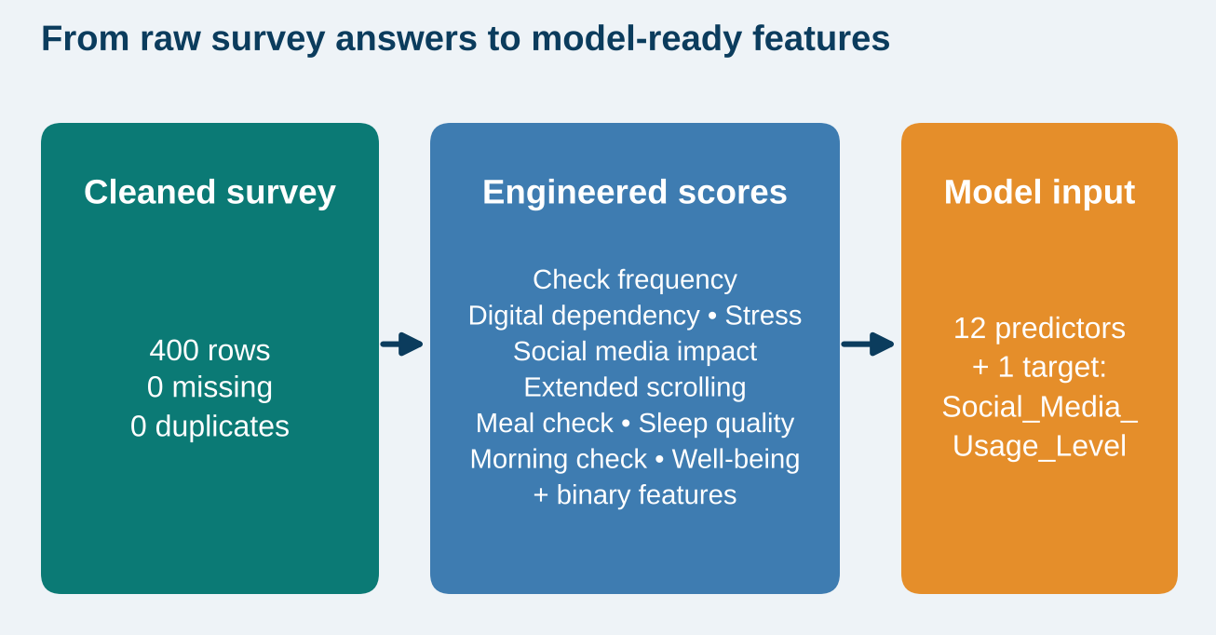



Data Preprocessing & Exploratory Analysis
Cleaning
Transformation
Feature Selection
Name removed (privacy); Age numeric; Timestamp datetime; 0 missing, 0 duplicates.
Numeric: median imputation + StandardScaler. Categorical: most-frequent imputation + OneHotEncoder.
9 engineered scores + binary features; 12 predictors and 1 target selected.
Notes:
Left: target class distribution (Low 140, Moderate 221, Heavy 39) shows imbalance. Right: how raw answers become 12 model-ready predictors. Add EDA plots from the project notebook here if desired.

Slide 10
Module-wise Description
1
Data Collection & Integration
2
Preprocessing & Feature Engineering
Purpose: Collect, inspect and integrate three datasets
Input → Output: Survey + 2 datasets → mapped, integrated data
Developed by: [Team Member 1]
Purpose: Clean data; build 9 scores and binary features
Input → Output: Raw survey → 12 predictors + target
Developed by: [Team Member 2]
3
EDA, Statistics & ML Modelling
4
Streamlit Dashboard & Reporting
Purpose: Analyse patterns; train and compare 5 classifiers
Input → Output: Model-ready data → metrics, best model
Developed by: [Team Member 3]
Purpose: Present data, charts and results (local app)
Input → Output: Cleaned data and results → dashboard views
Developed by: [Team Members 1–3]
Notes:
Four modules. Replace the bracketed team-member names with the real owner of each module.

Slide 11

Algorithms & Technologies Used
Logistic Regression
Decision Tree & Random Forest
KNN & SVM
Why chosen
Interpretable multi-class baseline. Best weighted F1 here (51.60%).
Key settings
Shared preprocessing pipeline; random_state = 42
Why chosen
Learn non-linear rules; the forest averages many trees. RF 46.25%, DT 43.75% accuracy.
Key settings
Shared pipeline; random_state = 42
Why chosen
Distance- and margin-based models for scaled scores. KNN 52.50%, SVM 41.25% accuracy.
Key settings
Shared pipeline; features scaled
Selection criteria: highest weighted F1 on the held-out test set → Logistic Regression.
Technologies: Python 3.13, pandas, NumPy, scikit-learn, Matplotlib, Seaborn, Streamlit, joblib.
Notes:
Five algorithms were compared. Logistic Regression won on weighted F1. Models were not extensively tuned, so results are baseline-level.

Slide 12
Implementation / Model Building
Feature Selection
Code snippet (simplified)
12 predictor features plus 1 target (Social_Media_Usage_Level) from engineered scores.
# Simplified from the project pipeline
X_train, X_test, y_train, y_test = \
train_test_split(X, y, test_size=0.2,
stratify=y, random_state=42)
numeric = Pipeline([
("impute", SimpleImputer(strategy="median")),
("scale", StandardScaler())])
categorical = Pipeline([
("impute", SimpleImputer(
strategy="most_frequent")),
("onehot", OneHotEncoder())])
pipe = Pipeline([("prep", preprocessor),
("model", model)])
pipe.fit(X_train, y_train)
Preprocessing Pipeline
Numeric: median imputation + StandardScaler. Categorical: most-frequent imputation + OneHotEncoder.
Data Splitting
Stratified 80/20 split: 320 training and 80 testing records (random_state = 42).
Configuration
Five classifiers. Classes: Low 140, Moderate 221, Heavy 39. Best chosen by weighted F1.
Notes:
Build order: select features, define the preprocessing pipeline, split with stratification, train five models inside the same pipeline.

Slide 13
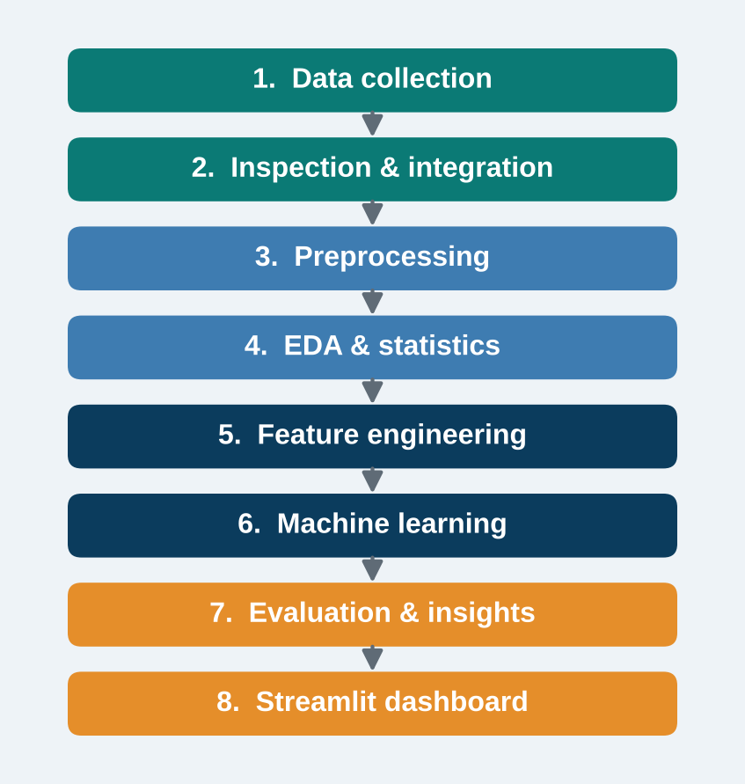
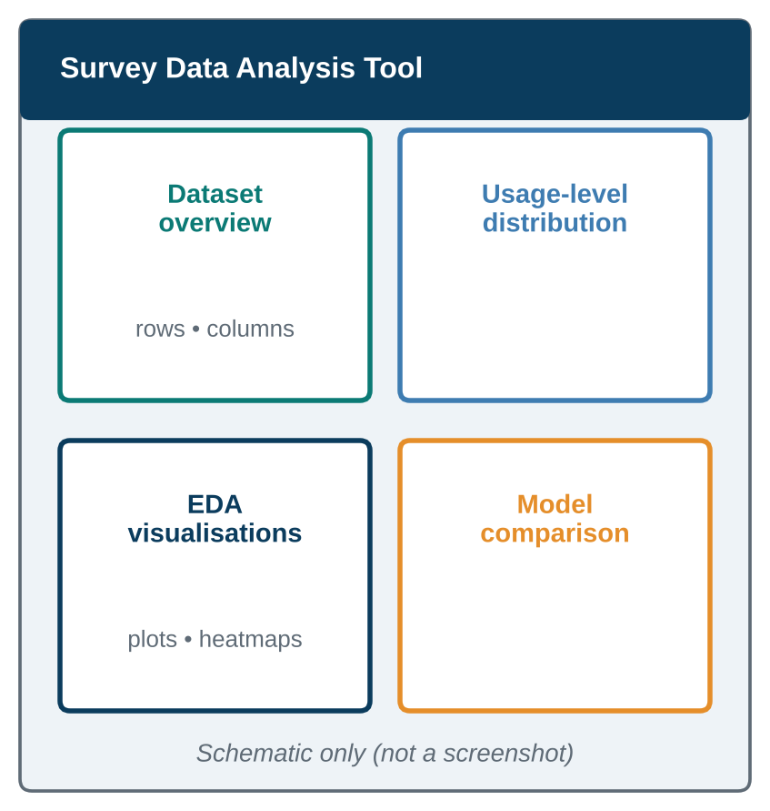
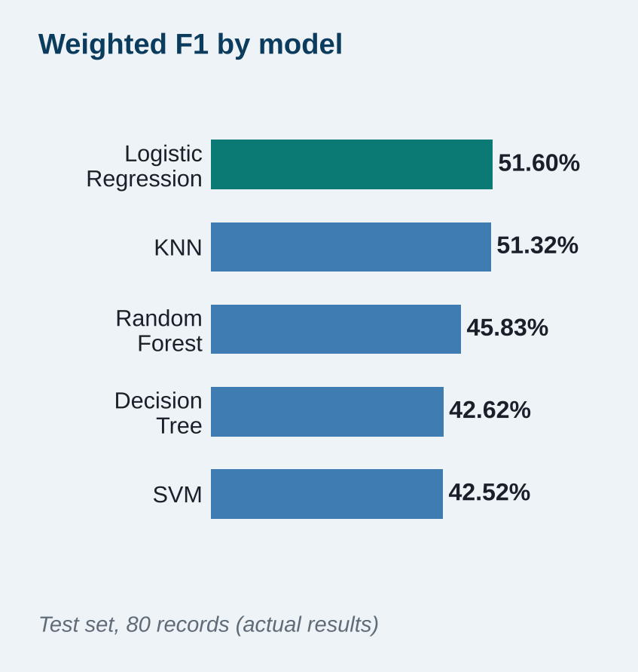
Working Prototype / Output Screens
End-to-end workflow
Pipeline stages from data to dashboard
Dashboard layout
Schematic of sections (not a screenshot)
Model comparison
Weighted F1 of the five classifiers
Notes:
These are schematic and chart visuals, not screenshots. Replace the middle panel with a real Streamlit screenshot when presenting if available.

Slide 14
Results & Performance Comparison
Model | Accuracy | Wtd F1
Logistic Regression | 56.25% | 51.60%
KNN | 52.50% | 51.32%
Random Forest | 46.25% | 45.83%
Decision Tree | 43.75% | 42.62%
SVM | 41.25% | 42.52%
Best: Logistic Regression
Weighted F1 51.60% | Precision 49.58% | Recall 56.25%
Models ranked by weighted F1. Precision and recall are reported for the best model only. Results come from a small test set (80 records) and mostly simulated survey data.
Notes:
Logistic Regression is best on weighted F1 (51.60%); KNN is very close (51.32%). Performance is moderate. Weighted precision and recall are available only for Logistic Regression, so no values are shown for other models.

Slide 15
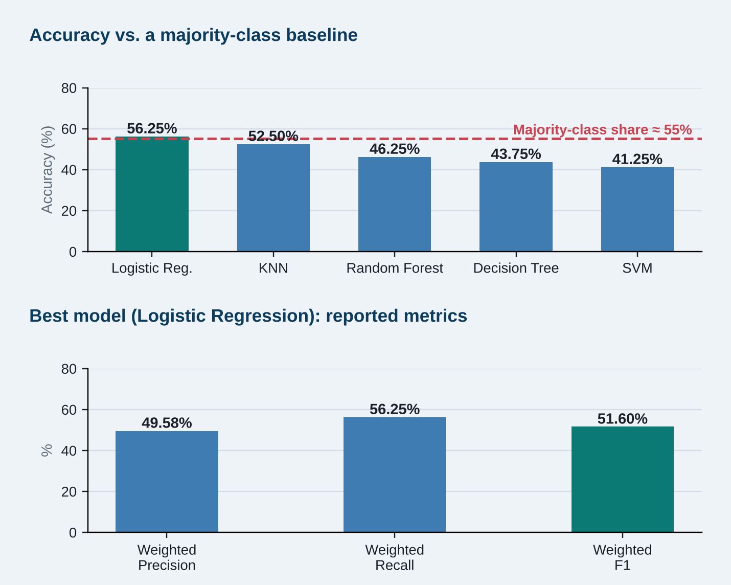
Analysis & Key Findings
51.60%
Best weighted F1: Logistic Regression
Interpretation: accuracy of 56.25% is only just above the ≈55% majority-class share, so performance is moderate.
Error analysis: Heavy users are rare (39 of 400), which likely limits minority-class prediction.
Key drivers: 12 engineered behaviour scores were used; feature importance is future work.
Notes:
Be candid: Logistic Regression is only slightly better than always predicting the Moderate class. A confusion matrix and feature-importance chart were not available, so none is shown. No statistical-significance claims are made.

Slide 16

Testing & Validation
Test ID | Test Description | Expected Result | Actual Result | Status
TC-01 | Missing-value check on cleaned survey | 0 missing values | 0 missing values | Pass
TC-02 | Duplicate-record check | 0 duplicates | 0 duplicates | Pass
TC-03 | Stratified 80/20 train-test split | 320 train / 80 test | 320 train / 80 test | Pass
TC-04 | Evaluate 5 models on held-out test set | Metrics for each model | Best: LR, weighted F1 51.60% | Done
Functional Testing
Validation Method
Performance Testing
Data-quality checks (missing values, duplicates, types) and pipeline runs.
Hold-out validation (stratified 80/20); cross-validation is future work.
Accuracy, weighted F1, precision and recall compared across models.
Notes:
Test cases reflect checks actually performed on the data and models. Formal unit tests and cross-validation are not claimed.

Slide 17


Challenges & Limitations
Challenges Faced
Limitations
Only 1 genuine response → simulated data added and clearly disclosed
Imbalanced classes (Heavy = 39) → stratified train-test split
Three differently shaped datasets → analysed separately, linked by variable mapping
Personal data → Name column removed
399 of 400 survey responses are simulated
Results do not represent all students
Moderate accuracy; small test set (80 records)
Not a diagnostic tool; dashboard is local only
Notes:
Each challenge is paired with its mitigation. Limitations are stated openly: simulated data, moderate accuracy, no diagnosis, local-only dashboard.

Slide 18

Conclusion
Built a Python tool that cleans, analyses and classifies student social media usage from three datasets (400-row survey).
1
Final Outcome
Logistic Regression led with 56.25% accuracy and 51.60% weighted F1, ahead of KNN, Random Forest, Decision Tree and SVM.
51.60%
2
Best weighted F1 (Logistic Regression)
Objectives implemented: 4 of 4
All 4 objectives implemented; performance is moderate, so more genuine data and tuning are needed.
3
Notes:
Revisit the objectives: all four were implemented. The headline result is moderate, which is an honest reflection of the small, mostly simulated survey.

Slide 19



Future Scope & Applications
Improve Performance
Collect more genuine data, tune models, add cross-validation
Applications
Student digital well-being awareness
Counselling support dashboards (not diagnosis)
Academic research on student behaviour
Colleges, counsellors and researchers
Expand Data / Features
Real multi-college surveys and more behaviour variables
Deploy & Build an Interface
Extend the local Streamlit app into a hosted web app
Scale & Secure
Consent, anonymisation and secure storage of student data
Notes:
Next steps map directly to the limitations: more genuine data, tuning, a hosted interface and privacy safeguards.

Slide 20
Team Contribution
Reg. No. | Name | Contribution / Modules Handled
[Reg. No.] | [Team Member 1] | Module 1 (data collection and integration), Module 4 (dashboard), report: introduction and dataset
[Reg. No.] | [Team Member 2] | Module 2 (preprocessing and feature engineering), EDA, report: methodology
[Reg. No.] | [Team Member 3] | Module 3 (statistics and ML modelling), evaluation, report: results and conclusion
1
2
3
4
Data Collection
& Integration
Preprocessing &
Feature Engineering
EDA, Statistics
& ML Modelling
Streamlit Dashboard
& Reporting
Notes:
Work was divided by module. Replace the bracketed names and registration numbers. Every member should be able to explain their own module.

Slide 21

References
[1] C. S. Andreassen, T. Torsheim, G. S. Brunborg, and S. Pallesen, “Development of a Facebook Addiction Scale,” Psychol. Rep., vol. 110, no. 2, pp. 501–517, 2012, doi: 10.2466/02.09.18.PR0.110.2.501-517.
[2] D. J. Kuss and M. D. Griffiths, “Social networking sites and addiction: Ten lessons learned,” Int. J. Environ. Res. Public Health, vol. 14, no. 3, p. 311, 2017, doi: 10.3390/ijerph14030311.
[3] M. G. Hunt, R. Marx, C. Lipson, and J. Young, “No more FOMO: Limiting social media decreases loneliness and depression,” J. Soc. Clin. Psychol., vol. 37, no. 10, pp. 751–768, 2018, doi: 10.1521/jscp.2018.37.10.751.
[4] B. Keles, N. McCrae, and A. Grealish, “A systematic review: the influence of social media on depression, anxiety and psychological distress in adolescents,” Int. J. Adolesc. Youth, vol. 25, no. 1, pp. 79–93, 2020, doi: 10.1080/02673843.2019.1590851.
[5] D. Fauziah, A. Wintarti, and Y. R. Dewi, “Analisis perbandingan model Random Forest dan XGBoost untuk klasifikasi tingkat kecanduan media sosial,” RAPIDS, vol. 1, no. 2, pp. 101–115, 2026. [Online]. Available: https://ejournal.unesa.ac.id/index.php/rapids/article/view/80676
[6] F. Pedregosa et al., “Scikit-learn: Machine learning in Python,” J. Mach. Learn. Res., vol. 12, pp. 2825–2830, 2011.
Project Links
GitHub: [Add repository URL]
Dataset: [Add dataset URL]
Demo: Local Streamlit app
Note: [1]–[6] are published sources; slides 8–18 are our own findings.
Notes:
References [1]-[6] are published sources. Results on slides 8-18 are this project's own findings. Add the repository and dataset links before presenting.

Slide 22
THANK YOU
Questions & Discussion
[Team email / contact details]
Guide: [Name and Designation], [Department]
Notes:
Leave this slide up during questions. Each member should be ready to answer questions about their own module.

