Slide 1

FUNCTIONAL REQUIREMENTS
Product Name: OpenCart (Frontend)
Prepared by: Sri Hari
Date: Jun 12, 2024

Slide 2
Overview
OpenCart is free open source e-commerce platform for online merchants. OpenCart provides a professional and reliable foundation from which to build a successful online store. This foundation appeals to a wide variety of users; ranging from seasoned web developers looking for a user-friendly interface to use, to shop owners just launching their business online for the first time. OpenCart has an extensive amount of features that gives you a strong hold over the customization of your store. With OpenCart's tools, you can help your online shop live up to its fullest potential.
Requirements
OpenCart requires certain technical requirements to be met for the store to operate properly. First, a web server must be created to make the OpenCart store publicly available on the web. Domain names and hosting services can easily be purchased for an affordable price.When selecting a hosting service, you should check to see that these server

Slide 3
requirements are provided and installed on their web servers:
These extensions must be enabled for OpenCart to install properly on the web server.
• PHP 5.4
• jQuery 2.1.1
• JavaScript
• Database (MySQL suggested)
• Web Server (Apache suggested
Open cart Frontend
This Document is intended to be used as an introduction to the OpenCart default store front. The store front reveals how the customer views and interacts with the store.

Slide 4
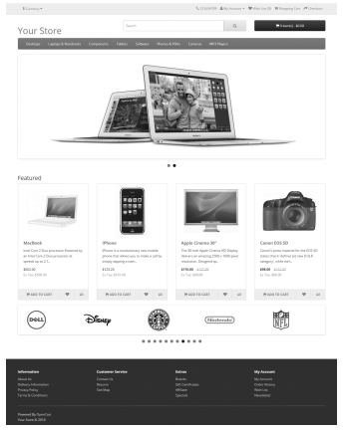
The products displayed above are sample data provided with the OpenCart installation. You can easily remove these samples and replace them with your own products later.

Slide 5
Navigating the shop
The default OpenCart theme ensures easy navigation for customers to browse the shop's products.
Home page
The home page is arguably the most important page in the shop, in terms of presentation. In most cases, this will be the first page that a customer interacts with (especially if they are directed to the store site from a search engine). The shop's homepage needs to be user-friendly, while at the same time highlighting the shop's products.
The first step in becoming familiar with the store front is understanding the anatomy of the OpenCart default homepage.
The header
The header will be displayed at the top of the page, on every page of the store; not just the home page.

Slide 6
The header has the following navigation options:
• Store logo : Clicking on this logo will direct the customer back to the home page of the store.
• Currency block: The customer can select which currency the store's products will be in by clicking on any of the currency icons.
• Shopping Cart: Displays the number of items purchased, and the total price of the order. Clicking on the button will containing all of products added to the cart and an option to "View Cart" or "Checkout".
• Search box : The customers can type in the search box to search for a product within the store’s product categories.
• Links : Links the customer to the Home page, Wish List, My Account, Shopping Cart, and Checkout.
• Telephone : Company telephone number.
• My Account : Customer can register or login from here.

Slide 7
The top menu
The top menu category displays only the top-level parent categories of products. Similar to the header, the top menu appears on every page. When a customer hovers over a category, a drop-down menu will display the sub-categories of that parent category.
When a parent category is clicked, the customer will be directed to the category page, which displays all the products within that category.
Slide show
The slideshow showcases multiple product banners of your choice, alternating images in a slideshow format. After a set period, one banner transitions to the next. These banners are useful for highlighting specific products, making them easily accessible to customers. When a banner is clicked, the customer is directed to the product's page.

Slide 8
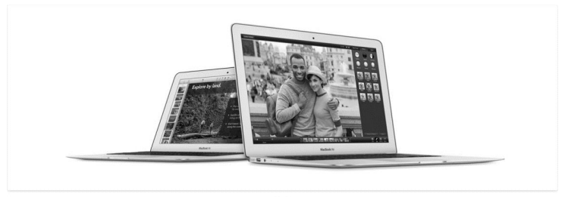
Unlike the top menu and header, the slideshow in the OpenCart default can only be viewed on the home page in this position.
Featured products
OpenCart gives you the option of featuring specific products of their choosing on the home page.

Slide 9
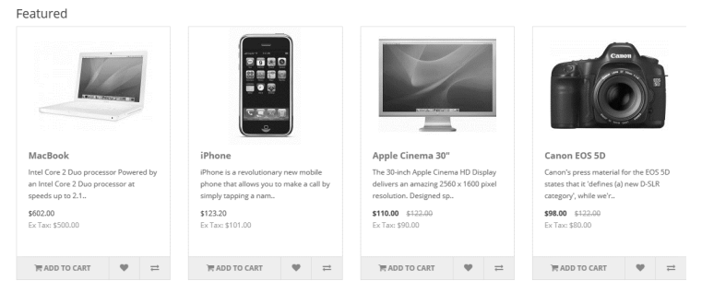
The Featured section includes the product image, name, price and an option to add the product directly to the Shopping Cart.
The carousel is only located on the Home Page in the default.
Footer
The footer is located at the bottom of every page, not just the Home Page. This block of miscellaneous links is useful in sorting relevant pages for the customer that may not logically sort anywhere else.

Slide 10
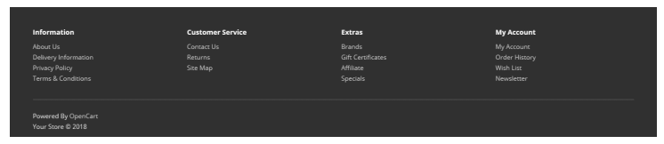
The footer is organized into the following sections:
Information: "About Us", "Delivery Information", "Privacy Policy", "Terms & Conditions"
Customer Service: "Contact Us", "Returns", "Site Map"
Extras: "Brands", "Gift Vouchers", "Affiliates", "Specials"
My Account: "My Account", "Order History", "Wish List", "Newsletter"
Product pages
The OpenCart default product page will follow the structural format seen below

Slide 11
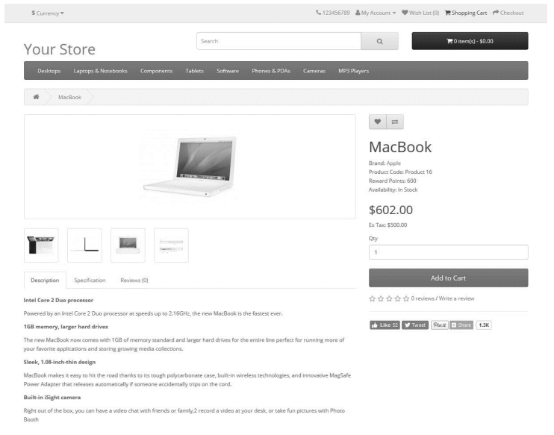

Slide 12
The product page is divided into the following sections:
Product Image: Displayed under the title on the left side, with alternate views of the product shown below it in smaller boxes. Clicking the main image will expand it for a detailed view.
Product Details: The product code, availability, and price are displayed to the right of the product image.
Cart: Customers can select a quantity and add the product to their cart, wish list, or compare list.
Rating/Sharing: Below the cart, customers can rate the product and share it on various social media platforms.
Description Tab: Located below the main product information, this area provides a detailed description.
Category product listings
Category product listings enable customers to browse products similar to other products within the same category. This is especially helpful for customers looking to compare products, a feature that will be explained under Categories. The category page can be accessed a number of ways. It can be accessed from the top menu, when a customer clicks on one of the parent categories. Also, on product pages a customer can access the category product listing page by clicking on a category on the left side category block.

Slide 13
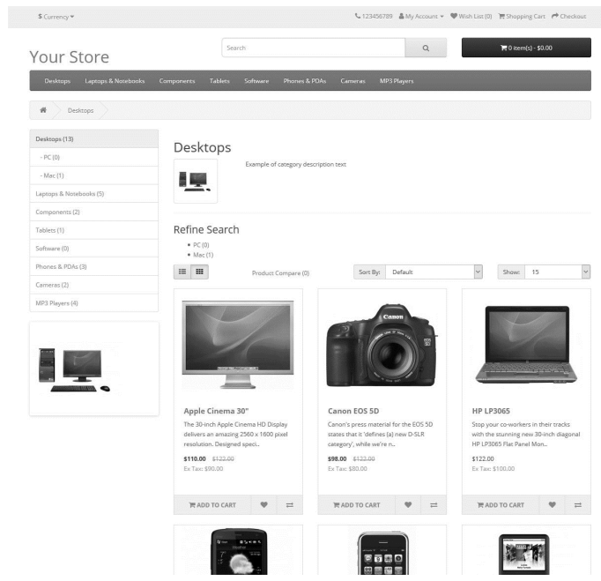
As seen above, the category block is displayed on the left-side like it is in the product page. There is space under the Category title at the top to add a description to the category. The "Refine Search" links to sub categories of that category for the user to browse. The products can be displayed according to the customer's preference: in a list or grid. The above image is sorted in the listing format. The products can be sorted according to name, price, rating, or model in the "Sort By" box. The

Slide 14
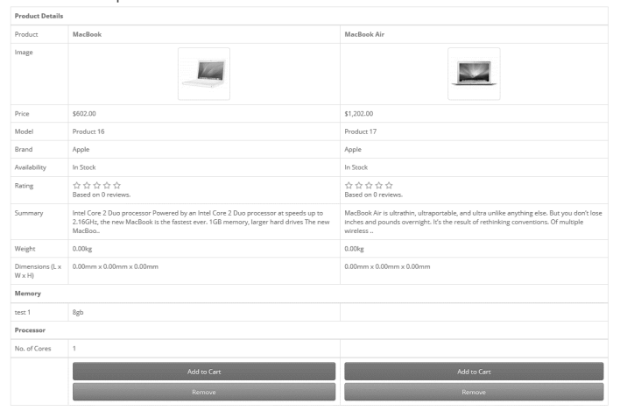
Product compare
The "Add to Compare" feature in the product section allows customers to compare different specifications, features, and prices of various products they are interested in.

Slide 15
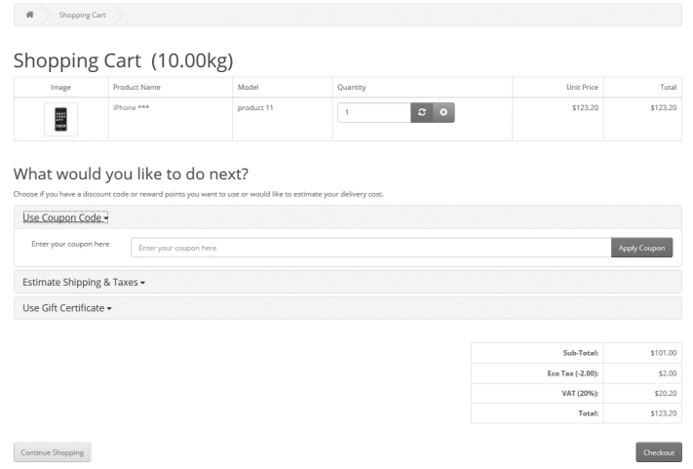
Shopping Cart page
Once a customer adds a product to the cart, they can access the shopping cart in the header under "Shopping Cart“.

Slide 16
The shopping cart gives an overview of the product selected by including the categories "Image", "Product Name", "Model", "Quantity", "Unit Price", and "Total". The customer has an option to add a coupon code or gift voucher, or estimate shipping & taxes, before heading to the checkout. The "Continue Shopping" button links back to the homepage.
Creating an account
Before a customer can continue checking out a product from the shopping cart, the customer needs to select either guest checkout or log into their account. The guest checkout doesn't require log-in details. Returning customers may want to make an account with the store.
There are a few ways a customer can make an account:
Checkout
Step 1 of the check out process allows the user to make an account before continuing with payment. Selecting "Register Account" will change

Slide 17
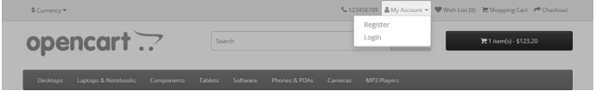
Step 2 of checkout from Billing to Account & Billing details. Account & Billing asks for the same personal details as Billing, except that it asks for the user to create a password for their account.
Header- “My Account”
Clicking "My Account" in the header presents options for customers to either log in or create an account. This page allows customers to log in if they already have an account or create a new one. In the "New Customer" section, customers can click "Continue" under Register Account to be directed to the "Register an Account" page.

Slide 18
Once a product is added to the cart, customers proceed to checkout to finalize their purchase. The Checkout page is accessible via the header section on every page, situated beneath the search box. Checkout using OpenCart is streamlined into 6 simple steps:
Step 1: Checkout Options
Customers can log in, register their account, or opt for guest checkout.
Step 2: Billing Details
Customers enter personal information such as First Name, Last Name, E-mail, Telephone, and address details.
Step 3: Delivery Details
If billing and delivery details are the same, customers can proceed directly to the Delivery Method. Otherwise, they fill out a separate form for delivery details.
Step 4: Delivery Method
Customers select their preferred shipping method and have the option to add comments about their order.
Step 5: Payment Method
Customers choose their payment method and can include additional comments if needed.
Step 6: Confirm Order
Customers review a summary of their purchase, including product details, quantity, pricing

Slide 19
Thanks for watching my open cart document
Prepared by: Sri Hari
Date: Jun 12, 2024

