Slide 1

FUNCTIONAL REQUIREMENTS
Product Name: Orange HRM (Frontend)
Prepared by: Sri Hari
Date: Jun 15, 2024

Slide 2
Contents
1. Purpose of the document: .........................................................................................................3
2. Project Overview:.........................................................................................................................3
2.1Audience:....................................................................................................................................3
2.2 Hardware and Hosting: ............................................................................................................3
3. Information Architecture............................................................................................................3 3.1 My info Module .........................................................................................................................4 3.1.1 My Info Module ..................................................................................................................4 3.1.2 Photograph .........................................................................................................................5 3.1.3 Contact Details ...................................................................................................................6 3.1.4 Emergency Contact............................................................................................................8 3.1.5 Dependants.........................................................................................................................9 3.1.6 Immigration ..................................................................................................................... 11 3.1.7 Job...................................................................................................................................... 12

Slide 3
3.1.8 Salary................................................................................................................................. 13
3.1.9 Report To.......................................................................................................................... 14 3.1.10 Qualifications................................................................................................................. 15 3.1.11 Membership .................................................................................................................. 22
4. Site Design .................................................................................................................................23
4.1 Aesthetic/HTML Requirements and Guidelines................................................................. 23
5. Sign-Off Document................................................................................................................... 23

Slide 4
1.Purpose of the document:
This is not a project plan. It is a guide for system architecture and development, not for phasing, timelines or deliverables.
This document is divided into three sections:
• Project Overview
• Information Architecture
• Site Design
2.Project Overview:
2.1 Audience:
This guide is designed to help ESS-User navigate and use OrangeHRM 3.0. It is intended for non-specialists, though specialists might also find it useful. By reading this guide, you'll learn how to use OrangeHRM through its graphical user interface and understand some of its advanced features that may not be immediately obvious.

Slide 5
2.2 Hardware and Hosting:
OrangeHRM’ s servers will be hosted at X company’s site.
OrangeHRM will be hosted on two servers: One to host the actual website and (language)code, and the other to host the (database name) database.
3.Information Architecture
Log in to the OrangeHRM System using your ESS-User account that has been created by the HR Admin as shown in Figure 1.0.
3.1 My info Module
My Info Module is a powerful tool providing employees of the company with the ability to view relevant information such as personal information and updating personal information with an internet enabled PC without having to involve the HR department.

Slide 6

The functionality of this module spans through the entire system, making information available anywhere, anytime. All information is subject to company’s defined security policy, where he/she can only view the information he/she is authorized to. An ESS-User can only edit certain fields in the ESS Module, maintaining the security and confidentiality of employee information

Slide 7
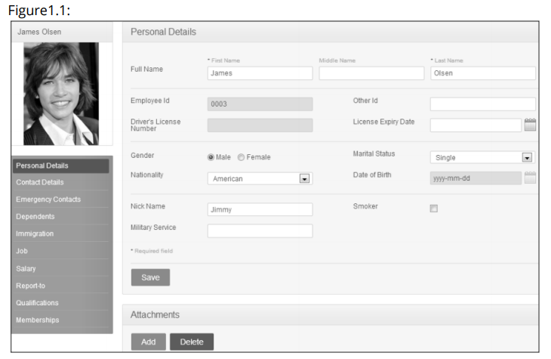
3.1.1 My Info Module:
When an ESS-User logs into the system for the first time, the first thing they will see is the “Personal Details” screen as shown in Figure 1.1. They are able to edit and enter certain fields.
The following are restricted fields where an ESS-User cannot make changes to the following details and need to be populated by the HR Admin and the respective ESSSupervisor.

Slide 8
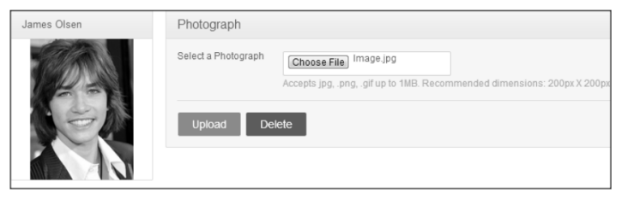
Personal Details
● Employee ID
● SSN No
● SIN No
● Driver License No
● Date of Birth
3.1.2 Photograph The ESS-User can add a photograph of himself/herself by clicking on the photograph at corner of the screen and the screen as shown in Figure 1.2 will appear.

Slide 9
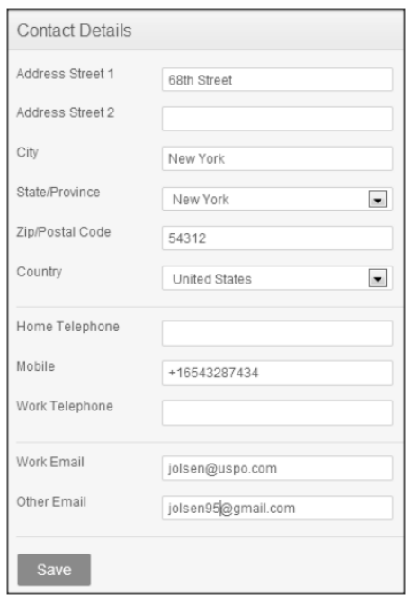
Click “Browse” and then select a photograph from the relevant path. Click “Upload” once you have selected the picture. The picture selected will be populated on the photograph section.
*Note: You may only upload a maximum size of 1 Megabyte in jpg, png, gif format.
3.1.3 Contact Details Contact information can be entered from here. Click on “Contact Details” under the Employee Details column and the screen as shown in Figure 1.3 will appear.
Click “Edit” to enter the information.
You can edit the following:
Country – Select the country from the drop down
Street 1
Street 2
City/Town

Slide 10
State/Province – If the country is United Sates you can select from the drop down or you need to enter it manually
ZIP Code Home
Telephone
Mobile Work
Telephone Work
Email
Other Email
Once you have completed this form click “Save”.
3.1.4 Emergency Contact
Contact details which will be needed during an emergency can be entered here. Select “Emergency Contacts” on the “Personal” column and the screen as shown in Figure 1.4 will appear.

Slide 11
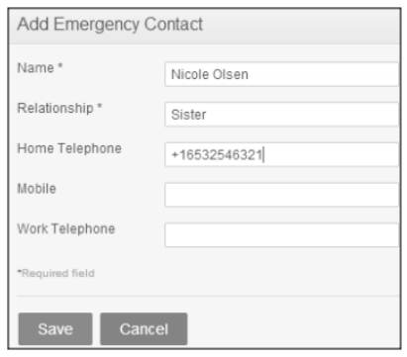
Enter the “Name” of the person you wish the company to contact in case of emergency, your “Relationship” with the contact person provided and a “Home Telephone” or “Mobile Number” the company can reach him/her.
3.1.5 Dependants
If you have any dependents you can enter them here. To add a dependent, click on “Dependents” under the “Personal” column and the screen as shown in Figure 1.6 will appear.

Slide 12
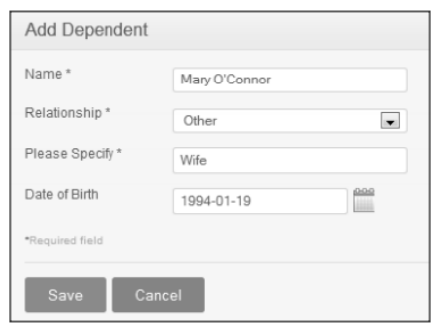
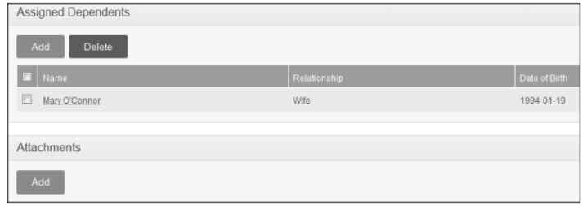
Enter the “Name” of your dependent, the “Relationship” of the dependent to you and his/her “Date of Birth”. Click “Save” once you have entered the following fields and your dependent will be listed as shown in Figure 1.7.

Slide 13
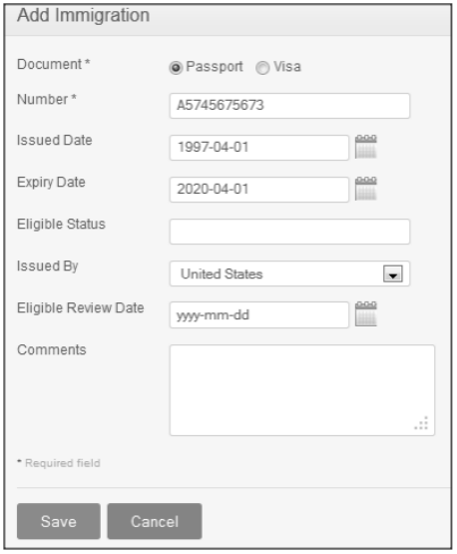
3.1.6 Immigration
Your immigration information can be entered here. To add your immigration information, select “Immigration” under the “Personal “column and the screen as shown in Figure 1.8 will appear.

Slide 14
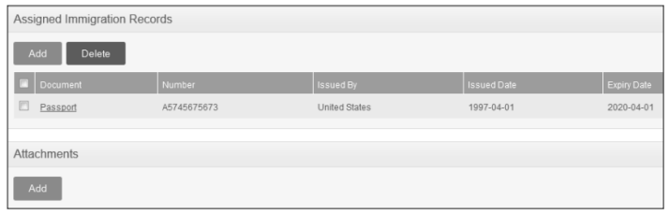
To delete an entry, click on the check box next to particular entry. It is also possible to delete multiple entries at the same time by clicking the check box entries you wish to delete and simply clicking “Delete”. You may also upload any attachment that would support the details you have entered on the form by clicking “Add” under the “Attachment” and selecting a file from a relevant path and uploading the following file by clicking “Upload”.
3.1.7 Job
The ESS-User cannot make changes in the job details. You are only able to view your job details that have been pre-defined by the administrator as shown in Figure 2.0.

Slide 15
You are restricted from editing the following fields:
● Job Title
● Jobs Specification
● Employment Status
● Job Category
● Joined Date
● Sub Unit
● Location
● Employment Contract Start Date
● Employment Contract End Date
● Attachments

Slide 16
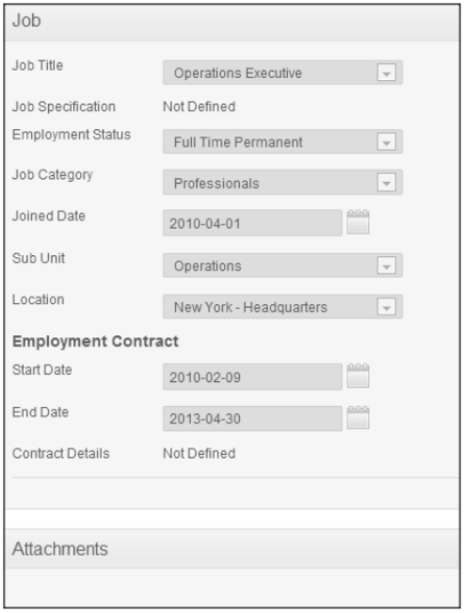
3.1.8 Salary
The salary information field is completely hidden from the ESS-User as shown in Figure 2.1. Only the HR Admin has access to this information and has to be manually communicated to the ESS-User

Slide 17
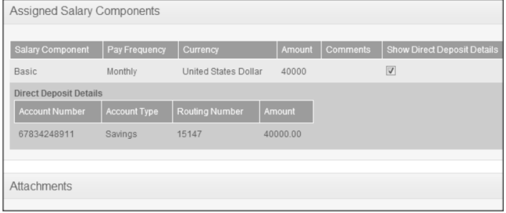
You are restricted from editing the following fields:
Salary
● Salary Component
● Pay Frequency
● Currency www.pavanonlinetrainings.com
● Amount
● Comments
● Direct Deposit Details
●Attachments

Slide 18
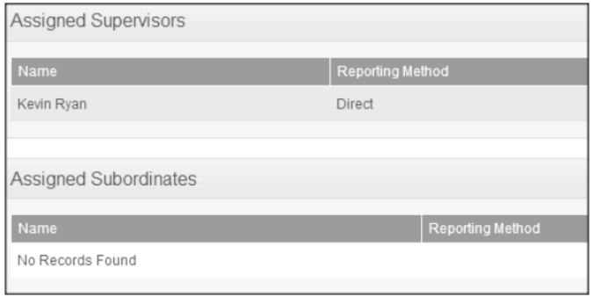
3.1.9 Report
To As an ESS-User, you are only able to view the list of supervisors that you report to and if you are an ESS-Supervisor as well, you will see the list of your subordinates as shown in Figure 2.2.
You are restricted from editing the following fields:
● Assigned Supervisors
● Assigned Subordinates
● Attachments

Slide 19
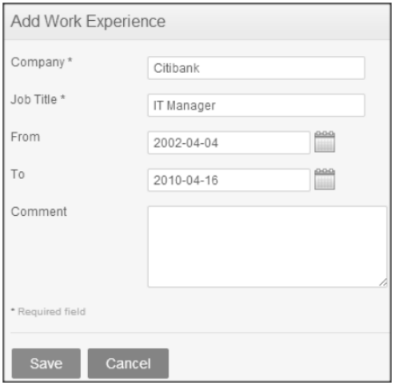
3.1.10 Qualifications
● Work Experience Your previous work experiences can be entered here. To enter previous work experiences, click “Add” under “Work Experience” and the screen as shown in Figure 2.3 will appear
Click “Save” once all the fields are entered and the particular work experience will be listed as shown in Figure 2.4.

Slide 20
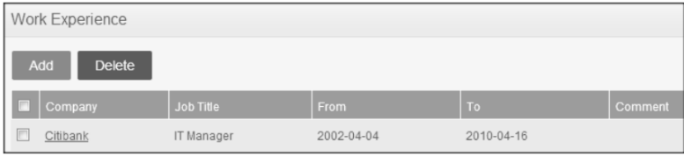
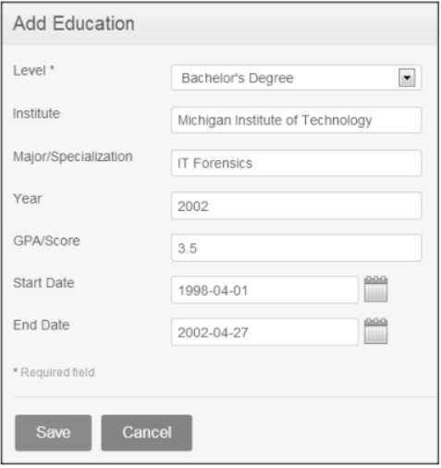
You may enter multiple entries of work experience. To delete an entry, click on the check box next to a particular entry. It is also possible to delete multiple entries at the same time by clicking the check box entries you wish to delete and simply clicking “Delete”.
● Education

Slide 21
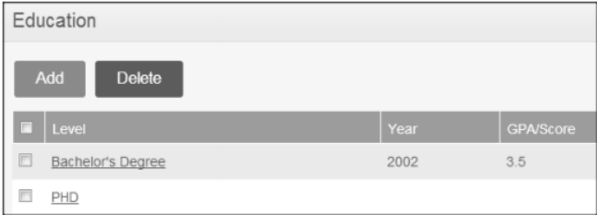
Click “Save” once all the fields are entered and the particular education details will be listed as shown in Figure 2.6.
To delete an entry, click on the check box next to particular entry. It is also possible to delete multiple entries at the same time by clicking the check box entries you wish to delete and simply clicking “Delete”.
● Skills
If you have any special talents or skills they can be entered here. To enter skills, click “Add” under “Skills” and the screen as shown in Figure 2.7 will appear.
Click “Save” once all the fields are entered and the particular skill will be listed as shown in Figure 2.8.

Slide 22
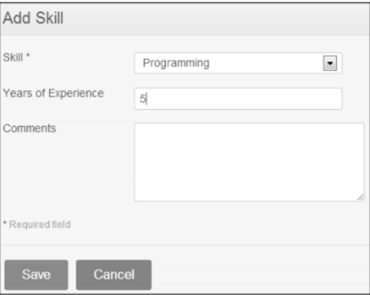
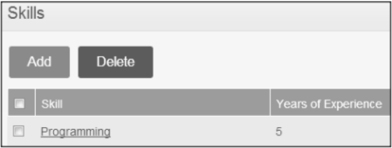
To delete an entry, click on the check box next to particular entry. It is also possible to delete multiple entries at the same time by clicking the check box entries you wish to delete and simply clicking “Delete”.
● Attachments
Any supporting documents regarding your qualification that you think is needed by the management can be attached here. Please note that each document cannot exceed 1 megabyte, but you can attach more than one document. To add an attachment, click “Add” under attachment and the screen as shown in Figure 3.3 will appear.

Slide 23
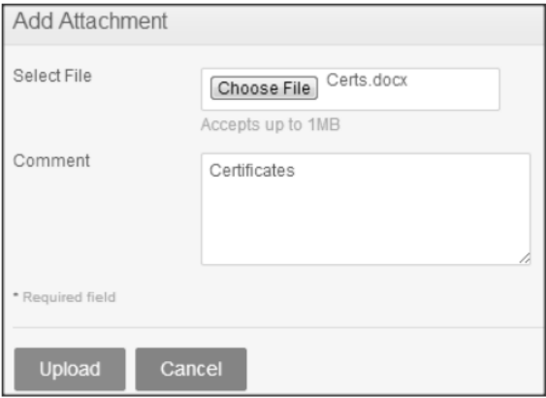
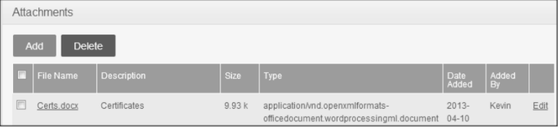
Once you have uploaded the file, the file will be listed as shown in Figure 3.4
To delete an entry click on the check box next to the particular entry and click “Delete”. Multiple selections can be deleted simultaneously.

Slide 24
4.Site Design
4.1 Aesthetic/HTML Requirements and Guidelines
OrangeHRM must deliver a compelling visitor experience. However, it cannot sacrifice usability and accessibility.
The web site ‘look’ must conform to the following requirements:
• The site should be HTML 4.0 compliant.
• All pages must download in less than 10 seconds over a 56k modem connection. - Performance requirement
• All pages must fit in a web browser displayed on a computer set to 640 x 480 pixels.
• All pages must use a web safe color palette.
• The site must be compatible with Internet Explorer 4, 5 and 5.5, and with Firefox 4-6, as well as Google Chrome 4.0 and later.
• All site pages should be available for search engine robots.
• All pages that use static images should be displayed correctly. G

Slide 25
5.Sign-Off Document
The following parties have read and agree with this Requirements Definition document for the OrangeHRM application account module functionality. After approval of this Requirements Definition phase, any significant changes in the scope of this project will require validation of existing project costs and schedules.

Slide 26
______________________________________ _________________________________ Name Date
Business Lead
______________________________________ ________________________________ Name Date
Project Manager

