Slide 1
Title: Mini java parser
CS5800 – theory of foundations
Western Michigan University
Instructor: Dr. Elise de Doncker
TA: Edwin Jose
Team members
Sri Harsha Godavarthi
Venu Modugula
Sathish Kumar madiga Mallayolla

Slide 2
Introduction
Yacc - stands for "Yet Another Compiler Compiler”
Purpose: YACC is designed to generate a parser: a program that reads source code written in a specific programming language and verifies that the syntax of the program is correct according to the grammatical rules of the language.
PLY is a pure-Python implementation of the popular compiler construction tools Lex and Yacc. It provides most of the standard Lex/Yacc features, translating them into Python's object-oriented paradigms and syntax. PLY is designed to be straightforward to use and is fully documented, making it accessible for those familiar with YACC.

Slide 3
Project Goal
Project specification
Create a mini Java compiler using Python(yacc) using ply
The input will be java.txt file
The output will be Parse Tree
Implement lexical analysis phase
Implement a parser using the LALR method ,CFG(context free Grammar)
Error handling
Generate a parse tree (AST)

Slide 4
Lexical Analysis
Lexical Analysis (Lexer): This process decomposes the input text into a series of meaningful elements known as tokens. The lex.py module in PLY aids in developing regular expressions that establish the patterns for identifying these tokens from the input program.
Types of tokens
It includes
i) keywords - reserved words for the programming language
ii) identifiers – user defined variables/ functions
iii) operators( Arthimatic and logical Operators)
iv) delimiters(separator’s )
v) literals (constants ).

Slide 5
Regular Expressions
A regular expression (often abbreviated as regex or regexp) is a sequence of characters that forms a search pattern, primarily used for string searching and matching.
Example for Regular Expressions in Python
Digits – r’ \d+(\.\d+)?’
Identifier/user_defined_variables: - [a-zA-Z_][a-zA-Z0-9_]*
i/p string: x=5.9
Lexical analysis output: [{token: “Identifier”,value: ‘x’},{token: ‘ASSIGN’,value: ‘=‘},{token: ‘Digits’,value: ‘5.9’}]

Slide 6
Parsing
It takes stream of tokens provided by the lexer (i.e. from lexical analysis) and uses Some Parsing Technique to checks whether it follows the defined grammar rules of the language and constructs parse tree.
Parsing Methods:
i) Top-down: It Attempts to derive the input string by making a series of guesses about which production rules to apply. If a wrong guess is made, the parser may need to backtrack and try a different rule (unless the parser is predictive and doesn’t require backtracking)
Examples:
Recursive Descent Parsing, LL(1), Predict-Lookahead Parsing

Slide 7
ii) Botton-up: Builds up the parse tree by creating the leaves first and then working up towards the root, eventually ending at the start symbol of the grammar. Examples: Shift-Reduce, LR(k) , LALR(K) parsing Disadvantages Using other parsing techniques but the result is not accurate and these techniques uses backtracking and some have shift-shift (or) reduce-reduce conflict

Slide 8
Tools and Technologies Programming Language: Python 3 Library: PLY (Python Lex-Yacc) Module System Requirements: 4 GB RAM AND 120 GB Operating System: Windows 11 LALR(K): this is bottom up parsing technique which will be used for syntactic analysis in compilers (i.e. for parsing). It looks k tokens a head and it reduces the stack elements using CFG rules and parse table constructed using first and follow sets defined for programming languages. Parser Tree: This is the syntax tree the parser generates for further optimization and transformation of source code to machine code. (the tree generated here is called Abstract Syntax Tree)

Slide 9
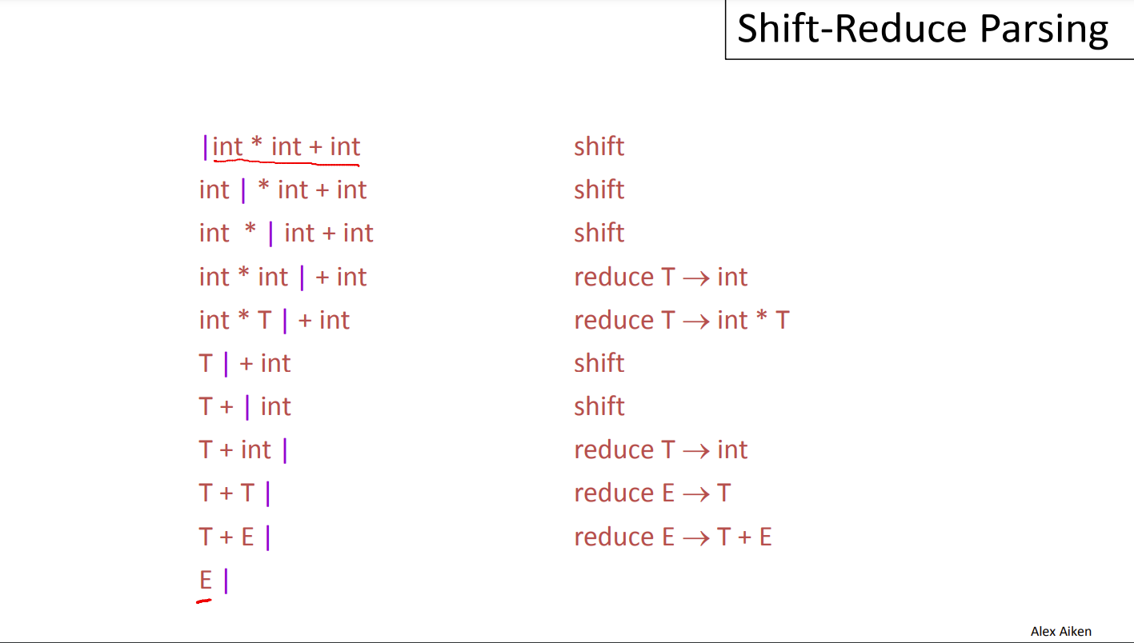
Shift Reduce Parsing

Slide 10
FIRST AND FOLLOW SETS

Slide 11
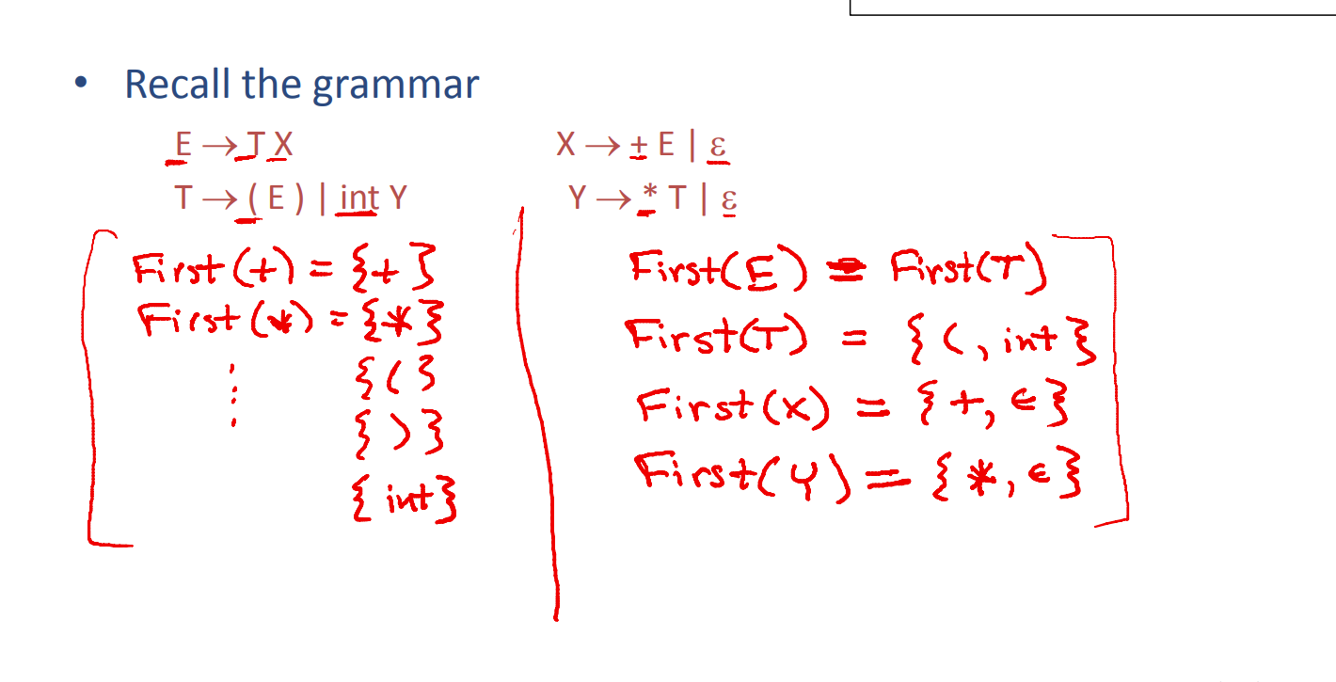

Slide 12
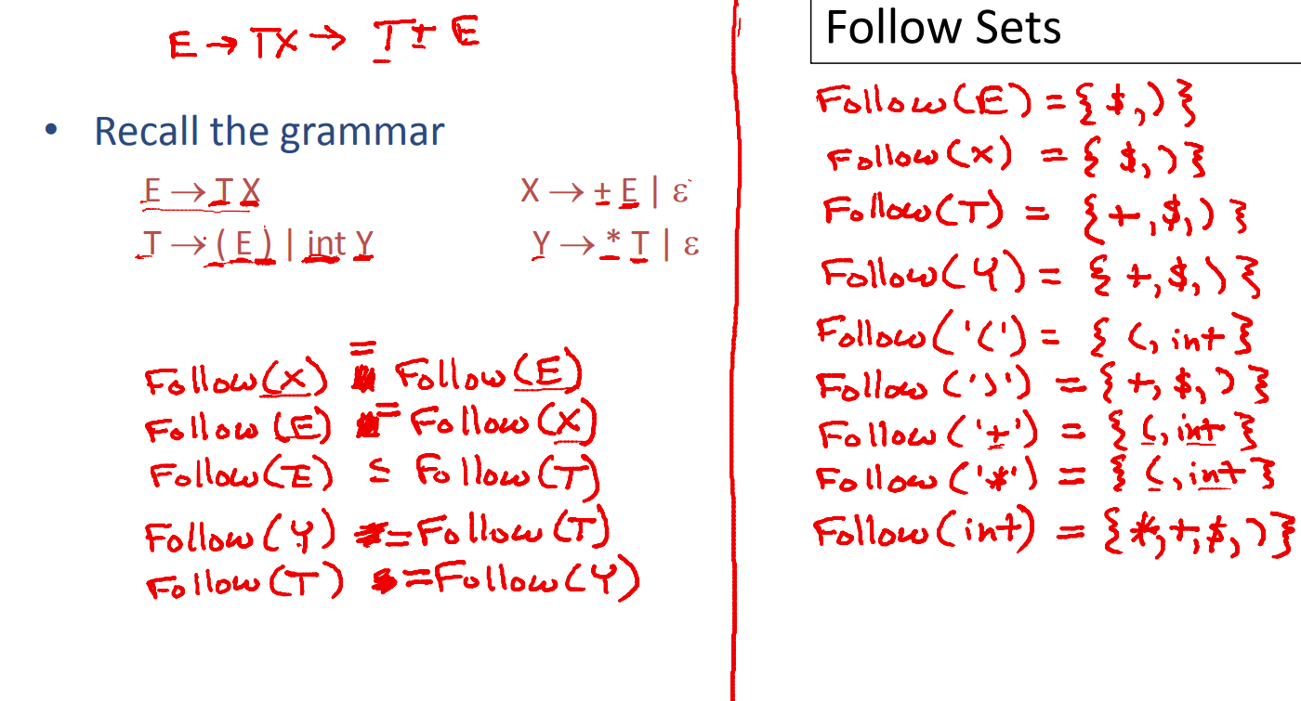

Slide 13
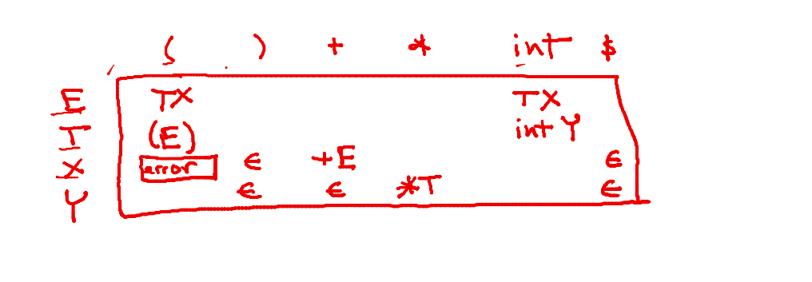
Parse Table

Slide 14
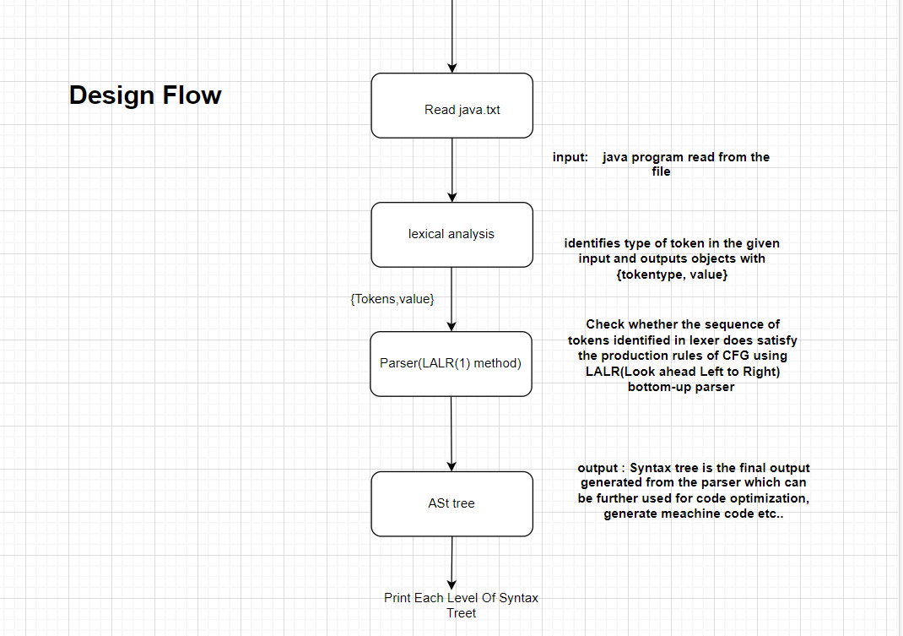

Slide 15
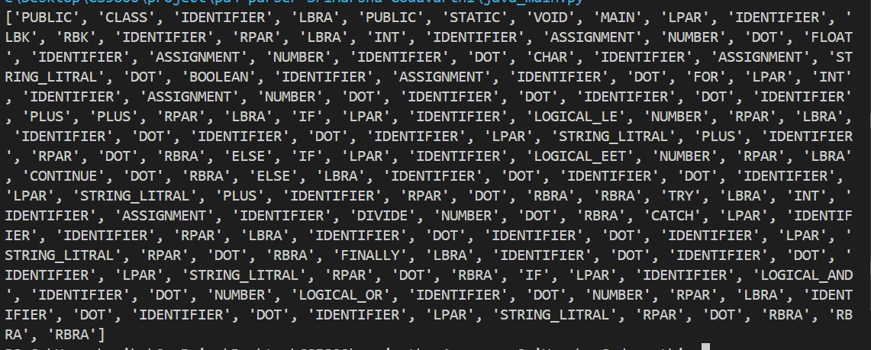
SCREEN SHOTS
Lexical Analysis Output

Slide 16
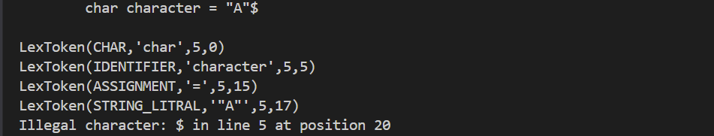
Invalid tokens

Slide 17
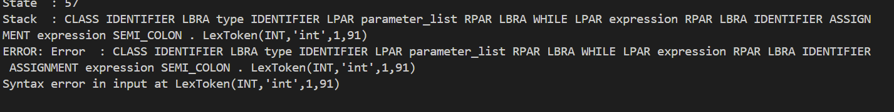
Syntax Error

Slide 18
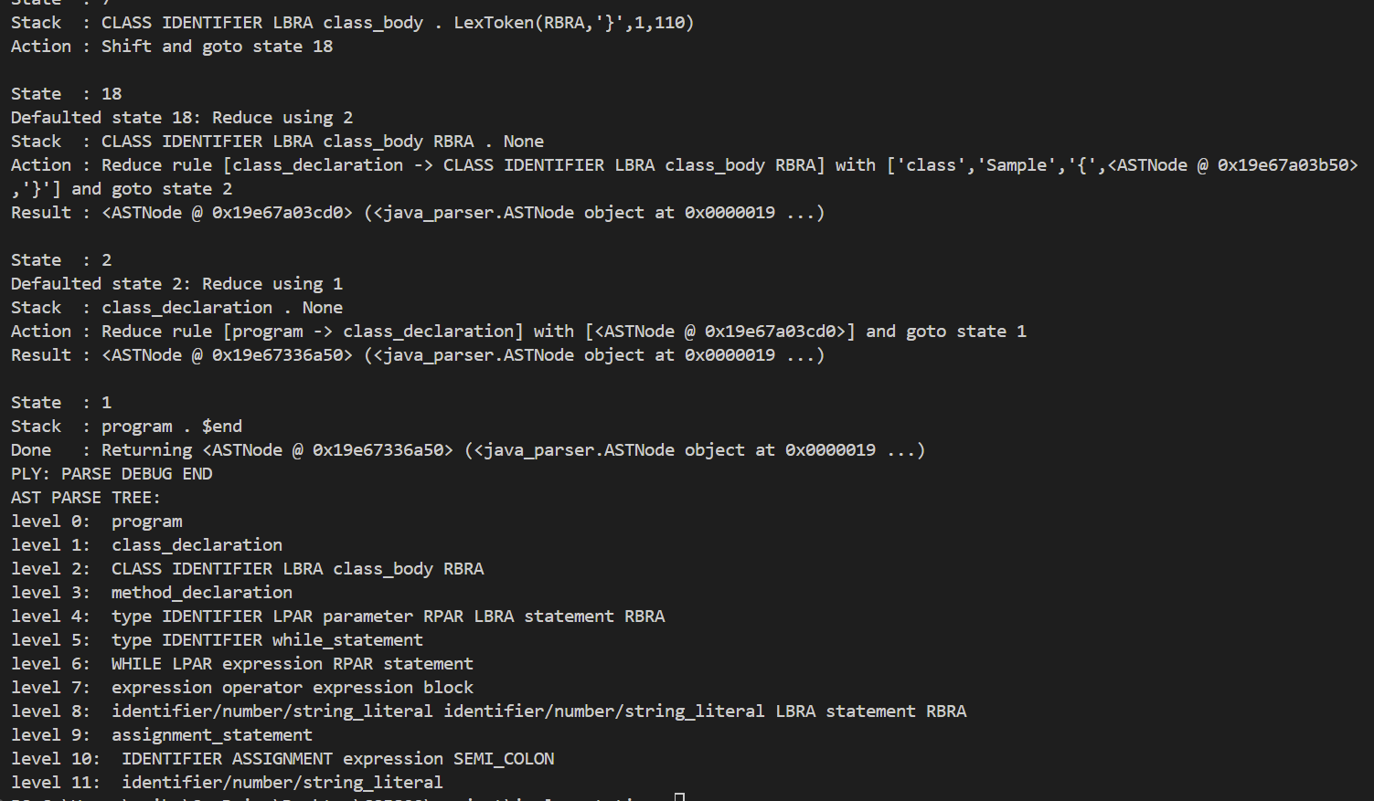

Slide 19
FUTURE ENHANCEMENT
Adding code generation
Adding Optimization For logic
IMPROVING THE CFG(context free Grammar)
Choosing good data structure for parse Tree

Slide 20
Q & A
Q: What enhancements are proposed for future versions of the compiler?
Future enhancements could include adding new token types (e.g., for functions and classes) and optimizing the grammar. Additionally, choosing a data structure for constructing the parse tree that allows for efficient insertion and traversal could be considered for performance improvements.
Q: What results were achieved in this project, and what challenges were encountered?
The project successfully reached all its goals, including the construction of the tokenizer and parser classes, and the generation of the AST. A challenge encountered was reduce-reduce conflicts during the use of a Shift-Reduce parser, which led to a switch to the LALR(1) parsing method.
Q: What kind of error handling mechanisms are integrated into the parser, and how do they function?
Error handling mechanisms are integrated into the parser to identify and report syntax errors during the parsing process. While the document doesn't detail the specific mechanisms, such methods typically involve recognizing unexpected tokens or deviations from the grammar rules and providing informative error messages to the user

Slide 21
What is the significance of using LALR(1) parsing for this project, and what advantages does it offer? LALR(1) parsing is significant for its efficiency in handling a large class of grammars while being less resource-intensive than other methods like canonical LR parsing. It offers the advantage of deterministic parsing with a single-token lookahead, which helps to resolve ambiguities and make parsing decisions without backtracking.

Slide 22
References
Jordan, W., Bejo, A., & Persada, A. G. (2019, December). The Development of Lexer and Parser as parts of compiler for GAMA32 processor’s instruction-set using Python. In 2019 International Seminar on Research of Information Technology and Intelligent Systems (ISRITI) (pp. 450-455). IEEE.
Ireland, S. M., & Martin, A. C. (2020). atomium—a Python structure parser. Bioinformatics, 36(9), 2750-2754.
Metsker, S. J. (2001). Building parsers with Java. Addison-Wesley Professional.
Hosseini, R., & Brusilovsky, P. (2013, January). Javaparser: A fine-grain concept indexing tool for java problems. In CEUR Workshop Proceedings (Vol. 1009, pp. 60-63). University of Pittsburgh.

Slide 23
References
https://ieeexplore.ieee.org/document/5942077
https://ieeexplore.ieee.org/xpl/ebooks/bookPdfWithBanner.jsp?fileName=6382043.pdf&bkn=6381794&pdfType=chapter
https://ieeexplore.ieee.org/document/6382048
https://ieeexplore.ieee.org/document/6382040
https://ieeexplore.ieee.org/document/6382042

Slide 24
Thank You

