Slide 1

Exploratory Data Analysis on AMEO Dataset

Slide 2
About me
I’m K.V Sri Harsha . I have done my MBA (Business Analytics).
My enthusiasm in IT sector lead me to choose Data Science as my career path to upskill myself
No prior work experience till date.
linkedin.com/in/sri-harsha-70612416b
https://github.com/SriHarsha5765

Slide 3
Problem Statement
To determine how salary is influenced by factors such as marks, educational qualifications, experience, and designation, enabling students to choose their career paths wisely based on skills, education, and other relevant factors.
Objective:
Analyze the target variable 'salary' and find insights from it

Slide 4
Description:
The dataset, sourced from the Aspiring Mind Employment Outcome 2015 study, focuses on employment outcomes of engineering graduates. It includes variables like salary, job titles, and locations, alongside standardized scores in cognitive, technical, and personality skills, and demographic features. With around 4000 data points, it provides insights into the factors influencing graduates' professional paths.

Slide 5
Data Cleaning and Data Manipulation :
• Dropping College ID and college city, ID etc
• Dropping columns which are unnecessary or may not be known prior to receiving a job offer.
• Changing the data type as required.

Slide 6
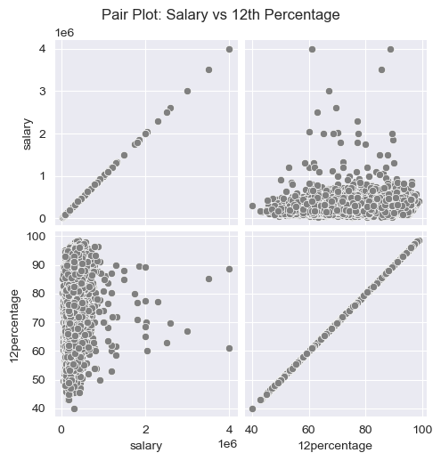
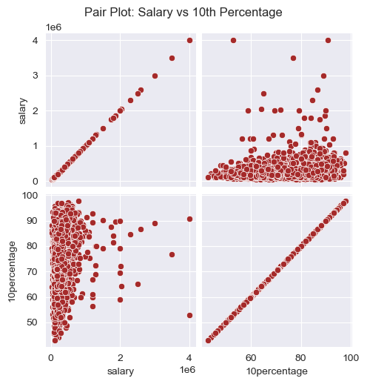
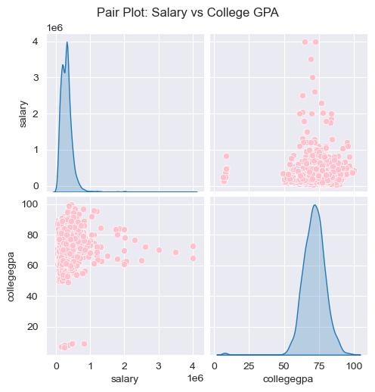
Insights :
There is no relationship between students marks and their salaries

Slide 7
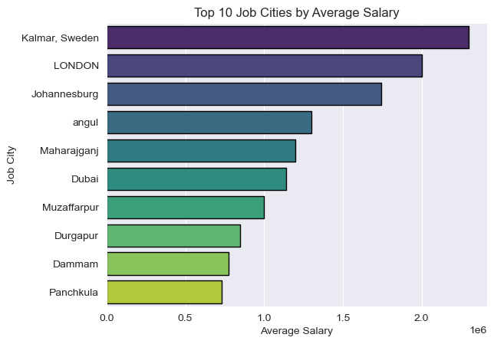
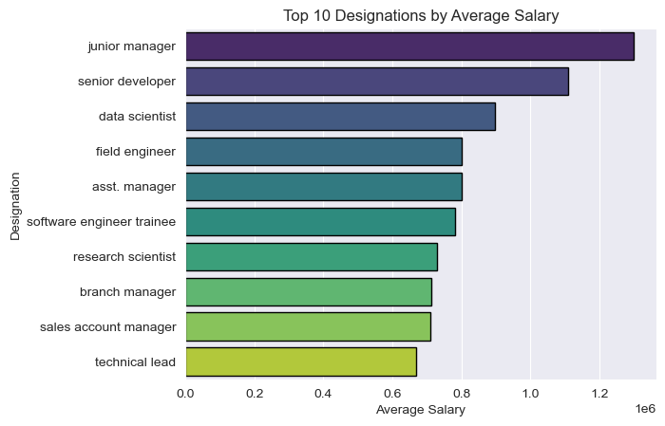
Students work in Kalmar,Sweden has earn more salary
Students in junior manager and senior devloper role earn more salary

Slide 8
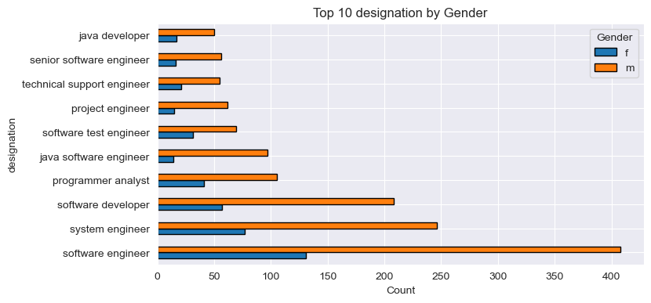
Almost males 2 times as of females in every designation.But female preferred software engineer

Slide 9
Conclusion :
Marks may not directly influence salary; instead skills take precedence.
Positions like junior manager and senior developer tend to yield higher salaries.
The employee ratio shows twice as many males as females in the workforce.
Jobs located in Sweden, particularly in Kalmar, offer higher salaries.

Slide 10

THANK YOU

