Slide 1


SMART INDIA HACKATHON 2026
Problem Statement ID – 26017
Problem Statement Title-Predictive Analytics System for Early Detection of Land Acquisition Delays
Theme- Smart Automation
PS Category- Software
Team ID-
Team Name- CypherLeek

Slide 2
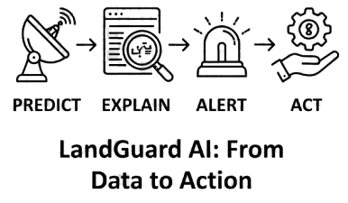
PREDICTIVE LAND ACQUISITION EARLY-WARNING SYSTEM
CYBERLEEK
PROBLEM:
Land acquisition involves multiple departments, complex procedures, and fragmented records, making delays difficult to detect early. This leads to cost overruns, disputes, and stalled projects.
OUR IDEA:
LandGuard AI predicts land-acquisition delay risks at every project stage.
It analyzes revenue, legal, R&R, and project data to identify risks, explains their causes, and alerts officials for early action.
Predict → Explain → Alert → Act
IDEA / SOLUTION
A centralized system that predicts land-acquisition delay risks before they become critical, enabling authorities to take preventive action.
INNOVATION & UNIQUENESS
❖ Stage-wise Intelligence — Predicts risk at individual acquisition stages rather than only overall project delay
❖ Explainable Predictions — Shows why a case is at risk instead of producing a black-box score
❖ Bottleneck Intelligence — Detects recurring issues affecting multiple projects, regions or departments
❖ Proactive Decision Support — Moves beyond monitoring by identifying risks early and supporting preventive action
❖ Predict → Explain → Act — Connects AI prediction directly with administrative intervention
❖ Predictive Intelligence – Stage-wise delay prediction using revenue, legal, R&R & project data.
❖ Smart Document & Risk Analysis – NLP/OCR processes legacy records while Explainable AI identifies key risk factors.
❖ Actionable Monitoring – GIS dashboard highlights high-risk projects with automated alerts & recommendations.

Slide 3
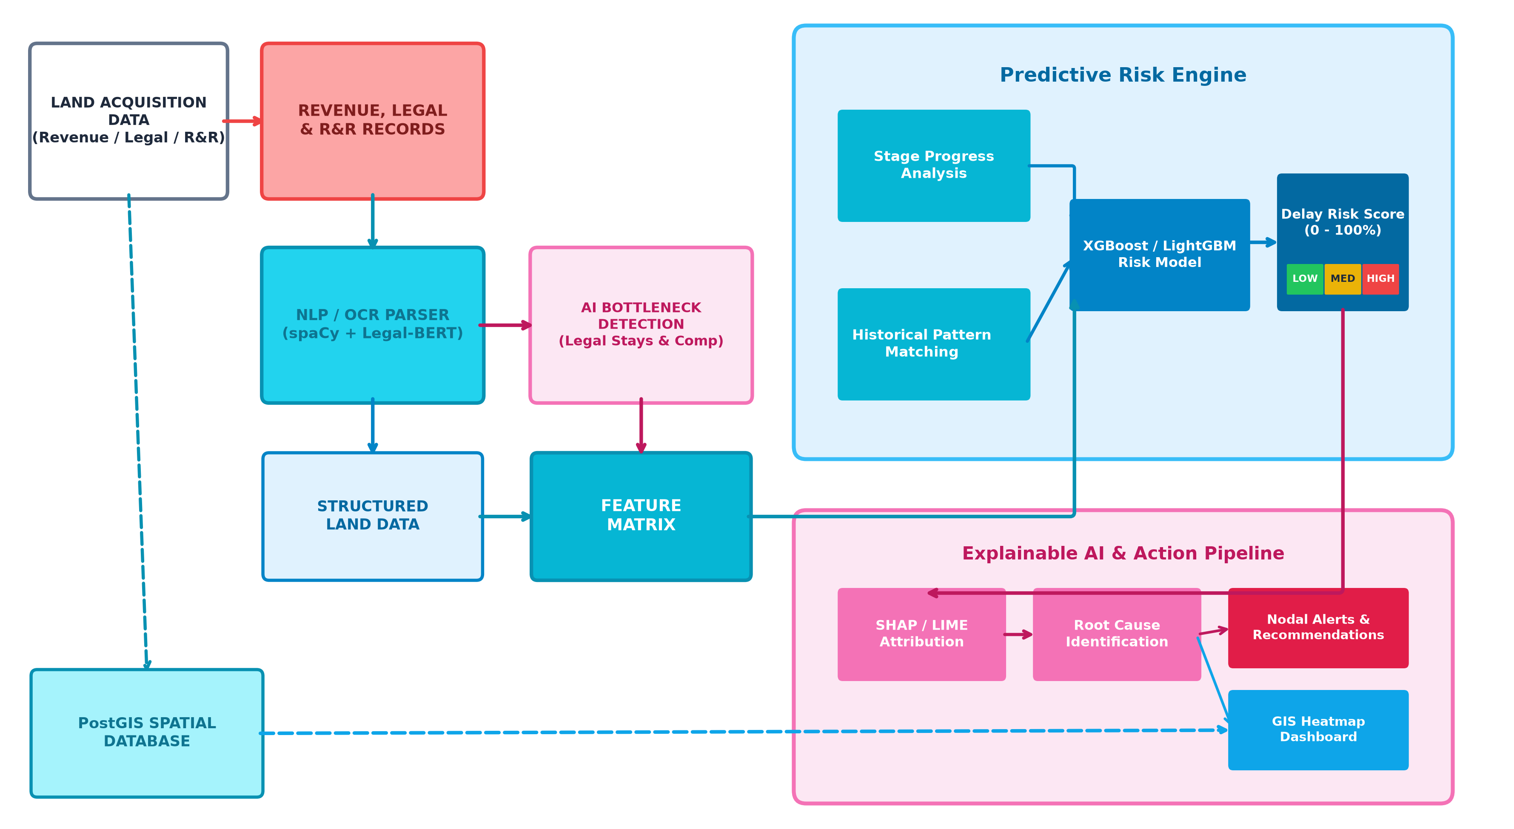
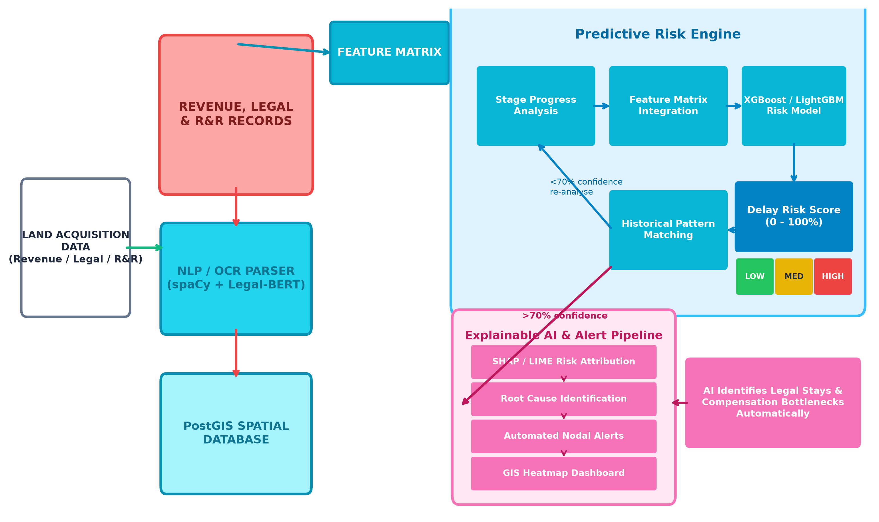
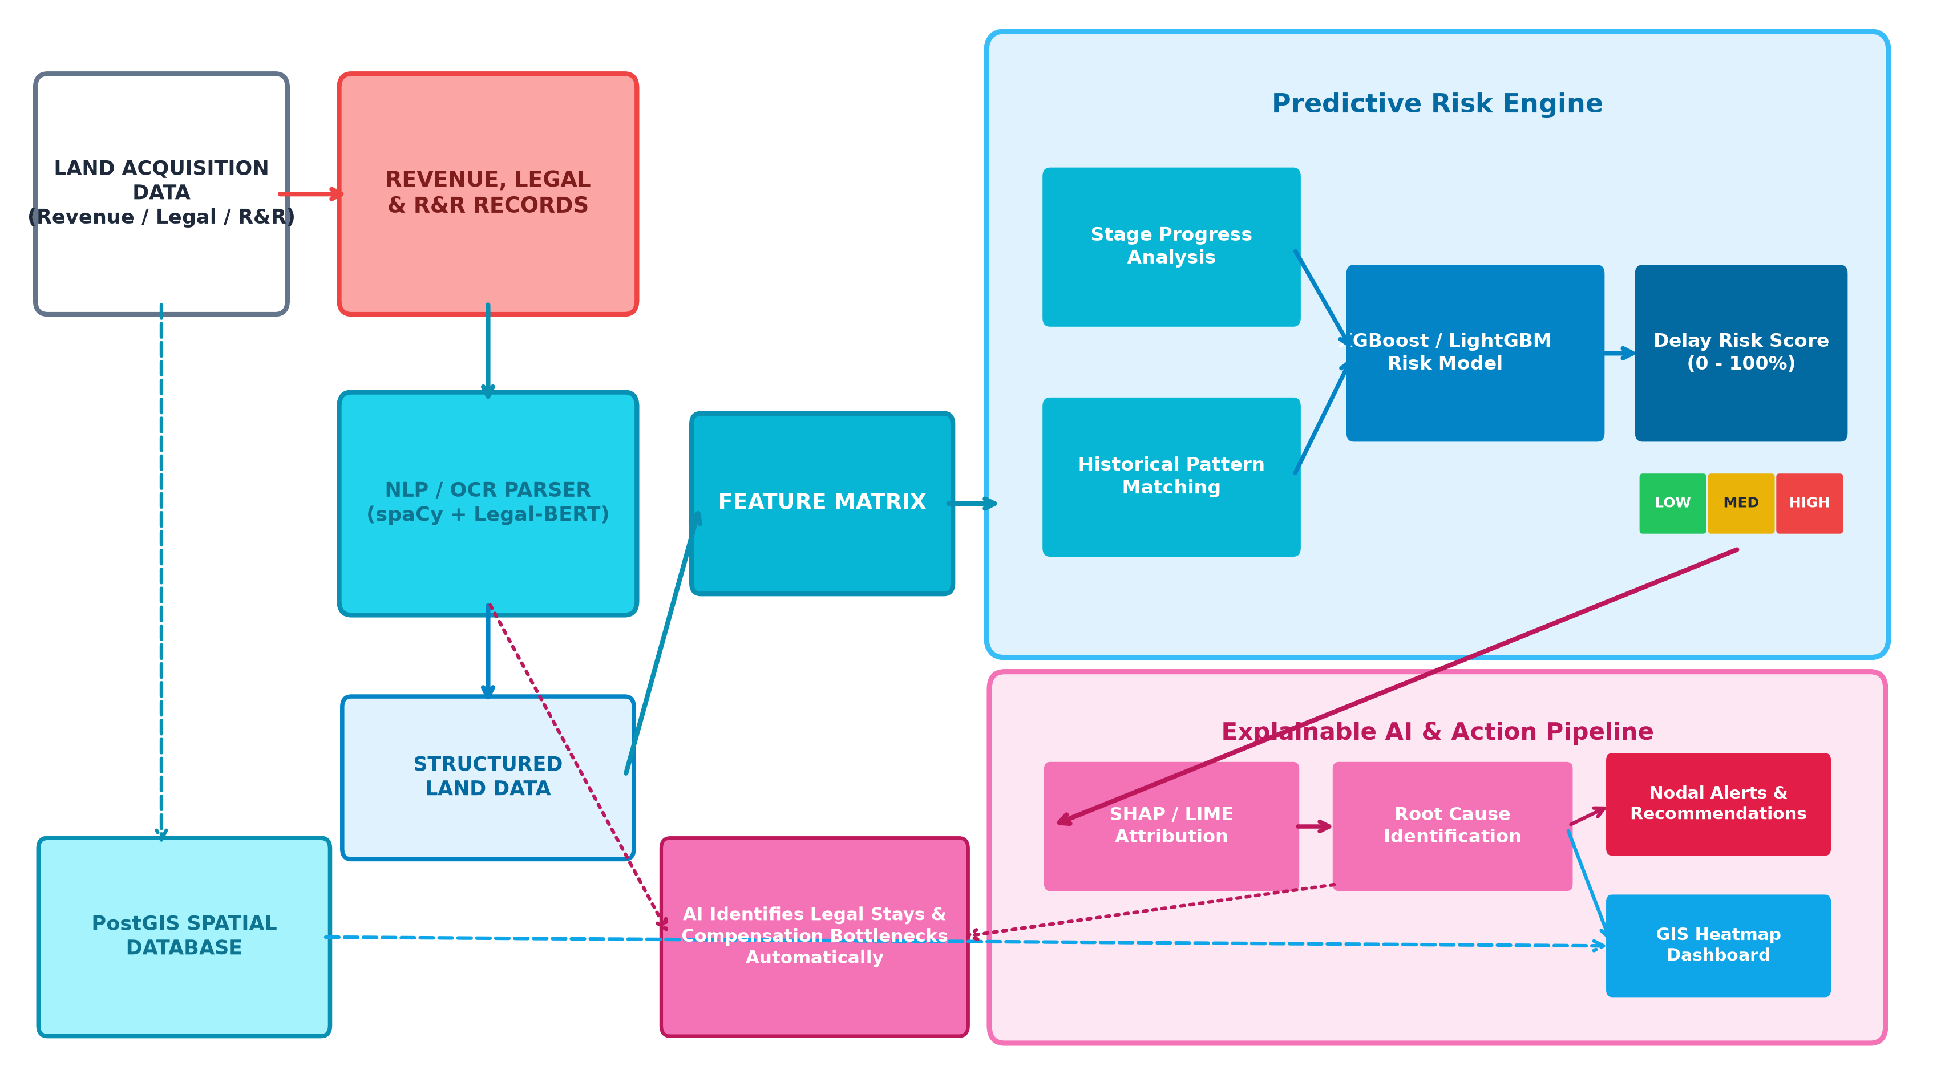
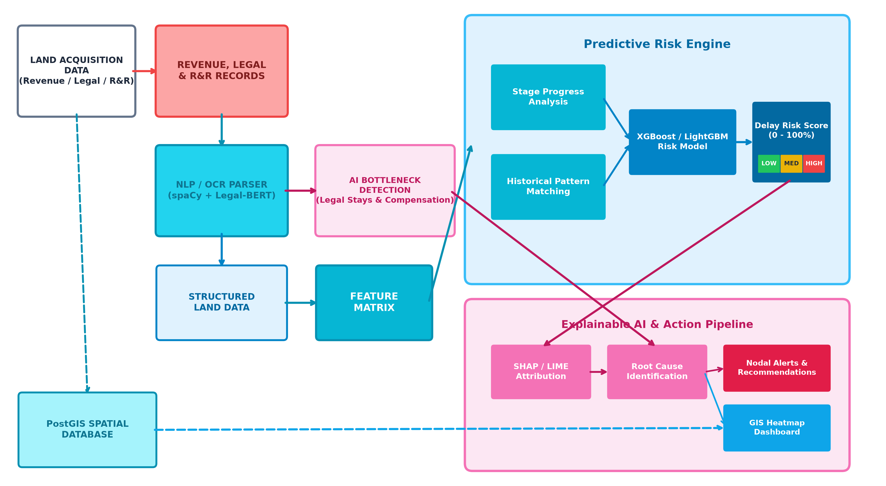
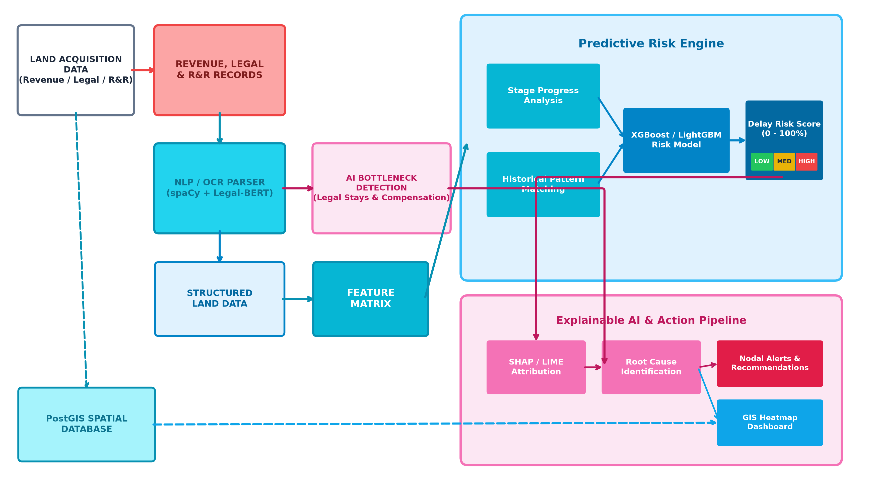
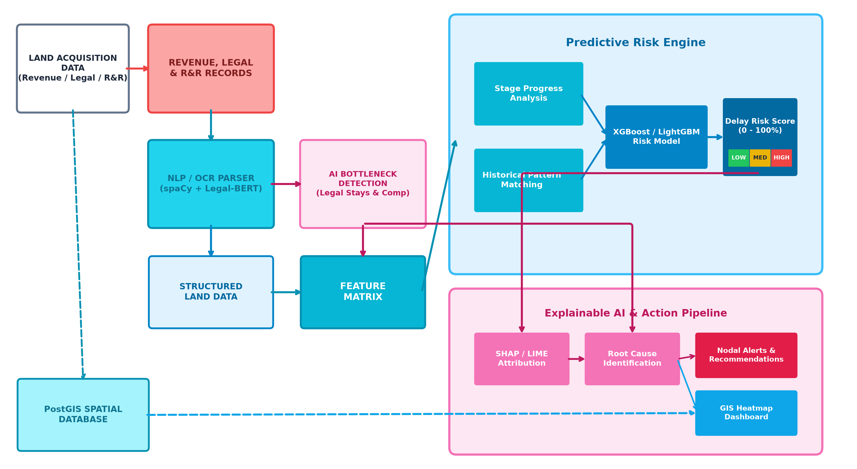
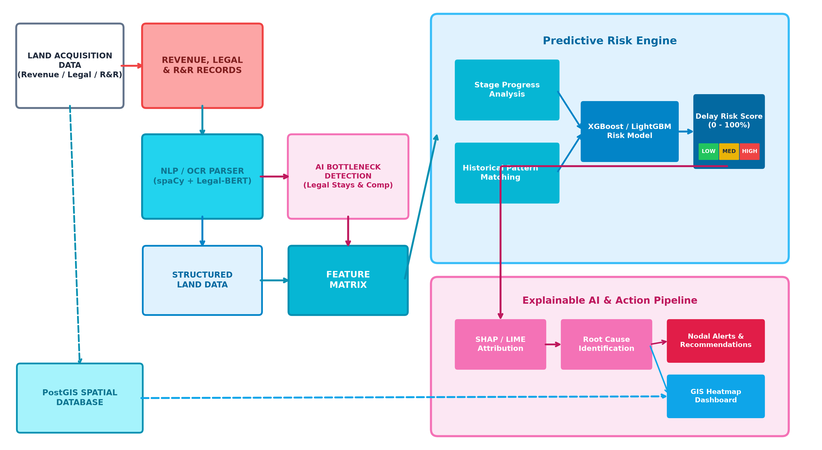



TECHNICAL APPROACH
CYBERLEEK
SOFTWARE / TECHNOLOGIES
❖ Python (Pandas, NumPy) – Handles data cleaning, transformation, preprocessing and feature engineering for land-acquisition records.
❖ Database – Maintains structured project, land, legal, compensation and R&R records for centralized analysis.
❖ OCR + NLP – Extracts information from scanned and legacy documents using OCR, spaCy and Legal-BERT for legal-text analysis.
❖ XGBoost / LightGBM – Uses historical and current acquisition data to predict delay risks at individual project stages.
❖ SHAP / LIME – Provides explainable predictions by identifying the major factors contributing to each delay-risk score.
❖ Flask/Django + React.js + GIS – Integrates backend APIs, interactive dashboards, geographic risk visualization and automated alerts.
FLOW CHART

Slide 4
FEASIBILITY AND VIABILITY
CYBERLEEK
FEASIBILITY:
❖ Technical – Proven ML/NLP models can integrate through standard REST APIs.
❖ Operational – Fits existing district revenue workflows without disrupting current procedures.
❖ Data – OCR and NLP enable processing of both structured and legacy records.
❖ Cost – Open-source technologies keep development and deployment costs low.
VIABILITY:
❖ Scalable – Can expand from pilot districts to state-level implementation.
❖ Integrable – Designed to work alongside existing land-record systems and portals.
❖ Actionable – Risk scores, explanations and alerts directly support officials' decisions.
❖ Long-term – Continuous feedback improves predictions as more acquisition cases are processed.
CHALLENGES:
❖ Data Fragmentation – Revenue, legal and R&R records remain distributed across departments.
❖ Legacy Documents – Records may be scanned, inconsistent or in regional languages.
❖ Data Quality – Missing or outdated records can affect prediction accuracy.
❖ User Trust – Officials may hesitate to rely on unexplained AI predictions.
MITIGATION STRATEGY:
❖ Unified ETL + OCR – Standardizes data from multiple departments and legacy documents.
❖ Multilingual NLP – Extracts useful information from regional-language records.
❖ Explainable AI – SHAP/LIME shows the factors behind each risk score.
❖ Human-in-the-Loop – Officer feedback and case outcomes continuously improve the system.

Slide 5
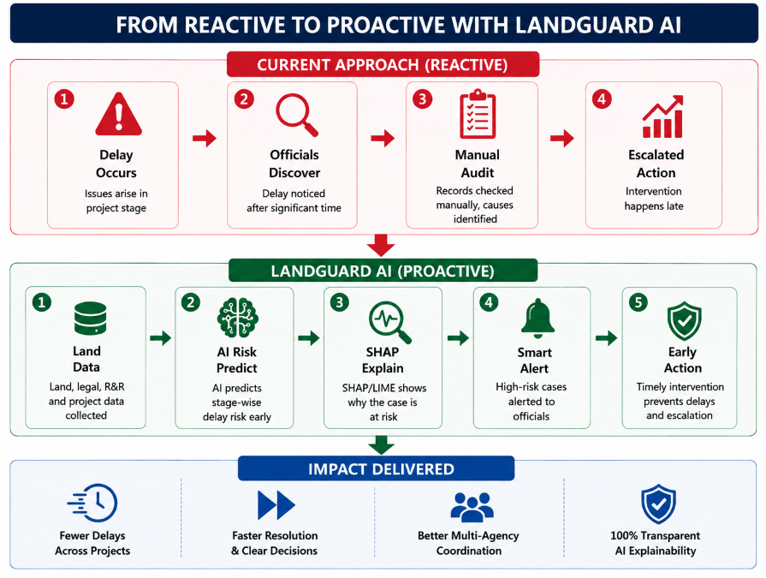
IMPACT AND BENEFITS
CYBERLEEK
DIRECT IMPACT ON TARGET USERS
❖ Revenue & Nodal Officers – Prioritize high-risk cases through early alerts. ❖ Project Authorities – Identify bottlenecks for faster intervention. ❖ Landowners & Families – Reduce compensation and R&R-related delays. ❖ Government Departments – Improve coordination through shared risk visibility.
STRATEGIC IMPACT
❖ Proactive Governance – Enables early intervention instead of reactive monitoring. ❖ Data-Driven Decisions – Converts fragmented records into actionable insights. ❖ Greater Transparency – Explains the reasons behind flagged risks. ❖ Scalable Monitoring – Identifies project and regional bottlenecks.
ECONOMIC & OPERATIONAL BENEFITS
❖ Reduced Project Delays – Detects bottlenecks before they escalate. ❖ Lower Cost Overruns – Enables faster intervention and resource planning. ❖ Faster R&R & Compensation – Highlights cases needing immediate attention. ❖ Improved Accountability – Tracks alerts, risks and follow-up actions.

Slide 6
RESEARCH & REFERENCES
CYBERLEEK
GOVERNMENT DATA
LEGAL & POLICY
TECHNICAL BASIS
MoSPI Reports
41.59%
Infrastructure projects faced time overruns due to land acquisition (March 2024).
RFCTLARR Act, 2013
Acquisition & R&R Framework
Statutory framework governing land acquisition, fair compensation, and R&R procedures.
XGBoost / LightGBM
Risk Prediction Engine
Gradient-boosting algorithms for multi-factor stage-wise delay risk prediction.
DILRMP Portal
95.09%
Villages with computerized Records of Rights (RoRs) integrated (Dec 2023).
NAKSHA Portal
GIS Digital Land Maps
Department of Land Resources GIS-integrated digital maps, drone & Web-GIS data.
SHAP / LIME & Legal-BERT
Explainable AI & Legal NLP
Factor attribution for predictions and NLP extraction of legal entities and clauses.
❖ MoSPI Reports – Infrastructure project cost & time overrun context.
❖ PM GatiShakti – Geospatial planning & inter-department coordination.
❖ DILRMP – Digital land-record management and integration.
❖ RFCTLARR Act, 2013 – Land acquisition, compensation & R&R framework.
❖ Acquisition Workflows – Reference for acquisition stages & statutory procedures.
❖ XGBoost / LightGBM – Predictive risk modelling.
❖ SHAP / LIME – Explainable AI & risk-factor analysis.
❖ Legal-BERT / NLP – Legal document understanding & extraction.

