Slide 1

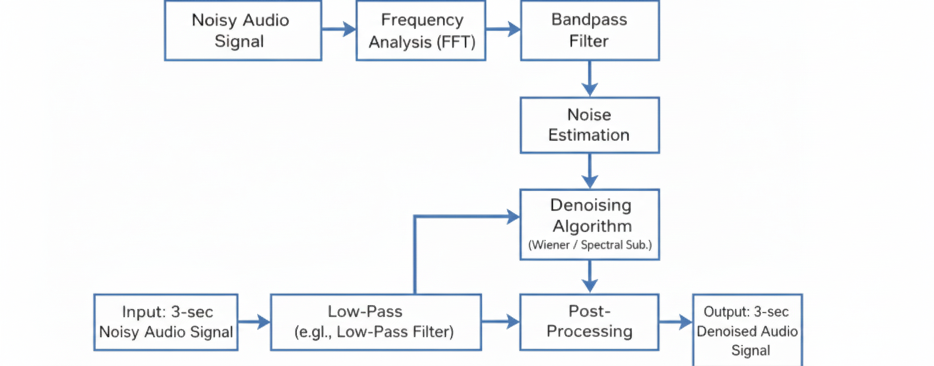
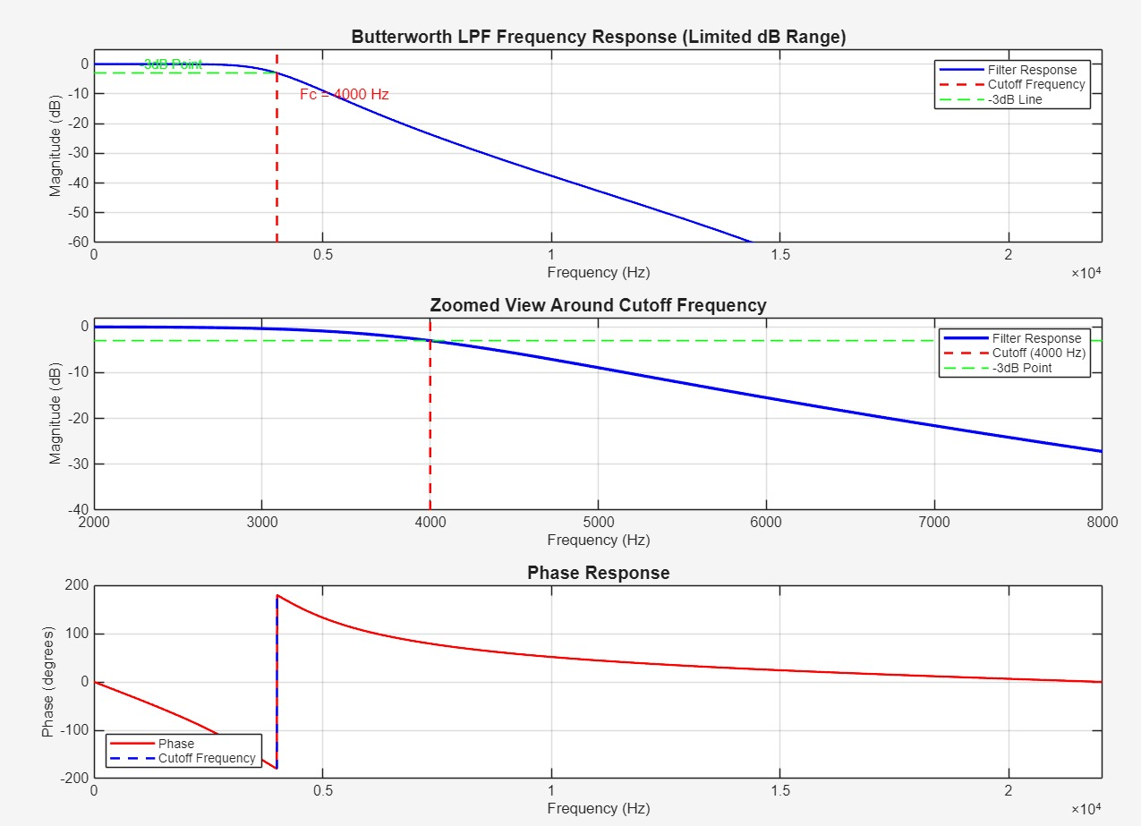
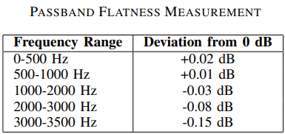
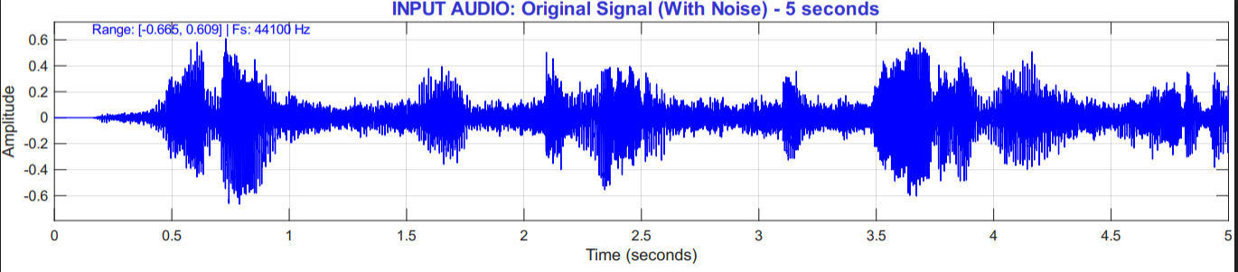
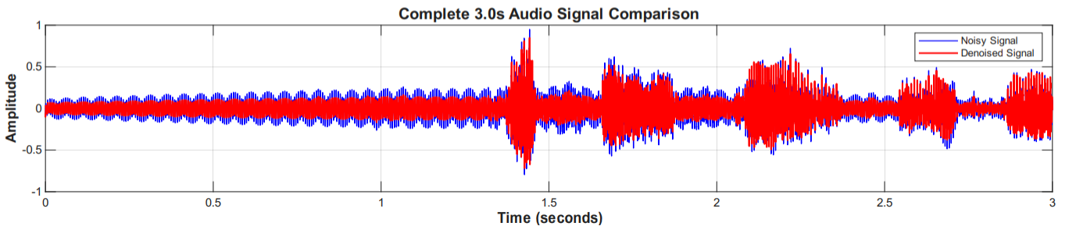
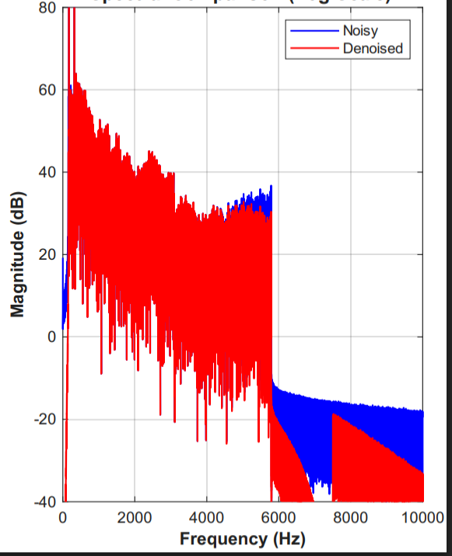
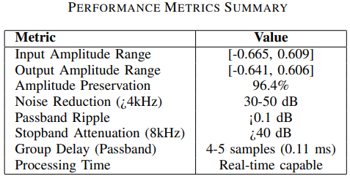
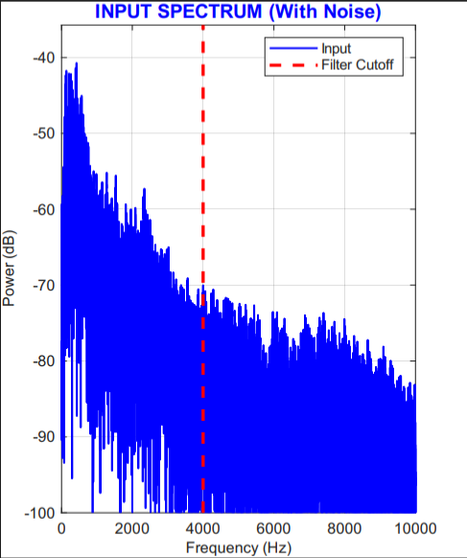
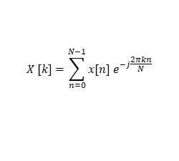
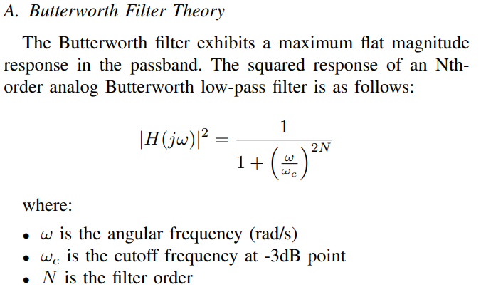
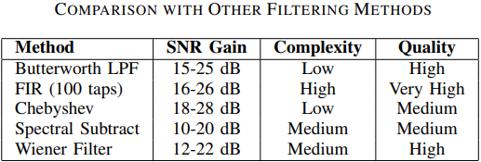
DSP using PBL Approach 2025-2026
Audio Denoising
Theme: Audio Signal Processing
Team D11: Srikrishna Hireholi , Karthik Terdal , Swaroop Swami , Mahantesh Imagoudar
Department of ECE
Need Statement
Block Diagram
Frequency Response of Filter
In the domain of audio signal processing, the current challenge lies in enhancing the quality of raw audio signals that are often corrupted by various forms of noise such as background interference, environmental disturbances, and recording artifacts. Effective audio denoising requires advanced digital signal processing techniques capable of suppressing unwanted noise while preserving the essential characteristics of the original audio signal. There is a crucial need to develop robust denoising algorithms that can improve signal clarity, intelligibility, and overall perceptual quality with minimal distortion.
Fig: Block diagram of Arrhythmia detection
Literature Survey
Signal Characteristics
Results
1. Audio Denoising Based on Short Time Fourier Transform Ashwin & Manoharan (2018): This paper implements an STFT-based audio denoising scheme where environmental noise is estimated adaptively and the noisy signal is reconstructed after denoising.
2. A Multi-Frame Approach to Frequency-Domain Single-Channel Noise Reduction Huang & Benesty (2012): This IEEE paper uses STFT with a multi-frame Wiener and MVDR filtering framework in the frequency domain to improve SNR and reduce speech distortion in noisy conditions.
3. Hybrid DSP/Deep Learning Approach to Real-Time Speech Enhancement Valin (2017): Though not IEEE published, this work combines classical DSP noise suppression with a neural network for gain estimation, achieving significant real-time denoising quality with low complexity.
Signal Parameters
Time domain signal
Signal length | Only for 1sec
Amplitude range | -0.665 to 0.609
Sampling frequency | 44100 Hz
Frequency range | 0 to 10000 Hz
Time domain output
Frequency Spectrum
Frequency domain output
Challenges and Considerations
Non-Stationary-Noise: Real-world audio signals are often affected by non-stationary noise whose characteristics vary over time. Designing denoising algorithms that can adapt to rapidly changing noise conditions without introducing artifacts remains a significant challenge.
Real-Time-Constraints: Applications such as live speech communication and hearing aids demand low-latency processing. Ensuring that denoising algorithms meet strict timing constraints without compromising performance is a key design challenge.
Parameter Selection and Tuning: Many denoising techniques rely on parameters such as filter cutoff frequencies, threshold values, or window sizes.
Problem Definition
Filter Design
Inferences and Future Scope
In the domain of audio signal processing, a major challenge is the presence of noise that degrades the quality and intelligibility of audio signals in real-world environments. To design efficient signal processing techniques for enhancing audio signal quality through noise reduction while preserving essential signal features is therefore a critical requirement.
Passband edge frequencies (Hz) | Stopband edge frequencies (Hz) | Passband gain (dB) | Stopband gain (dB) | Filter order N
2000 Hz | 8000 Hz | 0 dB | -3dB Point | 4
DSP algorithms were applied for real-world audio signal analysis to address the problem of noise corruption. Frequency-domain analysis provided valuable insight into the spectral characteristics of the audio signal, enabling effective identification of noise components. This analysis facilitated the selection and design of appropriate digital filtering techniques for noise reduction. ==intelligibility.
Further exploration of advanced DSP algorithms and adaptive filtering techniques can contribute to improved noise suppression, better preservation of signal features, and enhanced overall performance of audio denoising systems.
Objectives
> Apply Fourier Transform techniques to analyze the frequency components of raw audio signals and identify noise-dominated spectral regions.
>Design and implement digital filtering techniques to effectively reduce noise from raw audio signals while preserving important signal characteristics.
>Develop algorithms for extracting relevant spectral and temporal features from the enhanced audio signals to assess signal quality and improve intelligibility.
Ideal impulse Response of Filter:
Hamming window function:
Impulse Response of FIR BP Filter:

