Slide 1

Mini Project
Team -02
Srikrishna Hireholi 459 01fe23bec224
Karthik Terdal 413 01fe23bec174
Swaroop Swamy 457 01fe23bec222
Mahantesh Imagoudar 406 01fe23bec166
Guide :Ujwala Patil

Slide 2
Introduction
A mini audio amplifier is a compact electronic circuit designed to increase the strength of low-level audio signals so they can drive speakers with sufficient volume. It is commonly used in portable and battery-powered devices where space and power consumption are limited. By boosting weak audio inputs, the amplifier ensures clear and audible sound reproduction. Mini audio amplifiers often use low-power integrated circuits and require only a few external components, making them easy to build and highly efficient. Because of their simplicity and versatility, they are widely used in DIY audio projects, small gadgets, and educational electronics applications.

Slide 3
Literature Survey
Research shows that mini audio amplifiers are essential for boosting low-level analog signals to
speaker-drivable levels.
LM386 is frequently referenced in academic papers as a preferred IC for low-power audio amplification.
Most literature highlights its ability to operate from 4V–12V, making it suitable for portable devices.
Studies show that LM386 provides stable output even with minimal external components.
Researchers emphasize using input coupling capacitors to block DC offset and protect speakers.
Many audio engineering papers compare LM386 performance with op-amp-based amplifiers for distortion levels.
Literature documents the importance of bypass (decoupling) capacitors to reduce unwanted oscillations.
Several designs include variable resistors for volume control and gain adjustment using external RC networks.
LM386 circuits appear in technical journals focusing on basic analog electronics and embedded audio systems.
Research indicates that LM386 is ideal for low-cost system design and educational hands-on learning.

Slide 4
Market Survey
Mini audio amplifiers are widely demanded in portable speakers, intercoms, buzzers,
Arduino projects, and radios.
LM386-based kits are popular in engineering colleges as beginner-level analog lab projects.
The IC is available from major brands like Texas Instruments, ON Semiconductor, and various
low-cost manufacturers.
Electronic marketplaces offer LM386 modules for ₹80–₹300 depending on PCB quality and added features.
Consumers prefer LM386 amplifiers because they work well even with simple 9V batteries.
Competing products include PAM8403, TDA series, and MAX audio amp chips, which offer higher wattage.
LM386 modules are commonly bundled with DIY audio bundles, robotics kits, and breadboard training kits.
Local electronics stores consistently stock LM386 due to high demand and stable supply availability.
The market shows continuous usage in hobby circuits even though advanced digital amplifiers are trending.
Small manufacturers prefer LM386 because it reduces design complexity and lowers production costs.

Slide 5
Requirement Analysis
Requires a low-level audio input source such as mobile, mic, or audio jack.
Needs a stable DC supply between 4V–12V for proper LM386 operation.
Requires an 8Ω or 4Ω speaker to produce audible sound output.
Needs input coupling capacitor to block DC from the audio source.
Requires output capacitor to protect the speaker from DC components.
Needs decoupling capacitor to reduce noise and prevent oscillations.
Requires proper grounding to ensure stable audio amplification.
Needs a potentiometer for adjusting input volume or gain.
Requires gain-setting components to control amplification level.
Needs correct polarity and safe wiring to avoid component damage.

Slide 6
Variants with Components
Basic LM386 amplifier with fixed gain 20 for simple low-power audio boosting.
High-gain LM386 variant with gain up to 200 using a capacitor between pins 1 and 8.
LM386 amplifier with volume control using a 10k–100k potentiometer at the input.
LM386 amplifier with tone control using RC filters for bass and treble adjustment.
Bass-boost LM386 variant using a low-frequency enhancement RC network.
Dual-stage LM386 amplifier providing higher output power and louder audio.
LM386 amplifier with a transistor or op-amp preamp for microphone sensitivity improvement.
LM386 variant with bass-cut filter for clearer voice-focused amplification.
LM386 amplifier with power filtering and polarity protection for stable operation.
Stereo LM386 variant using two ICs to drive left and right channels independently.

Slide 7
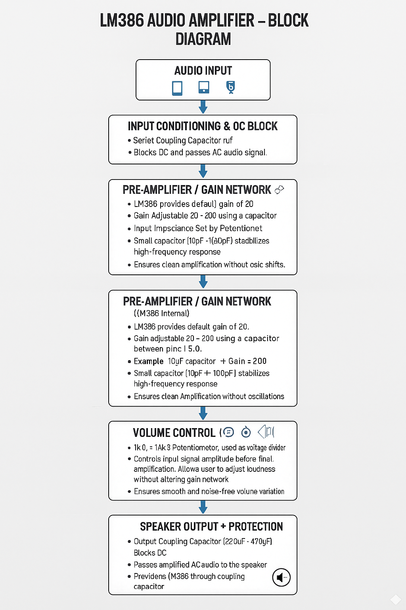
Block Diagram
                Block Diagram

Slide 8
List Of Components Required
LM386 Audio Amplifier IC
Electrolytic Capacitor 10µF (for gain control between pin 1 & 8)
Electrolytic Capacitor 100µF (output coupling capacitor)
Electrolytic Capacitor 220µF / 470µF (power supply filter capacitor)
Ceramic Capacitor 0.047µF / 0.05µF (noise decoupling capacitor)
Ceramic Capacitor 0.1µF (input filtering/decoupling)
Resistor 10Ω (output RC network for stability)
Speaker 8Ω / 4Ω (audio output load)
Audio Input Jack (3.5 mm) or signal input wires
Potentiometer 10k / 20k (volume control – optional)
9V Battery / DC Supply (5–12V)
Connecting wires / PCB / Breadboard

Slide 9
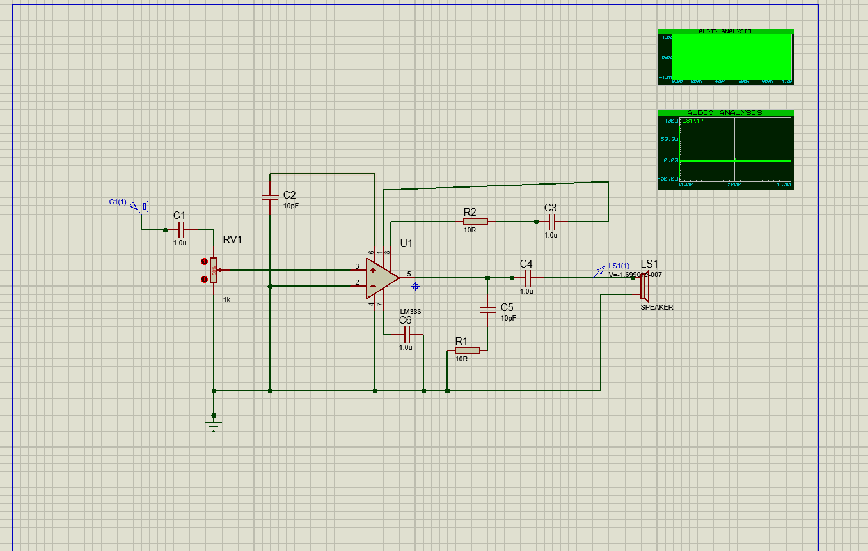
Simulations

Slide 10
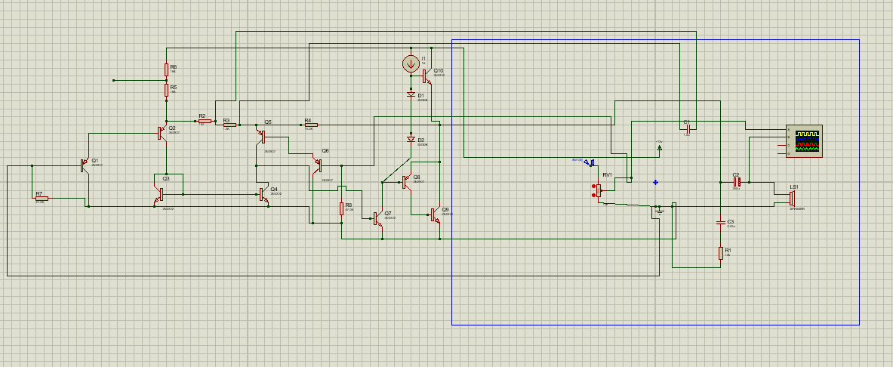

Slide 11
Reflection Questions
1. What is the difference between voltage amplification and power amplification in a mini audio amplifier?
Answer:
Voltage amplification increases the small input audio signal level, while power amplification provides enough current to drive the 8Ω speaker in the LM386 circuit.
2. Why do we use a coupling capacitor at the input of a mini amplifier?
Answer:
The coupling capacitor removes DC components from the input and allows only AC audio to enter the LM386, preventing distortion and protecting the IC.
3. What is the meaning of gain, and how is it set using components in LM386?
Answer:
Gain is the ratio of output signal to input signal, and in LM386 it is set by placing a 10µF capacitor between pins 1 and 8 to increase gain up to 200.
4. Why is biasing required in an amplifier stage?
Answer:
Biasing sets the LM386 input at mid-supply voltage so the AC audio can swing positively and negatively without clipping.
5. What happens when the amplifier’s gain is set too high?
Answer:
Excessive gain causes noise, distortion, and oscillation, especially in high-gain LM386 configurations.

Slide 12
6. What is clipping, and why does it occur?
Answer:
Clipping occurs when the LM386 output attempts to exceed the supply voltage limits (e.g., ±4.5V on 9V supply), flattening the waveform.
7. What is the purpose of the output capacitor in the LM386 circuit?
Answer:
The output capacitor blocks DC and allows only the amplified AC signal to reach the speaker, preventing speaker damage.
8. Why must audio signals be AC?
Answer:
Audio signals represent sound vibrations, which naturally alternate above and below zero, requiring AC to reproduce them correctly.
9. How does speaker impedance affect the LM386 output?
Answer:
Lower speaker impedance draws more current, causing LM386 heating or distortion, while higher impedance reduces loudness.
10. Why is a heat sink sometimes needed in mini amplifiers?
Answer:
A heat sink prevents overheating when LM386 drives a 4Ω or 8Ω speaker at high volume.

Slide 13
11. What decides the input coupling capacitor value?
Answer:
Its value sets the bass response; larger capacitor → better low-frequency reproduction in the LM386.
12. How does supply voltage affect maximum output power?
Answer:
Higher supply voltage increases LM386 output swing and lets it deliver more power to the speaker.
13. Why is a bypass capacitor required at the LM386 supply pin?
Answer:
It stabilizes the power line, filters noise, and prevents oscillation or hum.
14. What role does the RC network play in gain?
Answer:
In LM386, the RC capacitor between pins 1 and 8 sets gain by controlling internal amplifier feedback.
15. How do RC filters remove noise?
Answer:
They attenuate high-frequency noise and deliver a cleaner audio signal to the speaker.
16. What happens if speaker impedance is lower than rated?
Answer:
LM386 is forced to deliver high current, causing heat and distortion.
17. How does grounding affect LM386 noise?
Answer:
Poor grounding creates hum, loops, and interference; proper grounding keeps the amplifier quiet.

Slide 14
18. What causes hissing noise in LM386 even with no input?
Answer:
Loose input wires, high gain capacitor, poor grounding, or missing bypass capacitor.
19. Why is bass weak in some LM386 circuits?
Answer:
Small input/output capacitors or poor speaker low-frequency response.
20. Why does the amplifier oscillate?
Answer:
High gain, long input wires, poor grounding, or missing decoupling capacitors.
21. Why is a 10Ω resistor and 0.05µF capacitor sometimes added at the LM386 output?
Answer:
This RC network (called a Zobel network) stabilizes the LM386 output, reduces high-frequency oscillation, and improves speaker performance.
22. Why does the LM386 require a large electrolytic capacitor (100µF or more) at the output?
Answer:
Because the LM386 is a single-supply amplifier, the output contains DC bias; the large capacitor blocks this DC and passes only the AC audio to the speaker.
23. What happens if the input audio signal amplitude is too high for the LM386?
Answer:
An excessively strong input causes distortion and clipping even at low gain because the LM386 cannot amplify beyond its supply voltage limits.

