Slide 1
Store Sales time series forecasting
Design Seminar
Project Guide
Dr. T V RAJINIKANTH
BATCH 4
G SRI NITHIN (18311A05K4)
CH S C A RAMA GANESH (18311A05J9)
SHEKKARI AKSHAY (18311A05N9)

Slide 2
Project Statement
Building models that forecast store sales by analyzing time series data

Slide 3
Abstract
Businesses forecast product demand - a common task of professional data scientists. Forecasts are especially relevant to brick-and-mortar grocery stores, which must dance delicately with how much inventory to buy. Predict a little over, and grocers are stuck with overstocked, perishable goods. Guess a little under, and popular items quickly sell out, leading to lost revenue and upset customers. More accurate forecasting, thanks to machine learning, could help ensure retailers please customers by having just enough of the right products at the right time. Current forecasting methods for retail have little data to back them up and are unlikely to be automated. The problem becomes even more complex as retailers add new locations with unique needs, new products, ever-transitioning seasonal tastes, and unpredictable product marketing. More accurate forecasting can decrease food waste related to overstocking and improve customer satisfaction. The results of this project, over time, might even ensure your local store has exactly what you need the next time you shop. The results of this project, over time, might even ensure your local store has exactly what you need the next time you shop.

Slide 4
Approach
Current forecasting methods for retail have little data to back them up and are unlikely to be automated. The problem becomes more complex as retailers add new locations with unique needs, new products, ever-transitioning seasonal tastes, and unpredictable product marketing.
We are going to use 4 years worth of data to train the model, and tryout several approaches to forecast sales
ARIMA - Hyper Parameter Tuning using the GRID & RANDOM search
LSTM - Designing own sequential model using tensor flow
ARIMA – LSTM Bagging – combining models by bagging
XGboosting

Slide 5
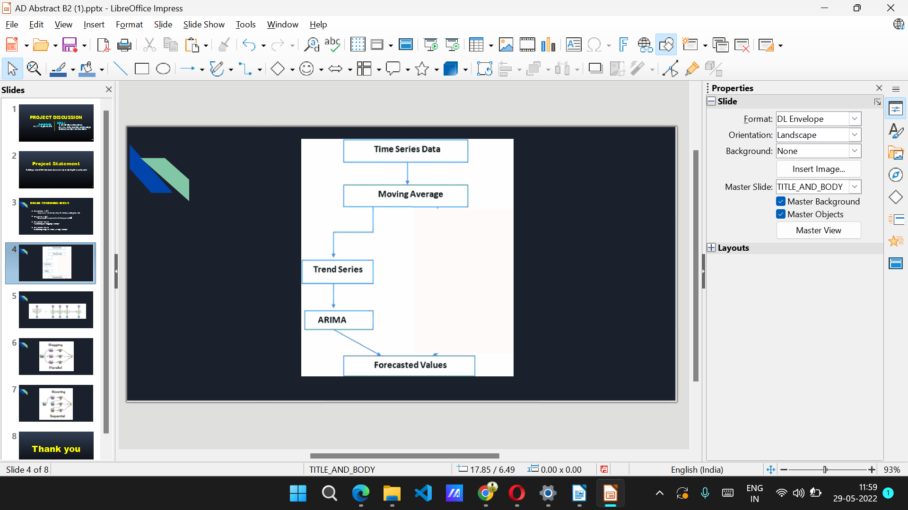
Architecture – ARIMA
ARIMA stands for AutoRegressive Integrated Moving Average. This is a machine learning algorithm used to perform time series forecasting. This is the combination of Auto Regression and Moving average as name suggests. Firstly, Autoregression is a time series model that uses observations from previous time steps as input to the regression equation to predict the value at the next time step. In simple words, it performs regression in previous time step t-1 to predict t. Now MA stands for moving average which is used in calculating the simple average in a particular time frame and dividing it with the total number of time frames taken.

Slide 6
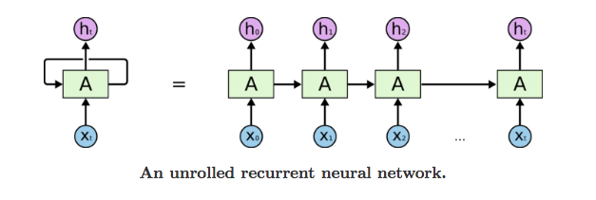
Architecture – LSTM
LSTM networks are an extension of recurrent neural networks (RNNs) mainly introduced to handle situations where RNNs fail. LSTM networks are a type of RNN that uses special units in addition to standard units. LSTM units include a 'memory cell' that can maintain information in memory for long periods of time. This memory cell lets them learn longer-term dependencies. Using LSTM, time series forecasting models can predict future values based on previous, sequential data. This provides greater accuracy for demand forecasters which results in better decision making for the business.

Slide 7
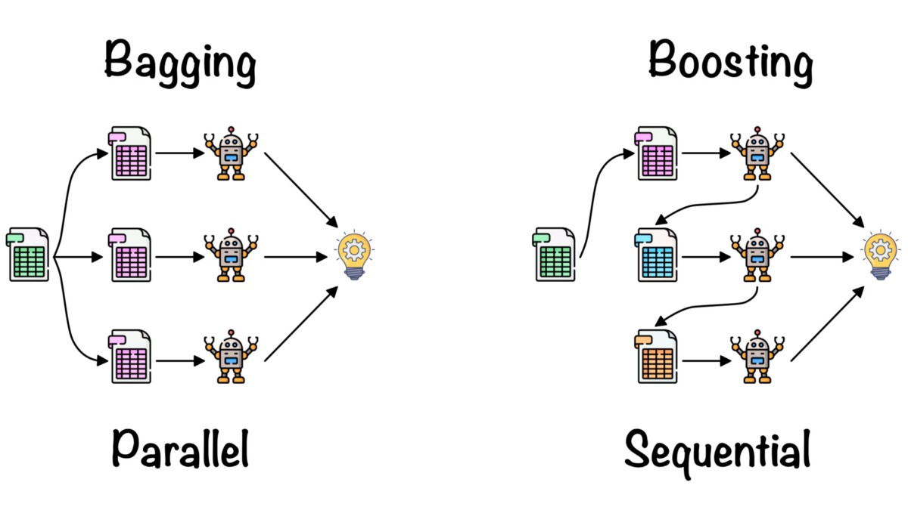
Architecture – ARIMA-LSTM Bagging
Bagging, also known as bootstrap aggregation, is the ensemble learning method that is commonly used to reduce variance within a noisy dataset. In bagging, a random sample of data in a training set is selected with replacement—meaning that the individual data points can be chosen more than once. After several data samples are generated, these weak models are then trained independently, and depending on the type of task—regression or classification, for example—the average or majority of those predictions yield a more accurate estimate.

Slide 8
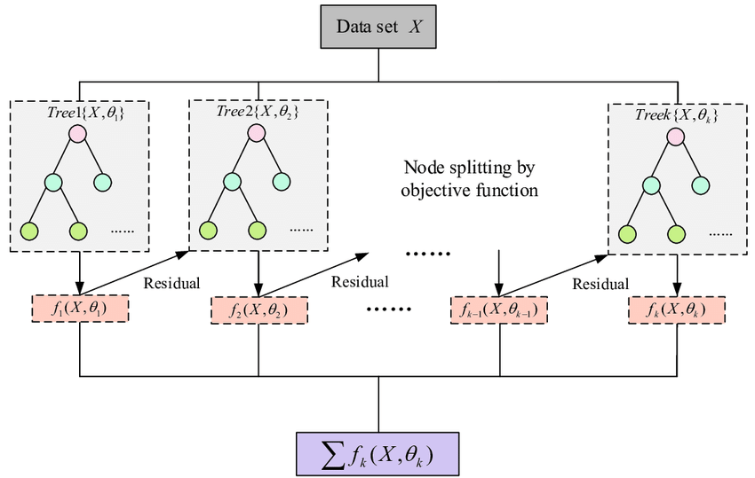
Architecture – XGBoost
XGBoost, which stands for Extreme Gradient Boosting. XGBoost is a popular and efficient open-source implementation of the gradient boosted trees algorithm.. Gradient boosting is a supervised learning algorithm, which attempts to accurately predict a target variable by combining the estimates of a set of simpler, weaker models.

Slide 9
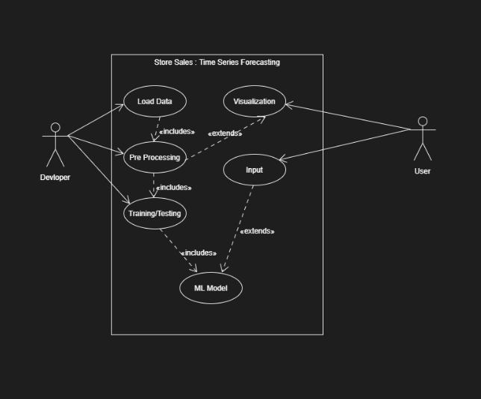
Use Case diagram

Slide 10
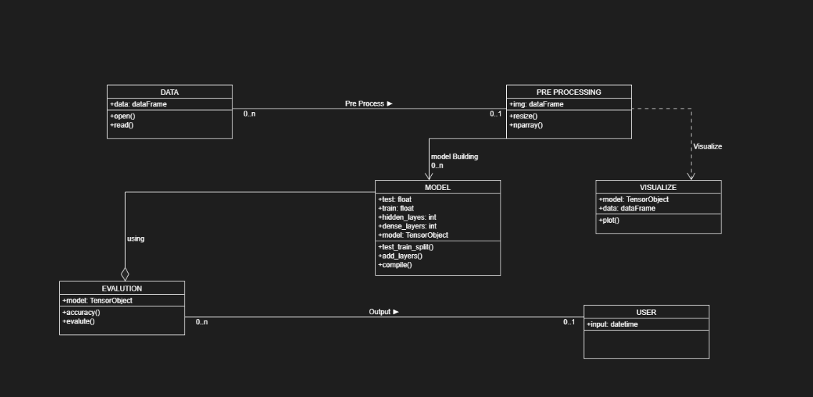
Class diagram

Slide 11
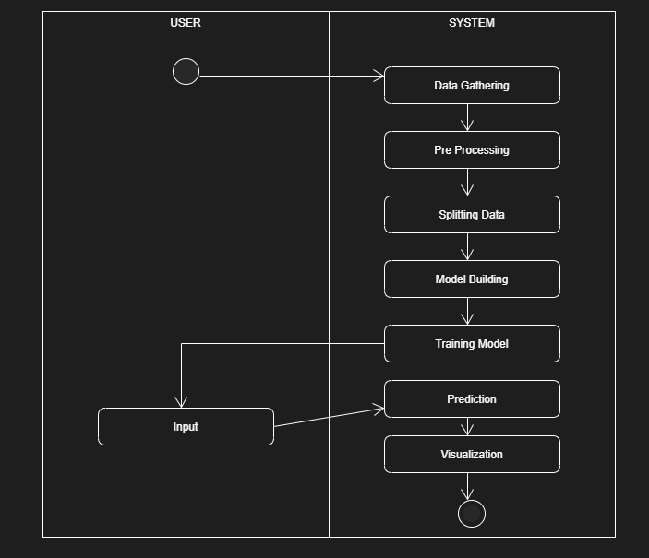
Activity diagram

Slide 12
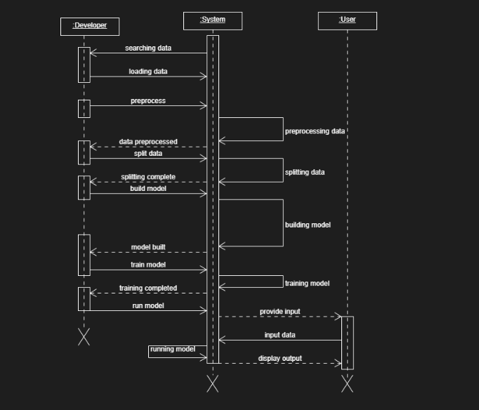
Sequence diagram

Slide 13
CONCLUSION
The design seminar for the Store sales time series forecasting explains the functioning of various entities in the project.
The implementation of the system follows the above designs illustrated in form of UML diagrams
THANK YOU

