Slide 1
Store Sales time series forecasting
Design Seminar
Project Guide
Dr. T V RAJINIKANTH
BATCH 4
G SRI NITHIN (18311A05K4)
CH S C A RAMA GANESH (18311A05J9)
SHEKKARI AKSHAY (18311A05N9)

Slide 2
Project Statement
Building models that forecast store sales by analyzing time series data

Slide 3
Abstract
The project titled ‘Store sales time series forecasting’ is based on the idea of predicting the quantity of sales of a product or services and estimating the growth or drop points of stores. There are many areas in today’s world where prediction or forecasting can be done. Forecasts are mainly essential to brick-and-mortar i.e physical grocery stores, which must invest delicately on how much inventory to buy. Grocers are stuck with overstock if they estimate a little high, and can’t use them since they might be perishable goods. Guess a little under & popular frequently bought items get quickly sold out, leading to loss in revenue and result in customer dissatisfaction. Thus, an efficient and best way of forecasting has become essential requirement for the sellers in order to sustain in the competition. Manually estimating the sales is a very tedious and could lead to human errors which can lead to poor management of the business, and more importantly it is time consuming. Hence it is important for a business organization to be able to achieve this objective by employing a system for forecasting. Moreover, the efficiency may be less in few cases where automation is considered as a good candidate. Our focus is on the forecasting store sales and display the gross sales of the chosen month. With the help of Artificial Intelligence and Machine Learning techniques, our focus is to read the sales data and thereby use it for trend analysis and forecast accordingly. The results of this project, help you evaluate the economical state of the store but on future improvements it can be improved in ways to highlight most sold items and least sold items etc., which can give insights as well as direction to improve on.

Slide 4
Approach
Current forecasting methods for retail have little data to back them up and are unlikely to be automated. The problem becomes more complex as retailers add new locations with unique needs, new products, ever-transitioning seasonal tastes, and unpredictable product marketing.
We are going to use 4 years worth of data to train the model, and tryout several approaches to forecast sales
ARIMA - Hyper Parameter Tuning using the GRID search
LSTM - Designing own sequential model using tensor flow
XGboosting

Slide 5
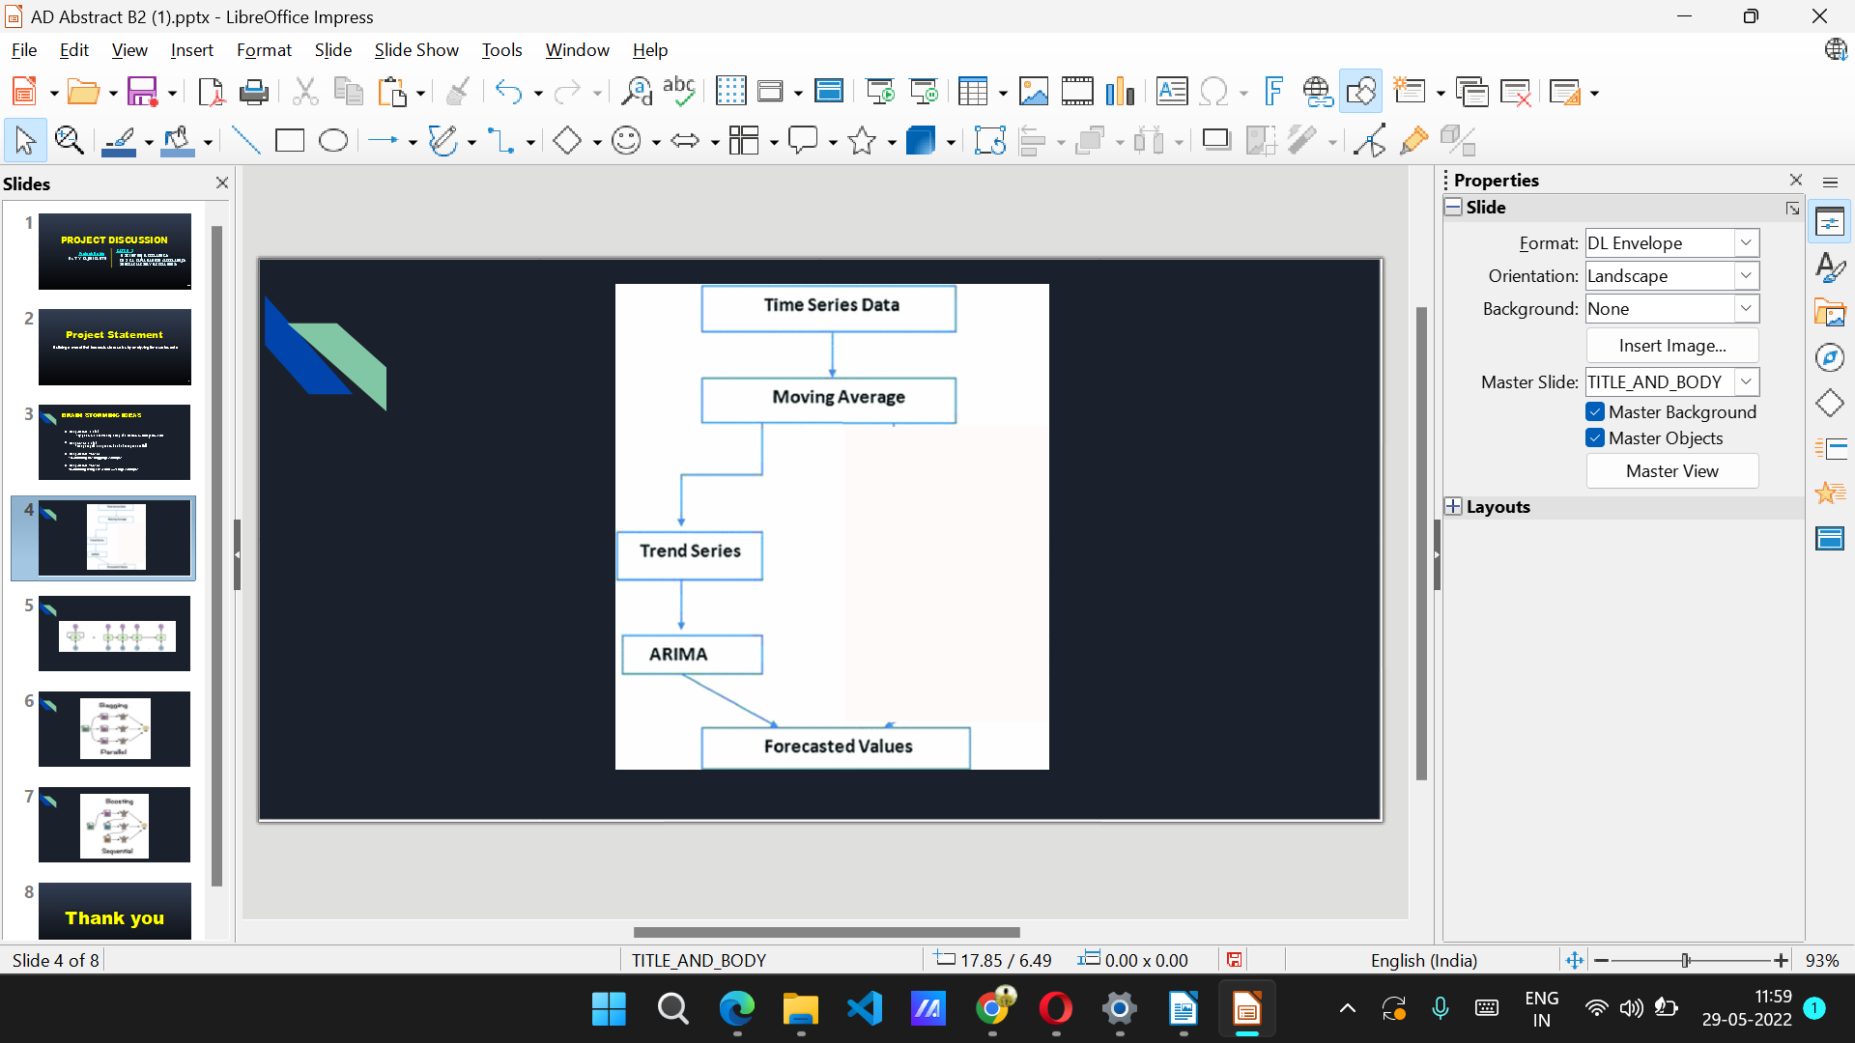
Architecture – ARIMA
ARIMA stands for AutoRegressive Integrated Moving Average. This is a machine learning algorithm used to perform time series forecasting. This is the combination of Auto Regression and Moving average as name suggests. Firstly, Autoregression is a time series model that uses observations from previous time steps as input to the regression equation to predict the value at the next time step. In simple words, it performs regression in previous time step t-1 to predict t. Now MA stands for moving average which is used in calculating the simple average in a particular time frame and dividing it with the total number of time frames taken.

Slide 6
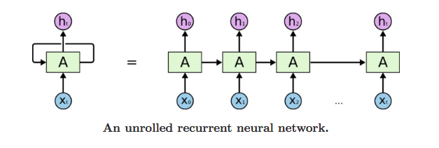
Architecture – LSTM
LSTM networks are an extension of recurrent neural networks (RNNs) mainly introduced to handle situations where RNNs fail. LSTM networks are a type of RNN that uses special units in addition to standard units. LSTM units include a 'memory cell' that can maintain information in memory for long periods of time. This memory cell lets them learn longer-term dependencies. Using LSTM, time series forecasting models can predict future values based on previous, sequential data. This provides greater accuracy for demand forecasters which results in better decision making for the business.

Slide 7
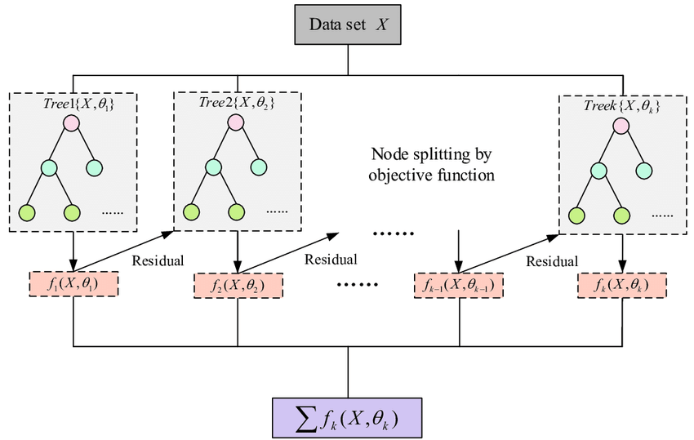
Architecture – XGBoost
XGBoost, which stands for Extreme Gradient Boosting. XGBoost is a popular and efficient open-source implementation of the gradient boosted trees algorithm.. Gradient boosting is a supervised learning algorithm, which attempts to accurately predict a target variable by combining the estimates of a set of simpler, weaker models.

Slide 8
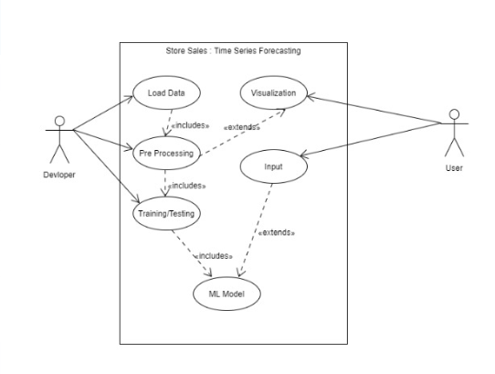
Use Case diagram

Slide 9
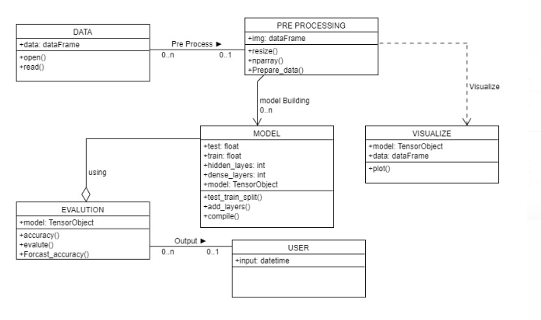
Class diagram

Slide 10
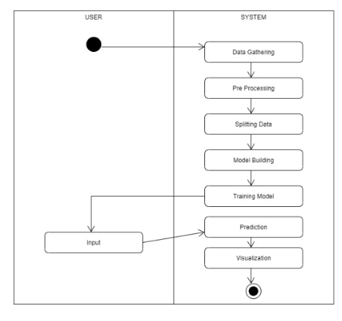
Activity diagram

Slide 11
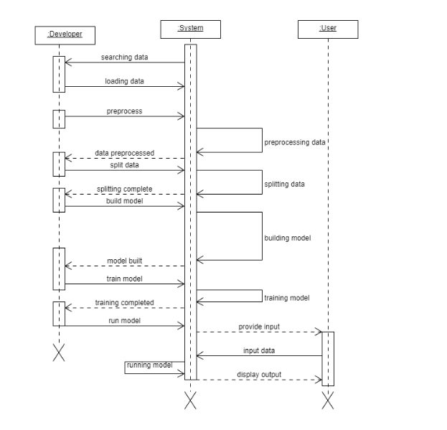
Sequence diagram

Slide 12
CONCLUSION
The design seminar for the Store sales time series forecasting explains the functioning of various entities in the project.
The implementation of the system follows the above designs illustrated in form of UML diagrams
THANK YOU

