Slide 1
C-DOT · PREDICTIVE USER PLANE
Predictive UPF Steering
Simulation to Working Demo
Data modelling, forecasting, controller experiments and evidence
Concise technical review · 09 August 2026
01
02
03
04
05
06
MODEL
›
GENERATE
›
FORECAST
›
OPTIMIZE
›
STEER
›
DEMO
traffic + events
30 s simulation
10–80 min
2 h cohort MPC
new sessions
evidence + outcome
Synthetic, reproducible and explicitly outside a production-release claim.
Implementation + documentation + frozen experiment review
01

Slide 2
EXECUTIVE SUMMARY
SYNTHETIC DATA
A complete predictive steering loop is implemented and measurable
TRAINING DATA
FORECAST WAPE
MEAN-PAIR UL GAIN
WEIGHTED UL GAIN
1.55M
7.63%
10.52%
2.84%
group × 10-minute rows
held-out macro mean
30 matched scenarios
tail-sensitive total
01 · Traffic model
02 · Synthetic history
03 · Forecaster
zones, services, probability and faults
30-second causal cohort simulation
demand and uncertainty by group
04 · Controller
05 · Steering
06 · Demo
cohort MPC certified against static
weighted placement for future sessions
actual outcomes and frozen evidence
Claim: reduced modeled overload exposure for future sessions—not guaranteed prevention, migration or live C-DOT actuation.
README.md · docs/extreme-forecaster-v1-results.md · docs/cohort-mpc-full-campaign-results.md
02

Slide 3
SIMULATION DATA · MODELLING
SYNTHETIC DATA
Stage 1 — model diverse traffic as controllable groups
Dimensions
Executable probability model
ZONES
GROUPS
N(g,t) ~ Poisson(λg × Fg,t)
8
96
urban · airport · stadium · industrial · rural
zone × DNN × slice × 5QI
Fg,t = daily curve × weekend factor × weekly noise × surge multiplier
12 SERVICE CLASSES
independent SHA-derived arrival and lifetime streams
Consumer video
Social/live
uniform integer session lifetime by class
Gaming
IMS voice
fixed class-level UL/DL Mbps per active session
Enterprise
Video conference
sessions retained as anchored cohorts after placement
Industrial URLLC
Massive IoT
Connected vehicle
Edge AI
5QI is forecast/QoS metadata, not a separate v1 steering key
Cloud backup
Public safety
configs/extreme_training_profile.json · simulator/macro/engine.py · docs/extreme-data-spec-and-cdot-gap-analysis.md
03

Slide 4
SIMULATION DATA · EXPERIMENTS
SYNTHETIC DATA
Stage 1 — generate normal regimes, stochastic surges and network stress
DAILY / WEEKLY
258,048 factors
service curves + weekend + U(0.86,1.16)
16-week corpus
FLASH CROWDS
192 episodes
12/week · random group · 2–10 h · ×2.5–8
112 days
322,560 ticks
16,128
10-minute buckets
BROWNOUTS
128 episodes
8/week · UL capacity ×0.18–0.70
1,548,288
group observations
24 UPFs
16 edge · 4 regional · 4 central
NEAR OUTAGES
48 episodes
3/week · degraded + 1% capacity
≈4.39 B
projected session arrivals
80 episodes
5/week · +25–140 ms
≈9.6 GiB
projected artifact volume
LATENCY
Outputs: run.parquet, group/UPF buckets, selection audits and hashed metadata.
Boundary: no mobility, persistent UE identity, heavy-tailed rates, packets or generated telemetry faults in the extreme profile.
experiments/build_extreme_history_manifest.py · docs/extreme-data-spec-and-cdot-gap-analysis.md §§3–8
04

Slide 5
FORECASTER · TRAINING
SYNTHETIC DATA
Stage 2 — transform the history into causal demand forecasts
30 s data
10 min bucket
Observation
Direct models
Calibration
Bundle
›
›
›
›
›
20 rows
arrivals + mean residual
sessions · UL · DL
8 horizons
p50 · p90 · p95
checksum + metrics
Model
Training optimizations
Calendar-ridge direct multi-horizon
vectorized O(n) feature construction
96 groups × 3 targets × 8 horizons = 2,304 models
RMS scaling for national-scale numerical stability
last, MA(6), trend, daily lag and calendar Fourier features
immutable JSON bundle with internal SHA-256
70% train · 15% calibration · 15% chronological test
adaptive conformal alpha after realized coverage
median bias correction + split conformal uncertainty
3:03 total · ~13 s fitting · ~1.8 GiB RSS
experiments/train_forecaster.py · forecasting/bundle.py · docs/extreme-forecaster-v1-results.md
05

Slide 6
FORECASTER · EVALUATION
SYNTHETIC DATA
Stage 2 — forecasting beats causal baselines, but surges remain difficult
Held-out WAPE by horizon
Baseline comparison
12%
10.7
Calendar ridge
7.63%
9.3
7.3
8.0
7.4
7.6
8%
6.1
Daily seasonal
13.71%
4.5
4%
MA(6)
14.30%
0%
10m
20m
30m
40m
50m
60m
70m
80m
Overall p90 coverage 94.21% · p95 coverage 96.69%
44.36% WAPE reduction vs seasonal naive
NORMAL
6.51% WAPE
SURGE
11.08% WAPE
BROWNOUT
5.09% WAPE
OUTAGE
5.29% WAPE
94.19% p90
30.73% p90
87.88% p90
73.96% p90
docs/extreme-forecaster-v1-results.md · docs/extreme-optimizer-tuning-results.md
06

Slide 7
OPTIMIZER · EXPERIMENT PROGRESSION
SYNTHETIC DATA
Stage 3 — experiments showed why a one-window optimizer was not enough
EXPERIMENT
WHAT CHANGED
RESULT / DECISION
One-day predictive pilot
trained p95 forecast + one-window HiGHS LP
+2.40% UL area; insufficient for campaign
Eight-profile tuning
gate, costs, safety factors and static blends
all validation profiles lost to static
Mechanism isolation
scheduled hints, anomaly, lifetime and concentration cap
lifetime helped, but no profile passed
Oracle action-space bound
full-day cohort survival + perfect fault knowledge
100% modeled UL reduction was feasible
Cohort MPC development
two-hour state transition + static certificate
~25.09% mean on five dev seeds
First 12-pair pilot
broader surge/fault/outage/mixed matrix
failed: 4.74% mean; profile rejected
Frozen MA6 MPC
50% static blend + unknown-fault fallback
advanced to fresh 30-pair campaign
Lesson: placements persist for hours; optimizing only the next bucket can create residual concentrations that later decisions cannot undo.
docs/extreme-optimizer-pilot-results.md · extreme-optimizer-tuning-results.md · extreme-oracle-bound-results.md · cohort-mpc-pilot-results.md
07

Slide 8
OPTIMIZER · CURRENT CONTROL LOOP
SYNTHETIC DATA
Stage 3 — the accepted controller plans cohorts, certifies the action and steers new sessions
CLOSED HISTORY
COHORT STATE
2 h MPC
STATIC REPLAY
CERTIFICATE
FIRST ACTION
causal MA(6) p95
›
UPF + remaining lifetime
›
12 future windows
›
same state + events
›
no worse guardrails
›
publish or exact static
Frozen MPC profile
How steering works
12 × 10-minute receding horizon
MPC outputs normalized weights per traffic group and eligible UPF.
exact anchored cohort state and expected survival
Unhealthy or ineligible destinations are removed and weights renormalized.
known future capacity path only after known_at_step
Each arriving session uses deterministic weighted rendezvous hashing.
50% optimized action + 50% contemporaneous static
Admission checks the selected UPF session limit.
fallback to static during unplanned capacity state
UL, DL, drop and session guardrails
The session stays anchored until its lifetime ends—no migration.
optimization/cohort_mpc.py · simulator/macro/controllers.py · simulator/macro/engine.py · steering/hashing.py
08

Slide 9
OPTIMIZER · FINAL EVALUATION
SYNTHETIC DATA
Stage 3 — the 30-pair campaign passes the demo gate, with visible tail risk
MEAN-PAIR UL
WEIGHTED UL
UL DROPPED
DL DROPPED
+10.52%
+2.84%
+12.42%
+9.34%
95% CI 4.81–16.93%
total overload area
aggregate reduction
aggregate reduction
AGGREGATE UL OVERLOAD-AREA REDUCTION
Tail and release boundary
Demand surge
8 pairs
+10.42%
Worst pair: −23.50%
Scheduled fault
8 pairs
+19.01%
all aggregate directional guardrails pass
Unannounced outage
7 pairs
+0.71%
fault-heavy individual regressions remain
working demo candidate—not production-ready
Mixed stress
7 pairs
+1.92%
docs/cohort-mpc-full-campaign-results.md · demo_api/data/cohort_mpc_full_campaign_evidence_v1.json
09

Slide 10
END-TO-END LOOP
SYNTHETIC DATA
From incoming data to a steering decision: one causal 10-minute iteration
Collect
30-second class arrivals and per-UPF sessions, UL/DL, capacity, health and quality
Close bucket
aggregate 20 ticks; history becomes available only after the window closes
01
02
Forecast
estimate future new-session demand and upper uncertainty by controllable group
Optimize
project anchored cohorts and future arrivals across the 12-window capacity path
03
04
Certify
compare MPC with static from the identical state and retain static on any failure
Steer + observe
new sessions use certified weights; realized placement and loss return as the next history
05
06
The dashboard displays this same loop; it does not substitute a prerecorded result for the live causal state.
simulator/macro/engine.py · experiments/train_forecaster.py · optimization/cohort_mpc.py · demo_api/runtime.py
10

Slide 11
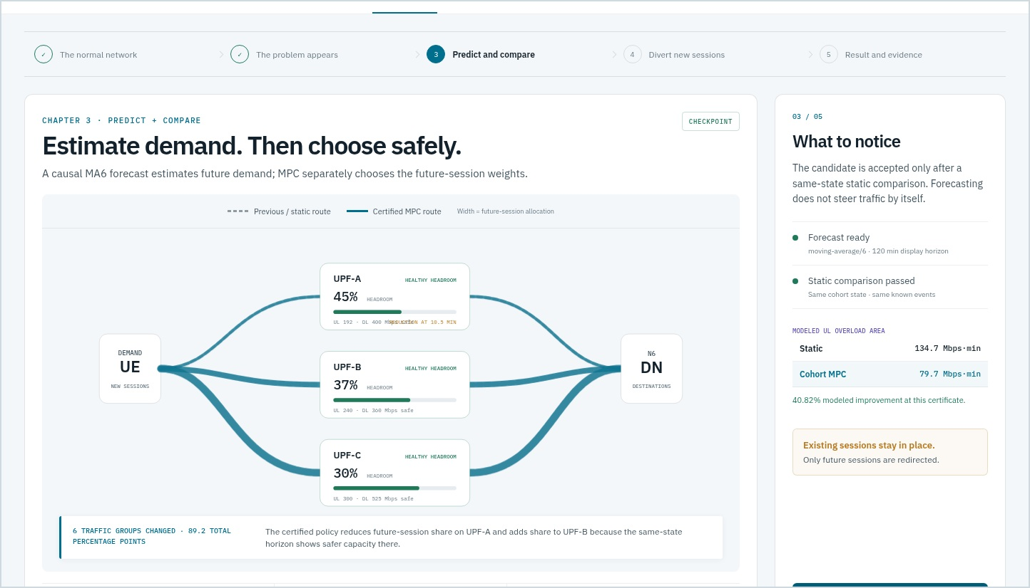
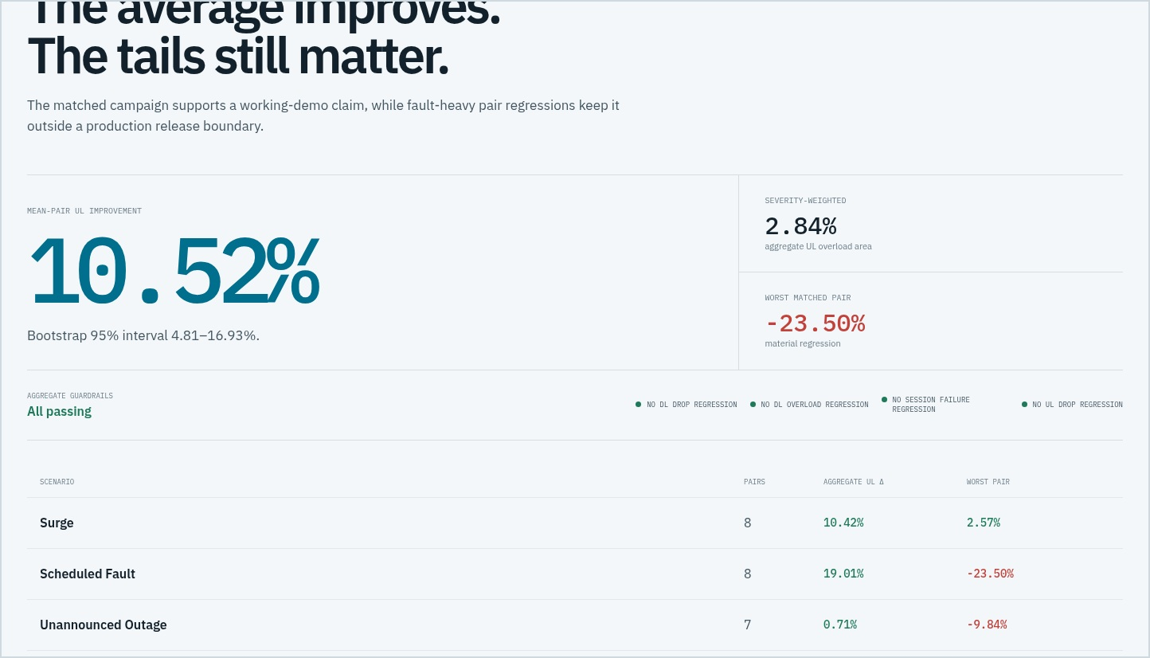
WORKING DASHBOARD
SYNTHETIC DATA
The demo focuses on traffic pressure, steering and evidence
LIVE STATE
STEERING PROOF
FORECAST CHECK
EVIDENCE
UPF load, capacity, health, headroom and loss
previous vs candidate weights and actual new-session placement
p50/p90 versus realized class demand
30-pair metrics, scenario tails and release boundary
frontend/tests/demo.spec.ts-snapshots/ · docs/presenter-guide.md
11

Slide 12
WORKING DEMO · WALKTHROUGH
SYNTHETIC DATA
A short guided scenario explains what changes—and what does not
STEP
AUDIENCE SEES
INTERPRETATION
1 · Normal
all UPFs inside safe envelopes
existing sessions are anchored
2 · Pressure
class demand rises; capacity threat becomes visible
forecast inputs are still causal
3 · Predict
future demand + same-state static comparison
forecast estimates; MPC chooses
4 · Divert
future-session route widths change
weights change, not existing sessions
5 · Result
actual placement, error, loss and frozen campaign
reduced exposure—not perfect prevention
Key language: ‘future sessions redirected’ and ‘modeled exposure reduced’; never ‘traffic migrated’ or ‘overload prevented.’
docs/presenter-guide.md · demo_api/story.py · demo_api/runtime.py
12

Slide 13
INTEGRATION BOUNDARY
SYNTHETIC DATA
What is ready today—and what C-DOT must provide for a calibrated pilot
Ready in the repository
Needed from C-DOT / testbed
deterministic multi-class traffic and fault simulation
live telemetry names, labels, quality and counter semantics
canonical artifacts and reproducible experiment evaluation
measured directional and session capacity envelopes
forecast bundle with uncertainty and causal inference
real topology, locality and UPF eligibility rules
static-certified cohort MPC and safe fallback
authenticated SMF/EMS policy publication interface
new-session-only simulated steering
decision on established-session migration capability
working evidence-oriented dashboard
shadow evaluation, untouched release seeds and tail gate
Recommended sequence: map telemetry → calibrate capacities → advisory replay → shadow recommendations → bounded new-session pilot.
docs/extreme-data-spec-and-cdot-gap-analysis.md · docs/cdot-session-migration-decision.md · docs/end-to-end-runbook.md
13

Slide 14
CONCLUSION
SYNTHETIC DATA
The evidence supports a credible working demo and a clear next pilot
Model the traffic.
Forecast the pressure.
Certify before steering.
EVIDENCE SNAPSHOT
112-day synthetic history
7.63% forecast WAPE
10.52% mean-pair UL gain
The strongest result is not one headline number—it is an end-to-end loop whose assumptions, experiments, gains and limitations remain traceable.
2.84% severity-weighted gain
all aggregate guardrails pass
fault-tail robustness still open
new-session steering only
Proposed discussion
Which C-DOT telemetry and actuation interfaces can support a calibrated shadow pilot?
C-DOT predictive UPF steering · concise technical review
14

