Slide 1
C-DOT · PREDICTIVE USER PLANE
Predictive UPF Steering
Simulation, Forecasting, Optimization & Demo
Implementation review and evidence-backed technical presentation
Prepared for academic review and the C-DOT team · 09 August 2026
01
02
03
04
05
SIMULATE
›
FORECAST
›
OPTIMIZE
›
STEER
›
DEMONSTRATE
30 s causal cohorts
10–80 min demand
2 h cohort MPC
new sessions only
live operator view
All performance evidence in this deck is synthetic and artifact-backed.
Repository review · implementation + docs + frozen experiment artifacts
01

Slide 2
EXECUTIVE SUMMARY
SYNTHETIC DATA
The system works end to end—and the evidence boundary is explicit
A complete synthetic loop is implemented; the controller is a working demo candidate, not a production release.
TRAINING CORPUS
FORECAST WAPE
MEAN-PAIR UL GAIN
SEVERITY-WEIGHTED GAIN
1.55M
7.63%
10.52%
2.84%
group × 10-minute observations
macro held-out, 10–80 min
30 matched static/MPC pairs
tail risk still material
What is implemented
Decision boundary
Deterministic synthetic data factory
The accepted claim is reduced modeled overload exposure for future sessions—not guaranteed overload prevention.
30-second cohort simulation, 8 zones, 12 services, 24 UPFs, seeded surges and faults.
Trained probabilistic forecast bundle
2,304 direct calendar-ridge models with p50/p90/p95 conformal envelopes.
Worst paired scenario: −23.50%
Causal cohort-state MPC
No established-session migration
Twelve 10-minute windows, persistent-session state, static anchoring, same-state certificate and fallback.
No live SMF/EMS actuation
Working dashboard demo
C-DOT telemetry and capacity calibration remain external
FastAPI + React, REST/WebSocket snapshots, class telemetry, per-UPF routing proof and frozen evidence.
docs/extreme-forecaster-v1-results.md · docs/cohort-mpc-full-campaign-results.md · README.md
02

Slide 3
EVIDENCE STANDARD
SYNTHETIC DATA
Review basis: implementation, documentation, artifacts and executable checks
01
Implementation
02
Design records
03
Frozen results
Simulator, forecasting, optimization, steering, API and React UI traced to source.
Architecture decisions, runbooks, traffic specification and C-DOT gap analysis reconciled.
Forecast bundle, optimizer tuning, oracle bound and 30-pair campaign evidence reviewed.
90 / 90
6 / 6
Evidence rule
backend tests passed
demo preflight gates passed
Synthetic values, workstation benchmarks and external integration assumptions are never mixed into a production claim.
contracts and telemetry reconstruction
traffic registry
deterministic simulator and Parquet
3-UPF / 6-class scenario
forecast leakage and bundle integrity
forecast bundle checksum
The worktree is currently dirty; frozen artifacts preserve hashes and exact code identities where documented.
HiGHS, cohort MPC and oracle bounds
FastAPI OpenAPI: 20 paths
API, story, rewind and campaign evidence
production-built operator console
frontend bundle checksum
env/bin/python -m unittest discover -s tests -v · env/bin/python scripts/preflight.py
03

Slide 4
ARCHITECTURE
SYNTHETIC DATA
The implementation is an artifact-backed, causal closed loop
SCENARIO
SIMULATE
AGGREGATE
FORECAST
OPTIMIZE
ACTUATE
Seeded manifest
+ topology + events
›
30 s cohorts
+ traffic accounting
›
20 ticks →
10 min observations
›
p50 / p90 / p95
1–12 windows
›
Cohort-state MPC
+ static certificate
›
Weighted rendezvous
new sessions only
OFFLINE
LIVE
Artifact factory
Control decision
Presentation runtime
PBS or workstation shards publish immutable Parquet, JSONL, selection audits and metadata hashes. The cluster is not required during a demo.
At a decision boundary, only closed history and declared known-at events are visible. The first MPC action is compared with static from the identical cohort state.
One FastAPI process advances the simulator, emits ordered WebSocket deltas, serves the React console and retains an append-only audit trail.
docs/system-architecture-decisions.md · docs/end-to-end-runbook.md · demo_api/runtime.py
04

Slide 5
STAGE 1 · SIMULATION DATA
SYNTHETIC DATA
Traffic is modeled by controllable groups—not by anonymous aggregate load
Population and dimensions
Zone and service diversity
ZONES
SERVICES
north-urban
south-urban
8
12
urban · industrial · airport · stadium · rural
consumer, enterprise, critical and IoT
east-urban
west-urban
industrial
airport
GROUPS
ELIGIBLE UPFS
96
6
stadium
rural
8 zones × 12 service profiles
2 edge + 2 regional + 2 central
Why grouping matters
Forecasts remain local to an operationally meaningful class.
Forecast / QoS key
(zone, DNN, S-NSSAI, 5QI)
UPF eligibility and path latency are enforced per group.
Routing weights can shift one class without assuming every session can reach every UPF.
5QI is descriptive in v1; it is not assumed to be an independent SMF selection key.
configs/extreme_training_profile.json · experiments/build_extreme_history_manifest.py · docs/extreme-data-spec-and-cdot-gap-analysis.md
05

Slide 6
STAGE 1 · PROBABILISTIC MODEL
SYNTHETIC DATA
The executable stochastic model is simple, reproducible and deliberately bounded
N(g,t) ~ Poisson( λg × Fg,t )
Determinism by construction
manifest seed fixes events
Fg,t = daily profile × weekend factor × U(0.86, 1.16) weekly noise × active surge
SHA-256-derived random stream per group
independent arrival and lifetime streams
Factors update hourly; arrivals are drawn every 30 seconds.
same seed + policy ⇒ same logical run
SESSION LIFETIME
SESSION RATE
STATE
LOAD
Discrete uniform integer draw within each class range.
Fixed UL/DL Mbps per active session for a class.
Placed sessions become aggregate cohorts with explicit departure steps.
Offered demand is the sum of fixed rates for all active sessions.
Not implemented in the extreme generator: AR(1), Markov bursts, heavy-tailed rate/lifetime, persistent UE identity, mobility, packet-level traffic or telemetry faults.
simulator/macro/engine.py::_poisson · configs/extreme_training_profile.json · docs/traffic-model-spec.md
06

Slide 7
STAGE 1 · TRAFFIC CATALOG
SYNTHETIC DATA
Twelve service classes create distinct temporal and directional demand
Values are per active session; lifetime ranges are from the executable extreme profile.
SERVICE / DNN
5QI
ARRIVALS / 30 s / ZONE
LIFETIME
UL / DL Mbps
CALENDAR
Consumer video
9
201.6–403.2
1–12 h
0.15 / 4.00
Evening
Social / live
8
112.0–224.0
10 m–2 h
2.00 / 1.00
Evening
Gaming
3
134.4–268.8
40 m–6 h
0.20 / 0.40
Late
IMS voice
1
89.6–179.2
10 m–4 h
0.08 / 0.08
Commute
Enterprise
7
112.0–224.0
30 m–8 h
1.00 / 2.00
Business
Video conference
2
89.6–179.2
30 m–6 h
1.50 / 1.50
Business
Industrial URLLC
82
67.2–134.4
4–24 h
0.10 / 0.08
Industrial
Massive IoT
9
224.0–448.0
6–48 h
0.020 / 0.004
Flat
Connected vehicle
84
112.0–224.0
5 m–1 h
0.50 / 1.00
Commute
Edge AI
7
56.0–112.0
10 m–2 h
3.00 / 6.00
Business
Cloud backup
9
22.4–44.8
1–12 h
8.00 / 2.00
Overnight
Public safety
65
33.6–67.2
20 m–3 h20
2.00 / 2.00
Flat
The same arrival count drives sessions, UL and DL via fixed class rates; identical target WAPE does not imply three independent traffic processes.
configs/extreme_training_profile.json · docs/extreme-data-spec-and-cdot-gap-analysis.md §4
07

Slide 8
STAGE 1 · SCENARIO CATALOGUE
SYNTHETIC DATA
Scenario generation covers normal regimes, random surges and network disturbances
DAILY / WEEKLY
258,048 factors
service curve × weekend × group/week noise
demand seasonality
FLASH CROWDS
192 episodes
12/week · random group · 2–10 h · ×2.5–8.0
localized step surges
BROWNOUTS
128 episodes
8/week · 1–8 h · UL ×0.18–0.70
capacity, queue, drops
NEAR OUTAGES
48 episodes
3/week · 1–4 h · degraded + 1% capacity
severe residual stress
LATENCY
80 episodes
5/week · 1–6 h · +25–140 ms
path-cost disturbance
Surge IDs are not stored in run.parquet; their multipliers are folded into hourly arrival-factor events. Fault effects appear as resulting UPF state.
experiments/build_extreme_history_manifest.py::_surges/_fault_events · docs/extreme-data-spec-and-cdot-gap-analysis.md §6
08

Slide 9
STAGE 1 · UPF TOPOLOGY
SYNTHETIC DATA
Eligibility and directional safety envelopes constrain every placement
24-UPF logical hierarchy
Per-instance capacity envelope
One traffic group sees exactly six eligible destinations
TIER
COUNT
UL
DL
SESSION CAP
SAFE
ZONE
north
south
east
west
Edge A
8
480 G
1.44 T
1.44 M
78% / 82%
industrial
airport
stadium
rural
Edge B
8
560 G
1.28 T
1.44 M
78% / 82%
EDGE
2 per zone
→
Regional
4
1.12 T
2.40 T
3.52 M
80% / 85%
Central
4
1.92 T
3.84 T
5.12 M
75% / 85%
REGIONAL
4 total
→
TOTAL
24
20.48 T
46.72 T
57.60 M
mixed
Admission filters: health ∈ {healthy, degraded} · group eligible · locality path exists · optional max latency · session capacity available.
CENTRAL
4 total
→
experiments/build_extreme_history_manifest.py::_upfs/_eligible_upfs · simulator/macro/config.py
09

Slide 10
STAGE 1 · SIMULATOR MECHANICS
SYNTHETIC DATA
Each 30-second tick preserves causal order and all traffic accounting states
CLOSE
At a 10-minute boundary, close the prior 20-tick history bucket.
EVENTS
Apply arrival, capacity, health and latency events for this tick.
1
2
POLICY
Replan if due using current state and only causal history.
ARRIVALS
Draw exact Poisson arrivals per group from independent streams.
3
4
SELECT
Filter eligible/healthy UPFs and run weighted rendezvous per session.
ADMIT
Check session capacity; draw uniform lifetime and create a cohort.
5
6
SERVE
Apply capacity, queues and drops separately for UL and DL.
EMIT
Write step telemetry, audit samples and boundary group/UPF state.
7
8
Traffic is recorded as offered → carried / queued / dropped, while admission failures and unplaced rejections remain separate.
simulator/macro/engine.py::Simulator.advance · simulator/macro/model.py · steering/hashing.py
10

Slide 11
STAGE 1 · DATASET AND ARTIFACTS
SYNTHETIC DATA
The 16-week extreme campaign is large enough to stress the full offline path
DURATION
TRAINING ROWS
PROJECTED SESSIONS
ARTIFACTS
112 d
1.548 M
4.39 B
≈9.6 GiB
322,560 × 30-second ticks
96 groups × 16,128 buckets
routed arrivals; audit sampled 1:5,000
one 112-day extreme shard
ARTIFACT
GRANULARITY
WHAT IT PROVES
run.parquet
1 row / 30 s
group arrivals + nested per-UPF UL/DL/session state
group_upf_buckets[]
10 min boundary
joint class/UPF active, admitted and rejected state
selection-audits.parquet
1 / 5,000 sessions
hashed key, eligible set, weights and selected UPF
run.jsonl
readable adapter
metadata + steps + retained selection audits
metadata.json
1 / shard
hashes, source identity, host/job and aggregate metrics
forecast bundle
1 immutable JSON
2,304 models, metrics, calibration and checksum
Measured one-day calibration: 5:06 wall time · 588 MiB peak RSS · 87.6 MiB output. A 112-day shard projects to ~9 h 32 m and ~64 GiB retained memory.
docs/extreme-data-spec-and-cdot-gap-analysis.md §§3,8 · simulator/macro/engine.py::write_parquet
11

Slide 12
STAGE 2 · FORECASTER TRAINING
SYNTHETIC DATA
Training converts canonical 30-second Parquet into leakage-safe direct forecasts
20 TICKS
10 MIN
OBSERVATION
DIRECT MODELS
CONFORMAL
BUNDLE
sum group arrivals
›
mean UPF residual state
›
sessions + UL + DL
›
3 targets × 8 horizons
›
p50 + p90 / p95 widths
›
checksum + metadata
Exact training row
What the v1 trainer does not consume
new_session_count = Σ arrivals in the 20 ticks
queue, drop or rejection fields as targets
new UL/DL = count × fixed class Mbps/session
selection audits or explicit event IDs
residual sessions and offered Mbps = duration mean across the bucket
packet counters, CPU, memory or resets/gaps
one DemandObservation emitted per controllable group
per-group measured carried throughput
experiments/train_forecaster.py::_bucket_sequence · forecasting/bundle.py
12

Slide 13
STAGE 2 · MODEL AND TRAINING OPTIMIZATIONS
SYNTHETIC DATA
The chosen forecaster favors transparency, speed and numerical stability
Calendar-ridge direct multi-horizon model
Engineering optimizations
FEATURE
ROLE
Vectorized row construction
NumPy builds each sequence in O(n); the prior scalar path rebuilt full histories.
last value
autoregressive level
RMS feature scaling
rolling mean (6)
one-hour causal baseline
stabilizes national-scale normal equations while preserving the bundle coefficient contract.
recent trend
local direction
Ordered split
70% train / 15% calibration / 15% test; features never cross the forecast origin.
daily seasonal lag
same-time prior-day structure
sin/cos time of day
continuous daily phase
Median bias correction
calibration residual median shifts the non-negative p50 point forecast.
sin/cos day of week
weekly calendar phase
Split conformal + ACI
intercept
group/horizon baseline
residual widths provide p90/p95; adaptive alpha reacts to realized coverage.
96 groups × 3 targets × 8 horizons = 2,304 nine-feature ridge systems
3:03 total · ~13 s fitting · ~1.8 GiB peak RSS · GPU unnecessary for v1
forecasting/bundle.py::_sequence_training_rows/_fit_direct_model · logs/extreme-forecaster-training-optimized.log
13

Slide 14
STAGE 2 · FORECAST RESULTS
SYNTHETIC DATA
Held-out performance is strong at operational horizons and degrades predictably with lead time
Macro WAPE by horizon
Fair baseline comparison
12%
10.73
Calendar ridge
9.34
7.63%
9%
7.95
7.42
7.63
7.35
6.09
Daily seasonal
6%
13.71%
4.48
3%
MA(6)
14.30%
0%
10m
20m
30m
40m
50m
60m
70m
80m
p90 upper-bound coverage stays between 93.10% and 94.96% across all eight horizons.
44.36% lower WAPE than daily seasonal naive.
docs/extreme-forecaster-v1-results.md §§3–4 · output/models/extreme-forecaster-v1-baseline-evaluation.json
14

Slide 15
STAGE 2 · REGIME ANALYSIS
SYNTHETIC DATA
Surges—not brownouts—are the dominant forecast weakness
REGIME
WAPE
P90 COVERAGE
INTERPRETATION
Normal
6.51%
94.19%
well calibrated
Surge
11.08%
30.73%
unannounced step-change is not predictable beforehand
Brownout
5.09%
87.88%
network state changes; offered demand does not
Near outage
5.29%
73.96%
demand accuracy stays normal; coverage weakens
Latency incident
5.04%
92.36%
path state changes, not demand
Operational consequence
Evaluation caveat
The controller needs robust fallback and static-relative certification; forecast accuracy alone cannot guarantee benefit.
The v1 70/15/15 split differs slightly from the manifest’s explicit 11/2/3-week boundary; event-stratified release reporting remains incomplete.
docs/extreme-optimizer-tuning-results.md §Forecast performance by regime · docs/extreme-forecaster-v1-results.md
15

Slide 16
STAGE 3 · CONTROLLER EVOLUTION
SYNTHETIC DATA
The optimizer evolved only after the evidence disproved the first design
01 · ONE-WINDOW LP
02 · MECHANISM TUNING
03 · ORACLE BOUND
04 · COHORT MPC
p95 forecast + residual load
›
hints · anomaly · lifetime · caps
›
full-day cohort relaxation
›
12-window state transition
Validation failed
Still worse than static
100% modeled UL reduction possible
10.52% mean-pair gain
Core lesson
New-session decisions persist for hours. A controller that optimizes only the next bucket can create residual concentrations that it cannot later undo.
The successful redesign carried cohort survival through a two-hour horizon and compared every candidate with static from the same state.
docs/extreme-optimizer-tuning-results.md · docs/extreme-oracle-bound-results.md · docs/cohort-mpc-full-campaign-results.md
16

Slide 17
STAGE 3 · FAILURE ANALYSIS
SYNTHETIC DATA
Why the one-window HiGHS controller lost to a strong static baseline
Mechanism of failure
Validation outcome versus static
Myopic horizon
Responsive gate p95
-7.1%
Minimizing next-window peak utilization ignores the future occupancy of long-lived cohorts.
Persistent placement
Static anchor · 10%
-9.1%
Only future sessions are controllable; already placed sessions cannot be rebalanced.
Default p95
-39.0%
Correlated concentration
A per-group weight cap does not prevent many groups from choosing the same failure domain.
Load-only aggressive
-76.5%
Forecast step-changes
Load-first · +35% safety
-93.8%
Surge p90 coverage collapses before an unannounced jump becomes observable.
Load-first · +15% safety
-168.0%
Static is robust
Capacity-weighted rendezvous spreads each group broadly and continuously.
No profile passed guardrails; reserved fresh test seeds were preserved rather than used for selection.
docs/static-controller-deep-research.md · docs/extreme-optimizer-tuning-results.md
17

Slide 18
STAGE 3 · COHORT MPC
SYNTHETIC DATA
Cohort-state MPC plans the consequences of today’s weights across twelve windows
State transition model
Frozen demo profile
Projected load(u,t) = anchored cohorts(u,t) + Σg,τ≤t x(g,τ,u) · demand(g,τ) · survival(g,t−τ)
MAX UPF WEIGHT
0.75
STATIC BLEND
50%
HORIZON
12 × 10 min = 2 hours
DEMAND
causal MA(6) p95; scheduled multipliers only after known_at_step
SOLVER TIMEOUT
2.0 s
OVERLOAD COST
1×
STATE
exact active cohorts by group, UPF, remaining lifetime and directional rate
CAPACITY PATH
current state + declared future health/capacity events
PHYSICAL DROP COST
10×
DECISION
continuous group→UPF weights for each horizon window
ACTION
only the first window is published; replan every 10 minutes
TERMINAL EXPOSURE
1×
UNPLANNED CAPACITY
fallback static
optimization/cohort_mpc.py · simulator/macro/controllers.py::CohortMPCController · configs/cohort_mpc_pilot_10pct_v2.json
18

Slide 19
STAGE 3 · SAFETY AND FALLBACK
SYNTHETIC DATA
Every MPC action is guarded by a same-state static certificate
1
›
2
›
3
›
4
›
5
FORECAST
SOLVE
REPLAY
CERTIFY
PUBLISH
12-window demand
HiGHS LP
static from same state
guardrails + gain
or exact static
Certificate requires
Fallback triggers
UL overload area no worse than static
insufficient history or forecast error
DL overload area no worse than static
solver infeasible / error / timeout
session overload no worse than static
certificate rejects the candidate
UL and DL physical drops no worse than static
observed unplanned capacity state
minimum score and modeled UL improvement
no healthy eligible route exists
optimization/cohort_mpc.py::_certificate · simulator/macro/controllers.py::_static_fallback · steering/policy.py
19

Slide 20
STAGE 3 · EVALUATION RESULTS
SYNTHETIC DATA
The frozen 30-pair campaign passes the working-demo gate
MEAN-PAIR UL
SEVERITY-WEIGHTED UL
UL DROPPED BYTES
DL DROPPED BYTES
+10.52%
+2.84%
+12.42%
+9.34%
bootstrap 95% CI: 4.81–16.93%
dominated by highest-overload days
aggregate reduction
aggregate reduction
Exactly paired experiment
Release decision
30 fresh seeds
Working demo candidate—not production-ready.
34001–34030; one simulated day per pair.
Common random numbers
same scenario, arrivals, lifetimes, event schedule and rendezvous namespace.
Four stress families
WORST MATCHED PAIR
8 surge · 8 scheduled fault · 7 unannounced outage · 7 mixed.
−23.50%
Aggregate guardrails
scheduled-fault tail regression
DL overload, both directional drops and establishment failures all pass.
docs/cohort-mpc-full-campaign-results.md · demo_api/data/cohort_mpc_full_campaign_evidence_v1.json
20

Slide 21
STAGE 3 · SCENARIO BREAKDOWN
SYNTHETIC DATA
Average gains are broad, but robustness is weakest under surprise and fault tails
AGGREGATE UL OVERLOAD-AREA REDUCTION
Worst pair by scenario
Demand surge
n=8
+10.42%
Demand surge
+2.57%
Scheduled fault
n=8
+19.01%
Scheduled fault
-23.50%
Unannounced outage
-9.84%
Unannounced outage
n=7
+0.71%
Mixed stress
-8.28%
Mixed stress
n=7
+1.92%
Next release gate: positive severity-weighted confidence bounds on untouched seeds, plus materially reduced unannounced-outage and scheduled-fault tails.
demo_api/data/cohort_mpc_full_campaign_evidence_v1.json · docs/cohort-mpc-full-campaign-results.md
21

Slide 22
STAGE 4 · WORKING DEMO
SYNTHETIC DATA
The dashboard is a real causal runtime—not a prerecorded animation
REACT OPERATOR CONSOLE
Live Dashboard · Evidence · Technical Detail · Expert mode
REST + WEBSOCKET
commands and snapshots · ordered versioned deltas · reconnect
FASTAPI ORCHESTRATOR
run lifecycle · auth roles · audit · story checkpoints · analytics
CAUSAL SIMULATION LOOP
30 s tick · 10 min control · forecast · MPC · actuator
FROZEN ARTIFACTS
scenario · forecast bundle · MPC profile · 30-pair evidence
The server chooses the policy before realizing the tick; event injection never rewrites prior telemetry. Rewind restores complete runtime state.
demo_api/main.py · demo_api/runtime.py · frontend/src/App.tsx · docs/system-architecture-decisions.md ADR-021–023
22

Slide 23
STAGE 4 · DASHBOARD DATA AND FEATURES
SYNTHETIC DATA
The operator sees both the decision and the evidence behind it
LIVE DASHBOARD
EVIDENCE
TECHNICAL DETAIL
per-UPF capacity, load, headroom and health
30 matched-pair frozen campaign
class arrivals, admissions and rejections
new-session route widths and weight deltas
mean-pair CI and severity-weighted total
p50/p90/actual forecast table
forecast → certificate → apply/hold trace
scenario-level aggregate and worst pair
static vs MPC certificate metrics
completed surge debrief and iteration ledger
artifact identity and production boundary
raw trace, deployment boundary and expert controls
DISPLAYED DATA SOURCES
simulator StepResult · canonical group/UPF buckets · Forecast · Policy · certificate · frozen campaign JSON
frontend/src/views.tsx · frontend/src/types.ts · demo_api/runtime.py::snapshot/comparison
23

Slide 24
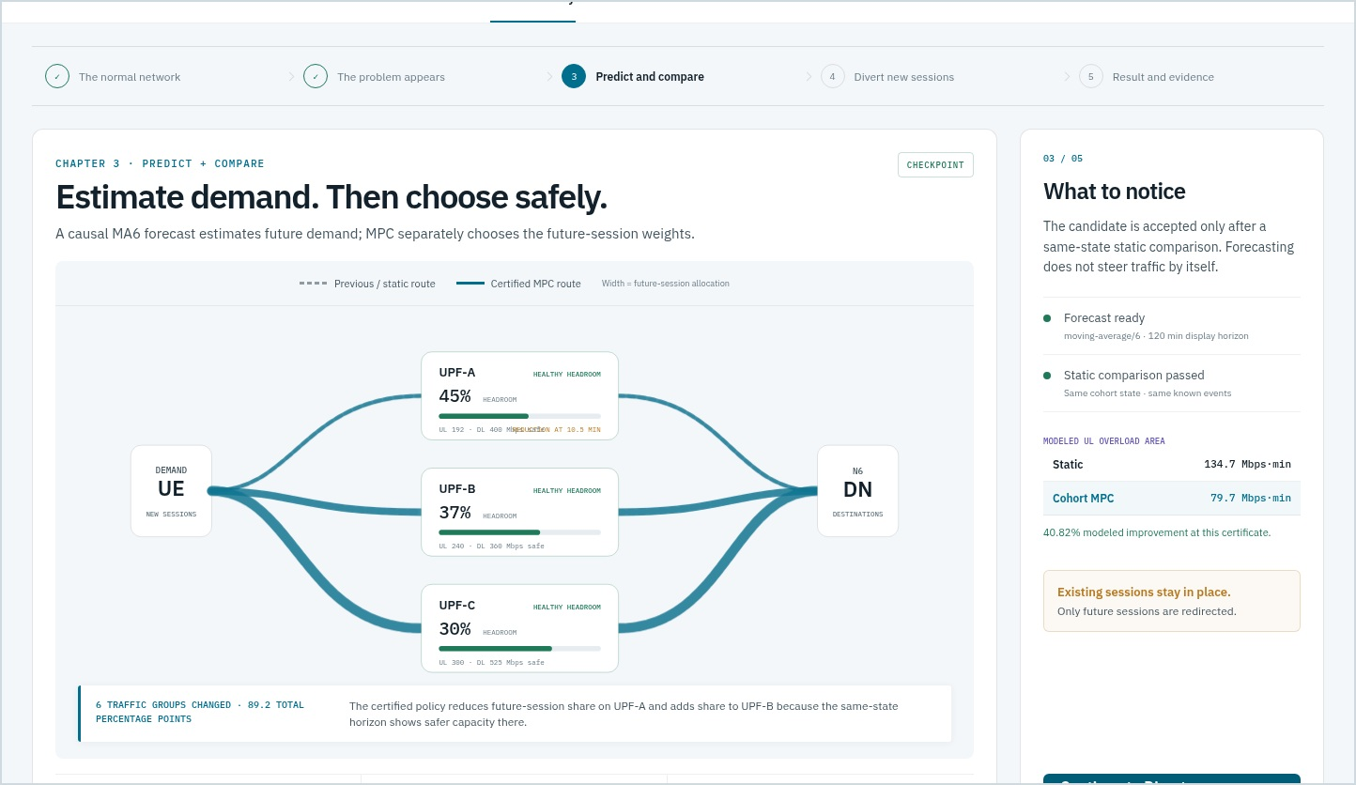
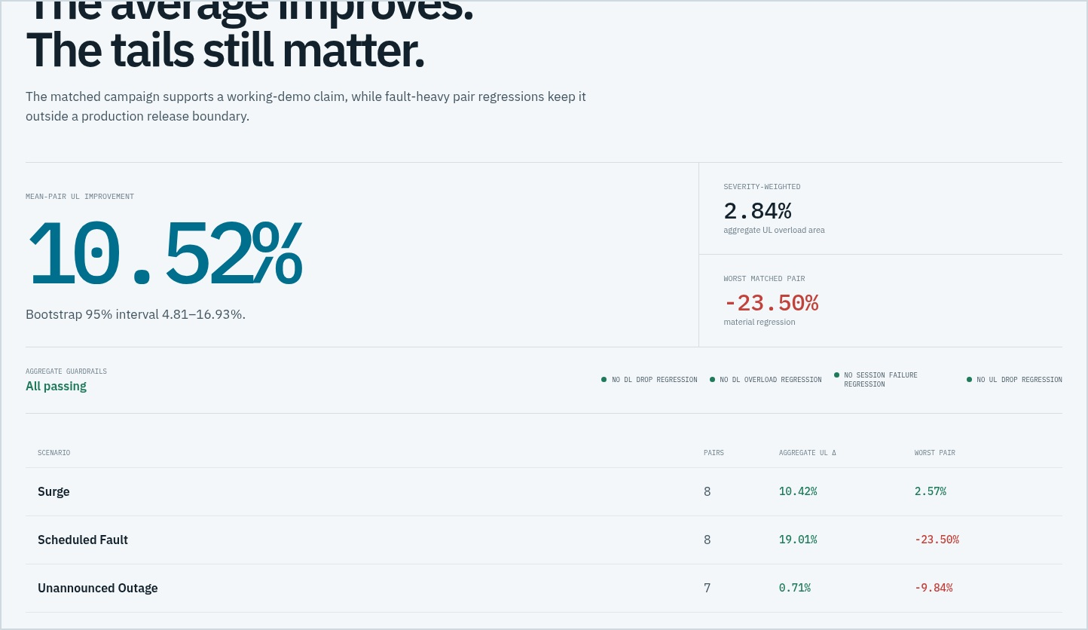
STAGE 4 · DASHBOARD EXPERIENCE
SYNTHETIC DATA
The actual console keeps routing, evidence and caveats visible
Predict + compare checkpoint
Frozen campaign evidence
Route widths encode future-session allocation; the side rail exposes the same-state static comparison and the no-migration caveat.
The evidence view leads with the 10.52% average but places severity weighting, worst pair and release status beside it.
frontend/tests/demo.spec.ts-snapshots/prediction-checkpoint-linux.png · evidence-ending-linux.png
24

Slide 25
STAGE 4 · HOW DIVERSION WORKS
SYNTHETIC DATA
Traffic diversion is deterministic weighted placement for newly arriving sessions
SIMULATOR PLACEMENT PATH
What a weight change means
requested = policy_weights[group_id]
allowed = {u:w for u,w in requested.items()
if u in eligible_upfs
and state[u].health in {healthy,degraded}}
weights = normalize(allowed)
selected = rendezvous_select(
session_key, stable_namespace, weights)
if active[selected] >= session_capacity:
reject()
else:
lifetime = randint(min_steps, max_steps)
create_anchored_cohort(selected, lifetime)
Before
Each new session hashes across the current eligible weighted set.
Policy epoch
MPC publishes new normalized weights after certification.
After
Only later arrivals use the new weighted scores.
Persistence
Admitted sessions stay on the selected UPF until their lifetime ends.
No migration
Existing TEIDs/sessions are never moved by this code.
The policy ID does not re-salt the hash namespace; paired runs share the selection randomization.
simulator/macro/engine.py::advance · steering/hashing.py::rendezvous_select · docs/cdot-session-migration-decision.md
25

Slide 26
STAGE 4 · PRESENTER WALKTHROUGH
SYNTHETIC DATA
A five-minute guided story makes the control loop explainable
TIME
CHECKPOINT
WHAT THE AUDIENCE SEES
DEFENSIBLE CLAIM
0:00
Normal network
three UPFs inside safe envelopes
established sessions remain anchored
0:35
Problem appears
stadium demand rises; known UPF-A UL reduction
pressure is visible before the route changes
1:20
Predict + compare
causal MA6 forecast + same-state certificate
forecast does not steer traffic by itself
2:35
Divert new sessions
new route widths and per-UPF weight deltas
future arrivals shift; existing sessions do not
3:40
Result + evidence
realized outcome, loss and frozen 30-pair evidence
modeled exposure is reduced, not eliminated
Deterministic checkpoints are server-side state: browser reload, brief disconnect and rewind do not invent or recompute realized history.
docs/presenter-guide.md · demo_api/story.py · demo_api/runtime.py::_guided_story/rewind
26

Slide 27
QUALITY ASSURANCE
SYNTHETIC DATA
Verification spans contracts, causality, optimization and the presentation surface
CONTRACTS
versioned schemas · round-trip fixtures · normalized policies
CAUSALITY
no future observations · known_at_step enforcement · append-only history
SIMULATOR
deterministic streams · queues/drops · Parquet schema · audit sampling
OPTIMIZER
hand-solvable LPs · eligibility · diversification · same-state certificate
EXPERIMENTS
exact pairing · reserved seeds · immutable outputs · bootstrap interval
DEMO
auth roles · OpenAPI · WebSocket order · rewind exactness · visual snapshots
BACKEND TESTS
API PATHS
VISUAL BASELINES
PREFLIGHT
90
20
13
PASS
all passed in 4.56 s
FastAPI preflight
desktop, tablet and mobile
all data labeled synthetic
tests/ · frontend/tests/demo.spec.ts · scripts/preflight.py · verified 09 Aug 2026
27

Slide 28
C-DOT INTEGRATION BOUNDARY
SYNTHETIC DATA
Simulation and production integration are intentionally separated
Available now
Requires C-DOT / testbed
deterministic cohort simulation and event injection
live Prometheus metric names, labels and scrape semantics
canonical Parquet, audit and hashed metadata
measured UPF UL/DL/session capacity envelopes
trained forecast bundle with uncertainty bounds
topology, locality and eligibility truth
causal cohort MPC with static certificate
authenticated SMF/EMS policy publication contract
simulated new-session actuation
confirmation of established-session relocation support
Prometheus-compatible synthetic metrics
free5GC/PacketRusher integration and saturation tests
REST/WebSocket operator dashboard
production drift, missingness and counter-reset behavior
advisory and placeholder actuator interfaces
untouched release campaign and tail-risk gate
demo_api/interfaces.py · docs/cdot-session-migration-decision.md · docs/extreme-data-spec-and-cdot-gap-analysis.md §§11–13
28

Slide 29
ROADMAP
SYNTHETIC DATA
Recommended path from working demo to C-DOT-calibrated pilot
Observe
Map N3/N6 counters, sessions, health and label cardinality into versioned telemetry contracts.
01
Calibrate
Measure directional throughput/session envelopes and reproduce overload thresholds on target UPF builds.
02
Replay
Run the existing forecaster and MPC in advisory mode against recorded representative history.
03
Shadow
Publish recommendations to an external store without actuation; compare static and MPC decisions online.
04
Pilot
Enable bounded new-session steering with fail-closed rollback and explicit operational approval.
05
Go/no-go principle: calibrate data and authority first; keep the current synthetic evidence intact as a reproducible engineering baseline.
docs/static-controller-deep-research.md §Recommended backlog · docs/end-to-end-runbook.md §Remaining implementation checklist
29

Slide 30
CONCLUSION
SYNTHETIC DATA
The engineering result is credible because the limitations are visible
Predict early.
Certify against static.
Steer only what is controllable.
FINAL TAKEAWAYS
7.63% forecast WAPE
10.52% mean-pair UL improvement
The repository demonstrates an end-to-end synthetic control loop with measurable average benefit, reproducible artifacts and an honest production boundary.
2.84% severity-weighted benefit
all aggregate guardrails pass
fault-tail risk remains
new-session placement only
Discussion
What telemetry, capacity and actuation interfaces can C-DOT expose for a calibrated shadow pilot?
C-DOT predictive UPF steering · technical review · 09 August 2026
30

Slide 31
APPENDIX · METRICS
SYNTHETIC DATA
Appendix: metric definitions used in the experiments
METRIC
DEFINITION
WHY IT MATTERS
WAPE
Σ|actual−p50| / Σ|actual|
scale-normalized forecast point error
p90 coverage
fraction where actual ≤ predicted upper p90
uncertainty calibration for conservative planning
UL overload area
Σ max(0, load/safe_capacity−1) × seconds
severity × duration above safe envelope
Overload duration
seconds with load above safe capacity
duration only; ignores magnitude
Dropped bytes
overflow beyond physical capacity and bounded queue
modeled service loss
Establishment failures
sessions rejected by capacity or no eligible route
admission quality guardrail
Mean-pair reduction
mean of per-seed relative reductions
equal weight to each paired scenario
Severity-weighted reduction
reduction in total area across all pairs
weights heavy overload days more strongly
Total variation
½ Σ|new weight−old weight|
policy churn / amount of routing change
The primary supplied-demo metric is directional UL overload area; DL is reported separately and cannot be hidden by a combined average.
forecasting/metrics.py · simulator/macro/engine.py::SimulationResult.summary · experiments/evaluate_cohort_mpc_candidate.py
31

Slide 32
APPENDIX · TRACEABILITY
SYNTHETIC DATA
Appendix: source map for implementation and evidence review
STAGE
PRIMARY IMPLEMENTATION
PRIMARY EVIDENCE / DOCS
Scenario generation
experiments/build_extreme_history_manifest.py
configs/extreme_training_profile.json
docs/extreme-data-spec-and-cdot-gap-analysis.md
docs/traffic-model-spec.md
Simulator
simulator/macro/engine.py
simulator/macro/config.py · model.py
docs/end-to-end-runbook.md
docs/system-architecture-decisions.md
Forecaster
experiments/train_forecaster.py
forecasting/bundle.py · baselines.py · metrics.py
docs/extreme-forecaster-v1-results.md
One-window LP
optimization/highs.py
simulator/macro/controllers.py
docs/extreme-optimizer-tuning-results.md
docs/static-controller-deep-research.md
Oracle + cohort MPC
optimization/oracle_bounds.py
optimization/cohort_mpc.py
docs/extreme-oracle-bound-results.md
docs/cohort-mpc-full-campaign-results.md
Steering
steering/hashing.py · policy.py · gate.py
docs/cdot-session-migration-decision.md
Working demo
demo_api/main.py · runtime.py · story.py
frontend/src/App.tsx · views.tsx
docs/presenter-guide.md
frontend/tests/demo.spec.ts-snapshots/
Frozen campaign evidence: demo_api/data/cohort_mpc_full_campaign_evidence_v1.json · source SHA-256 bd1d3727…b662c
Repository: /home/prarabdha/work/5g-simulation · deck generated from current workspace state
32

