Slide 1
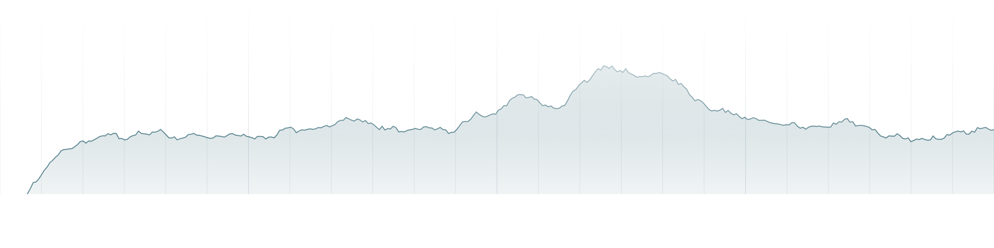
DIGITAL TWIN · FORECASTING · CONTROL SCIENCE
Sending 5G traffic to the right box before it jams
A digital twin of a national 5G user plane, a demand forecaster, an optimizer — and 588 head-to-head experiments to find out whether the smart version actually wins.
16 M
24
96
112
588
0
SIMULATED USERS
UPF BOXES
TRAFFIC GROUPS
DAYS SIMULATED
CONTROLLER TESTS
UNSAFE RELEASES
C-DOT · Predictive UPF steering · Evidence review

Slide 2
HOW THIS DECK IS ORGANISED
Four parts
00 — The big picture
What the problem is, how the system fits together, and the headline result.
01 — The simulator
How we model national 5G traffic, how we check it is right, and how we ran it on 12 cluster nodes.
02 — The forecaster
How we predict demand, which models we tried, and which one we kept.
03 — The optimizer
Seven controller designs, what each one scored, and why the simple rule is still in production.
04 — Conclusion
What is true, and the three questions that unblock everything else.
CONTENTS
02

Slide 3
00
THE BIG PICTURE
What we built, and what we learned
A UPF is the box that carries 5G user traffic. When a phone starts a session, the network picks which UPF it attaches to. That pick is the only thing we can control. The question: does predicting traffic make that pick better than a simple fixed rule?
03

Slide 4
THE PROBLEM
One box, one lever
WHAT A UPF IS
WHAT WE CAN AND CANNOT CHANGE
A UPF — User Plane Function — is the box that carries 5G user traffic. Every video, call and download passes through one.
If a UPF gets too busy, traffic queues up, and then it gets dropped. That is the failure we are trying to avoid.
When a phone starts a new session, a component called the SMF decides which UPF it attaches to.
We can change where NEW sessions are sent. That is the entire lever.
We cannot move a session once it is running. Whether C-DOT's system can do that at all is still an open question — and it turns out to be the most important one in this whole project.
Sessions last hours. So most of the load on a box at any moment was placed there long ago, and cannot be taken back.
THE QUESTION THIS PROJECT ANSWERS
Can predicting how much traffic is coming let us place new sessions better than a simple capacity-proportional rule — well enough, and safely enough, to deploy?
00 · THE BIG PICTURE
04
Notes:
PLAIN ENGLISH: We control only where a new session starts. We do not control the load already committed by existing sessions.
SAY: Think of choosing a parking building when a car enters. Once parked, we currently assume the car cannot be moved.
IF ASKED: Session migration is an open C-DOT question, not a proven impossibility.
DO NOT CLAIM: That we steer packets or live traffic.

Slide 5
HOW THE SYSTEM WORKS
The loop, end to end
The system runs once every 10 minutes. The most important rule is that no stage is allowed to see the future.
STEP 1
STEP 2
STEP 3
STEP 4
STEP 5
Simulate
Clean up
Predict
Decide
Check & apply
Generate 30 seconds of network activity: who starts a session, how long it lasts, how much bandwidth it uses, which boxes are healthy.
Turn raw counters into usable measurements. Throw away readings that are broken — resets, gaps, duplicates, stale samples.
For each traffic group, forecast demand 10 to 80 minutes ahead. Give a best guess and a safe upper bound.
An optimizer works out what share of new sessions each box should receive, given the forecast and the capacity limits.
A separate checker validates the plan. If anything looks wrong, fall back to the simple rule instead.
WHY “NO PEEKING” MATTERS
Telemetry arrives in 30-second buckets, and a bucket is only usable once it closes. Every input feature carries a timestamp, and training discards anything that was not yet available when the forecast was made. A decision made at time t can only affect sessions starting after t. Without this rule, a model can quietly cheat and look far better than it really is.
00 · THE BIG PICTURE
05
Notes:
PLAIN ENGLISH: Every ten minutes the system observes closed telemetry, predicts demand, proposes weights, validates them, and either recommends them or retains static.
SAY: The validator—not the optimizer—has the final word.
IF ASKED: A decision at time t affects only sessions beginning after t.

Slide 6
THE HEADLINE RESULT
The platform works. The controllers win where the loss is declared.
The platform evidence is strong. Predictive control is useful only inside a declared capacity event; outside that boundary, Static remains the default.
0 bytes
4.1%
11.64%
100%
0 / 473
TRAFFIC ACCOUNTING GAP
RSS GROWTH AT 7× DURATION
LOWER FORECAST ERROR
CLAIRVOYANT FAULT CEILING
DECLARED-EVENT REGRESSIONS
SESSION-LENGTH ESTIMATION
WHAT 11.64% MEANS
CONTROLLERS IN ONE LINE
Learned from ordinary logs
Error fell; accuracy is not 11.64%
Now · before · across time
Kaplan–Meier uses only session start/stop records and correctly includes sessions still running when the log ends. In 125 blind trials across five hidden duration families, mean calibration error stayed about 2.9–4.2%; stale data always fell back to Static.
Moving-average WAPE was 14.160%; LightGBM reached 12.512%. Relative error reduction = (14.160−12.512)/14.160 = 11.64%. The promotion rule required at least 15% and no unsafe slice, so LightGBM was useful evidence but was not released.
LP: choose the safest traffic split for the next step.
Pre-drain: use a maintenance notice to stop adding sessions to the affected UPF early.
MPC: plan across a two-hour horizon, apply only the first action, then solve again.
Oracle: knows the future; it is a ceiling, never a deployment option.
00 · THE BIG PICTURE
Forecast phase 2 · survival phase 3 · oracle study
06

Slide 7
THE V4 RESULT
Predictive steering wins where the loss is declared
Re-run after an audit of the evaluator, on 25 000 paired simulated days. The controllers now beat the simple rule — but only for capacity loss that is announced in advance, and the boundary is as important as the gain.
+24.0%
0 / 473
36 / 160
3 / 4
25 000
OVERLOAD REMOVED
ON UNSEEN SEEDS
REGRESSIONS ON
DECLARED EVENTS
CONFIGURATIONS PASSED
EVERY GATE
SURVIVED FRESH-SEED
VALIDATION
PAIRED SIMULATED
DAYS
WHAT THE CONTROLLERS NOW WIN
WHAT IT STILL COSTS
On declared maintenance the guarded pre-drain removes 55.2% of uplink overload, and on maintenance followed by a stadium-scale surge, 52.2%. Across 473 pairs of those two families it did not lose a single one.
Cohort MPC clears every gate too, at 33.1% and 32.4%, with a tenth of the collateral harm and a tenth of the routing churn.
When maintenance is announced and then a second, unannounced brownout lands on a box the controller has already drained onto, pre-drain loses in 30.5% of cases. The family is still net positive, but the worst cases are severe.
MPC cuts that exposure to 6.6% of cases. That is the trade C-DOT chooses between.
00 · THE BIG PICTURE
07
Notes:
PLAIN ENGLISH: The controller helps when capacity loss is announced. It deliberately behaves like static when there is no declared event.
SAY: The boundary is the result: declared loss, yes; pure surprise, tie; declared loss followed by another surprise, residual risk.
DO NOT CLAIM: Universal 24% improvement.

Slide 8
READ THIS FIRST
Five caveats that bound every number in this deck
None of these are disclaimers added afterwards. Each one changes how a figure on a later slide should be read.
CAVEAT 1
CAVEAT 4
This is a shadow controller in simulation.
One stress family produced no measurable stress.
No policy touched live traffic. Every record in the project is labelled synthetic and none of it is calibrated to real C-DOT capacity figures.
An unannounced demand surge never overloaded any box, even at 4x arrivals across a zone. That family scores a guaranteed zero, so the headline is conservative.
CAVEAT 2
CAVEAT 5
Only about 3% of load is controllable.
Chosen on one seed pool, judged on another.
The lever is where NEW sessions are placed. Sessions already established are never migrated, so a controller can only steer the margin.
The headline numbers come from a pool never inspected before the candidates were frozen. Screening numbers are 3-4 points higher and are not the claim.
CAVEAT 3
HOW TO READ THE OPTIMIZER SECTION
Gains are for announced capacity loss only.
Experiments 1-6 are the earlier campaign.
With no declared event the controller publishes bit-exact static output. Both pure-surprise families are deliberate ties, verified byte for byte.
They remain on the record for method and for the negative results. Experiment 7 supersedes their conclusion.
00 · THE BIG PICTURE
08

Slide 9
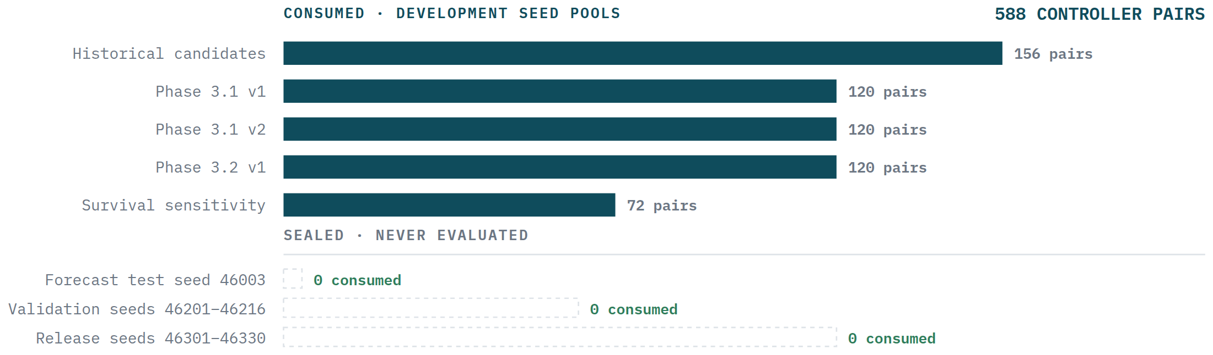
METHOD
How we decided what counts as a win
Every experiment was written down before it ran, with a fixed list of pass/fail checks. Test data sits in three separate pools, and a controller only reaches the next pool by passing every check on the current one.
One main number, chosen up front
Uplink overload area: how far above the safe limit a box goes, times how long it stays there.
Every comparison is like-for-like
Same day, same random numbers, same failures. Any difference is the controller alone.
Error bars are compulsory
Average gain, a 95% confidence range, a severity-weighted total, and the single worst day.
When in doubt, stop
Stale data, uncertain telemetry or an infeasible plan all hand control back to the simple rule.
00 · THE BIG PICTURE
09
Notes:
PLAIN ENGLISH: We decide the success rules before looking at protected results and compare controllers on exactly matched days.
SAY: Same seed, same failure, same traffic—only the controller changes.
IF ASKED: Confidence intervals and worst-case days prevent a good average from hiding unsafe cases.

Slide 10
01
THE SIMULATOR
Building a copy of a national 5G network
We do not simulate individual data packets — far too slow at this size. We simulate sessions: one starts, uses bandwidth for a while, then ends. We track how much each box is carrying and whether it exceeds its safe limit. Fast enough to run 112 simulated days.
10

Slide 11
THE ENGINE
What happens in one 30-second step
Each mechanism draws from its own stream of random numbers, so changing the failure schedule cannot accidentally change which users arrive. Twenty steps — 10 minutes — make one decision round.
01
Time of day. Daily and weekly cycles. Home areas peak in the evening, business areas mid-day, 7–11 hours apart. People move between zones; the total headcount is conserved exactly.
05
Session size and length. Duration from a heavy-tailed distribution — most short, a few very long. Uplink and downlink bandwidth drawn together, so they are correlated.
02
Scheduled events. A stadium match or planned maintenance is applied only after the moment the controller was actually told about it.
06
Placement. Each new session goes to a box chosen by whichever rule is active. This is the only lever in the whole system.
03
Random variation. A slow drift where each step partly carries over from the last, plus occasional bursts of random length.
07
Capacity check. Apply failures, then count traffic offered, carried, queued, dropped and rejected — separately for uplink and downlink.
04
New sessions arrive. Drawn from a Poisson process whose rate changes over the day.
08
Emit telemetry. Write counters out, including flags for resets, restarts, and missing or stale readings.
01 · THE SIMULATOR
11
Notes:
PLAIN ENGLISH: Each 30-second step updates time-of-day traffic, events, session arrivals, placement, capacity and telemetry.
SAY: Separate random-number streams stop a code change in failures from silently changing arrivals.
IF ASKED: This is discrete-time session simulation, not packet simulation.

Slide 12
STRUCTURE
How traffic is grouped
Demand is split into 96 traffic groups: 8 area types × 12 service classes. Each has its own arrival rate, session length, bandwidth profile and list of boxes it may use. The forecaster predicts per group; the optimizer decides per group.
ITEM
VALUE
DETAIL
Area types
8
four urban, plus industrial, airport, stadium and rural — detailed next slide
Service types
12
consumer internet, video, voice; enterprise VPN; industry telemetry & control; vehicles; public safety; stadium media; IoT; roaming
Traffic groups
96
8 area types × 12 service classes
UPF boxes
24
16 edge, 4 regional, 4 central; each group may use 6 of them
Edge box capacity
2.6 / 5.2 Tbps
uplink / downlink, with 78% / 80% treated as the safe operating limit
Session limit
170 000
per box, with 82% as the safe limit
Network delay
7 / 22 ms
staying in your own zone vs crossing into another
Simulated users
16 000 000
modelled as population counts, not individual subscriber identities
The capacity numbers are assumptions we chose. C-DOT has not published real per-box capacity, so these are placeholders until we get the real figures.
01 · THE SIMULATOR
12
Notes:
PLAIN ENGLISH: We divide demand into 96 groups so unlike services are not averaged together.
SAY: A stadium uploader and an IoT meter should not share one forecast or one routing policy.
IF ASKED: The selection key is area/DNN/slice; 5QI is descriptive unless C-DOT confirms otherwise.

Slide 13
AREAS
The eight area types we model
Eight archetypes choose service mix and daily shape. Z(k) is a dimensionless multiplier on a service's base arrival rate: below 1 means less synthetic traffic than the reference area; above 1 means more.
AREA
WHAT IT REPRESENTS
SCALE Z(K)
SERVICES THAT DOMINATE
DAILY SHAPE
north-urban
Dense residential
0.70
Consumer video, social, gaming
Evening peak around 20:00
south-urban
Dense residential
0.80
Consumer video, social, gaming
Evening peak around 20:00
east-urban
Mixed residential / retail
0.90
Consumer video, voice, enterprise
Broad evening peak
west-urban
Mixed residential / retail
1.00
Consumer video, voice, enterprise
Broad evening peak
industrial
Factory / logistics estate
1.10
Industrial URLLC, massive IoT, edge AI
Flat-ish, day-shift bias
airport
Transport hub
1.20
Roaming, voice, video conference, V2X
Twin commute peaks
stadium
Large-event venue
1.30
Social / live upload, video, voice
Idle, then extreme event spikes
rural
Sparse coverage
1.40
Voice, massive IoT, consumer video
Low amplitude, flat
HOW TO READ Z(k) — AND WHY IT IS LINEAR
Z(k) multiplies the base session-arrival rate λs. Example: Z=0.70 generates 30% less traffic than the reference Z=1.00; Z=1.40 generates 40% more. The current z(k)=0.70+0.10k ramp is deliberately linear so load rises in equal, auditable steps while we test scaling. It is not a geographic claim: rural is highest only because it is last in the list. Real subscriber counts should replace this ramp during C-DOT calibration.
01 · THE SIMULATOR
13
Notes:
PLAIN ENGLISH: Area labels choose service mixes and daily shapes. The current population scale is synthetic.
SAY: Rural appearing largest is a known index-ramp artifact, not a claim about Indian usage.
DO NOT CLAIM: Geographic calibration.

Slide 14
AREAS
How the shape of a day differs by area
A wrapped Gaussian is an ordinary bell-shaped peak placed on a 24-hour clock: distance wraps across midnight, so a 23:30 peak continues smoothly after 00:00. Add one peak for a single rush or two for morning/evening commute. The service class sets this timing; the area sets which classes and how much of each are present.
DAILY PROFILE
CURVE
CLASSES THAT USE IT
TYPICAL AREA
Evening
0.42 + 1.18 · peak(20:00, 3.2 h)
Consumer video, social / live
Residential areas
Late evening
0.45 + 1.25 · peak(22:00, 3.8 h)
Gaming
Residential areas
Business
0.28 + 1.32 · peak(13:00, 4.0 h)
Enterprise, video conference, edge AI
Commercial areas
Industrial
0.55 + 0.90 · peak(11:00, 5.2 h)
Industrial URLLC
Factory estates
Commute
0.38 + 0.88 · peak(08:00) + 1.00 · peak(18:00)
IMS voice, connected vehicle
Airport, transit
Overnight
0.30 + 1.35 · peak(02:00, 2.8 h)
Cloud backup
Everywhere
Flat
0.92 + 0.08 · sin(2π(h − 6)/24)
Massive IoT, public safety
Everywhere
WRAPPED GAUSSIAN, IN PLAIN ENGLISH
WHAT HAPPENS AFTER THE DAILY SHAPE
Gaussian = a smooth bell, controlled by centre time c and width w. Wrapped = use circular clock distance δ(h,c)=min(|h−c|, 24−|h−c|), so midnight has no artificial jump. Sum = add multiple bells when a service has more than one busy period. A baseline α keeps traffic non-zero between peaks.
The daily curve is multiplied by a weekend factor, seeded weekly noise U[0.86,1.16], and any active surge. This separation makes the cause of a peak explicit: calendar behaviour, week-to-week variation, or an event.
01 · THE SIMULATOR
14
Notes:
PLAIN ENGLISH: Area labels choose service mixes and daily shapes. The current population scale is synthetic.
SAY: Rural appearing largest is a known index-ramp artifact, not a claim about Indian usage.
DO NOT CLAIM: Geographic calibration.

Slide 15
TRAFFIC CLASSES
The twelve categories of 5G traffic
Each class carries a 3GPP 5QI value, its own data network name and slice identifier, its own session length, and its own uplink/downlink balance. Together they span the three families 5G is designed for: broadband, ultra-reliable low-latency, and massive machine-type.
CLASS
5QI
DATA NETWORK
SESSION LENGTH
UL / DL MBPS
DAILY PROFILE
WEEKEND
EXAMPLE
Consumer video
9
internet-video
1–12 h
0.15 / 4.00
Evening
1.25
Streaming to a phone
Social / live
8
social-live
10 m–2 h
2.00 / 1.00
Evening
1.35
Uploading from a crowd
Gaming
3
gaming
40 m–6 h
0.20 / 0.40
Late
1.30
Latency-sensitive play
IMS voice
1
ims-voice
10 m–4 h
0.08 / 0.08
Commute
0.90
Carrier voice calls
Enterprise
7
enterprise
30 m–8 h
1.00 / 2.00
Business
0.45
Office VPN and web
Video conference
2
enterprise-rtc
30 m–6 h
1.50 / 1.50
Business
0.50
Symmetric real-time
Industrial URLLC
82
factory-control
4–24 h
0.10 / 0.08
Industrial
0.75
Machine control loops
Massive IoT
9
mmtc
6–48 h
0.020 / 0.004
Flat
1.00
Meters and sensors
Connected vehicle
84
v2x
5 m–1 h
0.50 / 1.00
Commute
0.80
V2X telemetry
Edge AI
7
edge-inference
10 m–2 h
3.00 / 6.00
Business
0.70
Inference at the edge
Cloud backup
9
enterprise-backup
1–12 h
8.00 / 2.00
Overnight
1.15
Bulk upload
Public safety
65
mission-critical
20 m–3 h
2.00 / 2.00
Flat
1.00
Mission-critical push
Eight areas × twelve classes = 96 traffic groups. The steering key is (area, data network, slice); 5QI is carried as descriptive metadata because it is not assumed to be a UPF-selection key. Base arrival rates run from 22.4 sessions per 30 s (cloud backup) to 448 (massive IoT) per group.
01 · THE SIMULATOR
15
Notes:
PLAIN ENGLISH: Twelve service classes differ in duration, bandwidth direction, latency sensitivity and time-of-day pattern.
SAY: The differences matter because a long IoT or industrial session commits capacity differently from a short social upload.
IF ASKED: 5QI comes from the service description; it is not automatically a UPF-selection key.

Slide 16
PLAIN ENGLISH · TRAFFIC MODEL
The mathematics is four familiar ideas stacked together
The formula on the next slide is bookkeeping, not magic. Read it from left to right.
01 · BASELINE
02 · SHAPE
How busy is this service normally?
What time and day is it?
Each area and service class starts with an average session-arrival rate. This fixes the scale, not the exact future.
Daily and weekly curves multiply the baseline. Residential traffic peaks in the evening; enterprise traffic peaks during working hours.
03 · RANDOMNESS
04 · SESSIONS
What makes today different?
How long does each decision remain?
Seeded random variation adds persistence, bursts and events. Separate random streams keep arrivals, failures and movement independent.
Arrivals become sessions with bandwidth and duration. Long-lived sessions create committed load that future decisions cannot undo.
OUTPUT CHECK · offered = carried + queued + dropped + rejected. If this identity fails, stop.
01 · THE SIMULATOR
16
Notes:
SAY: There are only four layers: average scale, time shape, randomness and session persistence. The next slide writes these four layers as equations.
IF ASKED: Every random draw is seeded and named so a result can be reproduced.

Slide 17
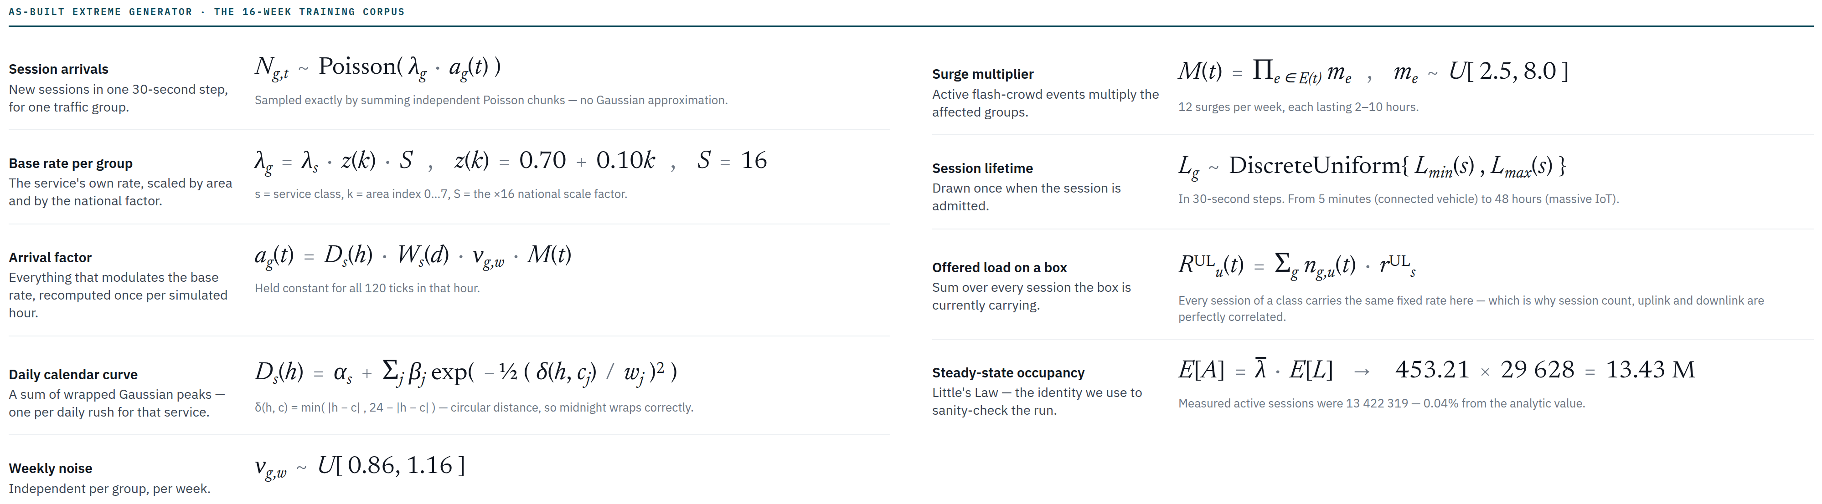
THE MODEL
How traffic is generated, mathematically
Every quantity below is drawn from a named distribution with a seeded, independent random stream. Same manifest, same seed, same result — bit for bit.
01 · THE SIMULATOR
17
Notes:
PLAIN ENGLISH: Arrival rate equals baseline multiplied by daily/weekly/event factors and correlated noise. Each arrival then receives bandwidth and duration.
SAY: The equations generate offered demand; capacity is applied afterwards.
DO NOT CLAIM: That the parameter values came from C-DOT.

Slide 18
THE MODEL · EQUATION-BY-EQUATION
Every equation has one job in the traffic generator
Read top to bottom: set the scale, shape the clock, draw sessions, keep them alive, then add their load on each UPF.
01
BASE SCALE
λg = λs · z(k) · S
02
TIME + EVENTS
ag(t) = Ds(h) · Ws(d) · νg,w · M(t)
Service rate × area multiplier × national scale. This sets expected volume before time-of-day effects.
Daily curve × weekend effect × weekly noise × active surges. Multiplication keeps each cause visible and independently testable.
03
ARRIVAL COUNT
Ng,t ~ Poisson(λg · ag(t))
04
PERSISTENCE
Lg ~ DiscreteUniform[Lmin(s), Lmax(s)]
Turns the expected rate into an integer number of new sessions in this 30-second tick. Poisson is the transparent count baseline; the seed makes it reproducible.
Each admitted session gets a lifetime. It remains anchored for that many ticks, which is why an early placement can still matter hours later.
05
BOX LOAD
RuUL(t) = Σg ng,u(t) · rsUL
06
SANITY CHECK
E[A] = λ̄ · E[L]
For each UPF, add the uplink rate of every active session it carries. Downlink and session count are accumulated the same way.
Little's Law predicts average active sessions from arrival rate × mean lifetime. Measured occupancy was within 0.04% of this analytic check.
OUTPUT IDENTITY · offered = carried + queued + dropped + rejected. If it fails, the run is invalid.
01 · THE SIMULATOR
build_extreme_history_manifest.py · traffic-model/1.0
18
Notes:
SAY: The generator is a pipeline. Scale and calendar determine expected arrivals; Poisson turns expectation into a count; lifetime creates persistence; summation creates UPF load; Little's Law and traffic conservation validate the output.

Slide 19
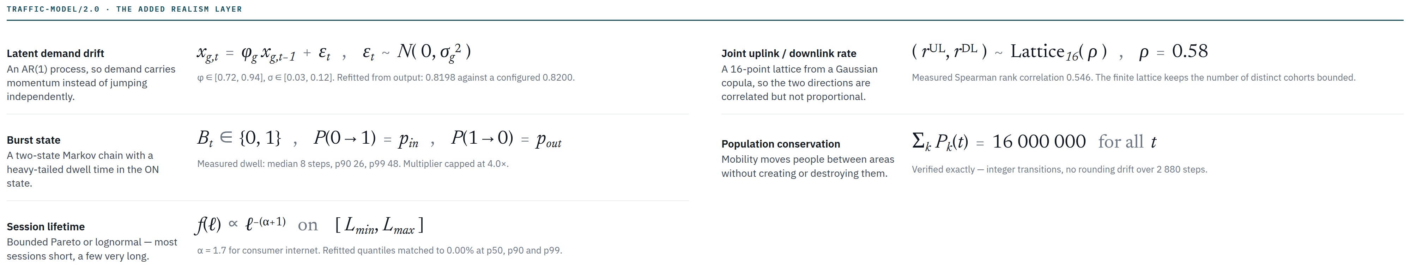
THE MODEL
The realism layer added on top
The 16-week corpus above uses fixed per-class rates and uniform session lengths. traffic-model/2.0 replaces those with correlated, heavy-tailed processes — and every one is re-fitted from the simulator's own output to check it came out right.
WHY BOTH MODELS EXIST
The 16-week training corpus was generated before the realism layer was built, so every throughput number in this deck comes from the simpler generator. The realism layer is validated and ready, but regenerating 112 days of history with it is a fresh multi-hour cluster run — one of the first items in the simulator backlog.
01 · THE SIMULATOR
19
Notes:
PLAIN ENGLISH: The first 16-week corpus used the simpler generator. The newer realism layer adds correlated bandwidth and heavy-tailed durations and validates them by re-fitting output.
SAY: The realism layer is ready, but the 112-day history has not yet been regenerated with it.
DO NOT MIX: Results from the older corpus with claims about the newer generator.

Slide 20
POSITIONING
Different simulators answer different 5G questions
This project is a long-horizon UPF-steering digital twin. Protocol load generators and radio simulators provide different fidelity; a serious validation plan uses them together.
THIS PROJECT
MOBILEUM dsTest
PACKETRUSHER / UERANSIM
5G-LENA / Simu5G
UPF steering over weeks
Core/CNF lab assurance
Open UE/gNB core testing
RAN / NR system simulation
Session-level demand, anchored load, faults, forecasts, LP/MPC/pre-drain, paired safety gates.
Emulates subscribers, network interfaces and protocol/application flows; stresses real systems under test and reports KPIs.
Exercises registration, sessions, N1/N2 and user-plane traffic against a 5G core with virtual UEs and gNBs.
Models radio, PHY/MAC, scheduling, interference, mobility and packet/data-plane behaviour in ns-3 or OMNeT++.
Best for: policy evidence and controllability limits.
Best for: conformance, interoperability and capacity.
Best for: open functional and load tests.
Best for: radio and end-to-end research.
HONEST BOUNDARY · We do not model NR radio or emit standards-compliant N1/N2/N3 traffic. Use dsTest or open UE/gNB tools to replay shortlisted steering policies against a real core.
01 · THE SIMULATOR
Public product/project pages checked 27 Aug 2026
20
Notes:
SAY: This is not a protocol-conformance or radio simulator. It complements those tools by testing long-horizon steering decisions and their safety evidence. Do not claim replacement of dsTest, PacketRusher, UERANSIM, 5G-LENA or Simu5G.
PUBLIC SOURCES CHECKED 27 AUG 2026:
https://www.mobileum.com/products/testing-assurance-observability/performance-and-functional-assurance/performance-testing
https://github.com/HewlettPackard/PacketRusher
https://github.com/aligungr/UERANSIM
https://apps.nsnam.org/app/nr/
https://simu5g.org/users-guide/overview

Slide 21
STRESS
Daily cycles, surges and failures
We model three kinds of stress and keep them independent. If surges and failures always happened together, a controller could score well just by spotting one and assuming the other.
DAILY CYCLE
EVENT SURGE — A STADIUM MATCH
EQUIPMENT FAILURES
Traffic rises and falls over the day and the week. Residential and business zones peak 7 to 11 hours apart, so the network never sees one single national peak. Weekends change both the height and the shape of the curve.
Six phases, each multiplying the normal arrival rate: crowd arrives ×1.5, kick-off ×2.1, match ×1.7, half-time uploads ×3.2, final whistle ×2.6, then a long exit tail. Upload-heavy services react hardest. Some events are announced two hours ahead; others are deliberately kept a surprise.
A box can lose part of its capacity — down to 45% — go almost fully offline (we leave 1% so the maths stays finite), suffer extra network delay, or restart. Recovery windows are modelled too.
×3.2
×0.45
1%
2 h
0
HALF-TIME
UPLOAD SURGE
BROWNOUT
CAPACITY LEFT
NEAR-TOTAL OUTAGE
CAPACITY LEFT
NOTICE FOR A
PLANNED FAILURE
NOTICE FOR A
SURPRISE SURGE
01 · THE SIMULATOR
21
Notes:
PLAIN ENGLISH: Demand surges and capacity failures are independent so a controller cannot learn that one always predicts the other.
SAY: Planned maintenance has notice; a surprise surge intentionally does not.
IF ASKED: Mixed stress is the hard case because pre-drained sessions may be committed to the next failing UPF.

Slide 22
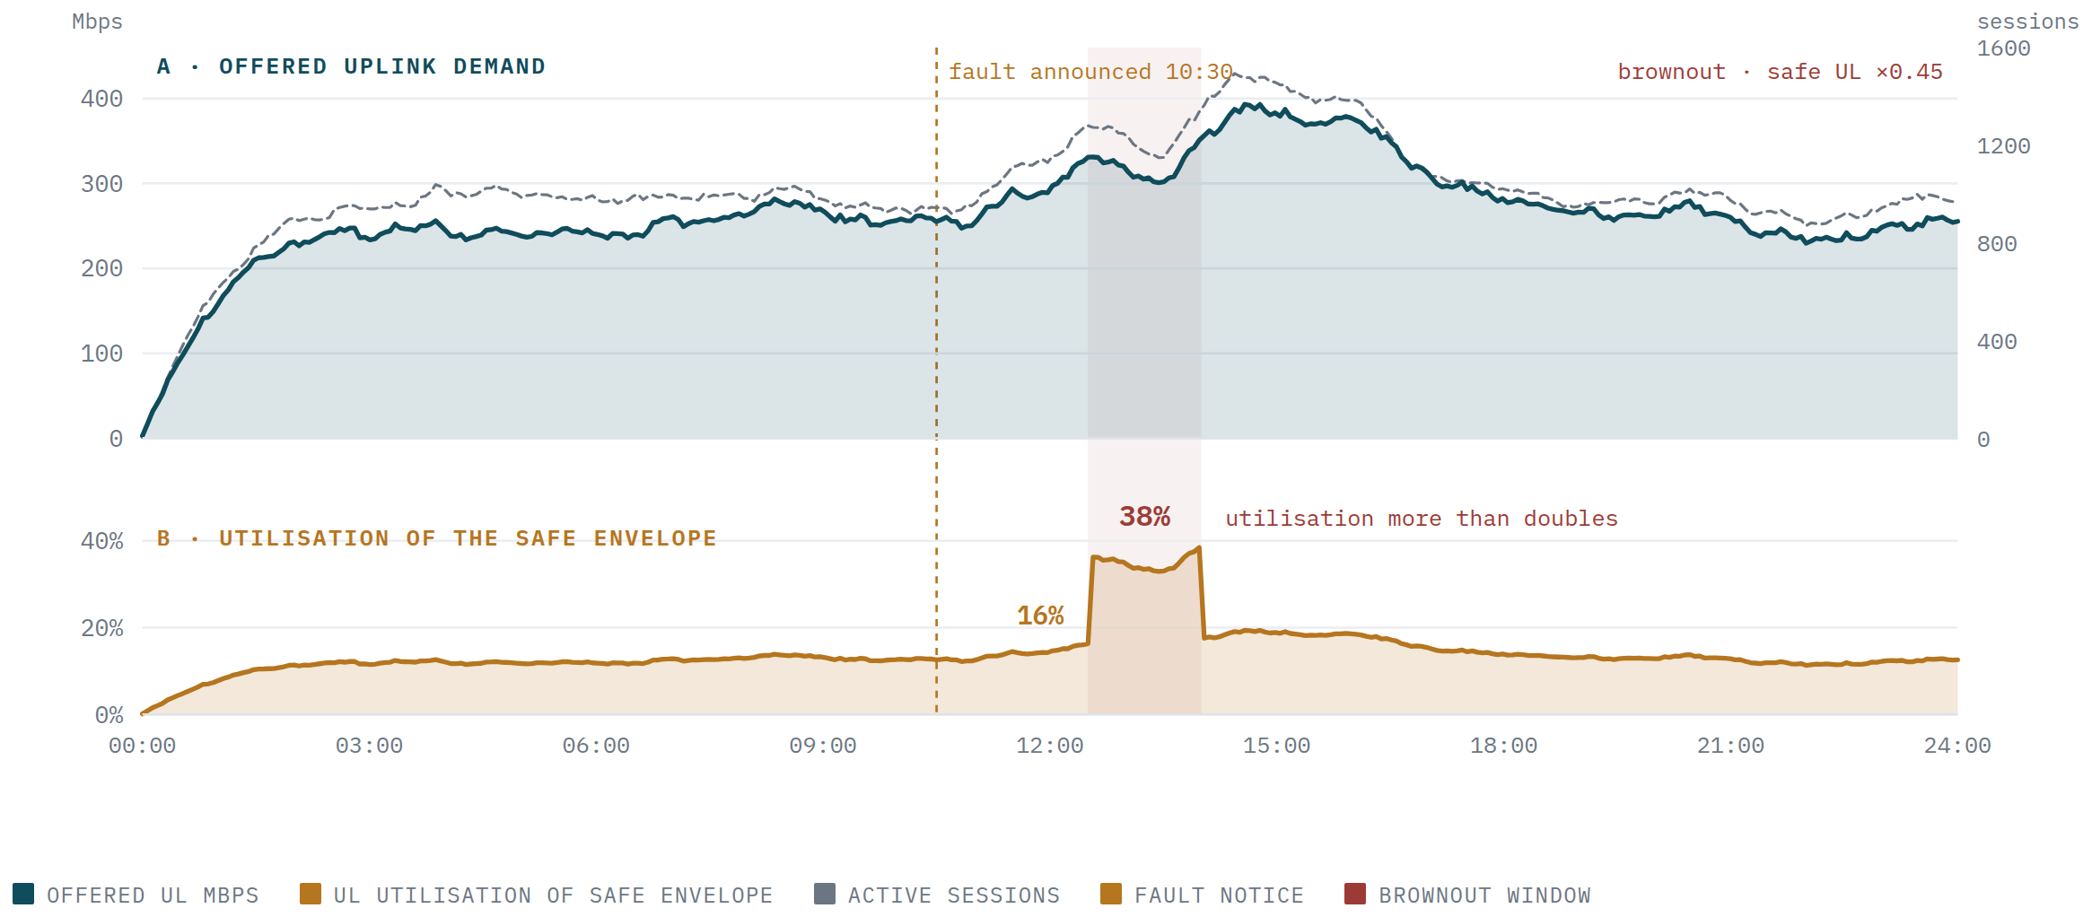
ONE SIMULATED DAY
Demand, capacity, and a planned brownout
What the top panel shows
Uplink demand on a Delhi-NCR edge box, rising through the evening as the stadium fills.
What the bottom panel shows
How close that box is to its safe limit — the number the controller actually reacts to.
The brownout at 12:30
Safe uplink capacity drops from 2 028 to 912.6 Mbps for 90 minutes.
Why it matters
Demand barely changes. But headroom halves, so utilisation jumps from 16% to 38%.
The controller knew at 10:30
Exactly two hours of warning — enough time to stop sending new sessions there.
01 · THE SIMULATOR
22

Slide 23
VERIFICATION
We test the simulator against itself
Claiming a simulator is realistic is easy. We check it instead: take its own output, re-fit every distribution from that output, and compare against what we asked for.
0.0 bytes
0.8198
0.00%
0.31%
EXACT
0
TRAFFIC THAT
DOESN'T ADD UP
MEASURED DRIFT
WE ASKED FOR 0.8200
SESSION-LENGTH
ERROR
BANDWIDTH
ERROR
PEOPLE COUNTED
IN AND OUT
SESSIONS SENT TO A
BANNED OR DEAD BOX
ONE SIMULATED DAY, IN BYTES
WHAT WE ARE NOT CLAIMING
A single day carries 377.2 TB down and 113.8 TB up.
Of that, 239.6 GB down and 81.2 GB up are dropped. Nothing is rejected, and nothing is left stuck in a queue at the end of the day.
Every byte is accounted for. The maximum discrepancy across the whole run is exactly zero.
The shapes come from published 3GPP standards and public measurement studies — how many service classes exist, how a stadium crowd behaves, how session lengths are distributed.
The absolute numbers — Mbps per session, box capacity, queue size — are our own assumptions.
Honest claim: standards-based, statistically verified synthetic traffic at national scale, not yet matched to real C-DOT measurements.
01 · THE SIMULATOR
23
Notes:
PLAIN ENGLISH: We ask whether the generated output matches the distributions and conservation laws requested in the configuration.
SAY: Internal validity is strong; external calibration to C-DOT is not yet done.
DO NOT CLAIM: Realism merely because the graphs look plausible.

Slide 24
DATA QUALITY
We deliberately break the telemetry
A model trained on perfect counters will fail the moment it meets a real network. So the measurement channel is generated separately from the truth, and we inject faults on purpose.
0.8%
0.4%
0.08%
0.04%
READINGS THAT
GO MISSING
READINGS THAT
ARE STALE
COUNTER
RESETS
PROCESS
RESTARTS
The clean-up layer then has to earn its numbers back. It never bridges across a counter reset, and it discards impossible values rather than smoothing them into something that merely looks plausible.
OUR BIGGEST PROCESS MISTAKE — CAUGHT BY THE CHECKS, NOT BY LUCK
Two complete rounds of forecast training data were thrown away because telemetry quality was averaged over a whole time bucket instead of using the latest reading from the relevant boxes — which is what the live system actually does. Eleven cluster jobs were cancelled. No protected test data was touched. We restarted from version 3.
01 · THE SIMULATOR
24
Notes:
PLAIN ENGLISH: The simulator creates clean truth and separately creates damaged telemetry. The pipeline must detect gaps, stale values and counter resets.
SAY: Never smooth across a reset; that invents traffic.
IF ASKED: Two training rounds were discarded when the quality aggregation semantics were found wrong.

Slide 25
SCALE
The numbers at full size
16 weeks of history at 30-second resolution: 112 days, 322 560 steps, 16 128 decision rounds.
THE CONFIGURATION
ONE MEASURED DAY
ITEM
VALUE
MEASUREMENT
VALUE
Time simulated
16 weeks / 112 days
New sessions started
39 156 949 / day
Step size
30 s
Average arrival rate
453 sessions/s
Total steps
322 560
Sessions active at day end
12 758 353
Decision round
10 min / 20 steps
Steady-state active sessions
13 422 319
Decision rounds
16 128
Average session length
8.23 h
Training rows
1 548 288
Uplink, average / peak
3.22 / 4.09 Tbps
Per-box records
7 741 440
Downlink, average / peak
8.15 / 15.34 Tbps
Arrival counts stored
30 965 760
Actually carried, up / down
3.18 / 8.03 Tbps
Box × group records
9 289 728
Total data offered
122.84 PB / day
Scheduled events
258 656
Total data carried
121.08 PB / day
Sessions routed
≈ 4.39 billion
Largest queue, up / down
8.94 / 17.88 GiB
Output data size
≈ 9.6 GiB
Run time for one day
5 m 06 s
Estimated run time
9 h 31 m
Peak memory used
602 MiB
01 · THE SIMULATOR
25
Notes:
PLAIN ENGLISH: Long runs stream results rather than accumulating them in memory. Independent scenario/seed shards use cluster parallelism.
SAY: We scale across experiments, not by splitting one ordinary simulation over 160 nodes.

Slide 26
KEY NUMBERS · THROUGHPUT
How much traffic actually moves
All figures are measured from the completed seed-20260805 calibration day at the 16-million-user scale. “Offered” is what the users asked for; “carried” is what the network actually delivered.
11.21 Tbps
3.18 Tbps
8.03 Tbps
19.43 Tbps
121.08 PB
1.43%
CARRIED, INSTANTANEOUS
AVERAGE, BOTH DIRECTIONS
CARRIED
UPLINK
CARRIED
DOWNLINK
PEAK OFFERED
BOTH DIRECTIONS
CARRIED
PER DAY
OFFERED TRAFFIC
NOT DELIVERED
MEASURE
UPLINK
DOWNLINK
BOTH DIRECTIONS
NOTE
Offered / demand, average
3.22 Tbps
8.15 Tbps
11.37 Tbps
what users asked for
Carried, instantaneous average
3.18 Tbps
8.03 Tbps
11.21 Tbps
what the network delivered
Offered / demand, peak
4.09 Tbps
15.34 Tbps
19.43 Tbps
highest 30-second step of the day
Peak-to-average ratio
1.27×
1.88×
1.71×
downlink is far burstier
Delivered fraction
98.76%
98.53%
98.57%
the rest is dropped at an overloaded box
Aggregate daily volume, offered
—
—
122.84 PB / day
Aggregate daily volume, carried
—
—
121.08 PB / day
1.76 PB / day lost
Consistency check: 121.08 PB per day × 8 bits ÷ 86 400 s = 11.21 Tbps. The daily aggregate and the instantaneous average agree exactly, which is what you want before trusting either of them.
01 · THE SIMULATOR
26
Notes:
PLAIN ENGLISH: These are measured outputs from one frozen synthetic calibration run, not configuration targets.
SAY: Offered is user demand; carried is served traffic; drops and rejects explain the difference.
DO NOT CLAIM: That the totals match C-DOT production traffic.

Slide 27
KEY NUMBERS · THROUGHPUT
What that means per session, per box, per step
Everything below is derived from the measured figures on the previous slide. The arithmetic is shown so it can be checked.
PER SESSION
VALUE
HOW IT IS DERIVED
PER BOX AND PER STEP
VALUE
HOW IT IS DERIVED
Sessions started per day
39 156 949
measured
Data carried per 30-second step
42.04 TB
121.08 PB ÷ 2 880 steps
Session arrival rate
453.21 / s
39 156 949 ÷ 86 400
Carried per UPF, average
467 Gbps
11.21 Tbps ÷ 24 boxes
New sessions per 30-second step
13 596
453.21 × 30
— uplink per UPF
132.5 Gbps
3.18 Tbps ÷ 24
Average session length
8.23 h
class-weighted mean
— downlink per UPF
334.6 Gbps
8.03 Tbps ÷ 24
Sessions active at any moment
13.42 M
Little's Law: 453.21 × 29 628 s
Session setups per UPF
18.9 / s
453.21 ÷ 24
Data carried per session
3.09 GB
121.08 PB ÷ 39.16 M
Active sessions per UPF
559 000
13.42 M ÷ 24
Throughput per active session
0.835 Mbps
11.21 Tbps ÷ 13.42 M
Fleet rated capacity
20.48 / 46.72 Tbps
UL / DL across 24 boxes
— uplink share
0.237 Mbps
3.18 Tbps ÷ 13.42 M
Fleet safe capacity
15.83 / 36.17 Tbps
after 75–80% safe thresholds
— downlink share
0.598 Mbps
8.03 Tbps ÷ 13.42 M
Utilisation of safe capacity
20.1% / 22.2%
uplink / downlink
THE NUMBER THAT EXPLAINS THE WHOLE OPTIMIZER RESULT
Across the fleet, the network runs at about 20% of its safe capacity. There is no aggregate shortage of capacity anywhere in this system. Every overload event is local and temporary — one box, during one surge or one failure. That is why a controller that redistributes load has so little to win, and why the failure-knowledge result in section 03 matters more than any demand forecast.
01 · THE SIMULATOR
27
Notes:
PLAIN ENGLISH: These are measured outputs from one frozen synthetic calibration run, not configuration targets.
SAY: Offered is user demand; carried is served traffic; drops and rejects explain the difference.
DO NOT CLAIM: That the totals match C-DOT production traffic.

Slide 28
PERSPECTIVE
Is this really C-DOT scale? Partly.
COMPARISON
OUR SIMULATION
PUBLIC C-DOT FIGURES
WHAT IT MEANS
Users / subscribers
16 M nominal, ≈13.4 M active sessions
≈12 million subscribers
Same order of magnitude — but sessions are not subscribers
Data per day
121.08 PB carried
more than 3 PB
We are about 40× higher
Network granularity
8 logical zones
75 000+ radio sites
Ours is far coarser
UPF boxes
24 synthetic
not published
Cannot compare
Per-box capacity
up to 1.92 / 3.84 Tbps
not published
Our own stress assumption
Telemetry format
our own schema
not published
Must come from C-DOT
SO WHAT SHOULD WE SAY?
Our session count is in the same range as one public national deployment figure. Our traffic volume is much higher and our network detail is much coarser. The defensible phrase is “national scale”, not “C-DOT scale”.
01 · THE SIMULATOR
28
Notes:
PLAIN ENGLISH: Some dimensions resemble national scale, while geography, capacity and subscriber calibration remain synthetic.
SAY: The honest answer is 'partly'—large enough to stress the machinery, not yet operator-calibrated.

Slide 29
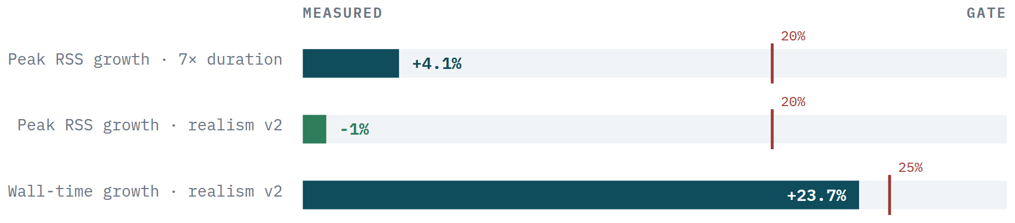
SCALING UP · STAGE 1
Prove memory stays flat
A 112-day run produces far more data than fits in memory. If the simulator accumulated it, the run length would be capped by RAM. It does not — and this is the measurement that proves it.
Seven times the length
used only 4.1% more memory, against a 20% limit.
The richer traffic model
added 23.7% run time and slightly less memory. Both pass.
WHAT RSS MEANS
Why this matters
WHERE THE DATA ACTUALLY GOES
RSS — Resident Set Size — is how much physical RAM a process is occupying right now. It excludes anything swapped out to disk, so it is the honest measure of what a worker costs the node.
We read it from the Linux kernel directly: the VmRSS field of /proc/<pid>/status, sampled by the parent for every worker. Swap comes from VmSwap alongside it — which is how we can state that swap stayed at exactly zero. “Peak RSS” is the highest value seen across the run.
It is what lets 12 nodes run 384 jobs without ever touching swap.
The simulator keeps at most one buffer of step rows in memory — 4 096 rows at the largest setting. When it fills, the buffer is written out as a compressed Parquet segment and cleared. Memory therefore tracks the buffer size, not the length of the run.
Those segments are written to scratch disk on the node the worker is already running on — not streamed over the network. Only when the shard finishes is the result copied once to the shared cluster filesystem, with a metadata file written last as the commit marker.
01 · THE SIMULATOR
29
Notes:
PLAIN ENGLISH: This test checks whether a longer simulation leaks memory.
SAY: Seven times the duration used only 4.1% more peak memory, supporting streaming execution.

Slide 30
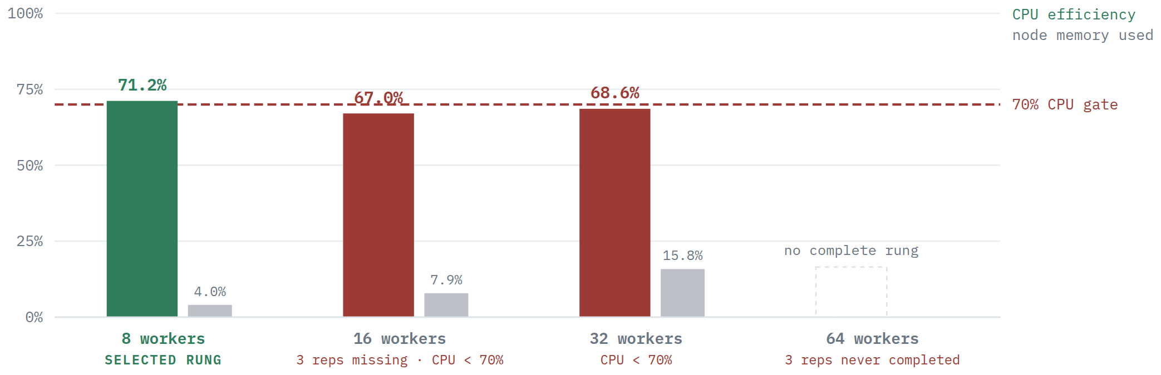
SCALING UP · STAGE 2
How many workers fit on one node?
Each node has 125 CPUs and 125 GB of RAM. We tried four settings, three times each, and required at least 70% CPU efficiency.
8 workers passed
at 71.2% CPU efficiency — the only setting that fully cleared the bar.
16 and 32 failed
at 67.0% and 68.6%, both below 70%.
64 never finished
all three required repetitions.
Memory was never the problem
even 32 workers used under 16% of the node's RAM. Something else is serialising.
01 · THE SIMULATOR
30
Notes:
PLAIN ENGLISH: This test finds how many independent workers a node can sustain before memory or scheduling overhead harms throughput.
SAY: Packing is measured rather than assumed.

Slide 31
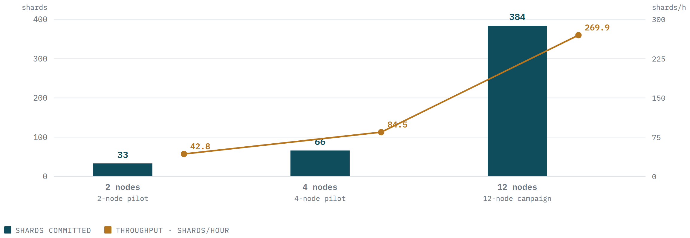
SCALING UP · STAGE 3
From 2 nodes to 4 to 12
Each node works on its own slice of the job list. Moving to 4 nodes requires a clean 2-node report; going beyond 4 requires a clean 4-node report on the exact same inputs — so a small unrelated test can never unlock the big expensive run.
12
384
85.4 min
NODES
USED
JOBS
COMPLETED
TOTAL TIME
ON 12 NODES
90.9%
5.4 GiB
0
CPU EFFICIENCY
WORST NODE 89.1%
PEAK MEMORY
OUT OF 120 GIB
CRASHES, SWAPS
OR LOST JOBS
01 · THE SIMULATOR
31
Notes:
PLAIN ENGLISH: Scale-out is gated: prove the same inputs on two nodes, then four, then twelve.
SAY: Each node owns independent work; matching hashes and complete shard reports gate the next rung.

Slide 32
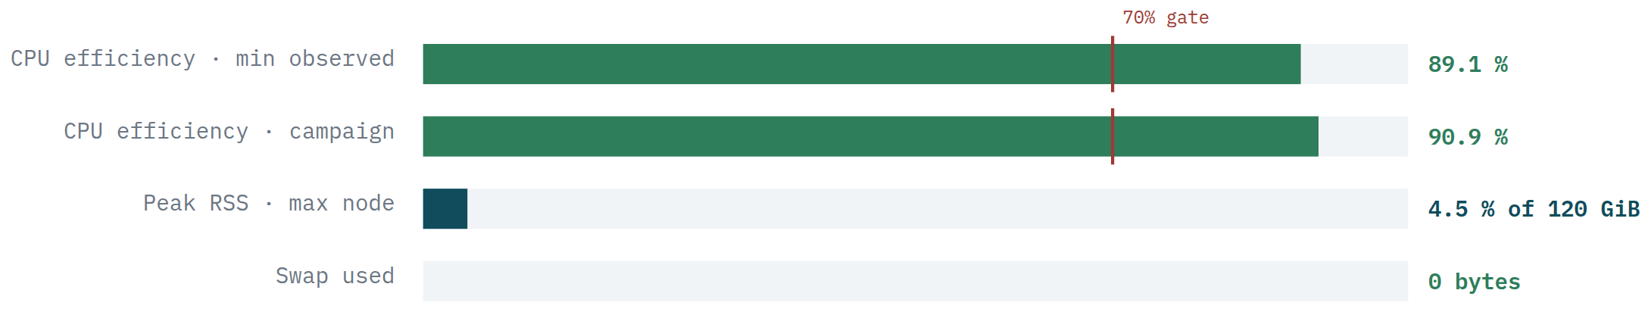
SCALING UP · RESULT
How much headroom was left
What this does not measure
This is campaign throughput — how fast we can run experiments. It is not a measurement of how fast a live control loop would respond.
Where the ceiling is
Every node passed every check. Peak memory never went above 4.5% of what was allocated, and the machine never had to swap to disk. That is the direct payoff of the memory work in stage 1.
Nothing in the design caps it at 12 nodes. We just need a clean 12-node report to unlock 24 or 48.
01 · THE SIMULATOR
32

Slide 33
SCALING UP · WALL TIME
A 16-week extreme shard is a ~9.5-hour job—not an 85-minute job
The 16-week number is a projection from the measured full one-day writer. The 12-node result is a separate measured campaign of many one-day shards.
MEASURED
5:06.31
× 112
9:31:46
WHAT WAS ACTUALLY MEASURED
384 one-day shards · 12 nodes
ONE SIMULATED DAY
LINEAR PROJECTION
16-WEEK PROJECTION
Wall time: 5,122.5 s = 85.4 min
Aggregate CPU efficiency: 90.9%
Worker failures: 0
Swap: 0
This proves campaign scale-out and deterministic orchestration. It does not measure a 16-week shard, so 85.4 minutes must not be quoted as the 16-week runtime.
ONE SHARD
MULTIPLE NODES
More nodes do not shorten it
Parallelise independent shards
The current engine is single-shard and CPU-bound. One 112-day simulation stays on one node; assigning 12 nodes to that same shard does not make it 12× faster. Plan a 12-hour reservation until an end-to-end 16-week capacity pilot is measured.
Use different nodes for different seeds, scenarios or controllers. Conservative planning: one extreme 16-week shard per node. Twelve nodes can therefore run twelve independent 16-week shards in one ~12-hour reservation; more shards need another wave.
01 · THE SIMULATOR
extreme-training-runbook.md · production metrics.json
33
Notes:
SAY: 9:31:46 is projected from a complete one-day measurement; reserve 12 hours. A single shard is not distributed across nodes. The 85.4-minute result is a measured 384-shard one-day campaign, not a 16-week timing.

Slide 34
NEGATIVE RESULTS
What did not work on the cluster
About half the scale-up effort went into things that failed. Each one changed the design.
WHAT WE TRIED
WHAT HAPPENED
WHAT WE DID INSTEAD
Asking for local scratch disk
REJECTED — C-DOT's scheduler has no such resource
Fall back to the node's own /tmp with an operator-supplied disk budget
Requesting memory separately
REJECTED — refused when node placement is also specified
Put memory inside the node request instead
16, 32 and 64 workers per node
FAILED — 67.0% and 68.6% CPU; 64 never completed
Locked in 8 workers per node as the only setting that fully passed
A quick 30-minute test on 2 nodes
NOT USABLE — 6.8% CPU efficiency, far too short
Kept only for checking scheduling and file writing; never for choosing settings
Development controllers at full scale
BLOCKED — those settings are development-only
A controller must pass a fresh held-out evaluation before running on more than 4 nodes
Forecast training data v1 and v2
DISCARDED — telemetry quality averaged wrongly
Cancelled 11 jobs, kept the data for audit only, regenerated as version 3
Re-running the baseline every time
WASTEFUL — every candidate re-simulated the baseline
Fix planned: compute each baseline once. Saves about half the compute
01 · THE SIMULATOR
34

Slide 35
NEXT STEPS
Bigger, and closer to a real operator
MAKING IT BIGGER
MAKING IT MORE REALISTIC
Stop re-running the baseline
Finer geography
Roughly half of every campaign is duplicated work. Computing each baseline once frees about 50% of the compute immediately.
8 zones cannot represent 75 000 radio sites. A cell-cluster layer with a realistic map of which box serves which area is the biggest gap.
Re-open the worker-count question
Packet and radio behaviour
16 and 32 workers failed on CPU, not memory. Profiling the file-writing path and thread settings is the highest-value next step.
We model sessions, not packets, and ignore radio scheduling. Specified but not yet built.
Independent uplink and downlink
Beyond 12 nodes
In the older data both were derived from session count, which is why all three forecast targets score identically.
Nothing in the design caps it. We need a clean 12-node report to unlock 24 or 48.
Real telemetry from C-DOT
A separate analysis layer
Metric names, scrape interval, counter behaviour, box capacities. All calibration is blocked on this.
Output files are immutable and hashed, so another system can read them without becoming a dependency.
Can sessions be moved?
The single most important open question — see section 03.
01 · THE SIMULATOR
35

Slide 36
02
THE FORECASTER
Predicting how much traffic is coming
Not one prediction — 96 traffic groups, three quantities each, eight time horizons each. And the optimizer does not just want a best guess. It wants a safe upper bound it can plan against. So we measure accuracy and reliability separately.
36

Slide 37
FORECASTING · FIRST PRINCIPLES
Five model families: what each one is trying to learn
A regression model predicts a number, not a class. Every family sees only information available at issue time; the difference is how flexibly it maps those inputs to future demand.
REFERENCE · MOVING AVERAGE
Average the last six completed windows. It is cheap, causal and surprisingly strong—so a complex model must beat it, not a weak straw man.
CALENDAR RIDGE
RIDGE v2
HISTOGRAM GRADIENT
Stable linear relation
Same idea, richer causal history
Many small decision trees
Nine lag, trend and calendar features are multiplied by learned coefficients. A ridge penalty shrinks unstable coefficients. Simple, fast, auditable; misses nonlinear thresholds.
Adds longer lags, rolling mean/std/max/slope, residual, quality and event features. Still linear, so interactions must be expressed through inputs.
Sequential trees correct earlier errors and capture thresholds such as 'surge score high AND evening'. Directly fits p50/p90/p95; more flexible, less transparent.
LIGHTGBM QUANTILE
REGIME ENSEMBLE
Efficient boosted trees
Switch model by operating state
A highly optimised tree booster for nonlinear interactions. Best pooled WAPE here, but its worst regime/horizon slice regressed beyond the safety guardrail.
Use the normal model ordinarily; switch after a scheduled event or observable surge. It caught peaks best, but overreacted badly in ordinary slices.
02 · THE FORECASTER
forecasting/candidates.py · phase-2 selection
37
Notes:
SAY: Ridge is a stable straight-line mapping. Boosted trees learn nonlinear thresholds. The regime ensemble switches models after a state becomes causally observable. Complexity must beat the moving-average baseline on every gate.

Slide 38
METHOD · FORECASTER I/O
Past telemetry goes in; demand distributions come out
One direct model is trained for every group × target × horizon. A direct model predicts that horizon in one step, so errors do not accumulate through recursive forecasts.
INPUTS AVAILABLE AT ISSUE TIME
OUTPUT FORECAST BUNDLE
CLOSED 10-MIN BUCKETS
CAUSAL FEATURE ROW
DIRECT MODELS
p50 / p90 / p95
new sessions · UL · DL
new sessions
Current ridge
last value · 6-window mean · trend
yesterday · clock/day cycles
Challengers add
long lags · rolling volatility
residual · event · quality
96 groups
× 3 targets
× 8 horizons
= 2,304 models
CALENDAR
p50 / p90 / p95
time/day · daily/weekly cycle
new UL Mbps
OPERATIONS
p50 / p90 / p95
declared events · lead time
new DL Mbps
QUALITY
10–80 min ahead
PROVENANCE
age · missing · counter reset
NO FUTURE VALUES ALLOWED
group · horizon · issued_at · flags
GROUP = one area × one service class (96 total). HORIZON = how far ahead the target window begins. p50 = central estimate; p90/p95 = upper planning bounds—not confidence scores.
02 · THE FORECASTER
forecasting/bundle.py · candidates.py
38
Notes:
PLAIN ENGLISH: The model predicts new-session demand per group at several horizons, plus an uncertainty bound.
SAY: Existing carried load is handled separately because it is already committed.
IF ASKED: Only features available at forecast issue time are permitted.

Slide 39
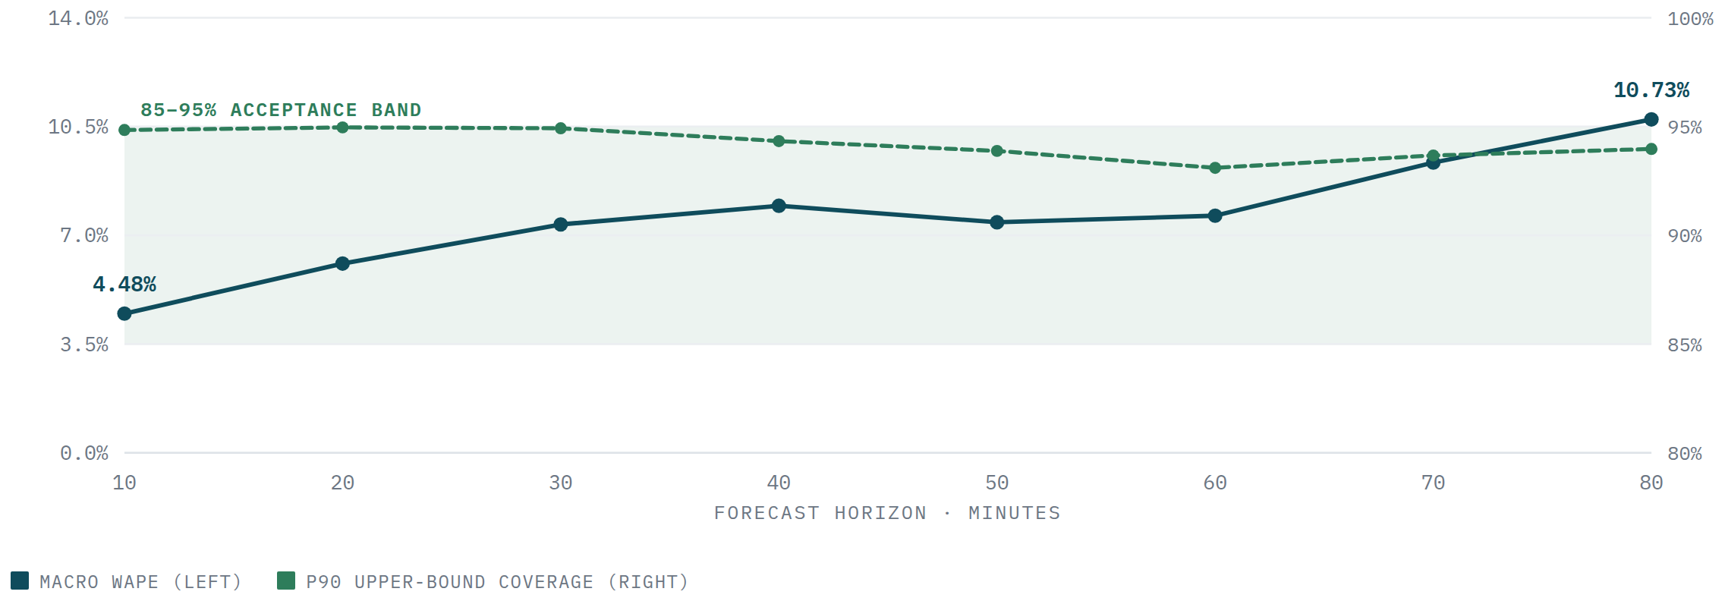
RESULTS
Accuracy on 16 weeks of history
WAPE is total absolute point error divided by total actual volume; lower is better. This 7.63% result belongs to the frozen calendar-ridge bundle's original holdout. The later five-family selection used a separate controlled evaluation, so 7.63% and 12.512% must not be compared directly.
7.63%
94.21%
96.69%
2 304
1.55 M
44.4%
AVERAGE ERROR
ON UNSEEN DATA
REALITY STAYED UNDER
THE 90% BOUND
SAME, FOR THE
95% BOUND
MODELS
TRAINED
TRAINING
ROWS
BETTER THAN
“SAME AS YESTERDAY”
Further ahead is harder
Error rises from 4.48% at 10 minutes to 10.73% at 80 minutes.
But the safety bound holds
It stays inside its 85–95% target range at every horizon.
That second property is the one that matters
The optimizer needs a bound it can still trust even where the point estimate gets shaky.
02 · THE FORECASTER
39
Notes:
PLAIN ENGLISH: WAPE is total absolute error divided by total actual demand. Lower is better.
SAY: It is volume-weighted and understandable, but it can hide a bad small slice, so worst-slice gates are separate.
DO NOT CLAIM: 7.63% error for every group or every event.

Slide 40
FORECASTING · SCORECARD
How error, safety coverage and release gates are calculated
There is no single 'accuracy score'. Point error, upper-bound reliability, event peaks and worst slices answer different operational questions.
POINT ERROR · LOWER IS BETTER
GAIN VS BASELINE · HIGHER IS BETTER
UPPER-BOUND COVERAGE
WAPE = Σ|actual−p50| / Σactual
(14.160−12.512) / 14.160 = 11.64%
p90 = p50 + 90th-percentile past error
A 12.512% WAPE means total absolute error equals 12.512% of total actual volume. It does not promise every row is within 12.512%.
This is relative error reduction—not 11.64% accuracy. The frozen promotion gate was ≥15% reduction.
The added margin is the 90th percentile of |actual−p50| on held-out calibration rows. On unseen rows, coverage = fraction(actual≤p90). Below 88% is unsafe; above 95% is overly wide.
EVENT PEAK UNDERPREDICTION
NO SLICE MAY GET >5% WORSE
miss = max(0, actual peak − predicted peak)
slice = one regime or one forecast horizon
Compare total miss with the baseline during scheduled or causally detected events. Gate: reduce these misses by ≥20%, because missing the peak is riskier than overshooting it.
Compute candidate WAPE ÷ baseline WAPE − 1 for each aggregate slice. The maximum must be ≤5%, so a good average cannot hide an unsafe event state or look-ahead time.
WHY LIGHTGBM WAS NOT PROMOTED · WAPE improved 11.64% (<15% gate) and peak misses improved 27.54% (pass), but its worst regime/horizon slice was 14.70% worse (>5% limit). There is no proof that 15% is impossible—only that this frozen data and feature set did not achieve it safely.
02 · THE FORECASTER
aggregate_forecast_selection.py · metrics.py
40
Notes:
SAY: 11.64% is a relative reduction in error. It is not forecast accuracy. The 15% threshold was frozen before selection, and LightGBM also failed the worst-slice guardrail, so retaining ridge follows the experiment contract.

Slide 41
COMPARISON
Against two simple baselines
Same test rows, and each baseline is also restricted to information available at its own forecast time — so this is a fair fight.
METHOD
AVERAGE ERROR
RIDGE IS BETTER BY
@10 MIN
@20 MIN
@80 MIN
Our model (calendar ridge)
7.63%
—
4.48%
6.09%
10.73%
Average of last 6 windows
14.30%
46.68%
7.58%
9.46%
20.84%
Same time yesterday
13.71%
44.36%
21.82%
21.82%
21.88%
ONE CAVEAT WE SHOULD BE UPFRONT ABOUT
Sessions, uplink and downlink all report the same 7.63% error. Not because the model learned three things well — because the older simulator calculated uplink and downlink by multiplying session count by a fixed number. They are the same series in different units. The newer traffic model gives every session its own bandwidth draw, and it needs to become the default before we claim anything about predicting throughput.
02 · THE FORECASTER
41
Notes:
PLAIN ENGLISH: A model earns value only by beating strong simple forecasts on identical rows.
SAY: Yesterday and seasonal baselines also obey the no-future rule.
IF ASKED: The comparison is causal and matched.

Slide 42
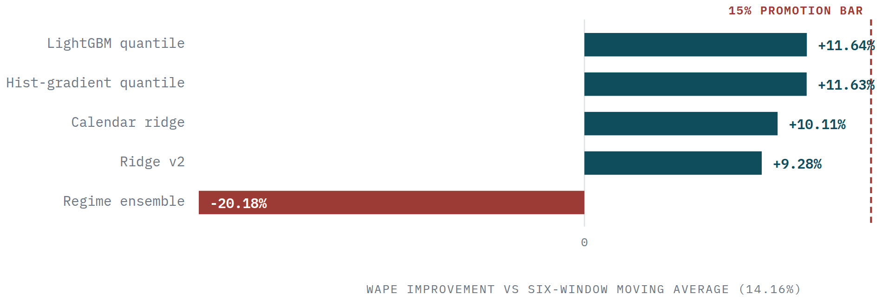
MODEL COMPARISON
Five model families, head to head
Promotion required every gate at once, with thresholds frozen before selection: ≥15% relative WAPE reduction, observed p90 coverage between 88–95%, ≥20% lower event peak miss, and ≤5% regression in every aggregate regime or horizon. Freezing the rules prevents lowering the bar after seeing a favourite model.
Best pooled error, but not release-ready
LightGBM: WAPE 14.160% → 12.512% = 11.64% lower error, not 11.64% accuracy. It missed the ≥15% promotion gate.
Why one average is not enough
The regime ensemble cut event peak misses by 64.2%, yet overall WAPE was 20.2% worse and its worst slice was 601.7% worse. Optimising the rare event damaged ordinary periods.
Decision: no challenger promoted
All five models failed at least one precommitted gate. Calendar ridge remains the auditable current model; it is not claimed to be globally best.
02 · THE FORECASTER
42
Notes:
PLAIN ENGLISH: The most accurate model is not automatically released. Every accuracy, coverage, peak and worst-slice gate must pass.
SAY: LightGBM won average accuracy but lost the release decision.
DO NOT CLAIM: That ridge is the globally best forecasting algorithm.

Slide 43
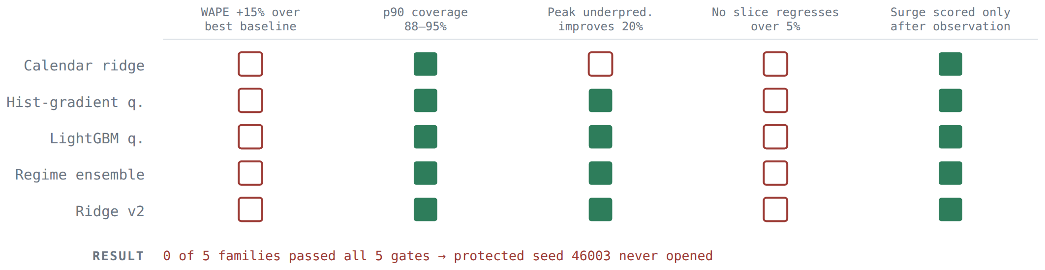
MODEL COMPARISON
Every family, every check
MODEL FAMILY
WAPE ↓
ERROR GAIN
p90 COVERAGE
PEAK-MISS GAIN
MAX REGRESSION
PROMOTED?
LightGBM
12.512%
+11.64%
93.53%
+27.5%
+14.70%
No
Histogram gradient boosting
12.513%
+11.63%
93.53%
+27.4%
+14.34%
No
Calendar ridge (current)
12.729%
+10.11%
93.60%
+11.9%
+11.39%
No
Ridge v2
12.846%
+9.28%
94.39%
+25.8%
+12.42%
No
Regime-switching ensemble
17.017%
−20.18%
94.81%
+64.2%
+601.7%
No
384 models trained, 384 calibrated, 480 result files, plus 96 independent audit jobs that reloaded every model through the real production loading code.
NOBODY PASSED
No model has a full column, so none was released and the locked test data was never opened. That is the rule working as intended — not an experiment left unfinished.
02 · THE FORECASTER
43
Notes:
PLAIN ENGLISH: The most accurate model is not automatically released. Every accuracy, coverage, peak and worst-slice gate must pass.
SAY: LightGBM won average accuracy but lost the release decision.
DO NOT CLAIM: That ridge is the globally best forecasting algorithm.

Slide 44
FAILURE MODE
Where the forecaster actually falls over
The overall average hides the failure that matters. Same model, same day, split by what was happening at the time.
SITUATION
ERROR
PER-GROUP ERROR
90% BOUND HOLDS
95% BOUND HOLDS
Normal
6.51%
6.26%
94.19%
96.71%
Traffic surge
11.08%
11.02%
30.73%
37.85%
Box at reduced capacity
5.09%
5.73%
87.88%
91.96%
Box nearly offline
5.29%
6.57%
73.96%
78.13%
Network delay spike
5.04%
5.06%
92.36%
96.18%
DURING A SURPRISE SURGE, THE SAFETY BOUND IS RIGHT ONLY 30% OF THE TIME
Equipment failures change the network, not how much traffic people generate — so prediction accuracy barely moves. Surges are different. When demand suddenly jumps and nobody warned us, there is nothing in the past data that predicts it. The safety bound — the exact thing the optimizer plans against — is wrong precisely when the optimizer needs it most. This one row explains most of section 03.
02 · THE FORECASTER
44
Notes:
PLAIN ENGLISH: Overall averages look acceptable while the event periods that matter remain hard.
SAY: This is why control evidence is required; forecast improvement does not guarantee operational improvement.

Slide 45
COST
How long it takes to train and to run
TRAINING
RUNNING IT LIVE
3 minutes 3 seconds for the whole 16-week model set. Of that, only 13 seconds is actual maths — fitting 2 304 tiny nine-input models. Everything else is reading data off disk. Peak memory 1.8 GB, one node, no GPU.
A GPU would be useless here. The bottleneck is disk, not computation. That only changes if we move to large boosted-tree or neural models later.
The five-family comparison was a real cluster job: 384 trained models, 384 calibrated models, 480 result files and 96 audit jobs.
96 forecasts per decision round — one per traffic group — handed straight to the optimizer. In the one-day test the controller used a safe fallback for the very first round, then produced forecasts normally for the remaining 143.
Forecasting is never the bottleneck at any scale we tested. Every speed problem in this project is in the optimizer, not the model.
Model files are checksum-verified on load. If a model was trained on different traffic groups than the scenario expects, the system refuses to start rather than quietly using the wrong thing.
02 · THE FORECASTER
45
Notes:
PLAIN ENGLISH: Training happens offline; inference happens on every decision round and must fit the operational deadline.
SAY: A more complex model is acceptable only if its accuracy benefit survives the end-to-end latency and release gates.

Slide 46
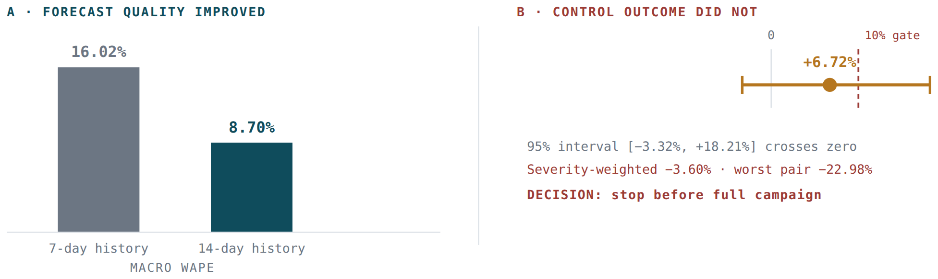
DECISION
Which model we use, and why
We retain calendar ridge with conformal upper bounds. In the common five-family comparison, LightGBM WAPE was 12.512% versus ridge at 12.729%—only 0.217 percentage points lower—and LightGBM failed the worst-slice guardrail.
Nothing beat the release bar
The rule says the current model stays unless a challenger passes all five checks. None did. Keeping ridge is the required answer, not a preference.
Nine inputs, closed form, 13 seconds
Retrainable anywhere, easy to audit, and you can look at each coefficient and understand it.
Doubling the training history from 7 to 14 days almost halved the error, 16.02% → 8.70%. We then ran a full controller campaign with that better model: +6.72% average, but a confidence range from −3.32% to +18.21% that includes zero, −3.60% weighted by severity, and −22.98% on the worst day. Decision: stop before spending the compute.
Reliable where it counts
94.2% and 96.7% coverage on unseen data — the property the optimizer actually consumes.
The real gains did not carry through
LightGBM's 27.5% better peak-catching is genuinely useful, but it came with a 14.7% worse slice — and a better forecast did not produce better control.
02 · THE FORECASTER
46
Notes:
PLAIN ENGLISH: Ridge stays because the selection contract says no challenger passed every gate.
SAY: Keeping a simpler model is the consequence of the rule, not personal preference.
IF ASKED: Conformal bounds give the optimizer a calibrated upper-demand estimate.

Slide 47
NEXT STEPS
Forecasting: fix the evaluation, then improve the model
Horizon = how far ahead we predict (10–80 minutes). Group = one area × one service class (96 total). A model-per-group-and-horizon lets a stadium uploader behave differently from rural IoT at 10 versus 80 minutes.
EVALUATION FIRST
MODEL IMPROVEMENT SECOND
01
Use the intended time split
04
Add weekly and event memory
Train on weeks 1–11, calibrate on 12–13, test on 14–16. Keep every event wholly inside one split.
Use a true one-week lag, rolling volatility and only those event features known at forecast issue time.
02
Report every operating slice
05
Select per group × horizon
Publish normal, surge, reduced-capacity, offline and delay results by horizon—not only a national average.
Choose ridge, seasonal or LightGBM on validation data for each task; never choose on test data.
03
Separate sessions, UL and DL
06
Pool sparse groups carefully
Give each session its own bandwidth so UL/DL forecasts are not just rescaled copies of session count.
Share signal across related services while retaining area and service identity; small groups lack enough events alone.
SURGE BOUND IS THE PRIORITY · observed coverage during surges was the binding weakness. Better event labels and faster bound adaptation matter before neural models or GPUs.
02 · THE FORECASTER
control_science_v1.json · forecast backlog
47
Notes:
PLAIN ENGLISH: Arrival rate equals baseline multiplied by daily/weekly/event factors and correlated noise. Each arrival then receives bandwidth and duration.
SAY: The equations generate offered demand; capacity is applied afterwards.
DO NOT CLAIM: That the parameter values came from C-DOT.

Slide 48
03
THE OPTIMIZER
Deciding where traffic goes — and when it genuinely helps
Experiments 1–6 show how the first designs failed. Experiment 7 records the evaluator audit and the corrected result: predictive steering wins for declared capacity loss, ties static on pure surprises, and remains shadow-only.
48

Slide 49
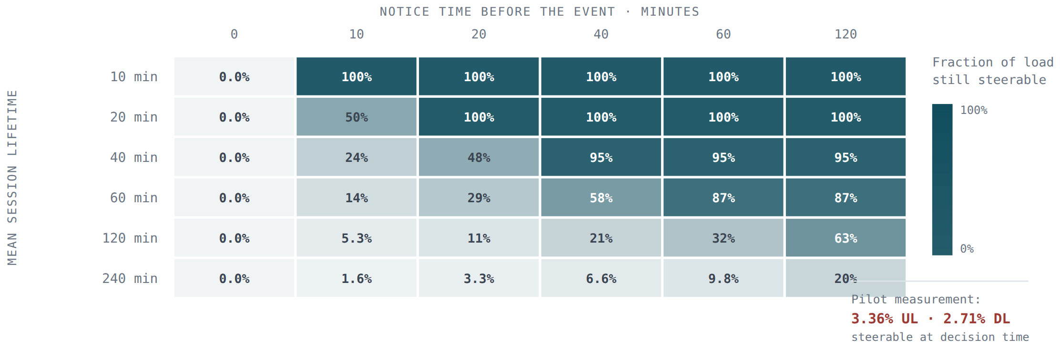
THE CONSTRAINT
Start with the lever
The only thing a controller can change is the share of NEW sessions each box receives. Sessions already running stay where they are. That is not a simplification we chose — it reflects a genuinely open question about whether C-DOT's system can move a live session.
Read it like this
Columns are how much warning we get. Rows are how long an average session lasts.
The realistic corner
10 minutes of warning, 4-hour sessions → only 1.6% of load is still movable.
Measured on a real test day
3.4% of uplink and 2.7% of downlink traffic was steerable at decision time.
THE AIRPORT OUTAGE, IN ONE NUMBER
One box went almost completely offline. That single event caused 103 965 of the controller's 105 181 total overload — 98.8% of it. All that traffic was already attached to the failed box, and a new-session-only lever cannot move it. Whatever the optimizer does with the remaining 1.2% simply cannot add up to a 20% improvement.
The consequence
No amount of clever optimisation recovers leverage the lever does not have.
03 · THE OPTIMIZER
49
Notes:
PLAIN ENGLISH: Only the small flow of new sessions is movable; hours of existing load are anchored.
SAY: This limited lever explains why prediction alone often has modest effect.
IF ASKED: The controllable fraction varies by scenario; the deck summarizes it as about 3%.

Slide 50
PLAIN ENGLISH · OPTIMIZER I/O
The optimizer turns demand and capacity into routing percentages
It never chooses a named subscriber. For each traffic group, it chooses what share of future session starts should go to each eligible UPF.
INPUTS
LP SOLVE
CANDIDATE PLAN
INDEPENDENT GATE
p50/p90/p95 demand
current anchored load
UPF capacity + health
eligibility + delay
maintenance notice
Variables: routing weights
Objective: minimise overload first, then delay + churn
Constraints: weights ≥0, sum=100%, capacity, health, eligibility
group → UPF weights
predicted utilisation
slack / overload
solver status + time
reason + provenance
Recompute feasibility
compare with Static
check telemetry age
check latency + churn
PASS → recommendation
FAIL → last safe Static
SAME CONTRACT, DIFFERENT LOOK-AHEAD
STATIC
REACTIVE
LP
PRE-DRAIN
MPC
ORACLE
No solve; capacity-proportional reference
Responds after overload is observed
Optimises the next decision only
LP activated by advance loss notice
LP across a horizon; apply first step, re-solve
Whole future known; ceiling only
03 · THE OPTIMIZER
optimization/highs.py · cohort_mpc.py · steering/gate.py
50
Notes:
SAY: The variables are percentages, the objective ranks undesirable outcomes, and constraints are hard rules. MPC repeats the same calculation over a horizon.
IF ASKED: A separate policy validator recomputes feasibility before publication.

Slide 51
THE CANDIDATES
Seven controllers
CONTROLLER
HOW IT WORKS
STATUS
Simple (static)
Split traffic in proportion to each healthy box's capacity. No forecast, no memory.
REFERENCE DEFAULT
Reactive
When a box gets busy, send less traffic to it.
Comparison
Forecast capacity
Simple rule, but adjust each box's headroom using the forecast.
Comparison
Linear program
Solve for the best split right now, given predicted demand and all capacity limits.
Tested
Cohort MPC
Plan two hours ahead. Track which sessions are running, when they end, what failures are coming.
Shadow only
Pre-drain
When we know a box is about to lose capacity, stop sending it new sessions in advance.
Shadow only
Oracle
Knows the whole day in advance. Solves the entire day at once.
NOT DEPLOYABLE
WHAT THE LINEAR PROGRAM ACTUALLY OPTIMISES
The unknowns are traffic shares per (group, box). The objective is dominated by a very large penalty on exceeding a box's safe limit, plus a smaller cost for general utilisation and small penalties for sending traffic out of zone or changing the plan too often. Constraints cover uplink and downlink capacity, session count, which boxes each group may use, box health, delay limits, and a cap on how much of one group can pile onto one box. If no valid answer exists, the solver says so rather than inventing one. Each solve is capped at one second.
03 · THE OPTIMIZER
51
Notes:
PLAIN ENGLISH: These controllers differ in how much future information and state they use. Static is the reference; oracle is an impossible upper bound.
SAY: Reactive is intuitive but harmful because it reacts after sessions are already committed.
DO NOT CLAIM: Any candidate is deployed on C-DOT.

Slide 52
EXPERIMENT 1
The linear program vs the simple rule
One busy simulated day: three four-hour local surges, a box at reduced capacity, a box nearly offline, a network delay incident, and recovery periods. All three controllers saw identical conditions.
MEASUREMENT
SIMPLE
REACTIVE
PREDICTIVE
PREDICTIVE VS SIMPLE
Reactive is worse than doing nothing clever
Uplink overload (main metric)
107 767 s
211 891 s
105 181 s
2.40% better
50% more overload and 59% more dropped data than predictive. So the real competition is the simple rule.
Downlink overload
59 906 s
118 167 s
56 376 s
5.89% better
Time spent overloaded, up
16 440 s
19 650 s
13 230 s
19.53% better
Time spent overloaded, down
30 480 s
7 200 s
7 200 s
76.38% better
Data dropped, up
49.27 TB
119.44 TB
49.16 TB
0.23% better
2.40% against a 20% target
Data dropped, down
79.19 TB
163.05 TB
76.30 TB
3.66% better
Failed session setups
0
0
0
no change
The predictive controller did beat the simple rule — by nowhere near enough.
It mostly chose not to act
It left the plan unchanged in 109 of 143 rounds, acting only 34 times.
03 · THE OPTIMIZER
52
Notes:
PLAIN ENGLISH: The LP found a valid mathematical solution but barely improved overload because it could move only new sessions.
SAY: Solver success and operational success are different questions.

Slide 53
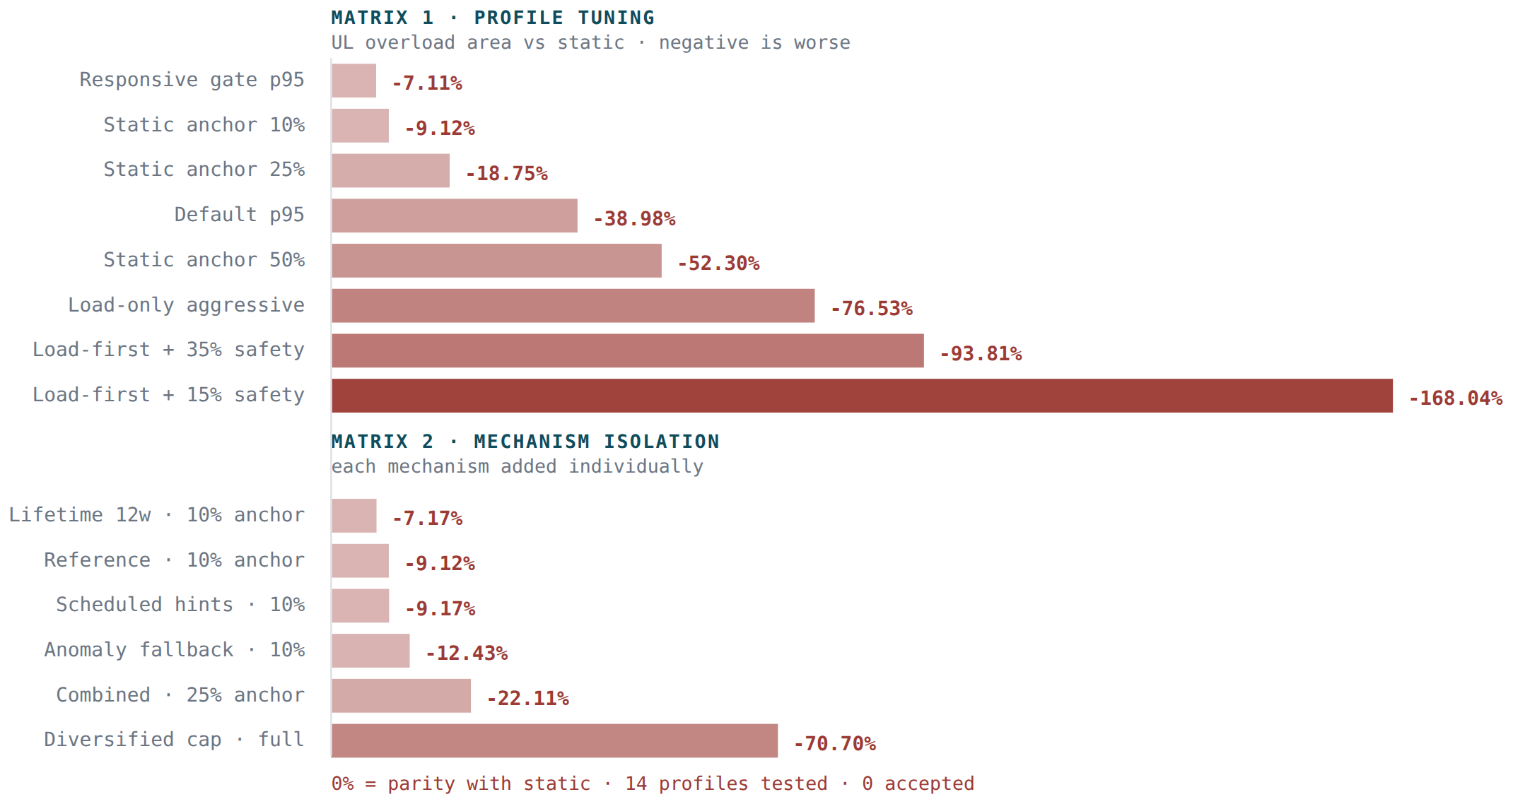
EXPERIMENT 2
Tuning made it worse, every time
Eight settings across two validation days, then six more that each added one specific capability. Negative means worse than the simple rule.
WHY THE OPTIMIZER ACTIVELY HURTS
It correctly reduces the peak inside its planning window by packing traffic onto whichever boxes look free right now. But sessions last hours. Those sessions become a permanent load that a new-session-only lever cannot undo later. The simple rule spreads every group across all its allowed boxes, which is far more robust. We confirmed it directly: several settings reduced immediate overload while making total overload and dropped data worse over the full day.
We then tested whether any single missing capability explained the gap: telling the optimizer about scheduled events, adding a surge detector, weighting by how long sessions last, and capping how much one box can take. All six variants still lost.
Session-length weighting helped a little — 1.95 percentage points against a 9-point deficit. The conclusion was explicit: the next change is not another parameter, it is a different kind of model.
03 · THE OPTIMIZER
53
Notes:
PLAIN ENGLISH: Changing penalty weights did not repair the weak lever.
SAY: Tuning a formulation cannot create controllability that the architecture does not provide.

Slide 54
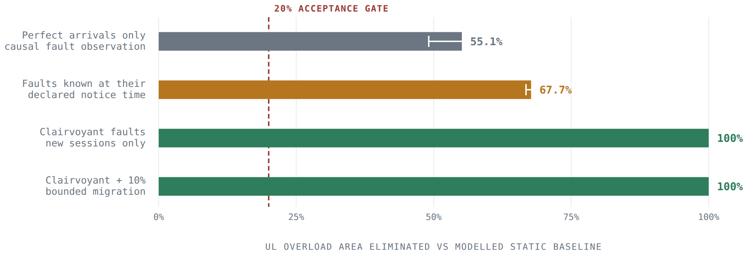
EXPERIMENT 3
How much room for improvement is there?
Before building something harder, we asked whether the problem is solvable at all. An oracle reads the exact arrivals for the whole day, then solves the entire day at once. It cannot be deployed — it knows the future — but it tells us the ceiling.
Failures matter more than demand
Knowing all future arrivals removes ~55% of overload. Knowing about failures in advance removes 100%.
That reframes the whole problem
We had been building better demand forecasts when the leverage was in failure knowledge.
The middle rows are unstable
One day gave −91%, the other +97%. Before an unannounced failure many plans look equally good, and the solver picks between them almost at random.
Which is itself evidence
The next controller needs a reason to prefer staying close to the simple rule, and it needs to care about where it leaves itself exposed later.
03 · THE OPTIMIZER
54
Notes:
PLAIN ENGLISH: The oracle asks whether improvement is theoretically available if the future were known.
SAY: It proves headroom exists, especially around known failures; it is not deployable evidence.

Slide 55
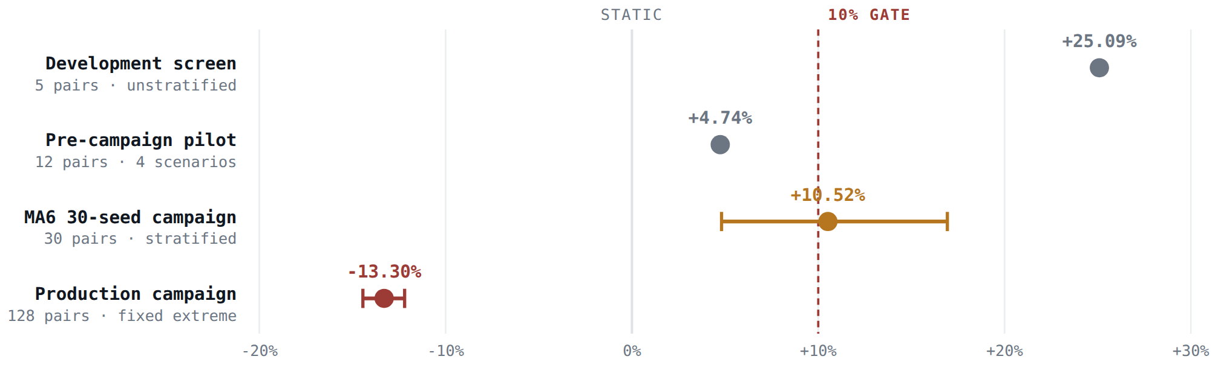
EXPERIMENT 4
MPC, in four rounds
MPC means Model Predictive Control: plan several steps ahead, act on the first step, re-plan with fresh information. Ours tracks every running session over a two-hour horizon, and only publishes a plan if it can prove that plan beats the simple rule from the same starting state.
ROUND
DAYS
AVERAGE GAIN
WORST DAY
VERDICT
First look
5
+25.09%
+22.87%
Promising
Wider test
12
+4.74%
−13.91%
Blocked
Full campaign
30
+10.52%
−23.50%
Demo only
Production test
128
−13.30%
−36.22%
Rejected
RECONCILING +10.52% WITH −13.30%
Both used the same controller, settings and metric. What differed was the mix of test days. The 30-day set was deliberately balanced across four stress types, and all the gain came from planned-failure days (+19% there) while surprise and mixed days were already slightly negative. The production set was a larger, different mix with no overlap. On it, only 2 of 128 days improved.
Every time we made the test stricter, the result got smaller — and on the realistic production test set it flipped negative.
03 · THE OPTIMIZER
55
Notes:
PLAIN ENGLISH: MPC predicts several future steps, applies one decision and replans. Earlier test pools gave unstable results.
SAY: Keep this negative history because it explains why Experiment 7 required an evaluator audit.
DO NOT CLAIM: The old −13.3% is the current conclusion.

Slide 56
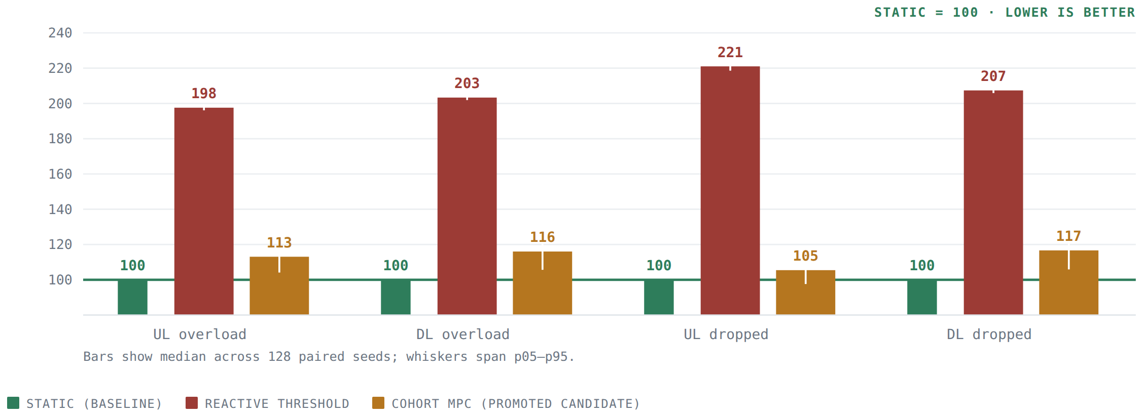
EXPERIMENT 4 · RESULT
128 production test days
The simple rule is set to 100 on every measure. Lower is better.
Reactive lands at 198–221%
on every single loss measure. It is the worst controller we tested.
MPC improves that to 105–117%
much better than reactive, and still consistently worse than doing nothing clever.
The simple rule wins on all four
uplink overload, downlink overload, uplink drops and downlink drops — simultaneously.
03 · THE OPTIMIZER
56
Notes:
PLAIN ENGLISH: MPC predicts several future steps, applies one decision and replans. Earlier test pools gave unstable results.
SAY: Keep this negative history because it explains why Experiment 7 required an evaluator audit.
DO NOT CLAIM: The old −13.3% is the current conclusion.

Slide 57
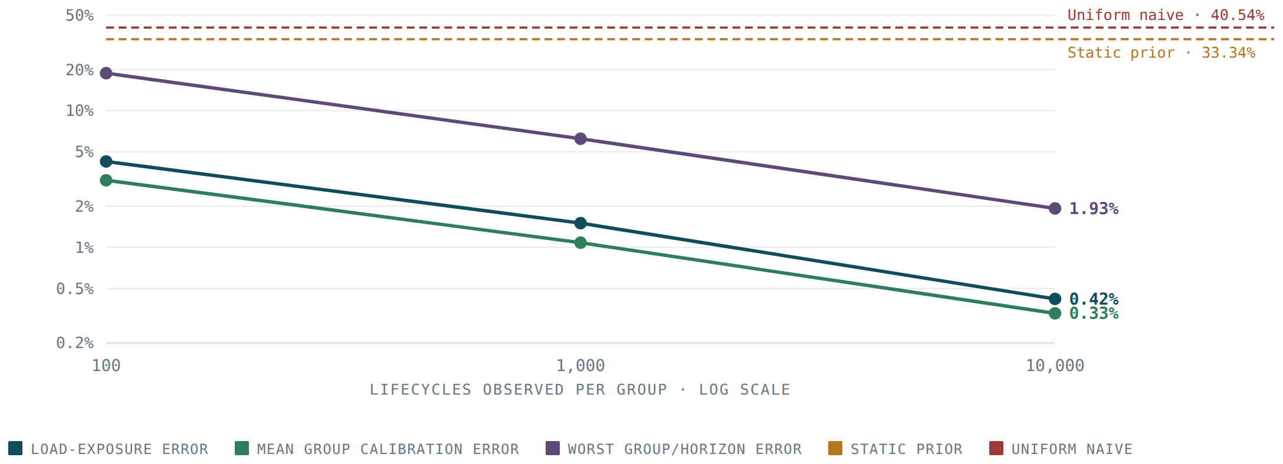
EXPERIMENT 5
Learning how long sessions last
MPC needs to know how long the sessions it places will occupy a box. Using the simulator's own setting would be cheating, so we estimate it from ordinary start/stop logs — using Kaplan–Meier, which handles the awkward part: many sessions are still running when we look.
More observations, better estimates
With 10 000 sessions per group the estimate is off by 0.42%. A fixed guess is off by 33.3%.
We tested it blind
25 trials against each of five distributions it was never told about. Average error 2.9–3.5%.
It handles drift
Drift mid-experiment raised error to 4.2%; re-estimating brought it back to 2.75%.
It fails safe
THE ESTIMATOR WORKS. IT JUST DOESN'T HELP.
Stale data triggered a fallback to the simple rule in 100% of trials.
Feeding these curves into MPC changed almost nothing. Across twelve test days: the perfect oracle curve gave +11.22%, the accurate estimated curve gave +9.91%, and a deliberately wrong uniform curve — off by 40.5% — gave the best result of all at +12.25%. In this setting, survival accuracy and control quality are essentially unrelated.
03 · THE OPTIMIZER
57
Notes:
PLAIN ENGLISH: MPC needs to estimate how much placed load will survive into each future step. Kaplan–Meier learns that survival curve from start/stop logs without peeking at simulator settings.
IF ASKED: It handles censored sessions that are still running at the end of an observation period.

Slide 58
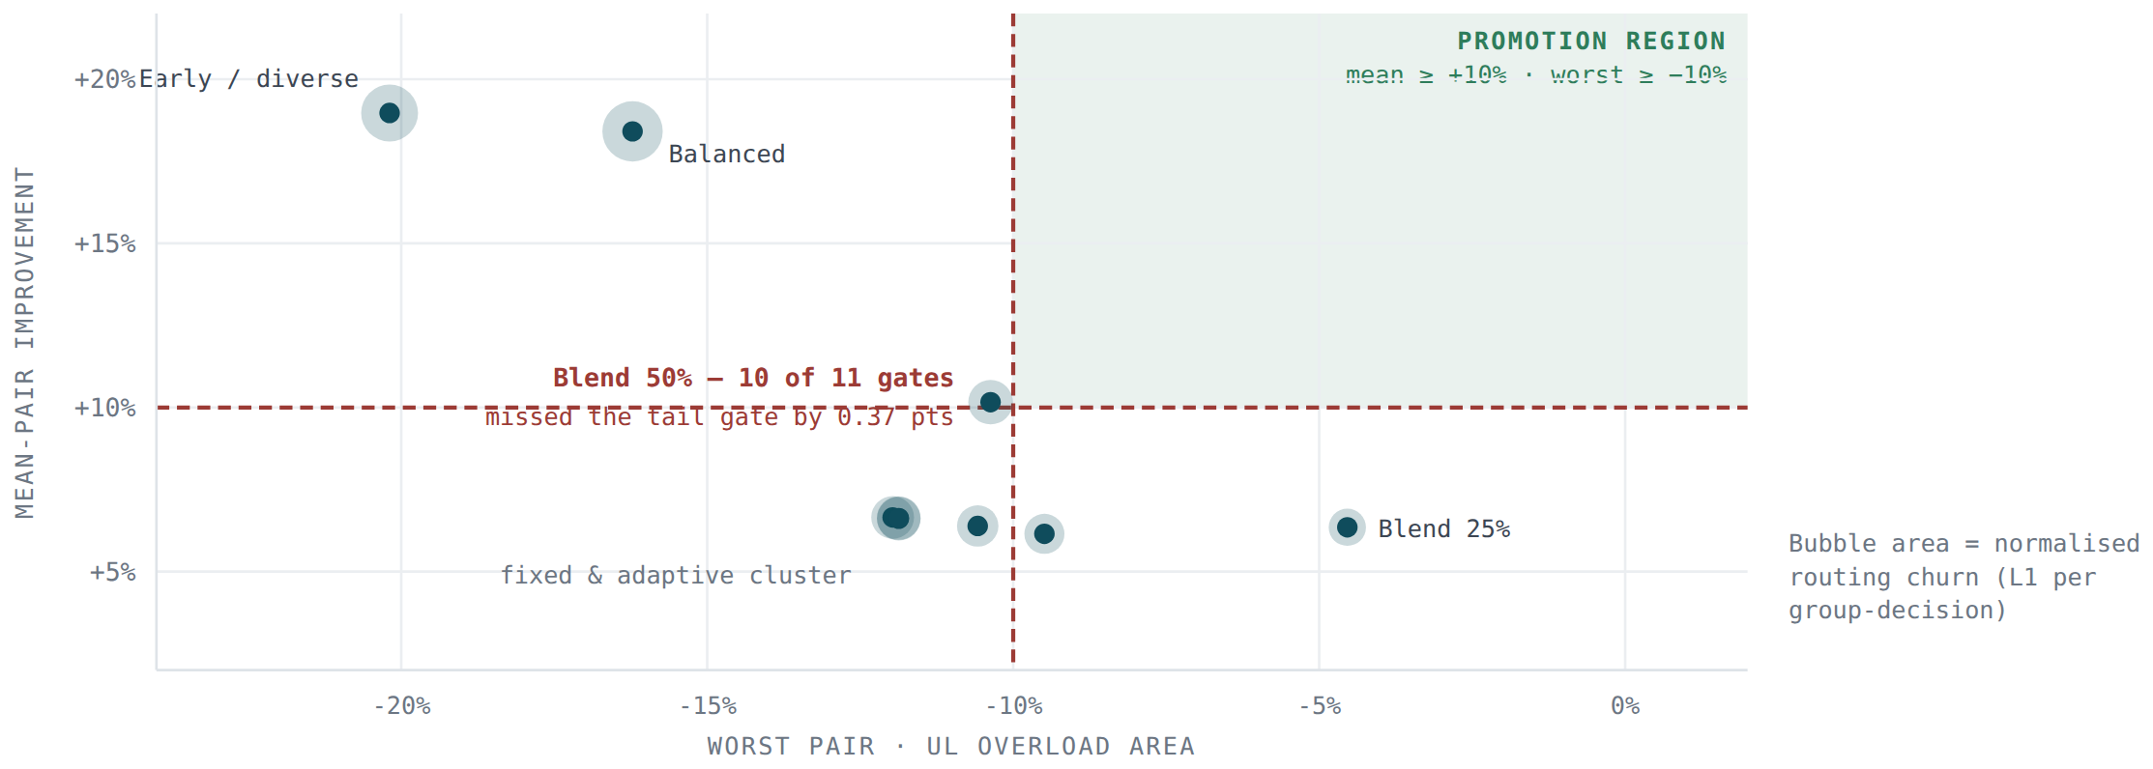
EXPERIMENT 6
Pre-drain, and an impossible trade-off
If failures matter more than demand, attack failures directly. Pre-drain does one thing: when we know a box will lose capacity soon, stop sending it new sessions ahead of time. Small problem — 648 unknowns — solves in about 30 milliseconds.
Each dot is one configuration
Average gain up the axis, worst-day loss across it. Bubble size is how much routing churn it causes.
The green box is the release zone
A configuration must land inside it. Nothing does.
Acting strongly
buys a good average and an unacceptable worst day.
Acting gently
is safe and gains too little.
The closest miss
50% strength passed ten of eleven checks and failed the worst-day limit by 0.37 percentage points. We did not relax the limit.
03 · THE OPTIMIZER
58
Notes:
PLAIN ENGLISH: Pre-drain uses advance maintenance notice to reduce new placements before capacity drops.
SAY: The older configuration campaign exposed the gain-versus-worst-case trade. Experiment 7 later corrected evaluator defects and superseded the release conclusion.

Slide 59
EXPERIMENT 6 · DETAIL
Every pre-drain configuration
240 test days on fresh data. A candidate must pass every check, not most of them.
CONFIGURATION
AVERAGE GAIN
95% RANGE
WORST DAY
PLANNED FAILURES
MIXED STRESS
SLOWEST DECISION
FAILED ON
Full strength
+18.41%
[+3.89, +35.43]
−16.22%
+79.20%
−5.58%
—
worst day, churn
Early & spread out
+18.97%
[+3.78, +36.63]
−20.19%
+83.05%
−7.18%
—
worst day, churn
50% strength
+10.16%
[+0.99, +21.92]
−10.37%
+43.89%
−3.27%
—
worst day only
25% strength
+6.35%
[+0.66, +14.19]
−4.54%
+26.76%
−1.37%
—
average only
Fixed 35%
+6.15%
[−0.84, +16.37]
−9.49%
+28.40%
−3.79%
764 ms
3 checks
Fixed 40%
+6.39%
[−0.99, +16.74]
−10.58%
+30.01%
−4.44%
225 ms
3 checks
Fixed 45%
+6.65%
[−1.12, +17.18]
−11.97%
+31.59%
−4.94%
970 ms
4 checks
Adaptive, early taper
+6.61%
[−1.15, +17.19]
−11.87%
+31.53%
−5.09%
739 ms
4 checks
Adaptive, late taper
+6.63%
[−1.15, +17.22]
−11.87%
+31.59%
−5.09%
628 ms
4 checks
WHY MAKING IT ADAPTIVE DIDN'T SAVE IT
We tried varying the strength based on how busy the box currently was. The mechanism worked — strength ranged from 25% to 50% as intended. It still failed on the same day. The known capacity loss entered the planning window first, and the surprise surge started well after that. At every pre-drain decision the box looked only 35% busy, so the controller applied full strength. By the time the surge arrived those sessions were already placed. Reacting to how busy things are right now cannot protect you from a surprise that arrives after you have already committed.
03 · THE OPTIMIZER
59
Notes:
PLAIN ENGLISH: Pre-drain uses advance maintenance notice to reduce new placements before capacity drops.
SAY: The older configuration campaign exposed the gain-versus-worst-case trade. Experiment 7 later corrected evaluator defects and superseded the release conclusion.

Slide 60
COST
How much compute a decision takes
We measured solver status, problem size, solve time and — importantly — the complete time to make a decision, not just the solver call. Earlier checks only looked at the solver, and that hid real outliers.
CONTROLLER
PROBLEM SIZE
SOLVE TIME
SLOWEST SOLVE
SLOWEST FULL DECISION
TIMEOUTS / ERRORS
Pre-drain
648 unknowns
27–28 ms typical
118–127 ms
225–970 ms
0 / 0
Cohort MPC
≈ 3 818 unknowns
4.1–4.2 s
6.18 s
5.4–6.2 s
0 / 0
Linear program
96 groups × 24 boxes
< 1 s (capped)
—
—
always solved
These worst-case times were measured while 120 simulations ran at once on a fully loaded 125-CPU machine. They are NOT a clean measurement of production speed and should not be quoted as one.
THE TIMEOUT DISCOVERY
CAMPAIGN COMPUTE
Early MPC runs showed the solver timing out about 69% of the time. We removed the timeout to check whether the negative result was just an artefact of the optimizer never running. It ran fine — and the gap did not close. So the negative result is real.
But the 2-second solver limit was never a limit on the whole decision. One decision makes several solver and validation calls.
Each 120-day campaign took about 1 hour 10 minutes on one exclusive 125-CPU node, running at roughly 12 000% CPU — about 120 cores busy at once.
Only the fixed 40% configuration met the new 500 ms decision budget, and it still failed on average gain, confidence and worst day. The speed check did its job: it exposed slow decisions that solver-only reporting had completely hidden.
03 · THE OPTIMIZER
60
Notes:
PLAIN ENGLISH: End-to-end decision time matters, not only solver time.
SAY: The latency budget includes feature preparation, solve, validation and policy construction.
IF ASKED: Faster cadence can raise churn without meaningful gain.

Slide 61
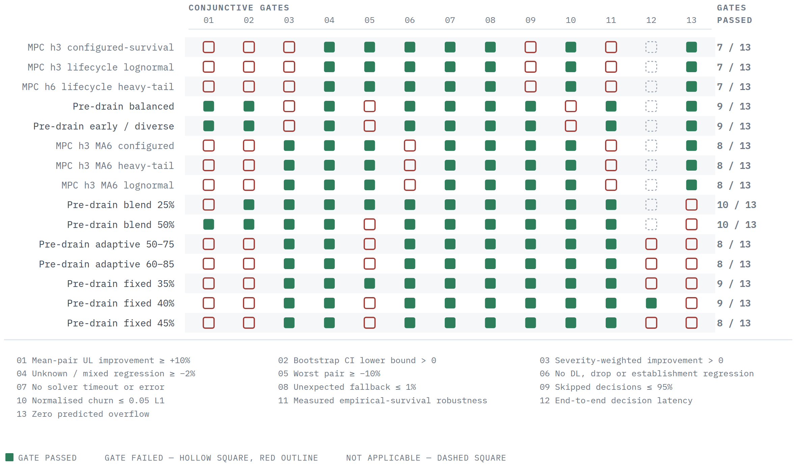
THE FULL SCORECARD
Fifteen candidates, thirteen checks
A candidate must fill every square.
NO EARLY CANDIDATE FILLED A ROW
The first three MPC variants failed for a different reason entirely: the trained forecaster needed 144 completed history windows to warm up, and the experiment only had 143. So all 10 368 decisions safely refused to act — correct behaviour, and useless as evidence.
WHAT CHANGED
A history-compatibility preflight now rejects that interface before an experiment can consume a development seed pool.
03 · THE OPTIMIZER
61
Notes:
PLAIN ENGLISH: A candidate must pass the whole row; one failed safety or evidence check blocks promotion.
SAY: This slide records the earlier campaign. Experiment 7's 36 passing configurations are the current result.

Slide 62
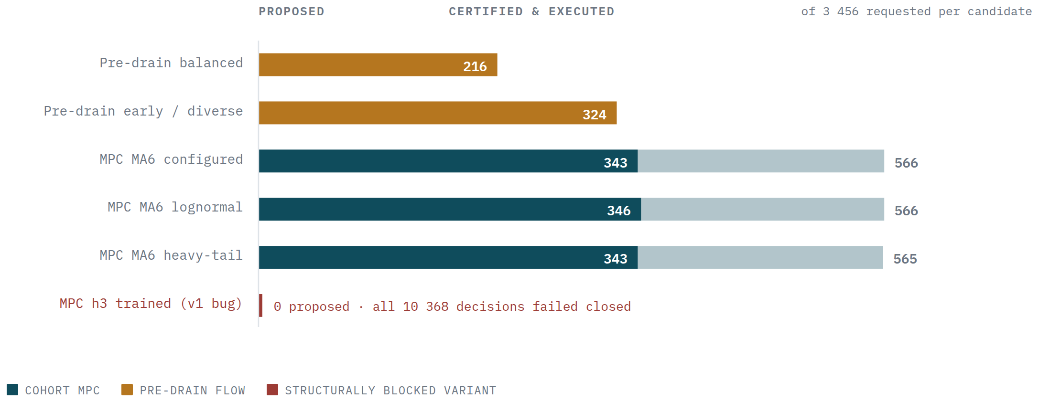
THE MACHINERY
What happened to every proposed action
MPC proposed 1 697 actions
across three variants, once the warm-up problem was fixed.
1 032 were executed
after passing the safety check.
665 were rejected
mostly because the improvement was not large enough to justify acting.
166 had no valid solution
and correctly fell back.
The machinery works end to end
The benefit is simply not there.
03 · THE OPTIMIZER
62
Notes:
PLAIN ENGLISH: Proposed actions move through preflight, solve, independent validation and fallback.
SAY: A feasible solver status is necessary but not sufficient for policy publication.

Slide 63
SELF-AUDIT
A safety problem we found in our own results
“SOLVED” DID NOT ALWAYS MEAN “VALID”
WHY REPORT THIS AT ALL?
A later review found that seven pre-drain configurations produced answers the solver marked as solved while still slightly exceeding a capacity limit. Previously we would have called those plans feasible. They were not.
Nobody outside the project would have found this. The affected experiments had already been rejected, so the headline conclusions do not change.
We report it because the value of this whole apparatus is that its claims can be trusted. An evidence system that quietly corrects its own record is worth more than one that never admits to a correction.
It also produced a real improvement: a check that did not exist before now runs on every candidate.
What changed
The system now reports any such excess explicitly.
A new mandatory check
“No capacity exceeded” is now a release requirement, not a nice-to-have.
Fail closed
Any violation hands control straight back to the simple rule.
What we did not do
We did not re-score the old experiments — their conclusions were negative anyway — but we no longer describe those actions as validated.
03 · THE OPTIMIZER
63
Notes:
PLAIN ENGLISH: The team found that some 'solved' plans still exceeded a constraint slightly.
SAY: The correct response was a new mandatory validation gate, not rounding the violation away.
IF ASKED: The affected candidates were already rejected, so no unsafe release occurred.

Slide 64
EXPERIMENT 7
Re-running the campaign after auditing the evaluator
The earlier campaign concluded no controller could beat the simple rule. An audit found three defects — all in the scoring code and the scenario generator, none in the controllers themselves. Fixing them changed the answer.
DEFECT 1 · UNITS
DEFECT 2 · METRIC
DEFECT 3 · SIZING
The optimiser and the scoreboard disagreed
One stress family scored infinity
The MPC horizon was set in windows, not hours
The simulator scores overload as load ÷ capacity − 1, a relative quantity. The safety guard and the pre-drain solver both worked in absolute Mbps. On a box cut to a tenth of its envelope those differ tenfold, so the controller undervalued exactly the action it exists to take.
An unavailable box has zero capacity, so those pairs scored infinity for both controllers — an exact tie that still failed a finite-metric check on all 160 configurations. That single check made the contract unpassable before any controller ran.
Halving the control cadence quintupled the optimisation, so every 2-minute configuration hit a 2-second solver budget that the acceptance rules allowed to be 120 seconds. The reported cadence finding was measuring a sizing bug.
WHAT CHANGED AS A RESULT
Configurations passing every gate: 0 of 160 → 36 of 160. Worst stress family: −1.7% → +24.2%. MPC solver timeouts: 40% at 10-minute cadence and 100% at 2-minute → zero.
03 · THE OPTIMIZER
64
Notes:
PLAIN ENGLISH: Three evaluator/scenario defects—not controller changes—had made the contract effectively impossible to pass.
SAY: Units, infinite tie metrics and horizon sizing were corrected, then candidates were re-run on frozen pools.
DO NOT CLAIM: That auditing always improves results; here it changed the measured answer.

Slide 65
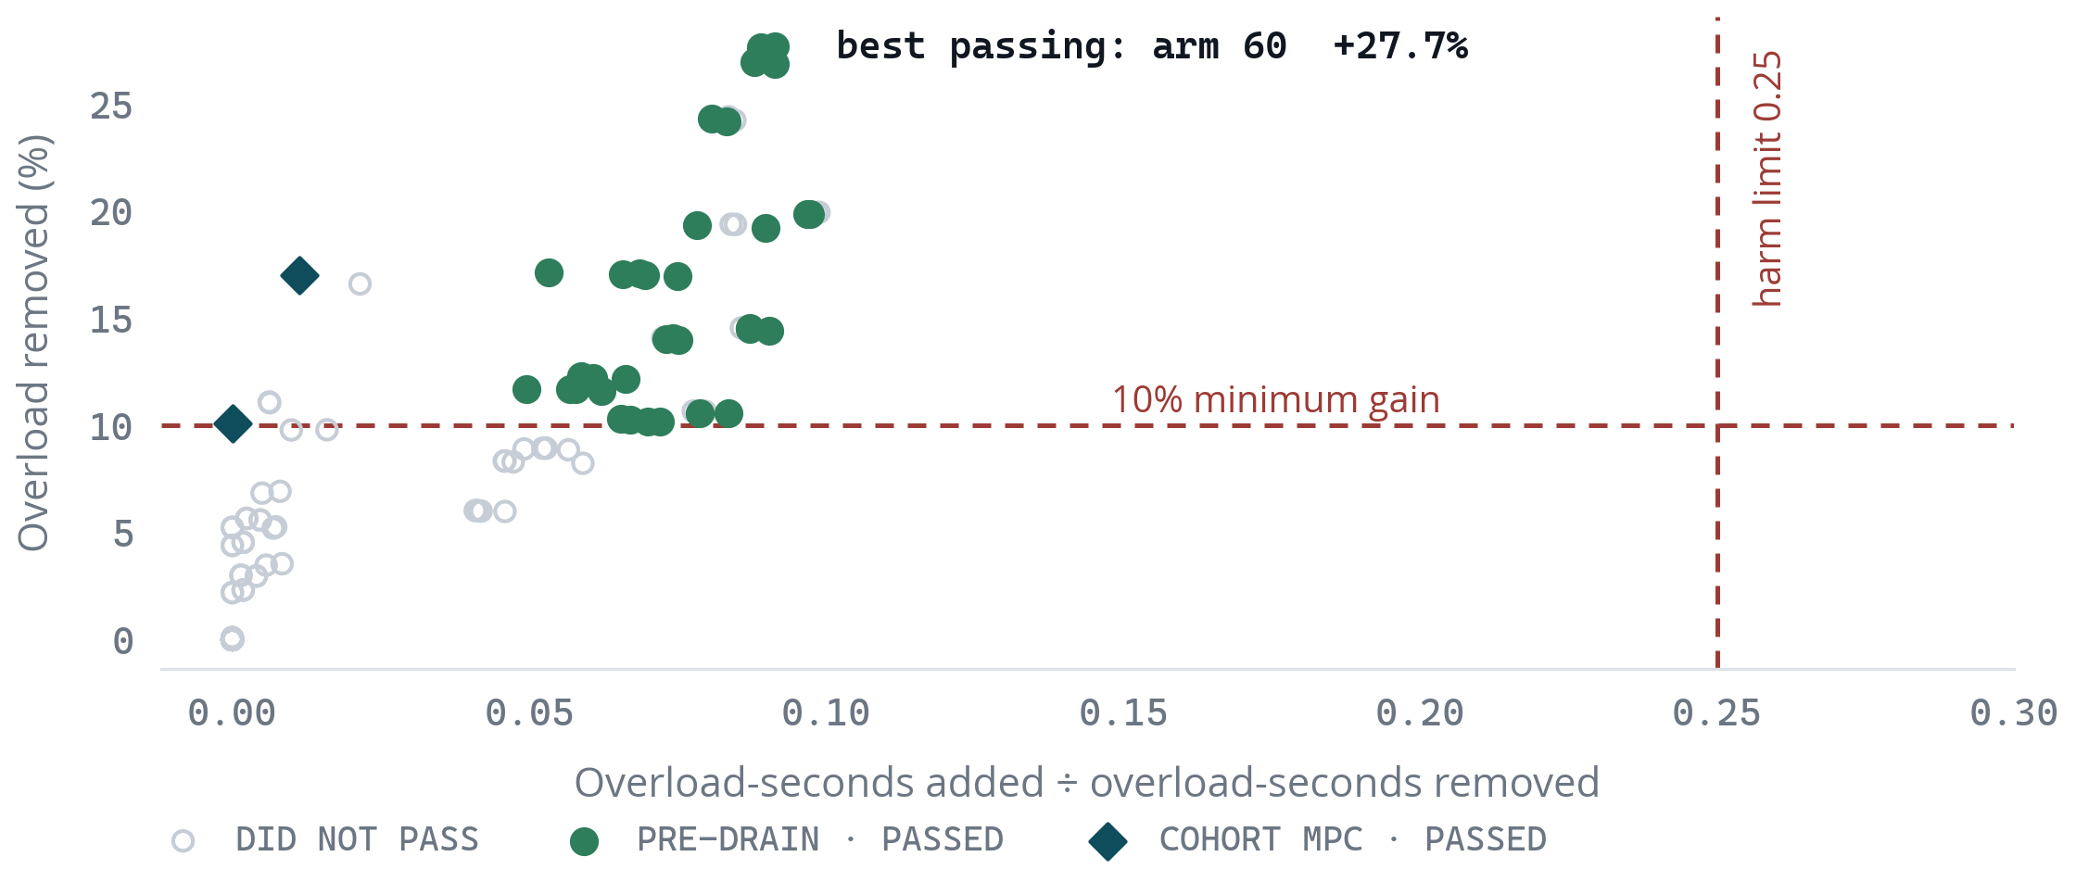
EXPERIMENT 7 · DISCOVERY
160 configurations, 20 000 paired simulated days
Every configuration is one point. To pass it must clear a 10% minimum gain and add no more than a quarter of the overload it removes — plus nine further checks.
36 of 160 cleared every check
against 0 of 160 in the earlier campaign, on the same simulator and the same 24-hour scenarios.
Pre-drain reaches further
the strongest passing configuration removes 27.7% of overload while adding 9% of what it removes.
MPC sits low and left
less gain, but collateral harm near zero — the conservative end of the same frontier.
THE SHAPE OF THE CAMPAIGN
Each configuration ran the same 125 paired days: five stress families x 25 seeds, one per CPU. 20 000 paired 24-hour simulations in total, 160 of 160 arms valid, zero non-finite results.
03 · THE OPTIMIZER
65
Notes:
PLAIN ENGLISH: Each dot is one configuration tested on the same 125 paired days. Thirty-six passed every gate.
SAY: Discovery selects candidates; it is not the headline evidence because selection creates optimism.

Slide 66
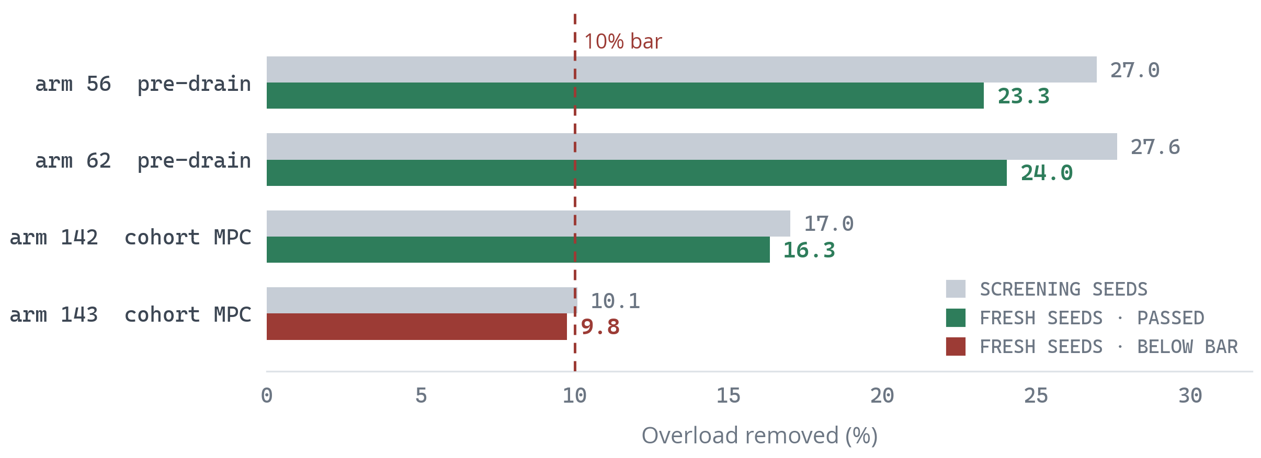
EXPERIMENT 7 · VALIDATION
Frozen candidates, on seeds never inspected
Configurations that look good on the data that chose them are not evidence. The four leaders were frozen by a rule written down in advance — ranked on the lower confidence bound, not the headline — then re-run on a separate seed pool.
Three of four held every gate
arm 143 fell just below the 10% bar at 9.8% and was not promoted.
The drop is 3-4 points, not a collapse
that gap is the selection bias being removed. A candidate that fell apart here would have been a screening artifact; none did.
Seeds are provably disjoint
from the screening pool, from every earlier campaign, and from the protected test set.
WHY THE SECOND POOL EXISTS
1 250 fresh paired days per candidate, 250 per stress family, drawn from seeds 81 000 and above — disjoint from the 80 000-80 124 screening pool, from every earlier campaign, and from the protected test set.
03 · THE OPTIMIZER
66
Notes:
PLAIN ENGLISH: Frozen leaders were tested on seeds never used for selection. Three of four kept every gate.
SAY: The 3–4 point drop is expected selection bias being removed.

Slide 67
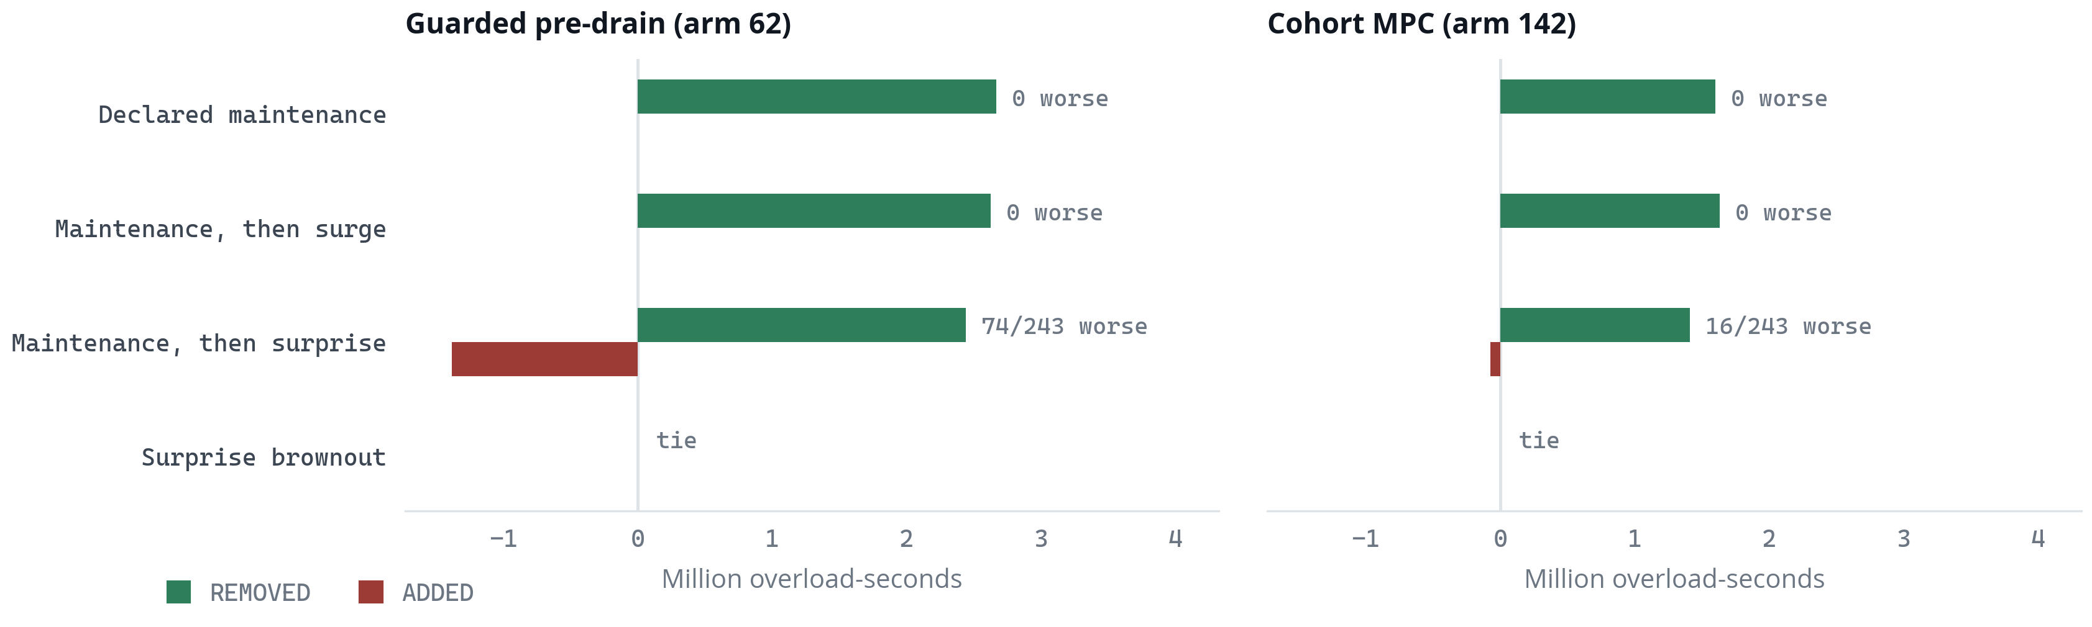
WHERE IT WINS AND WHERE IT LOSES
Three states, not two
A claim that predictive steering is simply better would not survive scrutiny, and it is not what the data says. Bars right of the line are overload removed; bars left are overload the controller added. Both panels share one scale.
Declared loss — wins, never loses
Pure surprise — bit-exact ties
Declared loss, then a surprise — can lose
473 informative pairs, 0 regressions. Median case removes 72% (pre-drain) and 40% (MPC) of uplink overload.
With no declared event the published policy is byte-for-byte identical to the simple rule. Verified, not assumed.
Pre-drain regresses in 74 of 243 pairs; MPC in 16 of 243. Still net positive, but this is the real exposure.
03 · THE OPTIMIZER
67
Notes:
PLAIN ENGLISH: There are three operational states: declared loss, pure surprise and declared loss followed by surprise.
SAY: Predictive wins the first, ties the second, and has residual risk in the third.
DO NOT CLAIM: 0 regressions across all stress families.

Slide 68
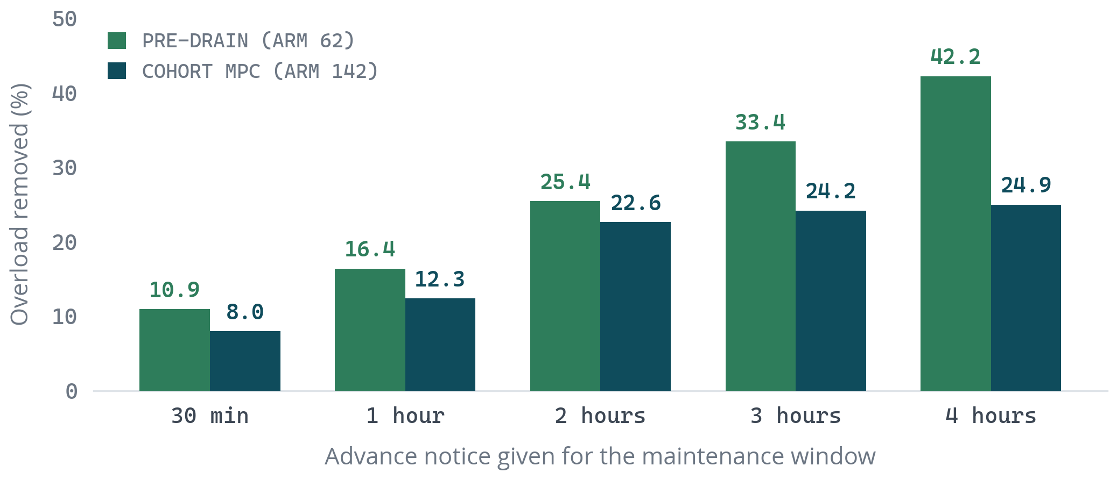
ADVANCE NOTICE
The resource that actually matters
Gain scales with how much warning the maintenance window carries. Notice is a property of the scenario, drawn from its seed, so every configuration faced the same schedule.
Four hours is worth 4x thirty minutes
pre-drain removes 42.2% of overload with four hours' warning and 10.9% with thirty minutes.
MPC saturates around 24%
its two-hour planning horizon cannot exploit three or four hours of notice; pre-drain keeps climbing.
This is a scheduling lever, not a model
the single cheapest way to increase the benefit is to announce maintenance earlier.
WHAT THIS MEANS OPERATIONALLY
Announcing a maintenance window three hours ahead instead of thirty minutes roughly triples the overload the controller can remove. That is a change to scheduling practice, not to any model.
03 · THE OPTIMIZER
68
Notes:
PLAIN ENGLISH: Notice time is a resource. More warning lets long-lived sessions drain naturally before capacity falls.
SAY: Three hours instead of thirty minutes can matter more than changing the model.

Slide 69
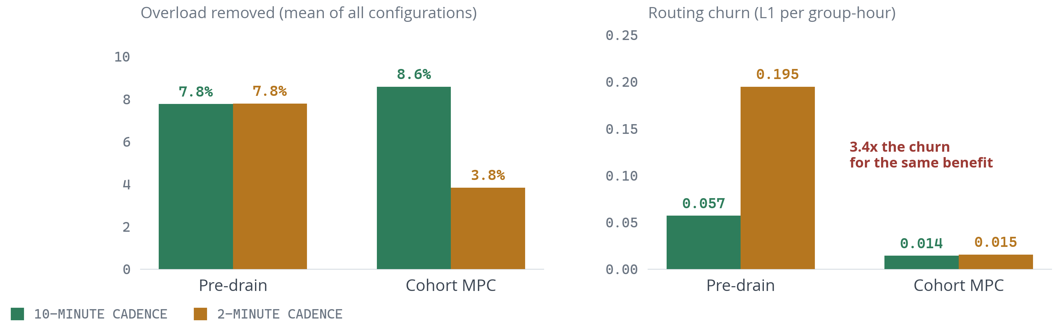
CADENCE
Two minutes buys churn, not benefit
Running the controller every 2 minutes instead of every 10 was tested across all 160 configurations, with the optimisation held to the same size so cadence trades lookahead against reactivity rather than against solver feasibility.
PASSED
Pre-drain · 10 min
26 / 64
Pre-drain · 2 min
8 / 64
Cohort MPC · 10 min
2 / 16
Cohort MPC · 2 min
0 / 16
THE SAME CONFIGURATION, RUN AT BOTH CADENCES
Arm 60 at 10 minutes removes 27.67% of overload with 0.192 churn and passes every check. Arm 124 — identical apart from cadence — removes 27.69% with 0.702 churn and fails on churn alone. Faster control bought two hundredths of a point for 3.7x the routing change.
03 · THE OPTIMIZER
69
Notes:
PLAIN ENGLISH: Solving more often did not materially improve gain, but it changed routing weights much more.
SAY: Two minutes bought 0.02 percentage points for 3.7 times the churn in the matched example.

Slide 70
DECISION
What we recommend running, and why
Static is the reference default. Evaluate guarded pre-drain or cohort MPC in shadow mode for declared maintenance windows only; no live policy publication is authorized.
Static remains the safe default
Outside a declared maintenance window, publish the capacity-proportional static policy. Pure surprises are verified bit-exact ties.
ONE SPECIFIC WARNING
The reactive controller is 98–121% worse than the simple rule on every production measure. “Move traffic away from the busy box” is the most intuitive policy and the worst one we tested. Whatever C-DOT deploys, it should not be that.
Declared events unlock predictive value
On held-out declared-event pairs, predictive steering removes overload without a single regression across 473 informative cases.
MPC is the conservative shadow candidate
Cohort MPC gives up some gain for roughly one tenth of pre-drain's collateral harm and routing churn.
STATIC
+24.0%
0 / 473
DEFAULT
POLICY
HELD-OUT
GAIN
DECLARED-EVENT
REGRESSIONS
Fail closed on uncertainty
Any stale telemetry, invalid plan, solver failure, undeclared event, or uncertain envelope retains the last safe static policy.
03 · THE OPTIMIZER
70
Notes:
PLAIN ENGLISH: Static is the reference default. Predictive candidates are for declared-maintenance shadow evaluation only.
SAY: No live policy publication is authorized.
IF ASKED: MPC is the conservative candidate; pre-drain has higher gain and higher mixed-event exposure.

Slide 71
REAL-WORLD DEPLOYMENT · OPERATING MODEL
Deploy the evidence loop first; earn the right to automate
The production service runs continuously, but a recommendation changes the network only after an independent gate—and initially, an operator—accepts it.
01
OBSERVE
02
CANONICALISE
03
FORECAST
04
OPTIMISE
05
CERTIFY
06
ADVISE / ACT
UPF/SMF counters
health · topology
maintenance notices
map labels → IDs
close 10-min bucket
flag gaps/resets
p50/p90/p95
new-session demand
10–80 min horizons
weights by scope
Static comparison
constraints + churn
freshness · capacity
eligibility · latency
solver + policy hash
operator console
versioned API + TTL
verify or rollback
NEXT CLOSED BUCKET → compare predicted vs realised load, requested vs realised shares, benefit vs Static, and any fallback; update coverage/drift monitors—not the protected release result.
1 · SHADOW
2 · SUPERVISED CANARY
3 · BOUNDED AUTOMATION
No network write
Human approval + bounded scope
Only after production gates
Generate signed JSON/CSV advisories, replay against recorded telemetry and score the counterfactual against Static.
Apply to one agreed TAC/DNN or maintenance window, cap the weight change, set a TTL, verify the read-back and keep one-click rollback.
Automatic apply requires confirmed IDs/semantics, calibrated envelopes, authenticated compare-and-swap, proven rollback, coverage/drift alarms and an audit trail.
Production principle: advisory by default; actuation is a separately authorised capability.
03 · THE OPTIMIZER
ADR-011/012/019/024 · C-DOT first-drop advisory
71
Notes:
SAY: The service may run every ten minutes from day one, but production write authority is a separate capability. Start with signed advisories and counterfactual scoring, then a supervised canary with TTL/read-back/rollback, and automate only after C-DOT confirms identifiers, policy semantics and capacity envelopes.

Slide 72
REAL-WORLD DEPLOYMENT · 10-MINUTE ADVISORY
Publish weights with a risk envelope—not a naked recommendation
Risk is a vector of measurable quantities, not one opaque confidence score. The operator sees expected benefit, tail exposure, uncertainty, churn and data quality before choosing APPLY, HOLD or ROLLBACK.
ADVISORY PACKET · EVERY 10 MINUTES
TAIL HEADROOM
min_u (C_u - L_u[p95]) / C_u
BENEFIT VS STATIC
risk(static) − risk(advisory)
IDENTITY
issued_at · target window · valid_until/TTL
telemetry watermark · model/policy hashes
How much capacity remains if demand reaches its p95 upper bound.
Same-state reduction in overload severity; negative means the advisory is worse.
ACTION
scope (TAC/DNN/slice) · current weights
recommended weights · maximum allowed change
FORECAST WIDTH
(p95 - p50) / max(p50, eps)
POLICY CHURN
0.5 Sum_g,u |w_new - w_current|
A dimensionless uncertainty band; wide forecasts demand more caution.
How much routing changes. Limit both total churn and the largest group shift.
RISK VECTOR
p50/p90/p95 load · p95 headroom
benefit vs Static · churn · quality flags
DECISION
RECOMMEND / HOLD / ROLLBACK
reason codes · approvals · read-back status
DATA / MODEL HEALTH
age · missing · resets · coverage · drift
REVERSIBILITY
TTL · read-back · rollback verified
Publish components and reason codes; never hide them inside one score.
An action is safer when it expires, can be verified, and can be reversed quickly.
CURRENT FIRST DROP → RED / HOLD: mapping and SMF semantics unconfirmed; capacities uncalibrated; new-session arrivals absent.
GREEN · RECOMMEND
AMBER · APPROVE
RED · HOLD / ROLLBACK
fresh + feasible + positive p95 headroom
narrow margin or high churn; canary only
stale, invalid, unconfirmed or worse than Static
03 · THE OPTIMIZER
advisory.json · ADR-009/011/024
72
Notes:
SAY: Do not compress risk into one confidence percentage. Publish tail headroom, same-state benefit over Static, forecast width, policy churn, data/model health and reversibility. The existing first C-DOT drop is a useful RED/HOLD example because the identity mapping, capacity values, session arrivals and SMF semantics are not yet production-safe.

Slide 73
NEXT STEPS
The optimizer
GET A BETTER LEVER
CHANGE THE METHOD, NOT THE NUMBERS
Settle the session-migration question with C-DOT
Limit commitments under uncertainty
The oracle shows that moving just 10% of live sessions per 10 minutes removes all overload. If the system can do it, model its cost. If not, publish the ceiling honestly and stop optimising against it.
Instead of another blend percentage, give the controller an explicit uncertainty budget it may not exceed.
Validate against a full simulated day
Not just “is this step better” but “does this whole plan still beat the simple rule”, including forecast error.
Add capacity as an action
Spinning up another box is a fundamentally different lever from redistributing existing ones. The simulator already supports it.
Do nothing when nothing is wrong
The controller sometimes accepts a small uplink loss for a large downlink gain on days with no uplink problem. It should decline.
Reversible placements
Short-lived allocations that can be revised before they turn into hours of committed load.
Design to the decision deadline
Treat 500 ms as a design constraint from the start, not something measured afterwards.
Reinforcement learning, later
Out of scope until the lever question is settled. An RL agent inherits exactly the same 1.6% of movable traffic.
03 · THE OPTIMIZER
73
Notes:
PLAIN ENGLISH: We decide the success rules before looking at protected results and compare controllers on exactly matched days.
SAY: Same seed, same failure, same traffic—only the controller changes.
IF ASKED: Confidence intervals and worst-case days prevent a good average from hiding unsafe cases.

Slide 74
04
CONCLUSION
The system knew when the algorithm wasn't ready
That is the real deliverable. A simulator, a forecaster and an optimizer are ordinary engineering. A test apparatus that can run 588 experiments, produce several genuinely exciting intermediate results, and still refuse to release any of them — that is the hard part.
74

Slide 75
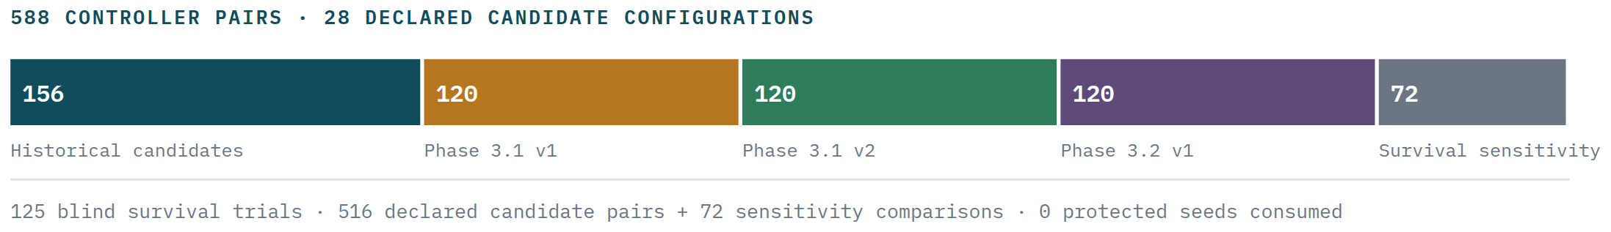
EVERYTHING WE RAN
The complete inventory
25 000
160
36
3 / 4
0
0
PAIRED SIMULATED
DAYS
V4 CONFIGURATIONS
SCREENED
PASSED EVERY
GATE
SURVIVED FRESH-SEED
VALIDATION
PROTECTED TEST
DATA USED
UNSAFE
RELEASES
04 · CONCLUSION
75

Slide 76
CONCLUSION
What is true, stated plainly
The simulator is solid engineering.
Traffic adds up to zero error, memory stays flat as runs get longer, every result is reproducible from a hash, and the final campaign ran 384 jobs on 12 nodes with no failures.
The forecaster and the survival estimator both work.
LightGBM improves every target and catches peaks 27.5% better. The survival estimator gets within 0.42% and survives five unknown distributions. Neither cleared its release bar.
The room to improve is real — but not where we were looking.
The oracle shows new-session steering can remove all overload, but only with advance knowledge of failures, not of demand.
Experiment 7 captured part of it, for declared events only.
After correcting three evaluator defects, 36 of 160 configurations clear every gate and three of four survive fresh-seed validation — but only where capacity loss is announced. Pure surprises remain bit-exact ties.
None of this is calibrated to real C-DOT traffic.
Every record is labelled synthetic. The next real milestone is a telemetry contract and capacity figures from the operator — not another model.
04 · CONCLUSION
76

Slide 77
THE PATH FORWARD
Three questions that unblock everything
01
02
03
Can a running session be moved to another box?
What does C-DOT's telemetry actually look like?
Is uplink overload the right thing to optimise?
Yes turns about 3% movable traffic into a more tractable problem, and makes every controller in this deck worth revisiting. No sets a hard, publishable ceiling on predictive steering — and tells us to spend the effort on capacity instead.
Metric names, scrape interval, counter behaviour, reset semantics, and real per-box capacity. Until we have these, “accuracy on C-DOT traffic” is not something we can measure.
We chose it in advance and stuck to it, which is why these results can be trusted. But it is dominated by single catastrophic outages. Reporting an “avoidable overload” measure alongside it — never instead of it — is the natural next refinement.
04 · CONCLUSION
77
Notes:
PLAIN ENGLISH: Three operator facts matter more than another model iteration: migration capability, telemetry contract and the right operational loss metric.
SAY: The meeting should assign owners to concrete inputs for a shadow replay.

Slide 78
The evidence system worked. That is what we are asking you to trust next.
Every figure in this deck comes from frozen result files in the project: the traffic realism evaluation, the forecaster freeze and baseline comparison, the five-family forecast selection, the three optimizer development campaigns, the survival campaign, the oracle bound evaluation, the MPC campaign results, and the final 12-node production metrics.
Nothing was re-scored to build this presentation, and no protected test data was used. All traffic data is synthetic.
C-DOT · Predictive UPF steering · Evidence review
78

Slide 79
APPENDIX · C-DOT DISCUSSION
Questions you are likely to be asked
Twenty-seven direct answers. Use these slides only when a question comes up; do not present them linearly.
A strong answer has three parts
1
Answer the exact question
2
State the evidence boundary
3
Name the next check
Lead with yes, no, or the measured result.
Synthetic, matched scope, declared event, or open assumption.
What real C-DOT input or shadow test resolves the uncertainty.
If you do not know a C-DOT fact, say so. Convert it into a shadow-pilot input—not a guess.
APPENDIX · PRESENTER SAFETY NET
79

Slide 80
Q&A · 01
Scope and architecture
Q01
What exactly can the controller change?
Only the destination weights for new sessions. It cannot move established sessions in the current contract.
Q02
Why not steer every packet?
UPF selection is a session-level SMF decision. Packet routing is a different control plane and is outside this project.
Q03
Is session migration impossible?
Not proven. It is an open C-DOT architecture question. The simulator currently assumes no migration and publishes that limit.
Answer first · boundary second · next check third
APPENDIX · C-DOT QUESTIONS
80

Slide 81
Q&A · 02
Traffic-model foundations
Q04
Why simulate sessions instead of packets?
The steering lever and congestion memory are session-level. Packet simulation at 16 million users would add cost without answering this decision question.
Q05
Why use Poisson arrivals?
It is a transparent baseline for counts in a short interval. Correlated drift, bursts and events are added separately; operator data should replace the assumptions.
Q06
Why use heavy-tailed session lengths?
Real workloads contain many short sessions and a few very long ones. Those long sessions are precisely why a bad placement remains committed.
Answer first · boundary second · next check third
APPENDIX · C-DOT QUESTIONS
81

Slide 82
Q&A · 03
Traffic realism and data
Q07
Are the UPF capacities real C-DOT values?
No. They are explicit synthetic envelopes. Real throughput and session limits are required before calibration or a shadow pilot.
Q08
How do you know the simulator is internally correct?
Conservation identities, deterministic seeds, distribution re-fitting, population conservation, eligibility checks and memory-scaling tests.
Q09
Why is rural scaled larger than urban?
It is a known synthetic ramp artifact, not a claim about Indian traffic. Real per-area subscriber counts are a priority calibration input.
Answer first · boundary second · next check third
APPENDIX · C-DOT QUESTIONS
82

Slide 83
Q&A · 04
Forecasting
Q10
Why keep ridge if LightGBM is more accurate?
The release rule required every gate. LightGBM improved average accuracy but failed a worst-slice gate; ridge was auditable and its uncertainty coverage was reliable.
Q11
What is a conformal bound?
An empirical safety margin calibrated on past forecast errors. A p90 bound is designed to cover roughly nine out of ten comparable outcomes.
Q12
How do you prevent the model from seeing the future?
Every feature has an availability time. Only closed telemetry buckets available at decision time may enter training or inference.
Answer first · boundary second · next check third
APPENDIX · C-DOT QUESTIONS
83

Slide 84
Q&A · 05
Optimizer mathematics
Q13
What are the optimizer's unknowns?
One non-negative routing weight for each eligible traffic-group/UPF pair, plus explicit slack or activation variables in some formulations.
Q14
What does the objective minimize?
Overload first, then smaller penalties for utilization, delay and policy churn. Safety is also enforced as constraints and checked independently.
Q15
What is the difference between LP and MPC?
The LP optimizes the present step. MPC plans over a horizon, applies only the first decision and re-plans as telemetry changes.
Answer first · boundary second · next check third
APPENDIX · C-DOT QUESTIONS
84

Slide 85
Q&A · 06
Controller evidence
Q16
Why does the oracle remove all overload?
It knows the future event schedule and solves the whole day jointly. It is an upper bound, not a deployable controller.
Q17
Why does pre-drain help planned maintenance?
Advance notice lets it stop adding long-lived sessions to a UPF before capacity falls.
Q18
Why can pre-drain lose under mixed stress?
It may drain sessions onto a UPF that later suffers an unannounced event. Those sessions are then anchored.
Answer first · boundary second · next check third
APPENDIX · C-DOT QUESTIONS
85

Slide 86
Q&A · 07
Experiment 7 and safety
Q19
Why did Experiment 7 reverse the earlier conclusion?
An audit found unit, finite-metric and horizon-sizing defects in the evaluator/scenario machinery. Correcting them made the declared-event benefit measurable.
Q20
Does 0/473 regressions prove universal safety?
No. It covers the informative declared-event pairs in the stated seed pools. Mixed declared-plus-surprise cases still contain regressions.
Q21
What does +24.0% mean?
Held-out reduction in the pre-declared uplink-overload metric versus matched static runs. It is not a throughput increase or a live-network result.
Answer first · boundary second · next check third
APPENDIX · C-DOT QUESTIONS
86

Slide 87
Q&A · 08
Operations and cluster
Q22
Why use 10-minute control instead of two minutes?
Two-minute control produced almost no extra gain and about 3.7 times the routing churn for a matched configuration.
Q23
How does the cluster work scale?
Across independent matched scenario/seed pairs. One simulation is normally one shard; it is not divided across 160 nodes.
Q24
What happens if the solver or telemetry fails?
The independent gate rejects the recommendation and retains the last safe static policy.
Answer first · boundary second · next check third
APPENDIX · C-DOT QUESTIONS
87

Slide 88
Q&A · 09
Deployment challenge questions
Q25
Why not use reinforcement learning?
RL inherits the same limited steering lever and adds validation difficulty. Settle the lever, telemetry and safety contract first.
Q26
What would you need from C-DOT next?
The SMF steering key, maintenance-notice workflow, real UPF safe envelopes and telemetry/reset semantics.
Q27
Are you asking us to deploy this controller?
No. The recommendation is a bounded shadow-advisory replay using real telemetry, with no live policy publication.
Answer first · boundary second · next check third
APPENDIX · C-DOT QUESTIONS
88

