Slide 1
Pratibimb
प्रतिबिंब (reflection)
A metabolic digital twin for Type 2 Diabetes that decides when to test
India-calibrated | Digital Twin Challenge 2026 | Happiest Health
Team SITARAM
Mohan Sriram Kunamsetty (Team Leader), QIS College of Engineering and Technology
Mohana Lakshmi Srija Kunamsetty (Team Member), RISE Krishna Sai College of Engineering and Technology
github.com/SriRamkunamsetty/SITARAM_QISCET
Notes:
Introduce the team, the challenge and the one-line idea: a digital twin that decides when to test.

Slide 2
The problem: silent lows, and CGM is out of reach
~101 million
67% / 73%
~Rs 9,000 / month
people with diabetes in India (ICMR-INDIAB-17, Lancet D&E 2023)
In sulfonylurea-treated adults on CGM, lows were typically nocturnal (67%) and asymptomatic (73%) (Middleton, Diabetes Care 2017)
cost of continuous CGM in India: Rs 4,200-5,250 per 14-day sensor (2026 retail prices)
The question we answer
With only 1-4 test strips a day, WHEN should a patient test so that dangerous lows are predicted before they happen?
Team SITARAM | Pratibimb | Digital Twin Challenge 2026
2
Notes:
Walk through the three numbers, then pose the question: if a patient can afford only a few strips a day, when should they test?

Slide 3
Our idea: a twin that learns, predicts, and decides when to test
1 Learn
2 Predict
3 Decide
A personal physiological model starts from the EHR and an Indian-specific prior, then learns the patient's insulin sensitivity, basal glucose and drug response from every reading.
Forecast glucose with honest uncertainty bands, and the probability of hypoglycaemia (below 70 and below 54 mg/dL) in the coming hours and overnight.
Choose the testing times that tell the twin the most about upcoming lows, and re-plan after every reading. Fewer strips, better warnings.
A classifier gives a number once. A digital twin keeps learning the patient and tells you what to do next.
Team SITARAM | Pratibimb | Digital Twin Challenge 2026
3
Notes:
Three verbs: learn, predict, decide. The third is what other teams do not have.

Slide 4
Healthcare use case: one patient, one day
Enrol
Personalise
Plan
Warn
Audit
Doctor creates the twin from the EHR: age, BMI, waist, HbA1c, fasting glucose, regimen.
Indian endotype prior, then the twin learns from each reading plus the meal and dose log.
Each morning: the most informative testing times for the patient's strip budget.
At bedtime: overnight hypoglycaemia risk with an uncertainty band. Doctor reviews the dose.
Every number traces back to the exact readings and events behind it.
Who benefits
Patients on sulfonylureas without a CGM, and the diabetologists who must decide who needs review tonight, not next month.
Team SITARAM | Pratibimb | Digital Twin Challenge 2026
4
Notes:
Take the five steps in order. Emphasise that the doctor stays in the loop and every number is auditable.

Slide 5
Why this is a digital twin, not just a prediction model
NASEM (2023): a virtual representation that is dynamically updated from its physical twin, has predictive capability, and informs decisions.
NASEM element | Pratibimb
Virtual representation of a specific patient | 10-state glucose, insulin, gut and drug model with 6 patient-specific parameters
Dynamically updated from the physical twin | Particle filter assimilates every reading (fingerstick or CGM)
Predictive capability | Posterior-predictive glucose trajectories and event probabilities
Informs decisions | Active-sensing planner (when to test), overnight risk at bedtime
Two-way data flow | The twin asks the patient to test at 16:30 and updates on the answer
Verification, validation, uncertainty | 29 unit tests, known-truth evaluation, bootstrap CIs, full audit log
Team SITARAM | Pratibimb | Digital Twin Challenge 2026
5
Notes:
Read the NASEM definition, then walk down the table. Each row is something a plain classifier cannot do.

Slide 6
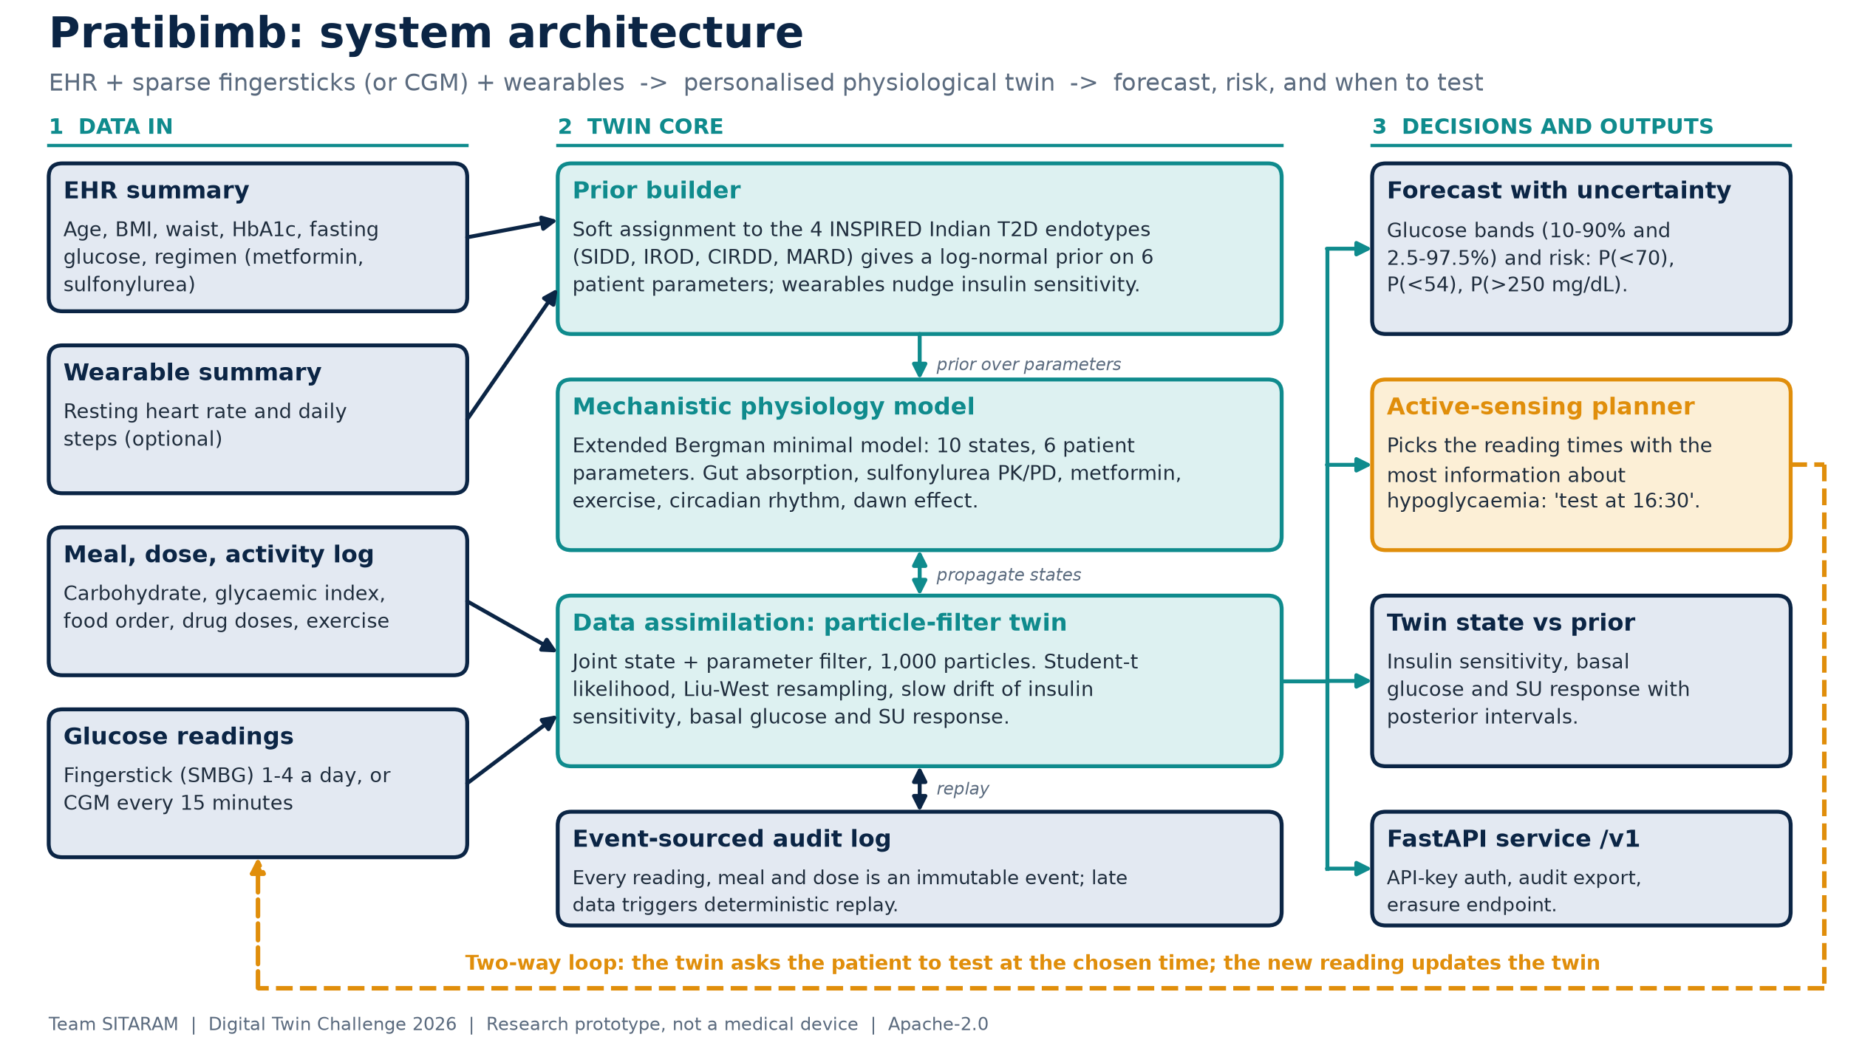
System architecture
Team SITARAM | Pratibimb | Digital Twin Challenge 2026
6
Notes:
Left to right: data in, twin core, decisions out. Point out the amber loop: the twin asks the patient for data.

Slide 7
AI / ML methods: hybrid physiology + probabilistic inference
Component | Method | Why
Mechanistic core | Extended Bergman minimal model: 10 states, 6 patient parameters, RK4 solver | Meaningful parameters; valid what-if simulation
Personalised prior | Soft assignment to 4 INSPIRED endotypes (n = 19,084), log-normal prior; wearables shift insulin sensitivity | Sensible twin on day 1, specific to Indian patients
Learning | Joint state + parameter particle filter, Student-t likelihood, Liu-West resampling, parameter drift | Learns online from sparse noisy data, with full posterior
Prediction | Posterior-predictive ensembles; P(<70), P(<54), P(>250 mg/dL) | Risk with uncertainty, not a point guess
Decision (active sensing) | Bayesian experimental design: greedy mutual information between readings and hypoglycaemia | Picks WHEN to test for the most information per strip
Stack: Python, NumPy (no GPU needed), FastAPI, Pydantic, Docker, GitHub Actions CI (Python 3.11 and 3.12).
Team SITARAM | Pratibimb | Digital Twin Challenge 2026
7
Notes:
Explain that this is deliberately not a black box. Each component is interpretable and carries uncertainty.

Slide 8
How we tested it
Virtual Indian cohort with known ground truth
40 sulfonylurea-treated patients drawn from the INSPIRED endotype mix; 7 evaluation days each; 1,120 risk windows (morning, afternoon, evening, night).
Honest mismatch
The simulator differs from the twin: perturbed constants, daily parameter drift, carbohydrate-counting error, unlogged snacks, missed doses, device noise.
Fair comparison
Same truth, logs, meter noise and seed for every policy; patient-level paired bootstrap.
Testing policies compared
No readings: prior + logs only
Fixed: routine fasting / post-meal schedule
Random: random waking times
Twin-scheduled: information-maximising times, re-planned after every reading
CGM: reading every 15 minutes (reference)
Metric: AUROC and Brier score of P(low) at the start of each window.
Team SITARAM | Pratibimb | Digital Twin Challenge 2026
8
Notes:
Stress that the truth is known, so we can score predictions exactly. Be upfront that this is synthetic data.

Slide 9
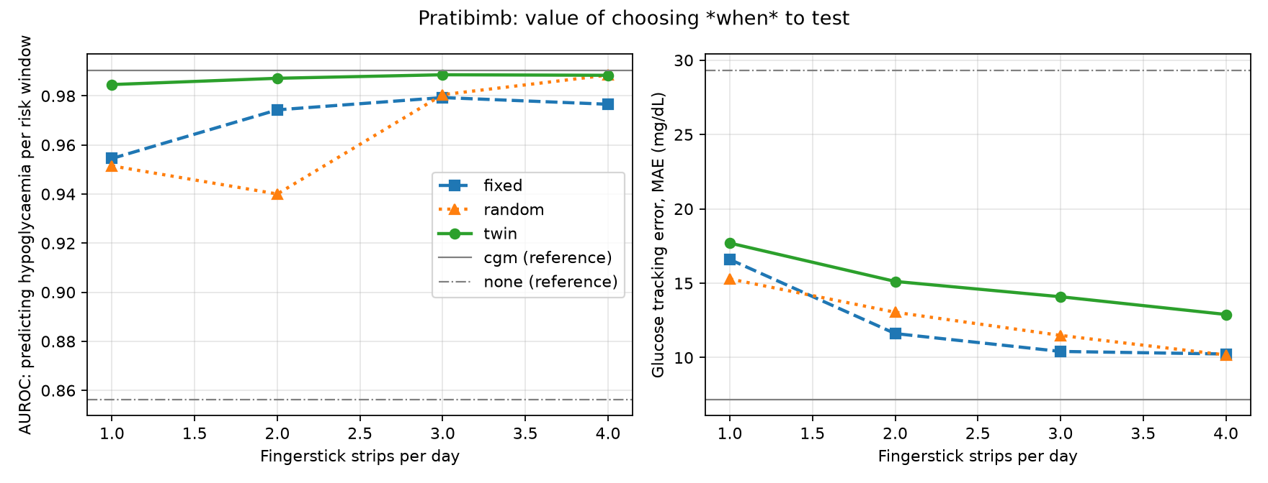
Results: twin-chosen testing predicts lows better with fewer strips
Policy | Strips/day | AUROC | Brier | Sens.
Fixed, budget 1 | 1.0 | 0.954 | 0.0251 | 0.72
Twin, budget 1 | 0.8 | 0.985 | 0.0167 | 0.79
Fixed, budget 2 | 2.0 | 0.974 | 0.0223 | 0.81
Twin, budget 2 | 1.4 | 0.987 | 0.0165 | 0.85
CGM (reference) | 65.0 | 0.990 | 0.0153 | 0.81
No readings | 0.0 | 0.856 | 0.0368 | 0.19
Chart: x-axis is the strip budget; the twin used fewer strips than the budget because it skips readings that would not change the risk estimate.
Brier improvement vs fixed schedule excludes zero at every budget (at 1 strip: +0.008, 95% CI +0.002 to +0.016).
AUROC / Brier: higher AUROC and lower Brier are better. Sens. = sensitivity at P >= 0.2.
Where it does not help
At 3-4 strips a day a random schedule performs about as well as the twin (no significant difference), and general glucose tracking is worse than the fixed schedule because the planner optimises for lows.
Team SITARAM | Pratibimb | Digital Twin Challenge 2026
9
Notes:
Read the table, not just the chart. At one or two strips the twin beats the fixed schedule and uses fewer strips. At three and four strips a random schedule catches up; say so.

Slide 10
What we claim, and what we do not
What the evidence supports
Limitations we state openly
At 1-2 strips a day, twin-chosen times predict hypoglycaemia better than the routine fasting / post-meal schedule.
The twin uses fewer strips: it skips readings that would not change the risk estimate.
With under one strip a day its risk ranking comes close to a CGM's (AUROC 0.985 vs 0.990).
Only 5 of 40 virtual patients had any low (47 windows): small evidence base.
Synthetic data only; the twin and simulator share model structure. Real-data validation is next.
At 3-4 strips a random schedule matches the twin.
General glucose tracking is worse than the fixed schedule (14.1 vs 10.4 mg/dL at budget 3): the planner optimises for lows.
Bottom line: a promising result on synthetic patients. Validation on real patient data decides whether it holds.
Team SITARAM | Pratibimb | Digital Twin Challenge 2026
10
Notes:
This slide protects our credibility. Read the limitations aloud: few events, synthetic data, and the tracking trade-off.

Slide 11
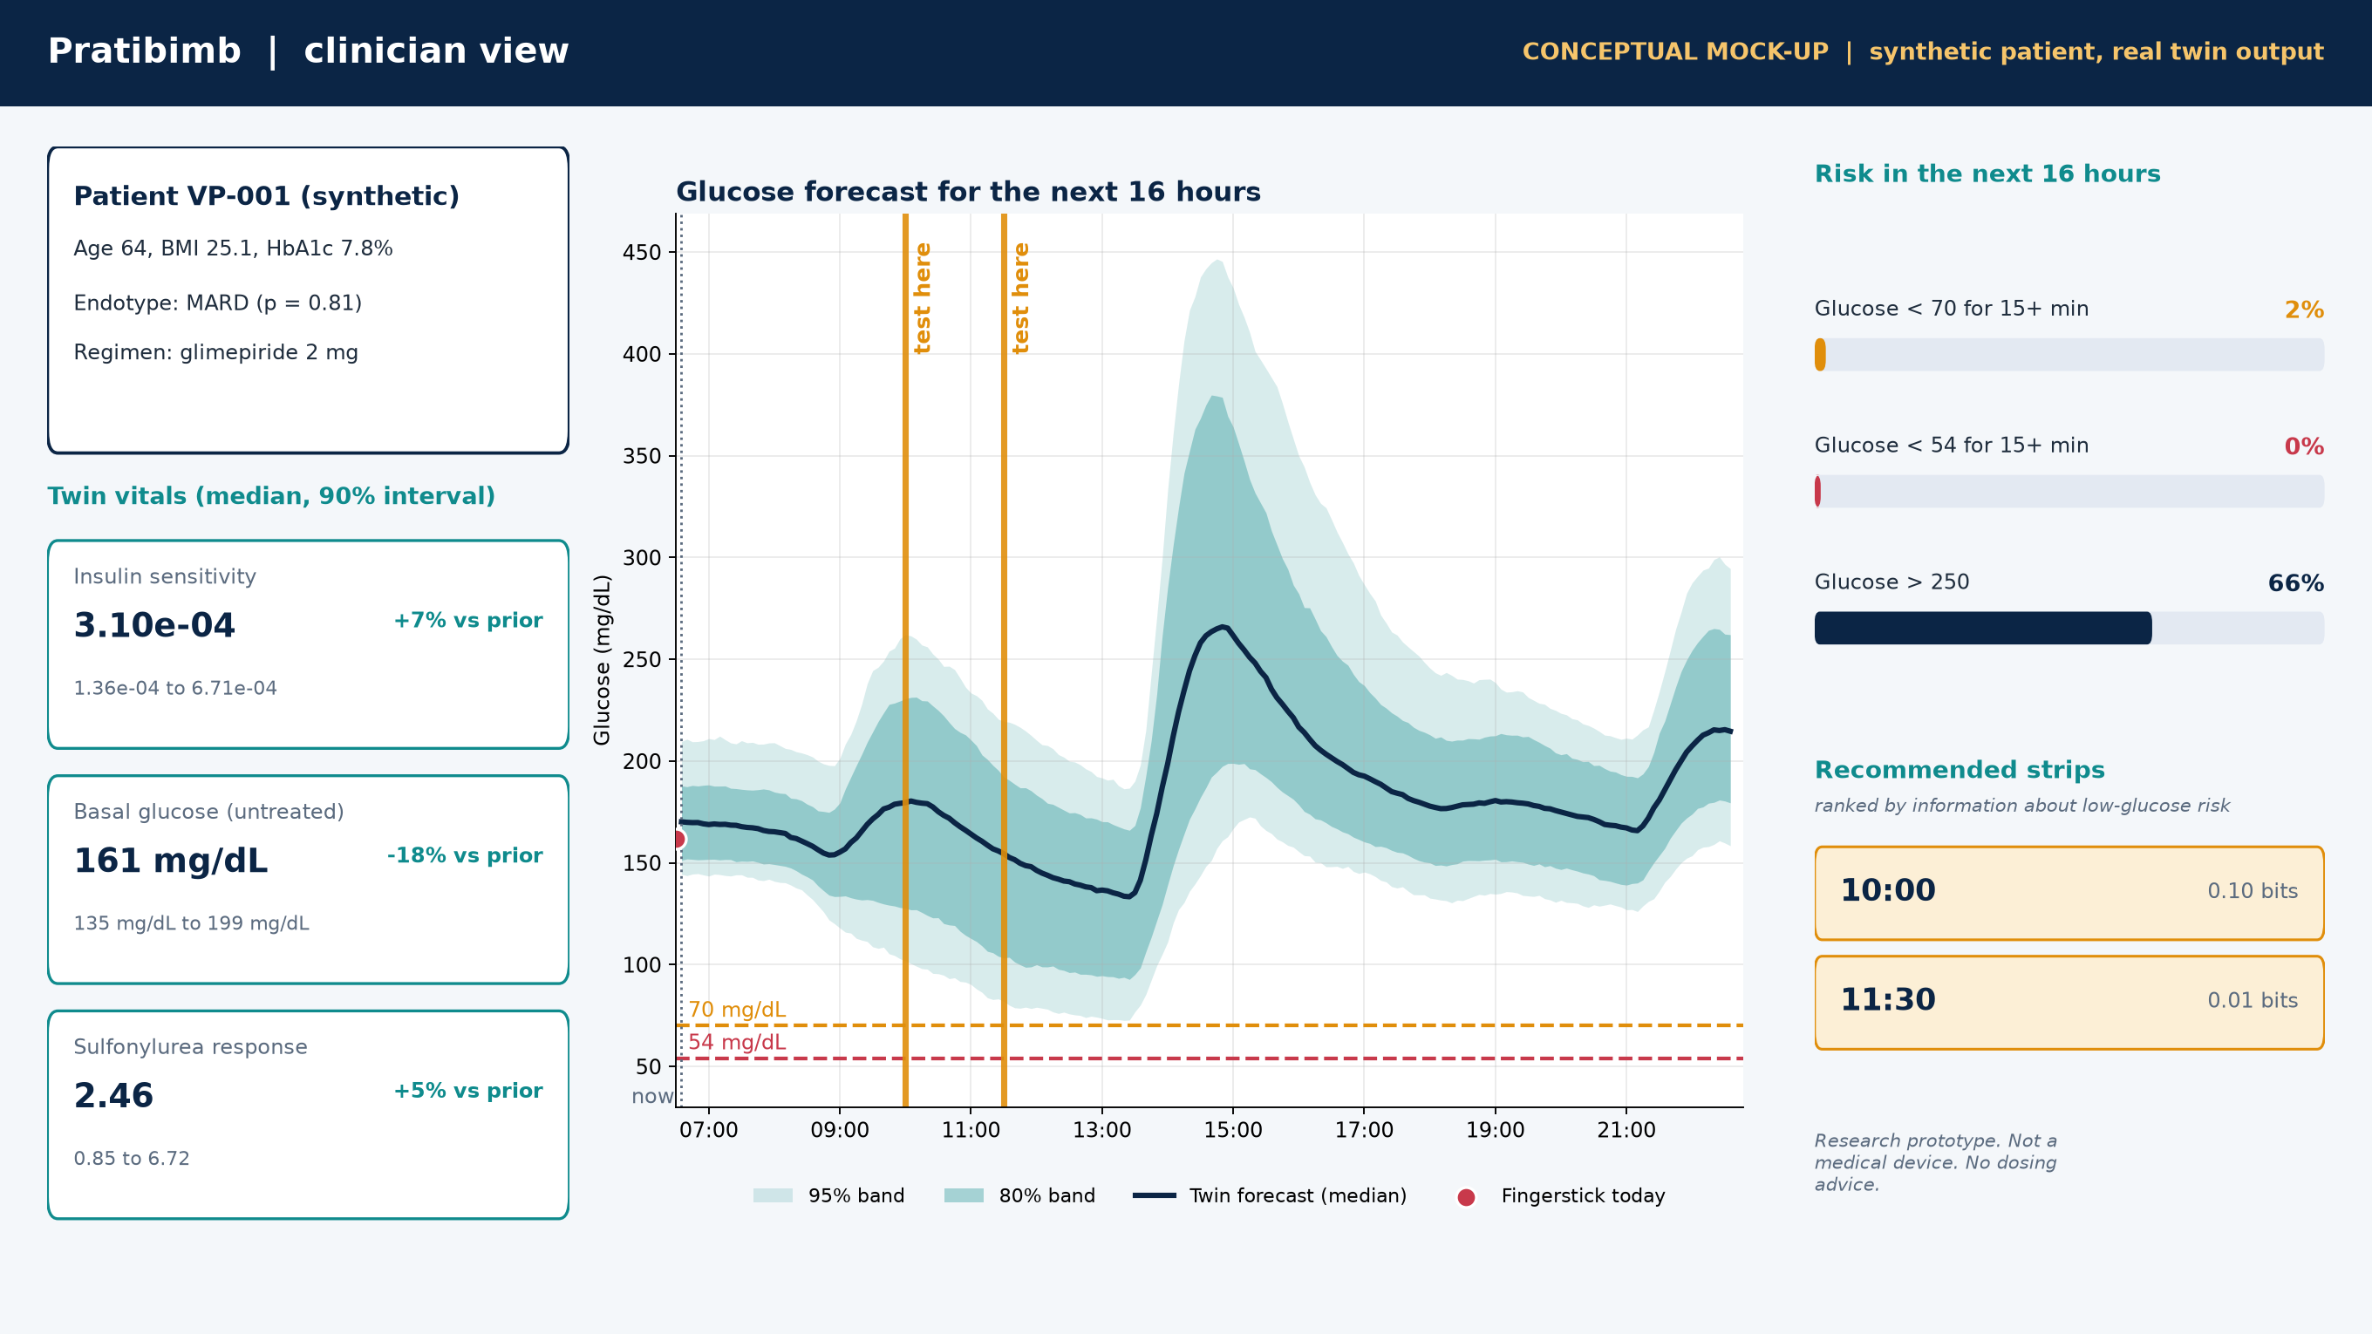
Conceptual clinician dashboard
Team SITARAM | Pratibimb | Digital Twin Challenge 2026
11
Notes:
Walk the doctor's eye path: patient on the left, forecast in the middle with the amber 'test here' markers, risks and strips on the right.

Slide 12
Safety, privacy and regulation by design
No dosing advice
Outputs are forecasts and risk. Every API response carries a research-prototype disclaimer.
Only synthetic and open data
No patient data in the repository; dataset licences documented in DATA.md.
Privacy by design (DPDP Act 2023 / Rules 2025)
No names or identifiers in the profile, erasure endpoint, full audit trail. Consent management is future work.
Regulatory awareness
CDSCO draft guidance on medical device software (21 Oct 2025) would treat a clinical version as SaMD; we make no clinical claims.
Auditability
Event-sourced: replaying the log reproduces every number the twin ever reported.
Team SITARAM | Pratibimb | Digital Twin Challenge 2026
12
Notes:
Say plainly that this is a research prototype and gives no dosing advice. Mention the DPDP and CDSCO points as design direction, not compliance claims.

Slide 13
Next steps and how to run it
Roadmap
Validate on real open data: ShanghaiT2DM, then CGMacros
Conformal calibration of forecast bands
Interactive clinician dashboard (this mock-up is conceptual)
DPP-4 and SGLT2 inhibitor mechanisms; fasting-day (vrat / Ramadan) scenario
ABDM FHIR R4 import of the EHR profile
Run it
uv sync --all-extras
uv run pytest
uv run python scripts/demo_day.py
uv run uvicorn pratibimb.api.app:app
Team SITARAM
Apache-2.0
github.com/SriRamkunamsetty/SITARAM_QISCET
Thank you. Questions?
Team SITARAM | Pratibimb | Digital Twin Challenge 2026
13
Notes:
Close with the roadmap and the repository link. Invite questions.

