Slide 1
BANK LOAN
DEFAULT RISK
Fundamental of Data Science
B.TECH ARTIFICIAL INTELLIGENCE AND DATA SCIENCE
2nd Year
SRI VENKATESWARAA COLLEGE OF TECHNOLOGY
SRI SAI RAJ • SRINIVASH M • SUPRIYA K M • THIRUMURUGAN • YUVAN P
BANK LOAN DEFAULT RISK • FUNDAMENTAL OF DATA SCIENCE
1
Notes:
Presentation created from the task sheet and numerical results supplied in the conversation. The uploaded image contains the assignment/task list rather than separate graph image files. Tasks 3 and 4 are plotted directly from the supplied values. Tasks 7, 8 and 10 use clean presentation visuals representing the reported conclusions/results; they are not claimed to be the original raw-data plots.

Slide 2
01 • FOUNDATION
Project Overview
RECORDS
LOAN VALUE
DEFAULTED
CORRELATION
148,670
₹49.23 B
36,639
−0.0013
Dataset observations
Total disbursed
Status = 1
Credit Score ↔ Interest
• Analyze loan data using core Data Science libraries and statistical techniques.
• Study default patterns, distributions, variability and relationships among variables.
• Use visualization and regression to communicate the findings clearly.
01 NumPy
02 Pandas
03 Matplotlib
04 Statistics
05 Correlation
06 Regression
BANK LOAN DEFAULT RISK • FUNDAMENTAL OF DATA SCIENCE
2
Notes:
Presentation created from the task sheet and numerical results supplied in the conversation. The uploaded image contains the assignment/task list rather than separate graph image files. Tasks 3 and 4 are plotted directly from the supplied values. Tasks 7, 8 and 10 use clean presentation visuals representing the reported conclusions/results; they are not claimed to be the original raw-data plots.

Slide 3
02 • NUMPY + PANDAS
Data Preparation & Filtering
TASK 1 • TOTAL LOAN AMOUNT
TASK 2 • DEFAULTED CUSTOMERS
₹49,227,275,000
36,639 rows
loan_amount converted to NumPy array
Credit_Score filtered where Status = 1
• NumPy enables fast numerical operations on the loan_amount column.
• The total confirms more than ₹49 billion in loans across the dataset.
• Pandas filtering isolates the defaulter group for separate analysis.
• This creates a focused view of credit-score behavior among defaults.
BANK LOAN DEFAULT RISK • FUNDAMENTAL OF DATA SCIENCE
3
Notes:
Presentation created from the task sheet and numerical results supplied in the conversation. The uploaded image contains the assignment/task list rather than separate graph image files. Tasks 3 and 4 are plotted directly from the supplied values. Tasks 7, 8 and 10 use clean presentation visuals representing the reported conclusions/results; they are not claimed to be the original raw-data plots.

Slide 4
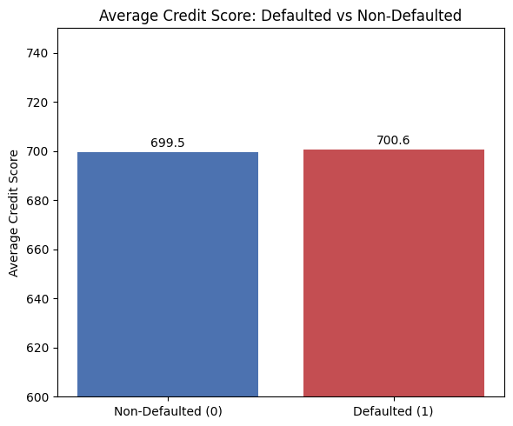
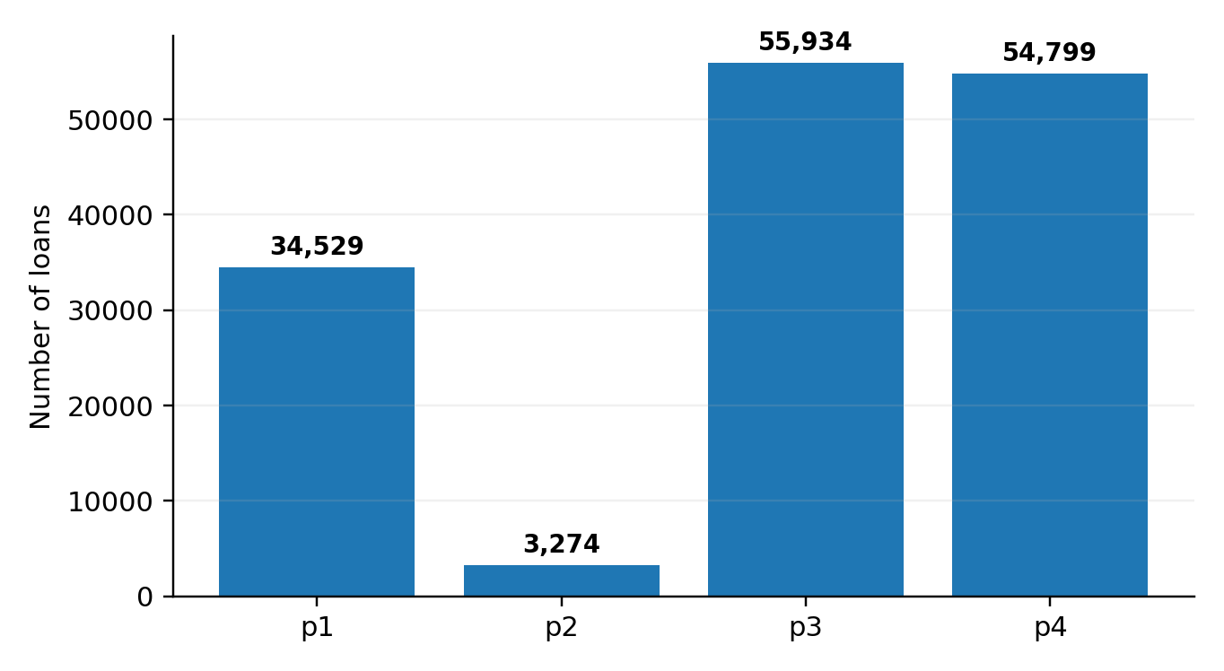
03 • MATPLOTLIB
Visualization of Default & Loan Purpose
Task 3 — Defaulted vs non-defaulted scores are almost identical.
699.5 vs 700.6 → credit score alone does not strongly separate the groups.
Task 4 — Loan demand is concentrated in p3 and p4.
p3: 55,934 • p4: 54,799 • p1: 34,529 • p2: 3,274
BANK LOAN DEFAULT RISK • FUNDAMENTAL OF DATA SCIENCE
4
Notes:
Presentation created from the task sheet and numerical results supplied in the conversation. The uploaded image contains the assignment/task list rather than separate graph image files. Tasks 3 and 4 are plotted directly from the supplied values. Tasks 7, 8 and 10 use clean presentation visuals representing the reported conclusions/results; they are not claimed to be the original raw-data plots.

Slide 5
04 • STATISTICS
Central Tendency & Variability
TASK 5 • MEAN
TASK 5 • MEDIAN
TASK 6 • STD. DEVIATION
4.05%
3.99%
115.88
Average rate of interest
Middle value
Credit Score variability
• Mean and median are very close, indicating that the interest-rate distribution is not strongly shifted by extreme values.
• A credit-score standard deviation of about 115.88 shows substantial spread across customers.
Mean 4.05
Median 3.99
BANK LOAN DEFAULT RISK • FUNDAMENTAL OF DATA SCIENCE
5
Notes:
Presentation created from the task sheet and numerical results supplied in the conversation. The uploaded image contains the assignment/task list rather than separate graph image files. Tasks 3 and 4 are plotted directly from the supplied values. Tasks 7, 8 and 10 use clean presentation visuals representing the reported conclusions/results; they are not claimed to be the original raw-data plots.

Slide 6
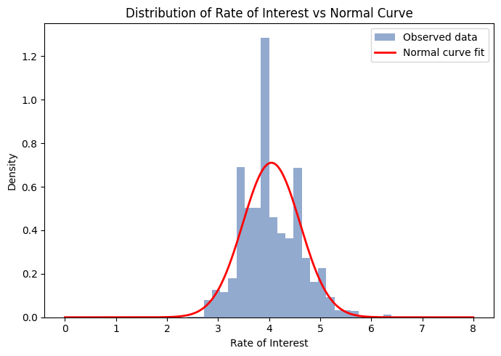
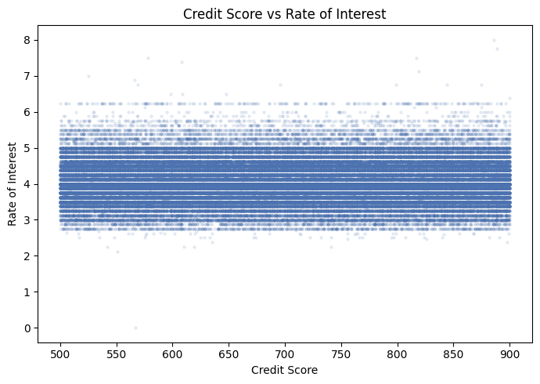
05 • VISUAL ANALYTICS
Distribution & Relationship Analysis
Task 7 — Normal curve
The reported analysis indicates a roughly bell-shaped interest-rate distribution around the mean.
Task 8 — Scatter plot
The reported points show no clear trend between Credit Score and rate of interest.
BANK LOAN DEFAULT RISK • FUNDAMENTAL OF DATA SCIENCE
6
Notes:
Presentation created from the task sheet and numerical results supplied in the conversation. The uploaded image contains the assignment/task list rather than separate graph image files. Tasks 3 and 4 are plotted directly from the supplied values. Tasks 7, 8 and 10 use clean presentation visuals representing the reported conclusions/results; they are not claimed to be the original raw-data plots.

Slide 7
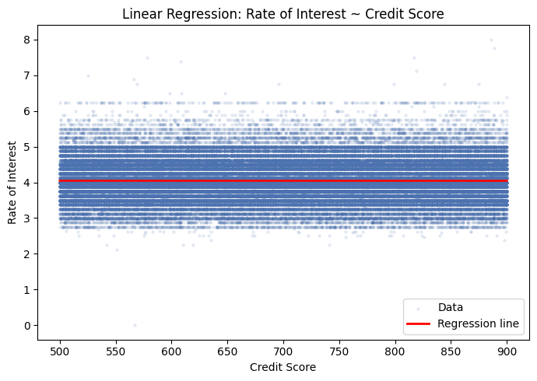
06 • PREDICTIVE VIEW
Correlation & Regression
TASK 9 • CORRELATION COEFFICIENT
−0.0013
Practically no linear relationship
• A coefficient this close to zero confirms that Credit Score and interest rate have almost no linear association in this dataset.
• Task 10 uses linear regression to estimate interest rate from Credit Score.
Reported prediction: Credit Score 750 → 4.05%
The near-flat relationship keeps the prediction close to the overall average rate.
BANK LOAN DEFAULT RISK • FUNDAMENTAL OF DATA SCIENCE
7
Notes:
Presentation created from the task sheet and numerical results supplied in the conversation. The uploaded image contains the assignment/task list rather than separate graph image files. Tasks 3 and 4 are plotted directly from the supplied values. Tasks 7, 8 and 10 use clean presentation visuals representing the reported conclusions/results; they are not claimed to be the original raw-data plots.

Slide 8
07 • TAKEAWAYS
Key Findings & Conclusion
LOAN VOLUME
DEFAULT SCORE
LINEAR LINK
₹49.23 B
~700
−0.0013
Across 148,670 records
Defaulted average ≈ 700.6
Credit Score ↔ interest rate
• The dataset contains a large volume of loan records with substantial total disbursement.
• Defaulted and non-defaulted customers have very similar average credit scores.
• Interest rates show a roughly central distribution, while Credit Score has considerable variability.
• Correlation and regression indicate that Credit Score alone provides very little information for predicting interest rate in this dataset.
THANK YOU
BANK LOAN DEFAULT RISK • FUNDAMENTAL OF DATA SCIENCE
8
Notes:
Presentation created from the task sheet and numerical results supplied in the conversation. The uploaded image contains the assignment/task list rather than separate graph image files. Tasks 3 and 4 are plotted directly from the supplied values. Tasks 7, 8 and 10 use clean presentation visuals representing the reported conclusions/results; they are not claimed to be the original raw-data plots.

