Slide 1


Discovering Linux Commands
Welcome to the world of Linux commands! In this presentation, we'll learn basic commands, file handling, process utilities, disk utilities, and more to unlock the true potential of Linux.

Slide 2
Basic Linux Commands 📝
cd
ls
Change the current directory to the specified one
List all the files and directories in the current directory
mkdir
rm
Create a new directory with the specified name
Remove a file or directory

Slide 3
File Handling Utilities 📁
1
cp
Copy one or more files to a different directory or rename them
mv
2
Move one or more files to a different directory or rename them
3
cat
Read, combine, and write files
head/tail
4
Print the first or last few lines of a file

Slide 4



Security by File Permissions 🔒
Ownership
File Permissions
Encryption
Set user and group ownership for files and directories
Restrict access to files and directories with chmod
Secure files and directories using encryption methods

Slide 5
Process Utilities 🛠
1
ps
List running processes with their status, resource usage, and owner information
kill
2
Terminate a running process using its process ID
3
jobs
List active jobs and their status

Slide 6
Disk Utilities 💾
df
du
mount
Display disk free space information
Estimate file space usage
Create a filesystem mount-point for a block device or remote filesystem

Slide 7
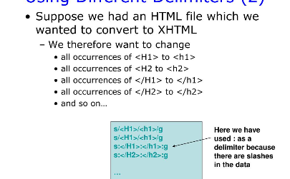

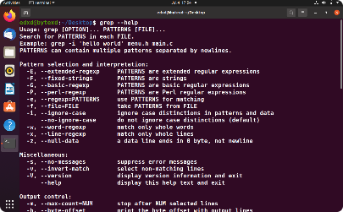
Sed, Awk, and Grep 🔍
Sed - Stream Editor
Awk - Text Processing
Grep - Search Text
Modify text files in-place or on the fly using pattern matching, substitution, and other commands
Search for specified patterns in one or more files or streams, displaying matching lines as output
Parse and transform text files using conditional statements, loops, and regular expressions

Slide 8

Wrap Up
Hopefully, this presentation has given you a good idea of the power of Linux commands. With these commands, you can automate repetitive tasks, speed up your workflow, and generally make your life a lot easier. Happy command line hacking!

