Slide 1
BLUESTOCK FINTECH | DATA ANALYST INTERNSHIP — COHORT 2026
Mutual Fund
Analytics Capstone
End-to-End Data Science: ETL • EDA • Analytics • Dashboard • Deployment
Sri Satya Thanuj Vummidi
June 2026
Fintech Division
github.com/Thanuj64
Author
Date
Division
GitHub
Notes:
Welcome. 7-day Bluestock Fintech Mutual Fund Analytics Capstone. Covers full data science lifecycle from ETL to dashboard and advanced analytics including all 5 bonus tasks.

Slide 2
SLIDE 2 OF 12
Problem Statement & Objective
What challenge does this project solve?
THE PROBLEM
OUR SOLUTION
Indian MF industry manages Rs.39T+ AUM — but analytics infrastructure is fragmented
Fund performance data spread across disparate sources with no unified view
Investors lack risk-adjusted comparison tools (Sharpe, Sortino, Alpha)
SIP continuity rates are poor — 97.8% of investors show irregular gaps
No real-time monitoring or automated reporting pipeline exists
End-to-end ETL pipeline: 10 datasets into SQLite star schema
Comprehensive EDA with 9 interactive visualisations
7 quantitative metrics: CAGR, Sharpe, Sortino, Alpha, Beta, Drawdown, Scorecard
4-page Power BI dashboard with full Bluestock branding
5 bonus features: Live ETL, Streamlit App, Monte Carlo, Efficient Frontier, Email Reports
Bluestock Fintech | Mutual Fund Analytics Capstone 2026
2 / 12
Notes:
Core problem: booming Indian MF industry lacks integrated analytics. This project builds that infrastructure from scratch.

Slide 3
SLIDE 3 OF 12
Data Sources
10 structured datasets covering the full MF ecosystem
01
Fund Master
06
Folio Count
40 schemes, 15 attributes
21 industry trend points
02
NAV History
07
Scheme Performance
46,000 daily NAV records
40 pre-computed metrics
03
AUM by Fund House
08
Investor Transactions
90 quarterly snapshots
32,778 buy/sell/SIP rows
04
Monthly SIP Inflows
09
Portfolio Holdings
48 months of SIP data
322 sector weight records
05
Category Inflows
10
Benchmark Indices
144 category-month rows
8,050 NIFTY 100 closes
46K+
32.8K
4 Yrs
10 AMCs
NAV Records
Transactions
Date Range
Fund Houses
Bluestock Fintech | Mutual Fund Analytics Capstone 2026
3 / 12
Notes:
10 CSV files spanning Jan 2022 to May 2026. Perfect AMFI code alignment between fund_master and nav_history (40 of 40 codes matched).

Slide 4
SLIDE 4 OF 12
System Architecture
Extract → Transform → Load → Analyse → Visualise → Deploy
RAW DATA
ETL
SQLITE DB
ANALYTICS
DASHBOARD
WEB APP
10 CSV Files
01-10_*.csv
etl_pipeline.py
Transform+Clean
Star Schema
2 dims + 8 facts
compute_metrics.py
7 Metrics
Power BI
4 Pages
Streamlit
b2_streamlit_app.py
→
→
→
→
→
BONUS LAYER
B1: Cron ETL (mfapi.in)
B2: Streamlit App
B3: Monte Carlo GBM
B4: Efficient Frontier
B5: Email Reports
Bluestock Fintech | Mutual Fund Analytics Capstone 2026
4 / 12
Notes:
Fully modular pipeline — each layer runs independently. Bonus layer adds production-grade capabilities: live data ingestion, web deployment, Monte Carlo simulation, and automated email reporting.

Slide 5
SLIDE 5 OF 12
EDA Highlights — Industry Overview
AUM growth, SIP trends, and fund universe composition
31.46%
Rs.39T
13.26Cr
Avg YoY SIP Growth
Total Industry AUM
Folios (Jan 2022)
Bluestock Fintech | Mutual Fund Analytics Capstone 2026
5 / 12
Notes:
SBI MF leads with Rs.8.5M crore AUM. SIP inflows grew 31.46% YoY average. Large Cap equity dominates with 14 of 40 schemes.

Slide 6
SLIDE 6 OF 12
EDA Highlights — Investor Behaviour
Demographics, transaction patterns, and geographic distribution
58.49%
Punjab & TN
32,778
97.8%
Lumpsum dominates
Top investing states
Total transactions
SIP investors at risk
transaction mix
Rs.0.32bn each
investor records
gap > 35 days
Bluestock Fintech | Mutual Fund Analytics Capstone 2026
6 / 12
Notes:
Critical: 97.8% of SIP investors have irregular gaps >35 days. Biggest retention opportunity. Age group investment is remarkably uniform across all segments.

Slide 7
SLIDE 7 OF 12
Performance Metrics — Returns & Risk
CAGR, Sharpe, Sortino computed for all 40 funds
36.07%
1.42
2.34
0.307
Best 3yr CAGR
Best Sharpe
Best Sortino
Best Alpha/day
Bluestock Fintech | Mutual Fund Analytics Capstone 2026
7 / 12
Notes:
Mid-Cap equity funds dominate all performance metrics. Best Sharpe of 1.42 is exceptional — anything above 1.0 indicates superior risk-adjusted performance. Risk-free rate: 6.5% (RBI repo rate proxy).

Slide 8
SLIDE 8 OF 12
Performance Metrics — Drawdown & Scorecard
Risk management and composite fund ranking
Rank | Fund | Score | 3yr CAGR | Sharpe
#1 | ICICI Pru Midcap | 80.60 | 30.21% | 1.21
#2 | Axis Midcap Fund | 80.50 | 25.66% | 1.28
#3 | Mirae Large Cap | 75.40 | 27.73% | 1.08
#4 | HDFC Mid-Cap | 73.70 | 25.66% | 1.05
#5 | DSP Small Cap | 73.70 | 33.63% | 1.11
Insight: Small-cap funds deliver highest CAGR but carry extreme drawdown risk (up to -52.57%). Mid-cap funds offer the best risk-adjusted trade-off. Composite scorecard weights: CAGR 30% | Sharpe 25% | Alpha 20% | Expense Ratio 15% | Drawdown 10%
Bluestock Fintech | Mutual Fund Analytics Capstone 2026
8 / 12
Notes:
The composite scorecard enables objective cross-category fund selection. ICICI Pru Midcap tops the ranking with score 80.60. Scorecard weights reflect industry best practice for retail fund selection.

Slide 9
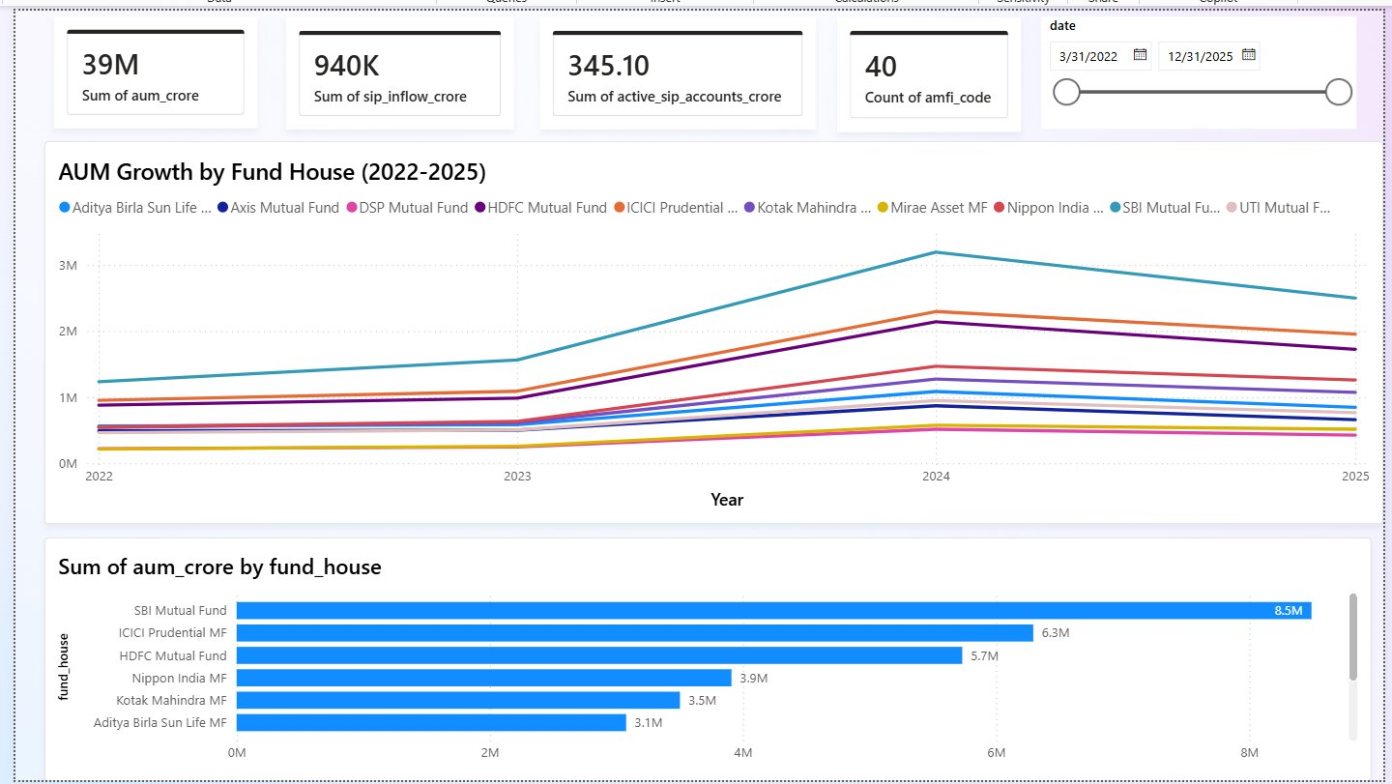
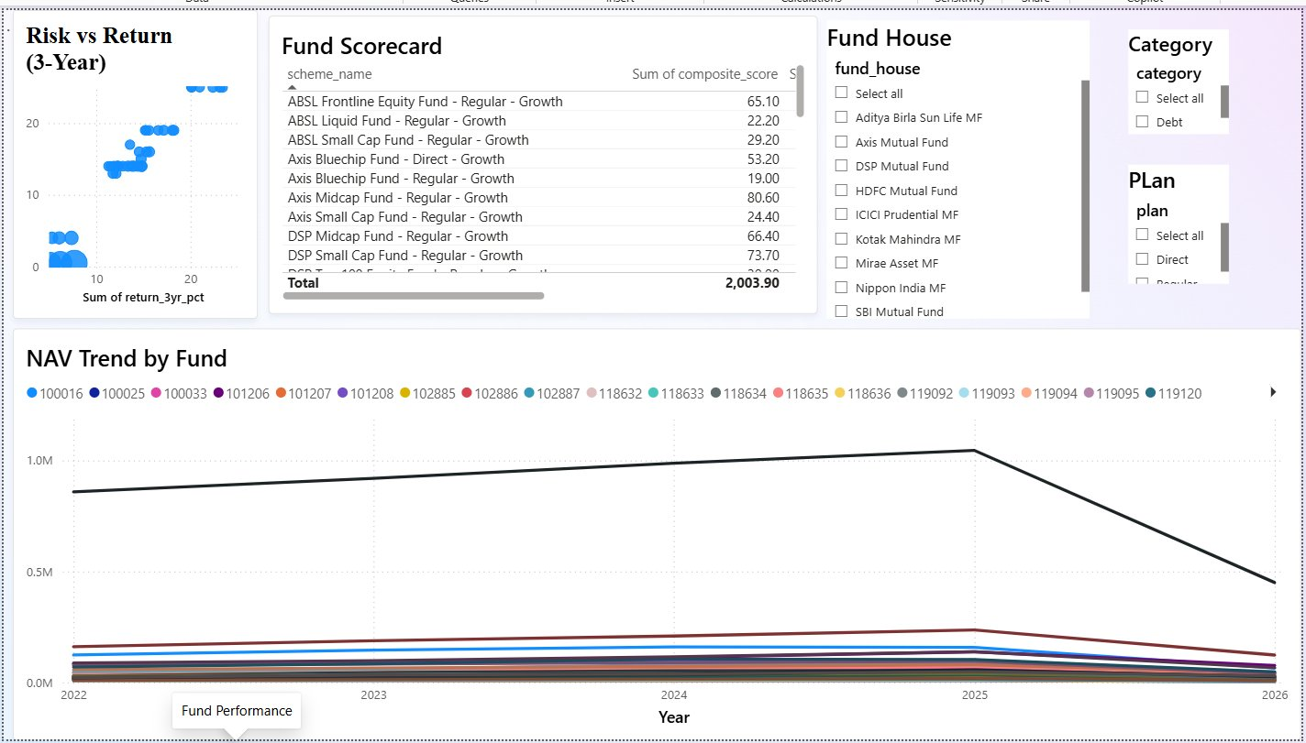
SLIDE 9 OF 12
Power BI Dashboard
Pages 1 & 2: Industry Overview + Fund Performance
Page 1: Industry Overview — KPIs, AUM growth, SIP bar chart
Page 2: Fund Performance — Risk/Return scatter, Scorecard table, NAV Trend 2022-2026
Bluestock brand theme (#0A1628 + #00D4FF)
4-page drill-through navigation
Dynamic slicers: Date Range, Fund House, Category, Plan (Regular/Direct)
Bluestock Fintech | Mutual Fund Analytics Capstone 2026
9 / 12
Notes:
The Power BI dashboard is the flagship deliverable. Page 1 is the industry-wide view; Page 2 provides fund-level drill-down with custom tooltips.

Slide 10
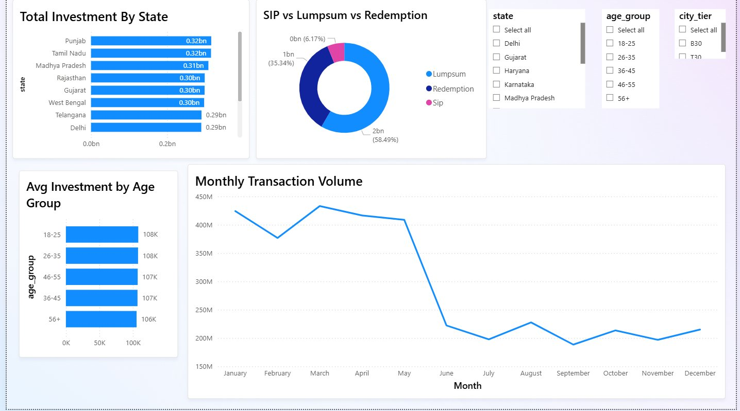
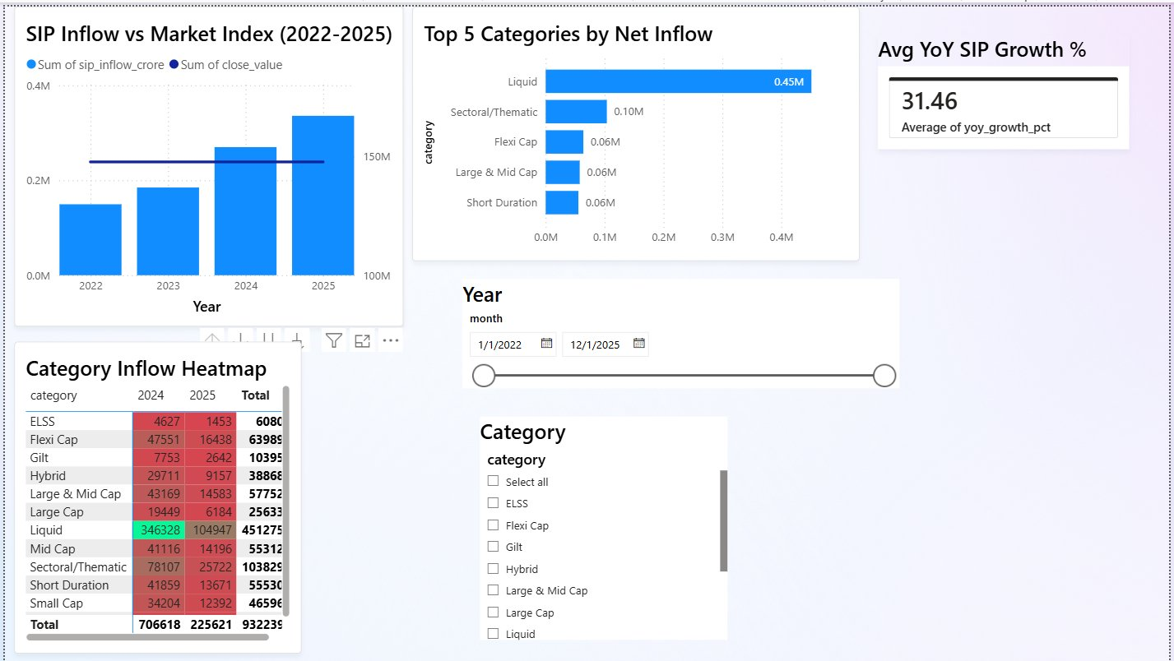
SLIDE 10 OF 12
Power BI Dashboard
Pages 3 & 4: Investor Analytics + SIP & Market Trends
Page 3: Investor Analytics — State-wise, SIP vs Lumpsum donut, Monthly volume
Page 4: SIP & Market Trends — Category heatmap, YoY growth 31.46%, SIP vs Index
Custom tooltips on fund hover showing detailed metrics
Cross-page filters: State, Age Group, City Tier (T30/B30)
Avg YoY SIP Growth KPI card: 31.46% | Category Inflow Heatmap with colour coding
Bluestock Fintech | Mutual Fund Analytics Capstone 2026
10 / 12
Notes:
Page 3 reveals geographic concentration and investor segmentation. Page 4 is the market-level view — SIP inflows vs NIFTY 100 overlay, category heatmap, and the headline 31.46% SIP YoY growth KPI.

Slide 11
SLIDE 11 OF 12
Key Findings & Recommendations
8 insights that drive actionable strategy
Mid-Cap Dominance
SIP Growth 31.46%
Widespread Alpha
Best risk-adjusted returns (Sharpe 1.2-1.42). Recommend 25-35% allocation for moderate-risk investors.
SIP inflows growing 31% YoY — structural retail shift. Liquid category leads net inflows at Rs.0.45M crore.
All funds show positive daily alpha vs NIFTY 100. Low R2 confirms genuine active management.
SIP Continuity Gap
Direct Plan Edge
B30 Opportunity
97.8% of SIP investors have gaps >35 days. Automated nudges could improve retention by 15-25%.
Direct plans: 0.7-0.9% lower expense ratios. Over 10 years this compounds to 8-12% additional NAV.
Investment concentrated in T30 cities. Tier-2/3 cities represent untapped growth with micro-SIP products.
Bluestock Fintech | Mutual Fund Analytics Capstone 2026
11 / 12
Notes:
The SIP continuity finding is the most actionable for Bluestock product team. 97.8% at-risk is real investor behaviour — a simple nudge campaign could meaningfully improve lifetime value and AUM retention.

Slide 12
BLUESTOCK FINTECH | MUTUAL FUND ANALYTICS CAPSTONE 2026
Thank You
7 Days
46K+
40
4-Page
5/5
Project Duration
Records Processed
Funds Analysed
Power BI Dashboard
Bonus Tasks Done
Sri Satya Thanuj Vummidi
✓ Final_Report.pdf
✓ Dashboard.pbix
✓ etl_pipeline.py
✓ compute_metrics.py
✓ Streamlit App (b2)
Data Analyst Intern — Bluestock Fintech, Cohort 2026
github.com/Thanuj64/bluestock_mf_capstone
Notes:
Thank you. Happy to walk through any section in detail — ETL architecture, Monte Carlo methodology, or Power BI DAX measures. All code available on GitHub at github.com/Thanuj64/bluestock_mf_capstone

