Slide 1


Slide 2
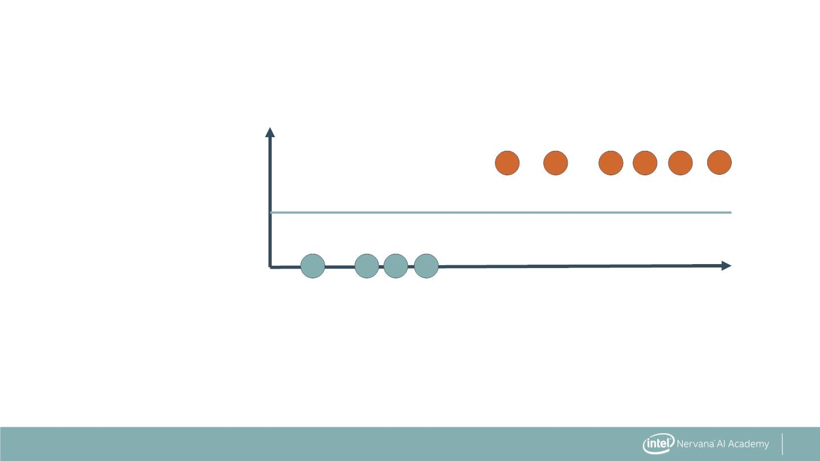
Support Vector Machines (SVM)
Patient
Status
After Five
Years
Lost: 1.0
0.5
Survived: 0.0
Number of Positive Nodes
3

Slide 3
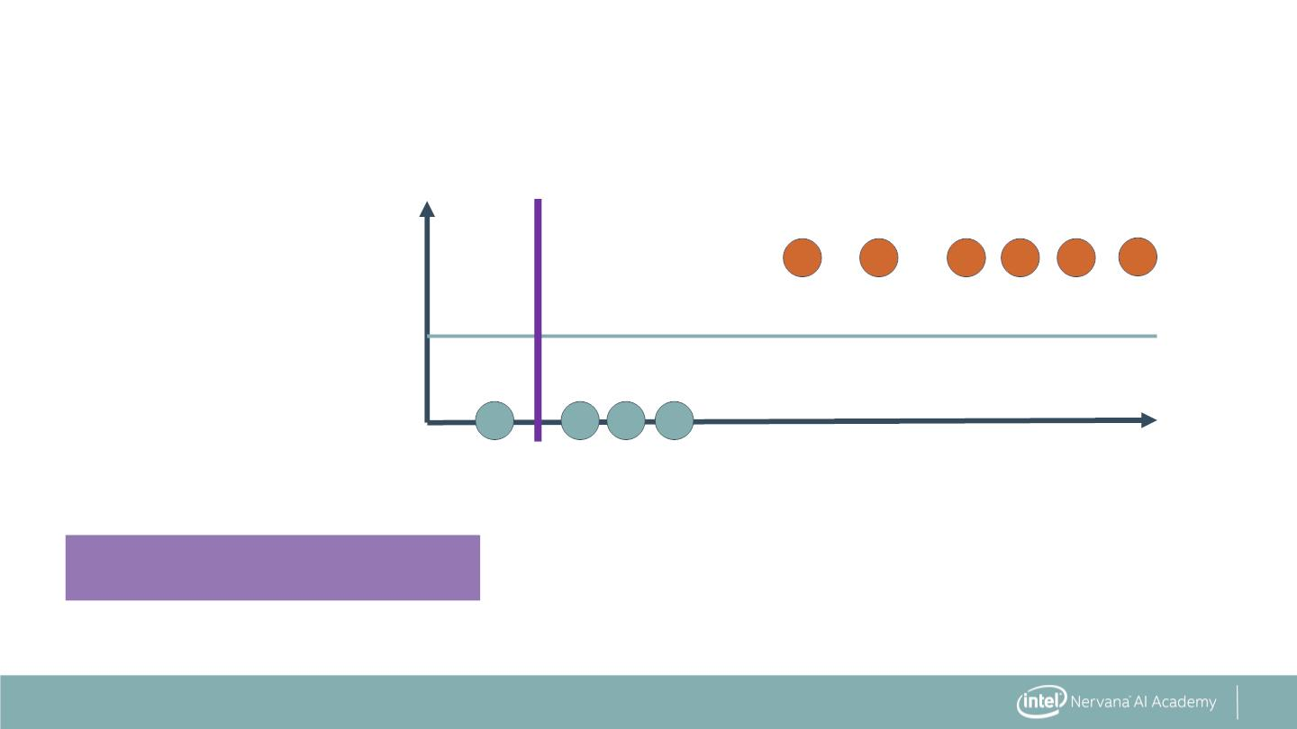
Support Vector Machines (SVM)
Patient
Status
After Five
Years
Lost: 1.0
0.5
Survived: 0.0
Number of Positive Nodes
Three misclassifications
4

Slide 4
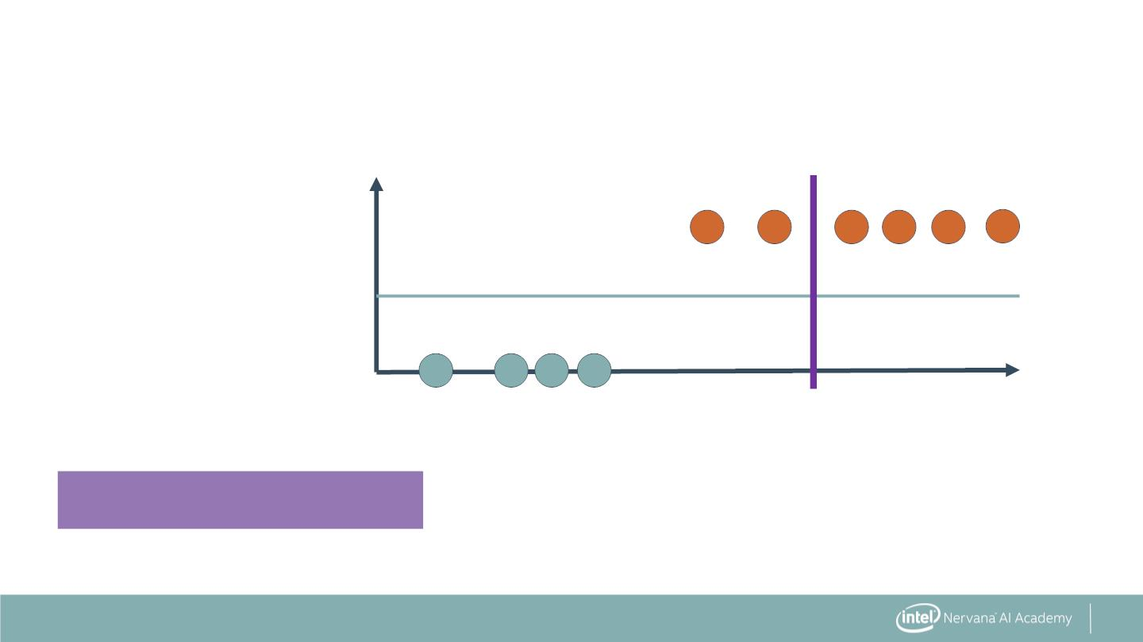
Support Vector Machines (SVM)
Patient
Status
After Five
Years
Lost: 1.0
0.5
Survived: 0.0
Number of Positive Nodes
Two misclassifications
5

Slide 5
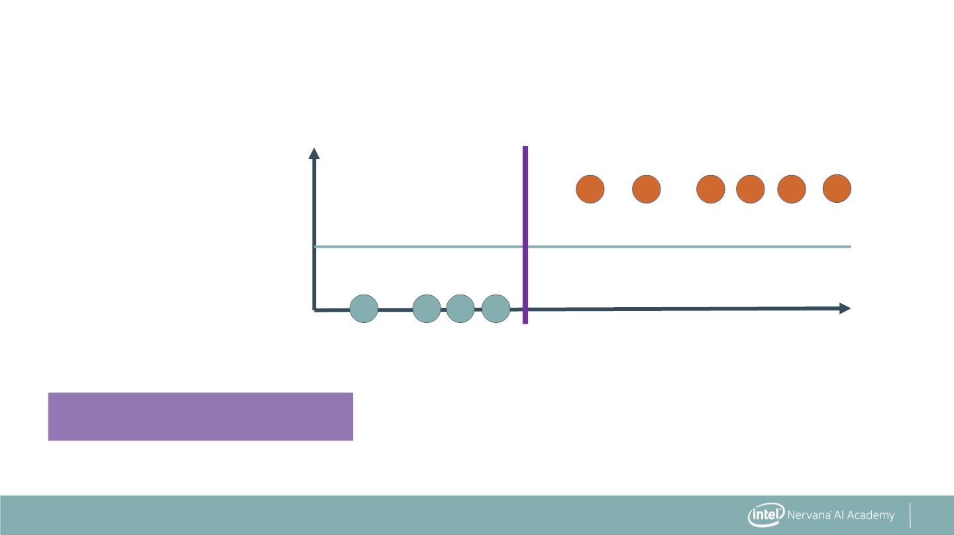
Support Vector Machines (SVM)
Patient
Status
After Five
Years
Lost: 1.0
0.5
Survived: 0.0
Number of Positive Nodes
No misclassifications
6

Slide 6
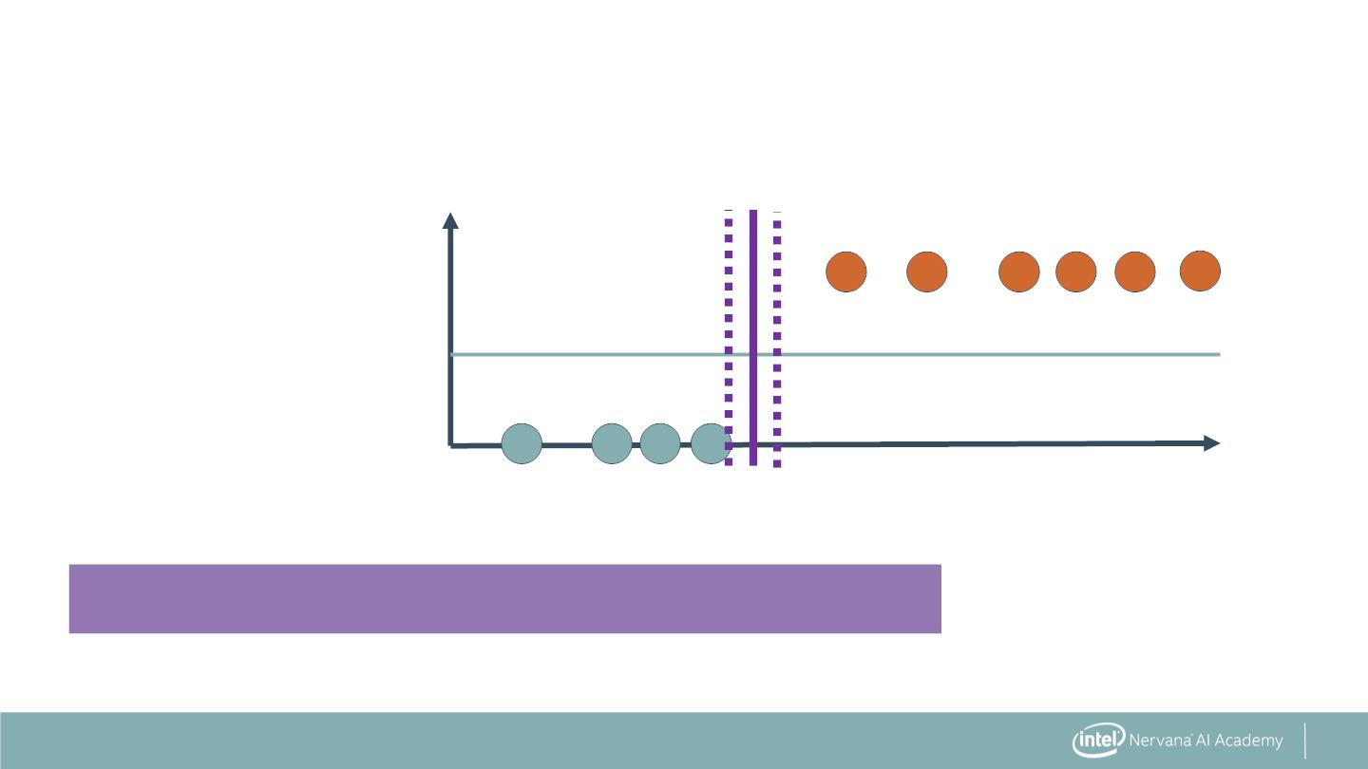
Support Vector Machines (SVM)
Patient
Status
After Five
Years
Lost: 1.0
0.5
Survived: 0.0
Number of Positive Nodes
No misclassifications—but is this the best position?
7

Slide 7
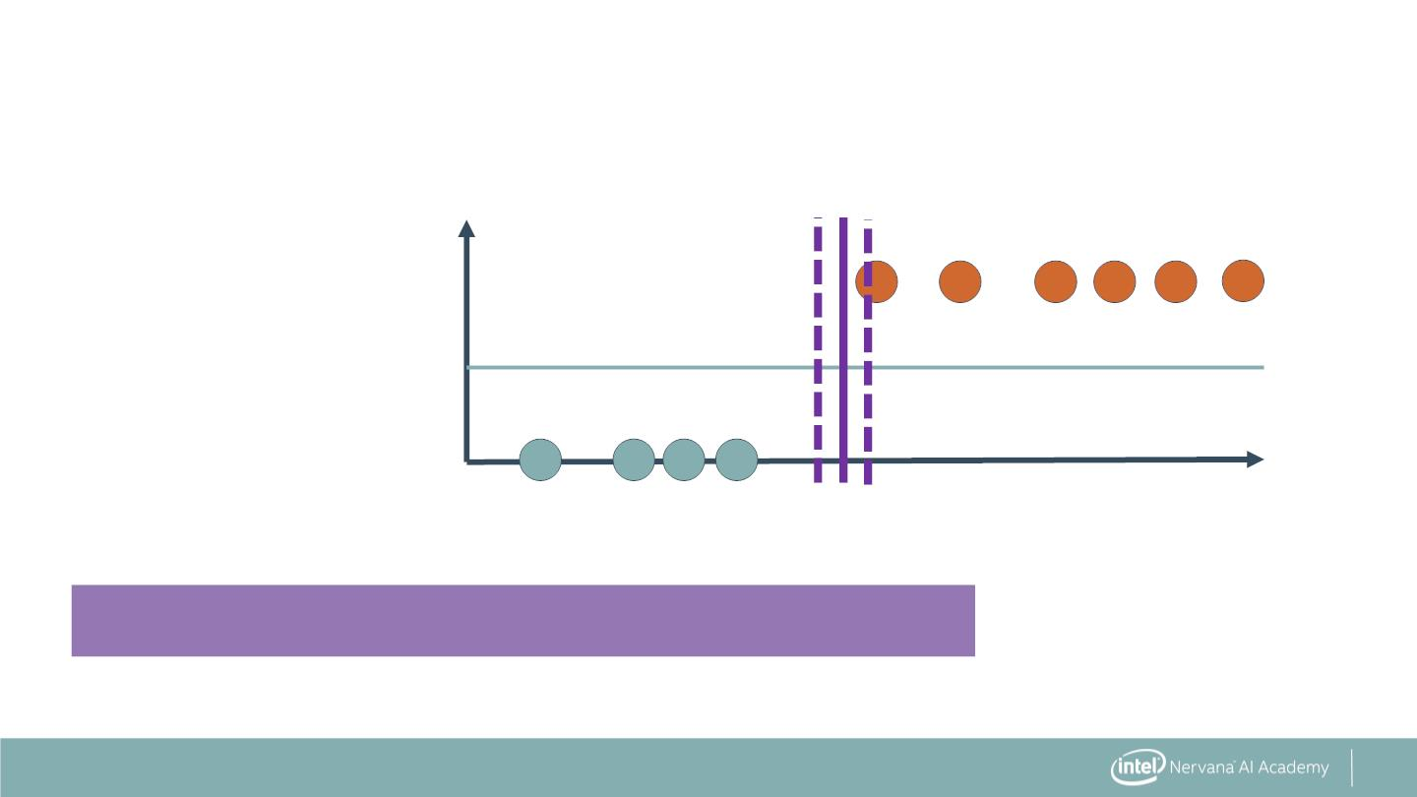
Support Vector Machines (SVM)
Patient
Status
After Five
Years
Lost: 1.0
0.5
Survived: 0.0
Number of Positive Nodes
No misclassifications—but is this the best position?
8

Slide 8
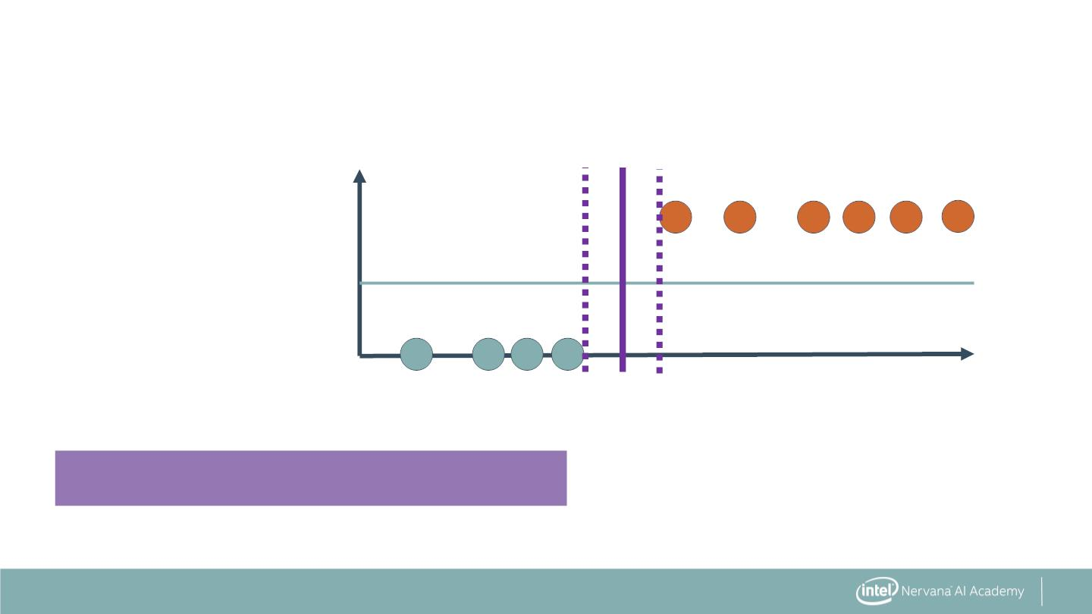
Support Vector Machines (SVM)
Patient
Status
After Five
Years
Lost: 1.0
0.5
Survived: 0.0
Number of Positive Nodes
Maximize the region between classes.
9

Slide 9
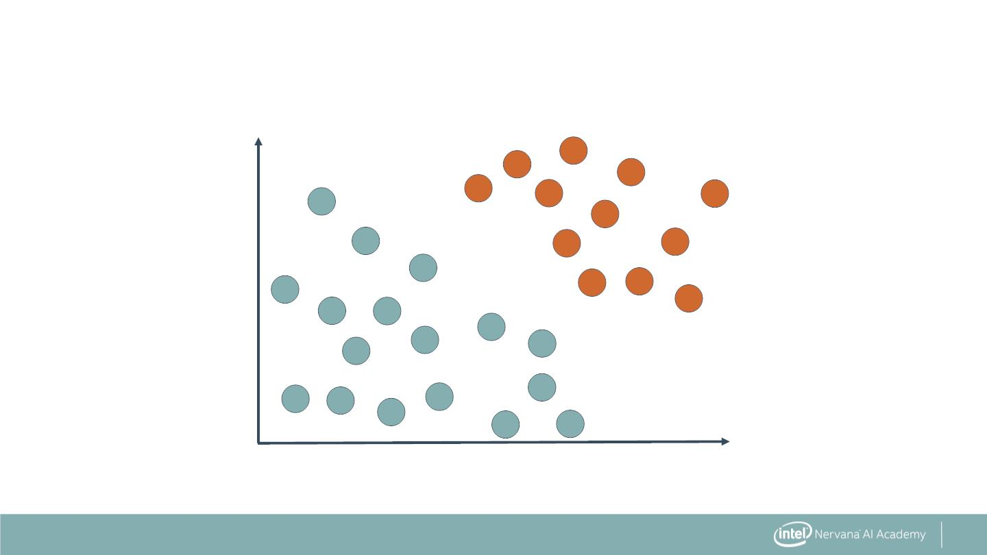
Classification with SVMs
Two features (nodes, age)
Two labels (survived, lost)
60
40
Age
20
0
10
20
Number of Malignant Nodes
11

Slide 10
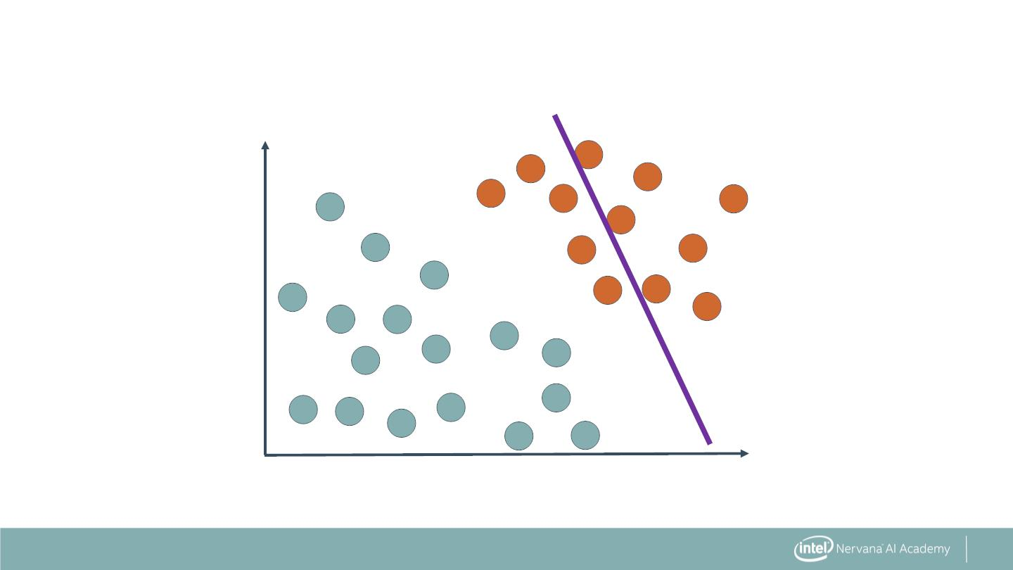
Classification with SVMs
Find the line that best separates classes.
60
40
Age
20
0
10
20
Number of Malignant Nodes
12

Slide 11
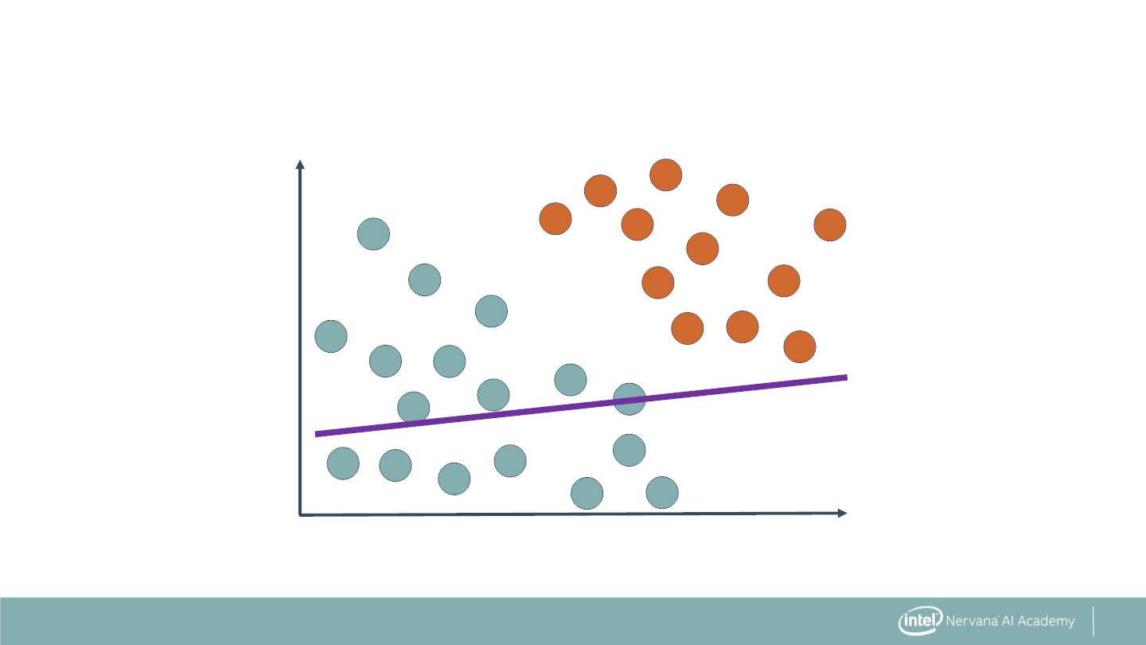
Classification with SVMs
Find the line that best separates classes.
60
40
Age
20
0
10
20
Number of Malignant Nodes
13

Slide 12
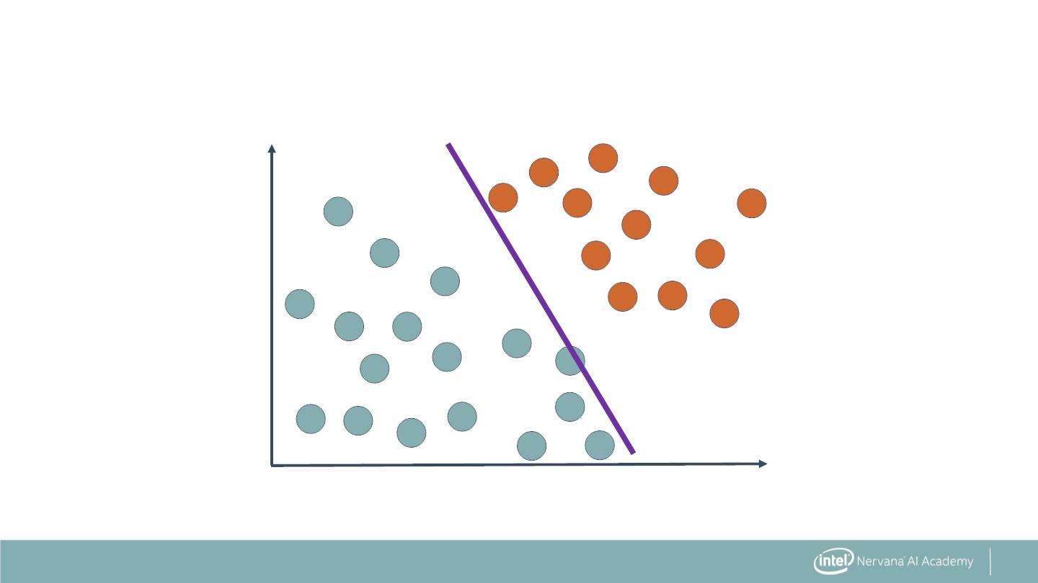
Classification with SVMs
Find the line that best separates classes.
60
40
Age
20
0
10
20
Number of Malignant Nodes
14

Slide 13
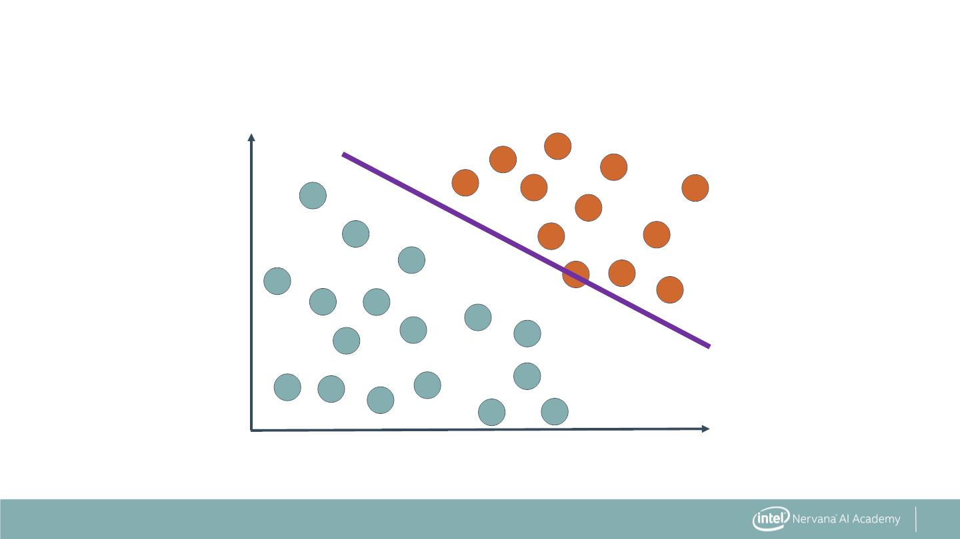
Classification with SVMs
Find the line that best separates classes.
60
40
Age
20
0
10
20
Number of Malignant Nodes
15

Slide 14
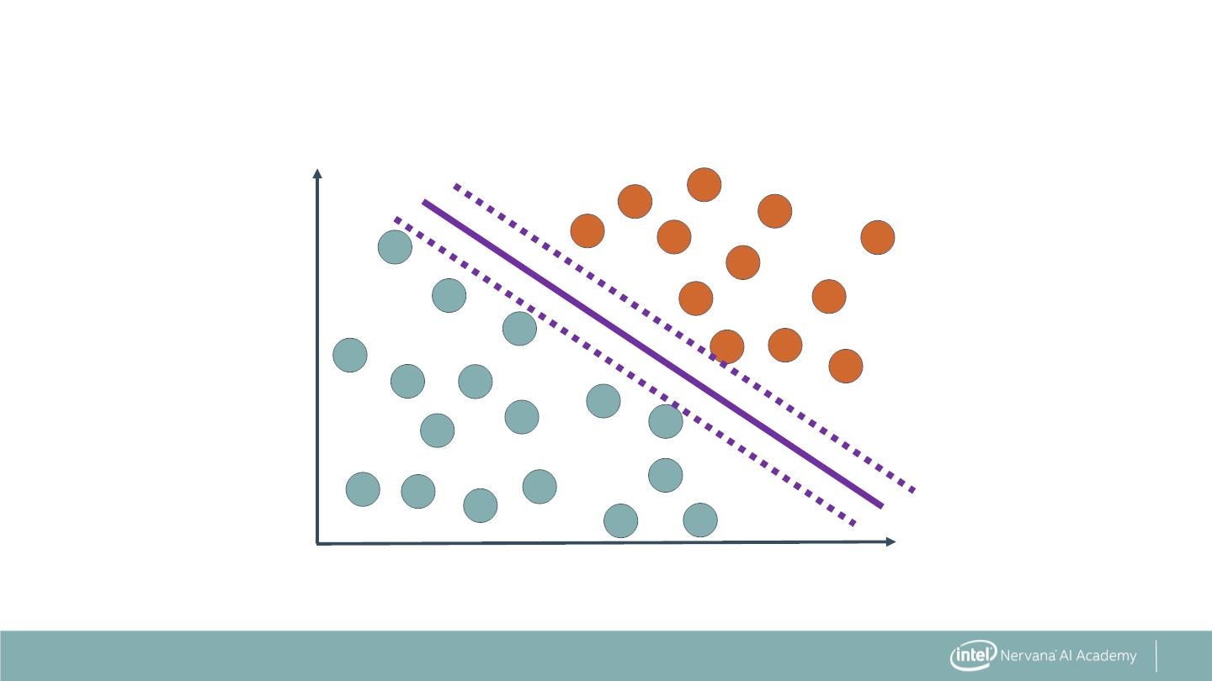
Classification with SVMs
Also, include the largest boundary possible.
60
40
Age
20
0
10
20
Number of Malignant Nodes
16

Slide 15
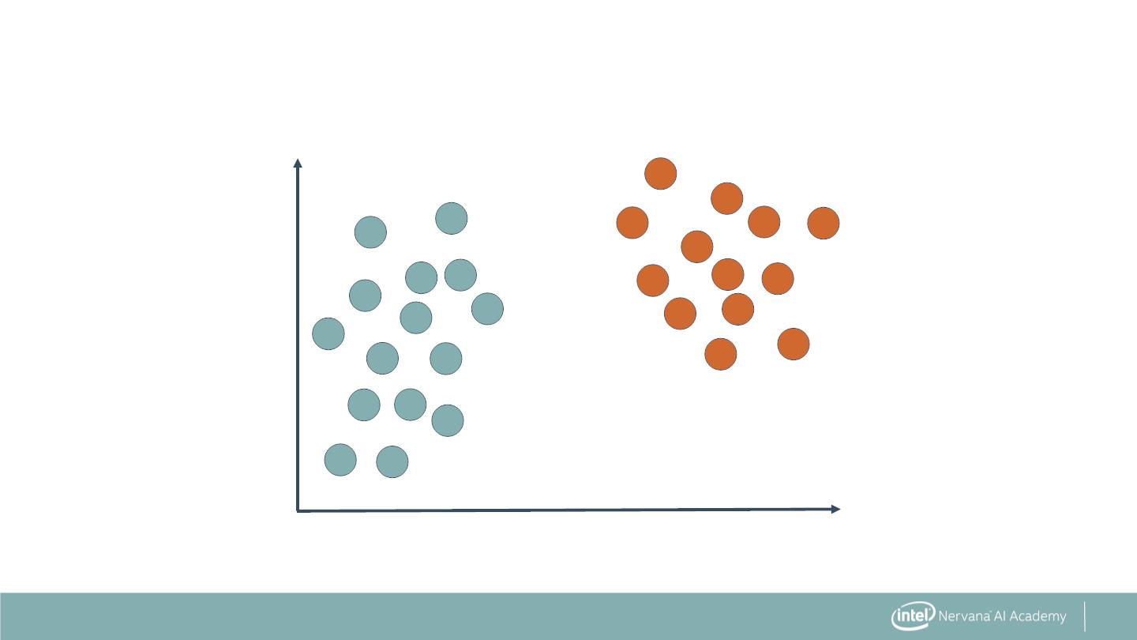
Outlier Sensitivity in SVMs
60
40
Age
20
0
10
20
Number of Malignant Nodes
25

Slide 16
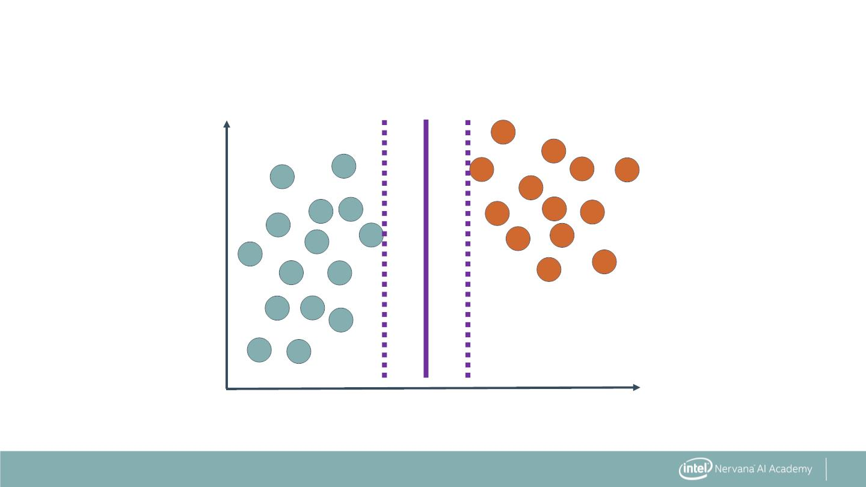
Outlier Sensitivity in SVMs
60
40
Age
20
0
10
20
Number of Malignant Nodes
26

Slide 17
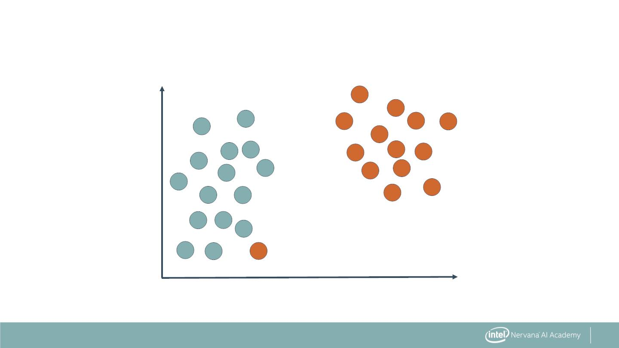
Outlier Sensitivity in SVMs
60
40
Age
20
0
10
20
Number of Malignant Nodes
27

Slide 18
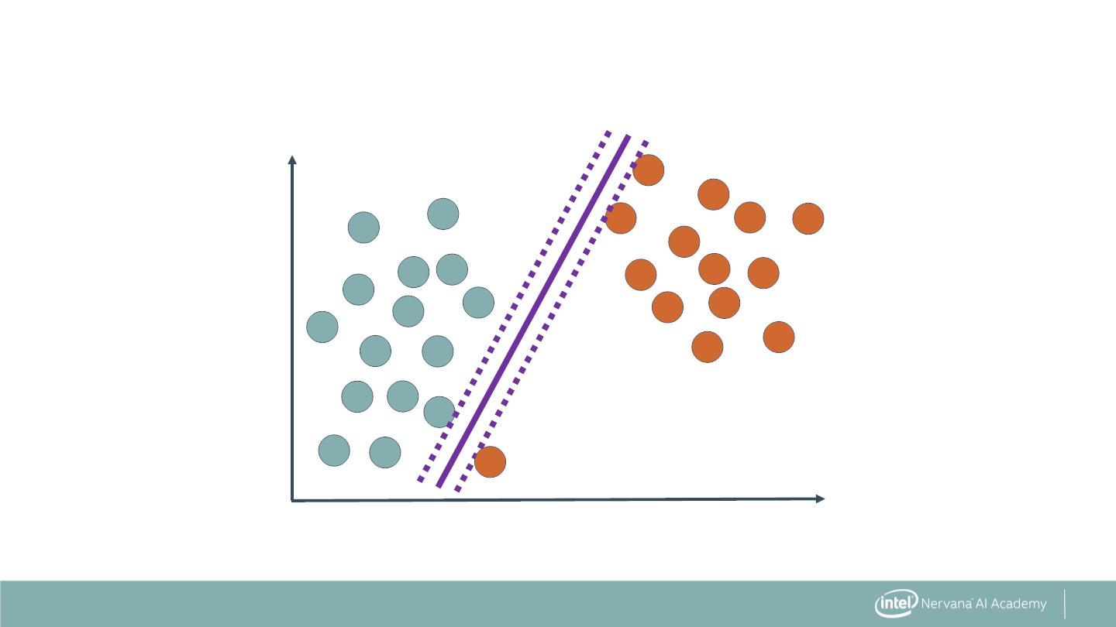
Outlier Sensitivity in SVMs
60
40
Age
20
0
10
20
Number of Malignant Nodes
28

Slide 19
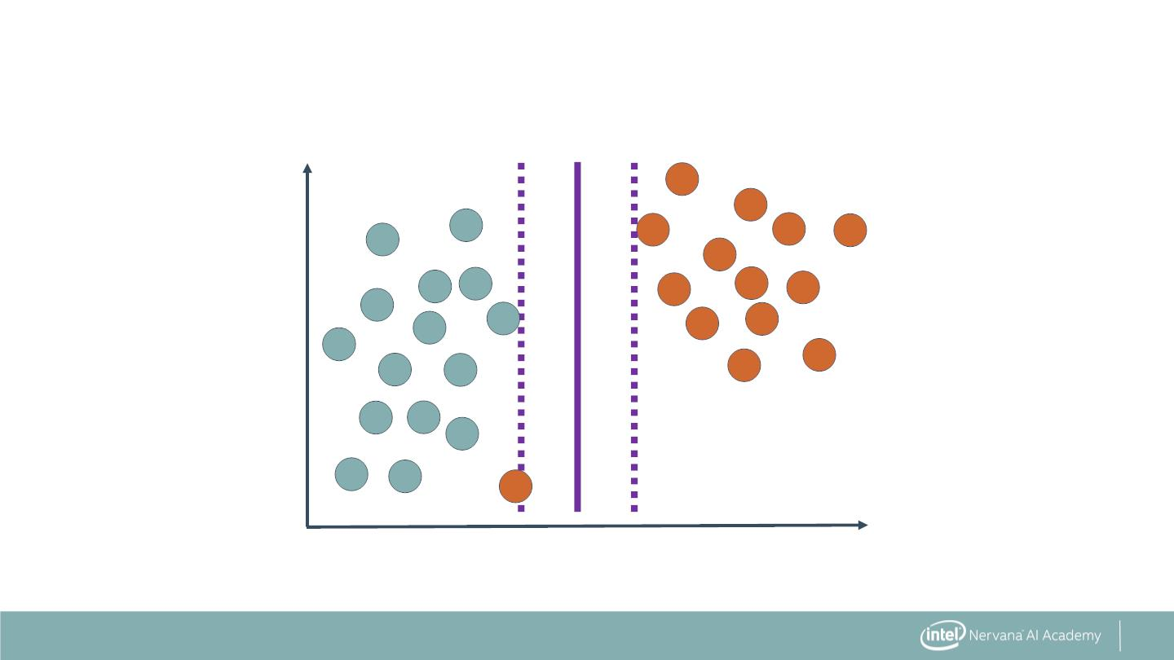
Outlier Sensitivity in SVMs
This is probably still the correct boundary.
60
40
Age
20
0
10
20
Number of Malignant Nodes
29

Slide 20

Linear SVM: The Syntax
Import the class containing the classification method.
from sklearn.svm import LinearSVC
39

Slide 21
Linear SVM: The Syntax
Import the class containing the classification method.
from sklearn.svm import LinearSVC
Create an instance of the class.
LinSVC = LinearSVC(penalty='l2', C=10.0)
40

Slide 22

Linear SVM: The Syntax
Import the class containing the classification method.
from sklearn.svm import LinearSVC
Create an instance of the class.
Regularization
parameters
LinSVC = LinearSVC(penalty='l2', C=10.0)
41

Slide 23
Linear SVM: The Syntax
Import the class containing the classification method.
from sklearn.svm import LinearSVC
Create an instance of the class.
LinSVC = LinearSVC(penalty='l2', C=10.0)
Fit the instance on the data and then predict the expected value.
LinSVC = LinSVC.fit(X_train, y_train)
y_predict = LinSVC.predict(X_test)
42

Slide 24
Linear SVM: The Syntax
Import the class containing the classification method.
from sklearn.svm import LinearSVC
Create an instance of the class.
LinSVC = LinearSVC(penalty='l2', C=10.0)
Fit the instance on the data and then predict the expected value.
LinSVC = LinSVC.fit(X_train, y_train)
y_predict = LinSVC.predict(X_test)
Tune regularization parameters with cross-validation.
43

Slide 25
SVMs with Kernels: The Syntax
Import the class containing the classification method.
from sklearn.svm import SVC
Create an instance of the class.
rbfSVC = SVC(kernel='rbf', gamma=1.0, C=10.0)
66

Slide 26

SVMs with Kernels: The Syntax
Import the class containing the classification method.
from sklearn.svm import SVC
Create an instance of the class.
Set kernel and
associated coefficient
(gamma).
rbfSVC = SVC(kernel='rbf', gamma=1.0, C=10.0)
67

Slide 27
SVMs with Kernels: The Syntax
Import the class containing the classification method.
from sklearn.svm import SVC
Create an instance of the class.
"C" is penalty
associated with
the error term.
rbfSVC = SVC(kernel='rbf', gamma=1.0, C=10.0)
68

Slide 28
SVMs with Kernels: The Syntax
Import the class containing the classification method.
from sklearn.svm import SVC
Create an instance of the class.
rbfSVC = SVC(kernel='rbf', gamma=1.0, C=10.0)
Fit the instance on the data and then predict the expected value.
rbfSVC = rbfSVC.fit(X_train, y_train)
y_predict = rbfSVC.predict(X_test)
69

Slide 29
SVMs with Kernels: The Syntax
Import the class containing the classification method.
from sklearn.svm import SVC
Create an instance of the class.
rbfSVC = SVC(kernel='rbf', gamma=1.0, C=10.0)
Fit the instance on the data and then predict the expected value.
rbfSVC = rbfSVC.fit(X_train, y_train)
y_predict = rbfSVC.predict(X_test)
Tune kernel and associated parameters with cross-validation.
70

