Slide 1

Development of a password manager to store different passwords using encryption and decryption

Slide 2
Objectives:-
To provide a secure and efficient solution for managing multiple passwords.
To use encryption and decryption techniques for protecting sensitive information.
To ensure the confidentiality and privacy of user's password data through robust security measures.

Slide 3
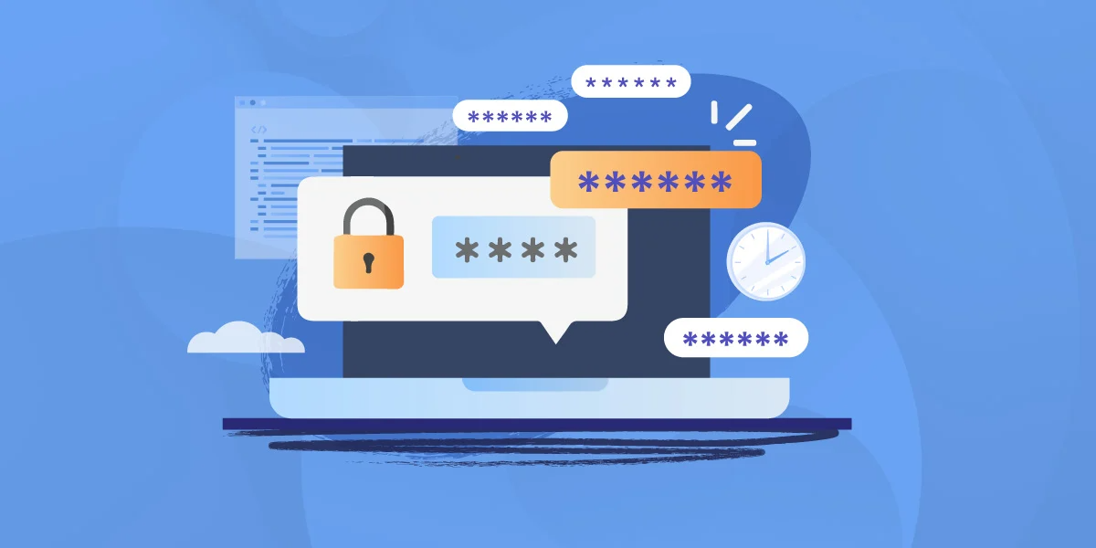
Contents:
Demo
Operation on files in python
Cryptography module
Encryption and decrpytion
Data flow

Slide 4

Introduction :
Password manager in python allows us to effectively store our encrypted passwords in a file format.
We can store passwords from multiple users.
It encrypts our credentials and store them and decrypts when required.

Slide 5



Steps in Solving Problem:
ENCRYPTING USER DATA
STORING USER DATA
ACCESSING ENCRYPTED DATA

Slide 6

Now Let’s See the Working of the Password Manager

Slide 7
File Operations in Python
Opening a file: To open a file in Python, you can use the built-in open() function. You can specify the file mode (e.g. read, write, append) when opening the file.
Reading a file: Once a file is opened, you can read its contents using the read() method. You can also read the file line by line using the readline() method, or read the entire file into a list using the readlines() method.
Writing to a file: You can write to a file by opening it in write or append mode, and then using the write() method. You can write a string or a list of strings to the file.
File modes: The mode you specify when opening a file determines how the file can be used. The most common modes are 'r' (read), 'w' (write), and 'a' (append).
Exceptions: When working with files, exceptions can occur if the file cannot be opened or if there is an error in reading or writing the file. You can use try-except statements to handle these exceptions.

Slide 8
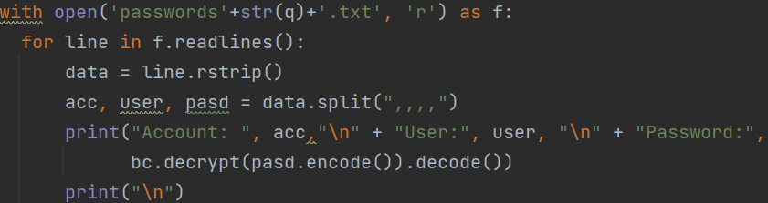

File Operations
Hiding A File

Slide 9

Hide Function
Hiding Files and Directories: The hide function in the OS module allows users to hide files and directories, so that they are not visible to other users or applications.
This can be useful for protecting sensitive information or for making files or directories available only to specific users.
Implementation Details: The implementation of the hide function in the OS module may vary depending on the operating system being used.
On Windows, the function may involve setting a hidden attribute on the file or directory, while on other systems it may involve changing the file or directory's permissions or creating a hidden file or directory with a special name or prefix.
Courtesy: Nounproject

Slide 10
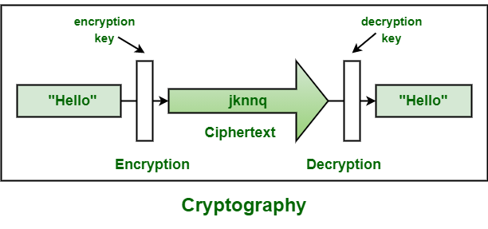
Cryptography Module
Encryption: The cryptography module provides functions for encrypting data, making it more secure and protected from unauthorized access.
Decryption: The cryptography module provides functions for decrypting encrypted data, allowing users to access the original data in its original form.
Key Generation: The cryptography module provides functions for generating encryption keys, which are used to encrypt and decrypt data.
Courtesy: GeeksforGeeks

Slide 11
Fernet Algorithm
Fernet is a symmetric encryption algorithm in the cryptography module of Python.
It is a high-level library for secure communication, designed to make it easy to encrypt and decrypt data.
Fernet uses the Advanced Encryption Standard (AES) in CBC mode, and it provides authenticated encryption, meaning that the encrypted data is guaranteed to be both confidential and authentic.
This makes Fernet ideal for use in applications where the confidentiality and authenticity of data is of critical importance, such as in secure email, file transfers, and other forms of secure communication.
Fernet is used for encrypting and decrypting data, while MD5 is used for generating hash values for verifying the integrity of data.

Slide 12
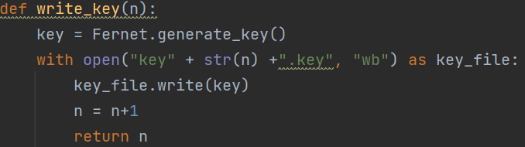


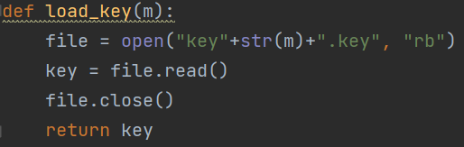
Key Generation
Encryption

Slide 13

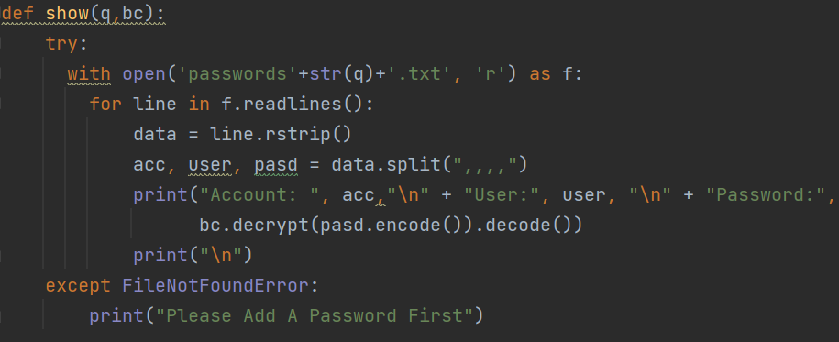
Decryption

Slide 14
Data Flow
Iterations will be calculated and stored
New User
Old User
List of users
Storing
Retrieve Users
Generate a cryptic key from fernet
Display all the users to select from
(Hidden)
Takes users master key and combine it with fernet key
Add Password
View Password
Key for Encryption
Take user data about password
Take master key from user
Combine the key with master key
Encrypting the password
Decrypting
Store the generated key
List of passwords
Display Users Passwords

Slide 15
References
Cryptography module, https://cryptography.io/en/latest/fernet/#using-passwords-with-fernet
Symmetric encryption, https://www.thepythoncode.com/article/encrypt-decrypt-files-symmetric-python
OS library, https://docs.python.org/3/library/os.html
Nested functions, https://www.freecodecamp.org/news/nested-functions-in-python/
File handling, https://www.geeksforgeeks.org/file-handling-python/

Slide 16

Thank you

