Slide 1
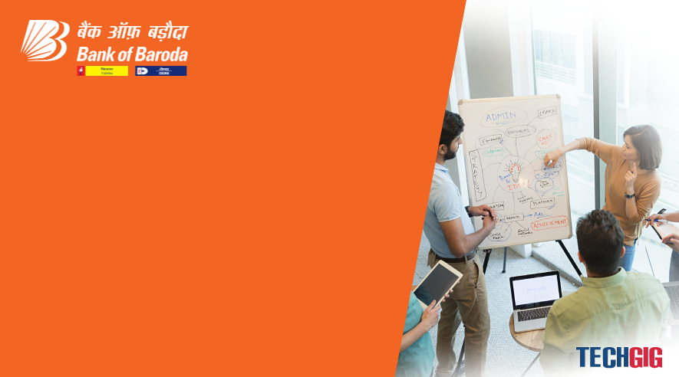

Bank of Baroda Hackathon - 2022
Technology Partner
Your Team Name : Elites_of_23
Your team bio : We are a team of college students from erode who enjoy solving problem's and providing Solution's.
Date :18/09/2022

Slide 2
Problem Statement?
Why did you decide to solve this Problem statement?
Digital Banking has great evolution over the years and will have huge progress on upcoming years. Password is the secure and current authentication of Digital Banking to make it more secure we need alternate authentication. Cyber attacks have been increasing rapidly every years, passwords seems to be not enough.

Slide 3
User Segment & Pain Points
Which user /advertiser segment would be early adopter of your product & why?
Mobile and Internet Banking users can be easily adopted to Pattern-based Authentication.
Pattern-based Authentication can be adoptable as we use Multi-factor authentication in various fields in name of Authentication
Patterns are graphical form of representation which can be easily remembered while users cannot remember strong passwords and save passwords with their social accounts which make it more Vulnerable.

Slide 4
Pre-Requisite
What are the alternatives/competitive products for the problem you are solving?
Biometrics can be used instead of patterns which is more secure, but the devices should be capable of the biometric we are using, In case of net banking.
Even authenticator can be used instead of patterns, but that is cannot be an alternative as it can be cracked or found with spyware in the device.
Pattern can have alternatives but other ways cannot be Efficient and more Secure.

Slide 5
Azure tools or resources
Azure tools or resources which are likely to be used by you for the prototype, if your idea gets selected Azure’s Key Vault: The Azure’s Key vault is a Microsoft’s Cloud-Storage solution for data Storages. Benefits: *Durable and highly available. *Secure. *Scalable. *Managed. *Accessible. It has an efficient client-side encryption and is durable as it has multiple copies of data. Considering several options as Synapse Analytics and SQL Databases Key Vault provides features as Files, blobs, disks, queues and Tables

Slide 6
Any Supporting Functional Documents
Present your solution, talk about methodology, architecture & scalability
Pattern-based Authentication is much easier and can be used for Mobile banking and Internet banking as it is similar to passwords/PIN’s.
Architecture of Pattern’s differs with retail banking(3x3) and corporate banking(4x4) which makes it more secure to use.
User defined pattern will be stored in cloud based databases and be used for authentication during logging-in into their account.
Scalability of Pattern based Authentication depend on the user as the grid can 3x3,3x4,4x4 depend on the User.
As Pattern based authentication has been implemented in Zig bank.
RBI’s Article on 18 Feb,2021-21/74 states implementing patterns will depend on user experience which can be secure than passwords getting cracked using keylogger’s, malwares/spywares.

Slide 7
Key Differentiators & Adoption Plan
How is your solution better than alternatives and how do you plan to build adoption?
It is essential to protect yourself adequately, and we know that passwords alone are not Enough.
Digital Banking and Mobile Banking can be easily adopted to Pattern based Authentication.
Pattern based authentication differ from the passwords and PIN’s which can be vulnerable though Social Engineering as 67% of attacks against individuals in 2019 involve Social Engineering.
It is easy to remember patterns instead of remembering pin’s & passwords.
A pattern is however secure, there are one billion possible patterns in a 3x3 grid with 9 Dots.
The pattern combination differ from grids and dots connected to it, which makes it more secure and more complicated to handle.
As we can provide password policies, weak patterns can be recognized and avoided.

Slide 8
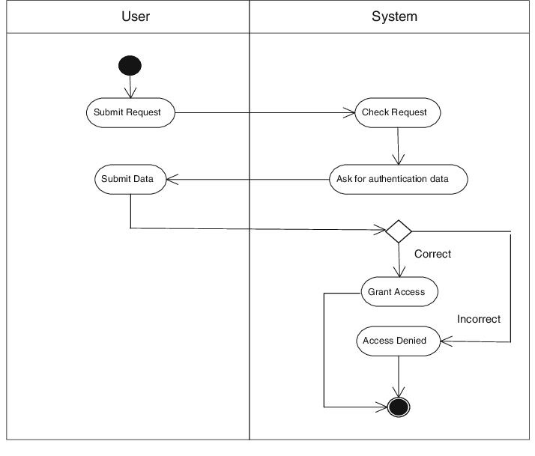
GitHub Repository Link & supporting diagrams, screenshots, if any
How far it can go?
Git hub Link:https://github.com/SriSuryaKumarM/Bank-of-Baroda-Hackathon
Diagram:

Slide 9
Thank You
Team member names
Sri Surya Kumar M.
Thanush S.
Sowmiya S.
Vanitha A P.

