Slide 1

Credit Risk Evaluation using Machine Learning
By Surya Vaddhiparthy
Under the guidance of Professor Dr. Guan Yue Hong

Slide 2
Fintech Companies
XGBoost
Interpretability
Scorecard
Logistic Regression

Slide 3

Goal
Enable access to credit for people with limited credit history

Slide 4

Steps
Identify the data
Exploratory data analysis
Data wrangling
Data visualization
Feature engineering
Machine learning
Class Imbalance
Model evaluation
Click to access source code

Slide 5
EDA and Data wrangling methods used
307,511 x 122
Target [1,0]
Int64, float64 and object
100,000 missing values
Imputation
Outliers
pd.read_csv:
df.head(): df.rename(columns=str.lower):
pd.set_option:
df.dtypes:
df.target.unique():
df.describe().T
df_missing=df.isna().sum():
df[['occupation_type']].fillna(value='Unknown’):
outliers = df[((df<(q1-1.5*IQR)) | (df>(q3+1.5*IQR)))]

Slide 6
Data Visualization
df.plot(kind='scatter',x==’ ',y=’’)
plt.boxplot
df.plot(kind='bar’)
df.plot(kind='pie',legend=True,figsize=(12,12)).

Slide 7
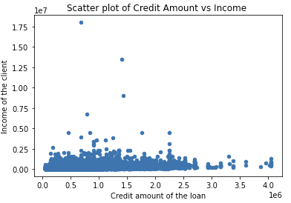

Slide 8
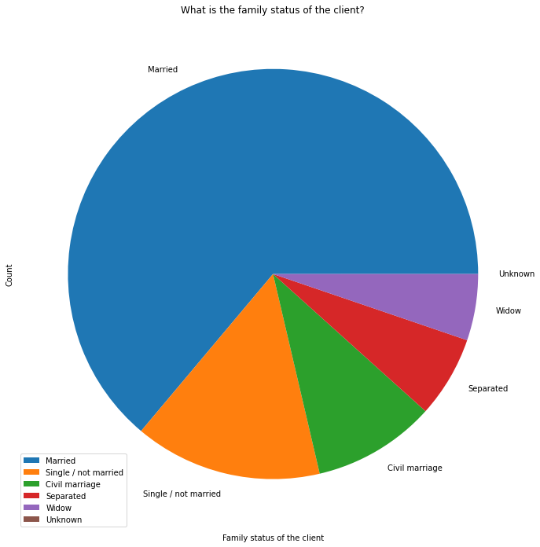

Slide 9
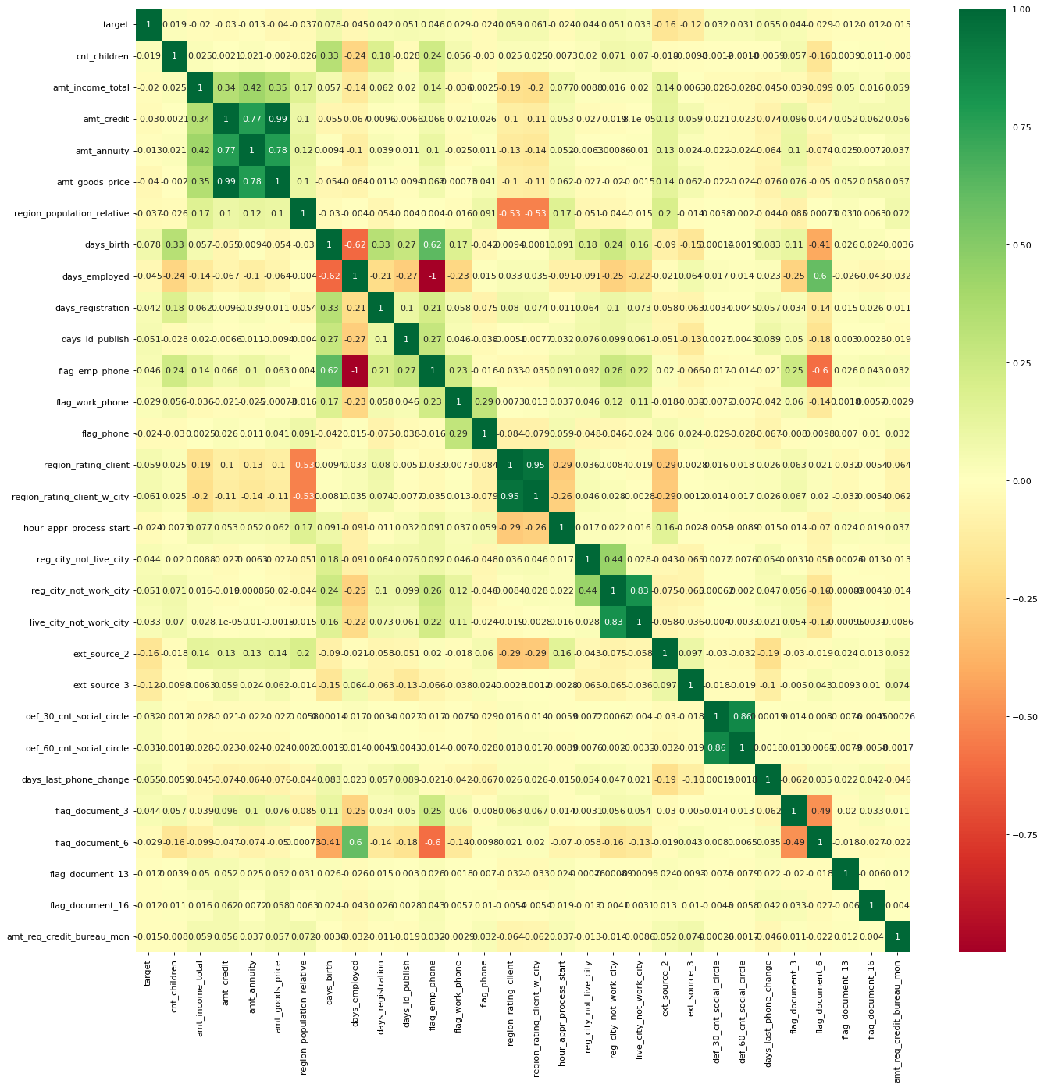

Slide 10
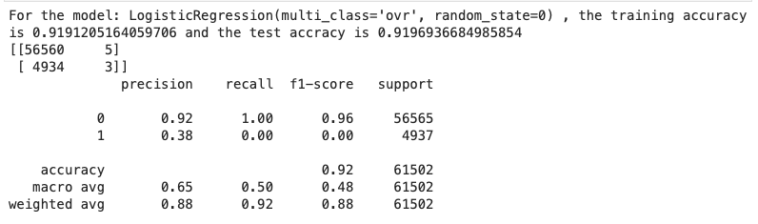
Logistic Regression

Slide 11
Image courtesy: ABC Network

Slide 12
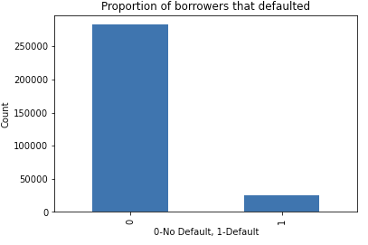

Slide 13
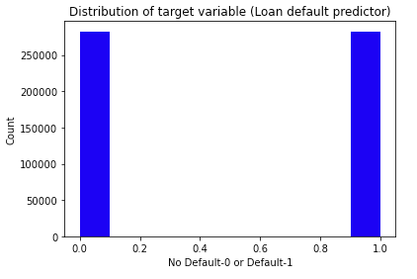
Preparing the data for Machine Learning
Scaling
Class Imbalance resolution using SMOTE

Slide 14
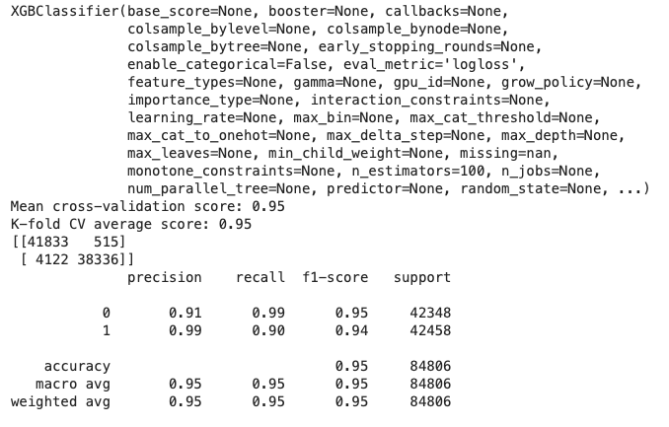
Extreme gradient boosting with synthetic minority over sampling

Slide 15
Machine Learning Model Evaluation
Model | Precision | Recall | F1-score | Imbalanced
Logistic Regression | 0.38 | 0.00 | 0.00 | Yes
Stochastic Gradient Descent | 0.05 | 0.00 | 0.00 | Yes
XGBoost | 0.55 | 0.02 | 0.04 | Yes
Stochastic Gradient Descent | 0.50 | 0.00 | 0.00 | No
XGBoost | 0.98 | 0.91 | 0.94 | No
Random Forest | 0.94 | 0.89 | 0.92 | No

Slide 16
Future scope
Deploying the final ML model
continuous variable to generate credit score
Identification of more effective alternative data

Slide 17

Thank You!

