Slide 1

Credit Risk Evaluation using Machine Learning
CS-5820 Project Group # 10
By Surya Vaddhiparthy
Under the guidance of Professor Dr. Guan Yue Hong

Slide 2

Goal
Enable access to credit for people with limited credit history

Slide 3

Steps
Identify the data
Exploratory data analysis
Data wrangling
Data visualization
Feature engineering
Machine learning
Class Imbalance
Model evaluation
Click to access source code

Slide 4
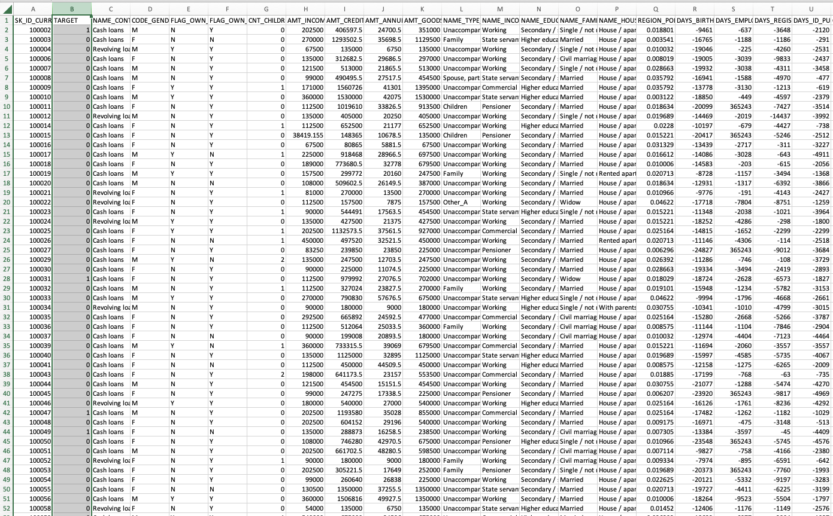
Data

Slide 5
Exploratory Data Analysis and Data Wrangling
307,511 x 122
Target [1,0]
Int64, float64 and object
100,000 missing values
Imputation
Outliers

Slide 6
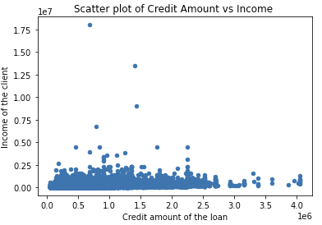
Data Visualization
df.plot(kind='scatter',x==’ ',y=’’)
plt.boxplot
df.plot(kind='bar’)
df.plot(kind='pie',legend=True,figsize=(12,12)).

Slide 7
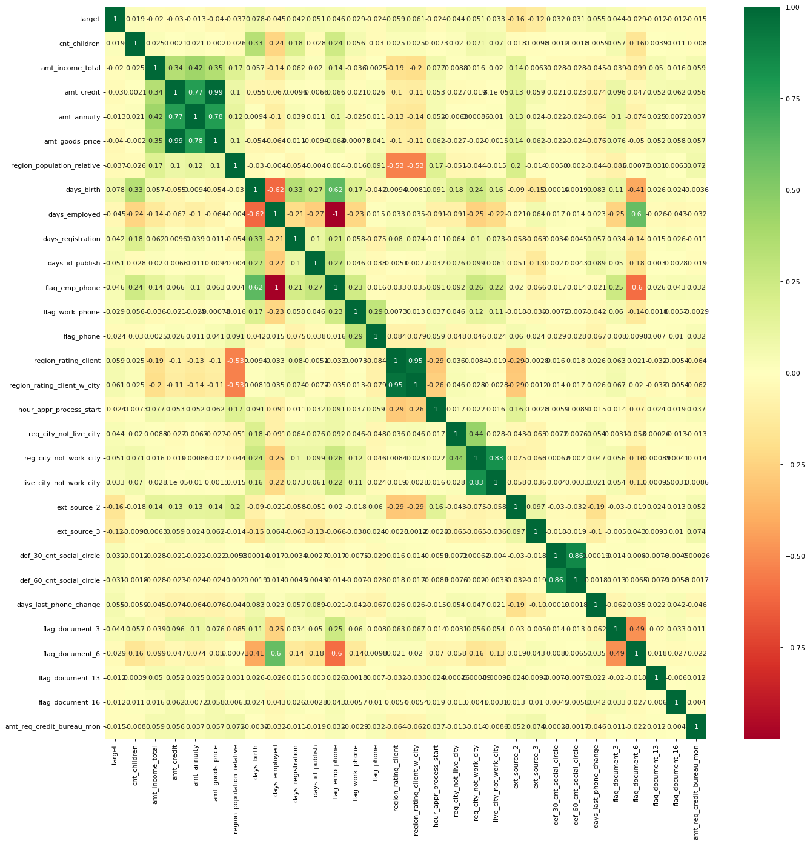
Feature Engineering

Slide 8
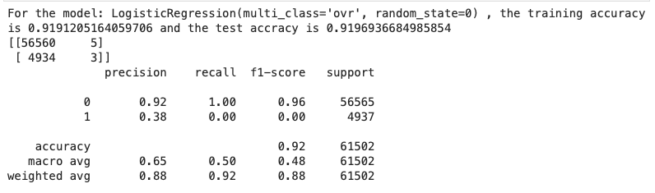
Machine Learning (Logistic Regression Model)

Slide 9
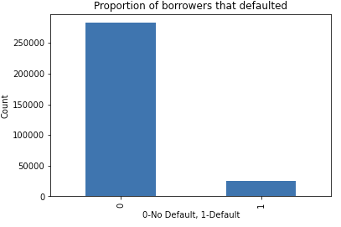
Class Imbalance

Slide 10
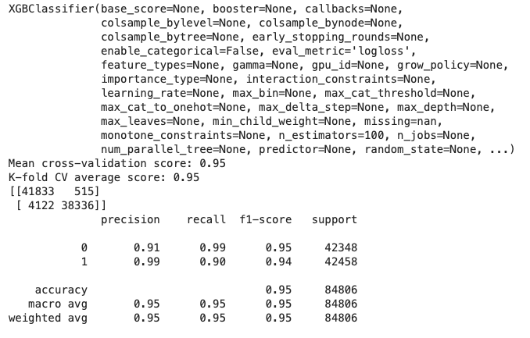
Extreme gradient boosting with synthetic minority over sampling

Slide 11
Machine Learning Model Evaluation
Model | Precision | Recall | F1-score | Imbalanced
Logistic Regression | 0.38 | 0.00 | 0.00 | Yes
Stochastic Gradient Descent | 0.05 | 0.00 | 0.00 | Yes
XGBoost | 0.55 | 0.02 | 0.04 | Yes
Stochastic Gradient Descent | 0.50 | 0.00 | 0.00 | No
XGBoost | 0.98 | 0.91 | 0.94 | No
Random Forest | 0.94 | 0.89 | 0.92 | No

Slide 12
Future scope
Deploying the final ML model
continuous variable to generate credit score
Identification of more effective alternative data

Slide 13

Thank You!

