Slide 1
MiniNykaa
A distributed shopping system built with Python sockets,
modelled on the architecture of Nykaa
Distributed Systems Mini Project | Reg. No. 23MCCE28
Notes:
Introduce the project: study Nykaa, identify distributed paradigms/algorithms, build a simplified version with socket programming.

Slide 2
Why Nykaa is a good case study
40M+
6,000+
165+
400 TB+
monthly active users
brands
physical stores
consolidated in data lake
Heavy reads (search, browse), spiky sale-day writes, huge behavioural data and consistency-critical inventory and orders: a natural fit for distributed design.
Source: AWS case study on Nykaa (figures as reported).

Slide 3
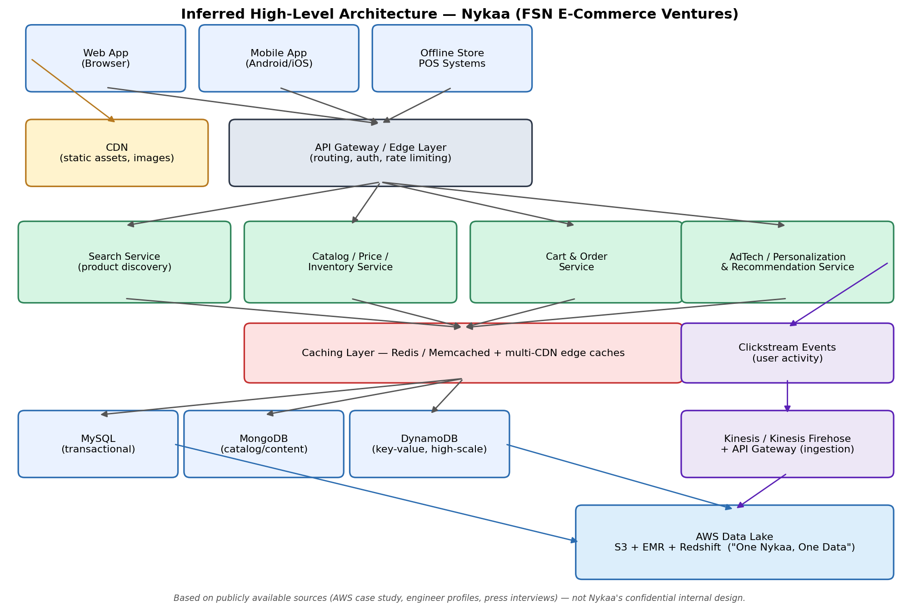
Nykaa architecture (from public sources)
Multi-tenant platform, Python and Java APIs
Microservices: Search, Price, Inventory, AdTech
MySQL + MongoDB + DynamoDB
CDN to Memcached/Redis caching
Kinesis to S3/EMR/Redshift data lake
Items not confirmed by Nykaa are marked inferred in the report.

Slide 4
Distributed paradigms identified
1
2
3
Client-server / n-tier
Microservices
API gateway
Thin clients, logic on servers
Search, price, inventory, ads
One entry point, hides topology
4
5
6
Multi-tenancy
Event streaming
Polyglot persistence
One platform, many businesses
Clickstream via Kinesis
SQL, document, key-value + lake

Slide 5
Algorithms: Nykaa vs MiniNykaa
Technique | Where in Nykaa (likely) | In MiniNykaa
Consistent hashing | DynamoDB, cache rings, Kinesis keys | Product to catalog shard
Load balancing | Service instances behind LBs | Front-door LB: round-robin / least-conn, retry
LRU cache + TTL | CDN to Memcached/Redis | Gateway cache, cross-gateway invalidation
Bully leader election | Replica-set elections | 3 order nodes, highest alive id leads
Leader-based replication | MySQL / MongoDB replicas | Versioned writes + snapshot resync
Heartbeat failure detection | Health checks, membership | LB, gateways and followers ping
Scatter-gather + unique IDs | Search shards; event IDs | List/search merge; UUID order IDs
Not implemented, but analysed: quorum, Raft, saga, event streaming.

Slide 6
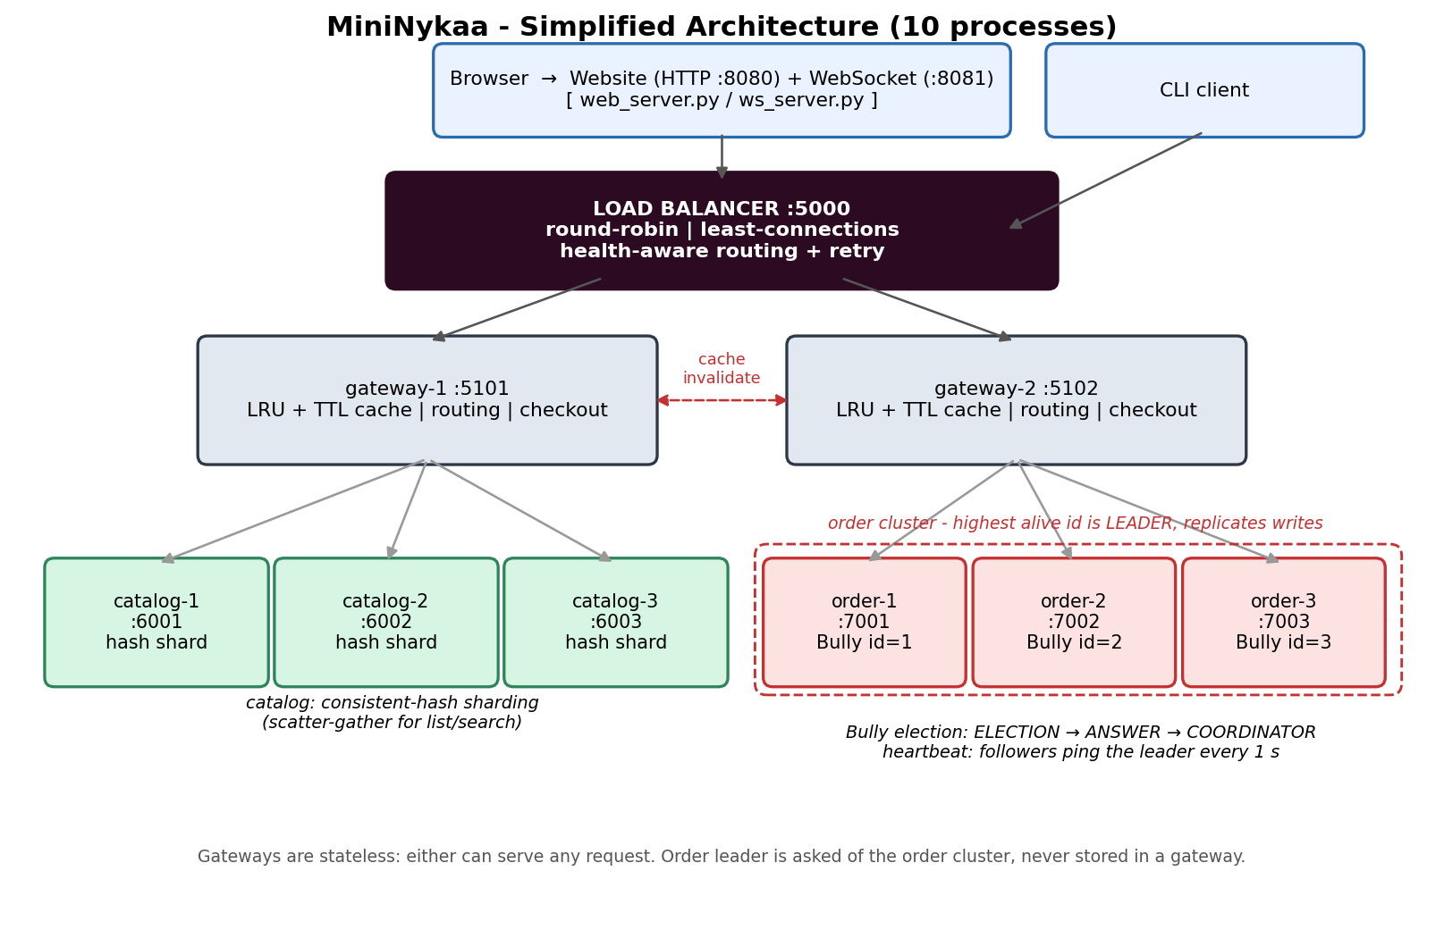
MiniNykaa design
Load balancer :5000 is the front door; 2 stateless gateways
3 catalog shards via consistent hashing
3 order replicas; Bully election picks the leader
LRU+TTL cache per gateway; heartbeats everywhere
Length-prefixed JSON over TCP

Slide 7
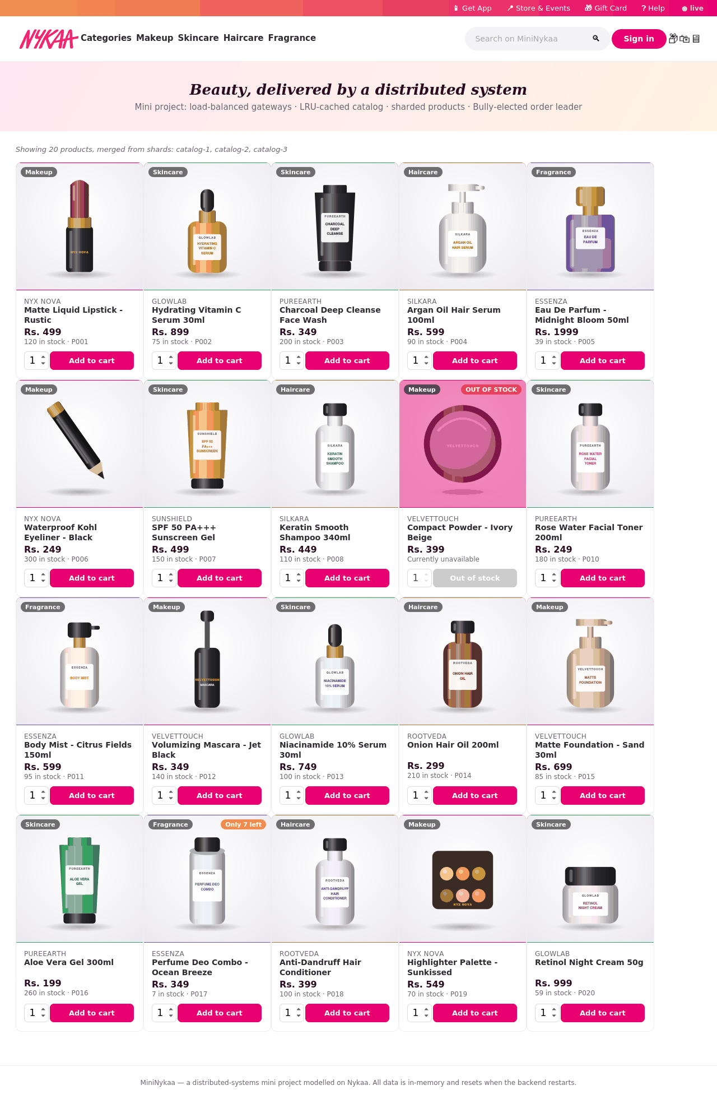
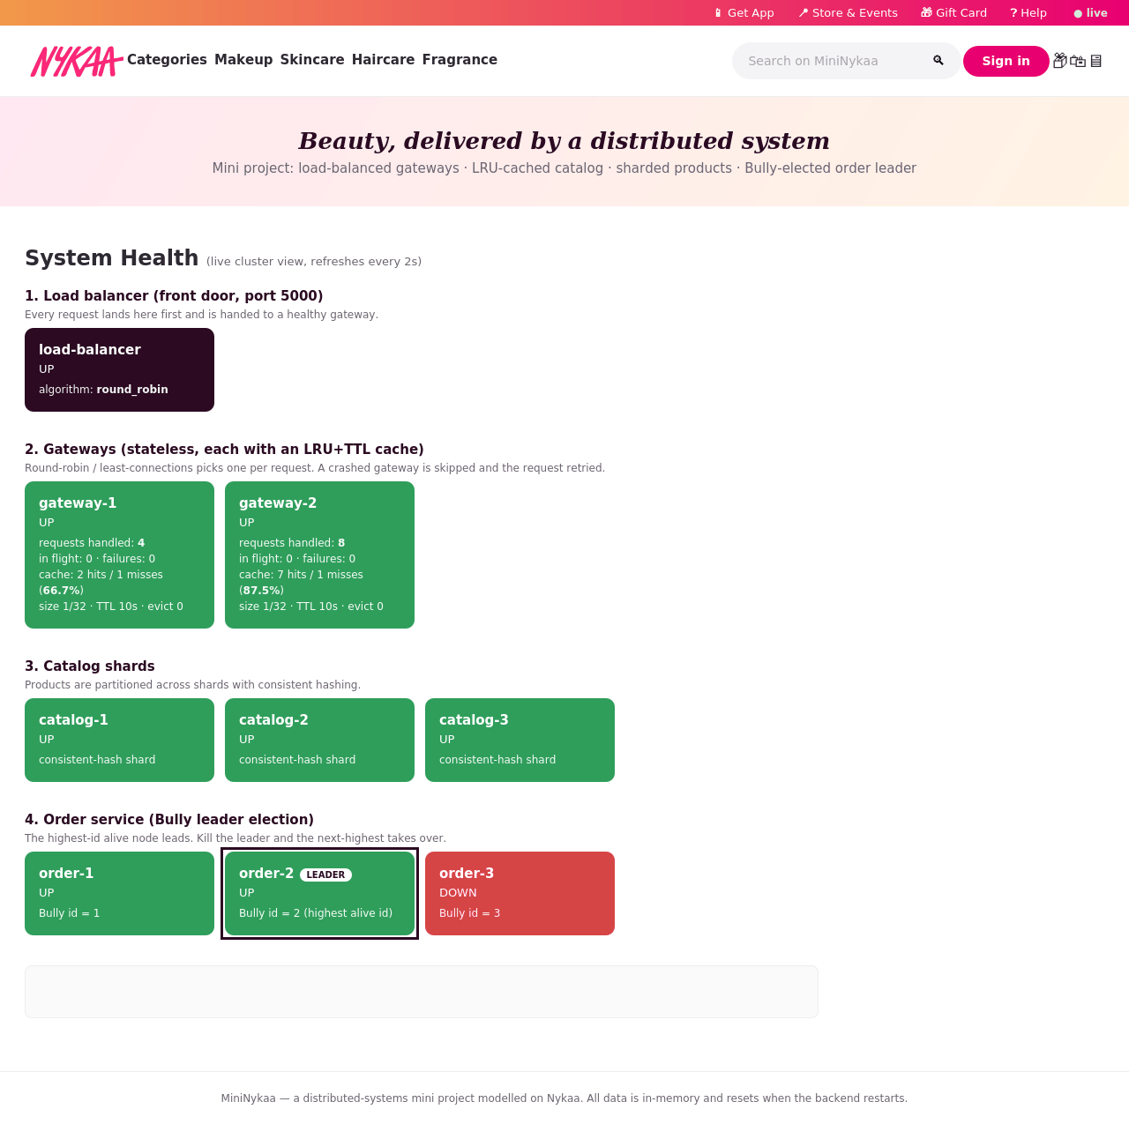
Website + Docker
Order leader crashed: order-2 elected. docker compose up starts all 10 containers.
Nykaa-styled storefront: live stock badges, working cart +/- and Remove, checkout, order history.

Slide 8
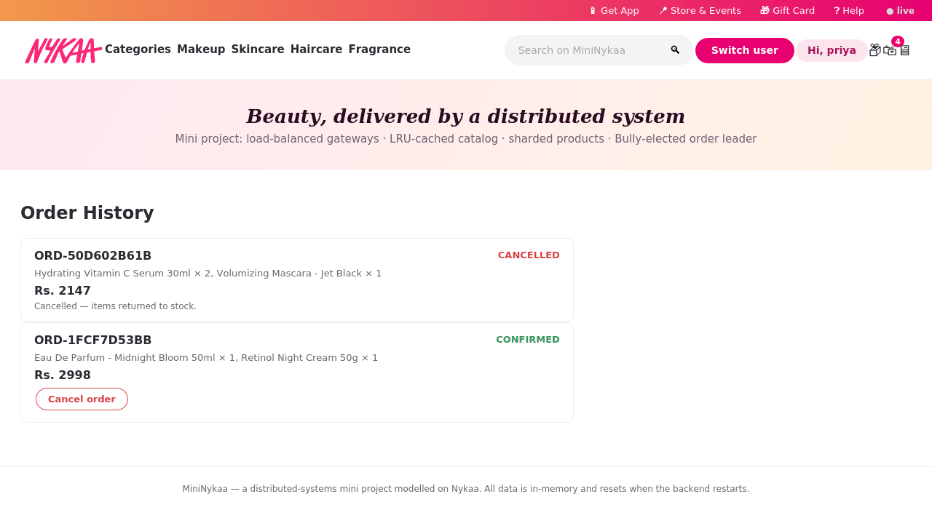
Cancellation, images, live sockets
Cancel order: CONFIRMED to CANCELLED, replicated, stock returned to the owning shard
Second cancel rejected, so no double restock
Product images on every card and in the cart
Top-bar panels: Get App, Stores, Gift Card, Help FAQ
Hand-written RFC 6455 WebSocket server on raw sockets pushes live stock and health

Slide 9
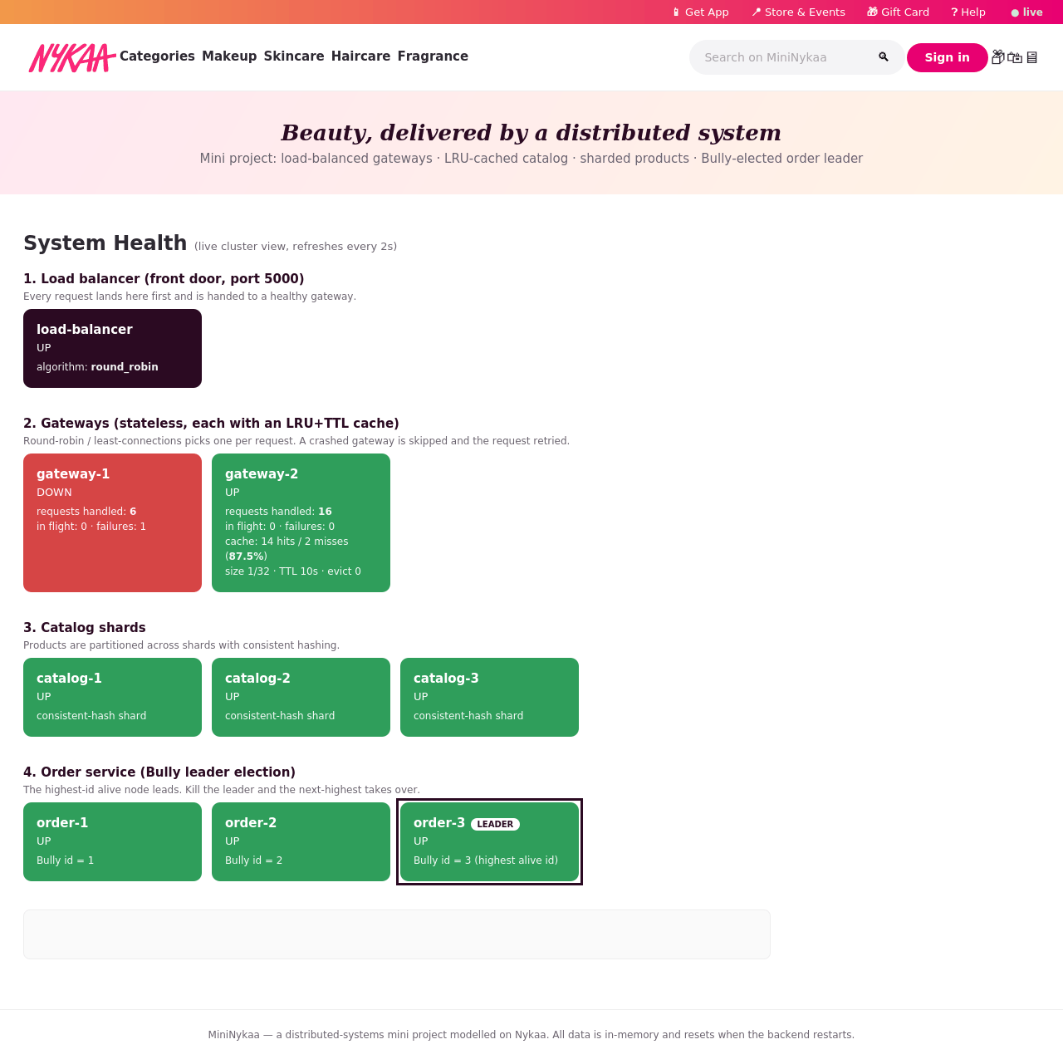
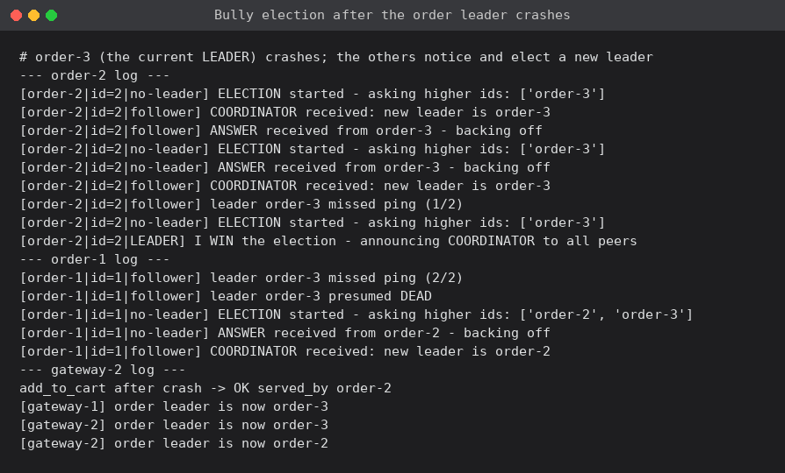
Results: election, load balancing, concurrency
Leader order-3 killed: order-2 elected in about 3 s, data intact; restarted order-3 reclaimed leadership. Gateway stopped: 0 failed requests. 20 concurrent checkouts: all succeed, unique IDs, exact stock.

Slide 10
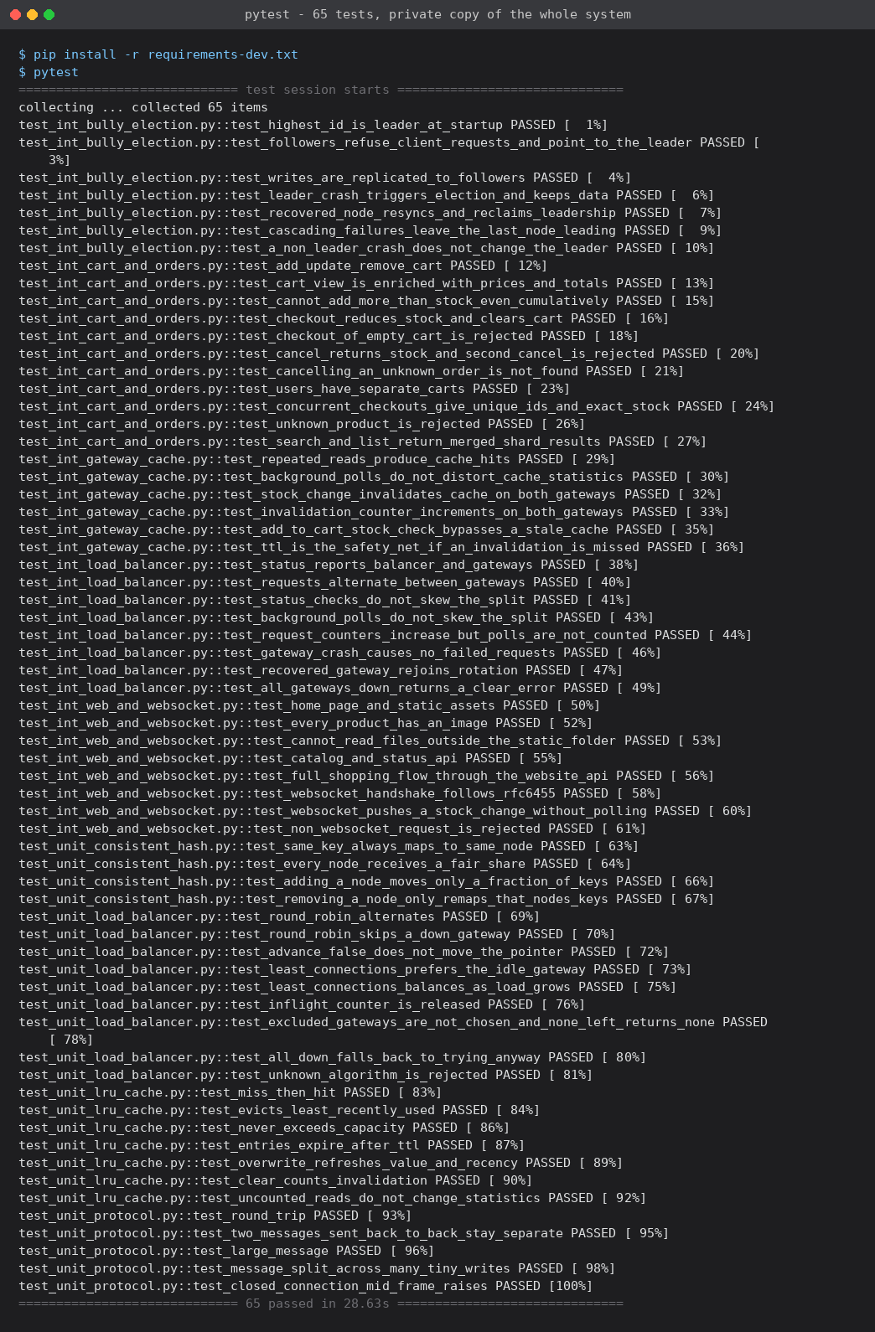
Automated tests: pytest
65 tests, about 30 s, all passing
25 unit: LRU/TTL, consistent hashing, framing, LB logic
40 integration on a private copy of all 10 processes
Kills gateways and the order leader, checks election, resync and zero failed requests
Mutation-checked: re-introduced 2 real bugs, tests failed, then passed again
MININYKAA_EXTERNAL=1 pytest tests a running deployment

