Slide 1
Customer Analysis & Statistical Validation
Data Analytics Internship - Task 4
Presented By:SRIUNNIKRISHNAN JS
ApexPlanet Internship Program

Slide 2
Project Objective
• Analyze customer purchasing behavior
• Identify high-value customer segments
• Study regional and sales trends
• Generate business recommendations
• Validate insights using statistical testing

Slide 3
Dataset Overview
Dataset Name: Superstore Sales Dataset
Total Rows: 9994
Total Columns: 21
Data Includes:
• Customer Information
• Product Details
• Sales & Profit
• Regional Data
• Discounts & Orders

Slide 4
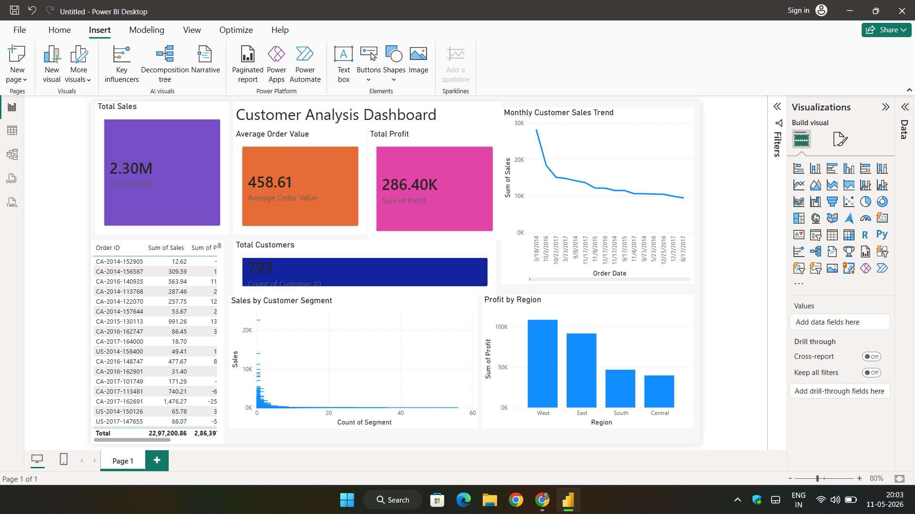
Key Performance Indicators

Slide 5
Customer Segment Analysis
Insights:
• Corporate customers generated highest sales
• Consumer segment contributed strong order volume
• Home Office segment showed lower contribution

Slide 6
Profit Analysis by Segment
Insights:
• Consumer segment produced strong profitability
• Corporate customers maintained stable profits
• Profitability varied across segments

Slide 7
Monthly Sales Trend
Insights:
• Sales increased during festive seasons
• Monthly fluctuations were observed
• Peak sales months generated higher revenue

Slide 8
Regional Customer Analysis
Insights:
• West region generated highest profit
• East region showed consistent sales
• Regional performance differed significantly

Slide 9
Top Customers Analysis
Insights:
• Few customers contributed major revenue
• High-value customers should be retained
• Customer loyalty programs can improve retention

Slide 10
Hypothesis Testing
Business Question:
Do discounts significantly affect customer purchases?
Null Hypothesis (H0):
Discounts do not affect customer purchases.
Alternative Hypothesis (H1):
Discounts significantly affect customer purchases.

Slide 11
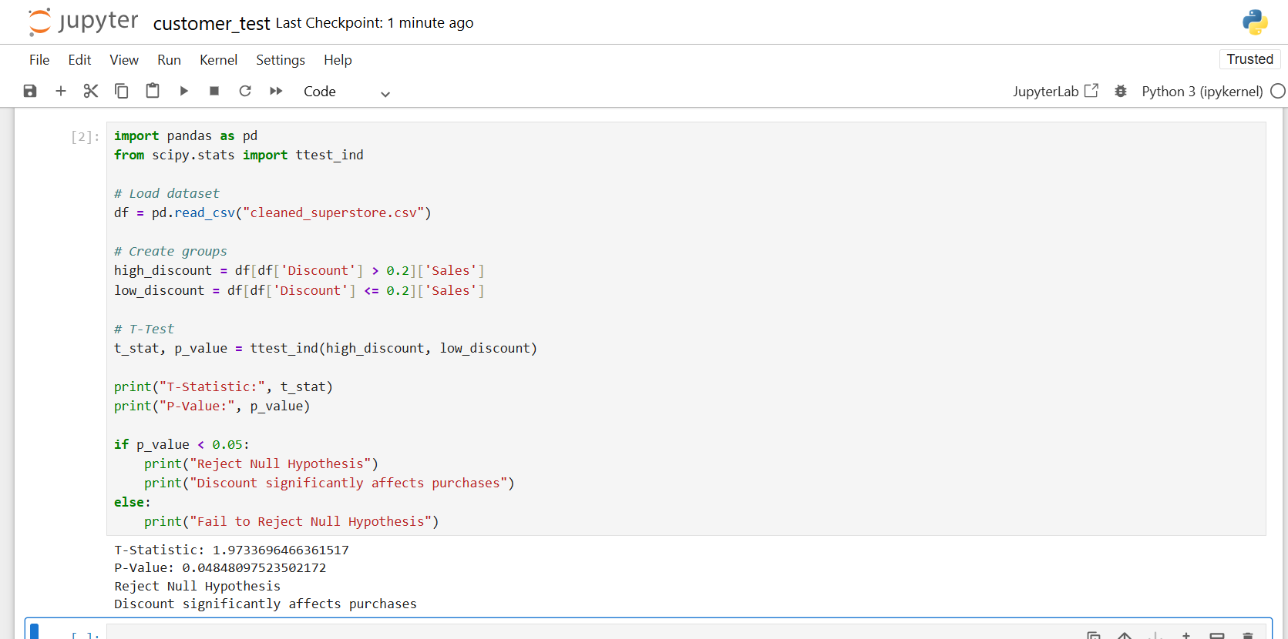
Statistical Test Results

Slide 12
Business Recommendations
1. Focus more on corporate customers
2. Improve customer retention strategies
3. Increase promotional campaigns
4. Expand operations in profitable regions
5. Enhance customer loyalty programs

Slide 13
Conclusion
The customer analysis identified
high-performing customer segments,
regional opportunities, and important
sales trends.
Statistical testing validated that
discount strategies significantly
impact customer purchasing behavior.

Slide 14
Thank You
Questions & Discussion

