Slide 1
CSDA 5430 Predictive Analytics
Chapter 16
Variable/Feature Selection
Notes:
https://www.socr.umich.edu/people/dinov/courses/DSPA_notes/16_FeatureSelection.html

Slide 2
Introduction
Variable selection and dimensionality reduction
Variable/feature selection methods
Random Forest Feature Selection
Case Study – ALS & QOL

Slide 3
Variable/Feature Selection
Variable selection, or feature selection, helps us focus on the most salient information contained in the observations
Variable/feature selection relates to dimensionality reduction
with differences
Method | Process Type | Goals | Approach
Variable selection | Discrete process | To select unique representative features from each group of similar features | To identify highly correlated variables and choose a representative feature by post processing the data
Dimension reduction | Continuous process | To denoise the data, enable simpler prediction, or group features so that low impact features have smaller weights | Find the essential, k≪n, components, factors, or clusters representing linear, or nonlinear, functions of the n variables which maximize an objective function like the proportion of explained variance
Supervised vs. unsupervised

Slide 4
Dimension Reduction
Reduce the number of features when dealing with a very large number of variables
Help extract a set of “uncorrelated” principal variables and reduce the complexity of the data
Construct new “uncorrelated” variables as functions of the old features
Not simply picking some of the original variables

Slide 5
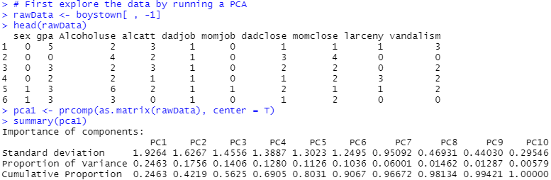
Dimension Reduction
PCA (principal component analysis) in exploring data (chapter 06)
Notes:
# from chapter 06
# 3.2 Step 2: Exploring and Preparing the Data
library(class)
library(gmodels)
boystown<-read.csv("https://umich.instructure.com/files/399119/download?download_frd=1", sep=" ")
boystown$sex<-boystown$sex-1
boystown$dadjob<--1*(boystown$dadjob-2)
boystown$momjob<--1*(boystown$momjob-2)
str(boystown)
# First explore the data by running a PCA
rawData <- boystown[ , -1]
head(rawData)
pca1 <- prcomp(as.matrix(rawData), center = T)
summary(pca1)
pca1$rotation
plot(pca1)
library(plotly)
plot_ly(x = c(1:length(pca1$sdev)), y = pca1$sdev*pca1$sdev, name = "Scree", type = "bar") %>%
layout(title="Scree Plot", xaxis = list(title="PC's"), yaxis = list(title="Variances (SD^2)"))

Slide 6
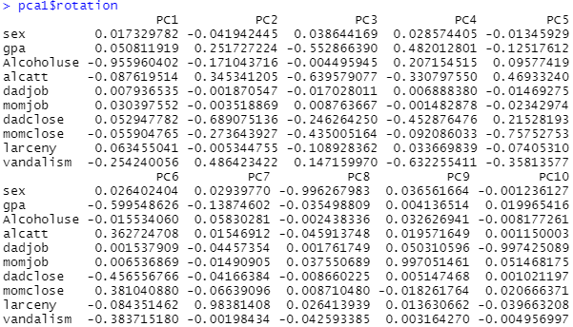
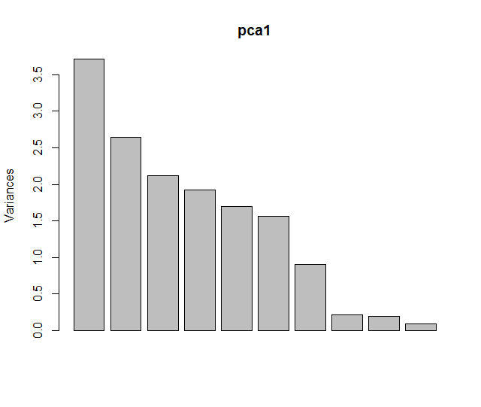
Dimension Reduction
PCA (principal component analysis) in exploring data (chapter 06)
Notes:
##############
# for supervised learning
# more than 1 vandalism or larceny conviction
Y <- ifelse (boystown$vandalism + boystown$larceny > 1, "Recidivism", "Control")
# covariate set excludes these 3 columns index/ID, vandalism, and larceny
X <- boystown[, -c(1, 10, 11)]
##############
# approach 1, PCA then partitioning
pca2 <- prcomp(as.matrix(X), center = T)
summary(pca2)
pca2$rotation
plot(pca2)
dim(pca2$x)
round(pca2$x, digits = 4)
# use PC1 - PC5
bt_pca_train <- pca2$x[1:150, 1:5]
bt_pca_test <- pca2$x[151:200, 1:5]
bt_train_labels <- Y[1:150]
bt_test_labels <- Y[151:200]
cbind(round(bt_pca_train, digits = 4), bt_train_labels)
table(bt_train_labels)
prop.table(table(bt_train_labels))
library(class)
bt_pca_test_pred<-knn(train=bt_pca_train, test=bt_pca_test, cl=bt_train_labels, k=9)
library(caret)
confusionMatrix(factor(bt_pca_test_pred, levels = c("Recidivism", "Control")),
factor(bt_test_labels, c("Recidivism", "Control")),
positive = "Recidivism")
##############
# approach 2, partitioning then PCA
bt_train <- X[1:150,]
bt_test <- X[151:200,]
bt_train_labels <- Y[1:150]
bt_test_labels <- Y[151:200]
bt_train_pca <- prcomp(as.matrix(bt_train), center = T)
summary(bt_train_pca)
bt_train_pca$rotation
plot(bt_train_pca)
dim(bt_train_pca$x)
round(bt_train_pca$x, digits = 4)
bt_train_pca1 = predict(bt_train_pca, bt_train)
bt_test_pca = predict(bt_train_pca, bt_test)
bt_pca_test_pred<-knn(train=bt_train_pca$x[,1:5], test=bt_test_pca[,1:5], cl=bt_train_labels, k=9)
confusionMatrix(factor(bt_pca_test_pred, levels = c("Recidivism", "Control")),
factor(bt_test_labels, c("Recidivism", "Control")),
positive = "Recidivism")

Slide 7
Feature Selection Methods
Major classes of variable or feature selection techniques
Filtering based techniques
Based on statistics (e.g., correlation-based feature selection)
Univariate vs. multivariate (correlation)
Wrapper based techniques
Based on model performance measures (e.g., recursive feature elimination)
Deterministic (forward or backward) vs. randomized
Embedded techniques
Based on model procedures (built-in)
Decision trees, random forests

Slide 8
Random Forest Feature Selection
Random forest based feature selection
An embedded technique
Prediction naturally leads to feature selection
Using information gain or accuracy gain
Splitting features capture the importance of variables
By computing its impact

Slide 9
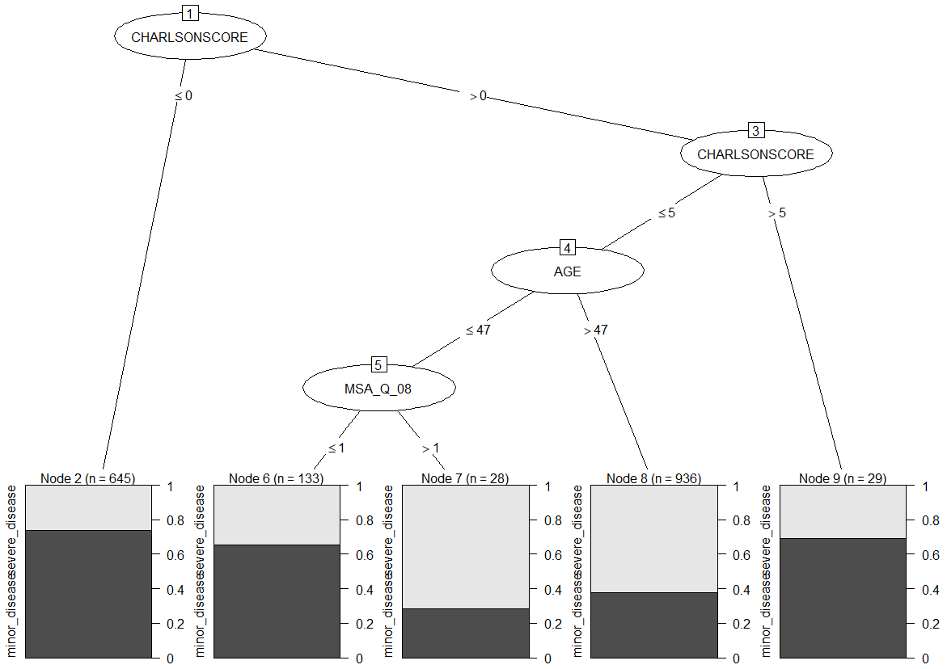
Random Forest Feature Selection
Feature importance leads to effective feature selection
Averaging information gain or accuracy gain
Boruta is a wrapper algorithm built around the random forest classification algorithm.

Slide 10
Feature Selection Algorithms
Algorithms used in case study for feature selection
Boruta
Randomized wrapper algorithm
RFE (recursive feature elimination)
Deterministic wrapper algorithm (backwards selection)
Filtering (univariate measure of goodness)
Stepwise and random forest
For comparison, both embedded
Notes:
https://www.machinelearningplus.com/machine-learning/feature-selection/

Slide 11
Case Study – ALS (Amyotrophic Lateral Sclerosis)
Step 1: collecting data
Step 2: exploring and preparing the data
Step 3: training a model on the data
Step 4: evaluating model performance
Comparing with RFE
Comparing with stepwise feature selection

Slide 12
Collecting Data
Definition of ALS (amyotrophic lateral sclerosis)
A fatal motor neuron disease that targets nerve cells in the spinal cord and brain
Characterized especially by increasing and spreading muscular weakness and atrophy
The dataset that contains 2,223 observations and 101 numeric variables
Outcome variable
ALSFRS slope
Patients’ clinical decline over a year

Slide 13
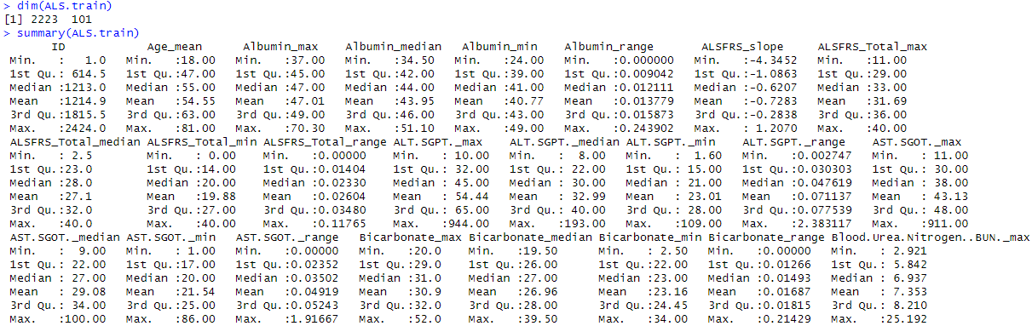
Collecting Data
The data contains multiple highly correlated features
Need to preprocess the variables before commencing with feature selection
Outcome
Partial list

Slide 14
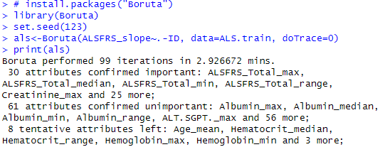
Training a Model on the Data
Use Boruta() function in Boruta package to perform variables selection
An all relevant feature selection wrapper algorithm
By default, Boruta uses Random Forest
Computes variable importance measure (VIM)
Performs a top-down search for relevant features
Progressively eliminating irrelevant features to stabilize that test
Boruta determines the important attributes from unimportant and tentative features.
Notes:
takes around 3 mins

Slide 15
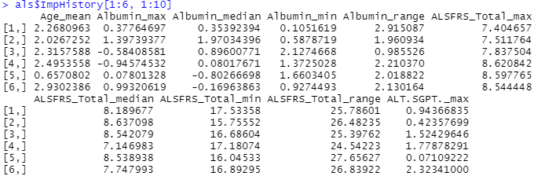
Training a Model on the Data
The importance scores for all features at every iteration
Stored in als$ImpHistory
List of top 6 iterations for first 10 features
Default iterations 100

Slide 16
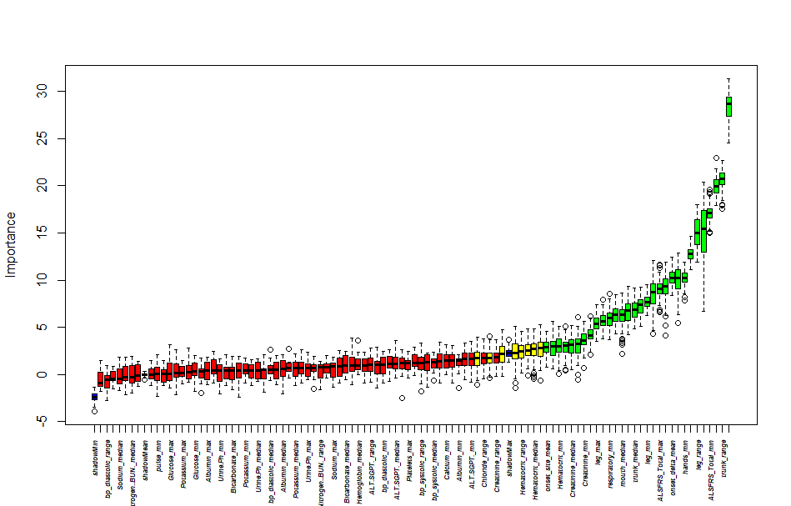
Training a Model on the Data
The importance scores for all features at every iteration
Boxplot importance of all features
Confirmed important
Confirmed unimportant
Tentative attributes

Slide 17
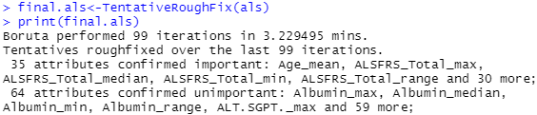
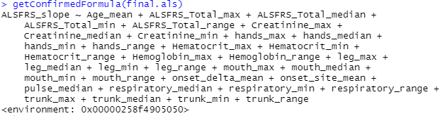
Training a Model on the Data
To get rid of tentative features
The function TentativeRoughFix()
Performs a simplified and weaker test for judging tentative attributes
Only when strict decision is highly desired
Confirmed important
Confirmed unimportant
No tentative
Confirmed 35 features

Slide 18
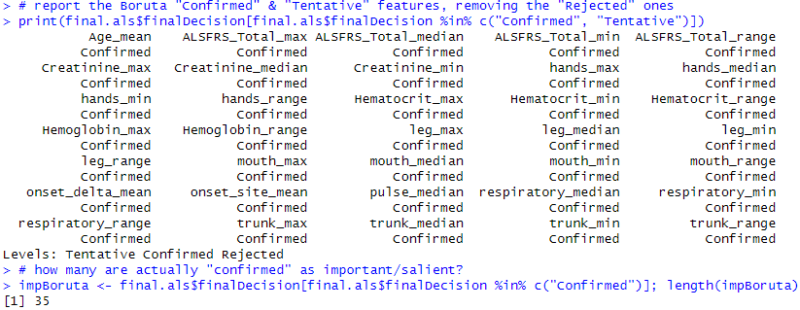
Training a Model on the Data
Remove rejected ones
List confirmed 35 features

Slide 19
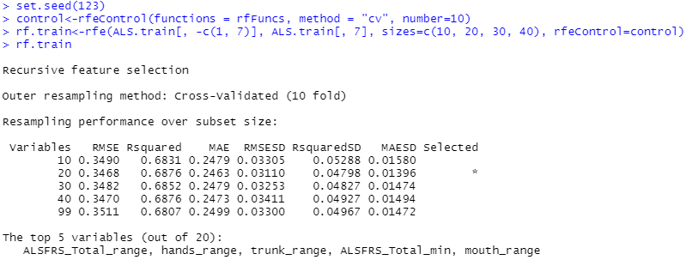
Evaluating Model Performance
Comparing with RFE (backwards recursive feature elimination)
RFE, in caret package, implements backwards selection based on predictor importance ranking
To compare the model performance for alternative numbers of features
Cross validation with 10 folds
Sizes specify the number of features that should be retained
Pre-defined functions:
lmFuncs -- linear regression
rfFuncs -- random forests
nbFuncs -- naive Bayes
treebagFuncs -- bagged trees
Notes:
takes around 10 mins

Slide 20
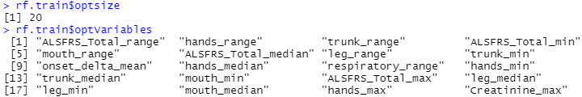
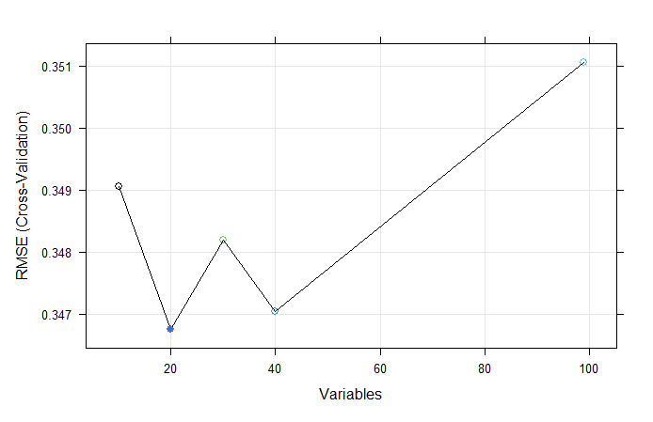
Evaluating Model Performance
RFE best subset
20 best subset
Notes:
rf.train$optsize
rf.train$optVariables

Slide 21
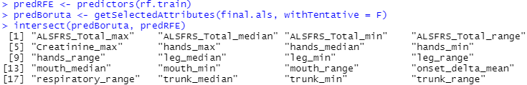
Evaluating Model Performance
Compare the final results of the two alternative feature selection methods
There are common variables chosen by the two techniques
Boruta method is effective when dealing with complex real world problems

Slide 22
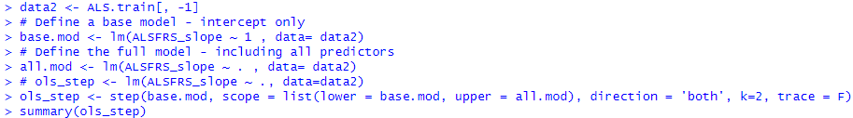
Evaluating Model Performance
Comparing with stepwise feature selection
Bidirectional stepwise linear model-based feature selection
Refer to ch09, the step() function choose a model in stepwise algorithm.
Scope defines the range of models examined in the stepwise search.
k=2 yields the genuine AIC criterion
k=log(n) refers to BIC

Slide 23
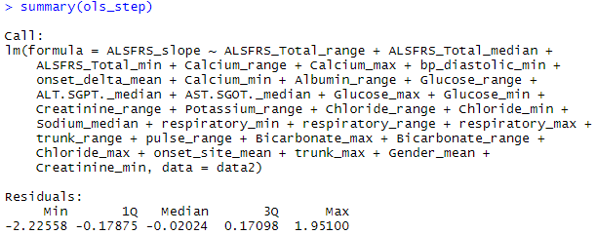
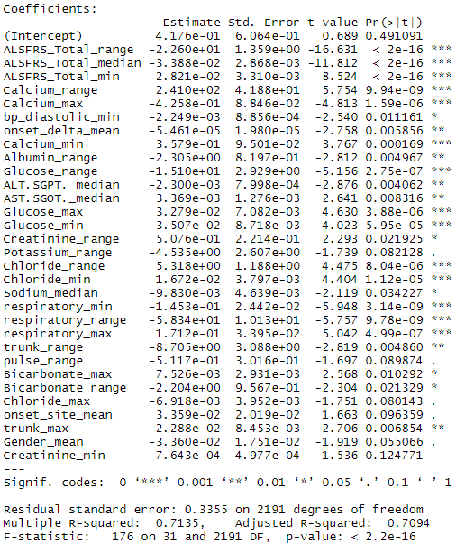
Evaluating Model Performance
Comparing with stepwise feature selection
Bidirectional stepwise linear model-based feature selection

Slide 24
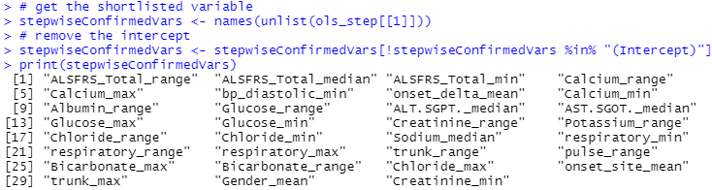

Evaluating Model Performance
Comparing with stepwise feature selection
Report the stepwise “Confirmed” (important) features
After intercept removed
After removing intercept, there are 31 stepwise confirmed features.
There are common variables chosen by the Boruta and Stepwise feature selection methods.
Notes:
intersect(intersect(predBoruta, stepwiseConfirmedVars), predRFE)

Slide 25
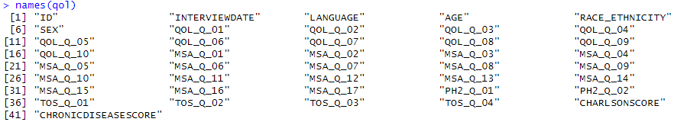
Case Study - QOL
Step 1: collecting data
Step 2: exploring and preparing the data
Step 3: training a model on the data
Step 4: evaluating model performance
Comparing with RFE
Comparing with stepwise feature selection
Notes:
## from chapter 8 decision tree
# 4.2 Step 2: exploring and preparing the data
qol<-read.csv("https://umich.instructure.com/files/481332/download?download_frd=1")
str(qol)
table(qol$QOL_Q_01)
qol<-qol[!qol$CHRONICDISEASESCORE==-9, ]
summary(qol$CHRONICDISEASESCORE)
qol$cd<-qol$CHRONICDISEASESCORE>1.497
# qol$cd<-factor(qol$cd, levels=c(F, T), labels = c("minor_disease", "severe_disease"))
# assuming it's more important to identify "severe disease"
qol$cd<-factor(qol$cd, levels=c(T, F), labels = c("severe_disease", "minor_disease"))
# 4.2.1 Data preparation: creating random training and test datasets
qol<-qol[order(qol$ID), ]
# Remove ID (col=1) # the clinical Diagnosis (col=41) will be handled later
qol <- qol[ , -1]
#qol_train<-qol[1:2114, ]
#qol_test<-qol[2115:2214, ]
set.seed(1234)
train_index <- sample(seq_len(nrow(qol)), size = 0.8*nrow(qol))
qol_train<-qol[train_index, ]
qol_test<-qol[-train_index, ]
prop.table(table(qol_train$cd))
prop.table(table(qol_test$cd))
## from chapter 16 variable/feature selection
# 3.3 Step 3 - training a model on the data
# install.packages("Boruta")
library(Boruta)
set.seed(123)
# !!!!!takes about 1 min!!!!!!
qol_Boruta<-Boruta(CHRONICDISEASESCORE~., data=qol_train[,-41], doTrace=0)
print(qol_Boruta)
qol_Boruta$ImpHistory[1:6, 1:10]
plot(qol_Boruta, xlab="", xaxt="n")
lz<-lapply(1:ncol(qol_Boruta$ImpHistory), function(i)
qol_Boruta$ImpHistory[is.finite(qol_Boruta$ImpHistory[, i]), i])
names(lz)<-colnames(qol_Boruta$ImpHistory)
lb<-sort(sapply(lz, median))
axis(side=1, las=2, labels=names(lb), at=1:ncol(qol_Boruta$ImpHistory), cex.axis=0.5, font = 4)
library(plotly)
df_long <- tidyr::gather(as.data.frame(qol_Boruta$ImpHistory), feature, measurement)
plot_ly(df_long, y = ~measurement, color = ~feature, type = "box") %>%
layout(title="Box-and-whisker Plots across all Features (QoL Data)",
xaxis = list(title="Features"),
yaxis = list(title="Importance"),
showlegend=F)
final.qol<-TentativeRoughFix(qol_Boruta)
print(final.qol)
final.qol$finalDecision
getConfirmedFormula(final.qol)
# report the Boruta "Confirmed" & "Tentative" features, removing the "Rejected" ones
print(final.qol$finalDecision[final.qol$finalDecision %in% c("Confirmed", "Tentative")])
# how many are actually "confirmed" as important/salient?
impBoruta <- final.qol$finalDecision[final.qol$finalDecision %in% c("Confirmed")]; length(impBoruta)
# 3.4 Step 4 - evaluating model performance
# 3.4.1 Comparing with RFE
library(caret)
library(randomForest)
set.seed(123)
control<-rfeControl(functions = rfFuncs, method = "cv", number=10)
#qol.rf.train<-rfe(qol_train[, -c(40,41)], qol_train[, 40], sizes=c(10, 20, 30, 40), rfeControl=control)
#!!!!!!!! takes around 3 mins!!!!!!!!
qol.rf.train<-rfe(qol_train[, -c(40,41)], qol_train[, 40], sizes=c(5, 10, 20, 30), rfeControl=control)
qol.rf.train
plot(qol.rf.train, type=c("g", "o"), cex=1, col=1:5)
predRFE <- predictors(qol.rf.train)
predBoruta <- getSelectedAttributes(final.qol, withTentative = F)
intersect(predBoruta, predRFE)
# 3.4.2 Comparing with stepwise feature selection
data2 <- qol_train[, -41]
# Define a base model - intercept only
base.mod <- lm(CHRONICDISEASESCORE ~ 1 , data= data2)
# Define the full model - including all predictors
all.mod <- lm(CHRONICDISEASESCORE ~ . , data= data2)
# ols_step <- lm(CHRONICDISEASESCORE ~ ., data=data2)
ols_step <- step(base.mod, scope = list(lower = base.mod, upper = all.mod), direction = 'both', k=2, trace = F)
summary(ols_step)
#ols_step
# get the shortlisted variable
stepwiseConfirmedVars <- names(unlist(ols_step[[1]]))
# remove the intercept
stepwiseConfirmedVars <- stepwiseConfirmedVars[!stepwiseConfirmedVars %in% "(Intercept)"]
print(stepwiseConfirmedVars)
library(mlbench)
library(caret)
# estimate variable importance
predStepwise <- varImp(ols_step, scale=FALSE)
# summarize importance
print(predStepwise)
# plot predStepwise
# plot(predStepwise)
# Boruta vs. Stepwise feataure selection
intersect(predBoruta, stepwiseConfirmedVars)
################
# ch08 decision tree
# 7.4 Step 5: Alternative Model2
# install.packages("randomForest")
require(randomForest)
set.seed(12)
# rf.fit <- tuneRF(qol_train[ , -40], qol_train[ , 40], stepFactor=1.5)
rf.fit1 <- randomForest(cd~. , data=qol_train[ , -40],importance=TRUE,ntree=2000,mtry=26)
#rf.fit2 <- randomForest(qol$CHRONICDISEASESCORE~. , data=qol_train[ , -41],importance=TRUE,ntree=2000,mtry=26)
varImpPlot(rf.fit1, cex=0.5); print(rf.fit1)
#varImpPlot(rf.fit2, cex=0.5); print(rf.fit)
qol_pred2<-predict(rf.fit1, qol_test, type = 'class')
confusionMatrix(table(qol_pred2, qol_test$cd))
imp <- randomForest::importance(rf.fit1)
impvar <- rownames(imp)[order(imp[, 1], decreasing=TRUE)]

Slide 26
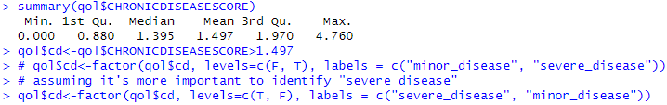
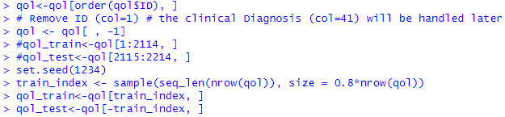
Collecting Data
The dataset that contains 2,214 observations and 40 variables
Outcome variable: cd derived from CHRONICDISEASESCORE

Slide 27
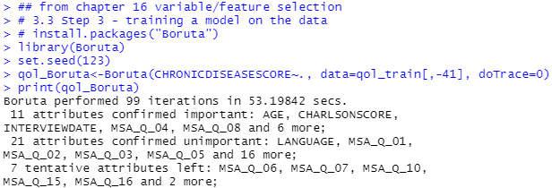
Training a Model on the Data
Use Boruta() function in Boruta package to perform variables selection
Notes:
takes about 1 mins

Slide 28
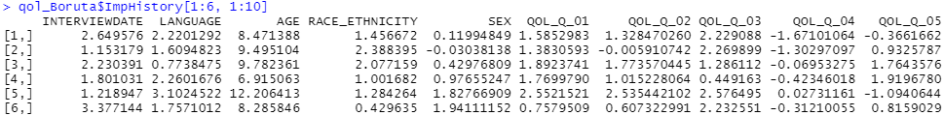
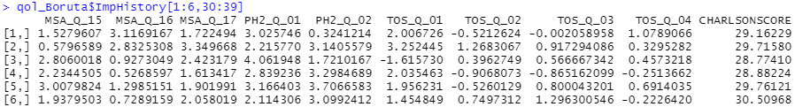
Training a Model on the Data
The importance scores for all features at every iteration
Stored in qol_Boruta$ImpHistory

Slide 29
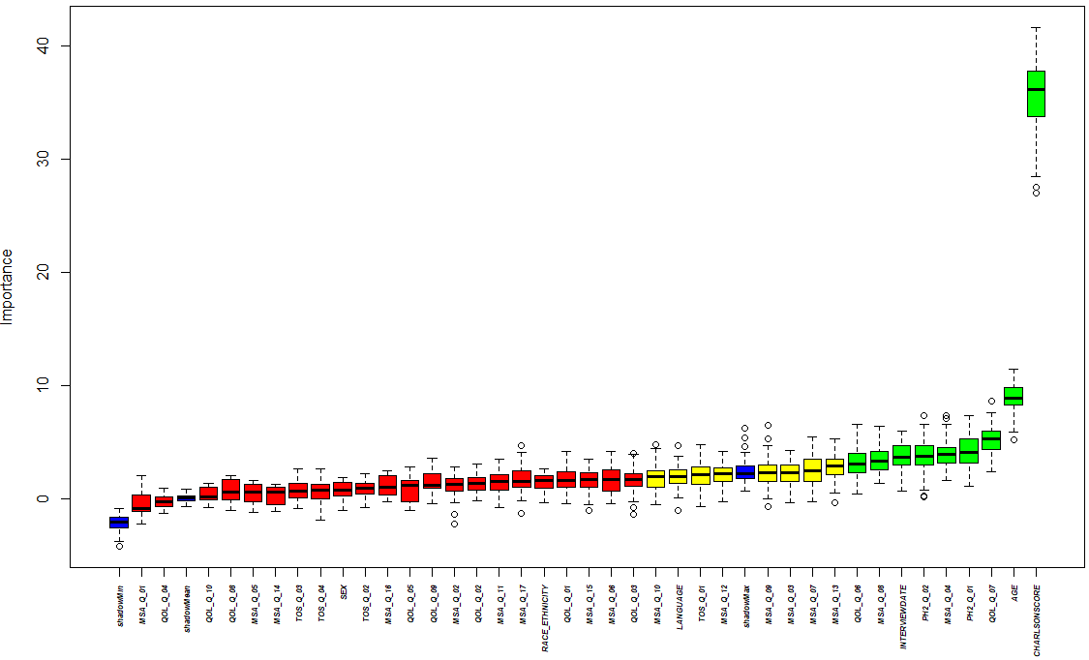
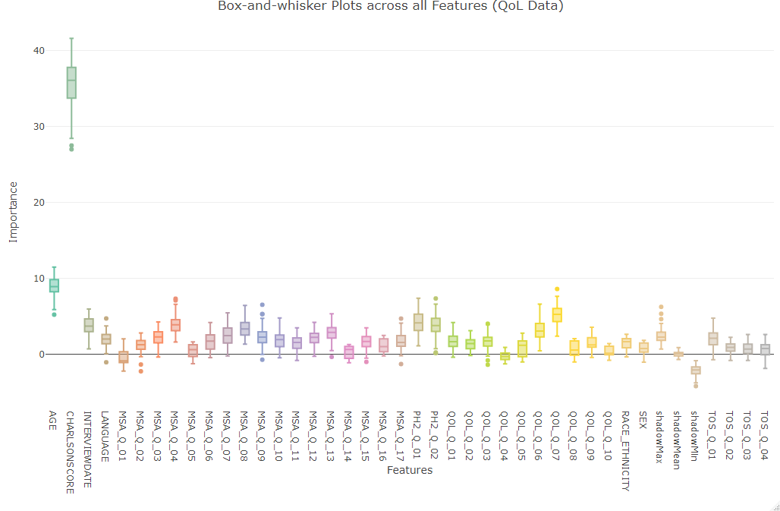
Training a Model on the Data
The importance scores for all features at every iteration
Stored in qol_Boruta$ImpHistory

Slide 30
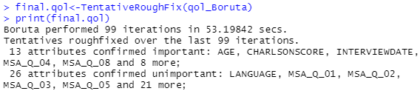

Training a Model on the Data
To get rid of tentative features
Only when strict decision is highly desired

Slide 31
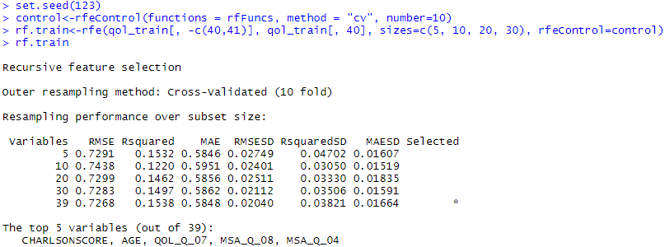
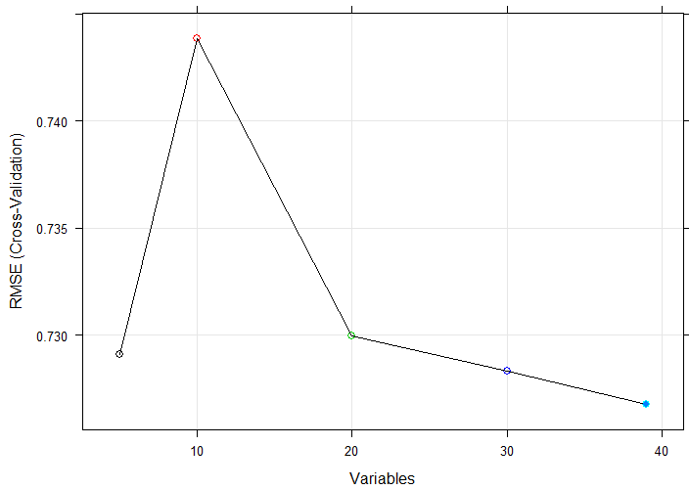
Evaluating Model Performance
Comparing with RFE (recursive feature elimination)
To compare the model performance for alternative numbers of features
sizes=c(5, 10, 20, 30)
Notes:
takes about 3 mins

Slide 32

Evaluating Model Performance
Compare the final results of the two alternative feature selection methods
There are common variables chosen by the two techniques
Boruta method is effective when dealing with complex real world problems

Slide 33
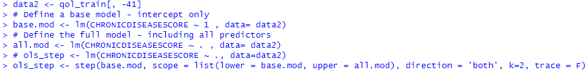
Evaluating Model Performance
Comparing with stepwise feature selection
Bidirectional stepwise linear model-based feature selection
k=2 yields the genuine AIC criterion
k=log(n) refers to BIC

Slide 34
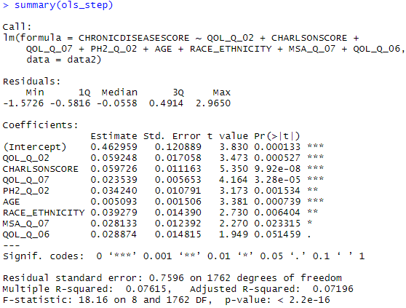
Evaluating Model Performance
Comparing with stepwise feature selection
Bidirectional stepwise linear model-based feature selection

Slide 35
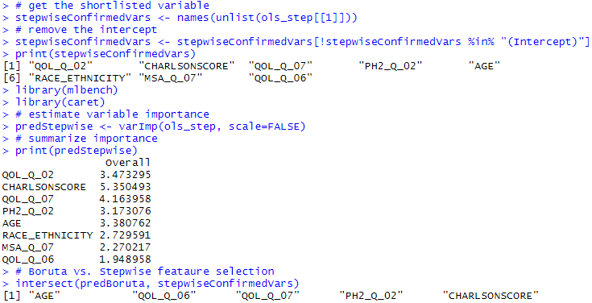
Evaluating Model Performance
Comparing with stepwise feature selection
Report the stepwise “Confirmed” (important) features:
There are 8 stepwise confirmed features.
There are common variables chosen by the Boruta and Stepwise feature selection methods.
Notes:
intersect(intersect(predBoruta, stepwiseConfirmedVars), predRFE)

Slide 36
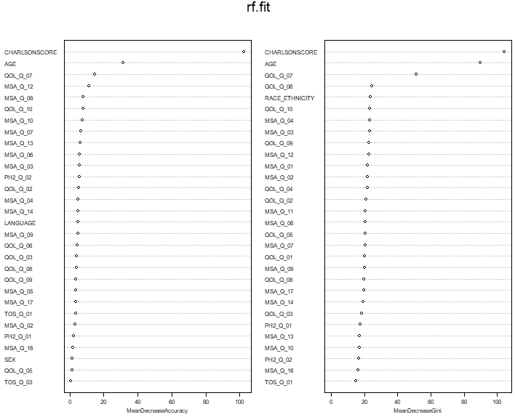
Evaluating Model Performance
Comparing with random forest (chapter 8 alternative model 2)

Slide 37
Applying Selected Features
Comparing alternative numbers of features from different models
Boruta | RFE top | Stepwise | Random forest
CHRONICDISEASESCORE ~
INTERVIEWDATE
AGE | x | x | x | x
QOL_Q_06 |  | x |  | x
QOL_Q_07 | x | x | x | x
MSA_Q_04 | x |  |  | x
MSA_Q_08 | x |  | x
MSA_Q_10 |  |  | x
MSA_Q_12 |  |  | x
MSA_Q_13
MSA_Q_15
PH2_Q_01
PH2_Q_02 |  | x
CHARLSONSCORE | x | x | x | x
QOL_Q_02 |  | x
RACE_ETHNICITY |  | x |  | x
MSA_Q_07 |  | x | x
QOL_Q_10 |  |  | x | x
MSA_Q_03 |  |  |  | x
Notes:
Boruta RFE top stepwise rf
INTERVIEWDATE
AGE x x x x
QOL_Q_06 x x
QOL_Q_07 x x x x
MSA_Q_04 x x
MSA_Q_08 x x
MSA_Q_10 x
MSA_Q_12 x
MSA_Q_13
MSA_Q_15
PH2_Q_01
PH2_Q_02 x
CHARLSONSCORE x x x x
QOL_Q_02 x
RACE_ETHNICITY x x
MSA_Q_07 x x
QOL_Q_10 x x
MSA_Q_03 x

Slide 38

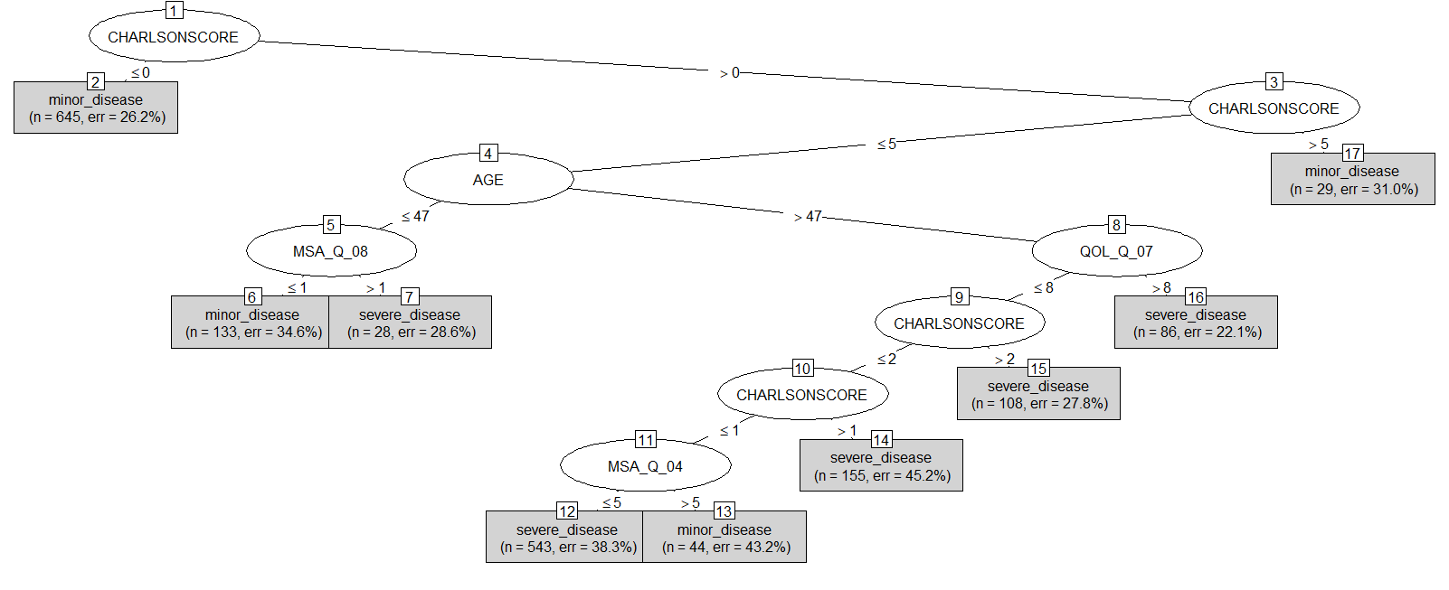
Applying Selected Features
From Chapter 8, classification tree with C5.0()
Using top 6 predictors
Notes:
qol<-read.csv("https://umich.instructure.com/files/481332/download?download_frd=1")
str(qol)
table(qol$QOL_Q_01)
qol<-qol[!qol$CHRONICDISEASESCORE==-9, ]
summary(qol$CHRONICDISEASESCORE)
qol$cd<-qol$CHRONICDISEASESCORE>1.497
# qol$cd<-factor(qol$cd, levels=c(F, T), labels = c("minor_disease", "severe_disease"))
# assuming it's more important to identify "severe disease"
qol$cd<-factor(qol$cd, levels=c(T, F), labels = c("severe_disease", "minor_disease"))
# 4.2.1 Data preparation: creating random training and test datasets
qol<-qol[order(qol$ID), ]
# Remove ID (col=1) # the clinical Diagnosis (col=41) will be handled later
qol <- qol[ , -1]
#qol_train<-qol[1:2114, ]
#qol_test<-qol[2115:2214, ]
set.seed(1234)
train_index <- sample(seq_len(nrow(qol)), size = 0.8*nrow(qol))
qol_train<-qol[train_index, ]
qol_test<-qol[-train_index, ]
prop.table(table(qol_train$cd))
prop.table(table(qol_test$cd))
# 4.3 Step 3: Training a Model On the Data
# install.packages("C50")
library(C50)
summary(qol_train[,-c(40, 41)])
# qol_train1<-qol_train[,c("INTERVIEWDATE", "AGE","QOL_Q_06","QOL_Q_07",
# 'MSA_Q_04',"MSA_Q_08","MSA_Q_10","MSA_Q_12",
# "MSA_Q_13" , 'MSA_Q_15',"PH2_Q_01","PH2_Q_02",
# "CHARLSONSCORE")]
qol_train1<-qol_train[,c("AGE","QOL_Q_06","QOL_Q_07",
'MSA_Q_04',"MSA_Q_08",
"CHARLSONSCORE")]
set.seed(1234)
qol_model<-C5.0(qol_train1, qol_train$cd)
qol_model
summary(qol_model)
# plot(qol_model, type = "simple")
# 4.4 Step 4: Evaluating Model Performance
# See docs for predict # ?C50::predict.C5.0
qol_pred<-predict(qol_model, qol_test[ ,-c(40, 41)]) # removing the last 2 columns CHRONICDISEASESCORE and cd, which represent the clinical outcomes we are predicting!
# install.packages("caret")
library(caret)
confusionMatrix(table(qol_pred, qol_test$cd))

Slide 39
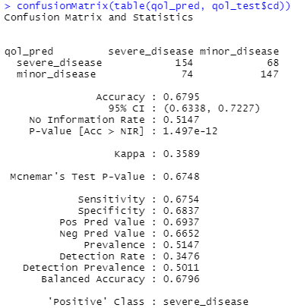
Applying Selected Features
From Chapter 8, classification tree with C5.0()
Using top 6 predictors
The classification performance is almost same as using 39 predictors (chapter 08 slide 27~29), with different tree size though.

