Slide 1
CSDA 5430 Predictive Analytics
Chapter 19
Natural Language Processing/Text Mining
Notes:
https://www.socr.umich.edu/people/dinov/courses/DSPA_notes/19_NLP_TextMining.html

Slide 2
Introduction
Text as a form of data
Various text processing strategies
Text preprocessing
Tokenization, text reduction, bag of words
Document term matrix or term document matrix
Document term frequency (TF)
Inverse document frequency (IDF)
Text mining analytics

Slide 3
Text as a Form of Data
Big data variety
Different types of data, mostly unstructured, being generated
Data come in text form
To classify support tickets as urgent or routine
To review documents and classify as relevant or irrelevant
In text data, input variables (features) are embedded as text in documents
Social media data
Twitter feed, blogs, online forums, review sites, and news articles
Notes and transcripts from contact centers and service centers

Slide 4
Text as a Form of Data
Text Is important
Text is just another form of data
Text is everywhere
In business, understanding customer feedback often requires understanding text
Text Is difficult
Text is unstructured data and relatively dirty
Intended for communication between people, context is important, much more so than with other forms of data
Need undergo a good amount of preprocessing before it can be used as input to a data mining algorithm

Slide 5
Text as a Form of Data
Text mining or text analytics (TM/TA) examines large volumes of unstructured text
Extract new information, discover context, identify linguistic motifs
Transform the text and derive quantitative data that can be further analyzed
Text analysis protocol involves:
Construction of a document-term matrix (DTM)
Apply a statistical analysis or a machine learning techniques for prediction, clustering, classification, similarity search, network/sentiment analysis, or forecasting using the DTM
Apply and evaluate the technique to new data

Slide 6
A Simple NLP/TM Example
Preprocessing and transform unstructured text
Define and load the unstructured-text documents
Create a new VCorpus (volatile corpus) object
To-lower case transformation
Text pre-processing
Remove Stopwords
Remove punctuation
Stemming: removal of plurals and action suffixes
Bags of words
Document-term matrix

Slide 7
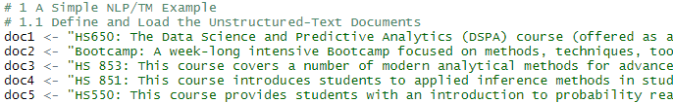
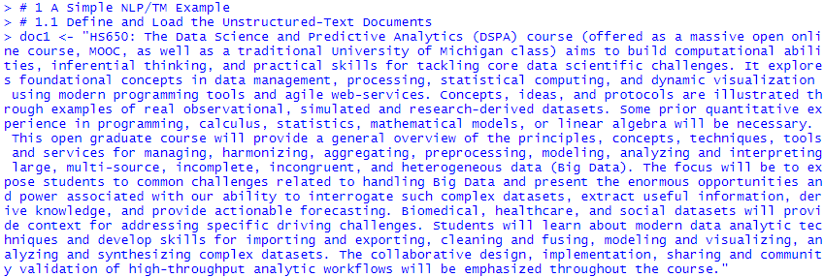
Define and Load the Unstructured-Text Documents
Use tm package to do text mining

Slide 8
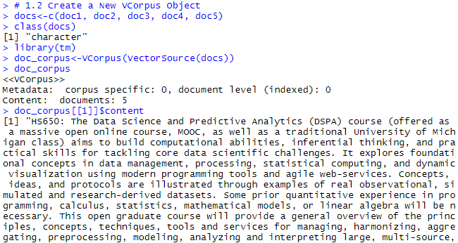
Create a New Corpus Object
Corpus is a collection of documents
The function VCorpus() creates a volatile corpus
The object includes all the text and some meta-data about the text
The goal is to process the text and produce structured quantitative representation of the original unstructured text.

Slide 9
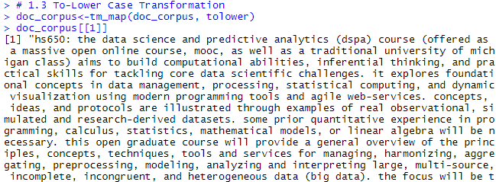
To-Lower Case Transformation
Convert everything to lower case
Notes:
#may use
doc_corpus<-tm_map(doc_corpus, content_transformer(tolower))
# if above line is used, the following line is unnecessary
doc_corpus<-tm_map(doc_corpus, PlainTextDocument)
# Function content_transformer() provides a convenient wrapper to access and set the content of a document.
# Most text manipulation functions from base R can directly be used with this wrapper.

Slide 10
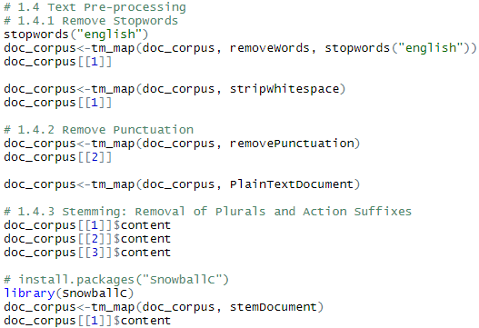
Text Pre-Processing
Tokenization
Process of taking a text and dividing it into separate “tokens” or terms
A token (term) is the basic unit of analysis
Remove stopwords
Stopwords, or common words
Have semantic meaning
But low analytic value
Remove punctuation
Stemming
Removal of plurals and action suffixes
Convert back to original format
Notes:
wordStem(c("win", "winning", "winner"))
getStemLanguages()

Slide 11
Bags of Words
Bag of words model
Treat every document as just a collection of individual words
Represent documents in matrix form based on their term frequencies (TFs)
Construct document-term matrix (DTM)
Or term-document matrix (TDM)
 | Term 1 | Term 2 | Term 3 | … | Term M
Doc 1
Doc 2
Doc 3
…
Doc N
The basic bag of words model is invariant to ordering of the words within a document.
N-gram sequences include sequences of adjacent words as terms.

Slide 12
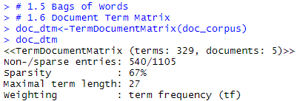
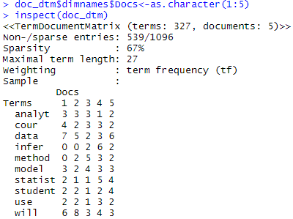
Document-Term Matrix
The DTM/TDM tell us if a specific term appear in a specific document
329 different terms in the 5 documents
540/(540/1105)
Construct a TDM.
Notes:
##Error in `[.simple_triplet_matrix`(x, docs, terms) : Repeated indices currently not allowed.
doc_dtm$dimnames$Docs<-as.character(1:5) #need this line to inspect
inspect(doc_dtm)

Slide 13
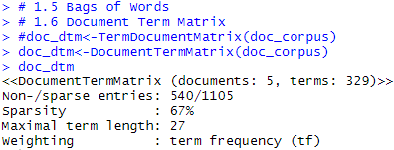
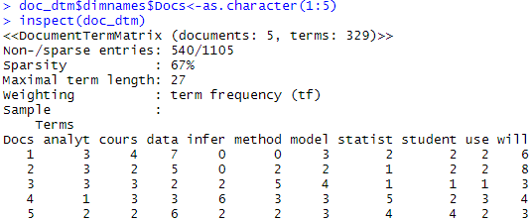
Document-Term Matrix
The DTM/TDM tell us if a specific term appear in a specific document
329 different terms in the 5 documents
Construct a DTM.
DTM and TDM contain same information.

Slide 14
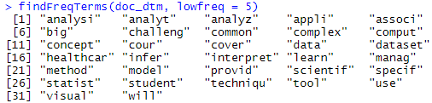
Document-Term Matrix
The DTM/TDM tell us if a specific term appear in a specific document
Find and report the frequent terms
Compute the correlations between terms
Determine the words that are highly correlated
Notes:
as.matrix(doc_dtm)[,"statist"]
as.matrix(doc_dtm)[,"appli"]
cor(as.matrix(doc_dtm)[,"statist"], as.matrix(doc_dtm)[,"appli"])
plot(as.matrix(doc_dtm)[,"statist"], as.matrix(doc_dtm)[,"appli"])

Slide 15
Case-Study: Job Ranking
2011 USA jobs ranking dataset
Step 1: make a VCorpus object
Step 2: clean the VCorpus object
Step 3: build document-term matrix
Modeling for analytics

Slide 16
Case-Study: Job Ranking
2011 USA jobs ranking dataset variables
Index: Ranks based on the overall score variable
Job Title: A brief title of the profession
Overall Score: Overall rank of this job using the remaining explanatory variables
Average Income (USD): An estimate of the mid-levels income for this profession
Work Environment: Reflects physical and emotional components
Stress Level: Expected level of job-related stress
Physical Demand: The total physical demand
Hiring Potential: Future outlook and future potential
Description: A brief job description for each profession
Notes:
Variables
Index: Ranks of the 200 most common jobs based on the Overall_Score variable (lower rank/index indicates better job, and higher rank indicates a less desirable job for 2011). Overall Rank Index represents the sum of the rankings in each of the five variable (below) where each of the variables are assumed (!) to be equally important.
Job_Title: A brief title of the profession.
Overall_Score: A Dependent variable corresponding to the linearly predicted overall rank of this job using the remaining explanatory variables (below).
Average_Income (USD): An estimate of the mid-levels income for this profession.
Work_Environment: Work environment for each job reflects 2 basic factors: physical and emotional components. Points are assigned for potential for adverse working conditions (larger scores). In other words, fewer work-environment points would yield a lower (better) job rank and higher points reflect lower quality environments.
Stress_Level: Expected level of job-related stress dependent on 11 potential stress factors. A high stress score implies that stress is a major part of the job, and lower stress score indicates lower job-relates stress. Factors contributing to stress level score include: Travel, Outlook/Growth Potential, Income, Deadlines, Working in the Public Eye, Competitiveness, Physical Demands, Environmental Conditions, Hazards Encountered, Own Life at Risk, Co-Worker Life at Risk, Meeting the Public.
Physical_Demand: The total physical demand if a job is measures using five categories: Sedentary Work (requiring only the occasional lifting of 10lbs or less), Light Work (requiring lifting a maximum of 20lbs), Medium Work (requiring lifting a maximum of 50lbs), Heavy Work (requiring lifting a maximum of 100lbs) and Very Heavy Work (requiring lifting in excess of 100lbs).
Hiring_Potential: The hiring-potential rank assigns higher scores to jobs with promising future outlook and lower scores for less future potential. This ranking is based on 3 factors: US Department of Labor expected employment growth (2011-2018), income growth potential (expected salary increase in the next 7 years), and unemployment chance (estimate of the likelihood for unemployment through 2018).
Description: A brief job description for each profession.

Slide 17
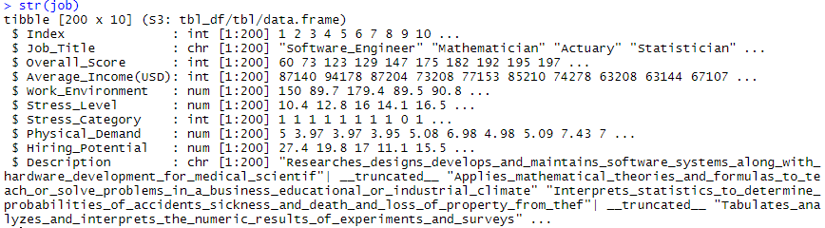
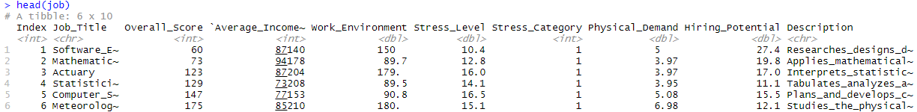
Case-Study: Job Ranking
2011 USA jobs ranking dataset

Slide 18
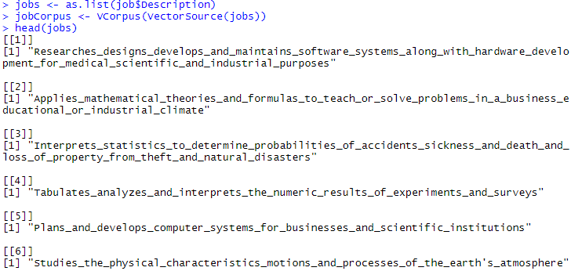
Make a VCorpus Object
The aim of our study now is to explore the difference between the top 30 desirable jobs and the bottom 100 jobs based on their textural job descriptions.
The documents are the Description column (a text vector) in the dataset

Slide 19
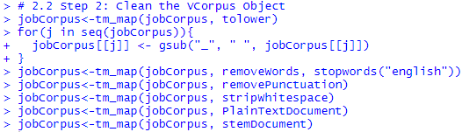
Clean the VCorpus Object
Converting to lower case
Removing stopwords, punctuation, white space
Substitute “_”
Stemming
Notes:
#may use
jobCorpus<-tm_map(jobCorpus, content_transformer(tolower))

Slide 20
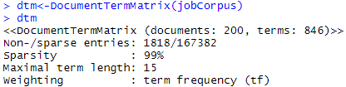
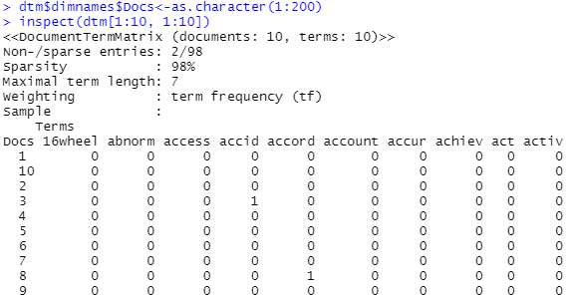
Build Document-Term Matrix
Obtain DTM (document-term matrix) object
Using tm::DocumentTermMatrix()
Notes:
##Error in `[.simple_triplet_matrix`(x, docs, terms) : Repeated indices currently not allowed.
dtm$dimnames$Docs<-as.character(1:200) #need this line to inspect
inspect(dtm[1:10, 1:10])

Slide 21
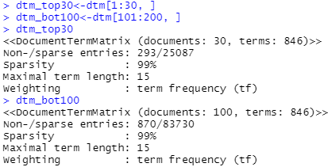
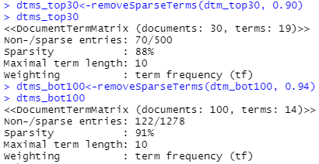
Build Document-Term Matrix
Top 30 and bottom 100 with maximal allowed sparsity
Remove some of the words that rarely appear in the job descriptions
removeSparseTerms()
smaller set of terms left
Notes:
Remove sparse terms from a document-term or term-document matrix.
removeSparseTerms(x, sparse)
x: a DocumentTermMatrix or a TermDocumentMatrix.
sparse: a numeric for the maximal allowed sparsity.

Slide 22
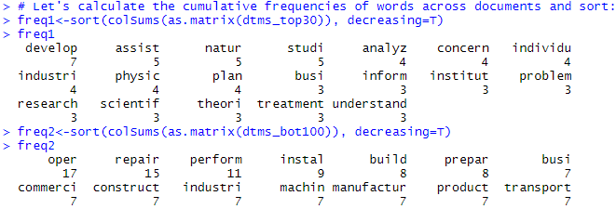
Term Frequency (TF)
Count the term frequencies in two document-term matrices
19 and 14 terms left respectively

Slide 23
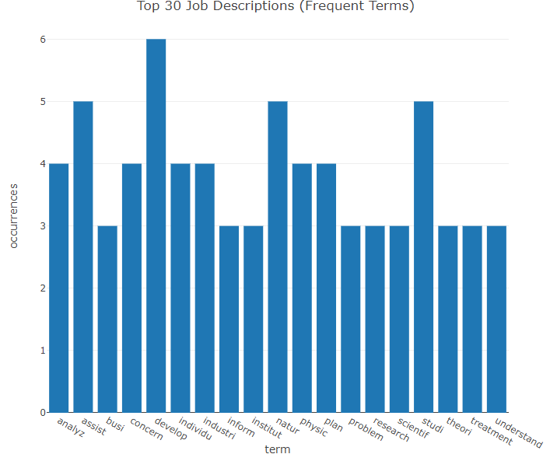
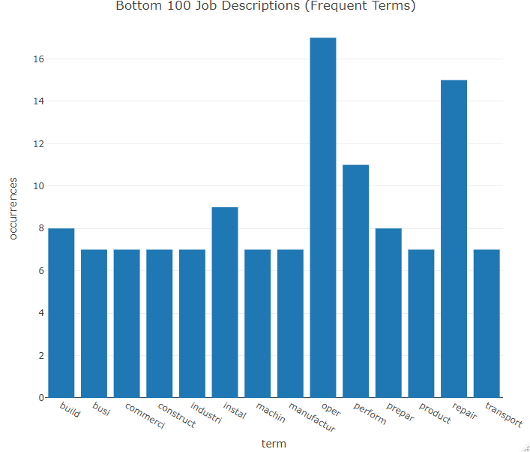
Term Frequency (TF)
Plot frequent words (top 30 vs. bottom 100 jobs)

Slide 24
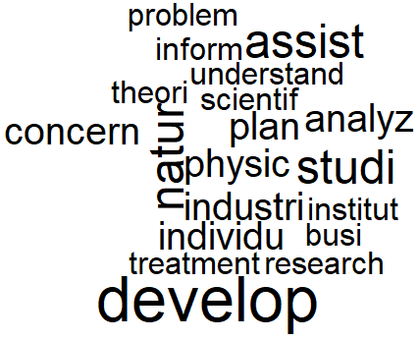
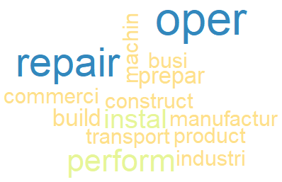
Word Cloud
Top 30 jobs tend to focus more on research or discovery
With frequent keywords like “study”, “nature”, and “analyze”
Bottom 100 jobs are more focused on mechanistic operations
With frequent keywords like “operation”, “repair”, and “perform”

Slide 25
Text Mining Analytics
Apply data analytics techniques on DTM or TDM
Prediction
Classification
Clustering
For job ranking case study, use DTM to build classifiers
To classify whether a job ranks top 30 in the job list
Outcome -- an indicator of high rank (job is in the top 30 list)
Classification model with naïve Bayes
As we did in chapter 7

Slide 26
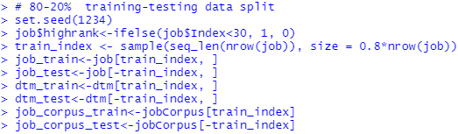
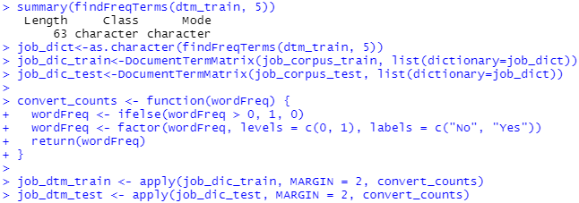
Text Mining Analytics – Classification
Classification model with naïve Bayes (as we did in chapter 7)
Preparing data
Labeling for supervised learning: the first task would be to create an indicator of high rank (job is in the top 30 list).
job_* contains outcome.
dtm_* contains predictors.
Job_corpus_* generates dtm.
Notes:
# 80-20% training-testing data split
set.seed(1234)
job$highrank<-ifelse(job$Index<30, 1, 0)
train_index <- sample(seq_len(nrow(job)), size = 0.8*nrow(job))
job_train<-job[train_index, ]
job_test<-job[-train_index, ]
dtm_train<-dtm[train_index, ]
dtm_test<-dtm[-train_index, ]
job_corpus_train<-jobCorpus[train_index]
job_corpus_test<-jobCorpus[-train_index]
###################### from chapter 7 NB
summary(findFreqTerms(dtm_train, 5))
job_dict<-as.character(findFreqTerms(dtm_train, 5))
job_dic_train<-DocumentTermMatrix(job_corpus_train, list(dictionary=job_dict))
job_dic_test<-DocumentTermMatrix(job_corpus_test, list(dictionary=job_dict))
convert_counts <- function(wordFreq) {
wordFreq <- ifelse(wordFreq > 0, 1, 0)
wordFreq <- factor(wordFreq, levels = c(0, 1), labels = c("No", "Yes"))
return(wordFreq)
}
job_dtm_train <- apply(job_dic_train, MARGIN = 2, convert_counts)
job_dtm_test <- apply(job_dic_test, MARGIN = 2, convert_counts)
library(e1071)
job_classifier <- naiveBayes(job_dtm_train, job_train$highrank)
job_test_pred<-predict(job_classifier, job_dtm_test)
caret::confusionMatrix(as.factor(job_test_pred), as.factor(job_test$highrank), positive = "1")

Slide 27

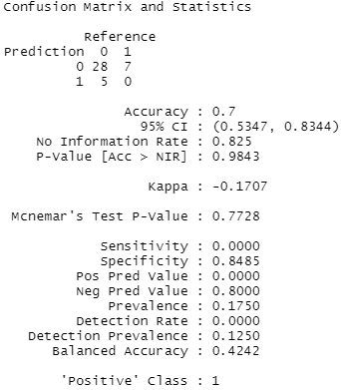
Text Mining Analytics – Classification
Classification model with naïve Bayes (as we did in chapter 7)
Training model and evaluating performance
accuracy = 0.7
sensitivity = 0
kappa = -0.1707
Notes:
prop.table(table(job$highrank))
prop.table(table(job_train$highrank))
prop.table(table(job_test$highrank))

Slide 28
Inverse Document Frequency (IDF)
Term Frequency (TF)
Frequency of a term contained in each document
TF is the counter for a term (how relevant a term to the document)
Document frequency (DF)
Frequency of a document containing each term
DF is the counter for a document (how relevant a document to the term)
Inverse document frequency (IDF)
Measure how common or rare a term is in the entire document set (corpus)

Slide 29

Inverse Document Frequency (IDF)
Measuring sparseness
How common it is in the entire corpus
A term should not be too rare
A term should not be too common
The distribution of the term over a corpus
The fewer documents in which a term occurs, the more significant it likely is to be to the documents is does occur in
Measured by IDF (inverse document frequency)
$$IDF\left(t\right)=log2\left(\frac{total number of documents}{\# documents containing term t}\right)$$

Slide 30

TF-IDF
Combining TF and IDF
TF-IDF (term frequency - inverse document frequency) measures the relative importance of a term
𝑇𝐹−𝐼𝐷𝐹(𝑡,𝑑) = 𝑇𝐹(𝑡,𝑑)×𝐼𝐷𝐹(𝑡)
$$TF\left(t,d\right)=\# times term t appears in document d$$
$$IDF\left(t\right)=log2\left(\frac{total number of documents}{\# documents containing term t}\right)$$

Slide 31
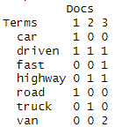
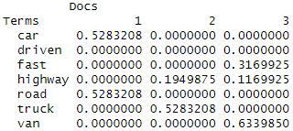
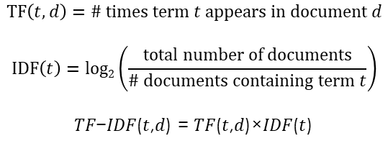
TF-IDF
Combining TF and IDF
$$TF\left(t,d\right)=\# times term t appears in document d$$
$$IDF\left(t\right)=log2\left(\frac{total number of documents}{\# documents containing term t}\right)$$
𝑇𝐹−𝐼𝐷𝐹(𝑡,𝑑) = 𝑇𝐹(𝑡,𝑑)×𝐼𝐷𝐹(𝑡)
TDM in TF
Terms | TF (normalized) 1 2 3 |  |  | IDF | TF-IDF 1 2 3
car | 1/3 | 0 | 0 | log₂(3/1)=1.585 | 0.5283 | 0 | 0
driven | 1/3 | 1/3 | 1/5 | log₂(3/3)=0 | 0 | 0 | 0
fast | 0 | 0 | 1/5 | log₂(3/1)=1.585 | 0 | 0 | 0.3170
highway | 0 | 1/3 | 1/5 | log₂(3/2)=0.585 | 0 | 0.1950 | 0.1170
road | 1/3 | 0 | 0 | log₂(3/1)=1.585 | 0.5283 | 0 | 0
truck | 0 | 1/3 | 0 | log₂(3/1)=1.585 | 0 | 0.5283 | 0
van | 0 | 0 | 2/5 | log₂(3/1)=1.585 | 0 | 0 | 0.6340
TDM in TF-IDF
Notes:
library(tm)
text <- c("The car is driven on the road.",
"The truck is driven on the highway.",
"The van is driven fast on the highway with other vans.")
corp <- Corpus(VectorSource(text))
corp <- tm_map(corp, content_transformer(tolower))
corp <- tm_map(corp, stripWhitespace)
corp <- tm_map(corp, removePunctuation)
corp <- tm_map(corp, removeWords, stopwords("english"))
corp <- tm_map(corp, stemDocument)
tdm_tf <- TermDocumentMatrix(corp)
inspect(tdm_tf)
tdm_tfidf <- weightTfIdf(tdm_tf)
inspect(tdm_tfidf)

Slide 32
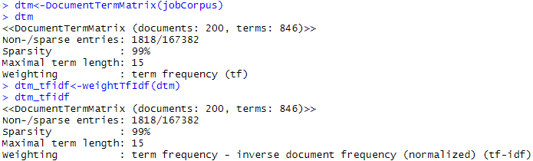
TF-IDF
TF-IDF factoring in both
Frequency of a term in a document
Frequency of documents with that term
Identifying documents with frequent occurrences of rare terms
Notes:
dtm<-DocumentTermMatrix(jobCorpus)
dtm
dtm_tfidf<-weightTfIdf(dtm)
dtm_tfidf

Slide 33
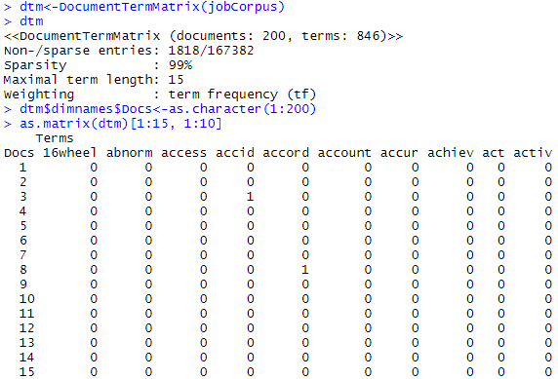
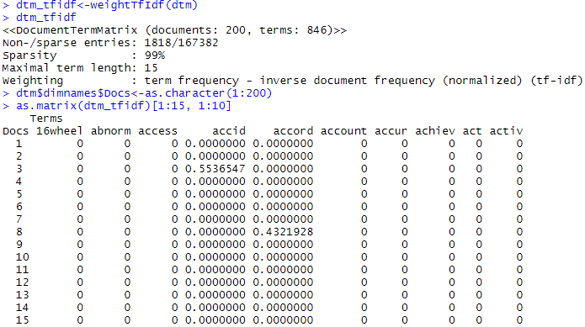
TF-IDF
TF-IDF factoring in both
Notes:
dtm<-DocumentTermMatrix(jobCorpus)
dtm
dtm$dimnames$Docs<-as.character(1:200)
as.matrix(dtm)[1:15, 1:10]
# or
inspect(dtm)
dtm_tfidf<-weightTfIdf(dtm)
dtm_tfidf
dtm$dimnames$Docs<-as.character(1:200)
as.matrix(dtm_tfidf)[1:15, 1:10]
# or
inspect(dtm_tfidf)

Slide 34
Dimension Reduction with LSA
Latent semantic analysis (LSA)
Converting relationships between terms and documents into more concise relationships between concepts and documents
Apply dimension reduction method to text data
Producing abstract concepts to describe documents
The set of concepts is smaller and better to describe documents than original set of terms
 | Term 1 | Term 2 | Term 3
Document 1
Document 2
Document 3
Document 4
 | Concept 1 | Concept 2 | Concept 3
Document 1
Document 2
Document 3
Document 4
Notes:
P.558, Shmueli, Machine Learnig for Business Analytics: Concepts, Techniques, and Applications in R

Slide 35
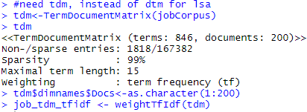
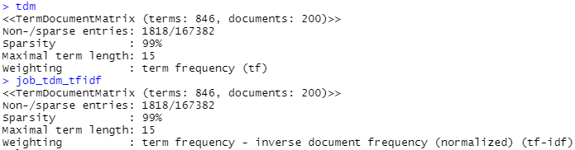
Classification Model with Naïve Bayes
TDM in TF and TFIDF
Notes:
#need tdm, instead of dtm for lsa
tdm<-TermDocumentMatrix(jobCorpus)
tdm
tdm$dimnames$Docs<-as.character(1:200)
job_tdm_tfidf <- weightTfIdf(tdm)
job_tdm_tfidf
library(lsa)
lsa.tfidf <- lsa(job_tdm_tfidf, dim=10)
#lsa.tfidf
words.df <- as.data.frame(as.matrix(lsa.tfidf$dk))
label <- c(rep(1, 30), rep(0, 170))
# sample 80% training data
set.seed(1)
training <- sample(c(1:200), 0.8*200)
# partitioning data
trainData = cbind(label = label[training], words.df[training,])
holdoutData = cbind(label = label[-training], words.df[-training,])
table(trainData$label);table(holdoutData$label)
### fitting NB
library(e1071)
library(caret)
job_classifier <- naiveBayes(trainData[,-1], trainData$label)
job_test_pred<-predict(job_classifier, holdoutData)
#confusionMatrix(as.factor(job_test_pred), as.factor(holdoutData$label), positive = "1")
confusionMatrix(factor(job_test_pred, levels = c(1,0)),
factor(holdoutData$label, levels = c(1,0)), positive = "1")
job_test_pred_raw<-predict(job_classifier, holdoutData, type = "raw")
confusionMatrix(factor(ifelse(job_test_pred_raw[,2]>0.5, 1, 0), levels = c(1,0)),
factor(holdoutData$label, levels = c(1,0)), positive = "1")

Slide 36
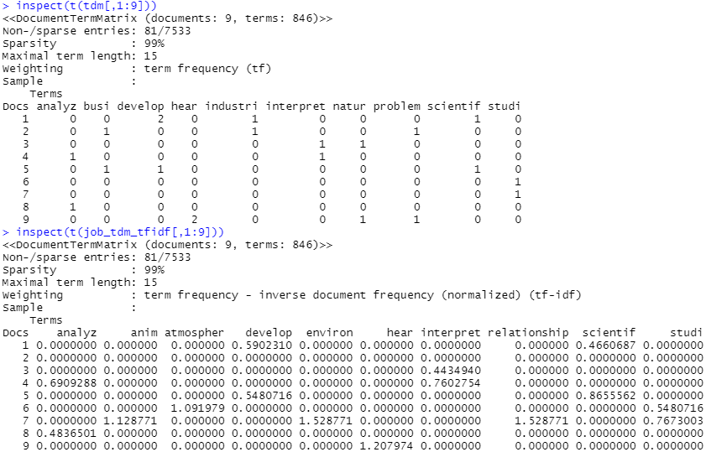
Classification Model with Naïve Bayes
TDM in TF and TFIDF
 | Term 1 | Term 2 | Term 3
Document 1
Document 2
Document 3
Document 4
Notes:
inspect(t(tdm[,1:9]))
inspect(t(job_tdm_tfidf[,1:9]))

Slide 37

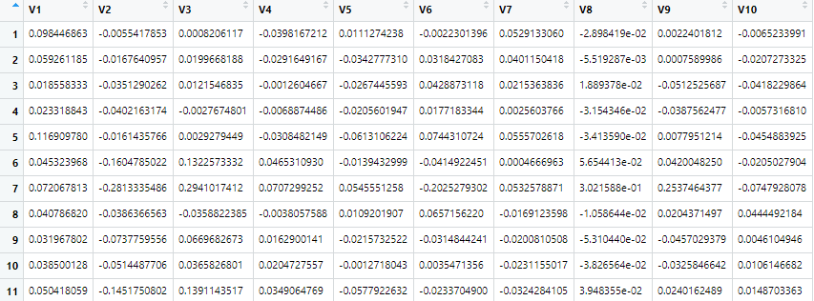
Classification Model with Naïve Bayes
LSA
To document-concept matrix
 | Concept 1 | Concept 2 | Concept 3
Document 1
Document 2
Document 3
Document 4
words.df
Notes:
A document-term matrix M is constructed with textmatrix() from a given text base of n documents containing m terms.
This matrix M of the size m × n is then decomposed via a singular value decomposition into:
term vector matrix T (constituting left singular vectors),
the document vector matrix D (constituting right singular vectors) being both orthonormal, and
the diagonal matrix S (constituting singular values).

Slide 38
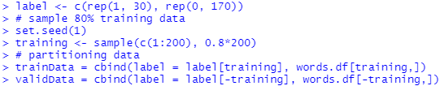
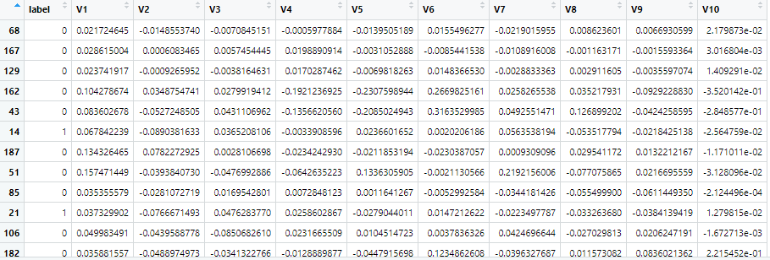
Classification Model with Naïve Bayes
Labeling -- outcome variable
Top 30 as 1 and the rest as 0
Partitioning (outcome variable attached)

Slide 39
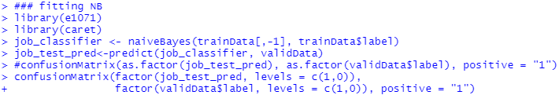
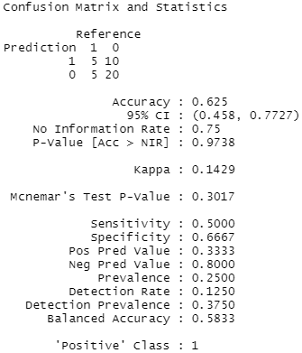
Classification Model with Naïve Bayes
Naïve Bays classifier
accuracy = 0.625
sensitivity = 0.5
May predict propensities and adjust threshold for classification

Slide 40
Summary
Text is a form of data
Preprocessing steps are needed before text can be mined
The goal is to produce a matrix with terms and documents
Matrix with terms only may not be effective for modeling
A set of concepts represents most of the variation in the documents
Document labels for supervised modeling

