Slide 1
CSDA 5430 Predictive Analytics
Chapter 11
Apriori Association Rules Learning
Notes:
https://www.socr.umich.edu/people/dinov/courses/DSPA_notes/11_Apriory_AssocRuleLearning.html

Slide 2
Motivation
Association rules
Measuring rules on their support, confidence, and lift
Apriori algorithm for association rule learning
Toy example of purchases of phone faceplates
Case studies: head and neck cancer medications and grocery purchases

Slide 3
Association Rules
Association rules are the result of process analytics that specify patterns of relationships among items
Market basket analysis
{charcoal, lighter, chicken wings} → {barbecue sauce}
Commonly used for unsupervised discovery of knowledge

Slide 4
Apriori Algorithm for Association Rule Learning
Association rules are mostly applied to transactional data
Market analysis, predict basket purchase
The Apriori property
All subsets of a frequent item-set must also be frequent
Only if itself and all of its subsets, including single elements, pairs, and triples, occur frequently
{charcoal, lighter, chicken wings} → {barbecue sauce}
{charcoal, lighter, chicken wings, barbecue sauce}
The prior belief about the properties of frequent elements
Efficiently reduce the number of combinations

Slide 5
Apriori Algorithm for Association Rule Learning
Examine all possible rules between items and select indicators of true dependence
Association rules in an “if–then” format
{antecedent, consequent}
Antecedent describes the IF part, and Consequent describes the THEN part
Itemsets – sets of items
Combinations of items, including single items
{charcoal, lighter, chicken wings} → {barbecue sauce}
X → Y (IF X, THEN Y)
X: antecedent (A)
Y: consequent (C)

Slide 6
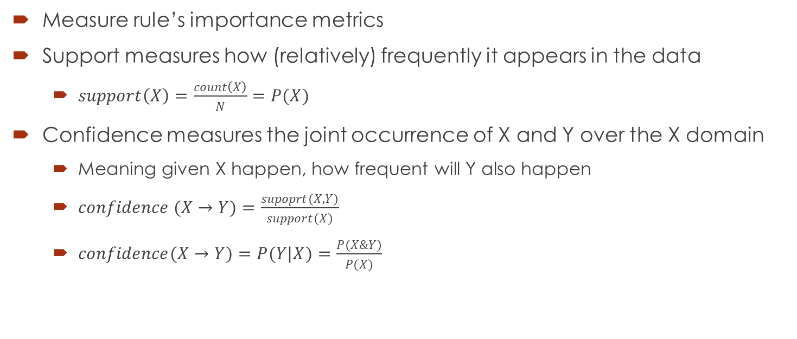
Rule Support and Confidence
Measure rule’s importance metrics
Support measures how (relatively) frequently it appears in the data
$support\left(X\right)=\frac{count\left(X\right)}{N}=P(X)$
Confidence measures the joint occurrence of X and Y over the X domain
Meaning given X happen, how frequent will Y also happen
$confidence (X→Y)=\frac{supoprt(X,Y)}{support(X)}$
$confidence(X→Y)=P(Y|X)=\frac{P(X\&Y)}{P(X)}$

Slide 7

Rule Support and Confidence
Example, 100,000 transactions
2000 include {orange juice & flu medication} and 800 of these include {soup}
The association rule: {orange juice, flu medication} → {soup}
support(X) = 0.02 (=2000/100,000)
support(X&Y) = 0.008 (=800/100,000)
confidence = 0.4 (= 800/2000)
High value of confidence suggests a strong association rule
100,000
X
Y
2,000
X&Y
800
$$confidence(X→Y)=P(Y|X)=\frac{P(X\&Y)}{P(X)}=\frac{0.008}{0.02}=0.4$$
Notes:
P.398, Shmueli, Machine Learning for Business Analytics: Concepts, Techniques, and Applications in R

Slide 8
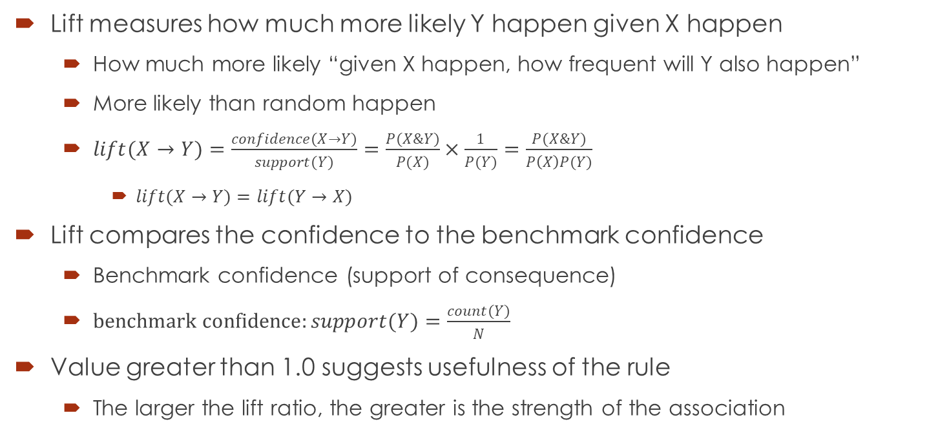
Rule Lift
Lift measures how much more likely Y happen given X happen
How much more likely “given X happen, how frequent will Y also happen”
More likely than random happen
$lift(X→Y)=\frac{confidence(X→Y)}{support(Y)}=\frac{P(X\&Y)}{P(X)}×\frac{1}{P(Y)}=\frac{P(X\&Y)}{P\left(X\right)P(Y)}$
$lift(X→Y)=$ $lift(Y→X)$
Lift compares the confidence to the benchmark confidence
Benchmark confidence (support of consequence)
$benchmark confidence:support(Y)=\frac{count(Y)}{N}$
Value greater than 1.0 suggests usefulness of the rule
The larger the lift ratio, the greater is the strength of the association

Slide 9
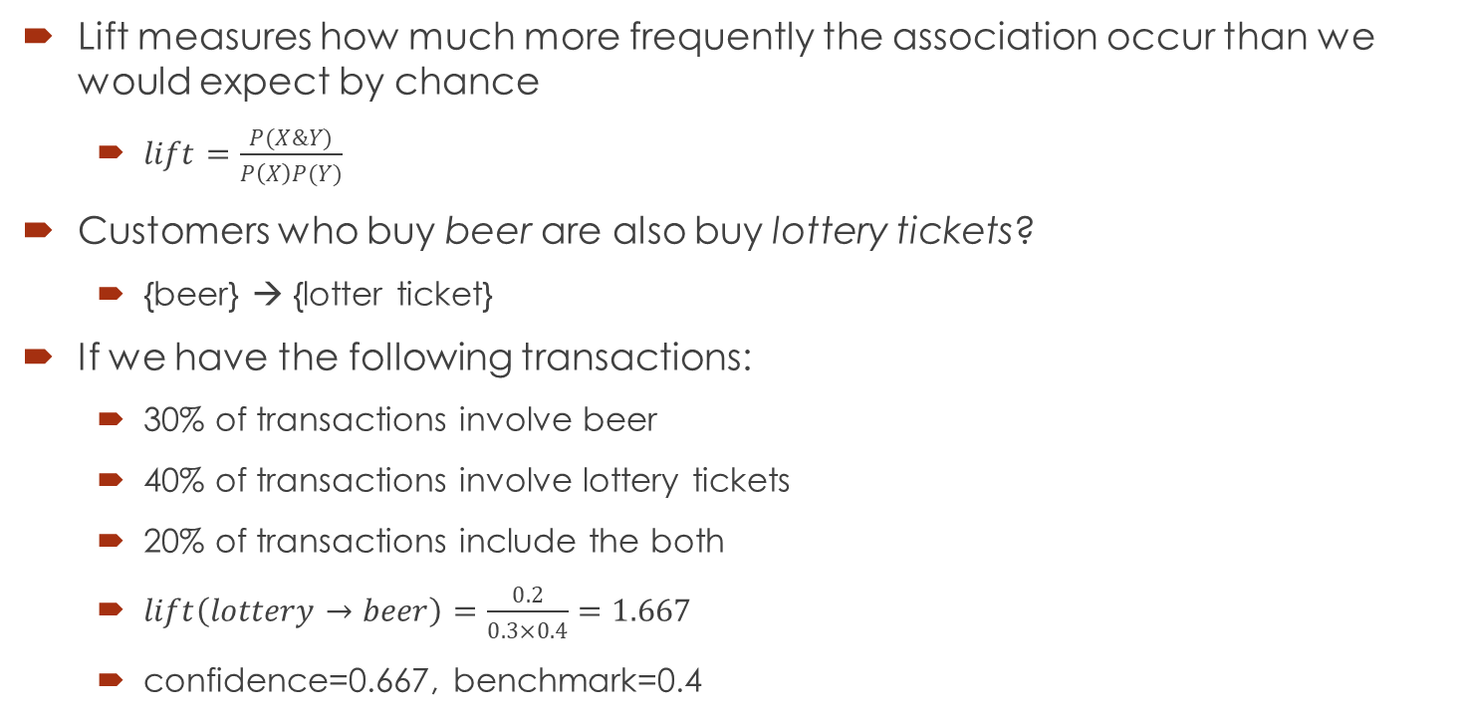
Rule Lift
Lift measures how much more frequently the association occur than we would expect by chance
$lift=\frac{P(X\&Y)}{P\left(X\right)P(Y)}$
Customers who buy beer are also buy lottery tickets?
{beer} → {lotter ticket}
If we have the following transactions:
30% of transactions involve beer
40% of transactions involve lottery tickets
20% of transactions include the both
$lift\left(lottery→beer\right)=\frac{0.2}{0.3×0.4}=1.667$
confidence=0.667, benchmark=0.4
X
Y
30%
X&Y
20%
40%

Slide 10

Building Rules with the Apriori Principle
Two-step process of building the sets of rules
Step 1: Filter all item-sets with a minimum support threshold
Step 2: Using the item-sets selected in step 1, generate new rules with confidence larger than a predefined minimum confidence threshold
Toy example
Transaction | Item 1 | Item 2 | Item 3 | Item 4
1 | 1 | 1 | 1 | 1
2 | 1 | 1 | 0 | 1
3 | 1 | 1 | 0 | 0
4 | 0 | 1 | 1 | 1
5 | 0 | 1 | 1 | 0
6 | 0 | 0 | 1 | 1
7 | 0 | 1 | 0 | 1

Slide 11

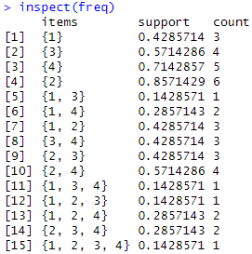



Building Rules with the Apriori Principle
Building the sets of rules
For example, an item-set is frequent if it appears in at least 3 transactions, i.e., the value 3 is the support threshold.
There are no frequent triplets.
Notes:
library(arules)
item_table = rbind(c(1,1,1,1),
c(1,1,0,1),
c(1,1,0,0),
c(0,1,1,1),
c(0,1,1,0),
c(0,0,1,1),
c(0,1,0,1))
item.mat<-as.matrix(item_table)
item.trans <- as(item.mat, "transactions")
inspect(item.trans)
freq <- apriori(item.trans, target = "freq")
inspect(freq)

Slide 12
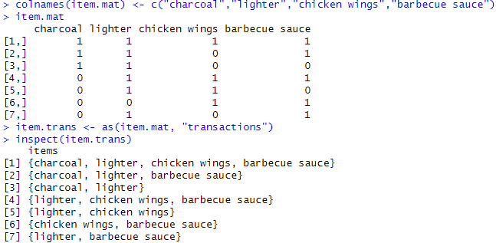
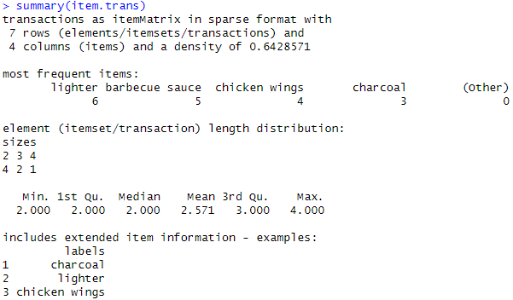
Building Rules with the Apriori Principle
Data in matrix format and transaction format
4 transactions with length of 2
2 transactions with length of 3
1 transactions with length of 4
Notes:
colnames(item.mat) <- c("charcoal","lighter","chicken wings","barbecue sauce")
item.mat
item.trans <- as(item.mat, "transactions")
item.trans
inspect(item.trans)
summary(item.trans)
freq <- apriori(item.trans, target = "freq")
inspect(freq)

Slide 13
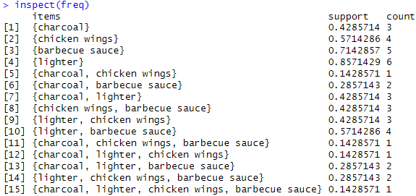
Building Rules with the Apriori Principle
Data support frequency
Transaction | charcoal | lighter | chicken wings | barbecue sauce
1 | 1 | 1 | 1 | 1
2 | 1 | 1 | 0 | 1
3 | 1 | 1 | 0 | 0
4 | 0 | 1 | 1 | 1
5 | 0 | 1 | 1 | 0
6 | 0 | 0 | 1 | 1
7 | 0 | 1 | 0 | 1

Slide 14
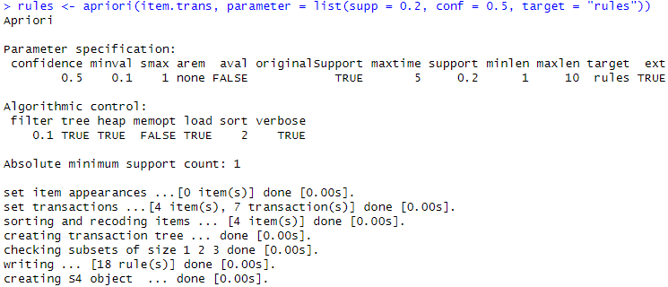
Building Rules with the Apriori Principle
Association rules
Minimum support (20%) and minimum confidence (50%)
Notes:
rules <- apriori(item.trans, parameter = list(supp = 0.2, conf = 0.5, target = "rules"))
# may use minlen
# inspect rules
inspect(head(sort(rules, by = "lift"), n = 6))
rules.tbl <- inspect(rules)
rules.tbl[rules.tbl$support >= 0.2 & rules.tbl$confidence >= 0.7,]
# do we see this rule: {charcoal, lighter, chicken wings} => {barbecue sauce}

Slide 15
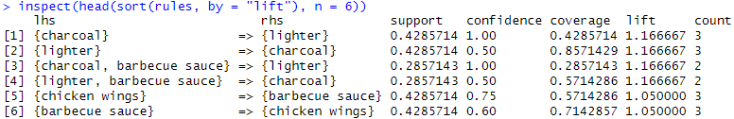
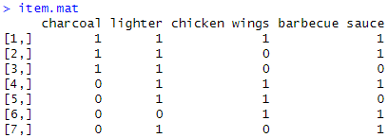
Building Rules with the Apriori Principle
Association rule measures
Rule #4: {lighter, barbecue sauce} => {charcoal}
Support: p(X&Y) = 2/7 = 0.2857
Confidence: p(Y|X) = p(X&Y)/p(X) = (2/7)/(4/7) = 0.5
Lift: (p(X&Y)/p(X))/p(Y) = 0.5/(3/7) = 1.1667
LHS: X (antecedent)
RHS: Y (consequent)
coverage (LHS-support): measures how often the rule can be applied

Slide 16
Interpreting the Results
Translate rule into understandable sentence
Rule #4: {lighter, barbecue sauce} => {charcoal}
support = 0.2857; confidence = 0.5; lift = 1.1667
Association rule in “if-then” statement
If lighter and barbecue sauce are purchased, then with confidence 50% charcoal will also be purchased. This rule has a lift of 1.1667.

Slide 17
Interpreting the Results
Support and lift have no direction
May not use lift to make recommendation for a particular directional rule
Confidence can be misleading
May not use confidence to make add-ons type recommendations
May not be the only measure to make recommendations
May consider other business measures (item price and function)
For cross selling or store layout recommendations
Transactions:
charcoal, lighter
charcoal, lighter
charcoal
charcoal
Rule 1. charcoal -> lighter
support = 0.5; confidence = 0.5; lift = 1
Rule 2. lighter -> charcoal
support = 0.5; confidence = 1; lift = 1
Notes:
4 transactions:
charcoal, lighter
charcoal, lighter
charcoal
charcoal
Rule 1. charcoal -> lighter
support(charcoal -> lighter) = p(charcoal & lighter) = 0.5
confidence (charcoal -> lighter) = p(charcoal & lighter) / p(charcoal) = 0.5/1 = 0.5
lift (charcoal -> lighter) = 0.5/0.5 = 1
Rule 2. lighter -> charcoal
Support (lighter -> charcoal) = p(lighter & charcoal) = 0.5
confidence (lighter -> charcoal) = p(lighter & charcoal) / p(lighter) = 0.5/0.5 = 1
lift (lighter -> charcoal) = 1/1 = 1

Slide 18
Case Study 1: Head and Neck Cancer Medications
Step 1 - collecting data
Step 2 - exploring and preparing the data
Visualizing item support - item frequency plots
Visualizing transaction data - plotting the sparse matrix
Step 3 - training a model on the data
Step 4 - evaluating model performance
Step 5 - sorting the set of association rules
Step 6 - taking subsets of association rules
Graphical depiction of association rules
Saving association rules to a file or data frame

Slide 19
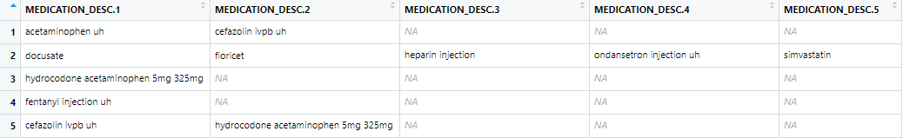
Collecting Data
Transactional healthcare data representing a subset of the Head and Neck Cancer Medication data
Datafile: 10_medication_descriptions.csv

Slide 20
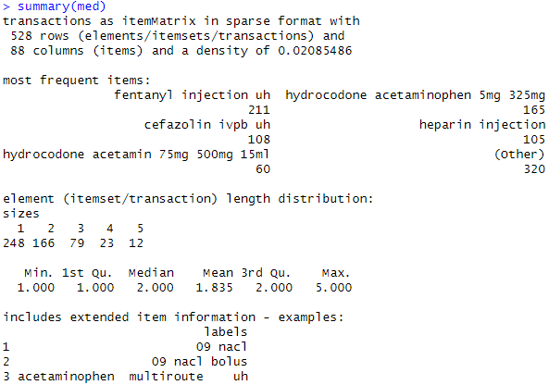
Exploring and Preparing the Data
Transactional data is stored as a matrix
Each row representing a basket (or transaction example)
Each column representing items in the transaction
528×88=46,464
248 transactions with length of 1
166 transactions with length of 2
79 transactions with length of 3
23 transactions with length of 4
12 transactions with length of 5
Notes:
# sep: a character string specifying how fields are separated in the data file.
# skip: number of lines to skip in the file before start reading data.
# rm.duplicates: a logical value specifying if duplicate items should be removed from the transactions.
med<-read.transactions("medication.csv", sep = ",", skip = 1, rm.duplicates=TRUE)

Slide 21
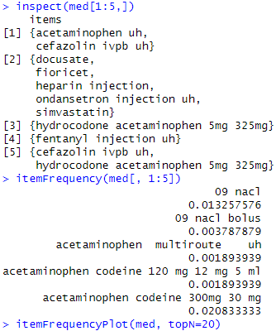
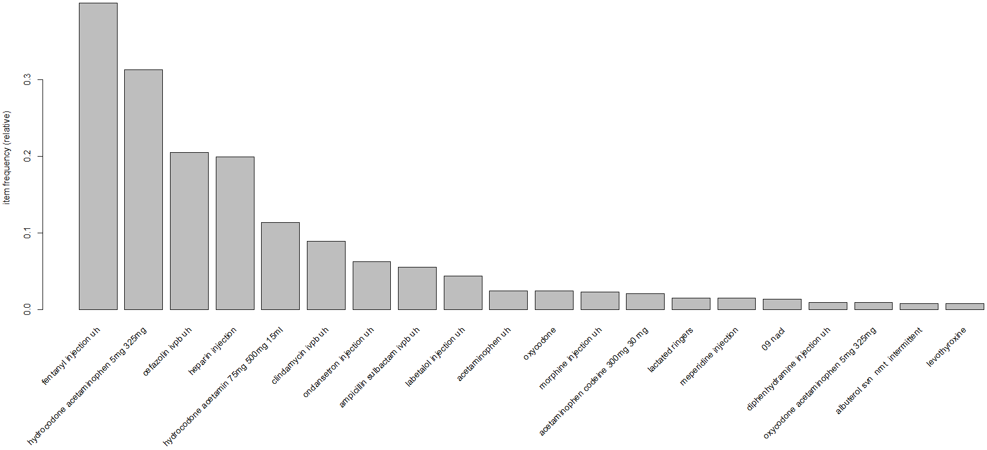
Visualizing Item Support - Item Frequency Plots
Visualize the information
Notes:
# for plotly view
# convert the data to a matrix
mat <- as.matrix(med@data)
# View matrix as image
# image(mat)
# capture the row/column names
rowNames <- med@itemInfo$labels
colNames <- paste0("S", c(1:dim(mat)[2]))
rownames(mat) <- rowNames
colnames(mat) <- colNames
# convert matrix to DF for processing, order rows based on their average (across subjects/cases/columns), back to matrix for display
df <- as.data.frame(1*mat)
df$avg <- rowMeans(df)
dfOrdered <- df[order(df$avg, decreasing = T), ]
matOrdered <- as.matrix(dfOrdered)
# track the ordered row names
rowNames <- rownames(dfOrdered)
colNames <- colnames(dfOrdered)
# 2D top 20 terms bar plot
# To order the meds based on "avg", instead of alphabetically (mind the "-" sign to order Large to small!)
library(plotly)
plot_ly(x = reorder(rowNames[c(1:20)], -dfOrdered[1:20, "avg"]), y=dfOrdered[1:20, "avg"], name="Top 20 Meds", type="bar") %>%
layout(title='Frequency of Medications (Top 20) based on averaging across Cases',
xaxis = list(title="Term"),
yaxis = list(title="Relative Frequency"))
# 3D surface plot
plot_ly(x = colNames, y = rowNames, z = 2*matOrdered, type = "surface") %>%
layout(title='Term (X) by Sample (Y) Frequency (Z) Plot',
xaxis = list(title="Term"),
yaxis = list(title="Sample ID")) %>% hide_colorbar()
# define a generic plot_ly ItemFrequency plotting function
itemFrequencyPlotly <- function(transactionObject, numTopItemps = 10, name="") {
name <- ifelse(name=="",
paste0('Frequency of Items (Top ', numTopItemps,
' ) based on averaging across Cases'),
paste0('Frequency of Items (Top ', numTopItemps,
' ) based on averaging across Cases (Data=', name, ')'))
mat <- as.matrix(transactionObject@data)
# View matrix as image
# image(mat)
# capture the row/column names
rowNames <- transactionObject@itemInfo$labels
colNames <- paste0("S", c(1:dim(mat)[2]))
rownames(mat) <- rowNames
colnames(mat) <- colNames
# convert matrix to DF for processing, order rows based on their average (across subjects/cases/columns), back to matrix for display
df <- as.data.frame(1*mat)
df$avg <- rowMeans(df)
dfOrdered <- df[order(df$avg, decreasing = T), ]
matOrdered <- as.matrix(dfOrdered)
# track the ordered row names
rowNames <- rownames(dfOrdered)
colNames <- colnames(dfOrdered)
# 2D top "20"numTopItemps" terms bar plot
# To order the meds based on "avg", instead of alphabetically (mind the "-" sign to order Large to small!)
plot_ly(x = reorder(rowNames[c(1:numTopItemps)], -dfOrdered[1:numTopItemps, "avg"]),
y=dfOrdered[1:numTopItemps, "avg"], name=paste0("Top ", numTopItemps, " Meds"), type="bar") %>%
layout(title=name,
xaxis = list(title="Terms"),
yaxis = list(title="Relative Frequency"))
}
itemFrequencyPlotly(med, numTopItemps = 10)

Slide 22
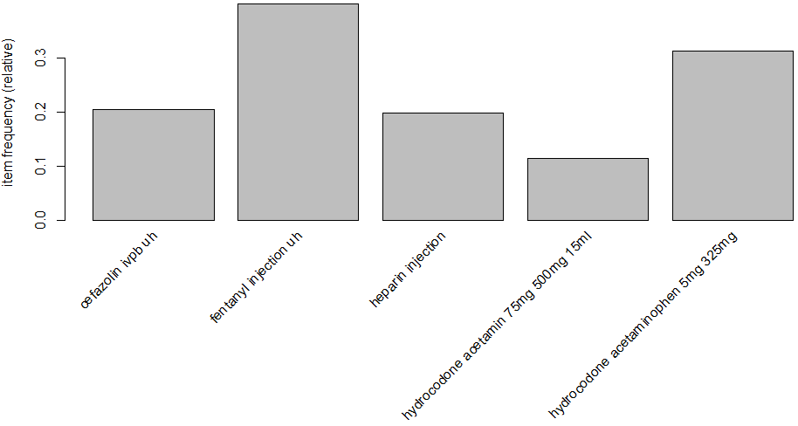
Visualizing Item Support - Item Frequency Plots
Plot the items with a threshold for support 0.1
Notes:
itemFrequencyPlot(med, support=0.1)

Slide 23
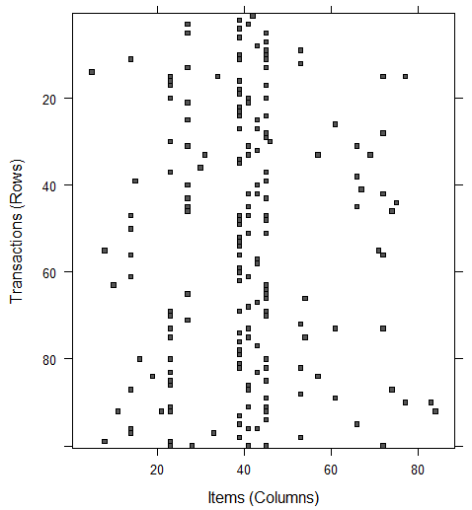
Visualizing Transaction Data - Plotting the Sparse Matrix
The sparse matrix will show what medications were prescribed for each patient
100 randomly chosen patients
It shows us clearly that some medications are more popular than others.
Notes:
plot_ly(x=reorder(rowNames[c(1:20)], -dfOrdered[1:20, "avg"]), y=colNames[1:15],
z=2*matOrdered[1:15, 1:20], type="heatmap") %>%
layout(title='Heatmap - Top-20 Medications for the first 15 Cases') %>% hide_colorbar()
subset_int <- sample(ncol(matOrdered), 50, replace = F)
# image(med[subset_int, ])
plot_ly(x=rowNames[1:30], y=colNames[subset_int],
z=2*t(matOrdered[1:30, subset_int]), type="heatmap") %>%
layout(title='Heatmap - Bottom-30 Medications for a Random set of 50 Patients') %>% hide_colorbar()

Slide 24
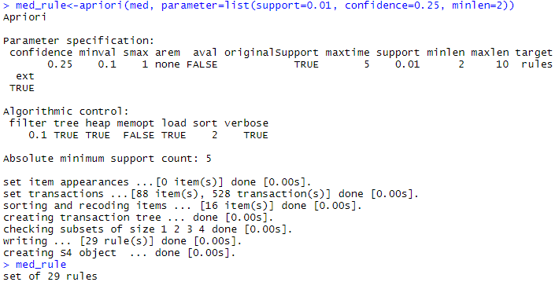
Training a Model on the Data
Build the association rules using the arules::apriori() function
Setting up the threshold
support=0.01
confidence=0.25
minlen=2
In practice, we might need some time to fine-tune these thresholds, which may require certain familiarity with the underlying process.

Slide 25
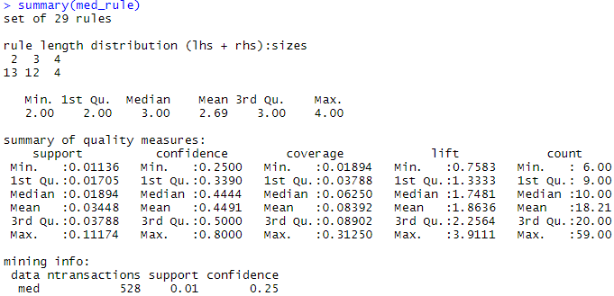
Evaluating Model Performance
Overall summary
13 rules that contain two items
12 rules containing 3 items
4 rules contain 4 items

Slide 26
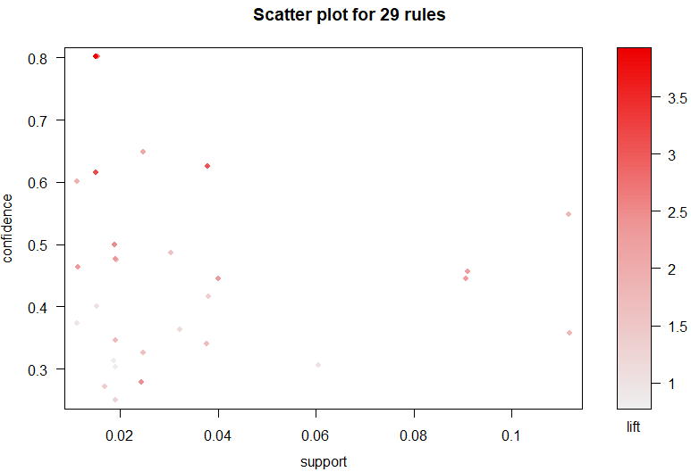

Evaluating Model Performance
The lift column shows how much more likely one medicine is to be prescribed to a patient given another medicine is prescribed
$lift(X→Y)=\frac{confidence(X→Y)}{support(Y)}$
higher lift is better
Notes:
# install.packages("arulesViz")
library(arulesViz)
# plot(sort(med_rule))
sortedRule <- sort(med_rule)
x1 <- sortedRule@quality$support
y1 <- sortedRule@quality$confidence
z1 <- sortedRule@quality$lift
col1 <- sortedRule@quality$count
ruleNames <- paste0("Rule", c(1:length(sortedRule@quality$support)))
library(plotly)
library(dplyr)
plot_ly(x = ~x1, y = ~y1, z = ~z1, color = ~z1, name=ruleNames) %>%
add_markers() %>%
layout(title=paste0("Arule Support-Confidence-Lift Plot (for all ", length(sortedRule@quality$support), " rules)"),
scene = list(xaxis = list(title = 'Support'),
yaxis = list(title = 'Confidence'),
zaxis = list(title = 'Lift'))) %>%
hide_colorbar()

Slide 27
Evaluating Model Performance
Utilize the inspect() function to see the rules
IF a head-and-neck patient has been prescribed acetaminophen (pain reliever and fever reducer), THEN it is likely that the patient is also prescribed cefazolin (antibiotic prescribed for treatment of resistant bacterial infections).
Bacterial infections are associated with fevers and some cancers.

Slide 28
Sorting the Set of Association Rules
Identify the most useful rules
Sorting the resulting association rules corresponding to high lift values
Rules may need to be interpreted by domain experts

Slide 29
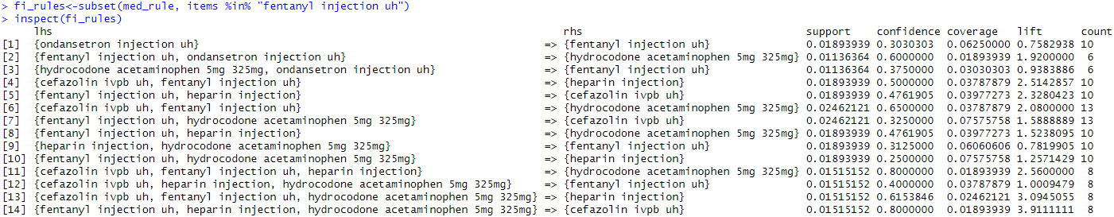
Taking Subsets of Association Rules
Narrow the rules down by making subsets to investigate associations that are linked to a specific item
14 rules

Slide 30
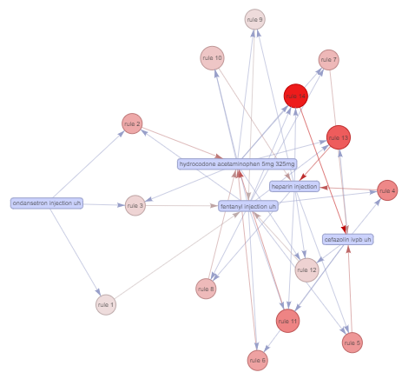
Graphical Depiction of Association Rules
Narrow the rules down by making subsets to investigate associations that are linked to a specific item
14 rules (5 items involved)
Notes:
subrules2 <- sample(subset(fi_rules, lift > 2), 5)
plot(sort(subrules2, by="lift"), method="grouped", control=list(type="items"), engine = "htmlwidget")
plot(sort(fi_rules, by="lift"), method="grouped", k = 7, control=list(type="items"), engine = "htmlwidget")
m <- rules2matrix(sort(fi_rules, by="lift")[1:10], measure = "lift")
# m
plot(fi_rules[1:10], method = "matrix", engine = "htmlwidget")
## Grouped matrix
# create a matrix with LHSs grouped in k = 10 groups
m <- rules2groupedMatrix(sort(fi_rules, by="lift")[1:10], k = 10)
# m$m
# number of rules per group
# table(m$clustering_rules)
# get rules for group 1
inspect(fi_rules[m$clustering_rules == 1])
# the corresponding plot
plot(fi_rules, method = "grouped matrix", k = 7, engine = "htmlwidget")
plot(fi_rules, method="graph", measure = "support", engine="htmlwidget", # nodeCol=rainbow(14),
shading = "lift", control = list(verbose = TRUE))

Slide 31
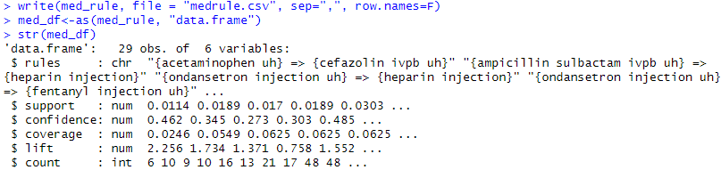
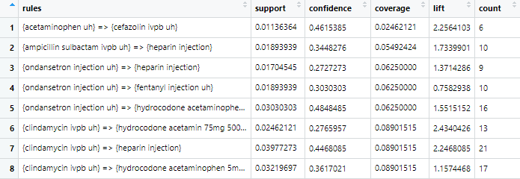
Saving Association Rules to a File or Data Frame
Convert the rules into a data frame

Slide 32
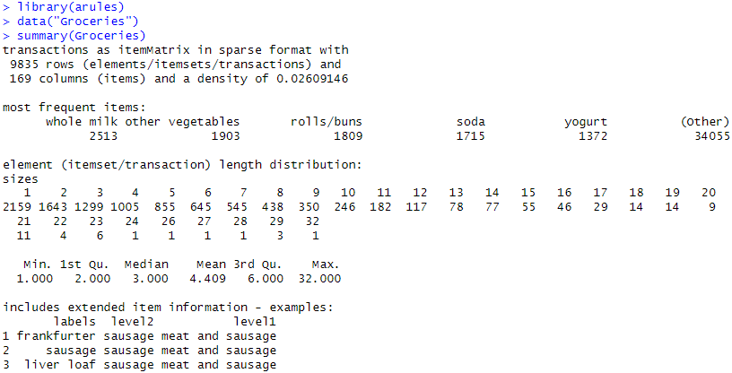
Practice Problems: Groceries
The associations of frequently purchased groceries
Using the grocery dataset in the R base
Notes:
The Groceries data set contains 1 month (30 days) of real-world point-of-sale transaction data from a typical local grocery outlet. The data set contains 9835 transactions and the items are aggregated to 169 categories.

Slide 33
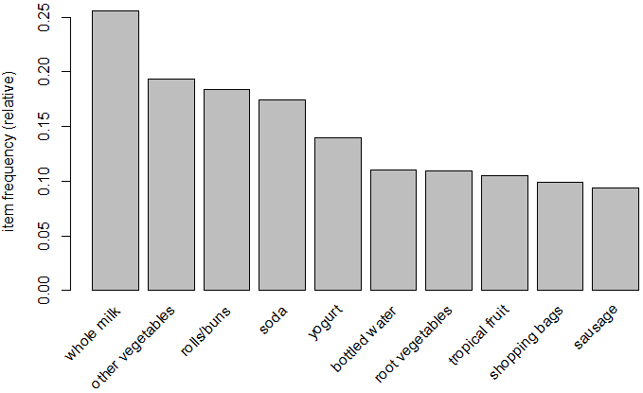
Practice Problems: Groceries
The associations of frequently purchased groceries
Using the grocery dataset in the R base
Notes:
# need define the function
itemFrequencyPlotly(Groceries, 10, "groceries")

Slide 34
Summary
Association rules learning is useful for discovering associations
Association rules are unsupervised learning
Suitable for large transactional data
The method is very transparent and easy to understand
Some rules can be built due to chance and may need further verification
Need consolidate to a small set of useful and strong rules

