Slide 1
CSDA 5430 Predictive Analytics
Chapter 13
Evaluating Model Performance
Notes:
https://www.socr.umich.edu/people/dinov/courses/DSPA_notes/13_ModelEvaluation.html

Slide 2
Introduction
Various evaluation strategies for prediction, clustering, classification, regression, and decision trees
Visualization of ROC curves and performance tradeoffs
Estimation of future performance, internal statistical cross-validation and bootstrap sampling

Slide 3
Evaluating Predictive Performance
Predictive accuracy is not the same as goodness-of-fit
Prediction – predicted numerical value
Mean absolute error (MAE), root mean squared error (RMSE), correlation
Classification – predicted class membership
Confusion matrix: accuracy, error rate, sensitivity, specificity, precision, recall, ROC, AUC

Slide 4
Measuring the Performance of Regression Methods
Prediction – predicted numerical value
Mean absolute error (MAE)
Average of residuals, more interpretable
Root mean squared error (RMSE)
Standard deviation of residuals, more sensitive to outliers
Correlation
Strength of statistical relationship, unitless
R-squared
Percentage of variance in outcome variable is explained

Slide 5
Measuring the Performance of Classification Methods
Classification accuracy represents just one view at evaluation of model performance or the reliability of clustering methods
For example, we may want the model to have as few true-negatives as possible
Three types of data to evaluate the performance of a classifier model
Actual class values (for supervised classification)
Predicted class values
Estimated probabilities of the prediction

Slide 6
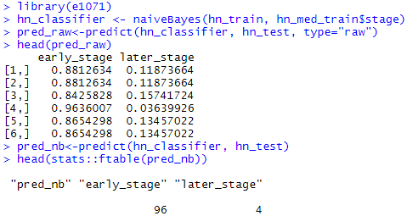
Measuring the Performance of Classification Methods
Estimated probabilities of the prediction
Case study from chapter 7 naïve Bayes
Head and Neck Cancer Medication
prediction with type="raw“

Slide 7
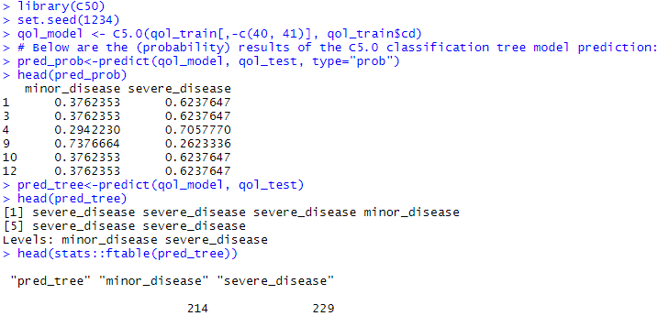
Measuring the Performance of Classification Methods
Estimated probabilities of the prediction
Case study from chapter 8 classification tree
Quality of Life and Chronic Disease
prediction with type=“prob“

Slide 8
Evaluation Strategies
Summaries of basic types of evaluation and validation strategies
Inference | Outcome | Evaluation Metrics | R functions
Classification & Prediction | Binary | Accuracy, Sensitivity, Specificity, PPV/Precision, NPV/Recall, LOR | caret::confusionMatrix, gmodels::CrossTable, cluster::silhouette
Classification & Prediction | Categorical | Accuracy, Sensitivity/Specificity, PPV, NPV, LOR, Silhouette Coefficient | caret::confusionMatrix, gmodels::CrossTable, cluster::silhouette
Regression Modeling | Real Quantitative | correlation coefficient, R², RMSE, Mutual Information, Homogeneity and Completeness Scores | cor, metrics::mse

Slide 9
Binary Outcomes
Confusion matrix and measurements
accuracy = (TP+TN)/(TP+TN+FP+FN)
error rate = (FP+FN)/(TP+TN+FP+FN)
= 1-accuracy
sensitivity = TP/(TP+FN)
specificity = TN/(TN+FP)
precision = TP/(TP+FP)
recall = TP/(TP+FN) -- sensitivity
type I err = 1-precision = 1-TP/(TP+FP) = FP/(TP+FP)
type II err = 1-recall = 1-TP/(TP+FN) = FN/(TP+FN)
 |  | Actual
 |  | Positive | Negative
Predicted | Positive | TP | FP
 | Negative | FN | TN
Notes:
https://medium.com/analytics-vidhya/confusion-matrix-accuracy-precision-recall-f1-score-ade299cf63cd

Slide 10


Binary Outcomes
Confusion matrix and measurements
table() function
 |  | Actual
 |  | Positive | Negative
Predicted | Positive | TP | FP
 | Negative | FN | TN
Is this accuracy (0.73) good?
Which class is positive? (Identifying positive or negative class has no effect on accuracy and error rate.)

Slide 11
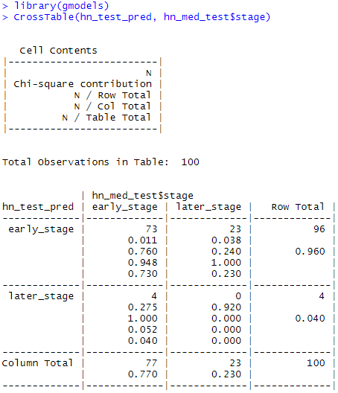
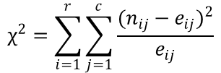
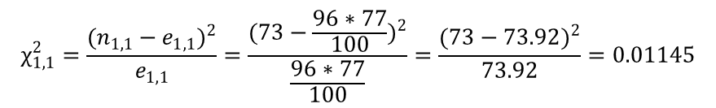



Binary Outcomes
Different ways to obtain confusion matrix
CrossTable() function
The Chi-square value computes relative discrepancy between observed and expected counts.
$$χ^{2}=\sum_{i=1}^{r}{\sum_{j=1}^{c}{\frac{{(n_{ij}−e_{ij})}^{2}}{e_{ij}}}}$$
$$n:observed$$
$$e:expected$$
$$e_{ij}=\frac{n_{i}n_{j}}{n}$$
$$e_{1,1}=\frac{96∗77}{100}$$
$$χ_{1,1}^{2}=\frac{{(n_{1,1}−e_{1,1})}^{2}}{e_{1,1}}=\frac{{(73−\frac{96∗77}{100})}^{2}}{\frac{96∗77}{100}}=\frac{{(73−73.92)}^{2}}{73.92}=0.01145$$

Slide 12
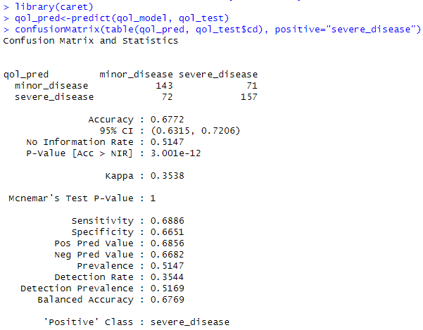
Other Measures of Performance Beyond Accuracy
Use of caret::confusionMatrix() function
May not need table()
Notes:
# may not need table()
qol_pred<-predict(qol_model, qol_test)
confusionMatrix(qol_pred, qol_test$cd, positive="severe_disease")
# re-level class
confusionMatrix(factor(qol_pred, levels = c("severe_disease", "minor_disease")),
factor(qol_test$cd, levels = c("severe_disease", "minor_disease")),
positive = "severe_disease")
# predict probobility
qol_pred<-predict(qol_model, qol_test, type="prob")
confusionMatrix(table(ifelse(qol_pred[,2]>0.5, "severe_disease", "minor_disease"), qol_test$cd), positive="severe_disease")

Slide 13
The Kappa (κ) Statistic
Kappa statistic compares classifier result with ground truth
Compares an observed classification accuracy with an expected classification accuracy
How much better is the agreement than would be expected by chance alone?
No agreement: ≤ 0
Poor agreement: 0-0.20
Fair agreement: 0.20-0.40
Moderate agreement: 0.40-0.60
Good agreement: 0.60-0.80
Very good agreement: 0.80-1

Slide 14
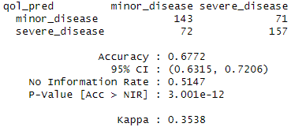

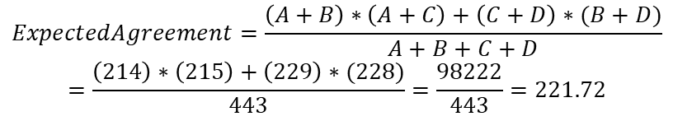
The Kappa (κ) Statistic
Kappa statistic compares classifier result with ground truth
Calculation of kappa statistics on “qol” case
$$ObservedAgreement=\left(A+D\right)=(143+157)=300$$
 |  | Actual
 |  | Minor | Severe
Predicted | Minor | A=143 | B=71 | A+B=214
 | Severe | C=72 | D=157 | C+D=229
 |  | A+C=215 | B+D=228 | N=443
$$ExpectedAgreement=\frac{\left(A+B\right)∗\left(A+C\right)+\left(C+D\right)∗(B+D)}{A+B+C+D}$$
$$=\frac{\left(214\right)∗\left(215\right)+\left(229\right)∗(228)}{443}=\frac{98222}{443}=221.72$$
$\left(Kappa\right) k=\frac{ObservedAgreement−ExpectedAgreement}{N−ExpectedAgreement}$= $\frac{300−221.72}{443−221.72}=0.35376$

Slide 15
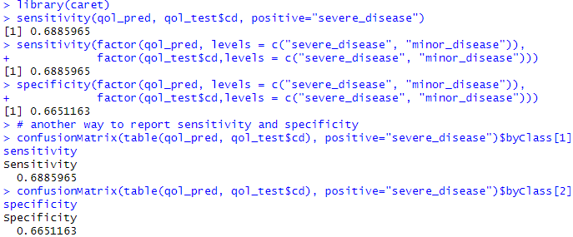
Sensitivity and Specificity
Sensitivity (true positive rate) measures the proportion of “success” observations that are correctly classified
sensitivity = TP/(TP+FN)
Specificity (true negative rate) measures the proportion of “failure” observations that are correctly classified
specificity = TN/(TN+FP)

Slide 16
Sensitivity and Specificity
Important class
Many times, it is more important to predict membership correctly in one class than another
Simultaneously high sensitivity and specificity may not be attainable
Tradeoff between sensitivity and specificity
 |  | Actual
 |  | Positive | Negative
Predicted | Positive | TP | FP
 | Negative | FN | TN

Slide 17

Precision and Recall
Precision measures the proportion of true “success” observations among predicted “success” observations
Recall is the proportion of true “success” among all “success”
A model with high recall captures most “interesting” cases
precision = TP/(TP+FP)
recall = TP/(TP+FN) -- sensitivity
 |  | Actual
 |  | Positive | Negative
Predicted | Positive | TP | FP
 | Negative | FN | TN

Slide 18
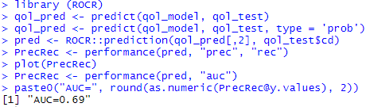
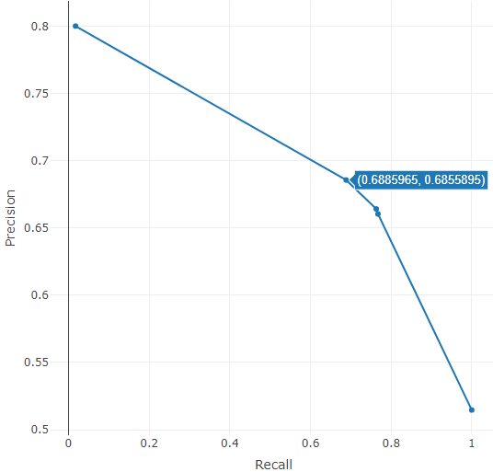
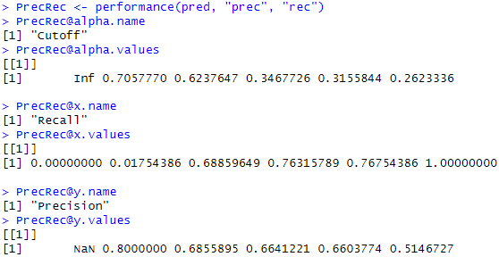
AUC
Report the Area under the ROC Curve (AUC)
Use ROCR functions
ROCR::performance()
“prec” – precision
“rec” – recall
Notes:
PrecRec <- performance(pred, "prec", "rec")
PrecRec@alpha.name
PrecRec@alpha.values
PrecRec@x.name
PrecRec@x.values
PrecRec@y.name
PrecRec@y.values

Slide 19

Type I and Type II Errors
Type I error is a false positive conclusion
Type II error is a false negative conclusion
precision = TP/(TP+FP)
recall = TP/(TP+FN) -- sensitivity
type I err = 1-precision = 1-TP/(TP+FP) = FP/(TP+FP)
type II err = 1-recall = 1-TP/(TP+FN) = FN/(TP+FN)
 |  | Actual
 |  | Positive | Negative
Predicted | Positive | TP | FP
 | Negative | FN | TN

Slide 20


The F-Measure
The F-measure (F1-score, F-score) combines precision and recall using the harmonic mean assuming equal weights
High F1-score means high precision and high recall
A perfect model will have F1-score of 1 (all correct predictions)
The more the precision and recall scores deviate from each other, the worse the F1-score will be
$$F1=\frac{2×precision×recall}{recall+precision}=\frac{2×TP}{2×TP+FP+FN}$$

Slide 21
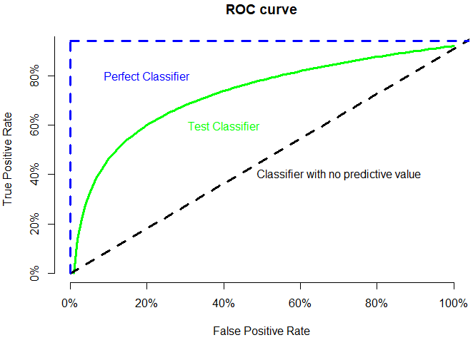
Visualizing Performance Tradeoffs (ROC Curve)
ROC (receiver operating characteristic) curves examines the trade-off between detecting true positives (TP) and avoiding the false positives (FP)
Show the performance of a classification model at all classification thresholds
 |  | Actual
 |  | Positive | Negative
Predicted | Positive | TP | FP
 | Negative | FN | TN
AUC (area under curve):
Outstanding: 0.9-1.0
Excellent/good: 0.8-0.9
Acceptable/fair: 0.7-0.8
Poor: 0.6-0.7
No discrimination: 0.5-0.6
TPR = TP/(TP+FN) -> sensitivity
FPR = FP/(FP+TN) -> 1- specificity
Notes:
https://developers.google.com/machine-learning/crash-course/classification/roc-and-auc
https://people.inf.elte.hu/kiss/11dwhdm/roc.pdf
https://medium.com/nerd-for-tech/understanding-receiver-operating-characteristic-roc-curve-f5eed11bc565
x <- seq(from=0, to=1.0, by=0.01) + 0.001
plot_ly(x = ~x, y = (log(100*x)+2.3)/(log(100*x[101])+2.3), line=list(color="lightgreen"),
name = 'Test Classifier', type='scatter', mode='lines', showlegend=T) %>%
add_lines(x=c(0,1), y=c(0,1), line=list(color="black", dash='dash'),
name="Classifier with no predictive value") %>%
add_segments(x=0, xend=0, y=0, yend = 1, line=list(color="blue"),
name="Perfect Classifier") %>%
add_segments(x=0, xend=1, y=1, yend = 1, line=list(color="blue"),
name="Perfect Classifier 2", showlegend=F) %>%
layout(title="ROC curve", legend = list(orientation = 'h'),
xaxis=list(title="False Positive Rate", scaleanchor="y", range=c(0,1)),
yaxis=list(title="True Positive Rate", scaleanchor="x"))

Slide 22
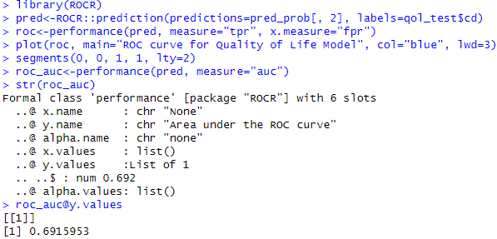
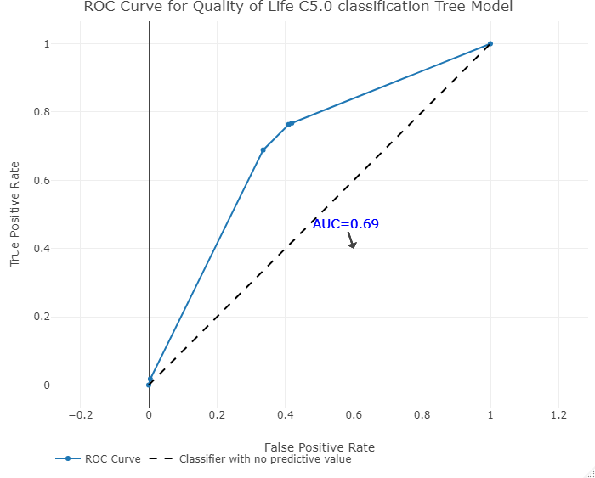
Visualizing Performance Tradeoffs (ROC Curve)
ROC curve using function ROCR::performance()
Specify a “performance” object by providing "tpr" and "fpr" parameters
ROCR::Prediction() takes
predicted probabilities and class labels
Notes:
> head(cbind(pred_prob[, 2], qol_test$cd))
[,1] [,2]
1 0.6237647 2
3 0.6237647 2
4 0.7057770 2
9 0.2623336 2
10 0.6237647 2
12 0.6237647 2
roc@y.name;roc@x.name;roc@alpha.name
roc@y.values;roc@x.values;roc@alpha.values

Slide 23
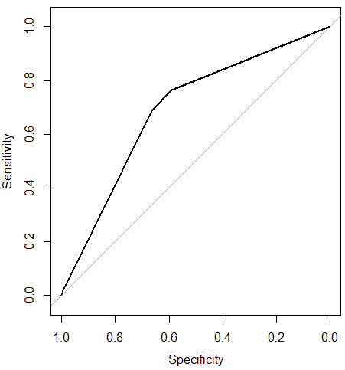
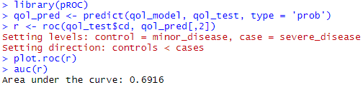
Visualizing Performance Tradeoffs (ROC Curve)
ROC curve using function pROC::roc()
Curve plot
AUC=0.6916
AUC=0.6916
pROC::roc() takes
class labels and predicted probabilities
Notes:
library(pROC)
qol_pred <- predict(qol_model, qol_test, type = 'prob')
r <- roc(qol_test$cd, qol_pred[,2])
plot.roc(r)
auc(r)

Slide 24
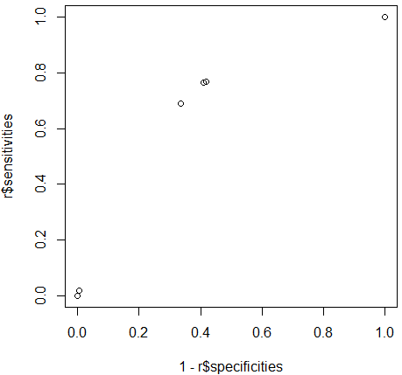
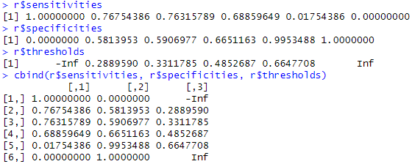
Visualizing Performance Tradeoffs (ROC Curve)
The pairs {sensitivity, 1-specificity} as the threshold value increases
Between 0 and 1
228 | 215
0 | 0
175 | 90
53 | 125
174 | 88
54 | 127
157 | 72
71 | 143
 |  | Actual
 |  | Positive | Negative
Predicted | Positive | TP | FP
 | Negative | FN | TN
4 | 1
224 | 214
0 | 0
228 | 215
Notes:
r$sensitivities
r$specificities
r$thresholds
#cbind(r$sensitivities, r$specificities, r$thresholds)
plot(1-r$specificities, r$sensitivities)
roc@y.values
roc@x.values
plot(qol_model)
plot(qol_model, type="simple")
qol_pred<-predict(qol_model, qol_test, type="prob")
confusionMatrix(factor(ifelse(pred_prob[,2]>0.5, "severe_disease", "minor_disease"), levels = c("severe_disease", "minor_disease")),
factor(qol_test$cd, levels = c("severe_disease", "minor_disease")),
positive="severe_disease")
df<-as.data.frame(cbind(rowid=row.names(qol_test),
pred_2=qol_pred[,2],
cd=qol_test$cd,
severe_disease=ifelse(qol_test$cd == "severe_disease", 1,0)))
df<-df[order(qol_pred[,2], decreasing = TRUE), ]
#write.csv(df, file = "df.csv")
qol_test(rowid)qol_pred[,2] qol_test$cd severe_disease
4 0.705777000 2 1 Inf 0 0
102 0.705777000 2 1 228 215
402 0.705777000 2 1 0.00000000 1.00000000 0.485327314
842 0.705777000 2 1
1088 0.705777000 1 0
1 0.623764700 2 1 0.6647708 4 1
3 0.623764700 2 1 224 214
10 0.623764700 2 1 0.01754386 0.995348837 0.492099323
12 0.623764700 2 1
19 0.623764700 1 0
32 0.623764700 1 0
44 0.623764700 1 0
45 0.623764700 1 0
77 0.623764700 2 1
79 0.623764700 2 1
89 0.623764700 2 1
93 0.623764700 2 1
94 0.623764700 2 1
105 0.623764700 1 0
108 0.623764700 1 0
150 0.623764700 2 1
151 0.623764700 2 1
165 0.623764700 2 1
183 0.623764700 1 0
190 0.623764700 1 0
206 0.623764700 2 1
227 0.623764700 2 1
246 0.623764700 1 0
248 0.623764700 1 0
271 0.623764700 2 1
273 0.623764700 2 1
276 0.623764700 1 0
280 0.623764700 2 1
281 0.623764700 2 1
282 0.623764700 2 1
302 0.623764700 2 1
333 0.623764700 2 1
342 0.623764700 2 1
345 0.623764700 1 0
347 0.623764700 2 1
359 0.623764700 2 1
371 0.623764700 1 0
375 0.623764700 2 1
387 0.623764700 2 1
419 0.623764700 1 0
426 0.623764700 2 1
430 0.623764700 1 0
431 0.623764700 1 0
442 0.623764700 2 1
456 0.623764700 2 1
457 0.623764700 2 1
468 0.623764700 2 1
471 0.623764700 2 1
479 0.623764700 2 1
485 0.623764700 1 0
493 0.623764700 2 1
506 0.623764700 1 0
550 0.623764700 2 1
565 0.623764700 2 1
603 0.623764700 1 0
623 0.623764700 1 0
634 0.623764700 2 1
647 0.623764700 2 1
653 0.623764700 1 0
661 0.623764700 2 1
662 0.623764700 2 1
670 0.623764700 2 1
683 0.623764700 2 1
688 0.623764700 1 0
696 0.623764700 2 1
705 0.623764700 1 0
707 0.623764700 2 1
708 0.623764700 2 1
717 0.623764700 1 0
720 0.623764700 1 0
761 0.623764700 2 1
764 0.623764700 1 0
784 0.623764700 2 1
790 0.623764700 2 1
803 0.623764700 1 0
805 0.623764700 2 1
811 0.623764700 1 0
816 0.623764700 1 0
835 0.623764700 2 1
845 0.623764700 2 1
846 0.623764700 2 1
847 0.623764700 2 1
876 0.623764700 2 1
895 0.623764700 2 1
906 0.623764700 2 1
909 0.623764700 1 0
928 0.623764700 2 1
933 0.623764700 1 0
941 0.623764700 2 1
954 0.623764700 2 1
955 0.623764700 2 1
959 0.623764700 2 1
982 0.623764700 2 1
988 0.623764700 2 1
1001 0.623764700 2 1
1011 0.623764700 2 1
1018 0.623764700 2 1
1022 0.623764700 2 1
1031 0.623764700 1 0
1040 0.623764700 1 0
1051 0.623764700 2 1
1056 0.623764700 2 1
1068 0.623764700 1 0
1082 0.623764700 1 0
1087 0.623764700 2 1
1096 0.623764700 2 1
1097 0.623764700 2 1
1114 0.623764700 2 1
1164 0.623764700 2 1
1177 0.623764700 2 1
1179 0.623764700 2 1
1209 0.623764700 1 0
1216 0.623764700 2 1
1218 0.623764700 2 1
1241 0.623764700 2 1
1244 0.623764700 1 0
1268 0.623764700 2 1
1299 0.623764700 2 1
1303 0.623764700 2 1
1324 0.623764700 2 1
1328 0.623764700 2 1
1329 0.623764700 2 1
1338 0.623764700 2 1
1339 0.623764700 2 1
1346 0.623764700 2 1
1354 0.623764700 2 1
1355 0.623764700 2 1
1365 0.623764700 2 1
1377 0.623764700 1 0
1391 0.623764700 1 0
1393 0.623764700 2 1
1397 0.623764700 2 1
1398 0.623764700 1 0
1408 0.623764700 1 0
1435 0.623764700 2 1
1436 0.623764700 2 1
1442 0.623764700 1 0
1448 0.623764700 2 1
1466 0.623764700 2 1
1488 0.623764700 2 1
1489 0.623764700 2 1
1500 0.623764700 2 1
1516 0.623764700 2 1
1520 0.623764700 2 1
1532 0.623764700 1 0
1535 0.623764700 2 1
1541 0.623764700 2 1
1549 0.623764700 2 1
1550 0.623764700 1 0
1568 0.623764700 2 1
1607 0.623764700 2 1
1616 0.623764700 2 1
1635 0.623764700 2 1
1638 0.623764700 2 1
1646 0.623764700 1 0
1652 0.623764700 2 1
1653 0.623764700 1 0
1671 0.623764700 2 1
1674 0.623764700 1 0
1684 0.623764700 2 1
1691 0.623764700 2 1
1735 0.623764700 2 1
1736 0.623764700 1 0
1744 0.623764700 2 1
1785 0.623764700 2 1
1789 0.623764700 1 0
1791 0.623764700 2 1
1798 0.623764700 1 0
1812 0.623764700 2 1
1815 0.623764700 2 1
1826 0.623764700 2 1
1845 0.623764700 2 1
1862 0.623764700 2 1
1863 0.623764700 2 1
1868 0.623764700 2 1
1872 0.623764700 1 0
1874 0.623764700 2 1
1898 0.623764700 1 0
1900 0.623764700 2 1
1928 0.623764700 2 1
1930 0.623764700 1 0
1936 0.623764700 1 0
1940 0.623764700 2 1
1942 0.623764700 2 1
1945 0.623764700 2 1
1955 0.623764700 1 0
1970 0.623764700 1 0
1981 0.623764700 1 0
1982 0.623764700 2 1
1983 0.623764700 1 0
2005 0.623764700 2 1
2014 0.623764700 2 1
2038 0.623764700 2 1
2043 0.623764700 2 1
2053 0.623764700 1 0
2058 0.623764700 1 0
2083 0.623764700 2 1
2085 0.623764700 2 1
2106 0.623764700 1 0
2129 0.623764700 1 0
2140 0.623764700 1 0
2147 0.623764700 1 0
2150 0.623764700 2 1
2154 0.623764700 2 1
2155 0.623764700 2 1
2161 0.623764700 2 1
2162 0.623764700 1 0
2176 0.623764700 2 1
2192 0.623764700 2 1
2193 0.623764700 2 1
2196 0.623764700 1 0
2202 0.623764700 2 1
2208 0.623764700 1 0
2218 0.623764700 2 1
2223 0.623764700 2 1
2251 0.623764700 2 1
2257 0.623764700 2 1
2271 0.623764700 1 0
2290 0.623764700 1 0
2318 0.623764700 2 1
2319 0.623764700 1 0
2320 0.623764700 1 0
2332 0.623764700 2 1
2351 0.623764700 2 1
109 0.346772600 2 1 0.4852687 157 72
127 0.346772600 1 0 71 143
154 0.346772600 2 1 0.688596491 0.665116279 0.677200903
161 0.346772600 1 0
254 0.346772600 2 1
304 0.346772600 2 1
308 0.346772600 2 1
464 0.346772600 1 0
481 0.346772600 1 0
530 0.346772600 2 1
734 0.346772600 2 1
796 0.346772600 1 0
960 0.346772600 2 1
972 0.346772600 1 0
1032 0.346772600 1 0
1176 0.346772600 1 0
1232 0.346772600 1 0
1284 0.346772600 2 1
1421 0.346772600 1 0
1452 0.346772600 1 0
1551 0.346772600 2 1
1598 0.346772600 1 0
1694 0.346772600 2 1
1698 0.346772600 2 1
1830 0.346772600 1 0
1968 0.346772600 2 1
1987 0.346772600 2 1
2087 0.346772600 1 0
2088 0.346772600 1 0
2095 0.346772600 1 0
2219 0.346772600 2 1
2261 0.346772600 2 1
2313 0.346772600 2 1
1989 0.315584400 2 1 0.3311785 174 88
2013 0.315584400 1 0 54 127
2107 0.315584400 1 0 0.763157895 0.590697674 0.679458239
9 0.262333600 2 1 0.288959 175 90
25 0.262333600 2 1 53 125
57 0.262333600 1 0 0.76754386 0.581395349 0.677200903
60 0.262333600 2 1
69 0.262333600 1 0
73 0.262333600 1 0
74 0.262333600 1 0
78 0.262333600 1 0
85 0.262333600 2 1
97 0.262333600 1 0
103 0.262333600 2 1
112 0.262333600 2 1
153 0.262333600 1 0
156 0.262333600 1 0
184 0.262333600 2 1
197 0.262333600 1 0
226 0.262333600 1 0
234 0.262333600 1 0
256 0.262333600 2 1
264 0.262333600 2 1
268 0.262333600 1 0
269 0.262333600 1 0
290 0.262333600 2 1
291 0.262333600 1 0
319 0.262333600 2 1
321 0.262333600 1 0
336 0.262333600 1 0
337 0.262333600 1 0
343 0.262333600 1 0
350 0.262333600 1 0
358 0.262333600 1 0
378 0.262333600 1 0
380 0.262333600 1 0
381 0.262333600 1 0
382 0.262333600 2 1
435 0.262333600 1 0
445 0.262333600 1 0
455 0.262333600 2 1
458 0.262333600 1 0
461 0.262333600 1 0
486 0.262333600 1 0
502 0.262333600 2 1
551 0.262333600 1 0
591 0.262333600 1 0
602 0.262333600 2 1
614 0.262333600 1 0
628 0.262333600 2 1
673 0.262333600 1 0
699 0.262333600 1 0
703 0.262333600 1 0
718 0.262333600 1 0
732 0.262333600 1 0
733 0.262333600 1 0
747 0.262333600 1 0
763 0.262333600 1 0
768 0.262333600 1 0
800 0.262333600 2 1
813 0.262333600 1 0
830 0.262333600 2 1
837 0.262333600 1 0
852 0.262333600 1 0
866 0.262333600 1 0
893 0.262333600 2 1
898 0.262333600 1 0
907 0.262333600 1 0
919 0.262333600 1 0
944 0.262333600 1 0
969 0.262333600 1 0
970 0.262333600 1 0
978 0.262333600 1 0
998 0.262333600 1 0
1023 0.262333600 2 1
1042 0.262333600 2 1
1047 0.262333600 1 0
1063 0.262333600 1 0
1076 0.262333600 2 1
1090 0.262333600 1 0
1095 0.262333600 1 0
1103 0.262333600 1 0
1104 0.262333600 1 0
1110 0.262333600 1 0
1111 0.262333600 2 1
1118 0.262333600 1 0
1122 0.262333600 1 0
1146 0.262333600 1 0
1150 0.262333600 1 0
1154 0.262333600 1 0
1157 0.262333600 1 0
1183 0.262333600 1 0
1196 0.262333600 1 0
1226 0.262333600 1 0
1301 0.262333600 2 1
1312 0.262333600 1 0
1321 0.262333600 1 0
1331 0.262333600 1 0
1333 0.262333600 1 0
1348 0.262333600 1 0
1349 0.262333600 2 1
1357 0.262333600 1 0
1367 0.262333600 1 0
1390 0.262333600 2 1
1399 0.262333600 2 1
1412 0.262333600 1 0
1420 0.262333600 1 0
1429 0.262333600 2 1
1454 0.262333600 1 0
1460 0.262333600 1 0
1473 0.262333600 2 1
1480 0.262333600 1 0
1494 0.262333600 2 1
1510 0.262333600 1 0
1515 0.262333600 1 0
1518 0.262333600 1 0
1519 0.262333600 1 0
1526 0.262333600 2 1
1544 0.262333600 2 1
1555 0.262333600 1 0
1561 0.262333600 1 0
1574 0.262333600 1 0
1577 0.262333600 2 1
1584 0.262333600 1 0
1627 0.262333600 1 0
1630 0.262333600 1 0
1631 0.262333600 2 1
1639 0.262333600 2 1
1644 0.262333600 1 0
1660 0.262333600 1 0
1688 0.262333600 2 1
1690 0.262333600 1 0
1693 0.262333600 2 1
1713 0.262333600 2 1
1718 0.262333600 1 0
1727 0.262333600 2 1
1740 0.262333600 1 0
1759 0.262333600 1 0
1811 0.262333600 1 0
1824 0.262333600 2 1
1848 0.262333600 1 0
1857 0.262333600 1 0
1859 0.262333600 2 1
1877 0.262333600 2 1
1882 0.262333600 2 1
1909 0.262333600 1 0
1910 0.262333600 1 0
1919 0.262333600 1 0
1920 0.262333600 2 1
1921 0.262333600 2 1
1922 0.262333600 1 0
1923 0.262333600 1 0
1952 0.262333600 1 0
1995 0.262333600 1 0
1998 0.262333600 2 1
2001 0.262333600 2 1
2059 0.262333600 1 0
2067 0.262333600 1 0
2081 0.262333600 1 0
2082 0.262333600 1 0
2103 0.262333600 1 0
2108 0.262333600 1 0
2132 0.262333600 2 1
2137 0.262333600 1 0
2144 0.262333600 1 0
2145 0.262333600 2 1
2148 0.262333600 2 1
2149 0.262333600 1 0
2158 0.262333600 1 0
2179 0.262333600 1 0
2222 0.262333600 1 0
2287 0.262333600 2 1
2289 0.262333600 1 0
2301 0.262333600 1 0
2304 0.262333600 1 0
2334 0.262333600 2 1
2337 0.262333600 1 0
2343 0.262333600 1 0
2346 0.262333600 1 0
2349 0.262333600 1 0
2350 0.262333600 2 1
#_of_row=443 -Inf 228 215
cbind(pred_prob[,2], qol_test$cd) 228 0 0
1.00000000 0.00000000 0.514672686

Slide 25
Estimating Future Performance
Instead of building the model on training data and measuring the model error on test data, there are alternative strategies
The holdout method
Reserve certain amount for testing
Cross-validation
Avoid overlapping test sets
Bootstrap sampling
Sample with replacement

Slide 26
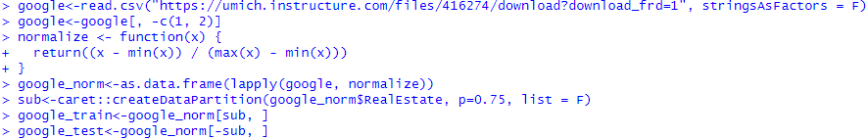
The Holdout Method
Partition a dataset into two separate sets
For training the model and testing (validating) the model performance
Randomized partition
Create a parameter that randomly draws numbers and use this parameter to extract random rows from the original dataset
Use caret::createDatePartition() method

Slide 27
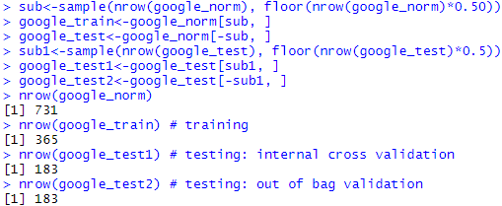
The Holdout Method
Can partition the original dataset into three separate subsets
For training, validation, and testing
May be 50%, 25%, and 25% respectively

Slide 28
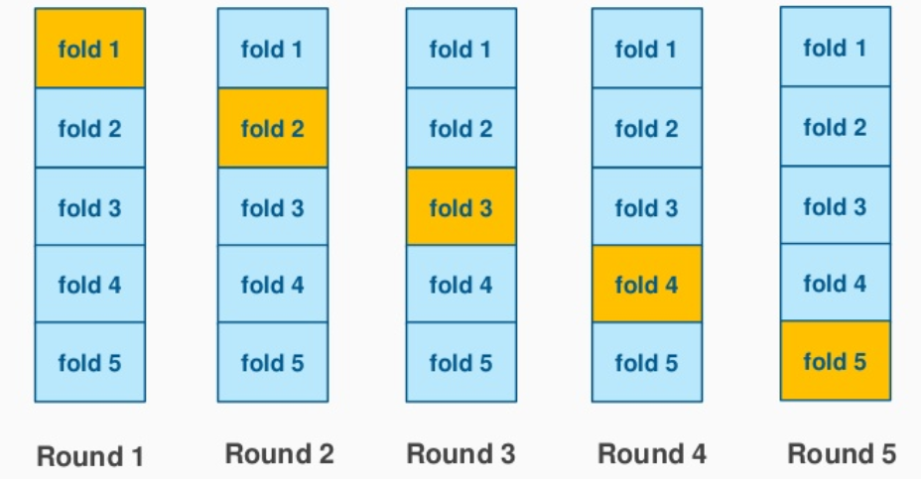
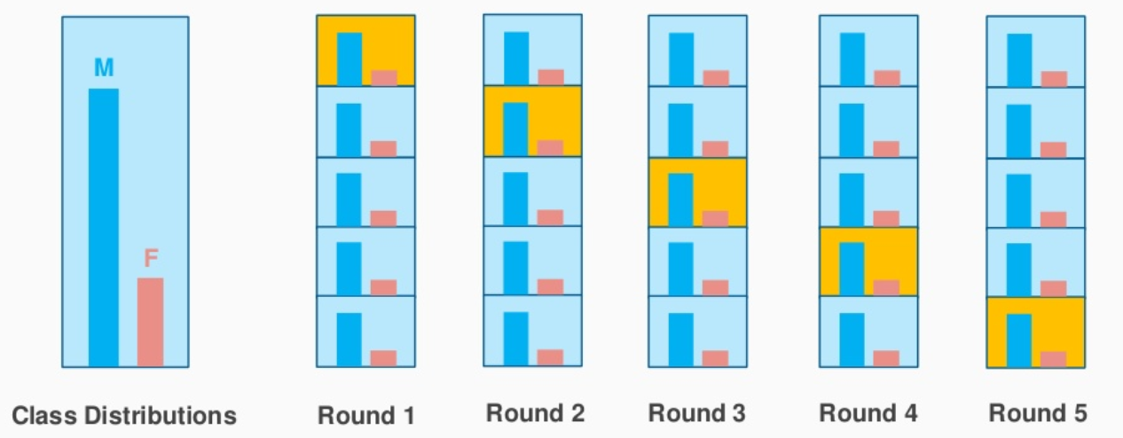
Cross-Validation
Validating predictive models by assessing the reliability and stability based on independent datasets
k-fold cross-validation (k-fold CV)
When k=n, k-fold CV is equivalent to LOOCV
Leave-one-out cross-validation (LOOCV)
Stratified cross-validation

Slide 29
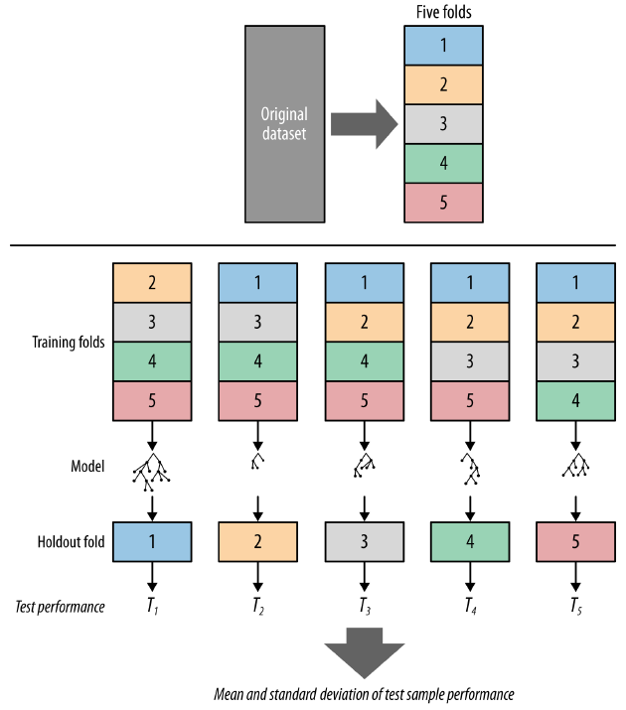
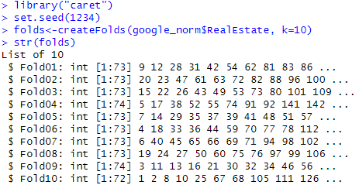
Cross-Validation
The k-fold cross-validation (k-fold CV)
Randomly partitions data into k folds
Each time, one is reserved for testing
caret::createFolds() function

Slide 30
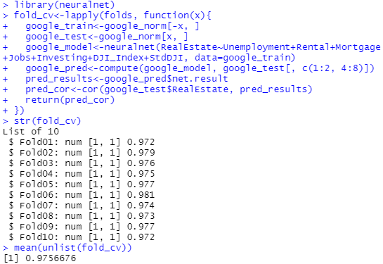
Cross-Validation
Neutral network model for the Google Trends data
For each fold
Training and testing data
Model and prediction
Report the agreement
Overall performance
10 folds created
Refer to NN model on PPT ch10 slides 26-28 where 75% training vs. 25% testing and correlation received.
The mean of overall model performance

Slide 31
Bootstrap Sampling
Sampling with replacement
Each observation could appear in multiple folds
Special case 632 bootstrap (0.632 training vs. 0.368 testing)
Training data will contain approximately 63.2% of the instances
error = 0.632*error_{test} + 0.368*error_{train}
Weighting corresponding errors: optimistic model performance on training data and the pessimistic model performance on testing data
Reliable for small samples, computationally intensive for large samples
Notes:
indices <- sample(1:500, 500, replace=TRUE) # sample With Replacement
length(unique(indices))
length(unique(indices))/500

Slide 32
Bootstrap Sampling
With bootstrap samples, the m models can be fitted (estimated) and aggregated
averaging the outputs for regression
voting methods for classification
Implementation of the 0.632 bootstrap technique for the QoL case-study

