Slide 1
CSDA 5430 Predictive Analytics
Chapter 14
Improving Model Performance
Notes:
https://www.socr.umich.edu/people/dinov/courses/DSPA_notes/14_ImprovingModelPerformance.html

Slide 2
Introduction
Ensembles of forecasting methods
Aggregate different predictive analytics strategies
Optimal parameters for a single ML method
Aggregate different methods into ensembles
Automated and customized parameter tuning
Meta-learning via bagging and boosting

Slide 3
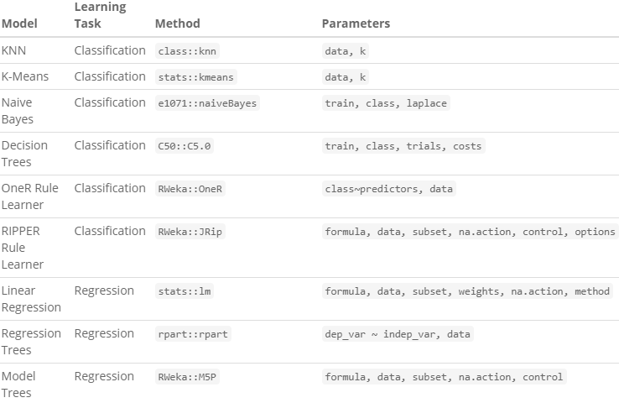
Improving Model Performance by Parameter Tuning
The process of searching through the parameter space, for the optimal parameter(s)
Core parameters of several machine learning techniques (partial)

Slide 4
Automated Parameter Tuning
Use caret::train() function for parameter tuning
Specify outcome & predictor features, and a specific method/algorithm
Possible values for method are found using names(getModelInfo())
For kNN
kNN_mod <- train(grade~., data=boystown_n, method="knn")
Test simultaneously multiple k values
Select the parameter(s) yielding the highest prediction accuracy

Slide 5
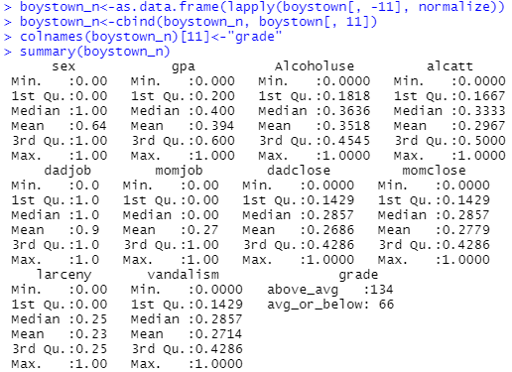
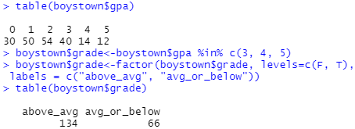
Automated Parameter Tuning
Boystown case study (ch06)
The variable of most interest is the GPA variable
Two classes of interest for this case study
GPA “C” or higher: “above average”
GPA below “C”: “average or below”
Notes:
Variables:
ID: Case subject identifier
Sex: dichotomous variable (1=male, 2=female)
GPA: Interval-level variable with range of 0-5 (0-“A” average, 1- “B” average, 2- “C” average, 3- “D” average, 4-“E”, 5-“F”")
Alcohol use: Interval level variable from 0-11 (drink everyday - never drinked)
Attitudes on drinking in the household: Alcatt- Interval level variable from 0-6 (totally approve - totally disapprove)
DadJob: 1-yes, dad has a job and 2- no
MomJob: 1-yes and 2-no
Parent closeness (example: In your opinion, does your mother make you feel close to her?)
Dadclose: Interval level variable 0-7 (usually-never)
Momclose: interval level variable 0-7 (usually-never)
Delinquency:
larceny (how many times have you taken things >$50?): Interval level data 0-4 (never - many times),
vandalism: Interval level data 0-7 (never - many times)

Slide 6
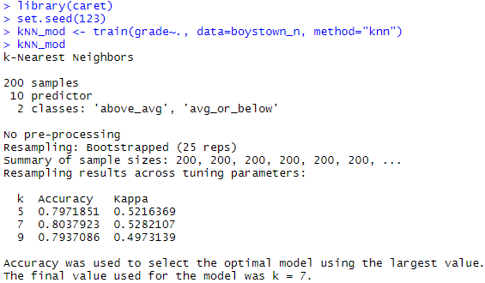
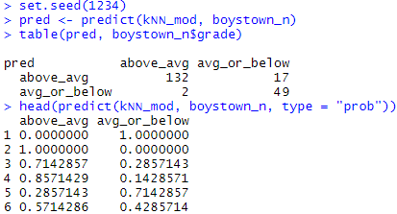
Automated Parameter Tuning
Boystown case study (ch06)
caret::train() function uses the complete dataset
random sampling for cross-validation
The optimal model k=7
re-substitution error
Notes:
Using boystown_n$gpa as predictor?

Slide 7
Customizing the Tuning Process
Use caret::trainControl() to customize re-sampling methods
method = "boot632“
The resampling method
number=25
The number of resampling iterations
selectionFunction = "oneSE“
the function used to select the optimal tuning parameter
grid<-expand.grid(k=c(1, 3, 5, 7, 9))
Possible tuning values
The optimal model has k=1
High accuracy and Kappa statistics
Notes:
Resampling method Method name Additional options and default values
Holdout sampling LGOCV p = 0.75 (training data proportion)
k-fold cross-validation cv number = 10 (number of folds)
Repeated k-fold cross validation repeatedcv number = 10 (number of folds), repeats = 10 (number of iterations)
Bootstrap sampling boot number = 25 (resampling iterations)
0.632 bootstrap boot632 number = 25 (resampling iterations)
Leave-one-out cross-validation LOOCV None

Slide 8
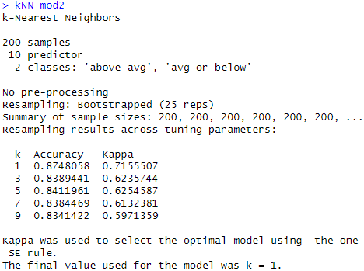
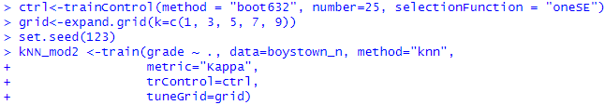
Customizing the Tuning Process
Use caret::trainControl() to customize re-sampling methods
Candidate models are better
The optimal model has k=1
High accuracy and Kappa statistics

Slide 9
Improving Model Performance with Meta-Learning
Meta-learning
Learning algorithms that learn from other learning algorithms
Ensemble of multiple learners relying either on single or multiple algorithms
Combine the outputs of several techniques and report consensus results that are more reliable
Bagging (Bootstrap Aggregating)
Averaging across multiple random data samples
Improve performance stability and decrease variance
Boosting
Improving areas in the data where our model makes errors, by forcing the model to pay more attention to those records
Reduce bias in parameter estimation

Slide 10
Ensemble
Combining results from multiple prediction methods or classifiers
Combining predictions (regressions)
Taking average, median, or weighted average
Weights can be proportional to model accuracy or to data quality
Combining classifications
Combining the results by voting on predicted classes for each observation
Weighted voting, assign heavier weights to scores from some models, based on considerations such as model accuracy or data quality

Slide 11
Bagging
Bagging (bootstrap aggregating)
Build multiple models with bootstrap samples using a single algorithm
The models’ predictions are combined with voting (for classification) or averaging (for numeric prediction).
Two steps
Generate multiple random samples – bootstrap sampling
Running an algorithm on each sample and producing scores

Slide 12
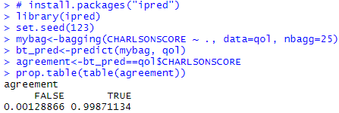
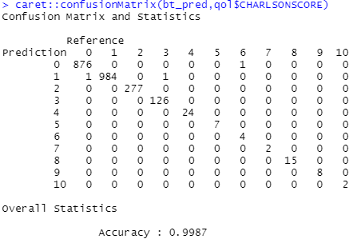
Bagging
Use ipred::bagging()
By default, bagging() uses rpart::rpart() for decision tree base learners
Parameter nbagg controls the number of bootstrap iterations
Entire dataset
Works well on its training data
Notes:
caret::confusionMatrix(bt_pred,qol$CHARLSONSCORE)

Slide 13
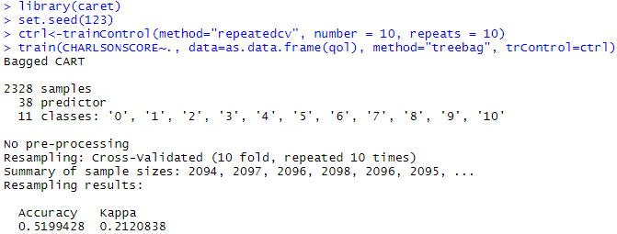
Bagging
Evaluate its performance on testing data
Use caret::train(), outcome is qol$CHARLSONSCORE
With 10 repeated CV as re-sampling method
number = 10 (number of folds), repeats = 10 (number of iterations)
Receiving marginal accuracy of 52% and a fair Kappa statistics.
Cannot forecast CHARLSONSCORE too well
Notes:
May take over 1 minute

Slide 14
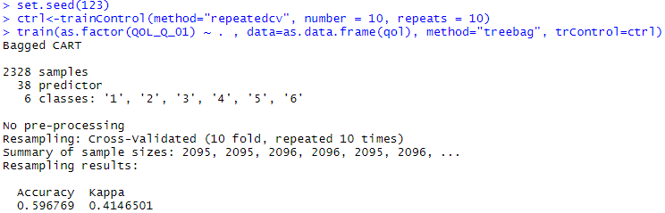
Bagging
The outcome is qol$QOL_Q_01
Use caret::train(),
With 10 repeated CV as re-sampling method
number = 10 (number of folds), repeats = 10 (number of iterations)
Receiving marginal accuracy of 0.6 and k = 0.41.
Better performance on qol$QOL_Q_p1
Notes:
May take over 1 minute

Slide 15
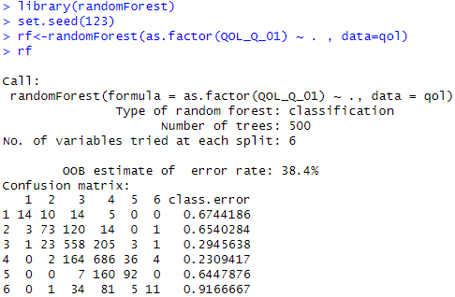
Random Forests
Random forests, or decision tree forests, represents a bagging method focusing on decision tree learners
Training random forests
ntree=500
mtry=6 (Number of features to randomly select at each split)
See also example on ch08 slide 46
Notes:
rf<-randomForest(as.factor(CHARLSONSCORE) ~ . , data=qol)
# OOB estimate of error rate: 46.48%

Slide 16
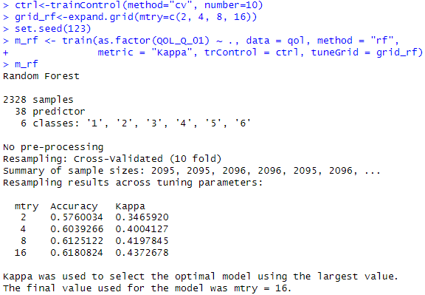
Evaluating Random Forest Performance
Reports more detailed model performance evaluations
Use caret::train() with control grid
10-folded CV re-sampling method
When mtry=16
accuracy = 0.62 & kappa = 0.44
Notes:
May take around 2 minutes

Slide 17
Boosting
Boosting employs non-uniform weights on different learners
More learners working on the remaining “hard-to-classify” observations
Directly improve areas in the data where our model makes errors
Usually, the boosting results are quite better than the top individual model
It is most commonly applied to decision trees
Steps:
Fit a model to the data
Draw a sample from the data so that misclassified records have higher probabilities of selection
Fit the model to the new sample
Repeat Steps 2–3 multiple times

Slide 18
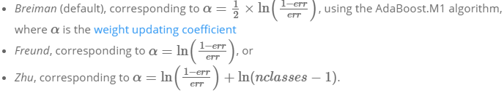
Adaptive Boosting
Adaptive boosting (AdaBoost)
Subsequent weak learners are tweaked in favor of those instances misclassified by the previous classifiers
Use adabag::boosting() function and specify coeflearn
default: coeflearn = 'Breiman'
AdaBoost.M1 (Breiman and Freund)
SAMME (Zhu)

Slide 19
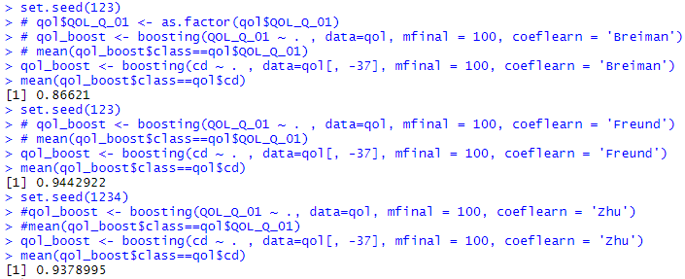
Adaptive Boosting
Use adabag::boosting() function and specify coeflearn
Outcome variable: cd
Accuracy
Notes:
confusionMatrix(as.factor(qol_boost$class),qol$cd)

Slide 20
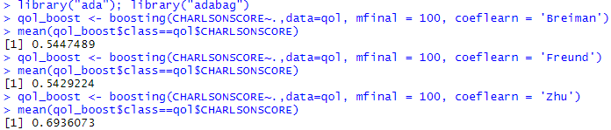
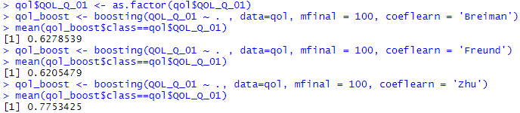
Adaptive Boosting
Use adabag::boosting() function and specify coeflearn
Outcome variables: CHARLSONSCORE and QOL_Q_01

Slide 21
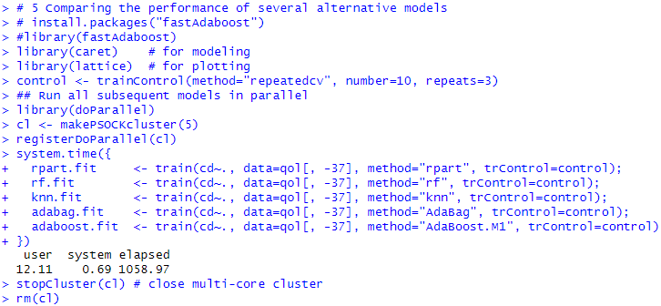
Comparing the Performance of Several Alternative Models
Model comparison for classification using rpart, random forest, knn, bagging, and boosting
Notes:
May take up to 20 minutes

Slide 22
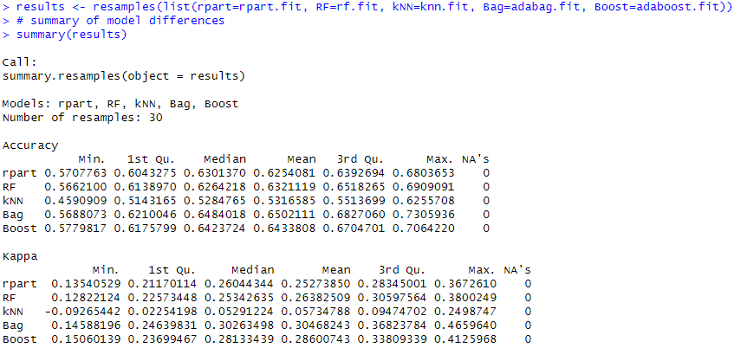
Comparing the Performance of Several Alternative Models
Model comparison for classification using rpart, random forest, knn, bagging, and boosting

Slide 23
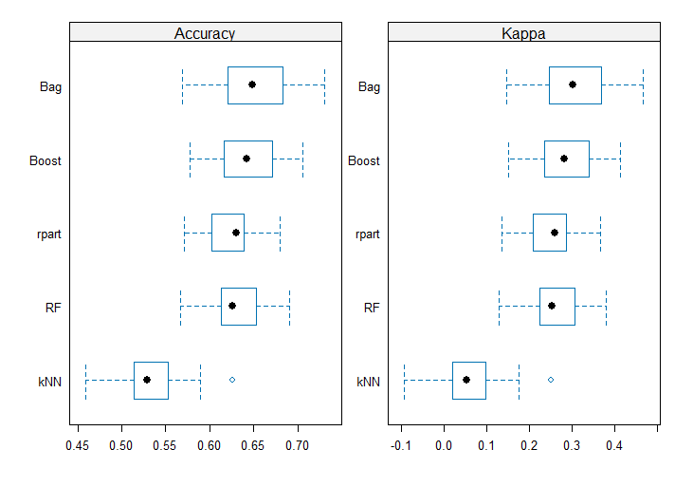
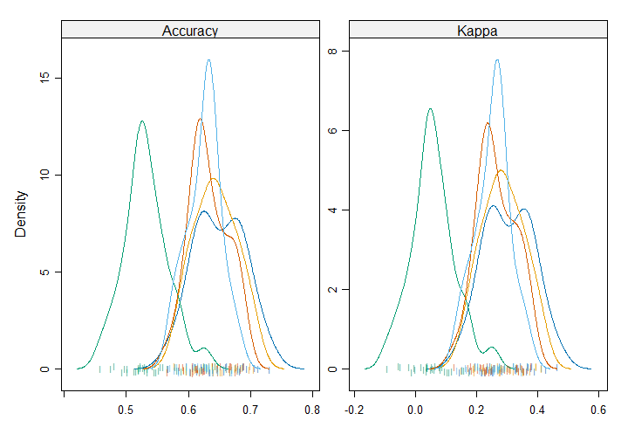
Comparing the Performance of Several Alternative Models
Model comparison for classification using rpart, random forest, knn, bagging, and boosting

Slide 24
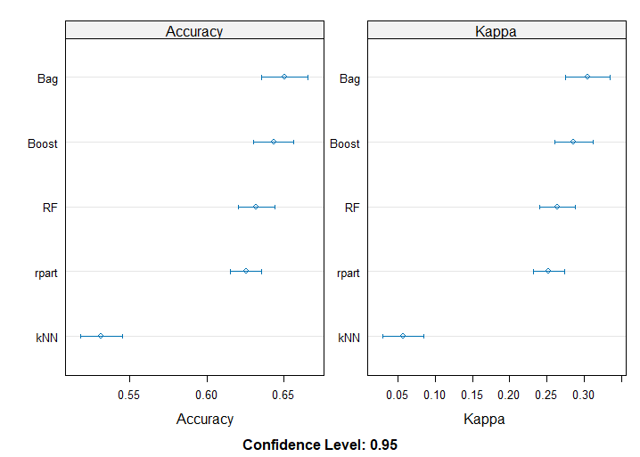
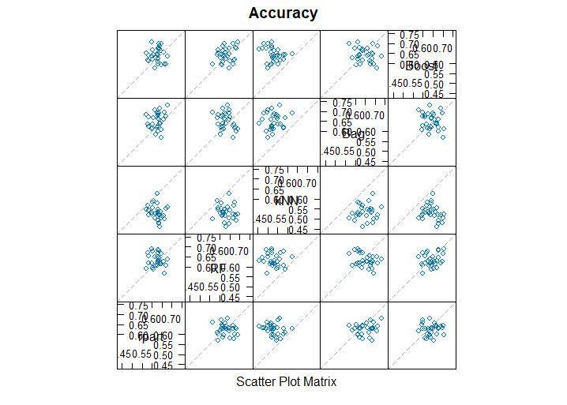
Comparing the Performance of Several Alternative Models
Model comparison for classification using rpart, random forest, knn, bagging, and boosting

Slide 25
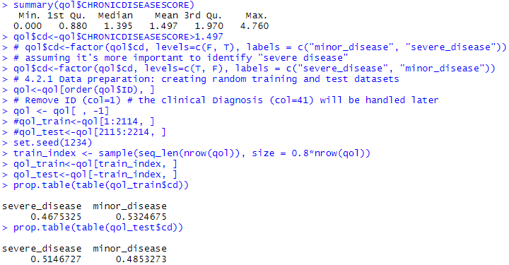
All-in-One: Single Tree, Bagging, Random Forest, Adaptive Boosting
From chapter 8 case study: quality of life and chronic disease
Preparing data
Notes:
# from chapter 8
# 4.2 Step 2: exploring and preparing the data
qol<-read.csv("https://umich.instructure.com/files/481332/download?download_frd=1")
str(qol)
table(qol$QOL_Q_01)
qol<-qol[!qol$CHRONICDISEASESCORE==-9, ]
summary(qol$CHRONICDISEASESCORE)
qol$cd<-qol$CHRONICDISEASESCORE>1.497
# qol$cd<-factor(qol$cd, levels=c(F, T), labels = c("minor_disease", "severe_disease"))
# assuming it's more important to identify "severe disease"
qol$cd<-factor(qol$cd, levels=c(T, F), labels = c("severe_disease", "minor_disease"))
# 4.2.1 Data preparation: creating random training and test datasets
qol<-qol[order(qol$ID), ]
# Remove ID (col=1) # the clinical Diagnosis (col=41) will be handled later
qol <- qol[ , -1]
#qol_train<-qol[1:2114, ]
#qol_test<-qol[2115:2214, ]
set.seed(1234)
train_index <- sample(seq_len(nrow(qol)), size = 0.8*nrow(qol))
qol_train<-qol[train_index, ]
qol_test<-qol[-train_index, ]
prop.table(table(qol_train$cd))
prop.table(table(qol_test$cd))

Slide 26
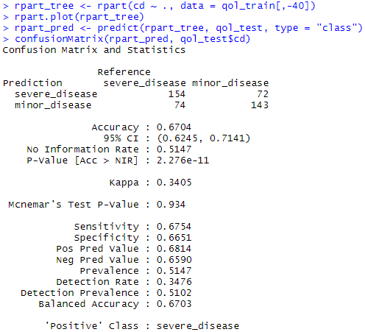
All-in-One: Single Tree, Bagging, Random Forest, Adaptive Boosting
From chapter 8 case study: quality of life and chronic disease
Sigle tree (rpart tree)
cp=0.01
See ch08 slide 35
Notes:
# single tree
library(rpart)
library(rpart.plot)
rpart_tree <- rpart(cd ~ ., data = qol_train[,-40])
rpart.plot(rpart_tree)
rpart_pred <- predict(rpart_tree, qol_test, type = "class")
confusionMatrix(rpart_pred, qol_test$cd)

Slide 27
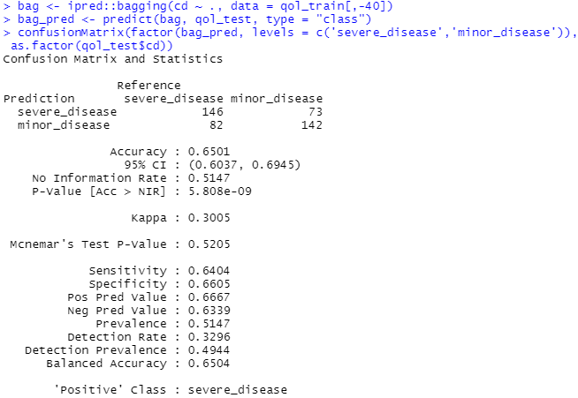
All-in-One: Single Tree, Bagging, Random Forest, Adaptive Boosting
From chapter 8 case study: quality of life and chronic disease
Bagging
nbagg=25
See slide 12
Notes:
# bagging default nbagg=25
bag <- ipred::bagging(cd ~ ., data = qol_train[,-40])
bag_pred <- predict(bag, qol_test, type = "class")
confusionMatrix(factor(bag_pred, levels = c('severe_disease','minor_disease')), as.factor(qol_test$cd))

Slide 28
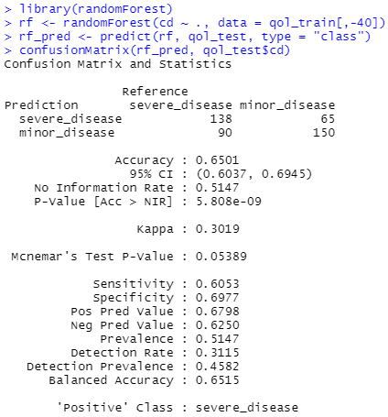
All-in-One: Single Tree, Bagging, Random Forest, Adaptive Boosting
From chapter 8 case study: quality of life and chronic disease
Random forest
ntree=500
mtry=6
See slide 15
Notes:
# random forest
library(randomForest)
rf <- randomForest(cd ~ ., data = qol_train[,-40])
rf_pred <- predict(rf, qol_test, type = "class")
confusionMatrix(rf_pred, qol_test$cd)

Slide 29
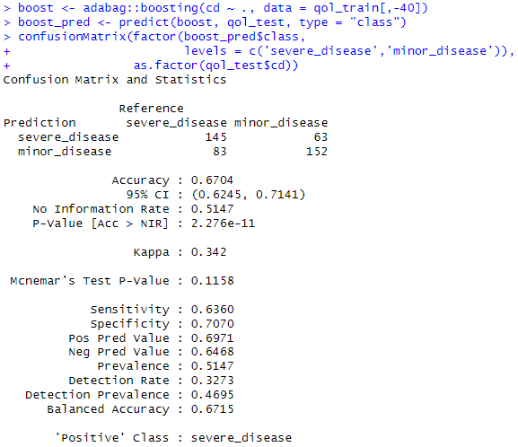
All-in-One: Single Tree, Bagging, Random Forest, Adaptive Boosting
From chapter 8 case study: quality of life and chronic disease
Adaptive boosting
coeflearn='Breiman'
See slide 19
Notes:
# boosting default: coeflearn = 'Breiman'
boost <- adabag::boosting(cd ~ ., data = qol_train[,-40])
boost_pred <- predict(boost, qol_test, type = "class")
confusionMatrix(factor(boost_pred$class, levels = c('severe_disease','minor_disease')), as.factor(qol_test$cd))

Slide 30
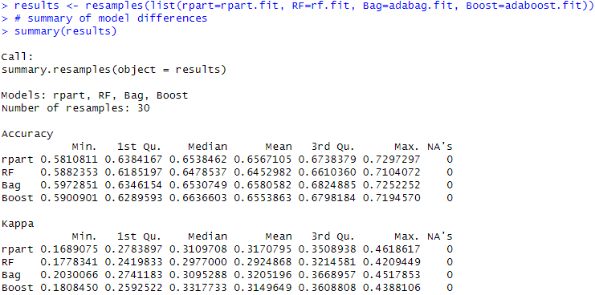
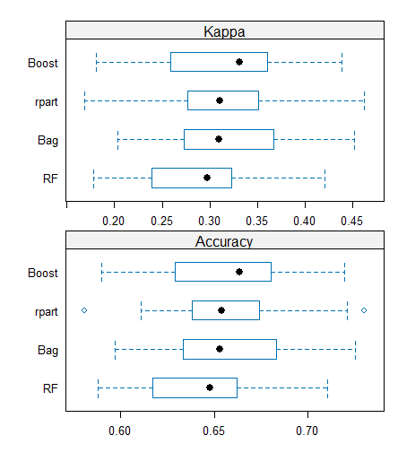
All-in-One: Single Tree, Bagging, Random Forest, Adaptive Boosting
Comparing the performance
Notes:
control <- trainControl(method="repeatedcv", number=10, repeats=3)
## Run all subsequent models in parallel
library(doParallel)
cl <- makePSOCKcluster(5)
registerDoParallel(cl)
system.time({
rpart.fit <- train(cd~., data=qol[,-40], method="rpart", trControl=control);
rf.fit <- train(cd~., data=qol[,-40], method="rf", trControl=control);
adabag.fit <- train(cd~., data=qol[,-40], method="AdaBag", trControl=control);
adaboost.fit <- train(cd~., data=qol[,-40], method="AdaBoost.M1", trControl=control)
})
stopCluster(cl) # close multi-core cluster
rm(cl)
results <- resamples(list(rpart=rpart.fit, RF=rf.fit, Bag=adabag.fit, Boost=adaboost.fit))
# summary of model differences
summary(results)
# Plot Accuracy Summaries
scales <- list(x=list(relation="free"), y=list(relation="free"))
bwplot(results, scales=scales) # Box plots of accuracy
densityplot(results, scales=scales, pch = "|") # Density plots of accuracy

