Slide 1
CSDA 5430 Predictive Analytics
Chapter 00
Introduction to Predictive Analytics
Notes:
https://www.socr.umich.edu/people/dinov/courses/DSPA_Topics.html

Slide 2
Introduction
Data and big data
Data science and predictive analytics
Predictive analytics process
Key concepts
Prediction and classification performance measures
Programming language R
Steps in predictive analytics process
List of case studies

Slide 3
Data and Big Data
Data and big data
The characteristics of big data
Volume, variety, velocity and veracity
Constructive characterization
Big Data Dimensions | Tools | Characteristics
Size | Harvesting and management of vast amounts of data | Volume
Complexity | Wranglers for dealing with heterogeneous data | Variety
Incongruency | Tools for data harmonization and aggregation | Veracity
Multi-source | Transfer and joint modeling of disparate elements | Variety
Multi-scale | Macro to meso to micro scale observations | Variety
Time | Techniques accounting for longitudinal patterns in the data | Velocity
Incomplete | Reliable management of missing data | Veracity

Slide 4
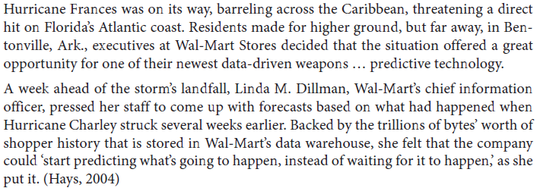
Data and Data Science
Hurricane and store readiness
Hurricane Frances was formed 8/24/2004
Hurricane Charley was formed 8/9/2004
Notes:
Foster Provost & Tom Fawcett, Data Science for Business
https://en.wikipedia.org/wiki/Hurricane_Frances
Hurricane Frances (formed 8/24/2004), The second most intense tropical cyclone in the Atlantic during 2004 and proved to be very destructive in Florida
https://en.wikipedia.org/wiki/Hurricane_Charley
Hurricane Charley (formed 8/9/2004), The first of four separate hurricanes to impact or strike Florida during 2004, along with Frances, Ivan and Jeanne, as well as one of the strongest hurricanes ever to strike the United States

Slide 5
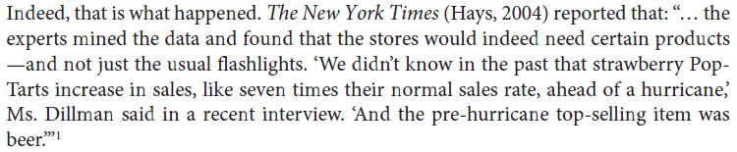
Data and Data Science
Hurricane and store readiness
Discover patterns due to the hurricane that were not obvious
To project the amount of increase in sales due to the hurricane?
To predict that people in the path of the hurricane would buy more bottled water?
To identify unusual local demand for products so that the company might be able to rush stock to the stores ahead of the hurricane’s landfall?
Notes:
Foster Provost & Tom Fawcett, Data Science for Business

Slide 6
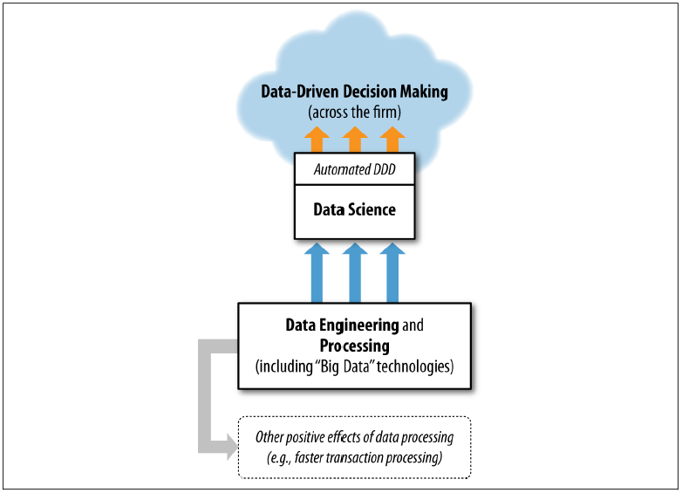
Data and Data Science
Data science in the context of various data-related processes in the organization
Notes:
Foster Provost & Tom Fawcett, Data Science for Business

Slide 7
Data Science
A mix of skills in the areas of statistics, machine learning, math, programming, business, and information technology
An emerging field
Extremely transdisciplinary - bridging between the theoretical, computational, experimental, and biosocial areas
Deals with enormous amounts of complex, incongruent and dynamic data from multiple sources
Aims to develop algorithms, methods, tools and services capable of ingesting such datasets and generating semi-automated decision support systems
Data science techniques
Data manipulation, data harmonization and aggregation, exploratory or confirmatory data analyses, predictive analytics, validation and fine-tuning

Slide 8
Predictive Analytics and Machine Learning (Data Mining)
Predictive analytics is a process of representing, interrogating and interpreting complex data
A core aim of predictive analytics is to forecast trends, predict patterns in the data, prognosticate the process behavior
Machine learning (data mining) refers to business analytics methods that go beyond counts, descriptive techniques, reporting, and methods based on business rules
Include statistical and machine-learning methods that inform decision-making
Predictive analytics vs. statistical analytics for business decision making
“What is the relationship between advertising and sales?”
“What advertisement, or recommended product, should be shown to online shopper?”

Slide 9
Other Technologies
Predictive analytics involves the application of various technologies
Statistics
Database querying
Data warehousing
Understand the differences and what technologies one needs to employ
Who are the most profitable customers?
Is there really a difference between the profitable customers and the average customer?
But who really are these customers? Can I characterize them?
Will some particular new customer be profitable? How much revenue should I expect this customer to generate?

Slide 10
Supervised and Unsupervised Learning
In supervised learning, predict or classify the outcome variable, “learning” from training data
Classification, prediction (regression)
In unsupervised learning, no outcome variable to predict or classify, no “learning”
Clustering, association rules
Predictive power in supervised learning and overfitting
Data partitions for training, holdout (testing)
Predictive accuracy is not the same as goodness-of-fit

Slide 11
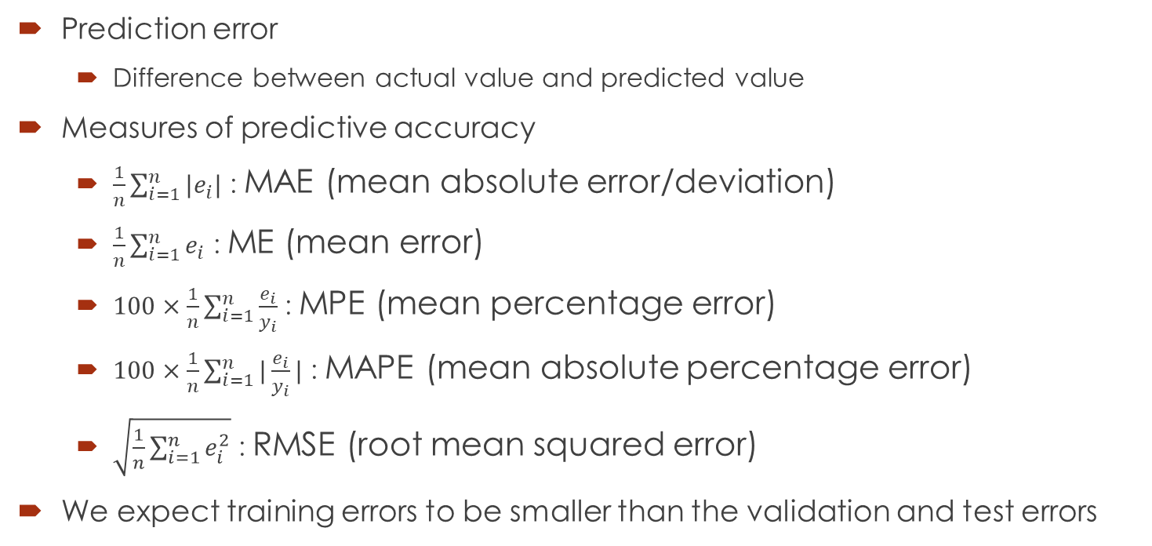
Prediction Performance Measures
Prediction error
Difference between actual value and predicted value
Measures of predictive accuracy
$\frac{1}{n}\sum_{i=1}^{n}{|e_{i}|}$ : MAE (mean absolute error/deviation)
$\frac{1}{n}\sum_{i=1}^{n}{e_{i}}$ : ME (mean error)
$100×\frac{1}{n}\sum_{i=1}^{n}{\frac{e_{i}}{y_{i}}}$ : MPE (mean percentage error)
$100×\frac{1}{n}\sum_{i=1}^{n}{|\frac{e_{i}}{y_{i}}|}$ : MAPE (mean absolute percentage error)
$\sqrt{\frac{1}{n}\sum_{i=1}^{n}{e_{i}^{2}}}$ : RMSE (root mean squared error)
We expect training errors to be smaller than the validation and test errors
Notes:
P.131, Shmueli, Machine Learning for Business Analytics: Concepts, Techniques, and Applications in R

Slide 12

Classification Performance Measures
Confusion matrix gives estimates of the true classification and misclassification rates
Overall error rate: $err=\frac{n_{1,2}+n_{2,1}}{n}$
Overall accuracy: $acceuracy=1−err=\frac{n_{1,1}+n_{2,2}}{n}$
 |  | Actual Class
 |  | C₁ | C₂
Predicted Class | C₁ | n_{1,1} = number of C₁ records classified correctly | n_{2,1} = number of C₂ records classified incorrectly as C₁
 | C₂ | n_{1,2} = number of C₁ records classified incorrectly as C₂ | n_{2,2} = number of C₂ records classified correctly
Notes:
P.139, Shmueli, Machine Learning for Business Analytics: Concepts, Techniques, and Applications in R

Slide 13
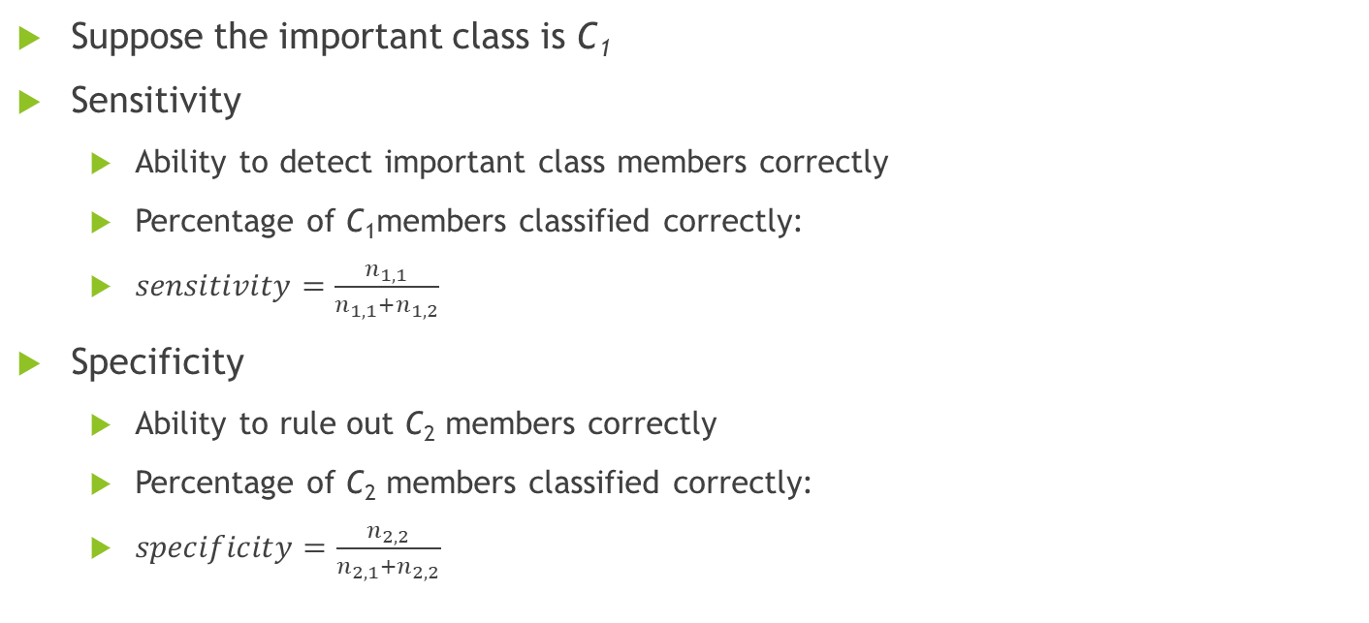
Classification Performance Measures
Suppose the important class is C₁
Sensitivity
Ability to detect important class members correctly
Percentage of C₁members classified correctly:
$sensitivity=\frac{n_{1,1}}{n_{1,1}+n_{1,2}}$
Specificity
Ability to rule out C₂ members correctly
Percentage of C₂ members classified correctly:
$specificity=\frac{n_{2,2}}{n_{2,1}+n_{2,2}}$
Notes:
P.143, Shmueli, Machine Learning for Business Analytics: Concepts, Techniques, and Applications in R

Slide 14
Programming Language R
Many different classes of software tools and programming languages
R is one of them
Advantages
Popularity, relatively easy to learn, IDE, free, open source, community, massive set of packages
Disadvantages
Most R uses are not programmers
Written to solve a pressing problem
Inconsistency across contributed packages

Slide 15
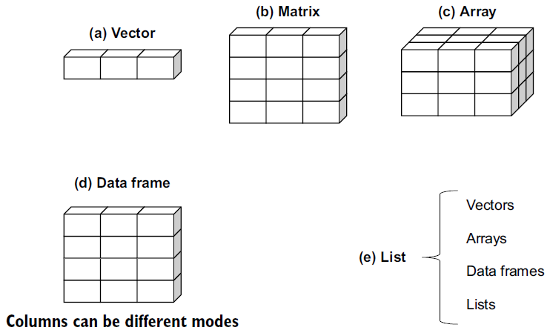
Data Structures in R
Scalar: one element
Vector: one-dimensional array
Matrix: two-dimensional array
Array: matrix in more than two dimensions
Data frame: general matrix
Columns can be in different modes/types
Most common
List: an ordered collection of objects (components)
Allows to gather a variety of objects under one name

Slide 16
Types of Variables
Numerical variable
Continuous or integer
Categorical variable
Numerical or text, ordered (ordinal) or un-ordered (nominal)
Categorical variables may require special handling
Dummy variable and factor
Patient ID | Admission Date | Age | Diabetes | Status
1 | 10/15/2018 | 25 | Type1 | Poor
2 | 11/01/2018 | 34 | Type2 | Improved
3 | 10/21/2018 | 28 | Type1 | Excellent
4 | 10/28/2018 | 52 | Type1 | Poor
Notes:
patientID <- c(1, 2, 3, 4)
admDate <- c("10/15/2018", "11/01/2018", "10/21/2018", "10/28/2018")
age <- c(25, 34, 28, 52)
diabetes <- c("Type1", "Type2", "Type1", "Type1")
status <- c("Poor", "Improved", "Excellent", "Poor")
patientData <- data.frame(patientID, admDate, age, diabetes, status)
str(patientData)
patientData$diabetes <- factor(patientData$diabetes)
patientData$status <- factor(patientData$status)
# or using as.factor()
# patientData$diabetes <- as.factor(patientData$diabetes)
# patientData$status <- as.factor(patientData$status)
levels(patientData$status)
str(patientData)
# override the default by specifying a levels option
patientData$status <- factor(patientData$status, levels=c("Poor", "Improved", "Excellent"))
levels(patientData$status)
str(patientData)
library(fastDummies)
patientData_dummies <- dummy_cols(patientData, select_columns = c("diabetes", "status"),
remove_first_dummy = FALSE, remove_selected_columns = FALSE)
str(patientData_dummies)

Slide 17
Predictive Analytics Process
Define purpose
Obtain data
Explore & clean data
Determine ML task
Choose ML methods
Apply methods & select final model
Evaluate performance
Deploy
Notes:
P.17, Shmueli, Machine Learning for Business Analytics: Concepts, Techniques, and Applications in R

Slide 18
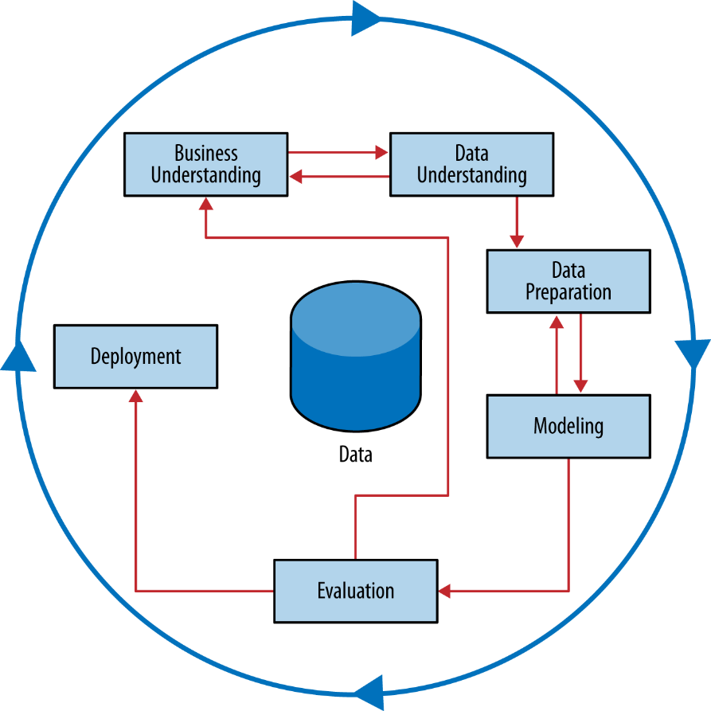
The CRISP Process
CRoss-Industry Standard Process for Data Mining

Slide 19
The Steps in Data Analytics
Develop an understanding of the purpose of the project
Obtain the dataset to be used in the analysis
Explore, clean, and preprocess the data
Reduce the data dimension, if necessary
Determine the machine learning task
Partition the data (for supervised tasks)
Choose the machine learning techniques to be used
Use algorithms to perform the task
Interpret the results of the algorithms
Deploy the model
Notes:
P.21, Shmueli, Machine Learning for Business Analytics: Concepts, Techniques, and Applications in R

Slide 20
The Steps in Data Analytics
Building a predictive model
Predicting home values in the West Roxbury neighborhood
Steps typical to many data analytics tasks using a familiar procedure: multiple linear regression
1. Determine the purpose
Let's assume that the purpose of our project is to predict the value of homes in West Roxbury
2. Obtain the data
We will use the 2014 West Roxbury housing data. The dataset in question is small enough that we do not need to sample from it—we can use it in its entirety
Notes:
P.41, Shmueli, Machine Learning for Business Analytics: Concepts, Techniques, and Applications in R

Slide 21
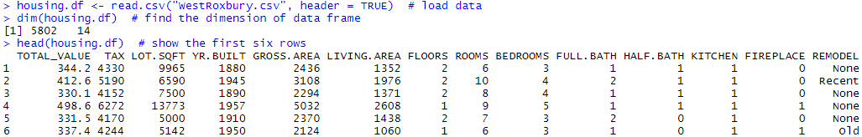
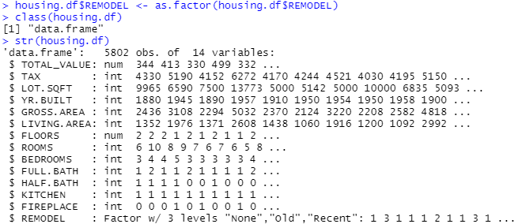
The Steps in Data Analytics
3. Explore, clean, and preprocess the data
Notes:
DESCRIPTION OF VARIABLES IN WEST ROXBURY (BOSTON) HOME VALUE DATASET
TOTAL VALUE Total assessed value for property, in thousands of USD
TAX Tax bill amount based on total assessed value multiplied by the tax rate, in USD
LOT SQ FT Total lot size of parcel in square feet
YR BUILT Year the property was built
GROSS AREA Gross floor area
LIVING AREA Total living area for residential properties (ft2)
FLOORS Number of floors
ROOMS Total number of rooms
BEDROOMS Total number of bedrooms
FULL BATH Total number of full baths
HALF BATH Total number of half baths
KITCHEN Total number of kitchens
FIREPLACE Total number of fireplaces
REMODEL When the house was remodeled (Recent/Old/None)

Slide 22
The Steps in Data Analytics
4. Reduce the data dimension
Our dataset has been prepared for presentation with fairly low dimension - it has only 13 variables, and the single categorical variable considered has only three categories (and hence adds two dummy variables)
Removed variables such as bldg_type, roof_type, and ext_fin
5. Determine the machine learning task
The specific task is to predict the value of TOTAL VALUE using the predictor variables
This is a supervised prediction task

Slide 23
The Steps in Data Analytics
6. Partition the data (for supervised tasks)
The training partition is used to build the model
The validation partition is used to see how well the model does when applied to new data
The test partition might also be used
7. Choose the technique
In this case, it is multiple linear regression.
Having divided the data into training and validation partitions, we can build a multiple linear regression model with the training data
We want to predict the value of a house in West Roxbury on the basis of all the other predictors (except TAX)

Slide 24
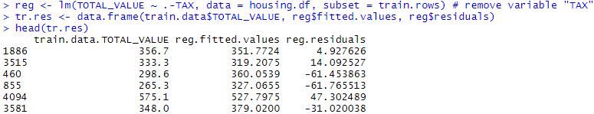
The Steps in Data Analytics
8. Use the algorithm to perform the task
Predict house value with the training data, then use the same model to predict values for the validation data
Fitting a regression model to training data

Slide 25
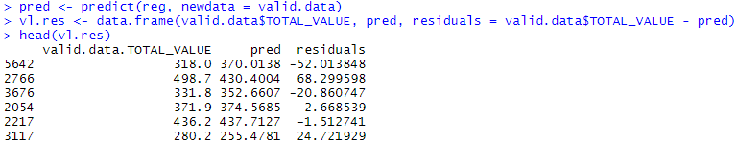
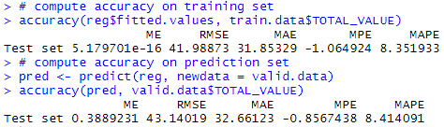
The Steps in Data Analytics
8. Use the algorithm to perform the task
Applying regression model to predict validation set
Computing model evaluation metrics

Slide 26
The Steps in Data Analytics
9. Interpret the results
At this stage we would typically try other prediction algorithms and see how they do error-wise
We might also try different “settings” on the various models
After choosing the best model, we use that model to predict the output variable in fresh data

Slide 27
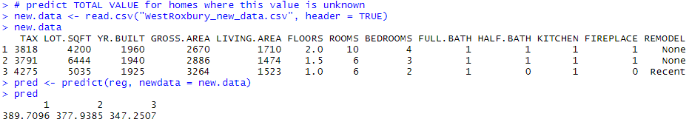
The Steps in Data Analytics
10. Deploy the model
After the best model is chosen, it is applied to new data to predict TOTAL VALUE for homes where this value is unknown

Slide 28
Major Case Studies in Chapters
 | ch06 | ch07 | ch08 | ch09 | ch10 | ch11 | ch12 | ch13 | ch14 | ch19
Boys Town | x |  |  |  |  |  |  |  | x
Head & Neck |  | x |  |  |  |  |  | x
Quality of Life |  |  | x |  |  |  |  | x | x
MLB Players |  |  |  | x
Google Trends |  |  |  |  | x |  |  | x
HN Medication |  |  |  |  |  | x
Divorce |  |  |  |  |  |  | x
Job Ranking |  |  |  |  |  |  |  |  |  | x

Slide 29
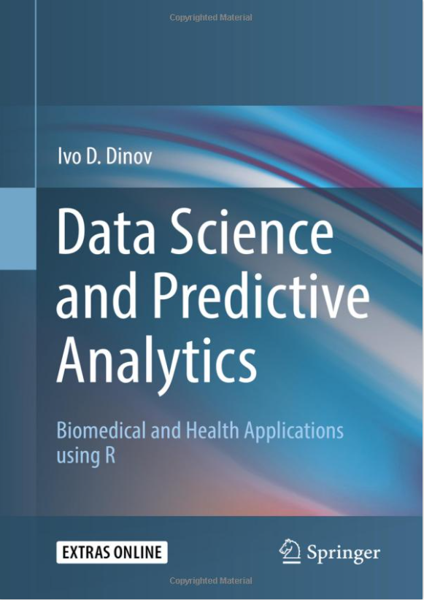
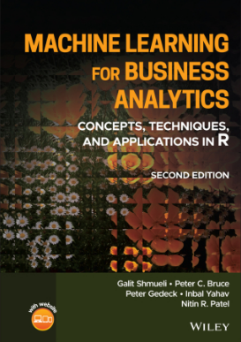
Textbook and Reference Materials
Data Science and Predictive Analytics
Machine Learning for Business Analytics
Notes:
Ivo Dinov, Data Science and Predictive Analytics
Galit Shmueli, Machine Learning for Business Analytics

