Slide 1
CSDA 5430 Predictive Analytics
Chapter 08
Decision Tree Divide and Conquer Classification
Notes:
https://www.socr.umich.edu/people/dinov/courses/DSPA_notes/08_DecisionTreeClass.html

Slide 2
Introduction
Overview
Decision-tree divide and conquer methods
Measures quantifying classification accuracy
Strategies for pruning decision trees
Case study
Classification rules

Slide 3
Overview
Decision tree enables classification via tree structures
Begin with a trunk representing all points
Iteratively, the trunk is split into narrower and narrower branches by forking-decisions
The final decision is obtained when the tree branching process terminates
The terminal (leaf) nodes represent the action to be taken as the result of the series of branching decisions
The leaf nodes provide the expected forecasting results given the series of events in the decision tree

Slide 4

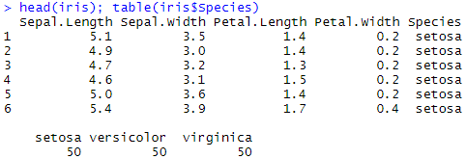
Hands-on Example: Iris Data
The Iris dataset
Attributes include
Sepal.Length
Sepal.Width
Petal.Length
Petal.Width
Classes of the Species
Setosa
Versicolor
Virginica
Notes:
https://www.snaplogic.com/machine-learning-showcase/iris-flower-classification

Slide 5
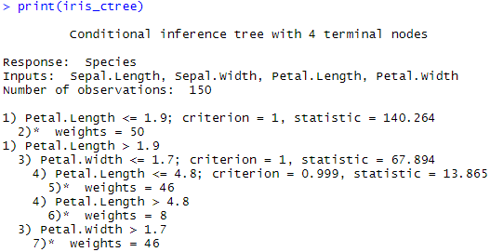
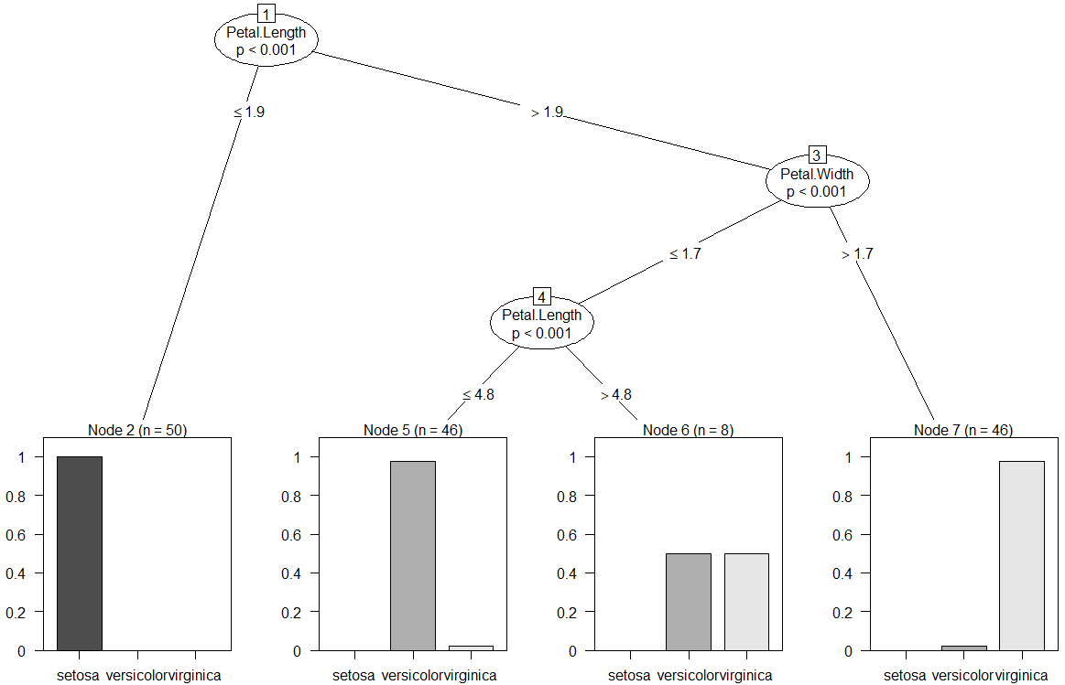
Hands-on Example: Iris Data
Build a decision tree with ctree() function
Notes:
table(predict(iris_ctree, iris), iris$Species)

Slide 6
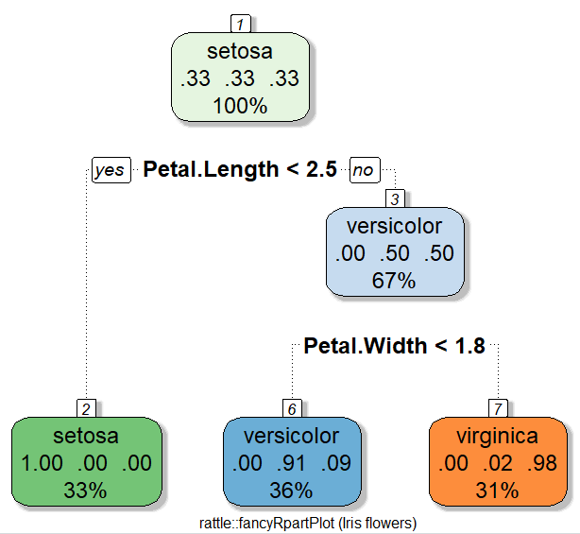
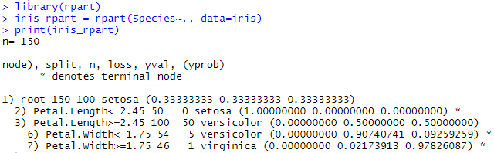
Hands-on Example: Iris Data
Build a decision tree with rpart() function
Notes:
table(predict(iris_rpart, iris, type="class"), iris$Species)
iris_c50 <- C50::C5.0(iris[,-5], iris$Species)
table(predict(iris_c50, iris), iris$Species)

Slide 7
Decision Tree Overview
The decision tree algorithm represents an upside-down tree with lots of branches
A series of logical decisions are encoded as branches between nodes of the tree
The classification begins at the root node and goes through many branches until it gets to the terminal nodes
This iterative process splits the data into different classes by a rigid criterion

Slide 8
Divide and Conquer
Recursive partitioning that use data features and attributes to split the data into groups (nodes) of similar classes
Objective
Information gain measure, or impurity reduction
The attribute with the highest information gain (i.e., greatest impurity reduction) is selected as the test attribute for the current node
Three main measures to evaluate the impurity reduction
Misclassification error
Gini index
Entropy

Slide 9
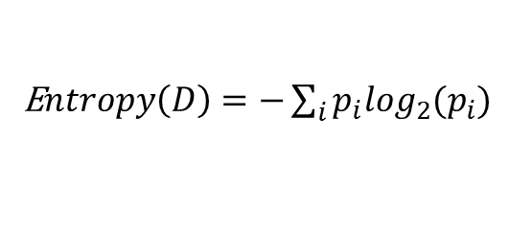
Entropy
The Entropy is an information measure of the amount of disorder or uncertainty in a system
If we have a segment of data that contains two classes, the first class contains 80% of the data and the second class contains the remaining 20%. Then, we have the following entropy:
Entropy(S)=−0.8log₂(0.8)−0.2log₂(0.2)=0.7219281
E$ntropy\left(D\right)=−\sum_{i}{p_{i}\log_{2}(p_{i})}$

Slide 10
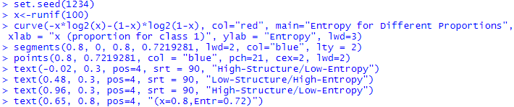
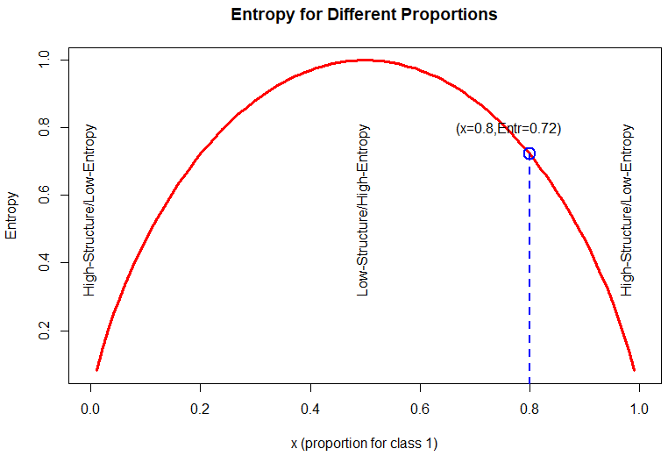
Entropy
For a two-class problem, the relationship between class-proportions and entropy is illustrated in the following graph
Assume x is the proportion for one of the classes

Slide 11
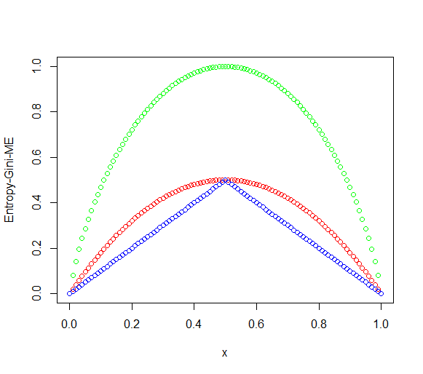



Misclassification Error and Gini Index
The Misclassification error and the Gini index are also applied to evaluate information gain
$$ME=1−\max_{k}{(p_{k})}$$
$$Gini=\sum_{k}{p_{k}(1−p_{k})}=1−\sum_{k}{p_{k}^{2}}$$
$$Entropy=−\sum_{k}{p_{k}\log_{2}(p_{k})}$$
Notes:
entropy<-function(p){
return (ifelse((p==1), 0,
ifelse((p==0), 0,
-p*log2(p)-(1-p)*log2(1-p))))
}
gini<-function(p){
return (1-(p*p+(1-p)*(1-p)))
}
ME<-function(p){
#return (1-max(p,1-p))
return (1-ifelse(p>(1-p), p, 1-p))
}
x <- seq(0, 1, 0.01)
plot(x,entropy(x), col="green", ylab = "Entropy-Gini-ME")
points(x, gini(x), col="red")
points(x,ME(x), col="blue")

Slide 12
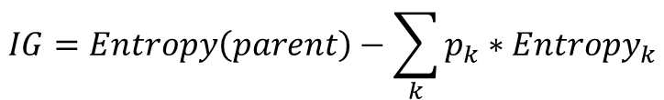
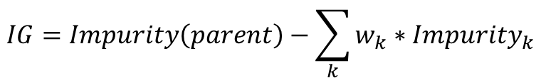
Information Gain
The objective of decision tree split is based on the information gain measure, or impurity reduction
Used to select the split attribute for decision node
$$IG=Impurity\left(parent\right)−\sum_{k}{w_{k}∗{Impurity}_{k}}$$
40, 40
p(C1)=40/80
p(C2)=40/80
$$IG=Entropy\left(parent\right)−\sum_{k}{p_{k}{∗Entropy}_{k}}$$
20, 40
20, 0
p(C1)=20/60
p(C2)=40/60
p(C1)=20/20
p(C2)=0/20

Slide 13
Information Gain
Before split dataset
40 C1 vs. 40 C2
Entropy = -p(C1)*log₂(p(C1))-p(C2)*log₂(p(C2))
= -0.5*log₂(0.5)-0.5*log₂(0.5)] = 1
After split
Combined impurity (weighted average)
Entropy=(60/80)(0.9183)+(20/80)(0.0000)=0.6887
Entropy(left) = −(20/60)log₂(20/60)−(40/60)log₂(40/60) = 0.9183
Entropy(right) = −(20/20)log₂(20/20)−(0/20)log₂(0/20) = 0.0000
IG = entropy(parent) – [p(left)*entropy(left) + p(right)*entropy(right)]
= 1 – [(60/80)* 0.9183 + (20/80)* 0.0000] = 1 – 0.6887 = 0.3113
40, 40
p(C1)=40/80
p(C2)=40/80
20, 40
20, 0
p(C1)=20/60
p(C2)=40/60
p(C1)=20/20
p(C2)=0/20
Notes:
# classification split
# (40, 40)
# into (20, 40) and (20, 0)
p_parent <- 40/80
p_left <- 20/60
w_left <- 60/80
p_right <- 20/20
w_right <- 20/80
entropy_parent <- entropy(p_parent)
entropy_left <- entropy(p_left)
entropy_right <- entropy(p_right)
IG_entropy = entropy_parent - w_left*entropy_left - w_right*entropy_right

Slide 14
C5.0 Decision Tree Algorithm
Measuring purity by calculating entropy (or gini, ME)
The smaller the entropy the more information is contained in the corresponding decision node split
High entropy indicate significant information content (randomness)
Low entropy indicates highly-compressible data with structure in it
Aim to find splits in the data that reduce the entropy
Increase the homogeneity of the elements within all classes
Information gain
Gain(F)=Entropy(S)−Entropy(S₁)

Slide 15
Pruning the Decision Tree
Overfitting
An extreme example would be that we make each observation as a class
How to control the size of the decision tree?
Make a cutoff
Early stopping, or pre-pruning
Post-pruning
The C5.0 algorithm uses the post-pruning method
First, grows an overfitting large tree
Then, cuts out nodes and branches

Slide 16
Case Study 1: Quality of Life and Chronic Disease
Step 1 - collecting data
Step 2 - exploring and preparing the data
Data preparation - creating random training and test datasets
Step 3 - training a model on the data
Step 4 - evaluating model performance
Step 5 - trial option
Loading the misclassification error matrix
Parameter tuning

Slide 17
Collecting Data
The Quality of life and chronic disease dataset
Case06_QoL_Symptom_ChronicIllness.csv
This dataset has 41 variables
Demographic variables
Patient reported variables
QOL (quality of life) question ratings
MSA (memorial symptom assessment) question ratings
PH (patient health) question ratings
TOS (tobacco screen) question ratings
Provider reported variables
Charlson Comorbidity Index: ranging from 0-10
Chronic Disease Score: ranging from 0-19
Notes:
Demographic variables
Participant ID
Interview date
Language (survey offered in Spanish or English)
Age
Race/ethnicity
Sex
Patient-reported survey variables
Provider-reported variables

Slide 18
Collecting Data
Driving challenges
Among patients with chronic illness, what symptoms are most strongly associated with poor quality of life?
Among patients with chronic illness, are quality of life scores, as measured by the PROMIS-QOL scale, strongly correlated with patient-reported symptom burden?
Among patients with chronic illness, are quality of life scores, as measured by the PROMIS-QOL scale, strongly correlated with comorbidity indices (non-patient reported)?
Is the Charlson Comorbidity Index strongly correlated with patient-reported symptom burden?
Is the Chronic Disease Score strongly correlated with patient-reported symptom burden?
Notes:
https://acsjournals.onlinelibrary.wiley.com/doi/10.1002/1097-0142%2820000901%2989%3A5%3C1162%3A%3AAID-CNCR26%3E3.0.CO%3B2-Y

Slide 19
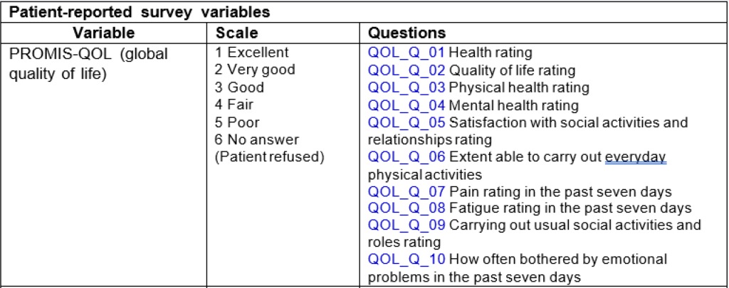
Collecting Data
Patient reported variables

Slide 20
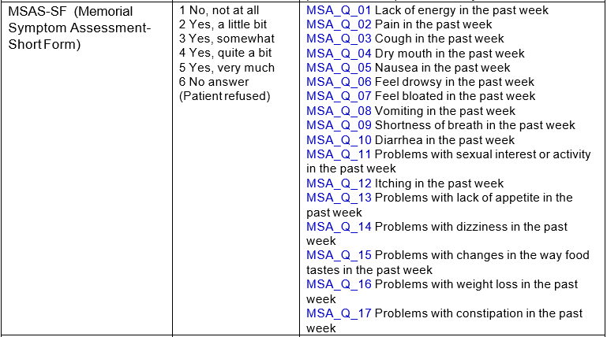
Collecting Data
Patient reported variables

Slide 21
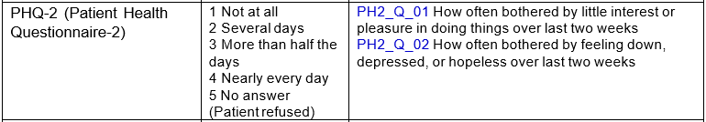
Collecting Data
Patient reported variables

Slide 22
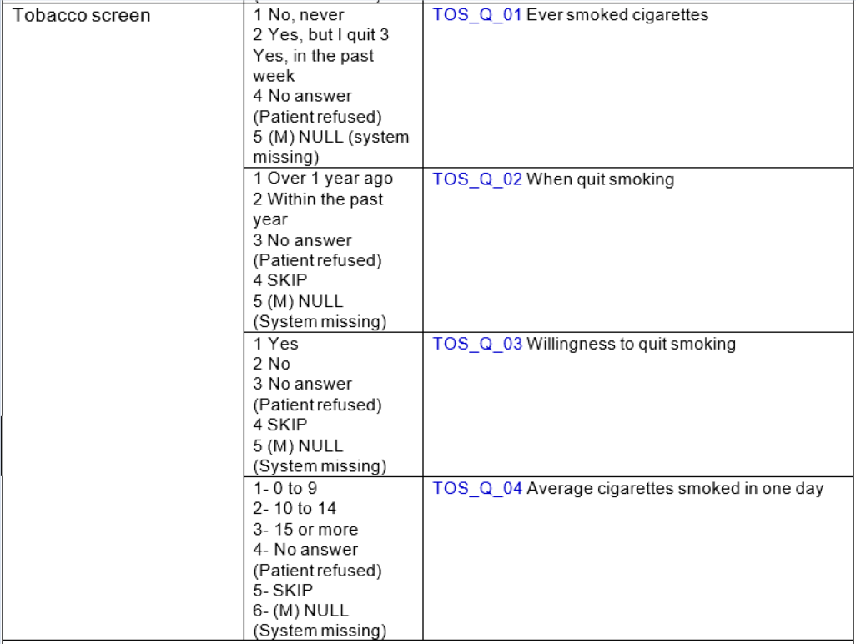
Collecting Data
Patient reported variables

Slide 23
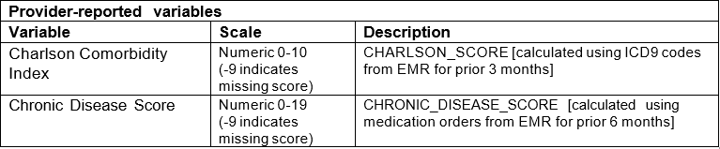
Collecting Data
Provider reported variables

Slide 24
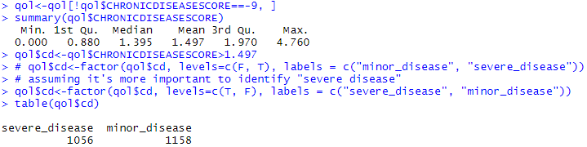
Exploring and Preparing the Data
Our variable of interest CHRONICDISEASESCORE
-9 indicates missing score
Create two classes using variable CHRONICDISEASESCORE
Class of severe disease (assuming this is the important class)
CHRONICDISEASESCORE > mean(CHRONICDISEASESCORE)
Class of minor disease
CHRONICDISEASESCORE ≤ mean(CHRONICDISEASESCORE)
Levels severe disease first
Notes:
table(qol$cd)

Slide 25
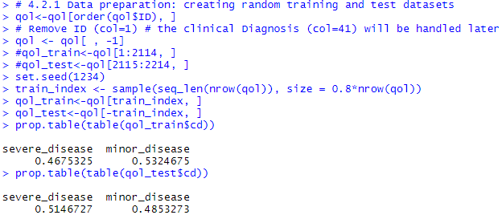
Data Preparation - Creating Random Training and Test Datasets
Random assignments of cases into training and testing sets
80-20% partitioning

Slide 26
Training a Model on the Data
Using the C5.0() function
The function C5.0() has following components:
m<-C5.0(train, class, trials=1, costs=NULL)
train: data frame containing numeric training data (features)
class: factor vector with the class for each row in the training data
trials: an optional number to control the boosting iterations (default=1)
costs: an optional matrix to specify the costs of false positive and false negative

Slide 27
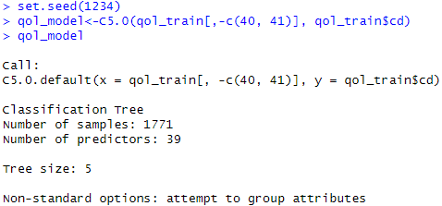
Training a Model on the Data
Using the C5.0() function
Training data that only contains features (predictors only)
Outcome variable is a factor

Slide 28
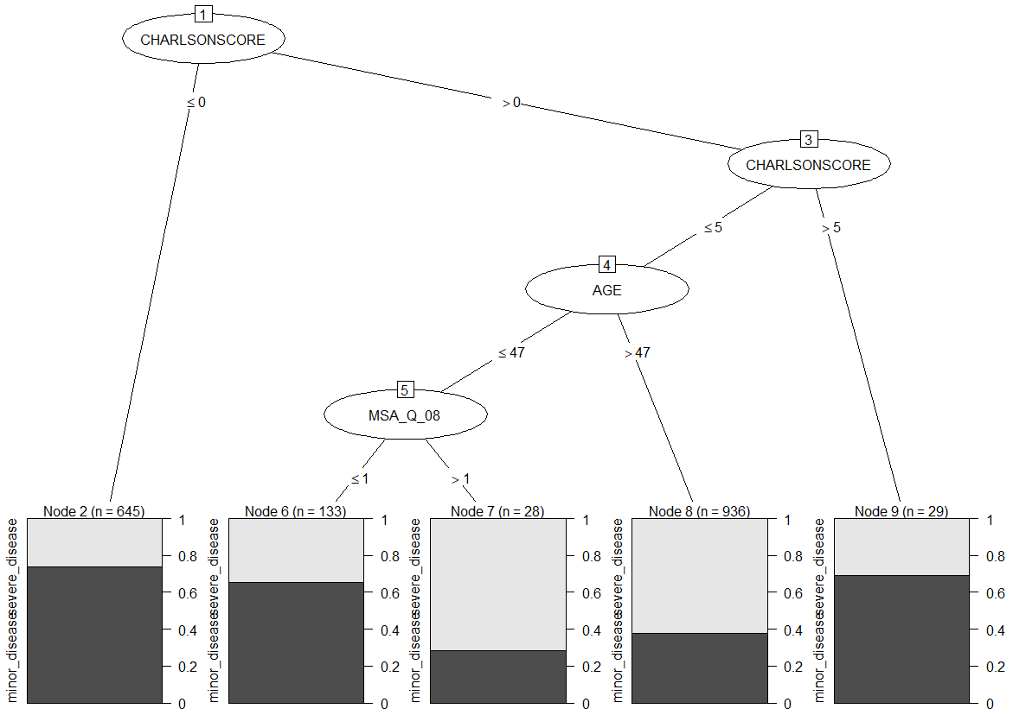
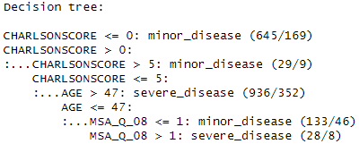
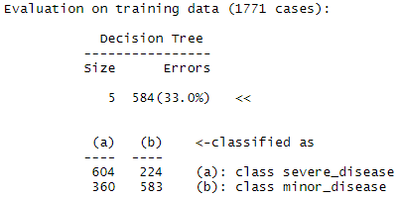
Training a Model on the Data
We have a tree that has 5 terminal nodes and the classification error for decision tree is 33% percent in the training data
Notes:
plot(qol_model)
plot(qol_model, type="simple") #simple vs. extended

Slide 29
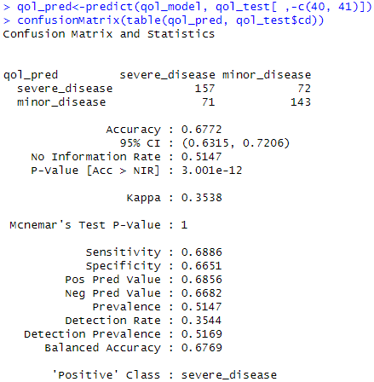
Evaluating Model Performance
The confusion matrix shows prediction accuracy on test data is about 68%

Slide 30
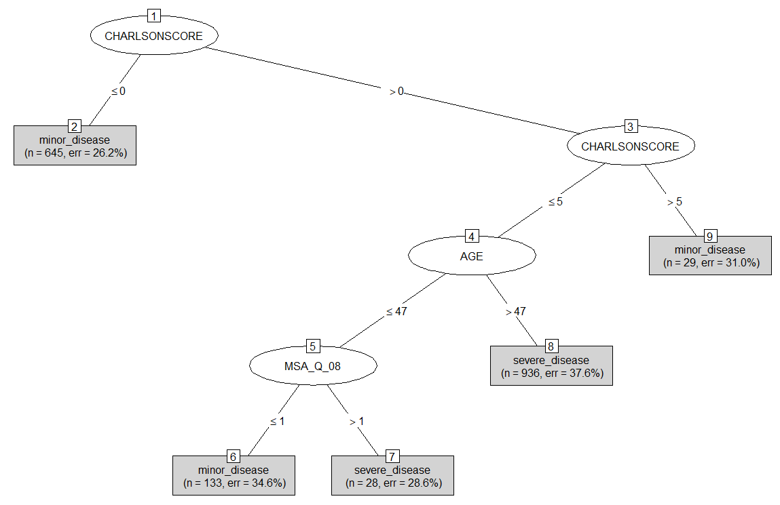
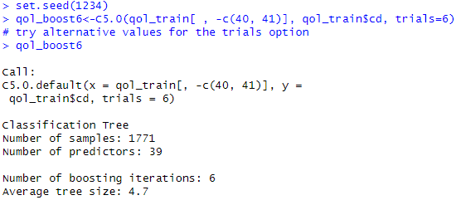
Trial Option
In C5.0 function, the trails option specifies the number of boosting iterations
An approach to reduce bias in parameter estimation
Using trials=6
Notes:
summary(qol_boost6)

Slide 31
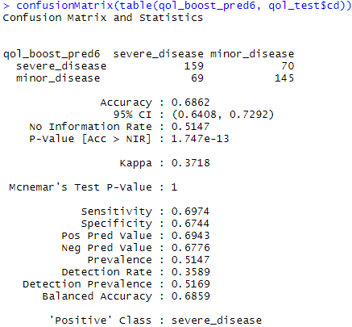
Trial Option
The accuracy is about 69%
How about trials=10?

Slide 32
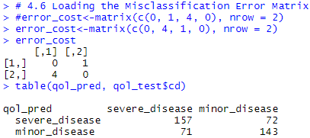
Loading the Misclassification Error Matrix
False negative (failure to detect a severe disease case) may be more costly than false positive (misclassifying a minor disease case as severe)
Misclassification errors can be expressed as a matrix
Match the confusion matrix
Notes:
table(qol_pred, qol_test$cd)

Slide 33
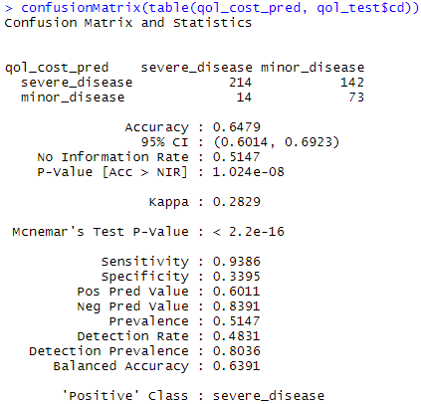
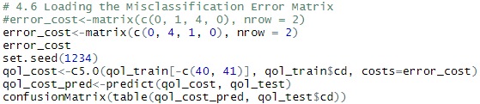
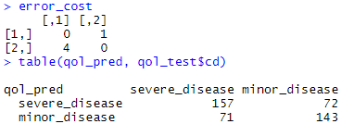
Loading the Misclassification Error Matrix
Build a decision tree with the option costs=error_cost
The false negative were reduced
At the cost of FP rate and overall accuracy
Notes:
Change positive class?

Slide 34
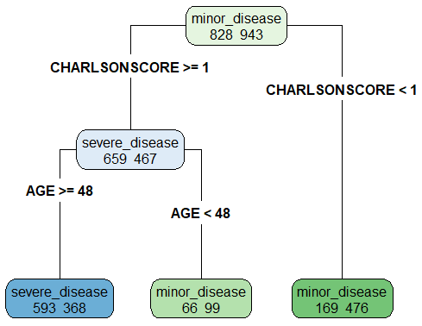
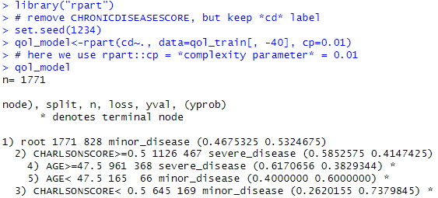
Parameter Tuning
Use rpart::cp = *complexity parameter* = 0.01
Penalty to the objective function
Control the amount of pruning
Complexity parameter

Slide 35
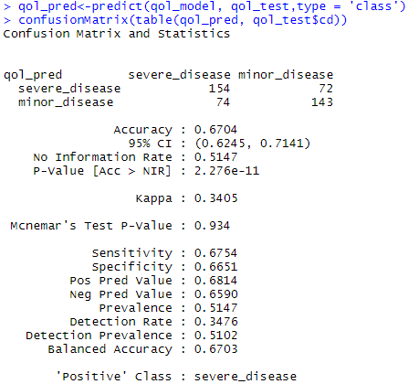
Parameter Tuning
Use rpart::cp = *complexity parameter* = 0.01
Confusion matrix performance is consistent with C5.0 results

Slide 36
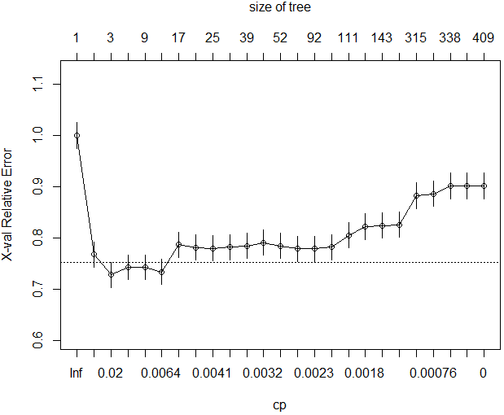
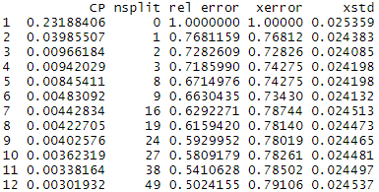
Parameter Tuning
Tune the parameters to further improve the results
Complexity parameter (cp)
Cross-validations number (xval)
Minimum split (minsplit)

Slide 37
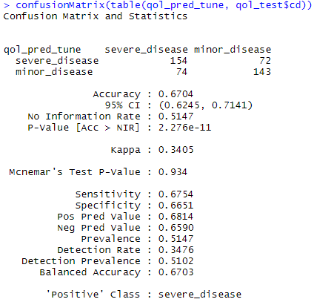
Parameter Tuning
Prune the tree according to the optimal cp

Slide 38
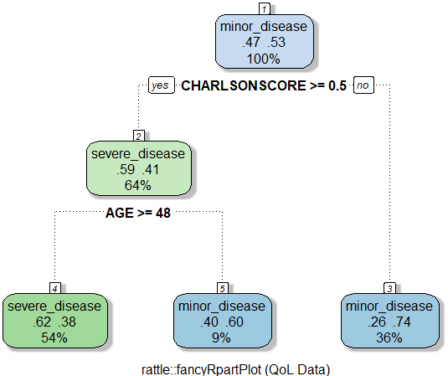
Parameter Tuning
Prune the tree according to the optimal cp
Tree-pruning generates simpler tree than original tree
Compare with un-pruned (full-grown) tree?

Slide 39
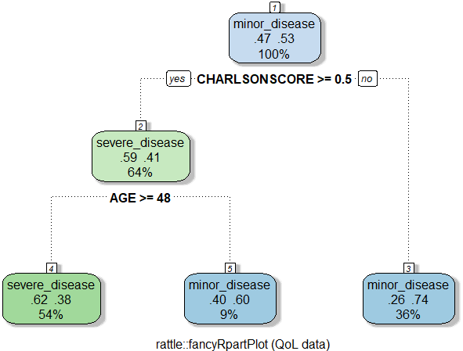
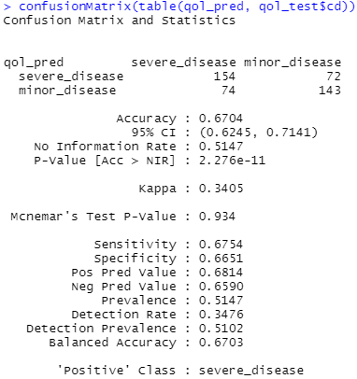
Compare Different Impurity Indices
Change split=“entropy” to “error” or “gini”

Slide 40
Classification Rules
Classification trees provide easily understandable classification rules
In IF-THEN logical statements (divide and conquer approach)
Each terminal node is equivalent to a classification rule
Each decision node in a tree has to be linked to past decisions
There are 4 rules:
IF Petal.Length <= 1.9 THEN Species = setosa
IF Petal.Length > 1.9 AND Petal.Width <= 1.7 AND Petal.Length <= 4.8 THEN Species = versicolor
IF Petal.Length > 1.9 AND Petal.Width <= 1.7 AND Petal.Length > 4.8 THEN Species = versicolor
IF Petal.Length > 1.9 AND Petal.Width > 1.7 THEN Species = virginica
Redundancy may be removed

Slide 41
Classification Rules
There are other classification rules that utilize if-else logical statements
The One Rule algorithm
ZeroR rule: assign the class without predictor
OneR rule: assign the class with one predictor
The RIPPER algorithm
Repeated Incremental Pruning to Produce Error Reduction
Three step process: grow, prune, and optimize
Notes:
https://rstudio-pubs-static.s3.amazonaws.com/194721_9f56225a73594f8fb8314401e40c0a44.html

Slide 42
Case Study 2: QoL in Chronic Disease (Take 2)
Apply classification rules
Skip step 1 and 2 on collecting data and preparing the data
Step 3 - training a model on the data
Step 4 - evaluating model performance
Step 5 - alternative model1 and alternative model2
Step 6 - alternative model3

Slide 43
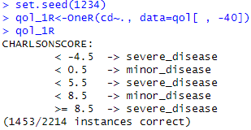
Training a Model on the Data
Using the OneR() function
66% accuracy by the “one rule”
1,453 out of 2,214 cases are correctly classified
Notes:
#-------
# ZeroR
#-------
#train
train.frq <- table(qol_train$cd)
max.frq <- which.max(train.frq)
model.zeror <- names(max.frq)
#test
test.count <- length(qol_test$cd)
test.error <- length(which(qol_test$cd != model.zeror))
test.accuracy <- 1-(test.error/test.count)

Slide 44
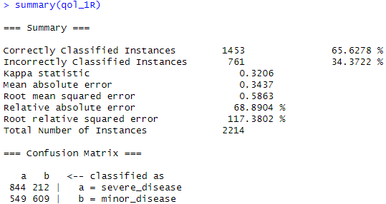
Evaluating Model Performance
The rule correctly specifies 66% of the patients
In line with the prior decision tree classification results
Notes:
qol_1R<-OneR(cd~., data=qol_train[ , -40])
pred_1R<-predict(qol_1R, qol_test)
caret::confusionMatrix(pred_1R, qol_test$cd)

Slide 45
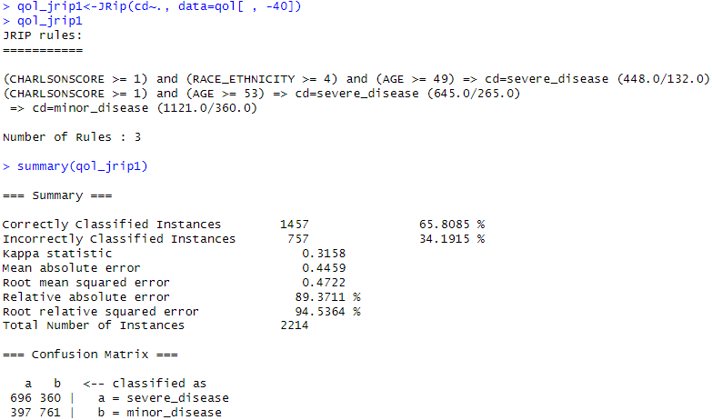
Alternative Model1
Using the RIPPER rule
JRip() function
3 rules
66% accuracy
Notes:
qol_jrip1<-JRip(cd~., data=qol_train[ , -40])
pred_jrip1<-predict(qol_jrip1, qol_test)
caret::confusionMatrix(pred_jrip1, qol_test$cd)

Slide 46
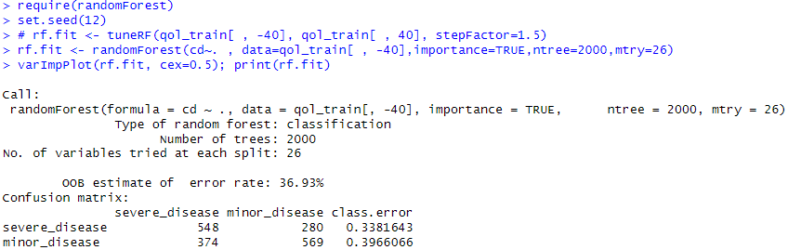
Alternative Model2
Ensemble with random forest classification
Repeat the generation of trees multiple times
Predict according to each tree’s performance
Ensemble those weighted votes into a combined classification result
Notes:
ntree: Number of trees to grow.
mtry: Number of variables randomly sampled as candidates at each split.

Slide 47
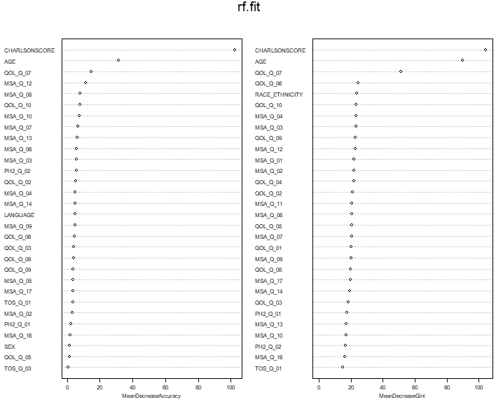
Alternative Model2
The variable importance plots

Slide 48
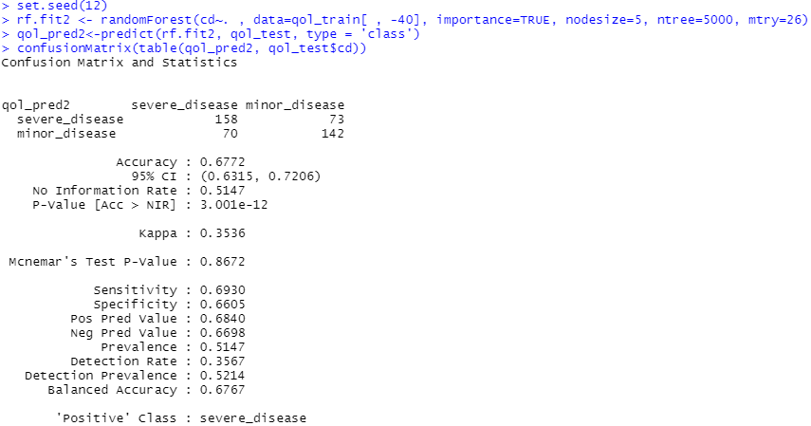
Alternative Model2
Performance

Slide 49
Advantages and Weaknesses
Tree methods are good classifiers and predictors
Generate transparent rules
Useful for variable selection
Important predictors usually show up on the top
Sensitive to changes in the data
Nonlinear and nonparametric
Require large dataset

