Slide 1
CSDA 5430 Predictive Analytics
Chapter 09
Forecasting Numeric Data using Regression Models
Notes:
https://www.socr.umich.edu/people/dinov/courses/DSPA_notes/09_RegressionForecasting.html

Slide 2
Motivation
Regression is for predicting numeric data
Predictive power of multiple linear regression
Regression modeling assumptions
The foundation of regression trees and model trees
Case-studies
Baseball Players and Heart Attack

Slide 3
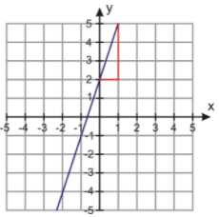

Understanding Linear Regression
Model of a relationship between outcome and predictors
Assume the relationships is linear
Simple linear regression
$\text{Slope}\text{−}\text{intercept} \text{formula}$: $y=a+bx$
y = 2 + 3x

Slide 4
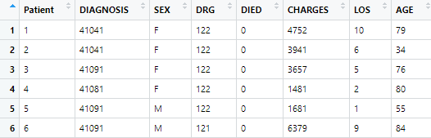
Understanding Linear Regression
Case study: heart attacks in adults
Driving challenges
Is length of stay (LOS) significantly correlated with dying in the hospital (DIED)?
Is the location of the injury to the heart (DIAGNOSIS) significantly correlated with dying in the hospital (DIED)?
Is gender a significant predictor of having cardiovascular complications and/or dying?
Notes:
# Case-Study: Heart Attacks in Adults
# Variables:
# AGE: Gives age of the patients in years
# SEX: Coded M for males F for females
# DIAGNOSIS: In the form of an International Classification of Diseases, 9th Edition, Clinical Modification code. These tell which part of the heart was affected.
# DRG: The Diagnosis Related Group. It groups together patients with similar management. In this data set there are just three different drgs.
# 121: for AMIs with cardiovascular complications who did not die.
# 122: for AMIs without cardiovascular complications who did not die.
# 123: for AMIs where the patient died.
# LOS gives the hospital length of stay in days.
# DIED: 1 for patients who died in hospital and a 0 otherwise.
# CHARGES: Gives the total hospital charges in dollars (USD).

Slide 5
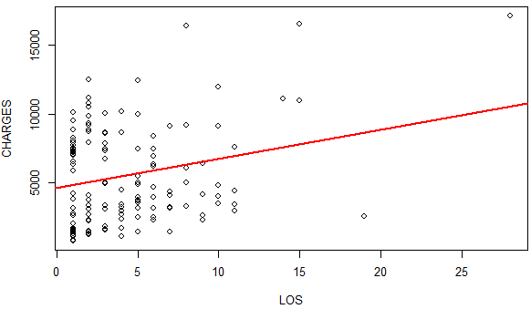
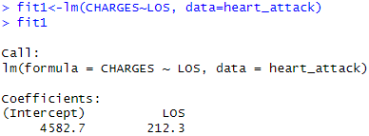

Understanding Linear Regression
Estimated model expression (charge vs. length of stay)
$\hat{y}=a+bx=4582.70+212.29x$
CHARGES = 4582.70 + 212.29 × LOS
Longer hospital stay is associated with higher charge
LOS =10: CHARGES = 4582.70 + 212.29 × 10 = 6705.6
Notes:
summary(fit1)
confint(fit1)
# t value: t = (b1-0)/SE(b1) = (212.29-0)/69.53

Slide 6
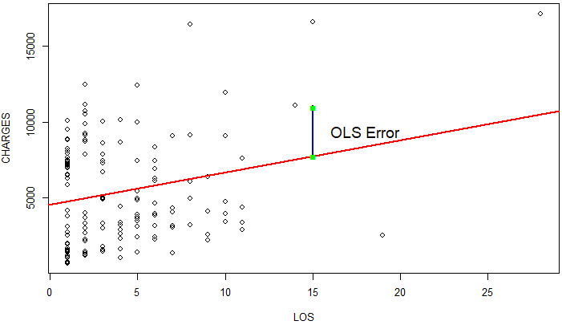
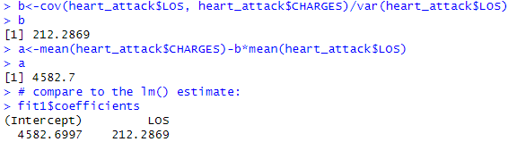

Ordinary Least Squares Estimation
Estimating method is ordinary least squares (OLS)
Minimized sum of the squared errors
The sum of squared vertical distance from each dot on the scatter plot to the regression line
$\sum_{i=1}^{n}{{(y_{i}−{\hat{y}}_{i})}^{2}=}\sum_{i=1}^{n}{{(y_{i}−(a+b×x_{i}))}^{2}}$
$b=\frac{cov(x,y)}{var(x)}, a=\overline{y}−b\overline{x}$
Notes:
hist(), mean(), var(), sd()
cov(), cor()

Slide 7
Model Assumptions
Linear regression modeling has five key assumptions
Linear relationship between outcome and the predictors
For linear regression
Multivariate normality
Normally distributed residuals
No or little multicollinearity
No closely related predictors
No auto-correlation, independence
No correlation of successive intervals in residuals
Homoscedasticity
Constant variance among residuals
Notes:
https://en.wikipedia.org/wiki/Multivariate_normal_distribution
https://en.wikipedia.org/wiki/Multicollinearity
https://en.wikipedia.org/wiki/Homoscedasticity_and_heteroscedasticity

Slide 8
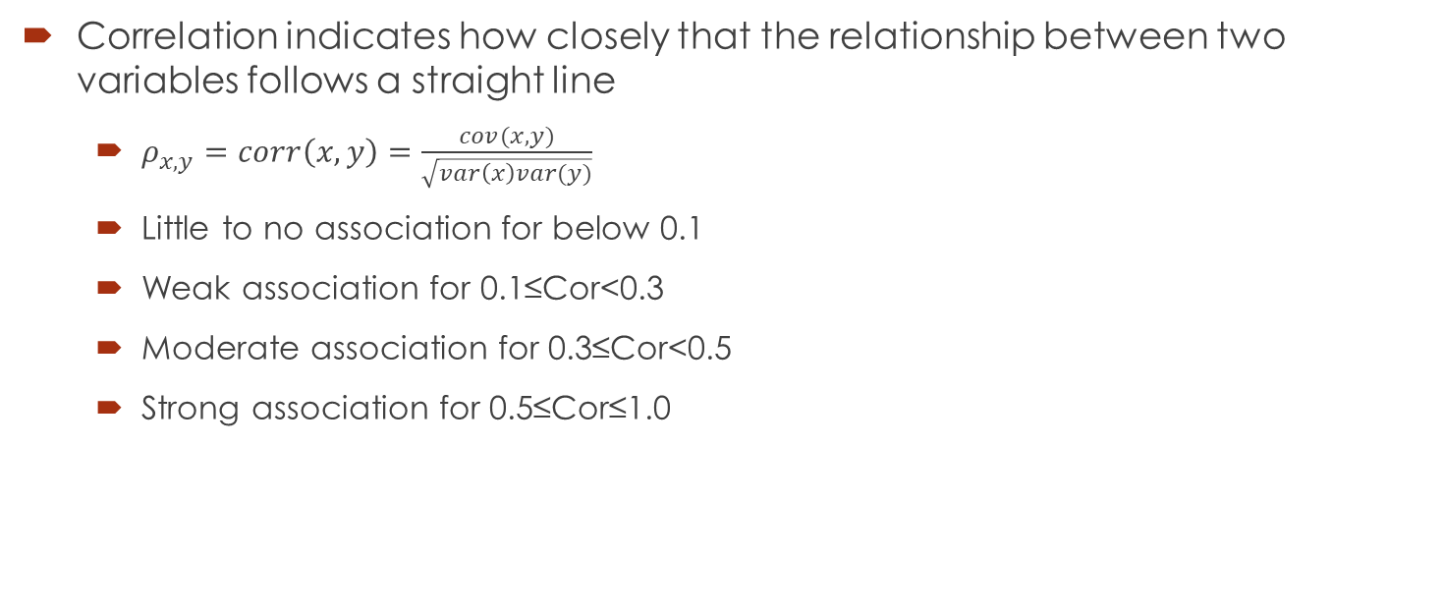
Correlations
Correlation indicates how closely that the relationship between two variables follows a straight line
$ρ_{x,y}=corr\left(x,y\right)=$ $\frac{cov(x,y)}{\sqrt{var\left(x\right)var(y)}}$
Little to no association for below 0.1
Weak association for 0.1≤Cor<0.3
Moderate association for 0.3≤Cor<0.5
Strong association for 0.5≤Cor≤1.0

Slide 9


Multiple Linear Regression
Multiple predictors and one dependent variable (outcome)
In total, k+1 coefficients to estimate
$y=β_{0}+{β_{1}x}_{1}+{β_{2}x}_{2}+…+{β_{k}x}_{k}+ε$
In matrix notation: $Y=Xβ+ε$
$\hat{β}={(X^{T}X)}^{−1}X^{T}Y$

Slide 10
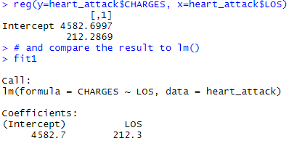
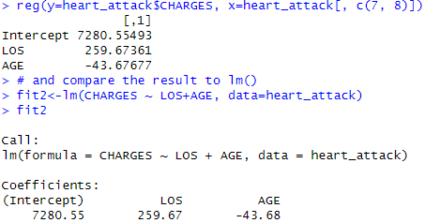
Multiple Linear Regression
Multiple predictors (k) and one dependent variable (outcome)
In total, k+1 coefficients to estimate
One predictor regression
Two predictors regression
CHARGES=4582.70+212.29×LOS
CHARGES=7280.55+259.67×LOS-43.68×AGES

Slide 11
Case Study 1: Baseball Players
Step 1 - collecting data
Step 2 - exploring and preparing the data
Exploring relationships among features - the correlation matrix
Multi-collinearity and feature-selection in high-dimensional data
Visualizing relationships among features - the scatterplot matrix
Step 3 - training a model on the data
Step 4 - evaluating model performance
Step 5 - improving model performance
Model specification - adding non-linear relationships
Transformation - converting a numeric variable to a binary indicator
Model specification - adding interaction effects

Slide 12
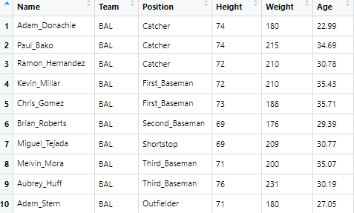
Collecting Data
The dataset contains 1034 records of heights and weights for some current and recent Major League Baseball (MLB) Players
01a_data.txt
Variables
Name
Team
Position
Height
Age
Weight (dependent variable)

Slide 13
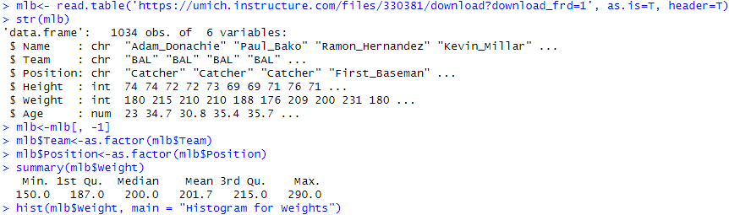
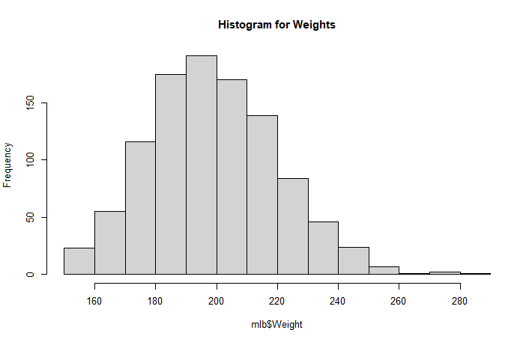
Exploring and Preparing the Data
The dependent variable Weight is somewhat right-skewed

Slide 14
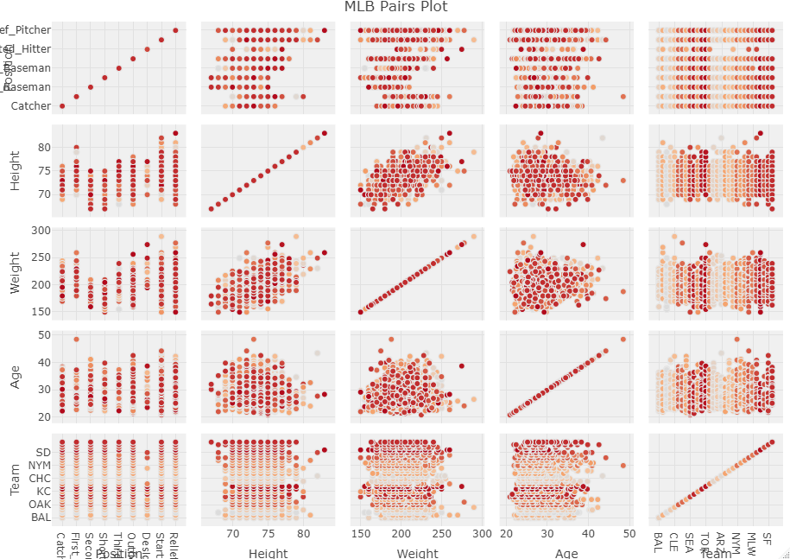
Exploring and Preparing the Data
Paris plot
Matrix of scatterplots
Notes:
# simple matrix of scatterplots
pairs(mlb)

Slide 15
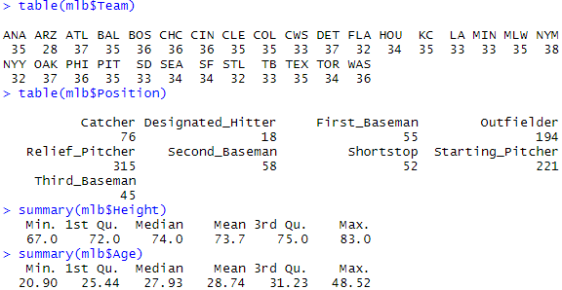
Exploring and Preparing the Data
Potential predictors (2 numerical and 2 categorical)
Team (30 unique values)
Position (9 unique values)
Hight
Age

Slide 16

Exploring Relationships among Features - the Correlation Matrix
Examining the independence of potential predictors and dependent variable
Multi-collinearity
Two predictors are highly correlated – both provide almost the same information
Common practice is to delete one of them in the model
Two numerical predictors
Height and age: correlation is weak
No multi-collinearity problem

Slide 17

Exploring Relationships among Features - the Correlation Matrix
Multi-collinearity and VIF (variance inflation factor)
The amount of artificial inflation of the variance due to multicollinearity of the covariates
VIF_{k} ∼ 1 implies that there is no multicollinearity
VIF_{k} > 4 suggests potential multicollinearity
VIF_{k} > 10 suggests serious multicollinearity
Multi-collinearity and feature-selection in high-dimensional data
When n ≥ k, use the VIF (n: observations, k: features)
When n ≤ k, solutions include dimension reduction (PCA) and feature selection (pairwise correlation, subset regression)
Notes:
mlb.dummy <- fastDummies::dummy_cols(mlb, remove_first_dummy=FALSE, remove_selected_columns=TRUE)
#mlb.dummy[1, 7] <- 0
#mlb.dummy[2, 34] <- 0
fit.dummy <- lm(Weight~., data=mlb.dummy)
fit.dummy
summary(fit.dummy)
car::vif(lm(Weight ~ ., data = mlb.dummy))
alias(lm(Weight ~ ., data = mlb.dummy))

Slide 18
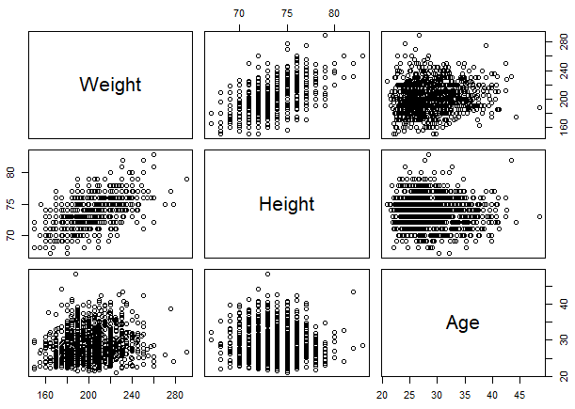
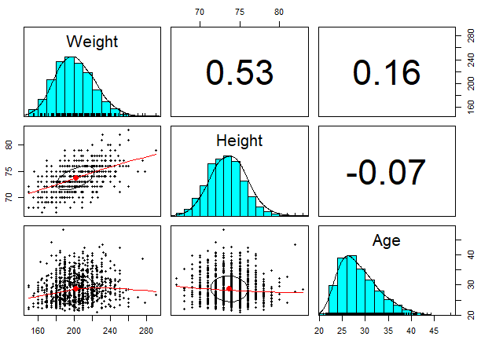
Visualizing Relationships among Features - the Scatterplot Matrix
Visualize pairwise correlations
Height and weight are positively and strongly correlated
Age and height, age and weight are very weak
Notes:
The pairs.panels() draws an ellipse around the mean with the axis length reflecting one standard deviation of the first and second principal components.
The narrower the ellipse, the greater the correlation between the variables. The wider and more round it is, the more the variables are uncorrelated.
# pairwise correlation on iris data
pairs.panels(iris[,-5])

Slide 19
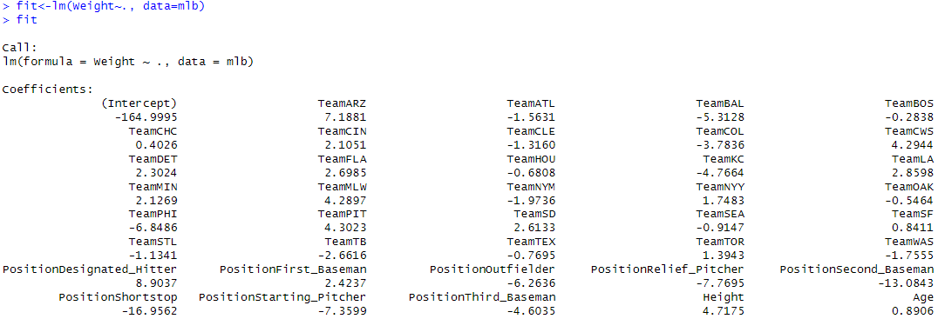
Training a Model on the Data
Use the function lm() to model linear relationship
Predictor coefficient: for every one unit change in each predictor variable, there is a constant change in the outcome, positive or negative
Categorical variables are included as N-1 dummy variables
model linear relationship on entire dataset
Notes:
# model linear relationship on entire dataset

Slide 20
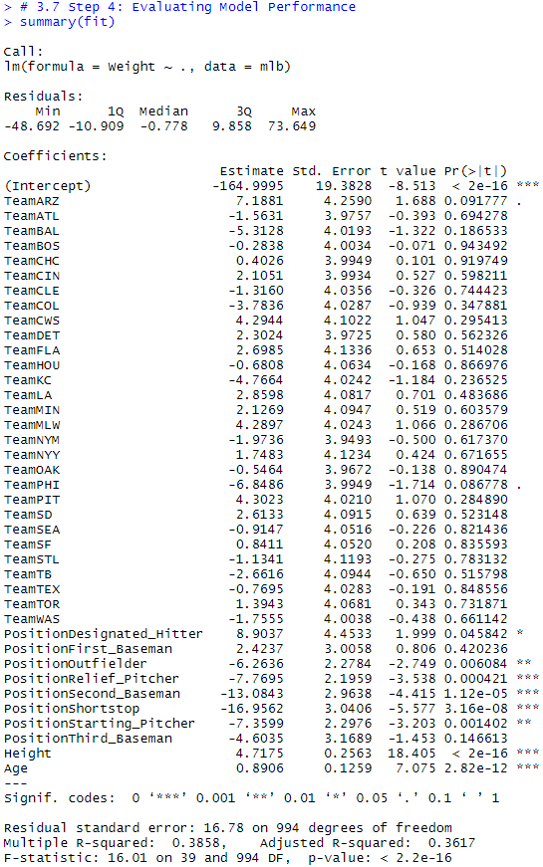
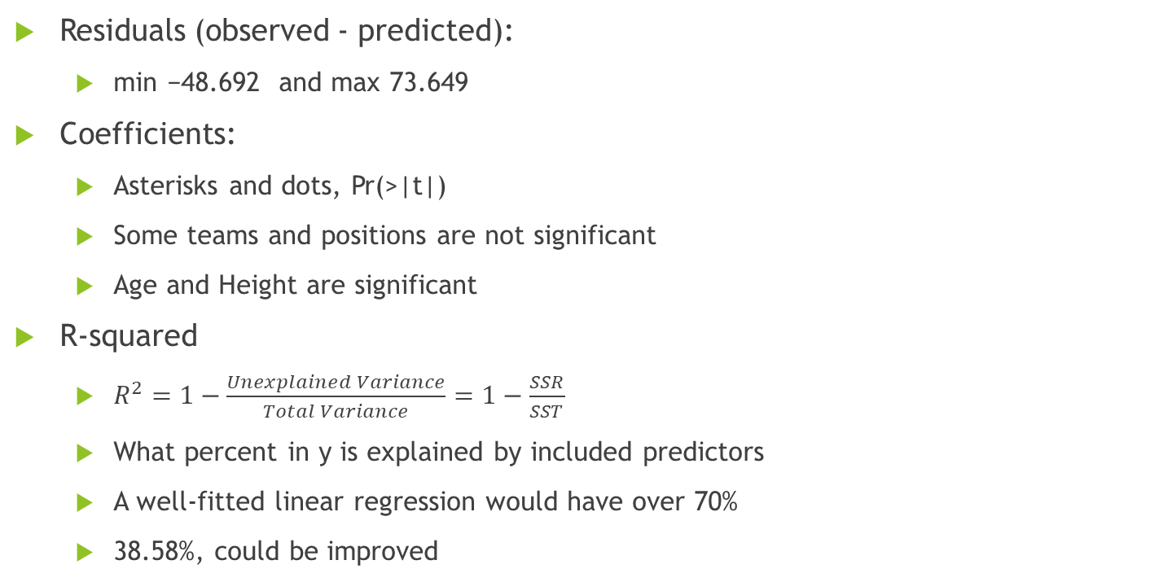
Evaluating Model Performance
Residuals (observed - predicted):
min −48.692 and max 73.649
Coefficients:
Asterisks and dots, Pr(>|t|)
Some teams and positions are not significant
Age and Height are significant
R-squared
$R^{2}=1−\frac{Unexplained Variance}{Total Variance}=1−\frac{SSR}{SST}$
What percent in y is explained by included predictors
A well-fitted linear regression would have over 70%
38.58%, could be improved
Notes:
Interpreting simple linear model output in R
https://feliperego.github.io/blog/2015/10/23/Interpreting-Model-Output-In-R

Slide 21
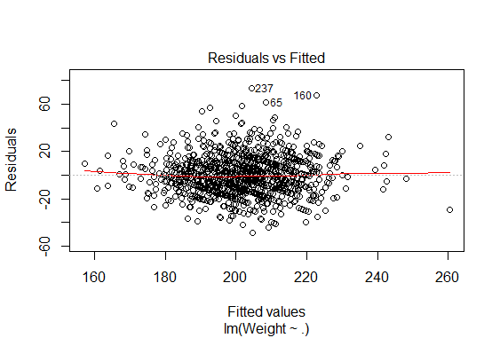
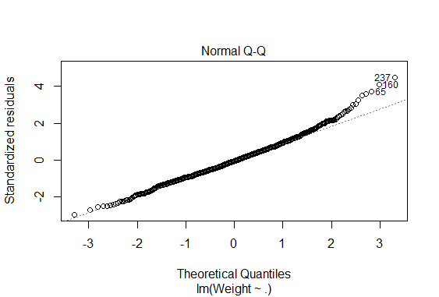
Evaluating Model Performance
Diagnostic plots
Residual vs Fitted
Residual diagnostic plot
Normal Q-Q
Normality assumption of the model
65, 160 and 237 are relatively far apart from the rest
The model is valid in terms of normality
Notes:
A Q-Q plot plots the distribution of our residuals against the theoretical normal distribution. The closer the points are to falling directly on the diagonal line then the more we can interpret the residuals as normally distributed.
hist(fit$residuals)

Slide 22

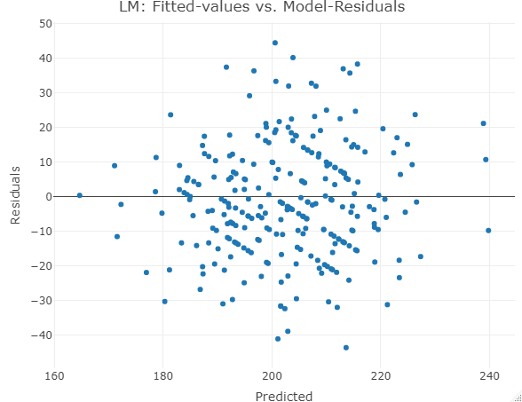
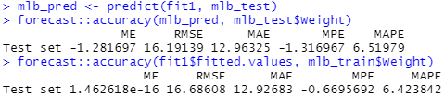
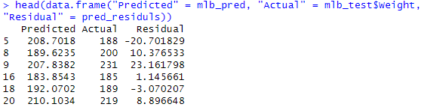
Evaluating Model Performance
Partition the data into training (75%) and testing (25%) sets
Fit a multiple linear regression model using only the training set
Predict weight of individuals in the testing set
Notes:
set.seed(1234)
train_index <- sample(seq_len(nrow(mlb)), size = 0.75*nrow(mlb))
mlb_train<-mlb[train_index, ]
mlb_test<-mlb[-train_index, ]
fit1<-lm(Weight~., data=mlb_train)
fit1
summary(fit1)
plot(fit1, which = 1:2)
mlb_pred <- predict(fit1, mlb_test)
forecast::accuracy(mlb_pred, mlb_test$Weight)
forecast::accuracy(fit1$fitted.values, mlb_train$Weight)
pred_residuls <- mlb_test$Weight - mlb_pred
head(data.frame("Predicted" = mlb_pred, "Actual" = mlb_test$Weight, "Residual" = pred_residuls))
#plot(mlb_pred, pred_residuls)
plot_ly(x=mlb_pred, y=pred_residuls, type="scatter", mode="markers") %>%
layout(title="LM: Fitted-values vs. Model-Residuals",
xaxis=list(title="Predicted"),
yaxis = list(title="Residuals"))
hist(pred_residuls)
plot(mlb_pred, mlb_test$Weight)
cor(mlb_pred, mlb_test$Weight)
points(mlb_pred[1], mlb_test$Weight[1], col = "red")
plot(fit1$fitted.values, mlb_train$Weight)
cor(fit1$fitted.values, mlb_train$Weight)
points(fit1$fitted.values[1], mlb_train$Weight[1], col = "red")

Slide 23
Improving Model Performance
Predictor selection
Business understanding is important
Selection of important features/predictors
More expensive to collect all predictors for prediction
The more predictors lead to the higher chance of missing values
Parsimony is an important property of good models
Estimates of coefficients are more stable for parsimonious models
Methods for reducing the number of predictors to a smaller set

Slide 24
Improving Model Performance
Use stepwise algorithm to choose a model: step() function
Backward
Start with all predictors
At each step, eliminate the least useful predictor
Forward
Start with no predictors
Add predictors one by one
Both
This is the default
Backward selection is preferable

Slide 25
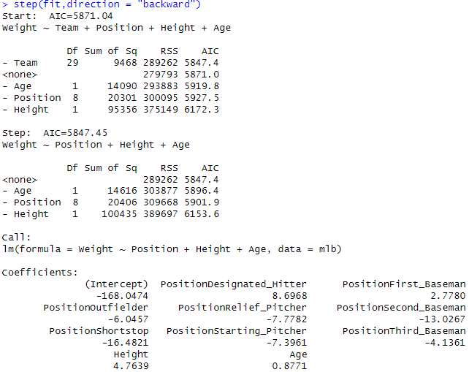
Improving Model Performance
Backward stepwise
Removing predictor Team results lower AIC

Slide 26
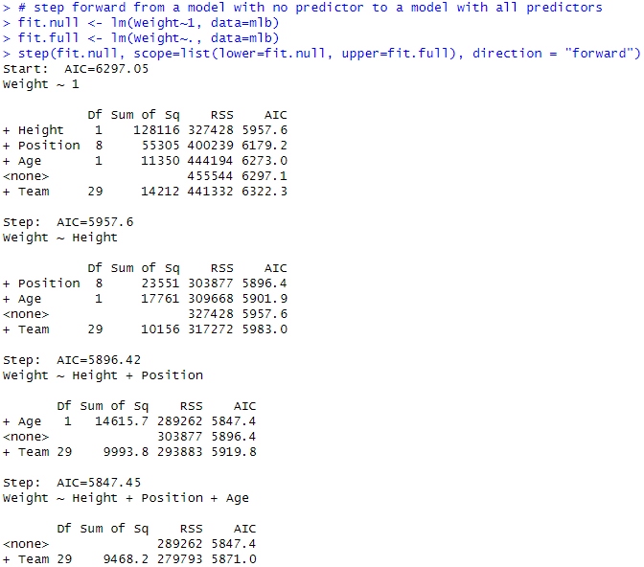
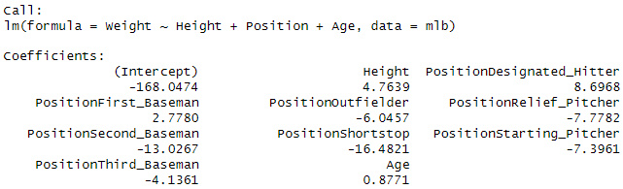
Improving Model Performance
Forward stepwise
Adding predictor Height results lower AIC
Notes:
direction is the mode of stepwise search, can be one of "both", "backward", or "forward", with a default of "both". If the scope argument is missing the default for direction is "backward".

Slide 27

Improving Model Performance
Commonly used criteria
AIC (Akaike information criterion)
BIC (Bayesian information criterion)
Adjusted R²
Measure the goodness of fit of a model
With penalty on the number of parameters
Both backward and forward feature selection methods utilize greedy algorithms
No guarantee an optimal model selection result
Exhaustive search available

Slide 28
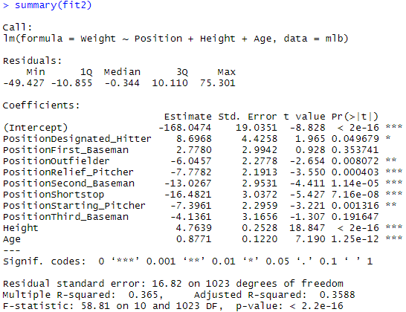
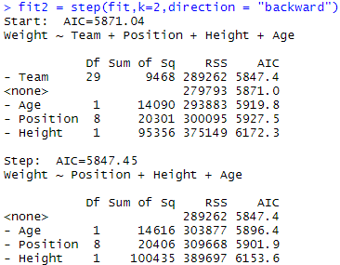
Improving Model Performance
Choose models based on various information criteria
k=2 yields the genuine AIC criterion
k=log(n) refers to BIC
Notes:
K is the multiple of the number of degrees of freedom used for the penalty. Only k = 2 gives the genuine AIC: k = log(n) is sometimes referred to as BIC or SBC.

Slide 29
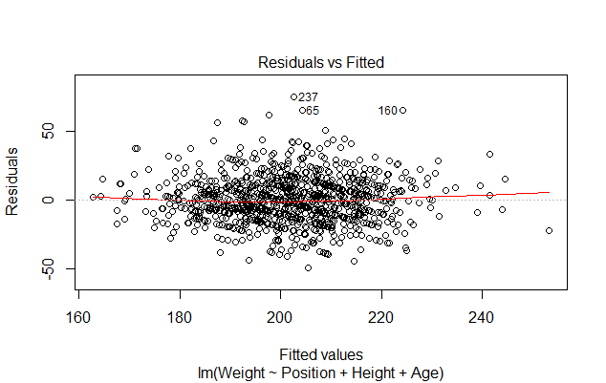
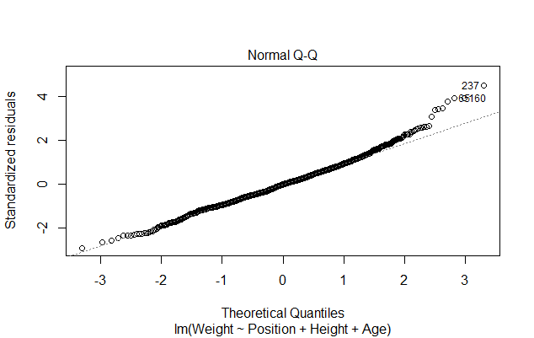
Improving Model Performance
Simpler models are preferable even if there is a little bit loss of performance
The simpler model and R²=0.365
The whole model is still very significant

Slide 30
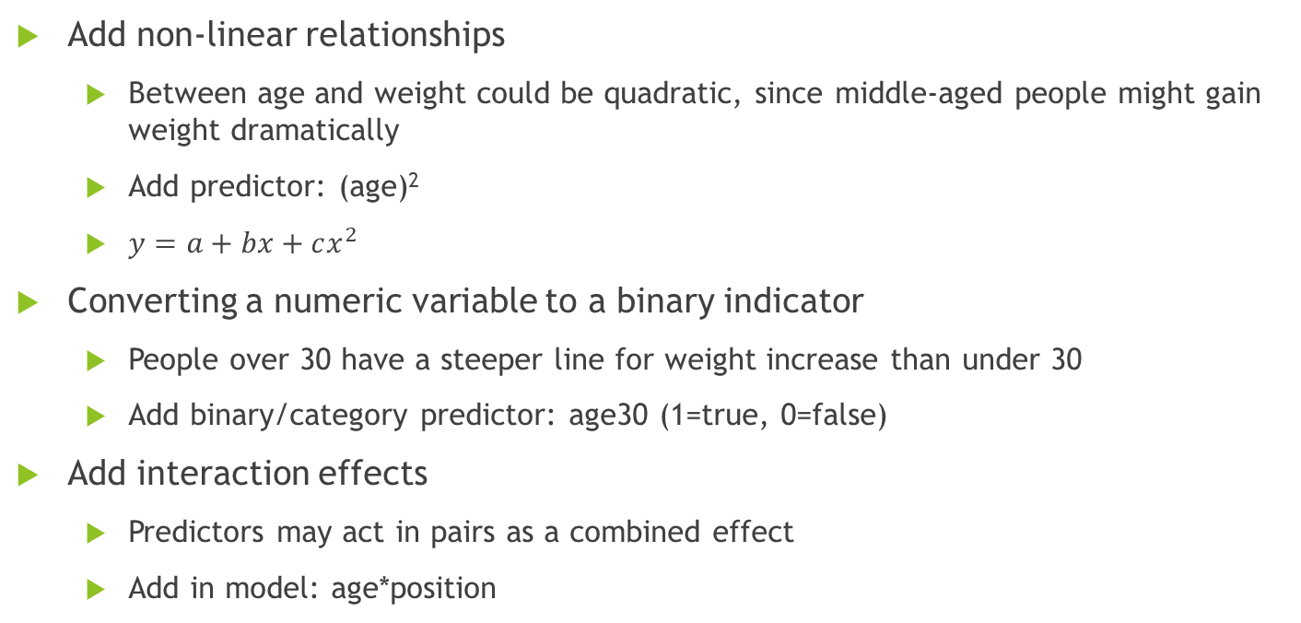
Model Specification
Add non-linear relationships
Between age and weight could be quadratic, since middle-aged people might gain weight dramatically
Add predictor: (age)²
$y=a+bx+cx^{2}$
Converting a numeric variable to a binary indicator
People over 30 have a steeper line for weight increase than under 30
Add binary/category predictor: age30 (1=true, 0=false)
Add interaction effects
Predictors may act in pairs as a combined effect
Add in model: age*position

Slide 31
Understanding Regression Trees and Model Trees
Add regression into decision trees to make numerical predictions
Numeric prediction trees are built in the same way as classification trees
Regression tree
Simple mean of the outcome values in each terminal node
Regression trees are piecewise-constant regression
Linear model tree
A linear functional model for the outcome values in each terminal node
Linear model trees can be seen as a form of locally weighted regression
Notes:
Regression Tree vs Linear Regression
https://quantifyinghealth.com/regression-tree-vs-linear-regression/

Slide 32
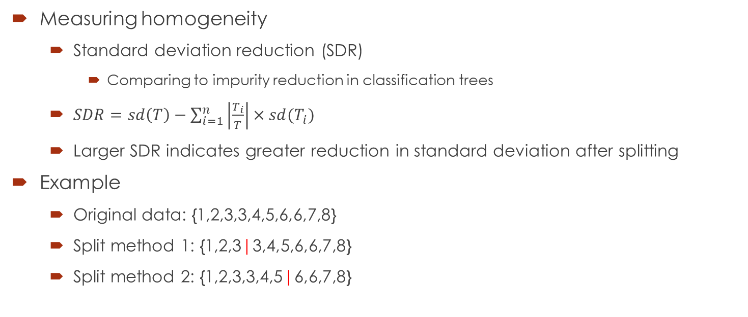
Understanding Regression Trees and Model Trees
Measuring homogeneity
Standard deviation reduction (SDR)
Comparing to impurity reduction in classification trees
$SDR=sd\left(T\right)−\sum_{i=1}^{n}{\left|\frac{T_{i}}{T}\right|×sd(T_{i})}$
Larger SDR indicates greater reduction in standard deviation after splitting
Example
Original data: {1,2,3,3,4,5,6,6,7,8}
Split method 1: {1,2,3|3,4,5,6,6,7,8}
Split method 2: {1,2,3,3,4,5|6,6,7,8}

Slide 33
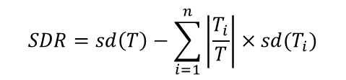
Understanding Regression Trees and Model Trees
Measuring homogeneity
Original data: {1,2,3,3,4,5,6,6,7,8}
$$SDR=sd\left(T\right)−\sum_{i=1}^{n}{\left|\frac{T_{i}}{T}\right|×sd(T_{i})}$$
Split method 1: {1,2,3|3,4,5,6,6,7,8}
Split method 2: {1,2,3,3,4,5|6,6,7,8}
Original data (T)
Original data (T)
10 observations
SD=2.273
10 observations
SD=2.273
Split method 1
Split method 2
Left
(T1)
Right
(T2)
Left
(T1)
Right
(T2)
3/10 observations
SD=1.000
Mean=2
7/10 observations
SD=1.718
Mean=5.57
6/10 observations
SD=1.414
Mean=3
4/10 observations
SD=0.957
Mean=6.75
split method 2 yields greater SDR (1.04) than method 1 (0.77)

Slide 34
Case Study 2: Baseball Players (Take 2)
Step 1 - Collecting Data (from case study 1)
Step 2 - exploring and preparing the data
Step 3 - training a model on the data
Visualizing decision trees
Step 4 - evaluating model performance
Measuring performance with mean absolute error
Step 5 - improving model performance

Slide 35

Exploring and Preparing the Data
Use the mlb dataset
Separate them into training and test datasets
Randomized split (75%-25%)

Slide 36
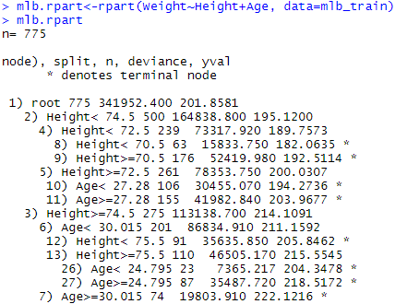
Training a Model on the Data
Use regression tree modeling with the rpart::rpart() function
Weight ~ Height + Age
Notes:
How about Weight ~ Height + Age + Team + Position?

Slide 37
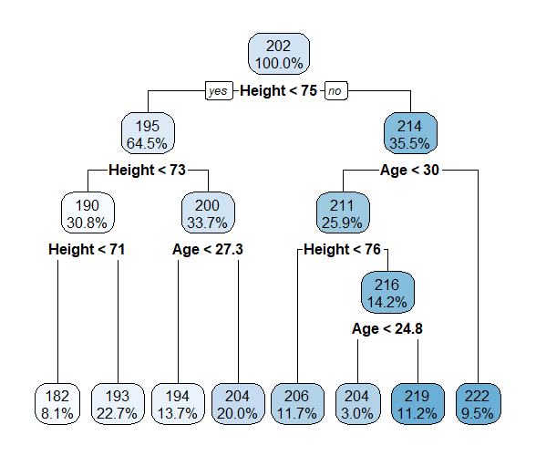
Visualizing Decision Tree
Use the rpart.plot::rpart.plot() function or fancyRpartPlot() function
Notes:
# regression tree with one predictor
# Hospital charge vs. length of stay in hospital
chg.rpart<-rpart(CHARGES~LOS, data=heart_attack)
chg.rpart
rpart.plot(chg.rpart, digits=3)
# linear regression
fit1<-lm(CHARGES~LOS, data=heart_attack)
plot(heart_attack$LOS, heart_attack$CHARGES, xlab="LOS", ylab = "CHARGES")
abline(fit1, lwd=2, col="red")
# regression tree segments
segments(0, 5268, 11, 5268, lwd=2, col="blue", lty = 1)
segments(11, 8507, 29, 8507, lwd=2, col="blue", lty = 1)
# more terminal nodes
chg.rpart<-rpart(CHARGES~LOS, data=heart_attack, cp=0)
chg.rpart
rpart.plot(chg.rpart, digits=3)
# linear regression
fit1<-lm(CHARGES~LOS, data=heart_attack)
plot(heart_attack$LOS, heart_attack$CHARGES, xlab="LOS", ylab = "CHARGES")
abline(fit1, lwd=2, col="red")
# regression tree segments
segments(0, 5142, 1.5, 5142, lwd=2, col="blue", lty = 1)
segments(1.5, 5792, 2.5, 5792, lwd=2, col="blue", lty = 1)
segments(2.5, 5515, 3.5, 5515, lwd=2, col="blue", lty = 1)
segments(3.5, 4042, 4.5, 4042, lwd=2, col="blue", lty = 1)
segments(4.5, 5063, 5.5, 5063, lwd=2, col="blue", lty = 1)
segments(5.5, 4743, 7.5, 4743, lwd=2, col="blue", lty = 1)
segments(7.5, 6317, 10.5, 6317, lwd=2, col="blue", lty = 1)
segments(10.5, 8507, 29, 8507, lwd=2, col="blue", lty = 1)

Slide 38
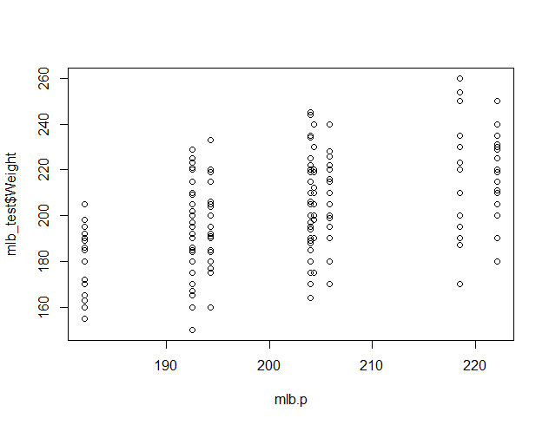
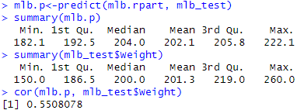
Evaluating Model Performance
Make predictions on test data with the prediction tree
Comparing statistics for the predicted and true value
The model cannot precisely identify extreme cases
However, within IQR, the predictions are relatively accurate.
The predicted values are moderately correlated with their true value counterparts
moderately correlated
Notes:
plot(mlb.p, mlb_test$Weight)
accuracy(mlb.p, mlb_test$Weight)
cor(mlb.p, mlb_test$Weight)
points(mlb.p[1], mlb_test$Weight[1], col = "red")
plot(mlb_pred, mlb_test$Weight)
accuracy(mlb_pred, mlb_test$Weight)
cor(mlb_pred, mlb_test$Weight)
points(mlb_pred[1], mlb_test$Weight[1], col = "red")

Slide 39
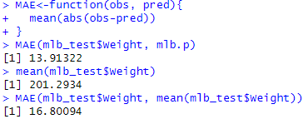
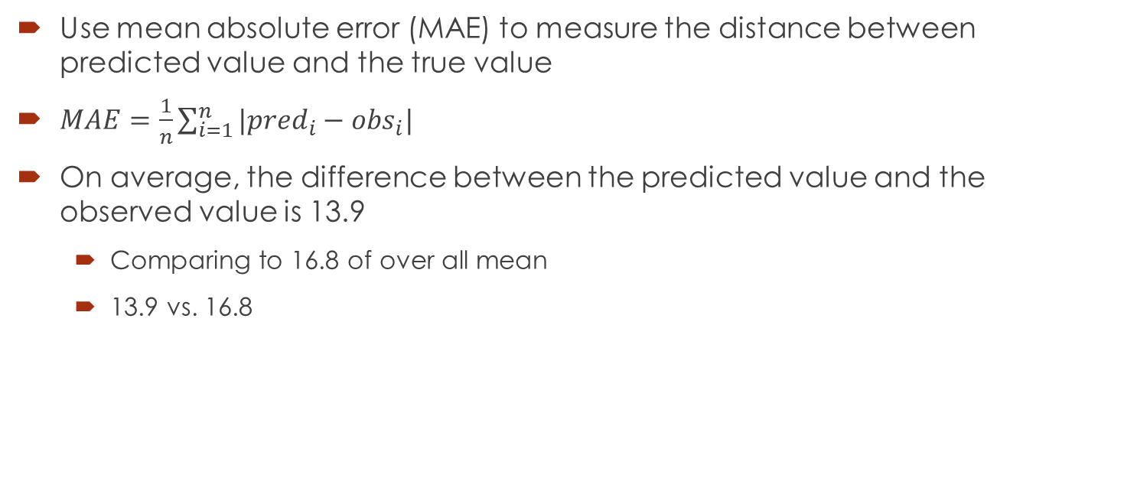
Evaluating Model Performance
Use mean absolute error (MAE) to measure the distance between predicted value and the true value
$MAE=\frac{1}{n}\sum_{i=1}^{n}{|{pred}_{i}−{obs}_{i}|}$
On average, the difference between the predicted value and the observed value is 13.9
Comparing to 16.8 of over all mean
13.9 vs. 16.8
Notes:
# compare with linear regression model
# Step 2: Exploring and Preparing the Data
set.seed(1234)
train_index <- sample(seq_len(nrow(mlb)), size = 0.75*nrow(mlb))
mlb_train<-mlb[train_index, ]
mlb_test<-mlb[-train_index, ]
hist(mlb_train$Weight)
hist(mlb_test$Weight)
# Step 3: Training a Model on the Data
fit<-lm(Weight~Height+Age, data=mlb_train)
fit
summary(fit)
# Step 4: Evaluating Model Performance
mlb_pred<-predict(fit, mlb_test)
summary(mlb_pred)
summary(mlb_test$Weight)
cor(mlb_pred, mlb_test$Weight)
MAE<-function(obs, pred){
mean(abs(obs-pred))
}
MAE(mlb_test$Weight, mlb_pred)
mean(mlb_test$Weight)
MAE(mlb_test$Weight, mean(mlb_test$Weight))

Slide 40
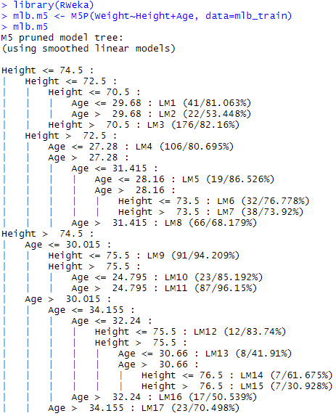
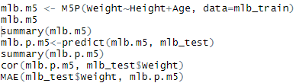
Improving Model Performance
Use a model tree instead of a regression tree
The RWeka::M5P() function

Slide 41
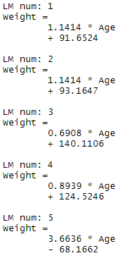
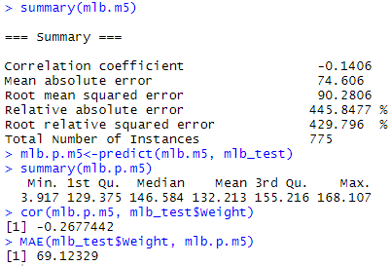
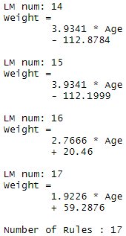
Improving Model Performance
Use a model tree instead of a regression tree
Different linear models at each terminal node

Slide 42
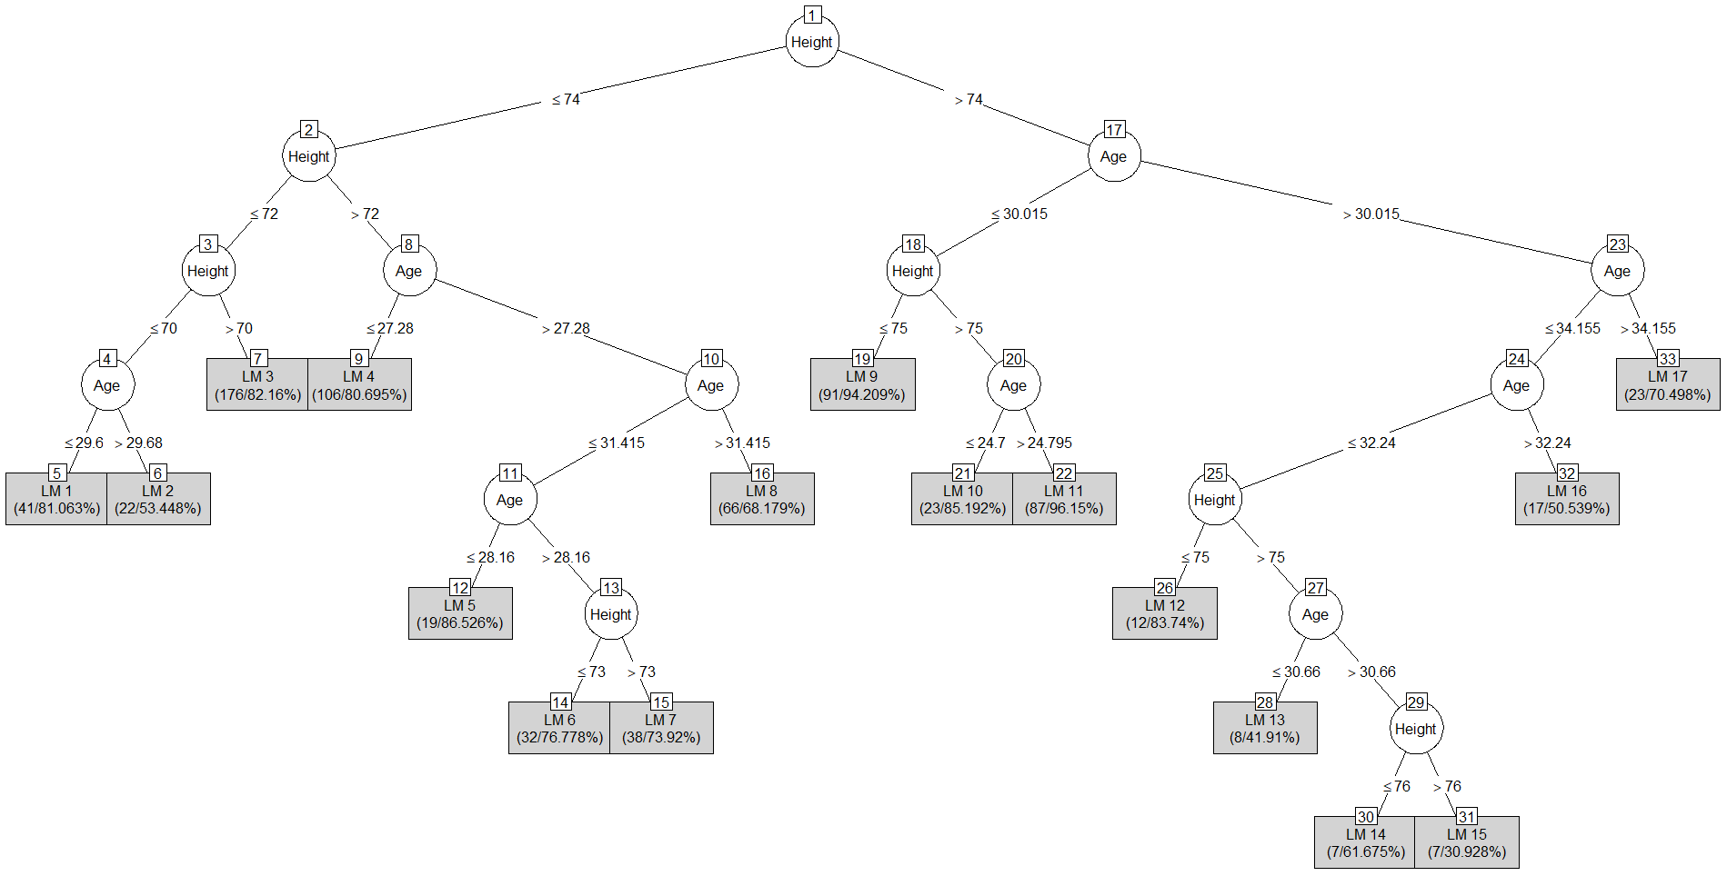
Improving Model Performance
Use a model tree instead of a regression tree
plot(mlb.m5, type="simple")
Notes:
We can use summary(mlb.m5) to report some rough diagnostic statistics of the model.
Notice that the correlation and MAE for the M5 model are better compared to the results of the previous rpart() model.
mlb.m5 <- M5P(Weight~., data=mlb_train)

Slide 43
Advantages and Weaknesses
Solid supervised learning algorithm – model based
Simple implementation, easy interpret and understand
Concerns that result from the assumptions required
Most problems in real world aren’t linear
Non-linear regression

