Slide 1
CSDA 5430 Predictive Analytics
Chapter 06
Lazy Learning - Classification Using Nearest Neighbors
Notes:
https://www.socr.umich.edu/people/dinov/courses/DSPA_notes/06_LazyLearning_kNN.html

Slide 2
Introduction
The k-nearest neighbor (kNN) algorithm
Distance function
Determining k
Feature rescaling
Case study

Slide 3
Motivation
Classification tasks could be very difficult
Features and target classes are numerous, complicated or extremely difficult to understand
Nearest neighbor classification may be appropriate
Assigning unlabeled cases to their most similar labeled neighbors may be fairly easy to accomplish
Help us understand the story behind the unlabeled data using known data
Avoiding analyzing those complicated features and target classes
Lazy algorithm
It relies heavy on the training instances

Slide 4
The kNN Algorithm Overview
Training dataset that has classified examples
Labeled by nominal variables and different features in ordinal or numerical variables
Testing dataset containing
Unlabeled examples with similar features as the training data
Match each test case with the k closest training records that are “nearest” to the test case, according to a certain similarity or distance measure
Assign a test case class label according to the majority vote of the k nearest training cases
k is typically odd to avoid ties
Assign to the class with the largest probability

Slide 5
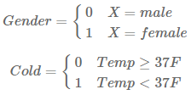


Distance Function and Dummy Coding
Euclidean distance as our similarity metric
$dist\left(a,b\right)=\sqrt{{\left(a1−b1\right)}^{2}+{\left(a2−b2\right)}^{2}+…+{\left(an−bn\right)}^{2}}$
Dummy variables for nominal features/variables
For multiple nominal categories, make each one as a dummy variable
Record Age Income ($) Gender
1 25 49,000 0
2 56 156,000 1
3 65 99,000 1
4 32 192,000 0
5 41 39,000 0
6 49 57,000 0
Euclidean distance for the first two records: $\sqrt{{\left(25−56\right)}^{2}+{(49,000−156,000)}^{2}+{(0−1)}^{2}}$
Notes:
Record Age Income ($) Gender
1 25 49,000 0
2 56 156,000 1
3 65 99,000 1
4 32 192,000 0
5 41 39,000 0
6 49 57,000 0
Euclidean distance for the first two records: $\sqrt{{\left(25−56\right)}^{2}+{(49,000−156,000)}^{2}+{(0−1)}^{2}}$

Slide 6
Ways to Determine k
The parameter k could not be too large or too small
The common practice is to calculate the square root of the number of training cases and use that number as (initial) estimate of k
A more robust way would be to choose several k values and select the one with the optimal (best) classifying performance

Slide 7


Rescaling of the Features
Data may need to be transferred into the same scale
Re-scaling can make each feature contribute to the distance in a relatively equal manner, avoiding potential bias
Alternative strategies to rescale the data
min-max normalization
Range from 0 to 1
Represent the distance between each value and its minimum as a percentage
z-score standardization
Have unbounded range
Represent each value as the number of standard deviations away from the mean
Notes:
normalize<-function(x){
return((x-min(x))/(max(x)-min(x)))
}
# some test examples:
normalize(c(1, 2, 3, 4, 5))
normalize(c(1, 3, 6, 7, 9))
zscore<-function(x){
return((x-mean(x))/(sd(x)))
}
# some test examples:
zscore(c(1, 2, 3, 4, 5))
zscore(c(1, 3, 6, 7, 9))
# can use scales::rescale() and scale()

Slide 8
Case Study: Youth Development
Step 1 - collecting data
Step 2 - exploring and preparing the data
Normalizing data
Data preparation - creating training and test datasets
Step 3 - training a model on the data
Step 4 - evaluating model performance
Step 5 - improving model performance
Testing alternative values of k
Quantitative assessment

Slide 9
Collecting Data
Overview
The Boys Town Study of Youth Development surveyed 3,065 students in junior high and high schools in the Midwestern United States (predominantly in Nebraska and Iowa) in the mid-1970s
The study focused on adolescent substance use and deviant behavior, school aspirations, and parental and friendship relationships
Additional topics included opinions toward, influences for or against, and legal ramifications of substance use
Driving Challenges:
Are there relations between social status and delinquency covariates?
Can we predict delinquent activities using alcohol abuse amount and parent closeness?
Are there relations between parent closeness and attitudes on drinking alcohol?

Slide 10
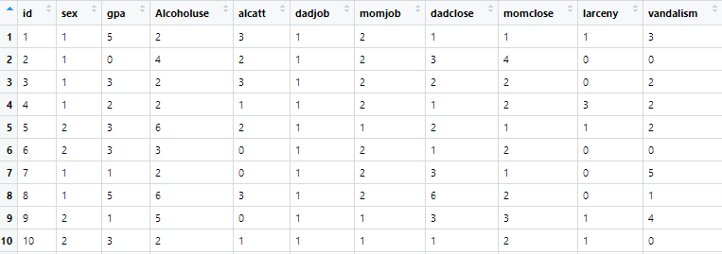
Collecting Data
Datafile: CaseStudy02_Boystown_Data.csv
Notes:
Variables:
ID: Case subject identifier
Sex: dichotomous variable (1=male, 2=female)
GPA: Interval-level variable with range of 0-5 (0-“A” average, 1- “B” average, 2- “C” average, 3- “D” average, 4-“E”, 5-“F”")
Alcohol use: Interval level variable from 0-11 (drink everyday - never drinked)
Attitudes on drinking in the household: Alcatt- Interval level variable from 0-6 (totally approve - totally disapprove)
DadJob: 1-yes, dad has a job and 2- no
MomJob: 1-yes and 2-no
Parent closeness (example: In your opinion, does your mother make you feel close to her?)
Dadclose: Interval level variable 0-7 (usually-never)
Momclose: interval level variable 0-7 (usually-never)
Delinquency:
larceny (how many times have you taken things >$50?): Interval level data 0-4 (never - many times),
vandalism: Interval level data 0-7 (never - many times)

Slide 11
Exploring and Preparing the Data
Possible outcome variables
We can focus on academic performance (GPA), recidivism (vandalism and larceny), alcohol use, or others
For this case study
Predict recidivism and use knn to classify participants in two categories
Two classes of interest
Recidivism: two or more infractions of vandalism and larceny
Control: one or no infractions
Notes:
Can focus on academic performance: GPA variable
Two classes of interest
1. above average: for GPA “C” or higher
2. average or below: for GPA below “C”

Slide 12
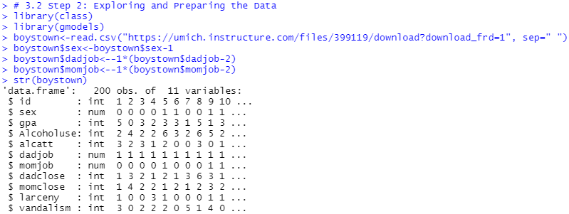
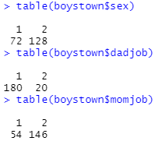
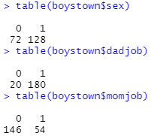
Exploring and Preparing the Data
Dummy variables: sex, dadjob, and momjob
Categorical variable must be converted to dummies, and all should be used
Before conversion After conversion
sex female
dad job yes
mom job yes
Notes:
# Sex: dichotomous variable (1=male, 2=female)
# DadJob: 1-yes, dad has a job and 2- no
# MomJob: 1-yes and 2-no
# can also use ifelse(test, yes, no) for conversion
boystown$sex <- ifelse(boystown$sex==1, 0, 1)
boystown$dadjob <- ifelse(boystown$dadjob==2, 0, 1)
boystown$momjob <- ifelse(boystown$momjob==2, 0, 1)

Slide 13
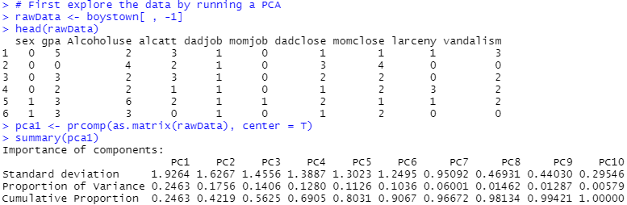
Exploring and Preparing the Data
Explore the data by running a PCA (principal component analysis)
Notes:
# First explore the data by running a PCA
rawData <- boystown[ , -1]
head(rawData)
pca1 <- prcomp(as.matrix(rawData), center = T)
summary(pca1)

Slide 14
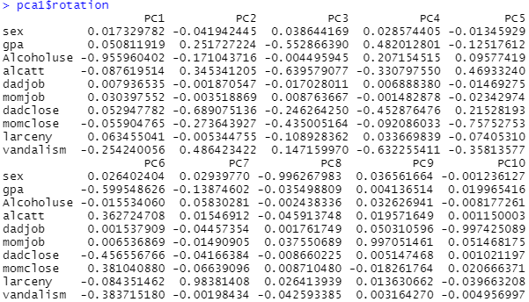
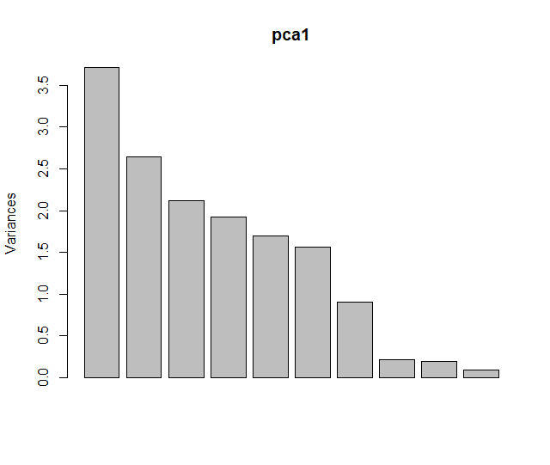
Exploring and Preparing the Data
Explore the data by running a PCA (principal component analysis)
Notes:
pca1$rotation
plot(pca1)
library(plotly)
plot_ly(x = c(1:length(pca1$sdev)), y = pca1$sdev*pca1$sdev, name = "Scree", type = "bar") %>%
layout(title="Scree Plot", xaxis = list(title="PC's"), yaxis = list(title="Variances (SD^2)"))

Slide 15
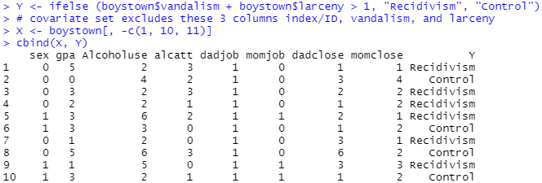
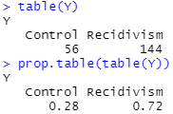
Exploring and Preparing the Data
New outcome variable: Y
Two categories: recidivism & control
The remaining 8 features/predictors: X
In different measuring scales
Need rescaling
Notes:
cbind(X, Y)
table(Y)
prop.table(table(Y))

Slide 16
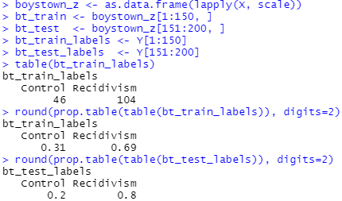
Exploring and Preparing the Data
Rescaling and partitioning
z-score standardization
3/4 for training and 1/4 for testing
We can see that most of the participants have incidents related to recidivism (~70-80%).
Notes:
Can use normalization for rescaling
Can use random sampling for partitioning
# rescaling based on training data
bt_train<-X[1:150, ]
bt_test<-X[151:200, ]
bt_train_labels <- Y[1:150]
bt_test_labels <- Y[151:200]
# initialize scaled training and testing data
bt_train_z <- bt_train
bt_test_z <- bt_test
# use preProcess() from the caret package to scale all predictors
library(caret)
bt_z_values <- preProcess(bt_train, method=c("center", "scale"))
bt_train_z <- predict(bt_z_values, bt_train)
bt_test_z <- predict(bt_z_values, bt_test)
bt_train <- bt_train_z
bt_test <- bt_test_z

Slide 17
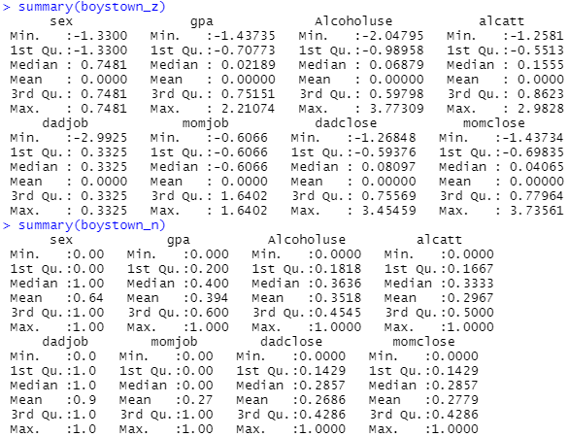
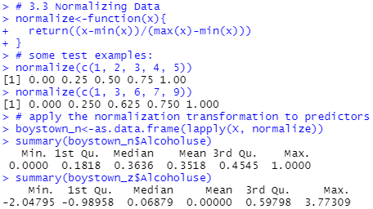
Normalizing Data
Using the min-max normalization formula
Notes:
# alternatively
as.data.frame(lapply(X, scale))
as.data.frame(lapply(X, scales::rescale))

Slide 18
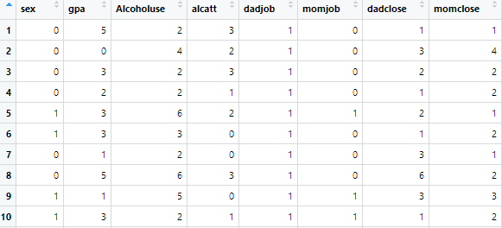
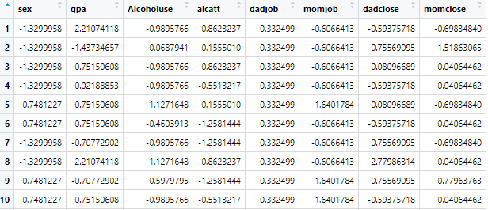
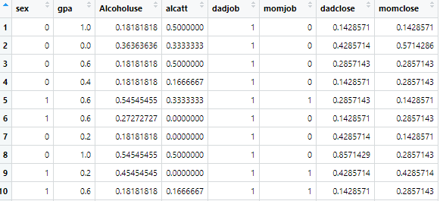
Normalizing Data
X vs. boystown_z vs. boystown_n

Slide 19
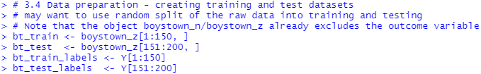
Data Preparation - Creating Training and Test Datasets
Use 3/4 of the data for training and the remaining 1/4 for testing
For simplicity, take the first cases as training and the remaining as testing
Better randomization strategy to split the data later

Slide 20
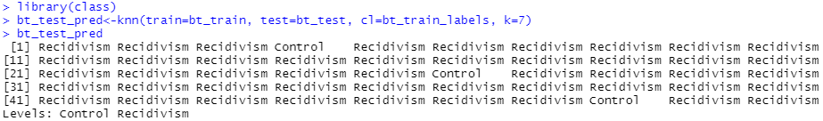
Training a Model on the Data
The function knn() returns factor of classifications of test set
p<-knn(train, test, class, k)
train: data frame containing numeric training data (features)
test: data frame containing numeric testing data (features)
class/cl: class for each observation in the training data
k: predetermined integer indication the number of nearest neighbors
We can first test with k=7

Slide 21
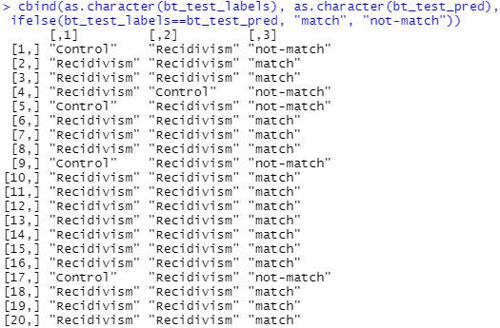
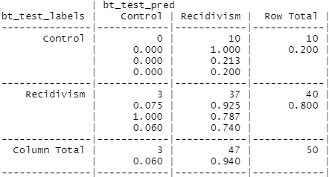
Evaluating Model Performance
The 2×2 table shows the matched true and predicted classes as well as the unmatched ones
Accuracy=(37+0)/50=0.74
Notes:
cbind(as.character(bt_test_labels), as.character(bt_test_pred), ifelse(bt_test_labels==bt_test_pred, "match", "not-match"))

Slide 22

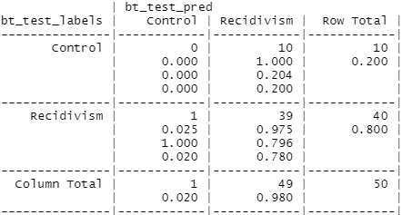
Improving Model Performance
Normalization strategy may play a role in the classification performance
Try alternative methods: standard z-score and min-max normalization
In general, there may be marginal differences
Accuracy=(39+0)/50=0.78
Notes:
how about k=14?

Slide 23
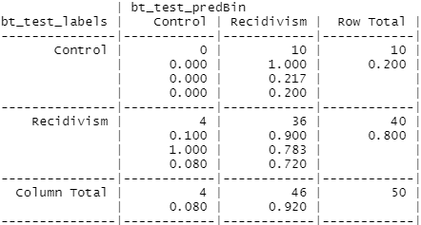
Improving Model Performance
Majority vote vs. specifying probability
k=14
Accuracy=(36+0)/50=0.72
Notes:
prob -- If this is true, the proportion of the votes for the winning class are returned.

Slide 24
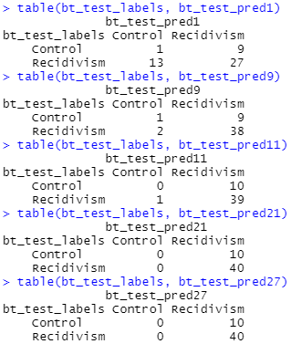
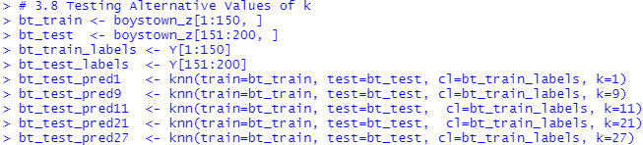
Testing Alternative Values of k
Test different k’s for their predicting performances
k=1,9,11,21,27
When k = n, equivalent to the naïve rule
Notes:
table(bt_test_labels, bt_test_pred1)
table(bt_test_labels, bt_test_pred9)
table(bt_test_labels, bt_test_pred11)
table(bt_test_labels, bt_test_pred21)
table(bt_test_labels, bt_test_pred27)

Slide 25
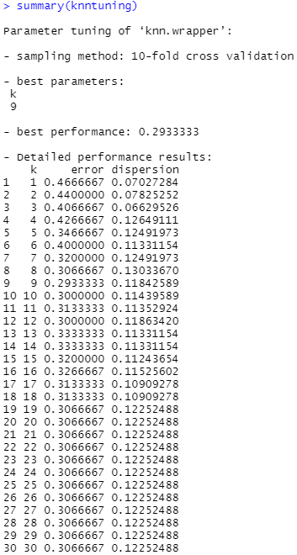
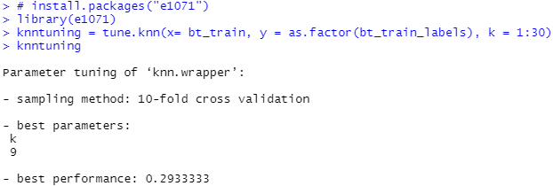
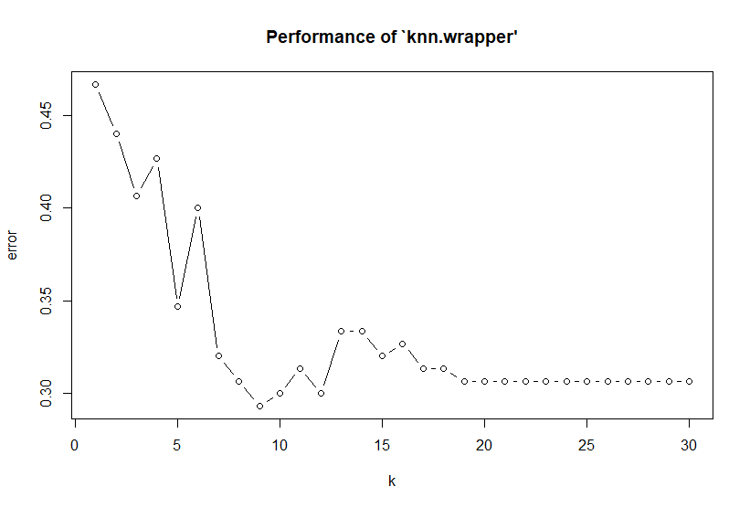
Testing Alternative Values of k
The choice of k in KNN can be fine-tuned
Using the e1071::tune.knn() method
Notes:
> plot(knntuning)
Use odd number for the best k. Avoid localization.

Slide 26
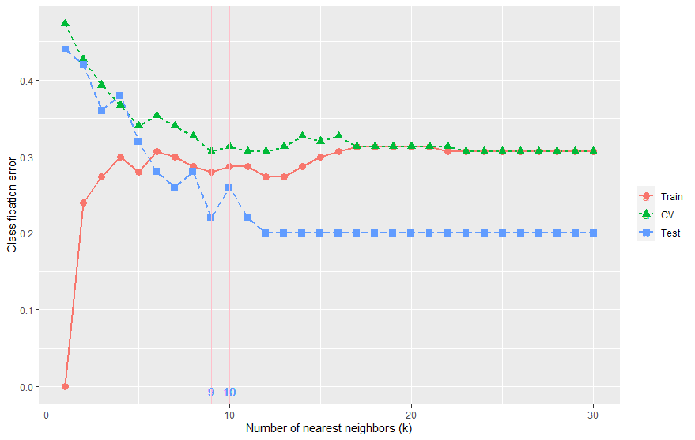
Testing Alternative Values of k
Visualize the error rate against the value of k
Select the optimal k that minimizes the cross-validation (CV) error.
Notes:
Use odd number for the best k. Avoid localization.

Slide 27
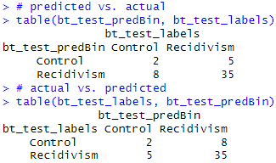
Quantitative Assessment
How well it predicts recidivism (or control)?
Important (Positive) class
Confusion matrix
Alternative layout
 | Reference/Actual
Predicted | Positive | Negative
Positive | TP | FP
Negative | FN | TN
Metrics | Sensitivity: TP/(TP+FN) | Specificity: TN/(TN+FP)
When positive is “Control”:
TP=2, FP=5, FN=8, TN=35,
Accuracy = (2+35)/50 = 0.74
Sensitivity = TP/(TP+FN) = 2/(2+8) = 0.2
Specificity = TN/(TN+FP) = 35/(35+5) = 0.875
When positive is “Recidivism”:
TP=35, FP=8, FN=5, TN=2
Accuracy = (35+2)/50 = 0.74
Sensitivity = TP/(TP+FN) = 35/(35+5) = 0.875
Specificity = TN/(TN+FP) = 2/(2+8) = 0.2
Notes:
# predicted vs. actual
table(bt_test_predBin, bt_test_labels)
# actual vs. predicted
table(bt_test_labels, bt_test_predBin)

Slide 28
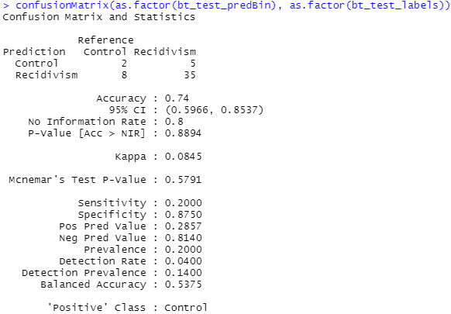
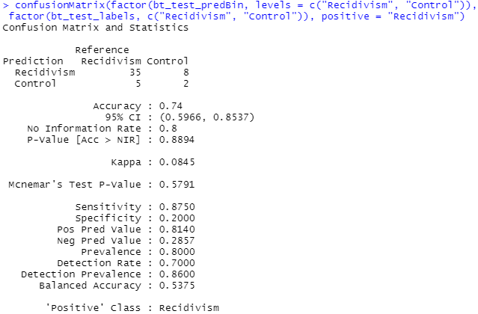
Quantitative Assessment
Use the confusionMatrix() method
Notes:
confusionMatrix(as.factor(bt_test_predBin), as.factor(bt_test_labels), positive = "Control")
confusionMatrix(as.factor(bt_test_predBin), as.factor(bt_test_labels), positive = "Recidivism")
confusionMatrix(factor(bt_test_predBin, levels = c("Recidivism", "Control")), factor(bt_test_labels, c("Recidivism", "Control")), positive = "Recidivism")

Slide 29
Advantages and Shortcomings
The main advantage is their simplicity and lack of parametric assumptions
Shortcomings
The time to find the nearest neighbors in a large training set can be prohibitive
The curse of dimensionality
The number of records required in the training set to qualify as large increases exponentially with the number of predictors p
k-NN is a “lazy learner” – time consuming
Require the model be run at prediction time which limits their use for real-time modeling
Notes:
pca2 <- prcomp(as.matrix(X), center = T)
summary(pca2)
pca2$rotation
plot(pca2)
dim(pca2$x)
round(pca2$x, digits = 4)
bt_pca_train <- pca2$x[1:150, 1:5]
bt_pca_test <- pca2$x[151:200, 1:5]
bt_train_labels <- Y[1:150]
bt_test_labels <- Y[151:200]
cbind(round(bt_pca_train, digits = 4), bt_train_labels)
table(bt_train_labels)
prop.table(table(bt_train_labels))
library(class)
bt_pca_test_pred<-knn(train=bt_pca_train, test=bt_pca_test, cl=bt_train_labels, k=7)
library(gmodels)
CrossTable(x=bt_test_labels, y=bt_pca_test_pred, prop.chisq = F)
library(e1071)
knntuning = tune.knn(x= bt_pca_train, y = as.factor(bt_train_labels), k = 1:30)
knntuning
plot(knntuning)
summary(knntuning)
##############
bt_train <- X[1:150,]
bt_test <- X[151:200,]
bt_train_labels <- Y[1:150]
bt_test_labels <- Y[151:200]
bt_train_pca <- prcomp(as.matrix(bt_train), center = T)
summary(bt_train_pca)
bt_train_pca$rotation
plot(bt_train_pca)
dim(bt_train_pca$x)
round(bt_train_pca$x, digits = 4)
bt_train_pca1 = predict(bt_train_pca, bt_train)
bt_test_pca = predict(bt_train_pca, bt_test)
library(class)
bt_pca_test_pred<-knn(train=bt_train_pca$x, test=bt_test_pca, cl=bt_train_labels, k=7)
library(gmodels)
CrossTable(x=bt_test_labels, y=bt_pca_test_pred, prop.chisq = F)
library(e1071)
knntuning = tune.knn(x= bt_train_pca$x, y = as.factor(bt_train_labels), k = 1:30)
knntuning
plot(knntuning)
summary(knntuning)

