Slide 1
CSDA 5430 Predictive Analytics
Chapter 07
Probabilistic Learning - Classification Using Naive Bayes
Notes:
https://www.socr.umich.edu/people/dinov/courses/DSPA_notes/07_NaiveBayesianClass.html

Slide 2
Introduction
Naive Bayes overview
Naive Bayes assumption
Conditional probability
Naive Bayes algorithm
Laplace estimation
Case study

Slide 3
Overview
Bayes classifiers use training data to calculate an observed probability of each class based on all the features
Frequently used for text classifications
Based on obtaining the conditional probability density function for each feature given the value of the class variable

Slide 4
Assumptions
All features are equally important and independent
This rarely happens in real world data
Even when the assumptions are violated, naive Bayes still performs fairly accurate
Particularly when the number of features is large

Slide 5
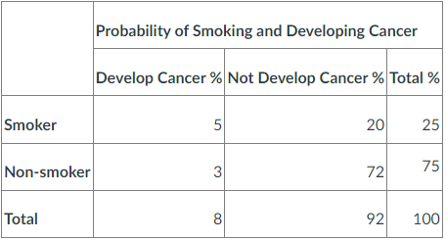
Joint Probability
Probability of two events occurring simultaneously
Probability of events A and B: P(A&B) = P(B&A)
For independent events, P(A&B)=P(A)*P(B)
The probability of a smoker developing cancer:
P(smoker&cancer) = P(cancer&smoker) = 0.05
Assume independent events
P(smoker&cancer) ≈ P(cancer)*P(smoker)

Slide 6
Conditional Probability
Probability of one event occurring in the presence of a second event
Probability of event A given event B: P(A|B)
The probability of an individual developing cancer given that the individual is a smoker:
P(cancer|smoker) = 5/25 = 0.2
Meaning, 20 % chance for a smoker developing cancer

Slide 7


Conditional Probability
Conditional probability and joint probability
P(A&B)= P(A|B)*P(B), P(B&A)= P(B|A)*P(A)
So, P(A|B)*P(B)=P(B|A)*P(A) → $P\left(A | B\right)=\frac{P(B|A)P\left(A\right)}{P\left(B\right)}$
P(cancer&smoker)
=P(cancer|smoker)*P(smoker)
=P(smoker|cancer)*P(cancer)
= 0.05
P(cancer|smoker)=0.2
P(smoker)=0.25
P(smoker|cancer)=5/8=0.625
P(cancer)=0.08
$$P\left(cancer | smoker\right)=\frac{P\left(smoker | cancer\right)P\left(cancer\right)}{P\left(smoker\right)}$$

Slide 8


Bayes Formula
Compute probability of hypothesis A given evidence B, P(A|B), by instead looking at the probability of the evidence given the hypothesis, P(B|A), as well as the unconditional probabilities of the hypothesis, P(A) and the evidence, P(B)
Naïve assumption
Assuming independent events
$$P\left(A | B\right)=\frac{P\left(B | A\right)P\left(A\right)}{P\left(B\right)}$$
$$P\left(C_{k} | F_{1},…,F_{n}\right)=\frac{P\left(F_{1},…,F_{n} | C_{k}\right)P\left(C_{k}\right)}{P\left(F_{1},…,F_{n}\right)}$$
$P\left(F_{1},…,F_{n} | C_{k}\right)≈P\left(F_{1} | C_{k}\right)$* $P\left(F_{2} | C_{k}\right)∗…∗P\left(F_{n} | C_{k}\right)$

Slide 9
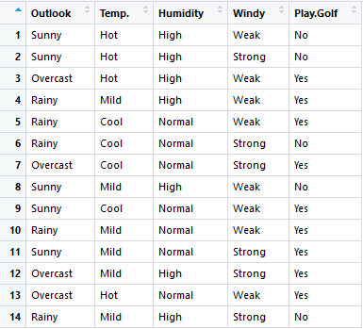

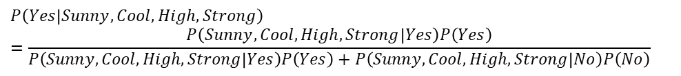
Example: Play Golf
The weather dataset describes the weather conditions for playing a game of golf. Given the weather conditions, each row classifies the conditions as fit (“Yes”) or unfit (“No”) for playing golf.
Classify a new day:
$$Pnb\left(Yes | Sunny, Cool, High, Strong\right)=\frac{P\left(Sunny | Yes\right)P\left(Cool | Yes\right)P\left(High | Yes\right)P\left(Strong | Yes\right)P\left(Yes\right)}{P\left(Sunny | Yes\right)P\left(Cool | Yes\right)P\left(High | Yes\right)P\left(Strong | Yes\right)P\left(Yes\right)+P\left(Sunny | No\right)P\left(Cool | No\right)P\left(High | No\right)P\left(Strong | No\right)P\left(No\right)}$$
Naïve Bayes
$$P\left(Yes | Sunny, Cool, High, Strong\right)=\frac{P\left(Sunny,Cool,High,Strong | Yes\right)P\left(Yes\right)}{P\left(Sunny,Cool,High,Strong | Yes\right)P\left(Yes\right)+P\left(Sunny,Cool,High,Strong | No\right)P\left(No\right)}$$
Complete Bayes

Slide 10
Example: Play Golf
It is easy to find the probability for Sunny, and probability for Cool, and probability for High , and probability for Strong individually given that it belongs to class Yes.
It is impossible in this case to find from the training data the probability for Sunny AND Cool AND High AND Strong given that it belongs to class Yes, because there is no any record in the training data matches such combination of predictor values!
$$Pnb\left(Yes | Sunny, Cool, High, Strong\right)=\frac{P\left(Sunny | Yes\right)P\left(Cool | Yes\right)P\left(High | Yes\right)P\left(Strong | Yes\right)P\left(Yes\right)}{P\left(Sunny | Yes\right)P\left(Cool | Yes\right)P\left(High | Yes\right)P\left(Strong | Yes\right)P\left(Yes\right)+P\left(Sunny | No\right)P\left(Cool | No\right)P\left(High | No\right)P\left(Strong | No\right)P\left(No\right)}$$
Naïve Bayes
$$P\left(Yes | Sunny, Cool, High, Strong\right)=\frac{P\left(Sunny,Cool,High,Strong | Yes\right)P\left(Yes\right)}{P\left(Sunny,Cool,High,Strong | Yes\right)P\left(Yes\right)+P\left(Sunny,Cool,High,Strong | No\right)P\left(No\right)}$$
Complete Bayes

Slide 11
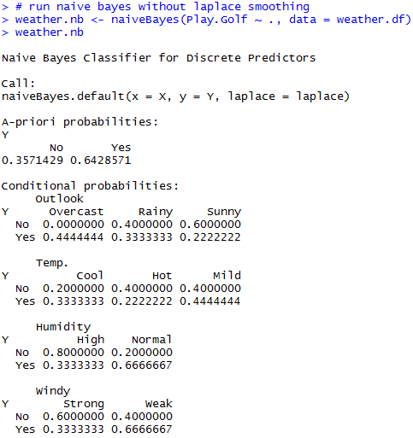
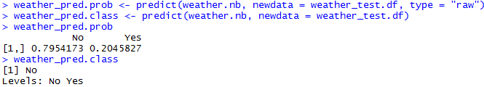





Example: Play Golf
$$P\left(Yes\right)$$
$$P\left(Sunny | Yes\right)$$
$$P\left(Cool | Yes\right)$$
$$P\left(High | Yes\right)$$
$$P\left(Strong | Yes\right)$$
Based on the naïve Bayes probability or ranking, classification for the new day is “No”.
Notes:
#############
# load data
library(e1071)
weather.df <- read.csv("weather.csv")
weather_test.df <- read.csv("weather_test.csv")
# run naive bayes without laplace smoothing
weather.nb <- naiveBayes(Play.Golf ~ ., data = weather.df)
weather.nb
weather_pred.prob <- predict(weather.nb, newdata = weather_test.df, type = "raw")
weather_pred.class <- predict(weather.nb, newdata = weather_test.df)

Slide 12
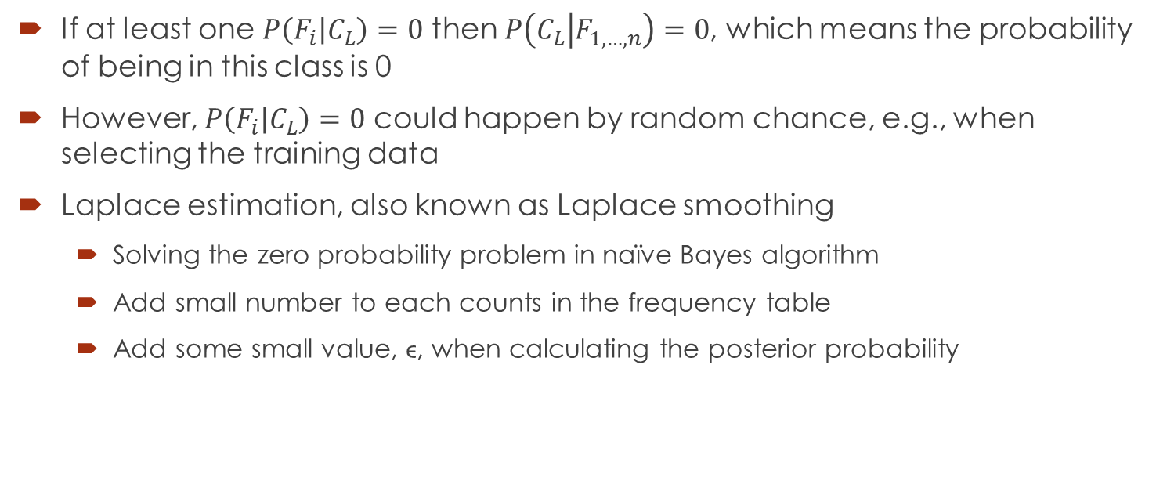
The Laplace Estimator
If at least one $P\left(F_{i} | C_{L}\right)=0$ then $P\left(C_{L} | F_{1,…,n}\right)=0$, which means the probability of being in this class is 0
However, $P\left(F_{i} | C_{L}\right)=0$ could happen by random chance, e.g., when selecting the training data
Laplace estimation, also known as Laplace smoothing
Solving the zero probability problem in naïve Bayes algorithm
Add small number to each counts in the frequency table
Add some small value, ϵ, when calculating the posterior probability

Slide 13
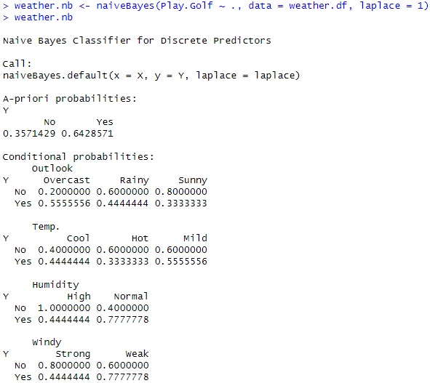
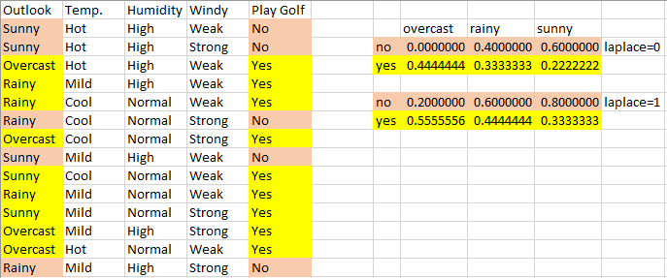
The Laplace Estimator
Laplace=1
P(overcast|no) = (0+1)/5
P(rainy|no) = (2+1)/5
P(sunny|no) = (3+1)/5
P(overcast|yes) = (4+1)/9
P(rainy|yes) = (3+1)/9
P(sunny|yes) = (2+1)/9
Notes:
weather.nb <- naiveBayes(Play.Golf ~ ., data = weather.df, laplace = 1)

Slide 14
Case Study: Head and Neck Cancer Medication
Step 1 - collecting data
Step 2 - exploring and preparing the data
Data preparation - processing text data for analysis
Data preparation - creating training and test datasets
Visualizing text data - word clouds
Data preparation - creating indicator features for frequent words
Step 3 - training a model on the data
Step 4 - evaluating model performance
Step 5 - improving model performance

Slide 15
Collecting Data
Overview
This case-study includes a partial subset of data for head and neck cancer patients. This dataset mainly focuses on the inpatient medication and cancer status of 595 patients
Driving Challenges:
Determine the relation between the patient SEER stage of cancer and other covariates, e.g., treatment medications, dosage, frequency, etc.
Use text-mining and/or natural language processing methods to extract structured data from the unstructured free-text, e.g., MEDICATION_DESC, MEDICATION_SUMMARY
Apply machine learning techniques to automatically segment the patients into clusters and determine how well these derived groupings correspond to patient phenotypes, e.g., cancer stage (SEER)

Slide 16
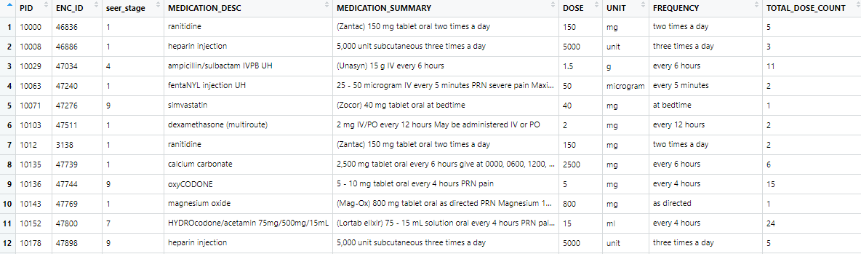
Collecting Data
Datafile: CaseStudy14_HeadNeck_Cancer_Medication.csv
Notes:
Variables:
PID: coded patient ID
ENC_ID: coded encounter ID
Seer_stage: SEER cancer stage (0 =In situ, 1=Localized, 2=Regional by direct extension, 3=Regional to lymph nodes, 4=Regional (both codes 2 and 3), 5=Regional, NOS, 7= Distant metastases/systemic disease, 8=Not applicable, 9=Unstaged, unknown, or unspecified). See: http://seer.cancer.gov/tools/ssm.
Medication_desc: description of the chemical composition of the medication
Medication_summary: brief description about medication brand and usage
Dose: the dosage in the medication summary
Unit: the unit for dosage in the Medication_summary
Frequency: the frequency of use in the Medication_summary
Total_dose_count: total dosage count according to the Medication_summary

Slide 17
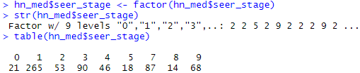
Exploring and Preparing the Data
The variable of most interest is the SEER_STATE variable
SEER cancer stage: (0 =In situ, 1=Localized, 2=Regional by direct extension, 3=Regional to lymph nodes, 4=Regional (both codes 2 and 3), 5=Regional, NOS, 7= Distant metastases/systemic disease, 8=Not applicable, 9=Unstaged, unknown, or unspecified).
Two categories of interest for this case study
no stage or early stage cancer (seer in [0:4]), and
later stage cancer (seer in [5:9])

Slide 18
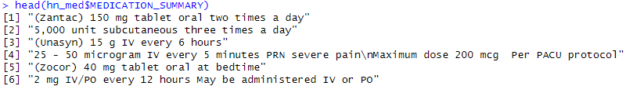
Data Preparation - Processing Text Data for Analysis
The medication_summary contains a great amount of text
Need do some text mining to prepare the data for analysis
Construct corpus of text
Convert to lower case
Remove punctuation
Remove numbers
Remove white spaces
Tokenization

Slide 19

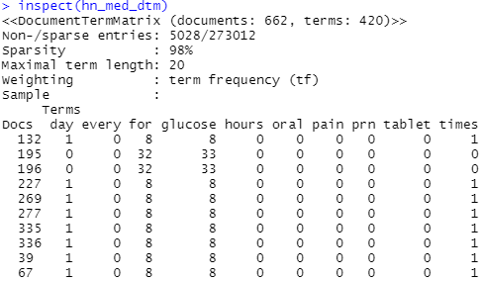
Data Preparation - Processing Text Data for Analysis
Tokenization
 | Term 1 | Term 2 | Term 3 | … | Term M
Doc 1
Doc 2
Doc 3
…
Doc N
Document Term Matrix (DTM)
Notes:
inspect(hn_med_dtm)
420 terms in 662 documents

Slide 20
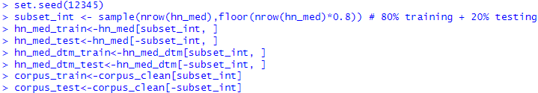
Data Preparation - Creating Training and Test Datasets
Separate the dataset into training and test subsets
Subset the raw data with other features, the corpus object and the document term matrix
80% training and 20% testing
Notes:
patient data data frame: hn_med, hn_med_train, hn_med_test
DTM matrix: hn_med_dtm, hn_med_dtm_train, hn_med_dtm_test
corpus: corpus_clean, corpus_train, corpus_test

Slide 21
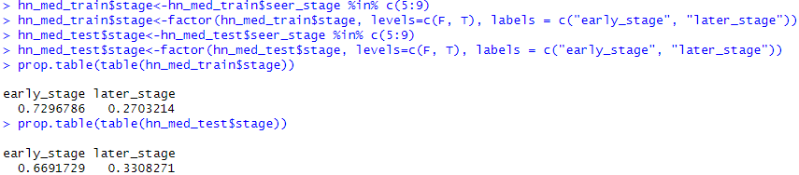
Data Preparation - Creating Training and Test Datasets
Outcome variable
Separate the seer_stage into two categories:
no stage or early stage cancer (seer in [0:4]), and
later stage cancer (seer in [5:9])

Slide 22
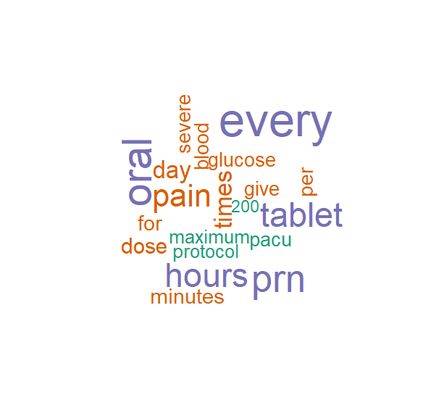
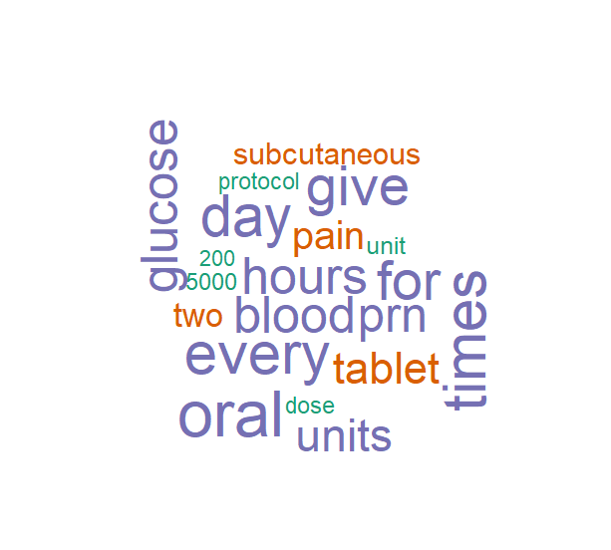
Visualizing Text Data - Word Clouds
A word cloud can help us visualize text data
The frequent words are somewhat different in the medication summaries of the early and later stage patients

Slide 23
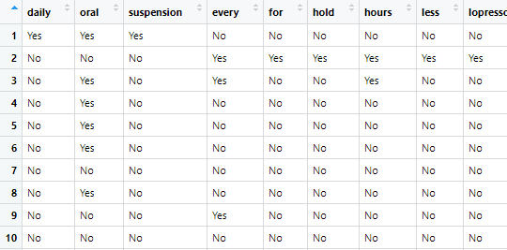
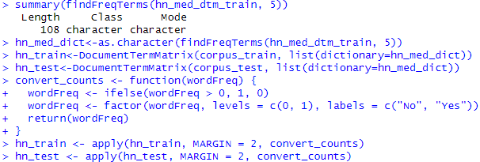
Data Preparation - Creating Indicator Features for Frequent Words
Make frequencies of words into features
For words that appeared at least in 5 different documents in the training data
Notes:
# before convert counts
inspect(hn_train)
108 terms in 529 documents
inspect(hn_test)
108 terms in 133 documents

Slide 24

Training a Model on the Data
The function naiveBayes() has following components:
train: data frame containing numeric training data (features)
class: factor vector with the class for each row in the training data
laplace: default is 0 and disables Laplace
The function predict() has the following components:
m: classifier trained by naiveBayes()
test: test data frame or matrix
type: either "class" or "raw"
Notes:
hn_test_pred<-predict(hn_classifier, hn_test, type = "raw")

Slide 25
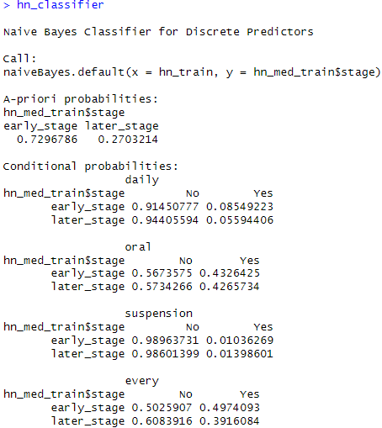
Training a Model on the Data
The classifier
Partial shown

Slide 26
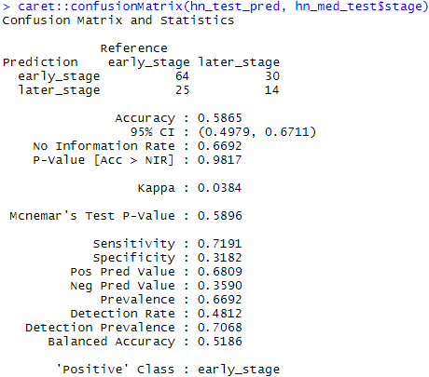

Evaluating Model Performance
Compare predicted class and the true class of our test dataset
Accuracy=(64+14)/133=0.5865

Slide 27
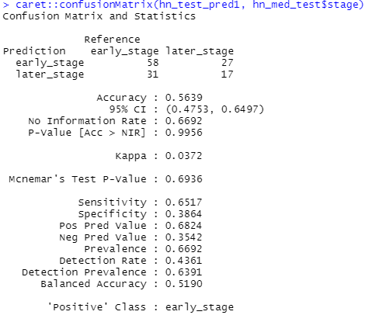

Improving Model Performance
Set Laplace=1, the accuracy goes to acc=75/133=0.56
Accuracy=(58+17)/133=0.5639
“Fail to identify true later stage patients in the testing dataset.”
Notes:
table(hn_test_pred1, hn_med_test$stage)
caret::confusionMatrix(hn_test_pred1, hn_med_test$stage)

Slide 28
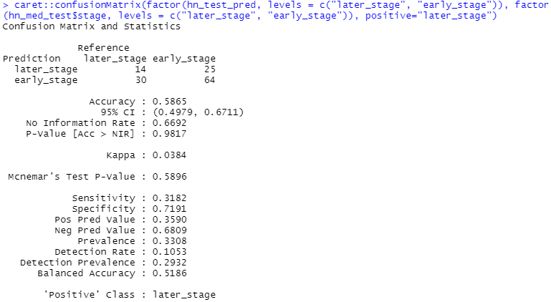
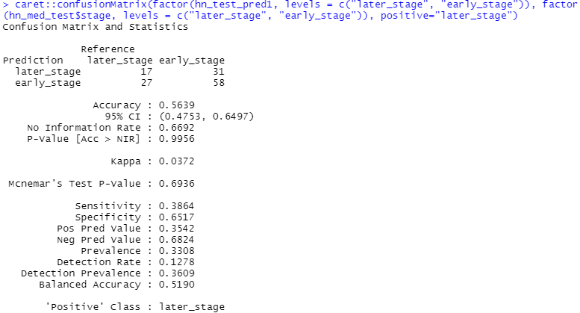
Improving Model Performance
“Fail to identify true later stage patients in the testing dataset.”
-- Low sensitivity on later stage
Notes:
-- low sensitivity: “Fail to identify true later stage patients in the testing dataset.“
caret::confusionMatrix(hn_test_pred, hn_med_test$stage, positive="later_stage")
caret::confusionMatrix(factor(hn_test_pred, levels = c("later_stage", "early_stage")), factor(hn_med_test$stage, levels = c("later_stage", "early_stage")), positive="later_stage")
-- laplace=1
caret::confusionMatrix(hn_test_pred1, hn_med_test$stage, positive="later_stage")
caret::confusionMatrix(factor(hn_test_pred1, levels = c("later_stage", "early_stage")), factor(hn_med_test$stage, levels = c("later_stage", "early_stage")), positive="later_stage")

Slide 29
Advantages and Shortcomings
Advantages
Simplicity, computational efficiency, good classification performance, and ability to handle categorical variables directly
Shortcomings
Requires a very large number of records to obtain good results
Assumes zero probability when a predictor category is not present in the training data
Provides very biased results when the goal is actually to estimate the probability of class membership (propensity)
Notes:
https://www.baeldung.com/cs/naive-bayes-classification-performance

