Slide 1
CSDA 5430 Predictive Analytics
Chapter 10
Black Box Machine-Learning Methods: Neural Networks
Notes:
https://www.socr.umich.edu/people/dinov/courses/DSPA_notes/10_ML_NN_SVM_Class.html

Slide 2
Introduction
Neural network and its important components
Logistic regression
Neural network tiny example
Case-studies
Google trends and the stock market
Neural network for regression
Neural network for classification

Slide 3
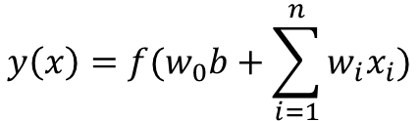
Understanding Neural Networks
From biological to artificial neurons
Black box methods
Nontransparent relationship between predictors and outcome variable
Artificial Neural Network (ANN) model mimics the biological brain response to multisource (sensory-motor) stimuli (inputs)
Three important components for building a neural network:
Activation function
Network topology
Training algorithm – determining weights
$$y\left(x\right)=f(w_{0}b+\sum_{i=1}^{n}{w_{i}x_{i}})$$

Slide 4
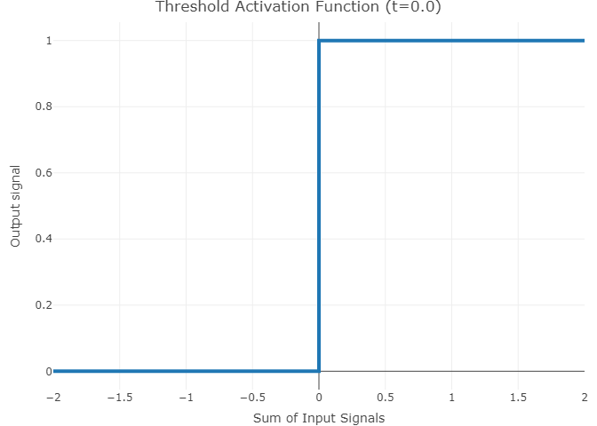
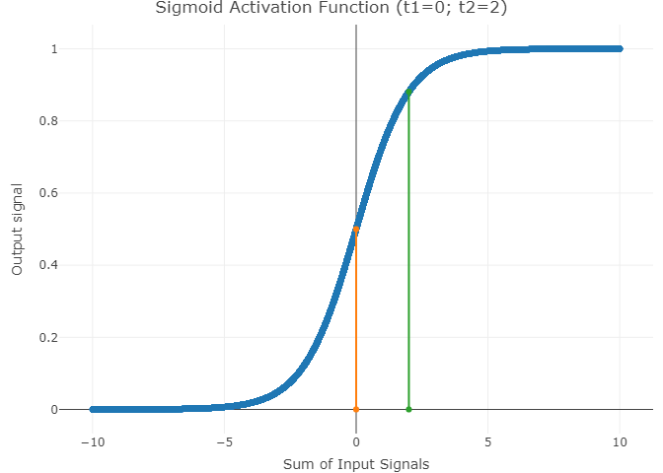

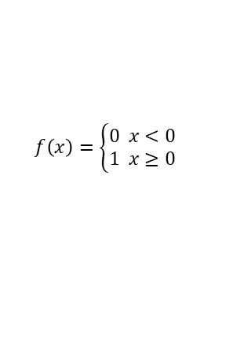
Activation Functions
Transforms weighted and summed inputs to output
The threshold activation function is the simplest
The sigmoid activation function is most commonly used
The output signal is ranged from 0 to 1
$$f\left(x\right)=\left\{\begin{aligned}0 x<0 \\ 1 x≥0\end{aligned}\right.$$
$$f\left(x\right)=\frac{1}{1+e^{−x}}$$
Notes:
1/(1+e^(-x))

Slide 5
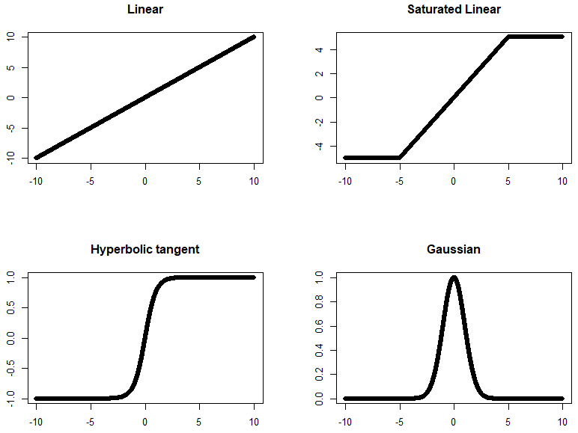




Activation Functions
Other activation functions might also be useful
$$f\left(x\right)=\left\{\begin{aligned}−5 x<5 \\ x −5≤x<5 \\ 5 x≥5\end{aligned}\right.$$
$$f\left(x\right)=x$$
$$f\left(x\right)=\frac{e^{x}−e^{−x}}{e^{x}+e^{−x}}$$
$$f\left(x\right)=e^{−\frac{x^{2}}{2}}$$
Notes:
(exp(x)-exp(-x))/(exp(x)+exp(-x))
exp(-x^2/2)

Slide 6
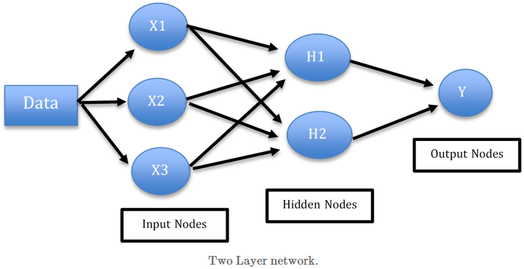
Network Topology
Represent network layers and nodes, and how they are connected
Input layer, output layer, and hidden layer
Notes:
A neural network with no hidden layers and a single output node?

Slide 7
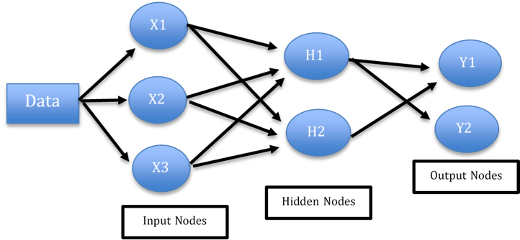
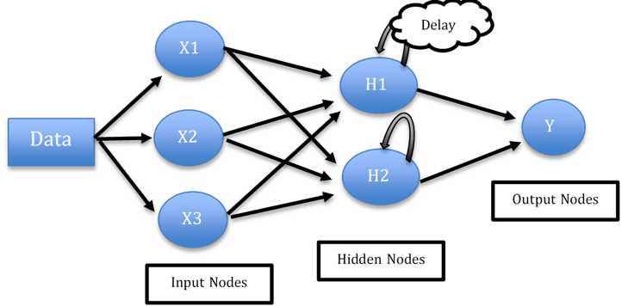
Network Topology
Directions of information travel
Feed-forward vs. feedback network

Slide 8
Network Topology
Number of nodes in each layer
Input layer
Number of nodes are predetermined by the dataset and predictors
Output layer
Categorical outcome with m classes, number of nodes should be m or m-1
Numerical outcome, single output node is used
Hidden layers
Number of nodes can be changed in the model
The most popular choice for the number of hidden layers is one
The goal
Simple model (fewer hidden nodes) with good performance

Slide 9
Training Algorithm
Training neural networks with backpropagation
Determine the weights with back-propagating errors
Assign random numbers for initial weights and adjust the weights iteratively
Each iteration contains two phases
Forward phase: from input layer to output layer using current weights
Backward phase: compare the outputs and true target values, change weights backward
Final set of weights minimize the total aggregate error for the network

Slide 10
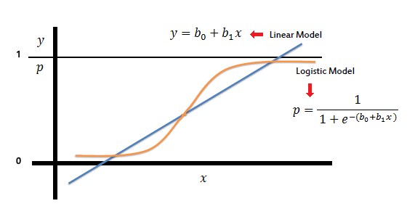
Logistic Regression
Extend the idea of linear regression to the situation where the outcome is categorical
Compare with linear regression
Multiple linear regression
Predicts continuous outcome variable
Logistic regression
Classifies categorical outcome variable
Logistic regression algorithm for classification
Yield estimates of the propensities (probabilities) of belonging to each class
Use a threshold value to classify each case into one of the classes

Slide 11



Logistic Regression
The logit can be modeled as a linear function of the predictors
The logit can be mapped back to a probability
$$p=\frac{1}{1+e^{−(β_{0}+β_{1}x_{1}+β_{2}x_{2}+…+β_{q}x_{q})}}$$
$$odds=\frac{p}{1−p}=e^{β_{0}+β_{1}x_{1}+β_{2}x_{2}+…+β_{q}x_{q}}$$
$logit=log\left(odds\right)=β_{0}+β_{1}x_{1}$+$β_{2}x_{2}$+…+$β_{q}x_{q}$

Slide 12
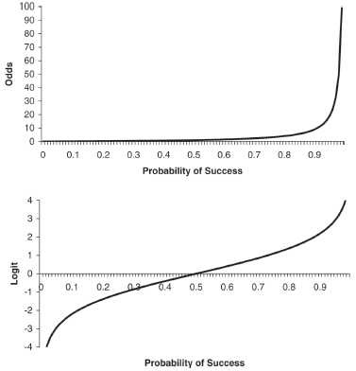

Logistic Regression
Probability ranging from 0 to 1
$p=\frac{odds}{1+odds} odds=\frac{p}{1−p}$
Odds ranging from 0 to ∞
$odds=e^{logit} logit=log\left(odds\right)$
Logit ranging from -∞ to ∞
$logit=β_{0}+β_{1}x_{1}$+$β_{2}x_{2}$+…+$β_{q}x_{q}$
$logit=log\left(\frac{p}{1−p}\right)$ $p=\frac{1}{1+e^{−(logit)}}$

Slide 13
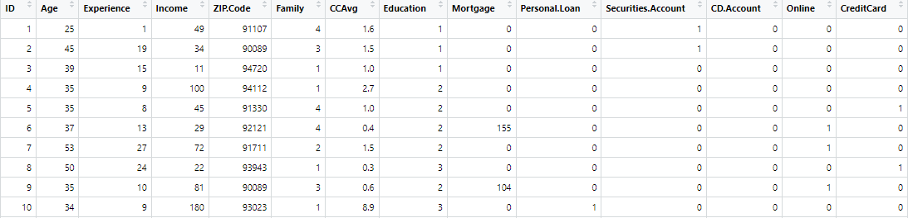
Example: Acceptance of Personal Loan
Identify customers who are most likely to accept the loan offer
Personal loan: 1 (accepted) & 0 (not accepted)
Notes:
Variable Description
ID Customer ID
Age Customer's age in completed years
Experience #years of professional experience
Income Annual income of the customer ($000)
ZIPCode Home Address ZIP code.
Family Family size of the customer
CCAvg Avg. spending on credit cards per month ($000)
Education Education Level. 1: Undergrad; 2: Graduate; 3: Advanced/Professional
Mortgage Value of house mortgage if any. ($000)
Personal Loan Did this customer accept the personal loan offered in the last campaign?
Securities Account Does the customer have a securities account with the bank?
CD Account Does the customer have a certificate of deposit (CD) account with the bank?
Online Does the customer use internet banking facilities?
CreditCard Does the customer use a credit card issued by UniversalBank?

Slide 14
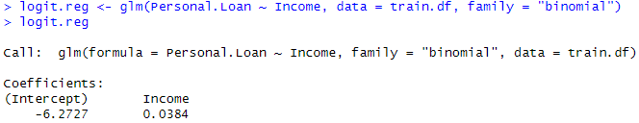

Example: Acceptance of Personal Loan
Fit the model with single predictor
Estimated model equation
$$P(Personal.Loan=1) =\frac{1}{1+e^{−(−6.2727+0.0384∗Income)}}$$
$$Odds(Personal.Loan=1)=e^{−6.2727+0.034∗Income}$$
$$Logit\left(Personal.Loan=1\right)=−6.2727+0.034∗Income$$
Notes:
bank.df <- read.csv("UniversalBank.csv")
bank.df <- bank.df[ , -c(1, 5)] # Drop ID and zip code columns.
bank.df$Education <- factor(bank.df$Education, levels = c(1, 2, 3),
labels = c("Undergrad", "Graduate", "Advanced/Professional"))
set.seed(2)
train.index <- sample(c(1:dim(bank.df)[1]), dim(bank.df)[1]*0.6)
train.df <- bank.df[train.index, ]
test.df <- bank.df[-train.index, ]
plot(train.df$Personal.Loan~train.df$Income)
logit.reg <- glm(Personal.Loan ~ Income, data = train.df, family = "binomial")
summary(logit.reg)

Slide 15
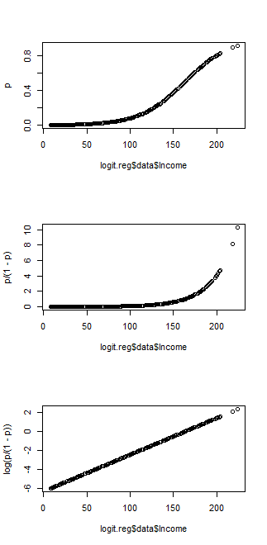
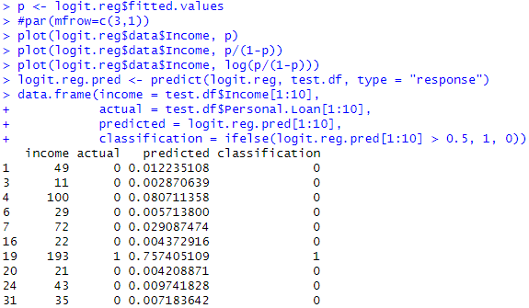
Example: Acceptance of Personal Loan
Plots of the fitted outcome
Classification
Notes:
p <- logit.reg$fitted.values
#par(mfrow=c(3,1))
plot(logit.reg$data$Income, p)
plot(logit.reg$data$Income, p/(1-p))
plot(logit.reg$data$Income, log(p/(1-p)))
logit.reg.pred <- predict(logit.reg, test.df, type = "response")
data.frame(income = test.df$Income[1:10],
actual = test.df$Personal.Loan[1:10],
predicted = logit.reg.pred[1:10],
classification = ifelse(logit.reg.pred[1:10] > 0.5, 1, 0))
library(caret)
confusionMatrix(factor(ifelse(logit.reg.pred > 0.5, 1, 0), levels = c(1,0)), factor(test.df$Personal.Loan, levels = c(1,0)))

Slide 16
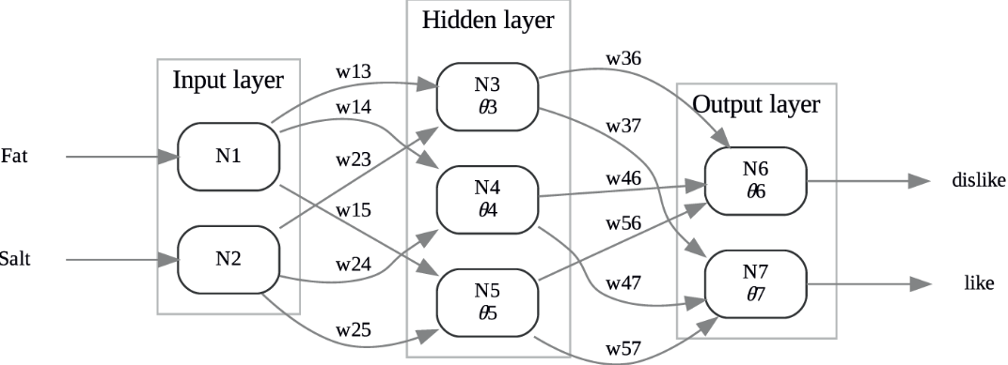
Neural Network: Tiny Example
Tiny example on tasting scores for six consumers and two predictors
Outcome variable: the cheese sample’s consumer taste preference
Network topology
2 input nodes, 2 output nodes, and 3 hidden nodes

Slide 17

Neural Network: Tiny Example
Activation function
Values of θ_{j} and w_{ij} are initialized to small numbers
Computing output of nodes
Input layer nodes
Take predictor values in, output same as input
Hidden layer nodes
Take values from input layer nodes, output a function of weighted inputs sum
Output layer nodes
Take values from hidden layer nodes, output the same function of weighted inputs sum
Notes:
When using a logistic activation function, neural networks perform best when the predictors and outcome variable are on a scale of [0,1]. For this reason, all variables should be scaled to a [0,1] interval before entering them into the network.

Slide 18

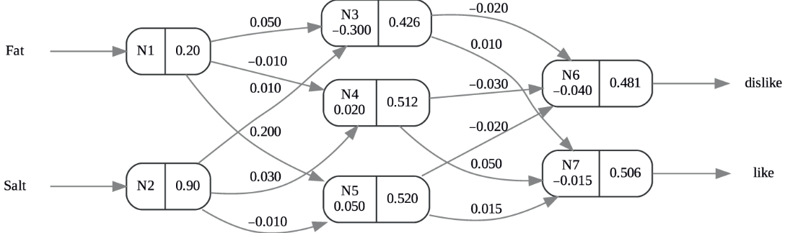
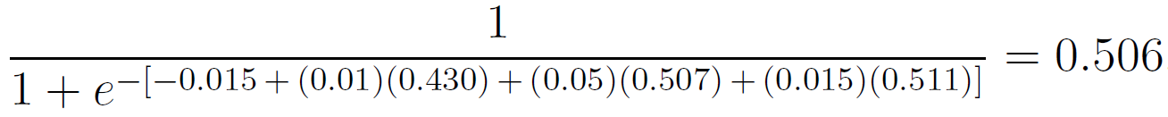
Neural Network: Tiny Example
Computing output of nodes
Using the first record in the tiny example and a logistic function
P(dislike) = Output6/(Output6+Output7) = 0.481/(0.481+0.506) = 0.49
P(like) = 1-P(dislike) = 0.506/(0.481+0.506) = 0.51
Notes:
Hidden layer
N3 = 1/(1+e^(-(-0.3+0.05*0.2+0.01*0.9))) = 0.43
N4 = 1/(1+e^(-(0.02+(-0.01)*0.2+0.03*0.9))) = 0.51
N5 = 1/(1+e^(-(0.05+0.2*0.2+(-0.01)*0.9))) = 0.52
Output layer
N6 = 1/(1+e^(-(-0.04+(-0.02)*0.43+(-0.03)*0.51+(-0.02)*0.52))) = 0.481
N7 = 1/(1+e^(-(-0.015+0.01*0.43+0.05*0.51+0.015*0.52))) = 0.506

Slide 19
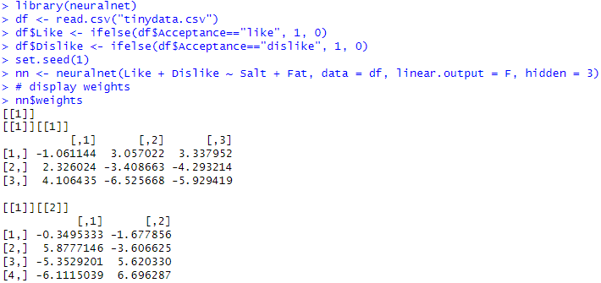
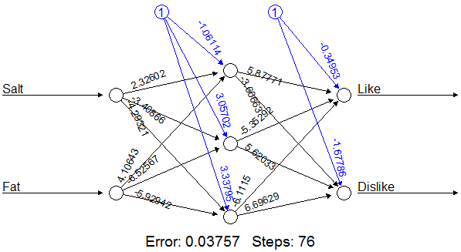
Neural Network: Tiny Example
Fitting the model
Notes:
# two output nodes
library(neuralnet)
df <- read.csv("tinydata.csv")
df$Like <- ifelse(df$Acceptance=="like", 1, 0)
df$Dislike <- ifelse(df$Acceptance=="dislike", 1, 0)
set.seed(1)
nn <- neuralnet(Like + Dislike ~ Salt + Fat, data = df, linear.output = F, hidden = 3)
# display weights
nn$weights
# display predictions
prediction(nn)
# plot network
plot(nn, rep="best")
library(caret)
predict <- compute(nn, data.frame(df$Salt, df$Fat))
predicted.class=apply(predict$net.result,1,which.max)-1
confusionMatrix(as.factor(ifelse(predicted.class=="1", "dislike", "like")), as.factor(df$Acceptance))

Slide 20
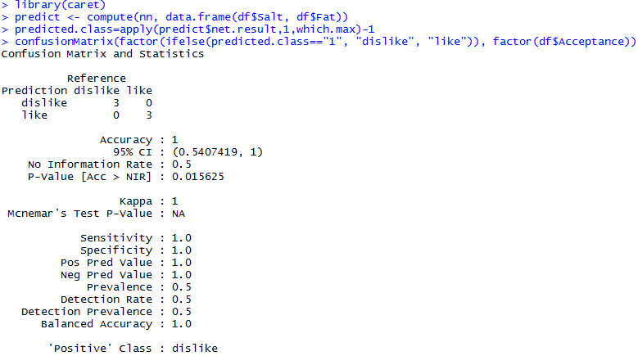
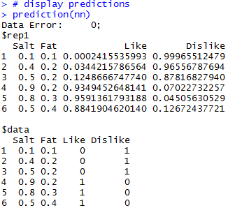
Neural Network: Tiny Example
Performance evaluation
Notes:
# alternatively, use predict(), instead of compute()
predict <- predict(nn, data.frame(df$Salt, df$Fat))
predicted.class=apply(predict,1,which.max)-1

Slide 21

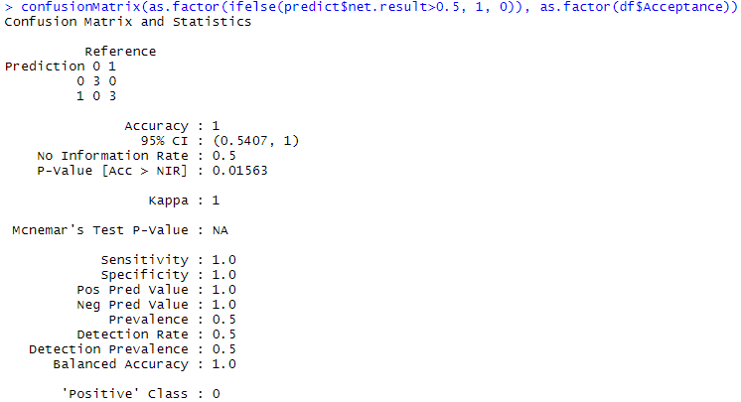
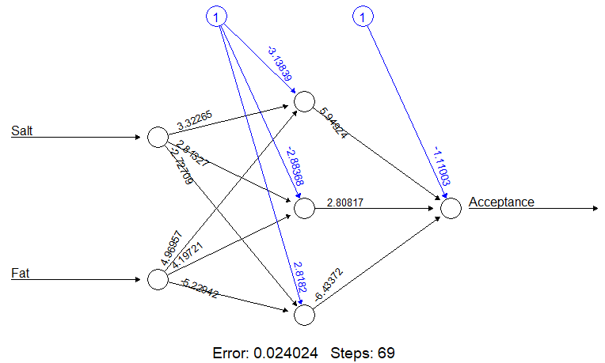
Neural Network: Tiny Example
Fit a model with one output node
Notes:
# one output node
library(neuralnet)
df <- read.csv("tinydata.csv")
df$Acceptance <- ifelse(df$Acceptance=="like", 1, 0)
set.seed(1)
nn <- neuralnet(Acceptance ~ Salt + Fat, data = df, linear.output = F, hidden = 3)
# display weights
nn$weights
# display predictions
prediction(nn)
# plot network
plot(nn, rep="best")
library(caret)
predict <- compute(nn, data.frame(df$Salt, df$Fat))
predict
confusionMatrix(as.factor(ifelse(predict$net.result>0.5, 1, 0)), as.factor(df$Acceptance))

Slide 22
Case Study 1: Google Trends and the Stock Market - Regression
Step 1 - collecting data
Step 2 - exploring and preparing the data
Step 3 - training a model on the data
Step 4 - evaluating model performance
Step 5 - improving model performance
Step 6 - adding additional layers

Slide 23
Collecting Data
Google search trends and the daily stock market index - Dow Jones Industrial average
Data file: CaseStudy13_GoogleTrends_Markets_Data.csv
Do our web search trends influence the stock market or does the stock market influence our web search trends?
Driving challenges
Do the Google trends data show increases in searches for unemployment and jobs?
What happens to rental and mortgage searches between 2008-2009?
Which search trends are most predictive of changes in Dow Jones Industrial averages?

Slide 24
Collecting Data
Each row represents one day (from 01/01/2008-12/31/2009)
Variables
Google Trends Common Columns (2)
Time index and date
Raw Data Columns (8)
30-Day Moving Average Data Columns (8)
180-Day Moving Average Data Columns (8)
Dependent variable: RealEstate
If Google Real Estate Index could be predicted by other variables in the dataset.
Search indices
1. Unemployment
2. Rental
3. RealEstate
4. Mortgage
5. Jobs
6. Investing
Market indices
7. DJI
8. StdDJI
Notes:
Unemployment: The Google Unemployment Index tracks queries related to "unemployment, social, social security, unemployment benefits" and so on.
Rental: The Google Rental Index tracks queries related to "rent, apartments, for rent, rentals", etc.
RealEstate: The Google Real Estate Index tracks queries related to "real estate, mortgage, rent, apartments" and so on.
Mortgage: The Google Mortgage Index tracks queries related to "mortgage, calculator, mortgage calculator, mortgage rates".
Jobs: The Google Jobs Index tracks queries related to "jobs, city, job, resume, career, monster" and so forth.
Investing: The Google Investing Index tracks queries related to "stock, finance, captial, yahoo finance, stocks", etc.
DJI_Index: The Dow Jones Industrial (DJI) index. These data are interpolated from 5 records per week (Dow Jones stocks are traded on week-days only) to 7 days per week to match the constant 7-day records of the Google-Trends data.
StdDJI: The standardized-DJI Index computed by: StdDJI = 3+(DJI-mean)/sd, where m= approximate mean and sd= standard-deviation of the DJI for the period (2008-2009).

Slide 25
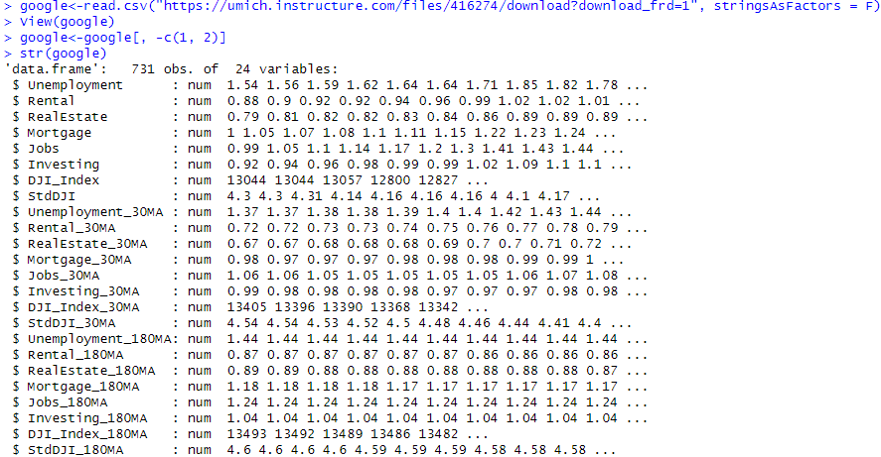
Exploring and Preparing the Data
The goal is to predict Google Real Estate Index with other indexes
Our focus

Slide 26
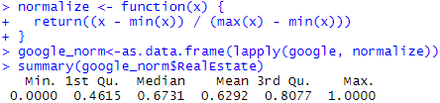
Exploring and Preparing the Data
Need normalize data
Make all features unitless and comparable
Split into training and testing data (75% vs 25%)

Slide 27
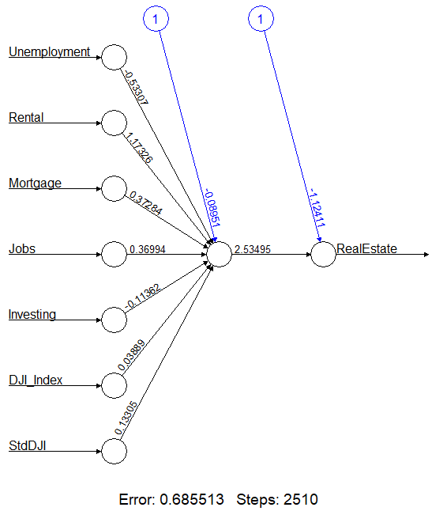

Training a Model on the Data
Use the function neuralnet::neuralnet()
Input, hidden, bias, and output nodes
Outputs could be different
Unless set seed
Error: aggregate sum of squared errors
Steps: iterations the model went through

Slide 28
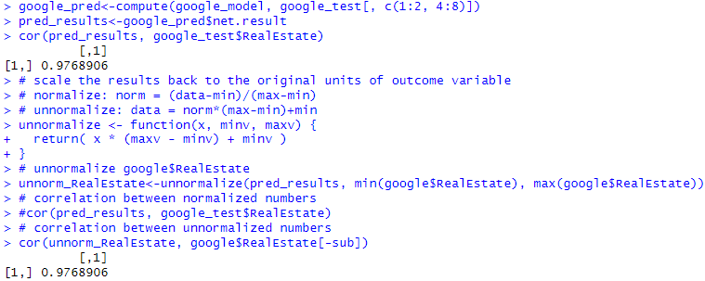
Evaluating Model Performance
Generate the model predictions using compute() function
Use the correlation between predicted results and observed Real Estate Index to evaluate the algorithm
A correlation over 0.9 is very good for real world datasets
Normalized results cannot be used for error measures like MAE.
Notes:
# scale the results back to the original units of outcome variable
# normalize: norm = (data-min)/(max-min)
# unnormalize: data = norm*(max-min)+min
unnormalize <- function(x, minv, maxv) {
return( x * (maxv - minv) + minv )
}
# unnormalize google$RealEstate
unnorm_RealEstate<-unnormalize(pred_results, min(google$RealEstate), max(google$RealEstate))
# correlation between normalized numbers
#cor(pred_results, google_test$RealEstate)
# correlation between unnormalized numbers
cor(unnorm_RealEstate, google$RealEstate[-sub])
MAE<-function(obs, pred){
mean(abs(obs-pred))
}
# MAE between normalized numbers
#MAE(google_test$RealEstate, pred_results)
# MAE between unnormalized numbers
MAE(google$RealEstate[-sub], unnorm_RealEstate)

Slide 29
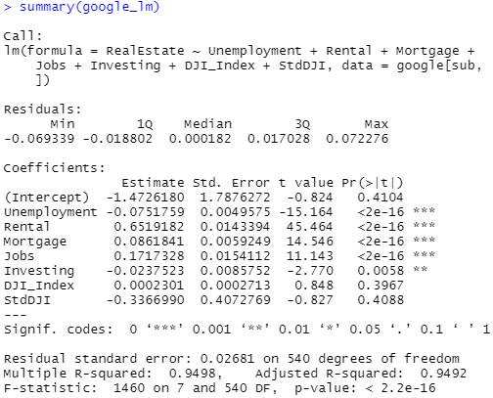
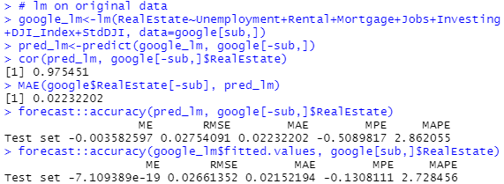
Evaluating Model Performance
Comparing with multiple linear regression algorithm
Resulting a similar correlation
Accuracy measures
on both testing and training data
Notes:
# lm on original data
google_lm<-lm(RealEstate~Unemployment+Rental+Mortgage+Jobs+Investing+DJI_Index+StdDJI, data=google[sub,])
pred_lm<-predict(google_lm, google[-sub,])
cor(pred_lm, google[-sub,]$RealEstate)
MAE(google$RealEstate[-sub], pred_lm)
library(forecast)
accuracy(pred_lm, google[-sub,]$RealEstate)
accuracy(google_lm$fitted.values, google[sub,]$RealEstate)
# nn prediction
accuracy(unnorm_RealEstate[,1], google$RealEstate[-sub])

Slide 30
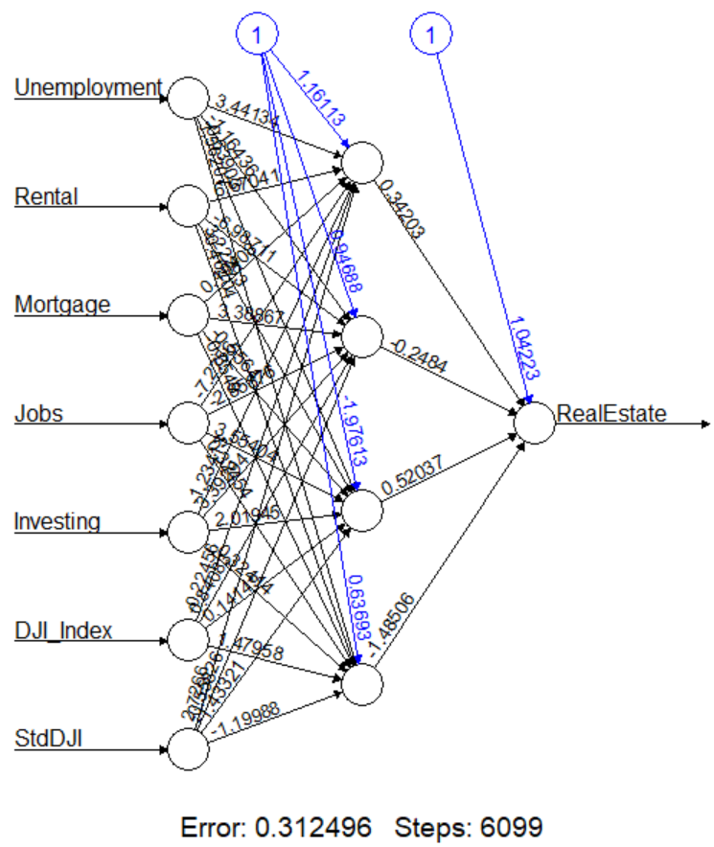
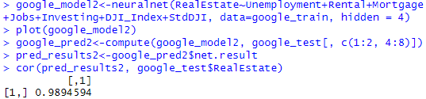
Improving Model Performance
A more complicated model: include 4 hidden nodes
Correlation is higher

Slide 31
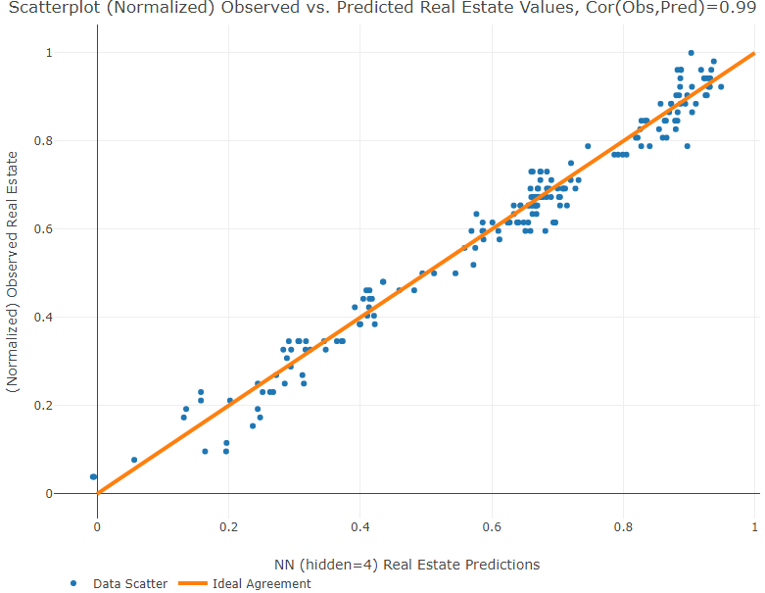
Improving Model Performance
A more complicated model: include 4 hidden nodes
Correlation is higher

Slide 32
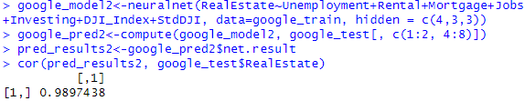
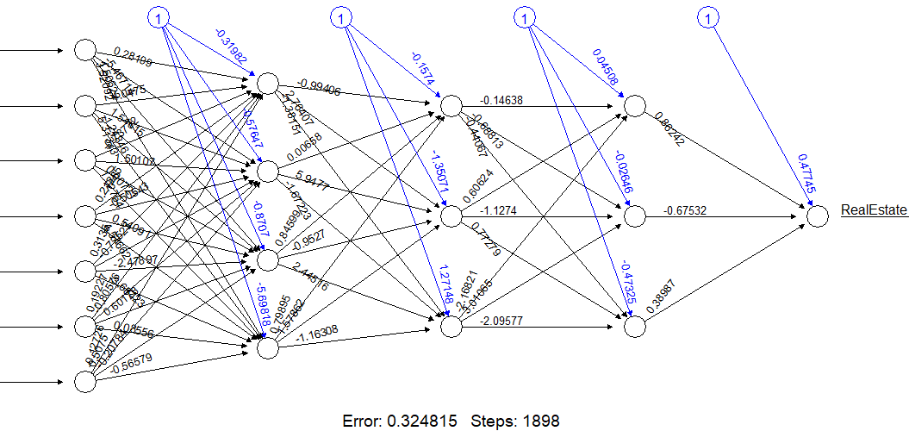
Adding Additional Layers
Use three hidden layers, each with 4,3,3 nodes, respectively
May overfit

Slide 33
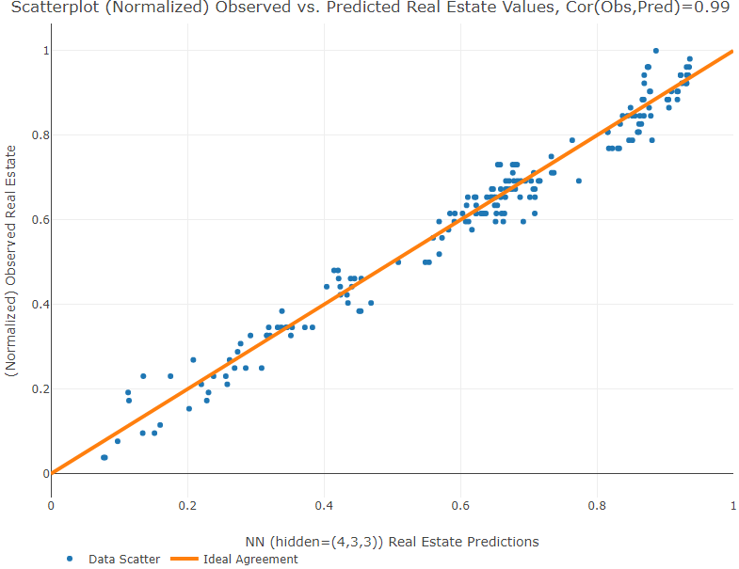
Adding Additional Layers
Use three hidden layers, each with 4,3,3 nodes, respectively

Slide 34
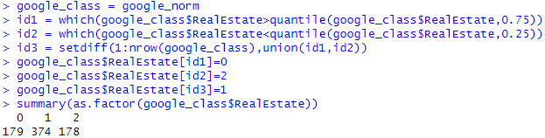
Case Study 2: Google Trends and the Stock Market - Classification
In practice, neural network may be more useful as a classifier
Make RealEstate categorization
0 for higher than 75% percentile
1 for between 75% and 25%
2 for lower than 0.25 percentile
Notes:
summary(google_class$RealEstate)
quantile(google_class$RealEstate)

Slide 35
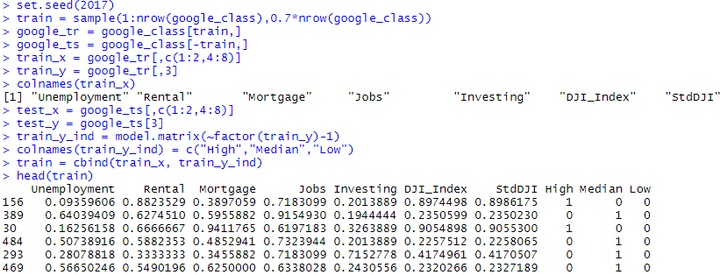
Case Study 2: Google Trends and the Stock Market - Classification
Divide the data to training and testing sets (70% vs. 30%)
Use 3 outcome variables (categorical) for training
This is not needed for testing dataset

Slide 36
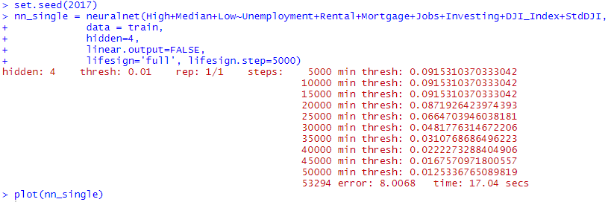
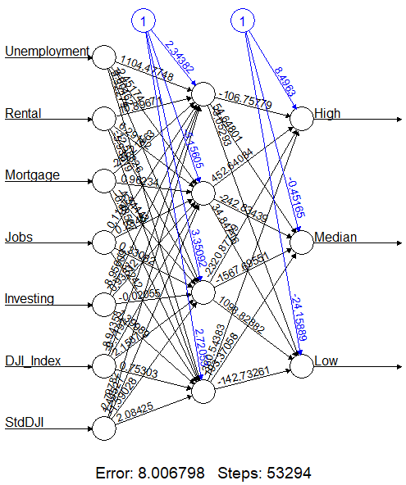
Case Study 2: Google Trends and the Stock Market - Classification
Training the model
Notes:
# algorithm may not converge
set.seed(1017)

Slide 37
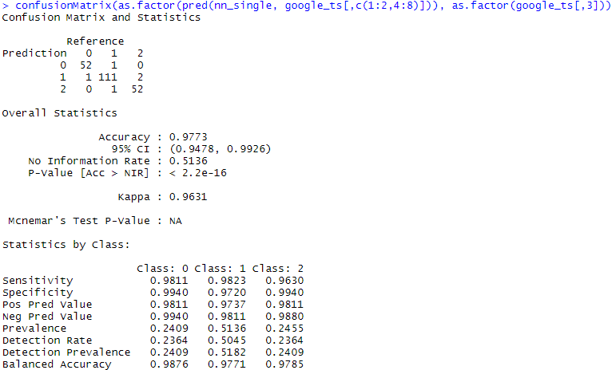
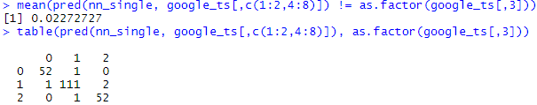
Case Study 2: Google Trends and the Stock Market - Classification
Evaluating performance
Error rate
Notes:
confusionMatrix(as.factor(pred(nn_single, google_ts[,c(1:2,4:8)])), as.factor(google_ts[,3]))

Slide 38
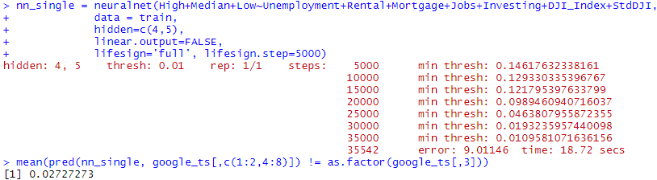
Case Study 2: Google Trends and the Stock Market - Classification
Using multiple hidden layers
A more complicated model won’t necessarily guarantee an improved performance.

Slide 39
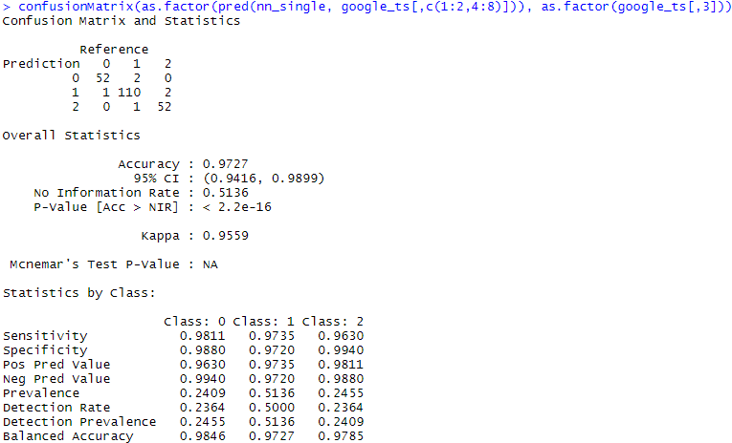
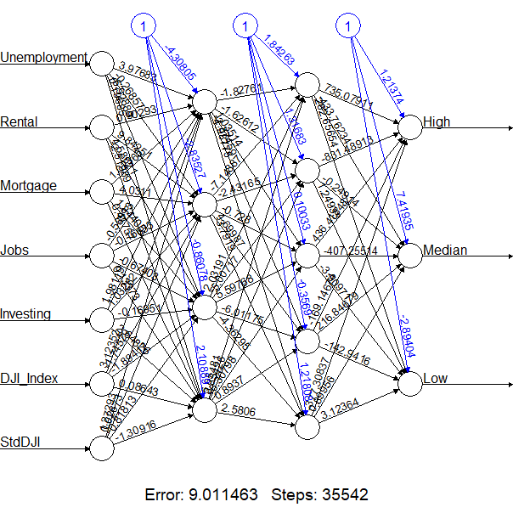
Case Study 2: Google Trends and the Stock Market - Classification

Slide 40
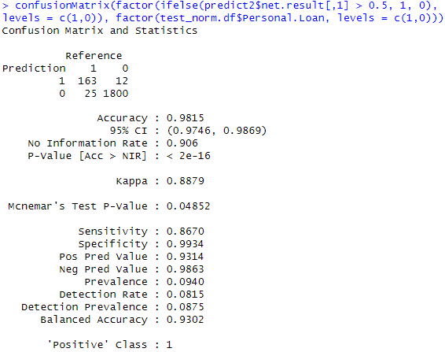
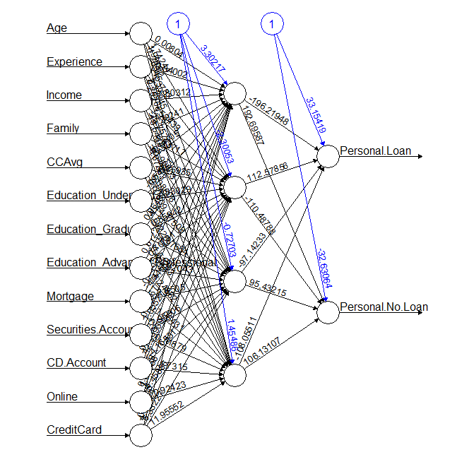
Example: Acceptance of Personal Loan – Neural Network for classification
Personal loan acceptance as a function of 13 predictors
Compare with logistic regression?
Notes:
# run neural network with one output node
bank.df <- read.csv("UniversalBank.csv")
bank.df <- bank.df[ , -c(1, 5)] # Drop ID and zip code columns.
bank.dummies.df <- bank.df[,-6]
bank.dummies.df$Education_Undergrad <- ifelse(bank.df$Education == 1, 1, 0)
bank.dummies.df$Education_Graduate <- ifelse(bank.df$Education == 2, 1, 0)
bank.dummies.df$Education_Advanced.Professional <- ifelse(bank.df$Education == 3, 1, 0)
normalize <- function(x) {
return((x - min(x)) / (max(x) - min(x)))
}
bank_norm.df<-as.data.frame(lapply(bank.dummies.df, normalize))
summary(bank_norm.df)
# partition data
set.seed(2)
train.index <- sample(c(1:dim(bank.df)[1]), dim(bank.df)[1]*0.6)
train_norm.df <- bank_norm.df[train.index, ]
test_norm.df <- bank_norm.df[-train.index, ]
set.seed(2017)
nn_loan1 = neuralnet(Personal.Loan ~ Age+Experience+Income+Family+CCAvg+Education_Undergrad
+Education_Graduate+Education_Advanced.Professional
+Mortgage+Securities.Account+CD.Account+Online+CreditCard,
data = train_norm.df,
hidden=4,
linear.output=FALSE,
lifesign='full', lifesign.step=5000)
plot(nn_loan1)
library(caret)
predict1 <- compute(nn_loan1, test_norm.df)
options(scipen=0)
head(predict1$net.result)
confusionMatrix(factor(ifelse(predict1$net.result > 0.5, 1, 0), levels = c(1,0)), factor(test_norm.df$Personal.Loan, levels = c(1,0)))
# run neural network with two output node
# add second output node
train_norm.df$Personal.No.Loan <- ifelse(train_norm.df$Personal.Loan, 0, 1)
test_norm.df$Personal.No.Loan <- ifelse(test_norm.df$Personal.Loan, 0, 1)
set.seed(2017)
nn_loan2 = neuralnet(Personal.Loan+Personal.No.Loan ~ Age+Experience+Income+Family+CCAvg+Education_Undergrad
+Education_Graduate+Education_Advanced.Professional
+Mortgage+Securities.Account+CD.Account+Online+CreditCard,
data = train_norm.df,
hidden=4,
linear.output=FALSE,
lifesign='full', lifesign.step=5000)
plot(nn_loan2)
library(caret)
predict2 <- compute(nn_loan2, test_norm.df)
predict2$net.result[1:10,1:2] # 1--personal.loan 2--personal.no.loan
confusionMatrix(factor(ifelse(predict2$net.result[,1] > 0.5, 1, 0), levels = c(1,0)), factor(test_norm.df$Personal.Loan, levels = c(1,0)))

Slide 41
Advantages and Weaknesses
Good predictive performance
Ability to capture highly complicated relationships
Blackbox nature – nontransparent relationship
Rely heavily on sufficient data for training
Heavy computation time

