Slide 1
Autonomous Clinical Decision Support System
An Agentic Retrieval-Augmented AI Doctor Co-Pilot
Udayveer 123108011
Pyata Harshith 123108056
Under the supervision of Dr. Vaibhav Aggarwal
Department of Computer Engineering
National Institute of Technology, Kurukshetra
Notes:
Open with the one-line framing: a language model on its own is not clinically usable, and this project asks whether that can be fixed by architecture rather than by a bigger model. Everything that follows is evidence for that claim.

Slide 2
Abstract
A general-purpose language model used as a clinical assistant fails in three predictable ways: it fabricates reference ranges, it reports a single-shot answer with no notion of its own reliability, and it leaves no audit trail. Any one of these is disqualifying in a clinical setting.
ACDSS turns a photograph of a laboratory report into a grounded diagnostic hypothesis and a contraindication-aware treatment plan
Two independent four-node LangGraph state machines, each retrieving from its own Chroma index
A confidence-gated conditional edge returns low-confidence results for re-analysis with the auditor's criticism attached
Contraindications derived before the planner runs — safety enforced by the shape of the graph, not the wording of a prompt
A Meta-Evaluator cross-validates the plan against the diagnosis and emits a quality score and safety verdict
3
Notes:
Explain the framing sentence first, then say the four bullets are the four design moves that answer it. Do not read the bullets — name each in three words and move on. The examiner will ask about the confidence gate, so flag it here.

Slide 3
The Problem
Why a language model alone is not clinically usable
Fabricated authority
Single-shot answers
No audit trail
Asked for the range of an unfamiliar assay, the model supplies a plausible interval rather than admitting it does not know.
A confident hallucination and a well-grounded inference are presented identically. The model carries no notion of its own reliability.
A clinician who disagrees with the output has no way to inspect the evidence that produced it.
RAG addresses the first failure and is now standard — but not the other two
One-shot pre-generation retrieval is a poor fit for a lab report: the useful queries are the marker names, unknown until extraction has run
The missing ingredient is process — clinical reasoning as an explicit graph, not one large prompt
4
Notes:
This is the slide that justifies the whole project. Spend time here.
Say plainly: these three failures are not fixed by a better model, they are properties of how the model is used. Then land the takeaway — we replace one large prompt with a graph of small steps, each with a defined input, output and failure behaviour. The pipeline is slower; in exchange it can say how confident it is, try again, and show its work.

Slide 4
Novel Features
What distinguishes this from prior agentic clinical work
Dual-agent, divergent knowledge bases
Bounded self-correction loop
Constraint before plan
Diagnosis and treatment are separate compiled state machines over separate vector indices neither can contaminate the other's evidence.
Low-confidence diagnoses return to the analysis node with the auditor's written criticism attached, capped at three passes.
Contraindications are derived before any plan exists, so the planner is structurally unable to propose a contraindicated step.
Pipeline-level Meta-Evaluator
Guardrails in code, not in the prompt
Deployed end to end
A third call cross-validates the plan against the diagnosis and emits a quality score, safety verdict and explicit flags.
Seven orchestrator tools with hard preconditions, it cannot analyse a report the patient did not upload.
A working web application drives the full journey through an explicit nine state session machine.
6
Notes:
This is the slide to linger on — it is the answer to 'what is new here?'.
Emphasise two: (1) constraint-before-plan, because it converts a safety hope into a safety guarantee — the planner never sees a world where the constraints are unknown; (2) the divergent knowledge bases, because a single index cannot separate reference-range evidence from management evidence.

Slide 5
01
Related Work and Research Gap
Four strands contribute a component — none is sufficient alone
Notes:
Transition line: every prior approach optimises one axis thoroughly and leaves the others to future work.

Slide 6
Related Work
Medical LLMs — Med42-v2, LLaMA-3 Meditron, AutoMedPrompt
  Improve the quality of a single answer without changing the shape of the interaction; we treat the base model as an implementation detail
Reasoning methods — chain-of-thought, chain-of-draft, reflection
  Reflective critique depends on the reliability of the scorer; we use a dedicated auditor whose numeric output drives control flow
Clinical RAG
  Retrieval does not guarantee comprehension — a model can quote a correct source and misread it
Agentic decision support — the CARE framework
  Closest antecedent; terminates at the diagnosis, leaving the consequential half of the problem outside the system
8
Notes:
Do not read all five. Name the strand, give the one-line limitation, move on. Spend your time on CARE — it is the closest antecedent and the examiner will want to know how you differ from it. The difference is that CARE stops at the diagnosis label and never asks whether the treatment is safe for this patient.

Slide 7
Research Gap
Approach | Grounded retrieval | Self-auditing | Treatment planning | Deployed interface
General-purpose LLM prompting | — | — | partial | —
Domain-tuned medical LLMs | — | — | partial | —
Prompt optimisation (AutoMedPrompt) | — | — | — | —
Single-shot clinical RAG | yes | — | — | partial
Reflective / self-critique methods | partial | yes | — | —
CARE (agentic diagnostic reasoning) | yes | yes | — | —
ACDSS (this work) | yes | yes | yes | yes
Diagnosis without action — agentic reasoning stops at the label
Shared, undifferentiated evidence — one index cannot separate reference-range from management evidence
No cross-validation — nothing checks that the plan is consistent with the diagnosis
9
Notes:
Read the last row of the table aloud, then the three gaps. Say clearly: the methodology chapter is organised around closing exactly these three.

Slide 8
02
Proposed Methodology
Retrieval as a node · auditing as a separate prompt · safety as graph topology
Notes:
State the four principles verbally: nothing asserted that was not retrieved; every output checked by a different prompt; safety is a property of the graph; uncertainty is surfaced, not smoothed.

Slide 9
Knowledge Bases and Vector Indexing
Two indices, built offline and queried independently
 | Diagnosis knowledge base | Treatment knowledge base
Source | Clinical Guide to Laboratory Tests | Treatment protocols (StatPearls)
Source pages | 45 | 25
Chunk size / overlap | 1,000 / 150 characters | 1,000 / 150 characters
Embedded chunks | 147 | 107
Retriever top-k | 3 | 2
Query formulation | one per extracted marker | one for the confirmed diagnosis
Context cap | 4,000 characters | 2,000 characters
Committed as built artefacts — retrieval is reproducible and no embedding call is made at request time
11
Notes:
Explain why k differs: the diagnosis index holds reference-range material where several nearby chunks are needed for one assay; the treatment index holds contiguous per-condition sections, so two suffice and more context window is left for the plan itself. That asymmetry is a design decision, not an accident.

Slide 10
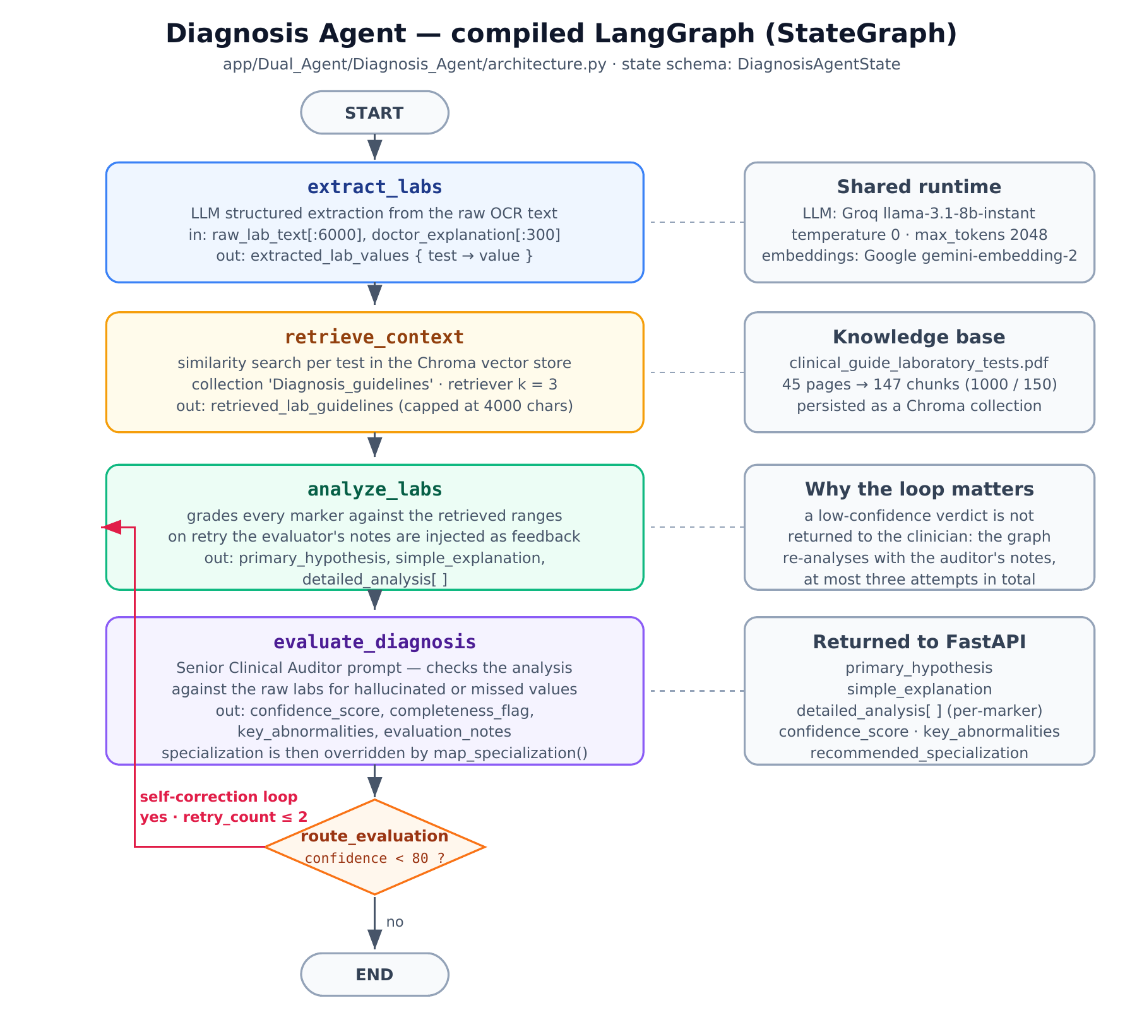
The Diagnosis Agent
Four sequential nodes with a conditional edge returning low-confidence results for targeted re-analysis
13
Notes:
Walk the four nodes in one sentence each.
1. Extraction — OCR text to test-name to result, keeping units, because discarding the unit makes the later comparison ambiguous.
2. Retrieval — one similarity query per marker, concatenated under a per-marker heading so the analyst knows which passage belongs to which marker.
3. Analysis — grades each marker strictly against the retrieved text, and states the finding twice: once for the clinician, once in plain language for the patient.
4. The auditor — the key idea. It is not asked how confident it feels; it is asked to compare two artefacts it did not produce and report hallucinated or missed values. That is what makes the score meaningful.

Slide 11
The Confidence Gate
Additional inference is spent only where the system judges itself uncertain
if c < 80 and r ≤ 2 → re-analyse
otherwise → END
Why the bound matters
Without it, a genuinely ambiguous case would loop until the request timed out — which is worse for the clinician than a clearly labelled uncertain answer.
If the budget is exhausted with confidence still low, the low score is returned and shown as low confidence. Nothing is hidden.
c = audited confidence, r = retries consumed
Bounded: the analysis node executes at most three times, whatever the confidence
Informed: the retry prompt carries the auditor's specific criticism — revision, not resampling
Fails safe: a missing audit summary defaults to 100 so a malformed state terminates rather than looping
14
Notes:
Put the equation on the board verbally: below eighty, and we have retries left, go back and analyse again. Otherwise stop.
The examiner's likely question is 'why 80 and why 2?' — answer honestly: chosen by judgement, and with a labelled corpus they become empirical questions. That is listed in future scope.

Slide 12
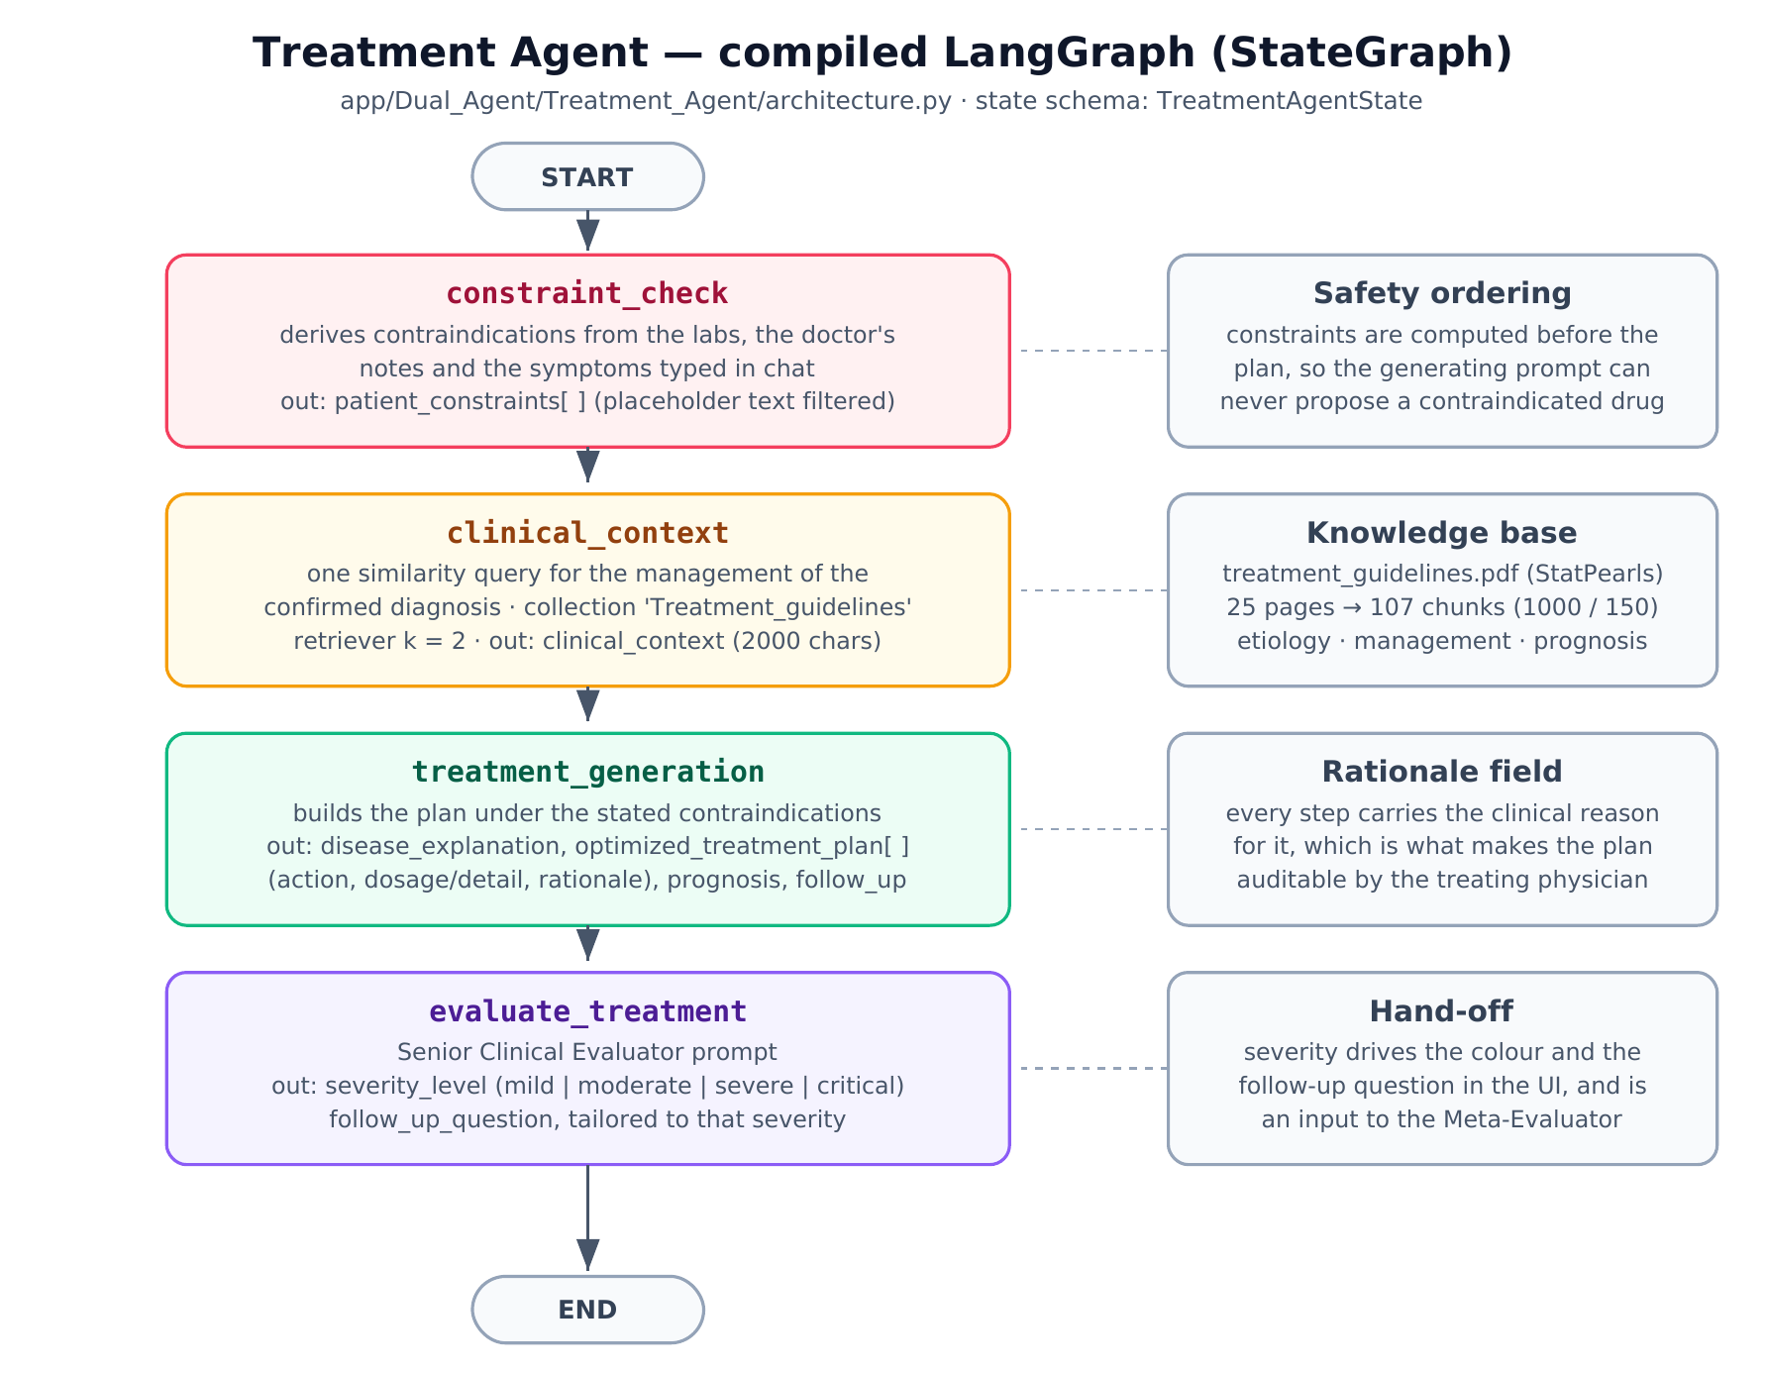
The Treatment Agent
Node ordering is the safety mechanism: contraindications are derived before any plan exists
15
Notes:
The one point to make here: the ordering IS the safety mechanism. Asking a model politely not to prescribe a contraindicated drug is unreliable; computing the constraints in a node that runs first makes it part of the planner's problem statement.
Also mention the rationale field — every step carries the clinical reason for it, which is what lets a clinician argue with the plan step by step rather than accepting or rejecting it wholesale.

Slide 13
The Meta-Evaluator
Nothing so far checks that the plan is appropriate for that diagnosis
A third call, outside both graphs
  Receives a compact summary — hypothesis, severity, key abnormal markers, step count, prognosis and the flagged contraindications
  Returns a quality score, consistency verdict, safety verdict, explicit safety flags and a recommendation of what to verify next
Two deliberate design points
  It receives a summary rather than the full artefacts, forcing the check to operate at the level of clinical coherence rather than re-litigating numbers the per-agent auditors already checked
  Contraindications are forwarded from the treatment agent, so it can confirm the constraint was honoured rather than merely recorded
Conservative by default: an un-parse able response yields 'review recommended' — a failed audit never presents as an approval
16
Notes:
The sentence worth saying slowly is the last one. Defaults matter in clinical software: when the audit itself fails, the system must degrade towards caution, not towards approval.

Slide 14
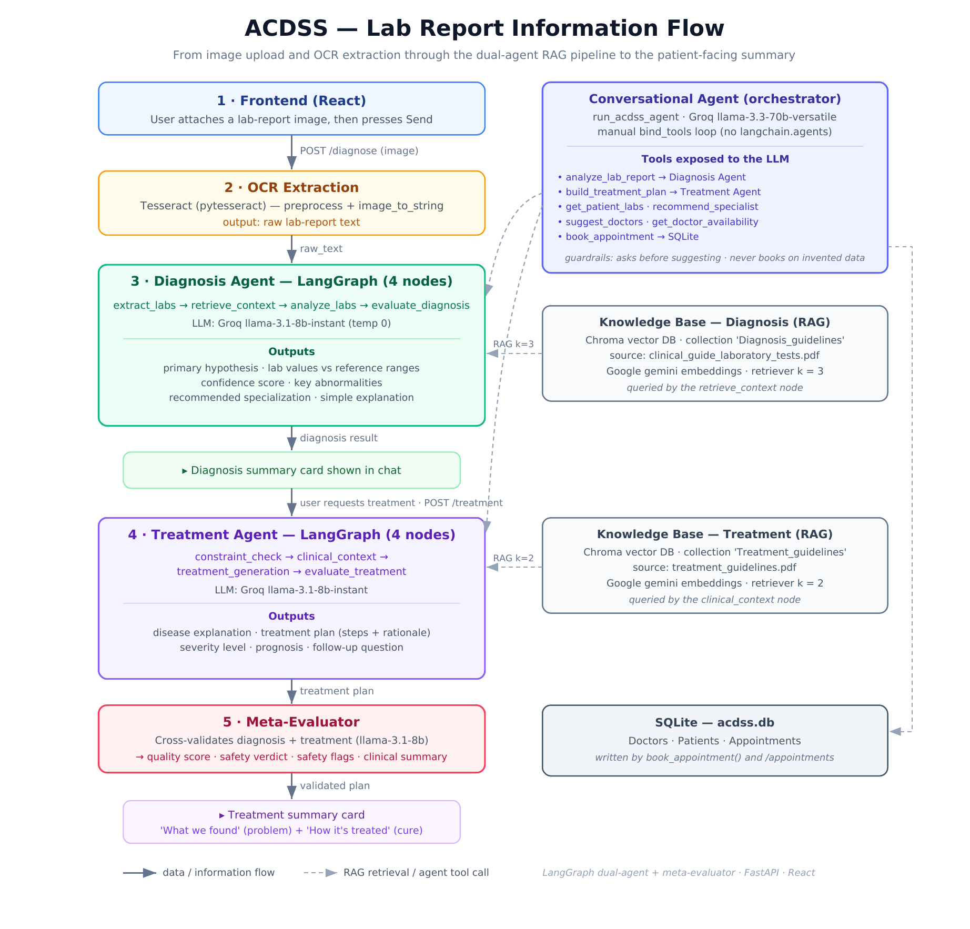
End-to-End Information Flow
From image upload and OCR through the dual-agent RAG pipeline and the Meta-Evaluator to the patient-facing summary
19
Notes:
Explain why the flow is split into two user-visible steps rather than one — a deliberate change since the mid-term.
It halves time to first output; it lets the patient add symptoms after seeing the report, which feeds both the contraindication node and the planner; and a treatment failure no longer discards a successful diagnosis.

Slide 15
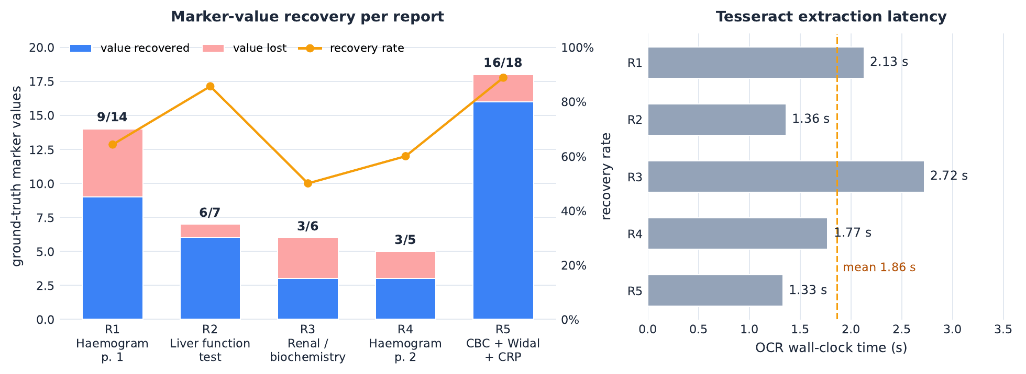
Results — OCR and Marker Recovery
74.0%
1.91 s
50 – 89%
of 50 ground-truth marker
values recovered
mean extraction latency
per page
spread across the five
reports
Recovery ranges from 50% on the hand-annotated biochemistry page to 89% on the flattest, highest-contrast report
ACDSS · B.Tech Project, End Term Evaluation
22
Notes:
Lead with the headline: a quarter of the clinical evidence never reaches the agents at all. Every downstream guarantee is conditional on a number the system may never have read.
Then say the aggregate is less informative than the spread, and the spread has a reproducible cause — which is the next slide.

Slide 16
Verification of the Deterministic Components
Audited confidence | r = 0 | r = 2 | r = 3
95 | END | END | END
88 | END | END | END
80 | END | END | END
79 | re-analyse | re-analyse | END
60 | re - analyse | re-analyse | END
42 | re-analyse | re-analyse | END
The threshold is exact
  80 terminates and 79 re-analyses — the acceptance region is exactly c ≥ 80
The budget is enforced
  At three retries the graph terminates regardless of score, bounding the worst case at one extraction, one retrieval, three analyses, three audits
The gate is monotone in confidence
  There is no score at which the system loops where a lower score would not
Tolerant JSON parsing recovers five of six malformed output shapes
  The sixth, containing no JSON at all, degrades to a safe empty dictionary by design
ACDSS · B.Tech Project, End Term Evaluation
24
Notes:
Say that this table is measured, not asserted — the routing function was swept exhaustively over its decision domain.
Then pre-empt the obvious question by raising it yourself: this does NOT establish that a retry improves the answer. That needs a labelled corpus and repeated live inference, and it is the first item in future scope.

Slide 17
System Characteristics
Measured from the built artefacts and the source
Property | Value
Compiled LangGraph state machines | 2 (4 nodes each)
Conditional edges | 1 (the confidence gate)
Model calls per run (no retry / max retry) | 7 / 11
Embedded guideline chunks (diagnosis / treatment) | 147 / 107
Retriever top-k (diagnosis / treatment) | 3 / 2
Confidence threshold / max analysis passes | 80 / 3
Tools exposed / tool-loop cap | 7 / 5 iterations
REST endpoints / relational tables | 7 / 5
Mean OCR latency per page | 1.91 s
Marker-value recovery (n = 50) | 74.0%
ACDSS · B.Tech Project, End Term Evaluation
25
Notes:
Use the model-call line: seven calls per run without a retry — extraction, analysis, audit; contraindication check, plan, severity; and the Meta-Evaluator. Retrieval adds none at request time because the indices are pre-built.
That is the price of the auditing architecture, and it is the argument for the two-step interface: the user reads the diagnosis after three calls rather than waiting for all seven.

Slide 18
Conclusion
The concept: clinical reasoning as an explicit, auditable graph — not one large prompt
Nothing is asserted that was not retrieved
The system knows when it does not know
Safety is a property of the topology
Retrieval is a node inside the graph, issued per marker, over two divergent indices — so diagnostic and management evidence never contaminate each other.
A separate auditor grades the analysis it did not produce, and the confidence gate spends extra inference only where that audit reports doubt.
Contraindications are derived before the planner exists, and a meta-evaluation stage cross-checks the plan against the diagnosis before either is shown.
Grounded
Self-aware
Safe by construction
Each of the three failure modes that opened this talk is answered by a structural property, not by a larger model
The architecture is verifiable: control flow confirms to specification across its full decision domain.
ACDSS · B.Tech Project, End Term Evaluation
27
Notes:
Close the loop deliberately: the three cards map one-to-one onto the three failure modes from the second slide. Fabricated authority is answered by grounding, single-shot answers by the auditor and confidence gate, and the missing audit trail by a pipeline whose every intermediate artefact is inspectable and whose plan is cross-validated.
The claim to make is a conceptual one: the contribution is not a model, it is an architecture in which these properties are structural rather than hoped for.
Then hand over honestly — diagnostic accuracy is still unmeasured and the retry loop is verified but not yet shown to help. Frame that as the platform being ready for the accuracy questions, which is exactly what the next slide covers.

Slide 19
References
W. Li, Y. Zhang, C. Wang, Y. Li, X. He, A. L. Wang, M. Xu, F. Zhang, H. Sun, K. Wang et al., “Care: A clinical agentic reasoning engine to enhance real-world diagnostic accuracy via structured medical reasoning,” Expert Systems with Applications, p. 131476, 2026.
J. U. Reza and Y. Mamatjan, “Ai agents for clinical data assessment: Enhancing decision-making with human-ai collaboration,” in 2025 IEEE 49th Annual Computers, Software, and Applications Conference (COMPSAC). IEEE, 2025, pp. 2112–2117
Chow, M. and Ng, O. "Beyond Chatbots: Moving Toward Multistep Modular AI Agents in Medical Education." JMIR Medical Education, 2025.
ACDSS · B.Tech Project, End Term Evaluation
29

Slide 20
Thank you

