Slide 1

Automatic Student Attendance System Based On Face Detection And Recognition
SRI VASANTHI B -211417104270
SUVATHI T -211417104280
UMA MAHESWARI S -211417104284
Guided by:
Mrs. R.DEVI,M.E.,
ASSISTANT PROFESSOR
DEPARTMENT OF CSE
PANIMALAR ENGINEERING COLLEGE
CHENNAI

Slide 2
ABSTRACT
Face recognition can be considered one of the most successful biometric identification methods among several types of biometric identification including fingerprints, DNA, palm print, hand geometry, iris recognition, retina and odour/scent. Face recognition provides biometric identification that utilizes the uniqueness of faces for security purposes. The problem with face recognition using biometric identification is its lengthy process and the accuracy of the results. This paper proposes solutions for a faster face recognition process with accurate results. The proposed face recognition process was done using a hybrid process of Haar Cascades and Eigenface methods, which can detect multiple faces (55 faces) in a single detection process. This improved face recognition approach was able to recognize multiple faces with 91.67% accuracy level.

Slide 3
LITERATURE SURVEY
Year | Title | Authors | Description | Advantage | Disadvantage
2019 | Student Attendance Monitoring System Using Image Processing. | Matilda, S., & Shahin, K | The approach is a champion amongst the best identity frameworks of each present one for conspicuous confirmation of people. | During the proposed approach to the discovery and recognizable proof of students faces is conferred. | Result is inaccurate.

Slide 4
Year | Title | Authors | Description | Advantage | Disadvantage
2019 | Attendance Management Using Facial Recognition | Rajath S Bharadwaj, Tejus S Rao, Vinay T R | Detect and recognize faces fail to overcome primal issues such as scaling, pose, illumination, rotation and occlusions. | The system's correctness due to use of large number of features (shape, color, LBP, wavelet, auto correlation, etc) of the face. | Updating can be done only for a single face though it scans many faces

Slide 5
Year | Title | Authors | Description | Advantage | Disadvantage
2018 | Face Detection and Recognition Student Attendance System. | Jireh Robert Jam | The use of clickers, ID cards swiping and manually writing down names on a sheet of paper as a method to track student attendants has prompted this project to be carried out. | Working prototype of a system that will facilitate class control during a classroom by detecting the frontal faces of scholar. | The recognition part can achieve approximately 60% recognition rate.

Slide 6
Year | Title | Authors | Description | Advantage | Disadvantage
2018 | FACE DETECTION AND RECOGNITION FOR AUTOMATIC ATTENDANCESYSTEM | Amulya S Nisarga Pilli Siva Gowtham Reddy Dr. Hariprasad S A Sunil M P | Implementionwith OpenCV and Raspberry Pi. | The precision of face recognition is almost more than 90% | If the image is out of the database it produces the faulty result.

Slide 7
Year | Title | Authors | Description | Advantage | Disadvantage
2018 | Automated Attendance System Using Image Processing. | Hapani.S, Prabhu.N, Parakhiya.N, Paghdal.M | This new system can ease the hectic attendance maintenance and handling the attendance will be more precise and efficient. | If student has or hasn’t wear the spectacles, caps and other accessories at the time of registration recognition is done from the video captured in the class. | Only 50% accuracy is obtained.

Slide 8
Year | Title | Authors | Description | Advantage | Disadvantage
2017 | An Approach to Maintain Attendance using Image Processing Technique | Cheng, et al. | Management of context of the scholars for the classroom lecture by using note PCs are all the students. | Can solve the matter of the face detection and improve the accuracy of face recognition. | Detection time was taking more to detect more faces

Slide 9
TECHNOLOGY STACK
HARDWARE REQUIREMENTS
Hard Disk : 500GB and Above
RAM : 4GB and Above
Processor : I3 and Above
Webcam : 1
SOFTWARE REQUIREMENTS
Operating System : Windows 7 , 8, 10 (64 bit)
Software : Python
Tools : Python 3.7 IDLE, Spyder

Slide 10
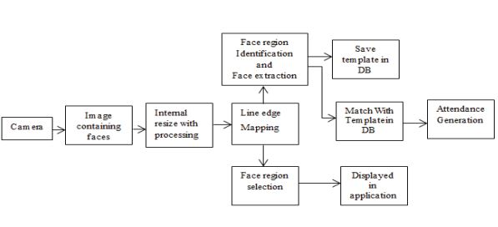
SYSTEM ARCHITECTURE

Slide 11
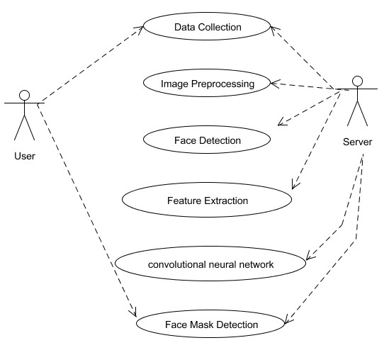
UML DIAGRAMS USE CASE DIAGRAM

Slide 12
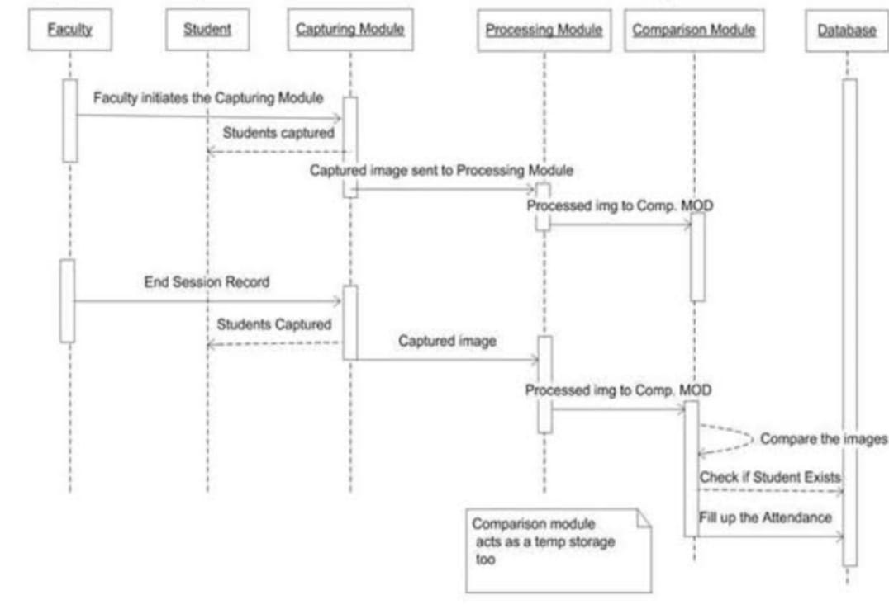
SEQUENCE DIAGRAM

Slide 13
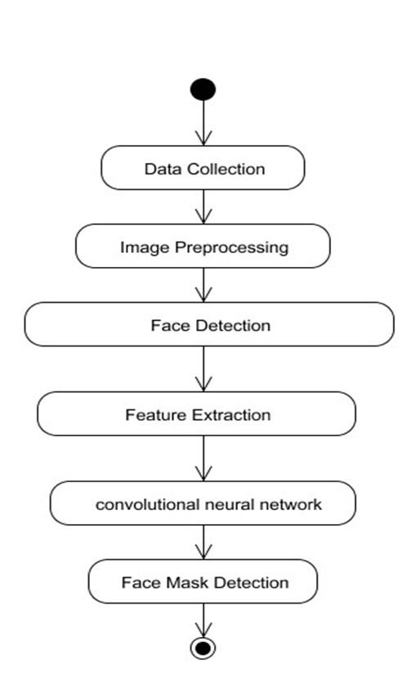
ACTIVITY DIAGRAM

Slide 14
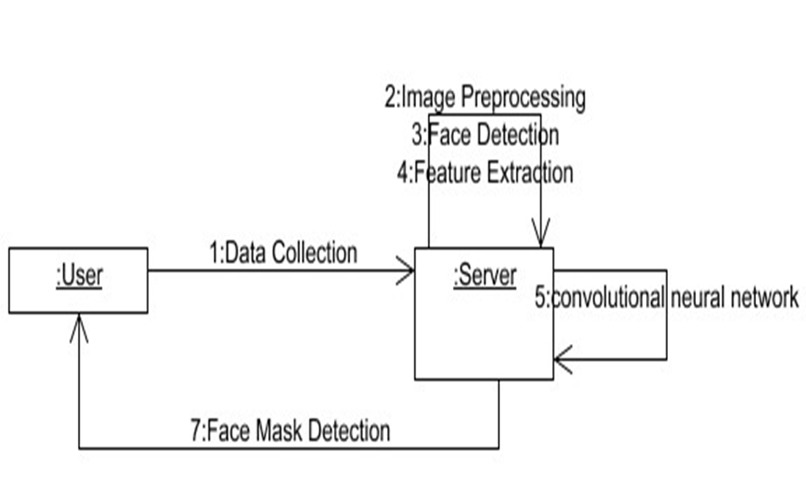
COLLABORATION DIAGRAM

Slide 15
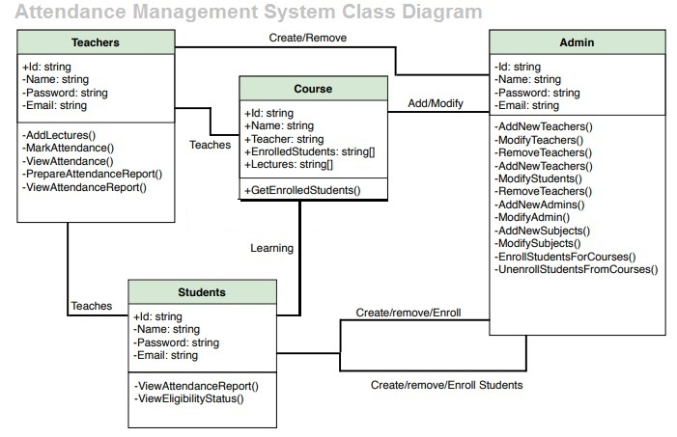
DB DESIGN

Slide 16
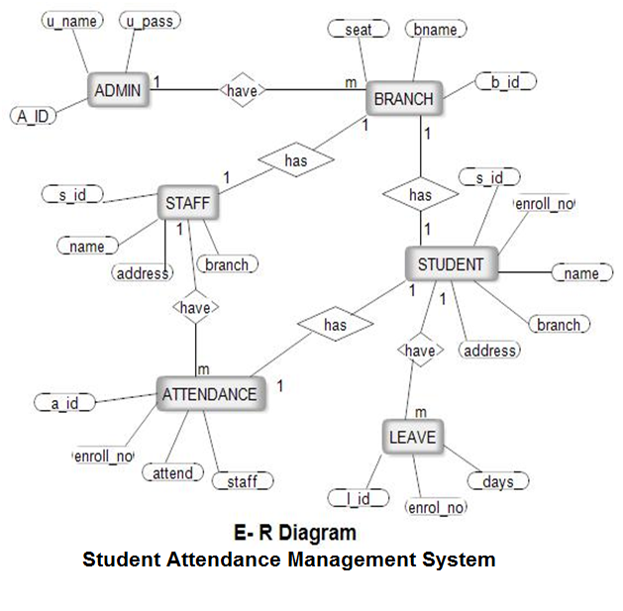
ER DIAGRAM

Slide 17
MODULE DESCRIPTION
Image Acquisition
Pre-Processing Image
Face detection
Face recognition

Slide 18
Image Acquisition
Image acquisition are often accomplished by digitally scanning an existing photograph or by using an electro-optical camera to accumulate a live picture of a topic . Video also can be used as a source of facial images. The most existing face recognition systems contain one camera.
The recognition rate is comparatively low when face images are of varied pose and expression and different illumination. With increasing of the pose angle, the popularity rate decreases. The recognition rate decreases greatly when the pose angle is larger than 30 degrees.

Slide 19
Pre-Processing Image
The system captures around 50 images of every individuals face. The images are converted into grey scale as LBPH operates using images in grey scale and the images are stored in a folder. The stored images will be saved with a name and ID unique to that person. In Image pre-processing HAAR CASCADE algorithm was used to train the image. HAAR CASCADE features are more useful in imageprocessing.

Slide 20
Face detection
The face detection work on detect multiple faces in a picture . Here we work on Open CV for Face Detection, and there are some steps that how face detection operates, which are as follows:-
Firstly the image is imported by providing the location of the image. Then the image is transformed from RGB to Grayscale because it's easy to detect faces within the grayscale.
After that, the image manipulation used, during which the resizing, cropping, blurring and sharpening of the pictures done if needed. The next step is image segmentation, which is employed for contour detection or segments the multiple objects during a single image in order that the classifier can quickly detect the objects and faces in the picture.
The next step is to use Haar-Like features algorithm, which is proposed by Voila and Jones for face detection. This algorithm used for locating the situation of the human faces during a frame or image. All face s shares some universal properties of the human face just like the eyes region is darker than its neighbor pixels and nose region is brighter than eyeregion.

Slide 21
4) The haar-like algorithm is additionally used for feature selection or feature extraction for an object in a picture, with the assistance of edge detection, line detection, centre detection for detecting eyes, nose, mouth, etc. in the picture. It is wont to select the essential features in a picture and extract these features for facedetection.
5) The next step is to offer the coordinates of x, y, w, h which makes a rectangle box up the image to point out the situation of the face or we can say that to show the region of interest in the image. After this, it can make a rectangle box up the world of interest where it detects the face. There also are many other detection techniques that are used together for detection like smile detection, eye detection, blink detection,etc.

Slide 22
Face recognition
Step 1: A picture of your face is captured from a photo or video. Your face might appear alone or during a crowd. Your image may show you looking straight ahead or nearly in profile.
Step 2: Facial recognition software reads the geometry of your face. Key factors include the distance between your eyes and the distance from forehead to chin. The software identifies facial landmarks — one system identifies 68 of them — that are key to distinguishing your face.
Step 3: Your facial signature — a mathematical formula — is compared to a database of known faces.
Step 4: A determination is made. Your face print may match that of a picture during a face recognition system database.

Slide 23
TESTING AND PERFORMANCE ANALYSIS
TEST CASE 1
TEST CASE 2
S.NO | ACTION | INPUT | EXPECTED OUTPUT | ACTUAL OUTPUT | TEST RESULT | TEST COMMENTS
1. | Login | username, password | homepage | homepage | pass | authorized user is logged in system
S.NO | ACTION | INPUT | EXPECTED OUTPUT | ACTUAL OUTPUT | TEST RESULT | TEST COMMENTS
2. | Registration | student roll no,name | New student details are added | New student details are added | Pass | Details of new student is added in database

Slide 24
TEST CASE 3
TEST CASE 4
S.NO | ACTION | INPUT | EXPECTED OUTPUT | ACTUAL OUTPUT | TEST RESULT | TEST COMMENTS
3. | Face recognition | Student face | Display student name,id | Display student name,id | pass | It will detect the face with trained images
S.NO | ACTION | INPUT | EXPECTED OUTPUT | ACTUAL OUTPUT | TEST RESULT | TEST COMMENTS
4. | Marking absent or present in excel sheet | Student face | Present | Absent | Fails | The student is absent in excel sheet. If student did not attend class or may be a new student who did not register his details.

Slide 25
PERFORMANCE ANALYSIS:
Our application is working very effectively even in a daily basis.
As far we tested 40-50 times,it is working in the same condition without any failures.
So we conclude that our application performance is “GOOD” and “HIGH”.

Slide 26

SCREENSHOTS
STUDENT ATTENDANCE SYSTEM:
APPLICATION

Slide 27
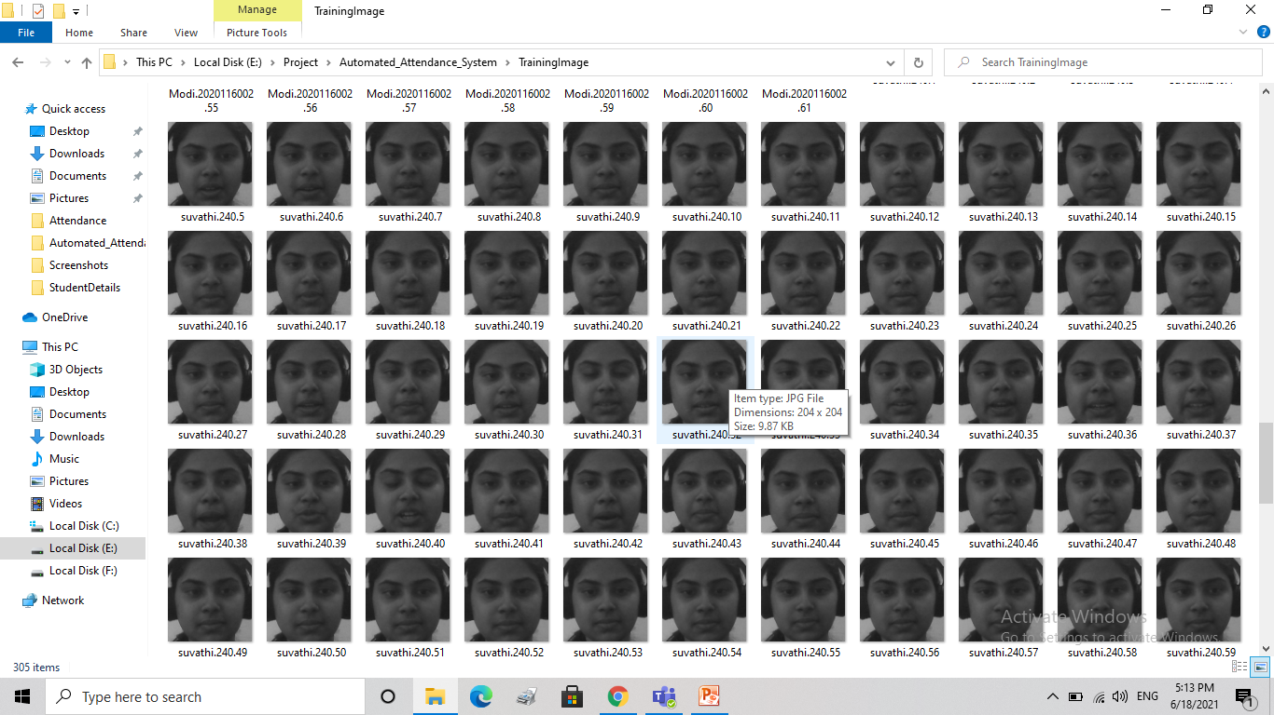
TRAINING IMAGE:

Slide 28

TRAINED IMAGE (SAMPLE):

Slide 29

ATTENDANCE VERIFICATION:

Slide 30
REFERENCE
ShireeshaChintalapati, M.V. Raghunadh, "Automated Attendance Management System Based On Face RecognitionAlgorithms", IEEE International Conference on Computational Intelligence and Computing Research,2013.
Kosov S., Scherbaum K., Faber K., ThormahlenT. and Seidel H.-P., "Rapid stereo- vision enhanced face detection", Image Processing (ICIP), 2009 16th IEEE International Conference on, IEEE, 1221-1224(2009).
Levada A., Correa D., Salvadeo D., Saito J. and Mascarenhas N., "Novel approaches for face recognition: templatematching using dynamic time warping and LSTM NeuralNetwork Supervised Classification", Systems, Signals and Image Processing, 2008. IWSSIP 2008. 15th International Conference on, IEEE, 241-244 (2008).

Slide 31
V. Blanz and T. Vetter, “Face recognition based on fitting a 3D morphable model,” IEEE Transactions On Pattern Analysis and Machine Intelligence, vol. 25, no. 9, September2003.
Y. Gao and K.H. Leung, “Face recognition using line edge map,” IEEE Transactions on Pattern Analysis and Machine Intelligence, vol. 24, no. 6, June2002.
Michal Dolecki, Pawel Karczmarek, Adam Kiersztyn, Witold Pedrycz , “Face recognition by humans performed on basis of linguistic and neural network”, Neural Networks (IJCNN)2016 International Joint Conference on , pp.5135-5140,2016,ISSN 2161-4407.

Slide 32
R. Bruneli and T. Poggio, “Face recognition: features versus templates,” IEEE Transactions on Pattern Analysis and Machine Intelligence, vol. 15, pp. 1042-1052, 1993.
Javier Ruiz Del Solar, Rodrigo Verschae, and Mauricio Correa. Face recognition in unconstrained environments: A comparative study. In ECCV Workshop on Faces in RealLife Images: Detection, Alignment, and Recognition, Marseille, France, October 2008
H.K.Ekenel and R.Stiefelhagen,Analysis of local appearance based face recognition: Effects of feature selection and feature

Slide 33
K. Wong, H. Law, and P. Tsang, “A System for Recognising Human Faces,” Proc. ICASSP, pp. 1,638-1,642,1989.
N. Dalal, B. Triggs “Histograms of oriented gradients for Human Detection”, IEEE Computer Society Conference on Computer Vision and Pattern Recognition , Vol. 1, 2005, pp. 886 –893.
S.Edelman, D.Reisfeld, and Y. Yeshurun, “A System for Face Recognition that Learns from Examples,” Proc. European Conf. Computer Vision, S. Sandini, ed., pp. 787-791. Springer- Verlag,1992.
P. Hallinan, “A Low-Dimensional Representation of Human Faces for Arbitrary Lighting Conditions,” Proc. IEEE Conf. Computer Vision and Pattern Recognition, pp. 995-999,1994
W.Zhao, R.Chellappa, P. J. Phillips, A. Rosenfeld, “Face Recognition: A Literature Survey.” ACM Computing Surveys, 2003, vol. 35, no. 4, pp.399-458.

Slide 34
.
L. Zhao and X. Xu, "Distance function for face recognition based on 2D PCA,"2011 Int. Conf. Multimed. Technol., pp. 5814-5817,2011.
Nasser, M. A. et al. (2011). "Automated facial recognition attendance system." Graduation Project, Petra University, January2011
RoshanTharanga, J. G., et al. "Smart Attendance Using Real Time Face Recognition (SMAR-FR)." Department of Electronic and Computer Engineering, Sri Lanka Institute of Information Technology (SLIIT), Malabe, SriLanka.
D. Cahi and K.N. Ngan, “Face segmentation using skin color map”, IEEE Trans.On Circuit and Systems for Video Technology, vol 9, no 4, pp. 551-564, Jun.1999.

