Slide 1
Multiple Crop-Invariant Disease Detection using SimCLR and
DANN
A Deep Learning and Domain Adaptation Approach
PRESENTED BY
SRI VATSA G
23MCB1009
M.Tech CSE (Big Data Analytics)
GUIDED BY
Dr. MONICA K M

Slide 2
ABSTRACT
💡 Hybrid Pipeline:
→ Combines SimCLR (Contrastive Learning) + DANN (Domain Adaptation)
🧠 Key Idea:
→ Learn disease features while suppressing crop-specific biases
📈 Benefits:
→ Low crop leakage in embeddings
→ Strong disease separability
🚀 Outcome:
→ Better generalization across crops — ideal for real-world plant diagnostics

Slide 3
Challenges in Multi-Crop Invariant Disease Detection
Crop-specific visual bias in disease features
Overfitting to crop cues instead of disease symptoms
Domain shift across different crops
Poor generalization of disease features
Imbalanced crop-disease distributions
High intra-class variability in disease appearance
Lack of standard metric to assess crop-invariance
Requires specialized learning strategies (e.g., DANN, SimCLR)

Slide 4
Gaps Found In Literature Survey
Most models are trained on single-crop datasets under controlled conditions, lacking real-world generalization.
Traditional metrics (Accuracy, F1-score) are inadequate for measuring domain leakage.
Visualization tools like UMAP are used qualitatively but lack quantitative evaluation.
No standardized Crop Invariance Score (CIS) to measure generalization across crops.
Few works explore self-supervised learning (SimCLR) combined with domain-adversarial training (DANN).
Lightweight and ensemble models improve accuracy but fail to control crop-specific feature entanglement.

Slide 5
Plant Village Dataset Distribution
No. | CROP | NO. OF CLASSES | TRAINING | VALIDATION | TESTING
1 | Apple | 4 | 3261 | 894 | 490
2 | Bell Pepper | 2 | 1764 | 477 | 237
3 | Cherry | 2 | 1415 | 438 | 199
4 | Corn | 4 | 3087 | 843 | 424
5 | Grape | 4 | 3209 | 949 | 481
6 | Peach | 2 | 2273 | 693 | 331
7 | Potato | 3 | 2083 | 640 | 277
8 | Strawberry | 2 | 1480 | 428 | 201
9 | Tomato | 10 | 13215 | 3719 | 1901

Slide 6
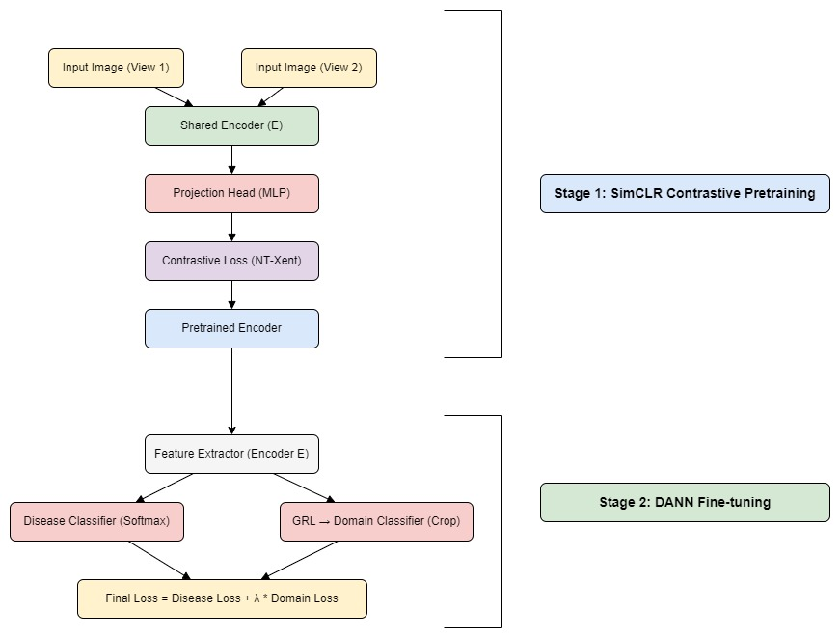
Proposed Architecture

Slide 7
Methodology
📦 Dataset Preparation
Structured PlantVillage dataset with Crop → Disease hierarchy
Converted to TFRecord format with crop and disease labels
🧠 Self-Supervised Pretraining (SimCLR)
Pretrained encoder using SimCLR contrastive learning
Learned general-purpose representations without using crop or disease labels

Slide 8
🔄 Model Fusion: SimCLR + DANN
SimCLR encoder used as feature extractor
Disease Classifier Head: Fully-connected layers to classify disease (softmax)
Domain Classifier Head (Crop): Connected via Gradient Reversal Layer (GRL) for adversarial crop suppression
🎯 Training Objective
Optimize combined loss:
Total Loss = Disease Classification Loss + λ × Crop Adversarial Loss

Slide 9
📈 Goal
Minimize crop bias in learned features
Enhance disease detection generalization across crops

Slide 10
Results
Model | Disease Accuracy | Disease Macro F1-score | Crop Invariance Score (%)
Baseline (Supervised) | 96.8 | 0.967 | 0
DANN (Semi-Supervised) | 94.1 | 0.941 | 0
SimCLR + DANN (Unsupervised) | 93.7 | 0.936 | 3.04

Slide 11
Crop Invariance Score Calculation
1. Freeze the Encoder:
Use the trained model’s encoder (e.g., SimCLR + DANN).
Extract feature embeddings for each image in the test set.
2. Train a Simple Linear Classifier
On these embeddings, train a linear classifier to predict the crop label only.
This classifier should not learn deep features — only what's already encoded.
3. Measure Accuracy = CLS (Crop Leakage Score):
If the classifier performs well, the embeddings contain crop cues.
High accuracy = More leakage = Bad for generalization.
4. Calculate CIS (Crop Invariance Score):
CIS = 100 - CLS

Slide 12
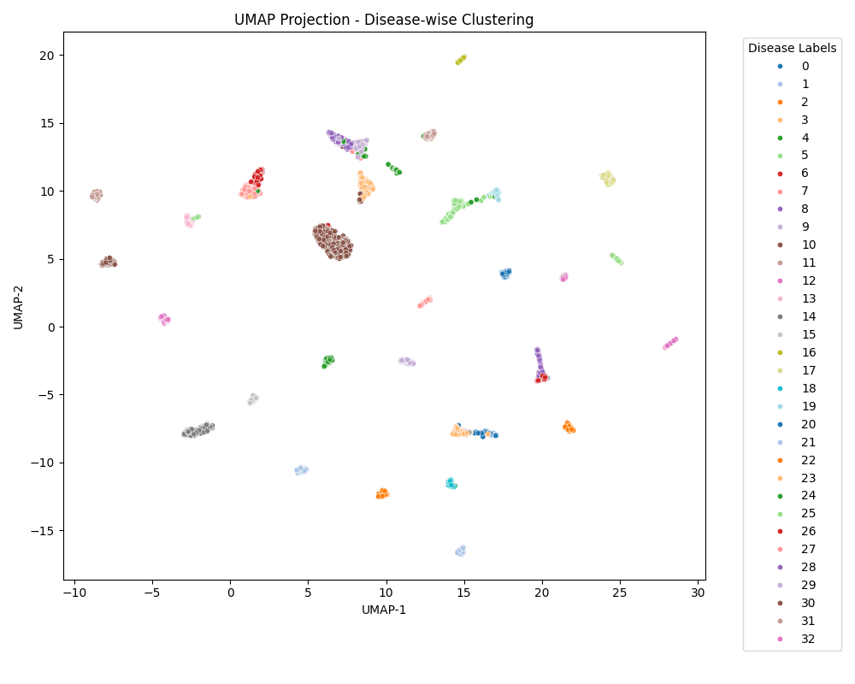
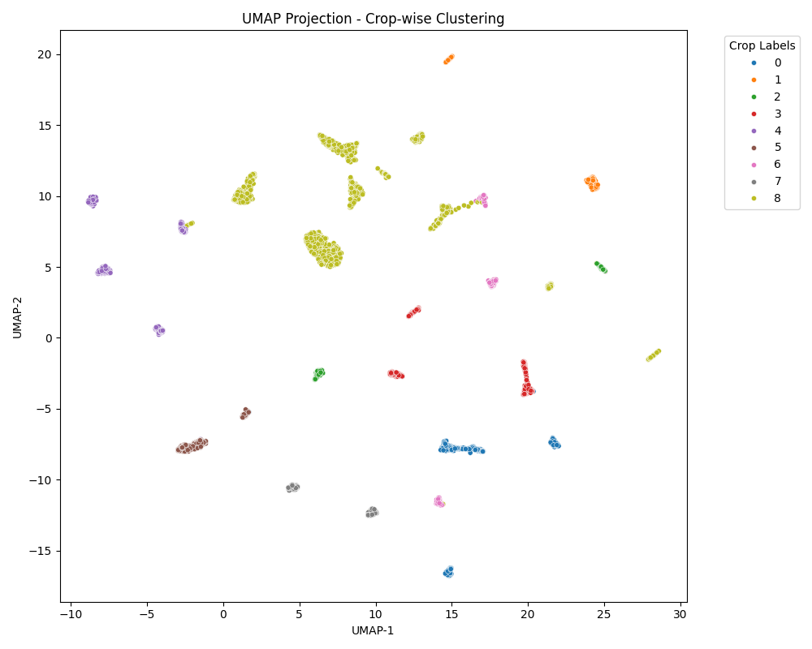
Unified Manifold Approximation and Projection (UMAP) plots for different models
BASELINE MODEL:

Slide 13
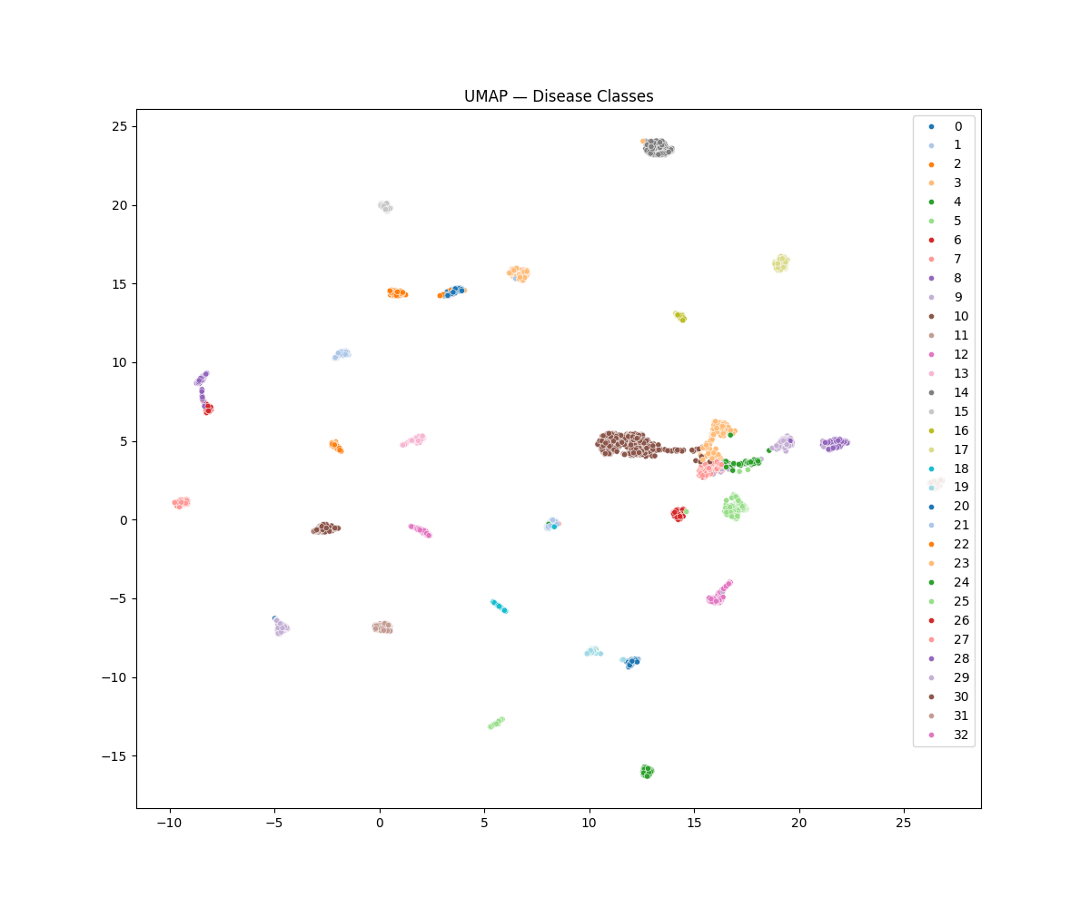
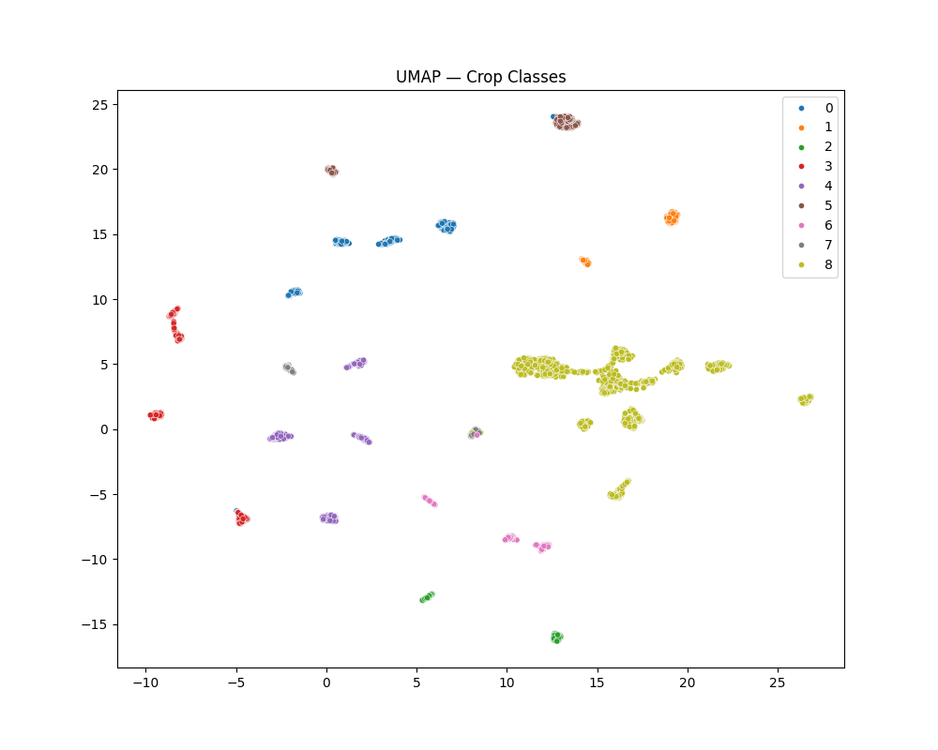
Unified Manifold Approximation and Projection (UMAP) plots for different models
Domain Adversarial (DANN) MODEL:

Slide 14
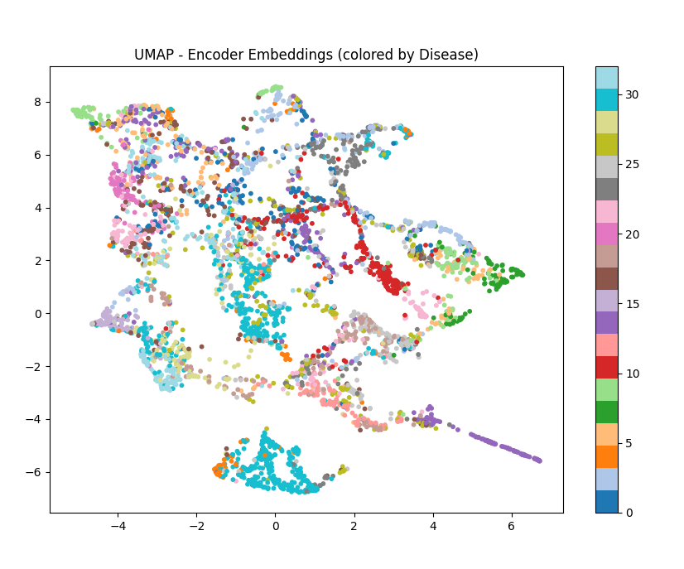
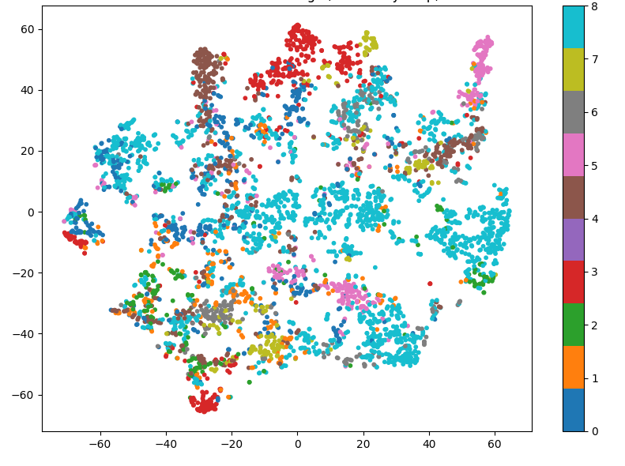
Unified Manifold Approximation and Projection (UMAP) plots for different models
SimCLR + DANN MODEL:

Slide 15
Inferences From Results And Visualizations
GOAL: Better Generalization, ❌ not Accuracy.
📌 Baseline Model (Supervised)
UMAP: Clear disease clusters, but retains crop bias
❌ Fails at generalization across unseen crops
📌 DANN (Semi-Supervised)
UMAP: Clear clusters, but still leaks crop identity
❌ Domain classifier not effective enough to hide crop signal
CIS: 0%

Slide 16
Inferences From Results And Visualizations
📌 SimCLR + DANN (Unsupervised Hybrid)
Slightly lower classification metrics (Disease Accuracy ≈ 93.7%)
UMAP: Disease embeddings well clustered, but crop features are entangled
✅ CIS: 3.04% → Better generalization
✅ Encoder learns robust, disease-centric features, independent of crop

Slide 17
Conclusion
Baseline (Supervised) performs best in terms of raw accuracy and F1-score, but it heavily relies on crop-specific cues, which violates crop-invariance.
DANN (Semi-Supervised) offers a strong trade-off — slightly lower accuracy but better generalization with crop-invariance, making it a more reliable model for real-world deployment.
SimCLR + DANN (Unsupervised Fusion) has the most crop-invariant behavior, but its classification performance is lower, indicating room for improvement in the pretraining setup.
Our goal is generalization and crop-invariant disease detection, for which SimCLR + DANN fusion is preferred.

Slide 18
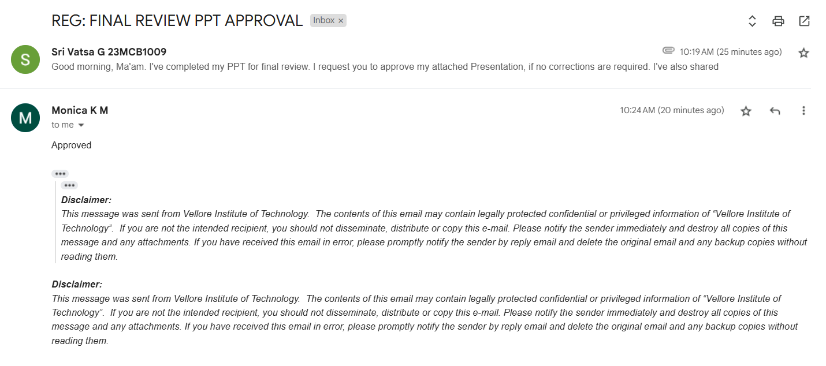
Guide Approval

Slide 19
REFERENCES
Chen, T., Kornblith, S., Norouzi, M., & Hinton, G. (2020). A Simple Framework for Contrastive Learning of Visual Representations. Proceedings of the 37th International Conference on Machine Learning (ICML), 119, 1597–1607.
Kumari, R., Singh, P., & Kumar, M. (2023). Cross-Domain Adaptation Techniques for Robust Plant Disease Detection: A DANN-CORAL Hybrid Approach. Expert Systems with Applications, 223, 119935. https://doi.org/10.1016/j.eswa.2022.119935
Ghosal, D., Sarkar, R., & Chakraborty, C. (2022). A novel deep learning method for detection and classification of plant diseases. Artificial Intelligence in Agriculture, 6, 37–46. https://doi.org/10.1016/j.aiia.2022.01.001
Sivakumar, A., Rani, K. U., & Sridhar, S. (2022). An Early and Smart Detection of Corn Plant Leaf Diseases Using IoT and Deep Learning Multi-Models. Computers and Electronics in Agriculture, 200, 107220.
Khan, R., et al. (2023). An efficient adaptive feature selection with deep learning model-based paddy plant leaf disease classification. Journal of King Saud University – Computer and Information Sciences, 35(3), 211–218.

Slide 20
Sharma, S., & Sharma, S. (2021). An ultra-lightweight efficient network for image-based plant disease and pest infection detection. Computers and Electronics in Agriculture, 190, 106489.
Yalavarthi, R., et al. (2022). Deep transfer learning-based automated detection of blast disease in paddy crop. Materials Today: Proceedings, 57, 363–368.
Ranjan, S., & Dey, A. (2022). Design and Implementation of FourCropNet – A CNN-Based Model for Plant Disease Classification. ICT Express, 8(2), 203–208.
Ahmed, S., & Islam, M. (2023). Enhancing plant disease detection through deep learning: A Depthwise CNN with squeeze and excitation integration and residual skip connections. Computers and Electronics in Agriculture, 207, 107695.
Gao, Y., et al. (2021). Exploiting Domain-Specific Features to Enhance Domain Generalization. Proceedings of the IEEE/CVF International Conference on Computer Vision (ICCV), 4993–5002.

Slide 21
Lin, T., et al. (2021). From Laboratory to Field: Unsupervised Domain Adaptation for Plant Disease Recognition. CVPR Workshops, 11, 123–132.
Raza, A., et al. (2023). Hybrid Ensemble Learning with CNN and RNN for Multimodal Cotton Plant Disease Detection. Computers in Biology and Medicine, 152, 106335.
Nayak, R., et al. (2021). Identification of Plant-Leaf Diseases Using CNN and Transfer-Learning Approach. Materials Today: Proceedings, 45, 4608–4614.
Ali, A., et al. (2022). Innovative Deep Learning Framework for Accurate Plant Disease Detection and Crop Productivity Enhancement. Information Processing in Agriculture, 9(4), 509–519.
Liu, Y., et al. (2022). Learn Feature Representation from Unlabeled Data using Self-Supervised Learning. International Journal of Computer Vision, 130, 548–565.

Slide 22
Zhou, H., et al. (2024). Multi-task learning model for agricultural pest detection and classification. Computers and Electronics in Agriculture, 209, 107859.
Zhang, L., et al. (2022). Plant leaf disease detection and classification using modified transfer learning models. Ecological Informatics, 69, 101636.
Rathod, M., et al. (2021). Plant Leaf Disease Detection Using Ensemble Learning and Explainable AI. Procedia Computer Science, 192, 1259–1268.
Ganin, Y., & Lempitsky, V. (2015). Unsupervised Domain Adaptation by Backpropagation. Proceedings of the 32nd International Conference on Machine Learning (ICML), 37, 1180–1189.
Yang, M., et al. (2022). Progressive Domain Adaptation for Object Detection. Proceedings of the IEEE/CVF Conference on Computer Vision and Pattern Recognition (CVPR), 12300–12310.

Slide 23
Chakraborty, S., et al. (2023). Reshaping Neuroimaging by Utilizing Transfer Learning and VGG Architecture and Ensemble with DANN Model. Biomedical Signal Processing and Control, 84, 104705.
Hu, J., et al. (2023). Self-supervised learning enhanced plant disease image classification with SimCLR. Computers and Electronics in Agriculture, 204, 107453.
Ramesh, K., et al. (2023). Self-Supervised Plant Phenotyping by Combining Domain Adaptation with 3D Plant Model Simulations. IEEE Transactions on Image Processing, 32, 1192–1203.
Singh, S., et al. (2022). Semantic segmentation for plant leaf disease classification and damage quantification. Computers and Electronics in Agriculture, 191, 106593.
Kumar, N., et al. (2021). Tomato Leaf Disease Detection Using Deep Learning Based Model. Journal of Ambient Intelligence and Humanized Computing, 12, 10457–10468.

