Slide 1
IBM University Engagement Project Submission
“Exploring the Power of Agentic AI with IBM Granite and LangFlow”

Slide 2

Project Tile – [Agentic AI for Personalized Course Pathways]
Domain of Project – [ Education ]
Student Name | Recent Passport Photo | Email ID | Mobile number [WhatsApp]
SABBELLA SRI VINAYA REDDY |  | vinayareddy156@gmail.com | 7337407999

Slide 3
Problem Statement -
Problem Statement : Agentic AI for Personalized Course Pathways
The Challenge
Students struggle to choose the right online courses that match their interests, skills, and career goals. The overwhelming number of courses and lack of personalized guidance make learning paths confusing. LearnMate AI addresses this by creating personalized learning roadmaps that adapt to students’ progress and preferences.
The Objective
Build an AI-powered Personalized Learning Agent (LearnMate AI) that provides intelligent learning guidance and customized course pathways for students based on their interests, current skills, and career goals. The solution should:
Personalized Learning Paths – Recommend courses and learning resources based on students' interests, skill levels, career goals, and available study time.
AI-Based Skill Assessment – Evaluate students' existing knowledge, identify skill gaps, and determine suitable learning starting points using IBM Granite.
Dynamic Roadmap Generation – Create structured learning roadmaps with courses, practical projects, milestones, and estimated completion timelines.
Progress Tracking & Feedback – Allow students to track completed milestones, provide feedback, and monitor their learning progress.
Multi-Agent System –
Student Assessment Agent – Evaluates current skills and identifies knowledge gaps.
Learning Path Agent – Generates personalized course roadmaps.
Course Recommendation Agent – Recommends relevant courses and learning resources.
Progress Tracking Agent – Monitors milestones and learning progress.
Adaptive Learning Agent – Updates recommendations based on feedback and performance.

Slide 4
Proposed Solution -
Proposed Solution: AI-Powered Personalized Learning Agent – LearnMate AI
The proposed solution is a multi-agent AI-powered Personalized Learning Agent (LearnMate AI) built using IBM watsonx.ai and IBM Granite models to provide personalized, adaptive learning pathways for students. The system addresses challenges in course selection, skill assessment, and career-oriented learning through an intelligent architecture that understands each student's interests, existing knowledge, and future goals.
At its core, LearnMate AI uses IBM Granite models to understand student inputs, evaluate skill levels, identify knowledge gaps, and generate customized learning roadmaps. Based on the student's interests, career goals, current abilities, and available study time, the system recommends relevant courses, learning resources, and practical projects. A curated course catalogue helps provide structured learning recommendations.
LearnMate AI uses five key agents:
1. Student Assessment Agent – Evaluates students' existing skills and identifies knowledge gaps.
2. Learning Path Agent – Creates personalized learning roadmaps based on students' goals and skill levels.
3. Course Recommendation Agent – Suggests relevant courses, tutorials, and learning resources.
4. Progress Tracking Agent – Monitors completed milestones and provides progress feedback.
5. Adaptive Learning Agent – Updates learning pathways based on performance and student feedback.
The system includes a React-based dashboard where students can complete assessments, view their roadmaps, explore recommended resources, interact with an AI learning coach, and track their progress.
IBM Granite models power the AI-driven assessment, roadmap generation, and personalized recommendations.
Overall, LearnMate AI helps students make better learning decisions through personalized guidance, structured roadmaps, and adaptive recommendations.

Slide 5
Technology Used
IBM Granite Models – For natural language understanding, skill assessment, reasoning, personalized roadmap generation, and adaptive learning recommendations.
IBM watsonx.ai – For accessing IBM Granite models, AI inference, and embedding capabilities.
IBM Cloud – Provides cloud infrastructure to support the deployment, scalability, and reliability of LearnMate AI.
IBM Cloudant – A NoSQL database used to store student profiles, personalized learning roadmaps, and progress records.
Python & Flask – For backend development, REST API creation, and coordination of the five AI agents.
React & Vite – For building an interactive dashboard where students can take assessments, explore learning roadmaps, chat with the AI coach, and track progress.
IBM Slate Embeddings – For semantic skill matching and identifying similarities between student interests and learning domains.

Slide 6
Components Used -
1. Student Onboarding – Collects student details, interests, skill levels, career goals, and weekly study hours.
2. IBM watsonx.ai Agent – Connects to IBM Granite models to process student inputs and generate personalized learning recommendations.
3. IBM Granite Models –
- ibm/granite-13b-instruct-v2 – For roadmap generation, skill assessment, and adaptive recommendations.
- ibm/granite-13b-chat-v2 – For conversational assessments and AI Coach Chat.
4. Assessment Agent – Evaluates students' existing skills and identifies knowledge gaps.
5. Roadmap Agent – Generates structured, personalized learning pathways with courses, projects, and milestones.
6. Course Catalog Component – Retrieves curated learning resources from IBM SkillsBuild, freeCodeCamp, Coursera, and other platforms.
7. Progress Tracking & Adaptive Agent – Tracks completed milestones, provides feedback, and updates roadmaps based on student progress.

Slide 7
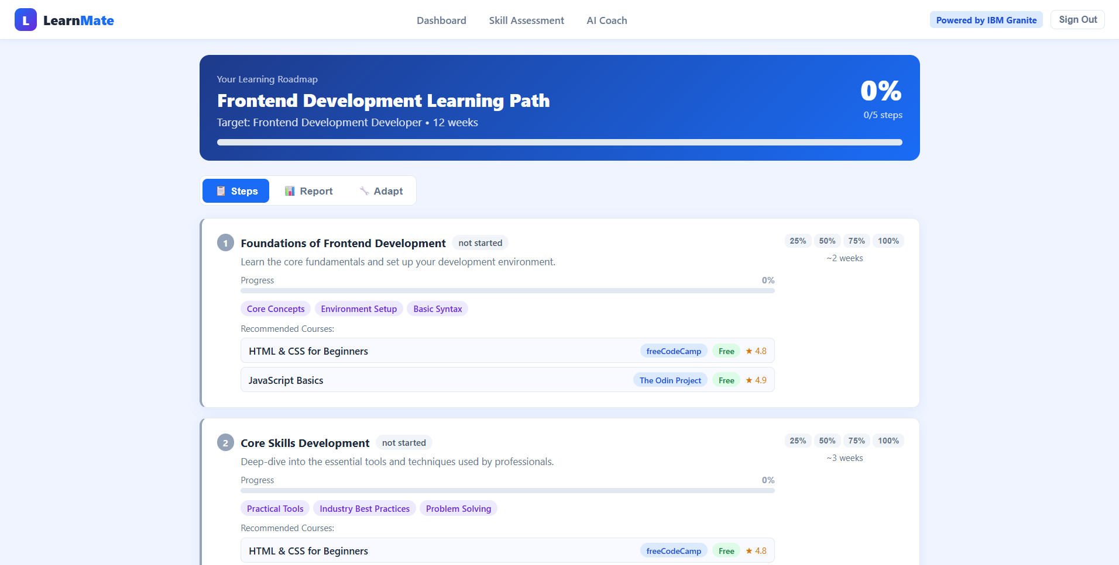
Output -

Slide 8
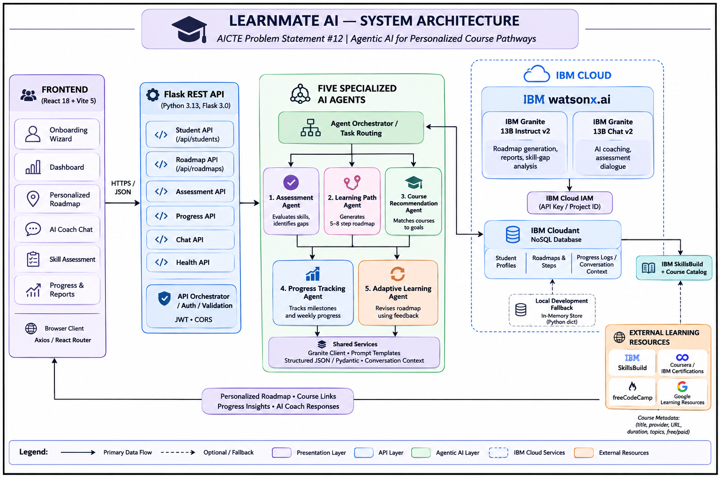
Architecture blueprint

Slide 9

Role of Agentic AI in the solution
Role of Agentic AI in LearnMate AI
Agentic AI enables LearnMate AI to function as an intelligent, adaptive learning assistant rather than a simple chatbot. Using IBM watsonx.ai and IBM Granite models, it coordinates five specialized agents to provide personalized learning guidance.
Each agent performs a specific task, such as assessing students' skills, identifying knowledge gaps, generating learning roadmaps, recommending courses, and tracking progress. These agents work together to create a structured learning experience.
Agentic AI also provides context awareness by considering students' interests, current skill levels, career goals, and available study hours. It enables continuous adaptation by updating learning pathways based on student performance, completed milestones, and feedback.
Additionally, the agents collaborate to make decisions and provide relevant recommendations throughout the learning journey.
Overall, Agentic AI makes LearnMate AI a proactive, personalized, and goal-oriented learning companion that guides students from their current skill level toward their desired career goals.

Slide 10
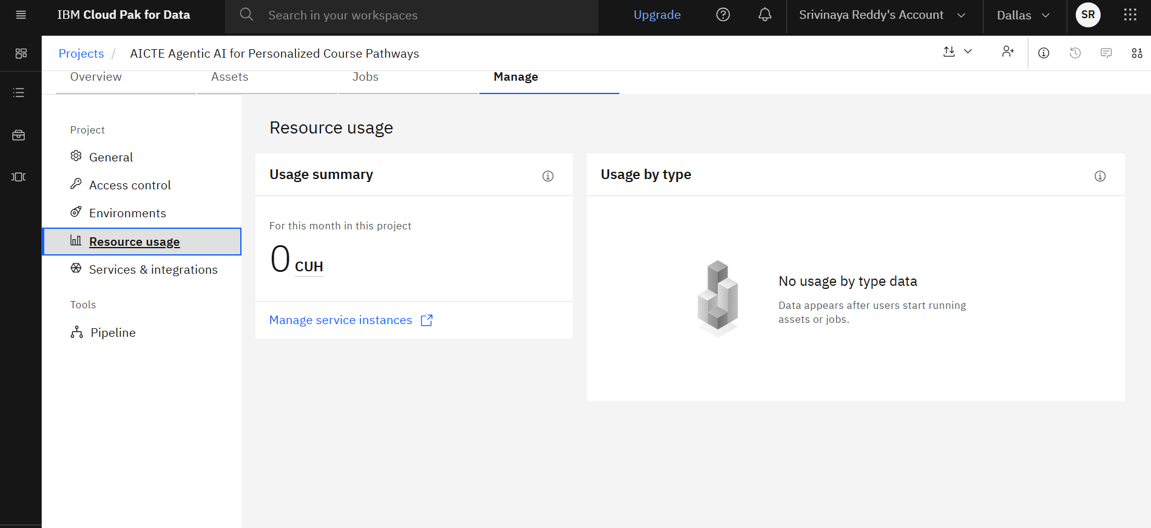
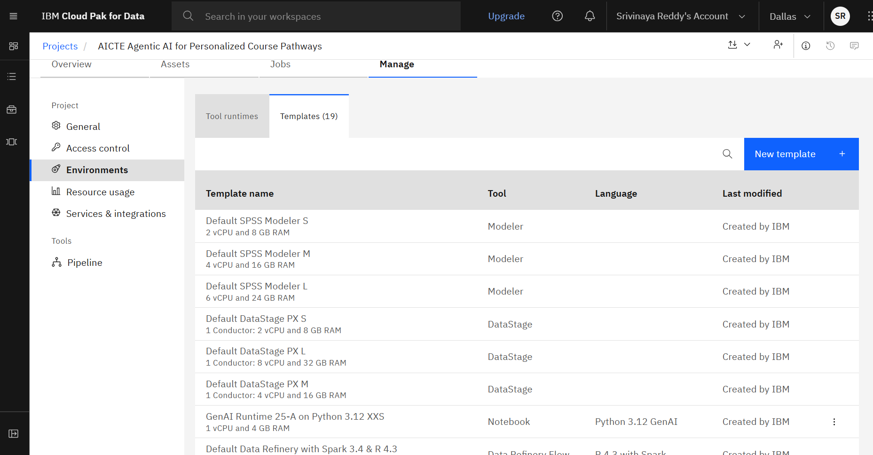
Token Usage
Before Prompt
After the Prompt
·
·
·

Slide 11
Novelty and Uniqueness
LearnMate AI stands out by combining Agentic AI, personalized learning, and adaptive roadmaps into one intelligent learning platform.
1. Multi-Agent Intelligence – Five specialized AI agents collaborate to assess skills, recommend courses, generate roadmaps, and track student progress instead of relying on a single chatbot.
2. Hyper-Personalized Learning – Creates customized learning pathways based on students' interests, current skill levels, career goals, and available study hours.
3. AI-Based Skill Gap Analysis – Identifies students' strengths and weaknesses through interactive assessments and provides recommendations to improve missing skills.
4. Dynamic Roadmap Adaptation – Continuously modifies learning paths based on student performance, completed milestones, and feedback.
5. Curated Course Recommendations – Connects students with relevant learning resources from IBM SkillsBuild, freeCodeCamp, Coursera, and other platforms.
6. AI Learning Coach – Provides conversational guidance and context-aware support to help students overcome learning difficulties.
7. IBM-Powered Intelligence – Uses IBM watsonx.ai and Granite models for AI-driven assessment, reasoning, and personalized recommendations.
This makes LearnMate AI more than a course recommendation platform: it is an intelligent, adaptive learning companion that guides students from their current skill level toward their career goals.

Slide 12
Git Hub Link
Github URL –
https://github.com/SriVinayaReddy/AICTE---IBM-SKILLSBUILD
·
·
·

Slide 13
Future Scope
1. Integration with Learning Platforms – LearnMate AI can be integrated with platforms like Coursera, Udemy, and IBM SkillsBuild to access updated courses, track enrollments, and recommend relevant learning resources.
2. AI-Powered Voice Assistant & Multilingual Support – Adding voice interaction and regional language support will allow students to communicate with the AI coach in their preferred language, making learning more accessible.
3. Advanced Skill Assessment – The system can include coding challenges, quizzes, and practical assessments to evaluate students' skills more accurately and identify knowledge gaps.
4. Real-Time Adaptive Learning Paths – Future versions can continuously update roadmaps based on assessment results, learning speed, completed tasks, and changing career goals.
5. Career Guidance & Job Market Integration – Integration with job portals and industry skill-demand data can help students identify in-demand skills, explore career opportunities, and prepare personalized career roadmaps.
·
·
·

Slide 14
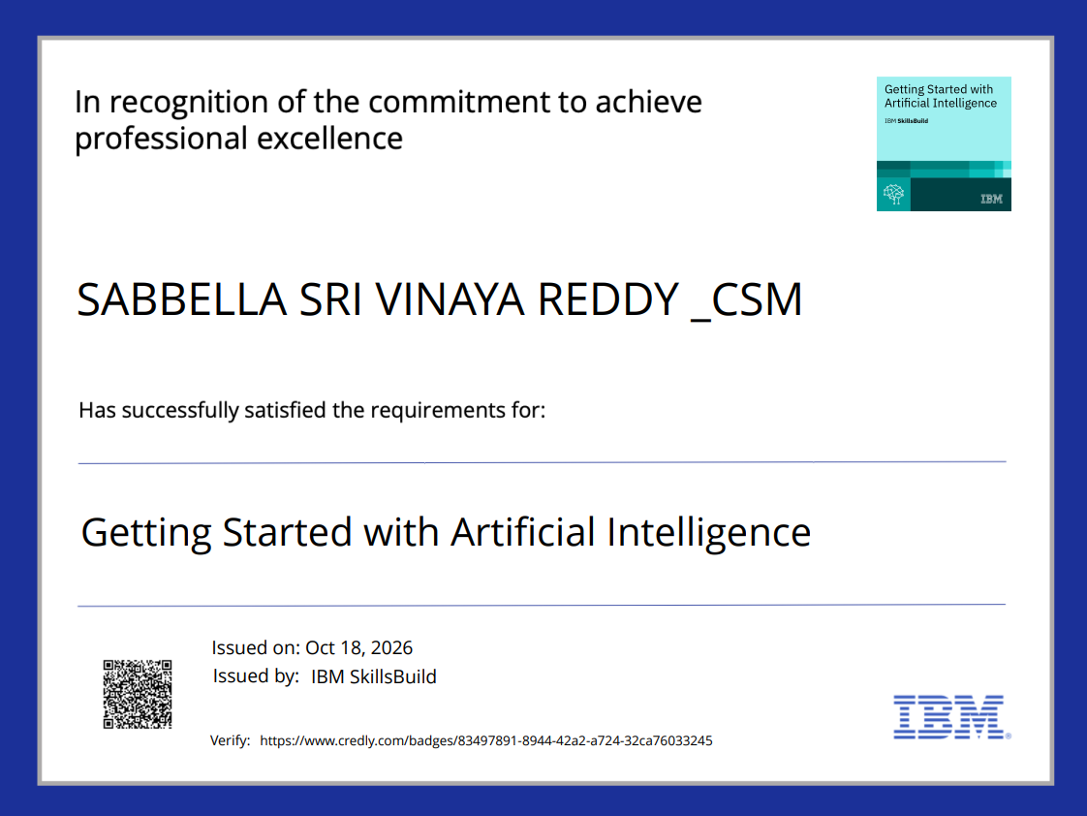
Certificates Earned:
Please add your credly certificate

Slide 15
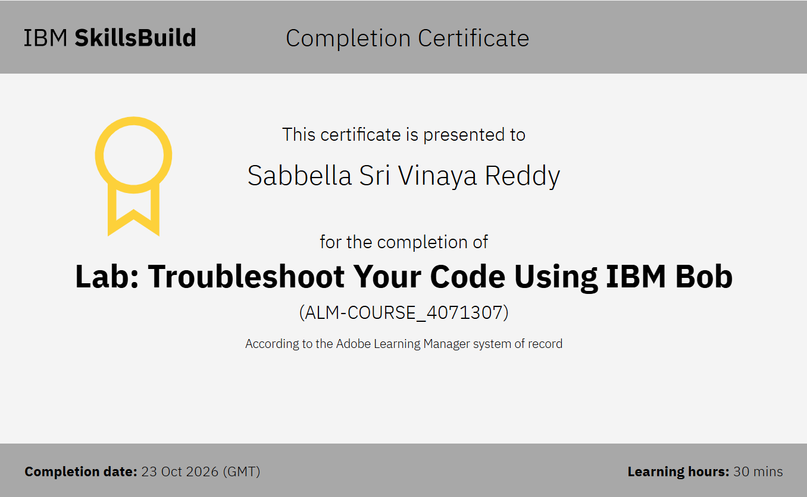
Certificates Earned:​
Add your IBM BOB Certificate

Slide 16


