Slide 1


Slide 2
Doc-Intelligence-PID
PowerPoint summary of the ultra-modern architecture and processing flow
AI Document Intelligence for Personal Insurance Documents
Frontend: ReactJS • Backend: FastAPI • Retrieval: Agentic AI + FAISS • vLLM with Vision (for OCR): Qwen2.5
Output: Extracted text and PID data Served by FastAPI and rendered by React UI
Customized and Restricted Backend Filters are used as Guard Rail
Target Audience
Personal Insurance Service Executives
Personal Insurance SPoC
Serving existing PID data
(Not PID Sales)
Doc-Intelligence-PID | Architecture Presentation

Slide 3
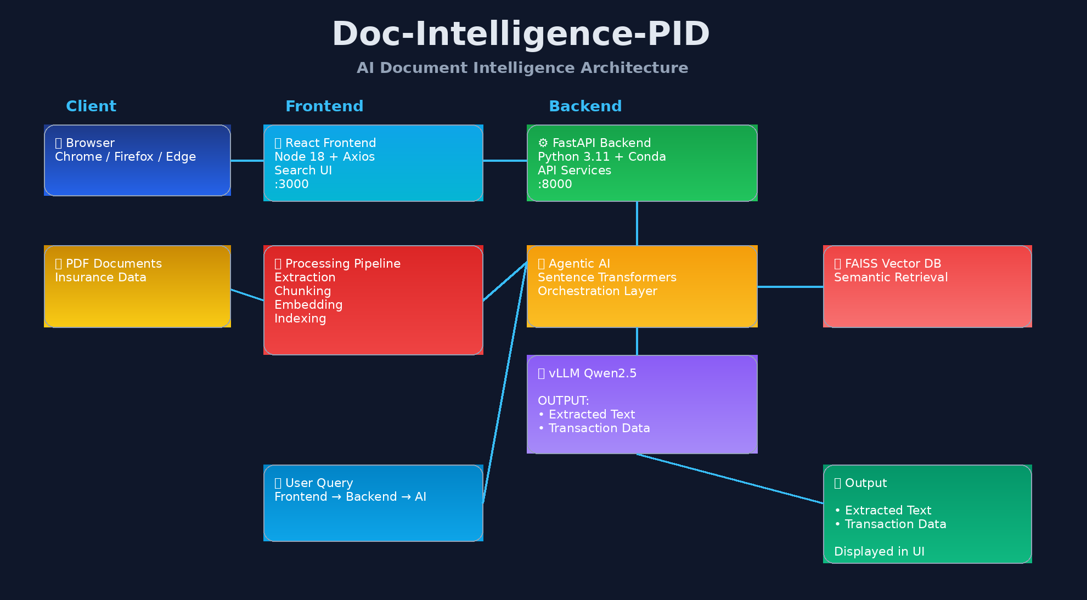
Solution Architecture
Ultra-modern visual layout of the end-to-end system
Doc-Intelligence-PID | Architecture Presentation

Slide 4
Core Components
What each layer is responsible for
Frontend
Backend
Agentic AI
FAISS
ReactJS on Node 18
Axios for API communication
UI for search, upload, and result display
FastAPI on Python 3.11
Conda environment
Request routing and result serving
Sentence Transformers mini LLM
Request/response orchestration
Context building for retrieval
Vector index
Top-K semantic retrieval
vLLM / Qwen2.5
Document Pipeline
Processes retrieved context
Extracts text and transaction data
Powers final responses
PDF ingestion
Extraction, chunking, embeddings, indexing
Feeds searchable content into FAISS
Doc-Intelligence-PID | Architecture Presentation

Slide 5
Ingestion Pipeline
How PDF documents become searchable assets
1. Input PDFs
2. Extraction
3. Chunking
4. Embeddings
5. Indexing
Insurance policies, or claims, or any data heavy documents
Text/OCR extraction from source PDFs
Document content split into manageable units
Sentence Transformer vectors created
Vectors stored in FAISS for retrieval
This pipeline prepares the local knowledge base for semantic search.
The output of this stage is a searchable FAISS index used at query time.
Doc-Intelligence-PID | Architecture Presentation

Slide 6
Runtime Query Flow
What happens when a user asks a question
User Query
Backend API
Agentic AI
Question entered in React UI
FastAPI receives and validates request
Builds context and retrieval strategy
FAISS Search
Agentic AI
UI Display
Finds the most relevant document chunks
Returns extracted text and PID data
Results shown in React UI and FastAPI
Doc-Intelligence-PID | Architecture Presentation

Slide 7
Output Experience
What the user sees and what the system returns
Served Data
Rendering Display Content
Extracted text from PDF content
PID data identified by the model
Results are tailored for local document intelligence workflows
ReactJS frontend for end-user interaction
FastAPI-backed service layer for delivery and API integration
Consistent result presentation across the application flow
This design keeps the interaction simple: query in, extracted text and transaction-focused results out.
Doc-Intelligence-PID | Architecture Presentation

Slide 8
Tech Stack Summary
project stack organized by layers
Environment
Frontend
Backend
AI / Search
Ubuntu / Windows
Conda environment
Localhost deployment
NodeJS 18
ReactJS
Axios
Browser support: Chrome, Firefox, Edge
React rendered at localhost:3000
Python 3.11
FastAPI
Served at localhost:8000
Sentence Transformers for AgenticAI
(Mini LM L5 v2)
FAISS-DB
Qwen2.5 via vLLM
Doc-Intelligence-PID | Architecture Presentation

Slide 9
Presentation Talking Points
Business Use Case: Dynamically searching and extracting PID information from PDF documents
Ingestion pipeline builds the FAISS index, and a Runtime pipeline answers user queries
Agentic AI act as the orchestration layer between FastAPI, FAISS
User-facing output: extracted text and PID data responded in FastAPI and rendered in React UI
Deployment model: local, privacy-friendly, modular for future scaling
Sematic + NLP content restricted filters are used as GUARD Rail
Doc-Intelligence-PID | Architecture Presentation

