Slide 1
STATEMENT
PROJECT WORK
DEFECT DETECTION OF MACHINES FOR BHEL
UNDER THE GUIDANCE OF
M.S.CHAITANYA KIRAN
DGM/IT INFORMATICS CENTRE IN BHEL

Slide 2



STATEMENT
Automated Defective Piece Identification System
Develop an advanced automated system for the identification and flagging of defective materials through sophisticated image analysis techniques. Establish stringent quality criteria and precise values to ensure accurate defect detection. Seamlessly integrate this solution with Web system to enable real-time alerts and notifications to relevant stakeholders, enhancing operational efficiency and quality control in the manufacturing process.
Convolutional Neural Network
Machine learning model
Fast API
Backend
Node.js
Web

Slide 3








MODEL DEVELOPMENT
Model Dev

Slide 4







BACKEND DEVELOPMENT
FAST API

Slide 5


WEB PAGE
Web page

Slide 6






GEN-AI
Gen-Ai

Slide 7




CONCLUSIONS
Conclusions

Slide 8
T
H
A
N
K
!
Y
!!
OU

Slide 10
1

Slide 11
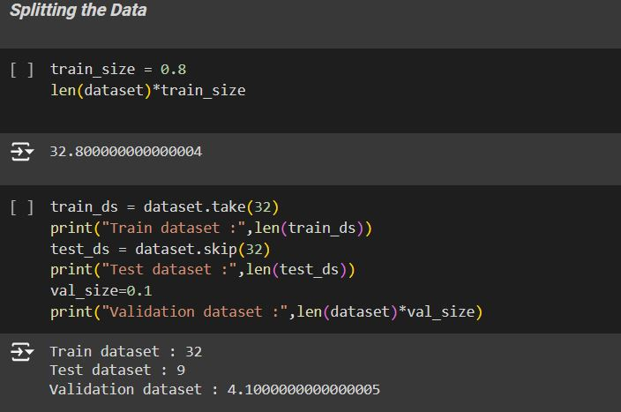
1
Data Preparation
Download the dataset from Kaggle, which should include images of both defective and non-defective items
Splitting dataset into training, validation, and test sets.

Slide 12
2

Slide 13
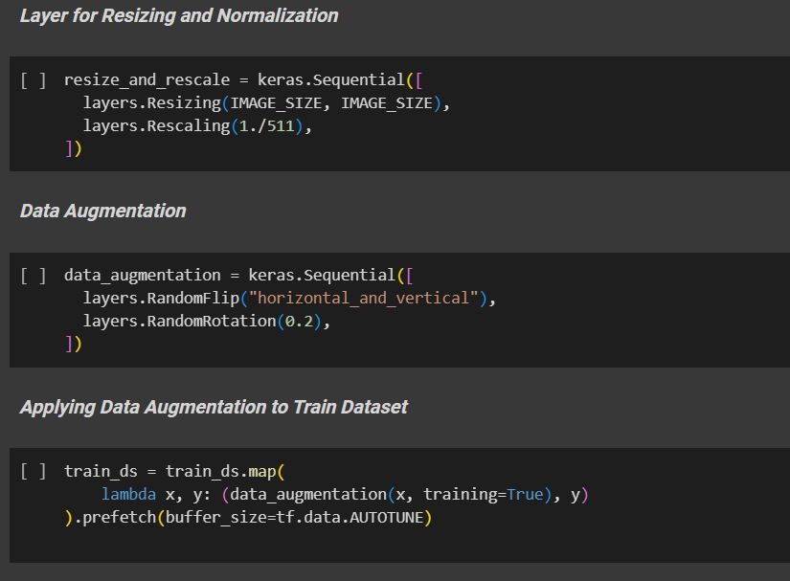
2
Data Augmentation and Normalization
Data Augmentation: Enhances model robustness by generating diverse training samples, reducing overfitting, and improving generalization to unseen data.
Rescaling: Standardizes feature ranges, ensuring numerical stability, faster convergence, and better model performance by preventing features with larger scales from dominating the learning process.s for previewing layouts and visual mockups.

Slide 14
3

Slide 15
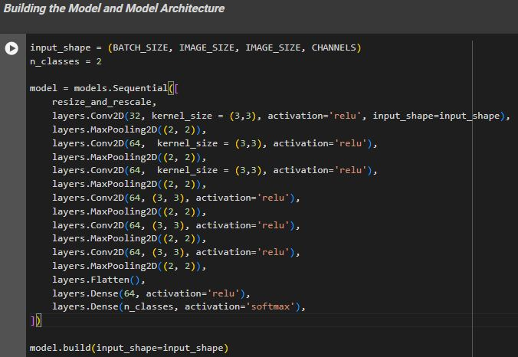
3
Model Architecture
#The architecture of a CNN model is crucial for effectively capturing spatial hierarchies in image data, ensuring the model learns both low-level and high-level features.
#Conv2D layers extract spatial features through convolution operations, MaxPooling2D layers reduce spatial dimensions to mitigate overfitting and computational load, and Dense layers at the end integrate learned features for final classification tasks.

Slide 16
4

Slide 17
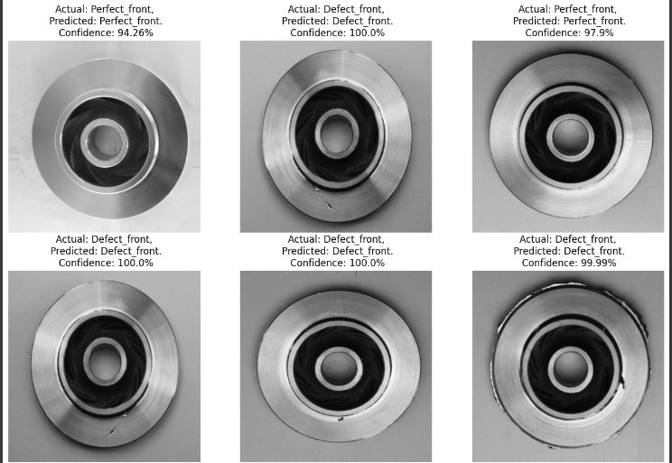
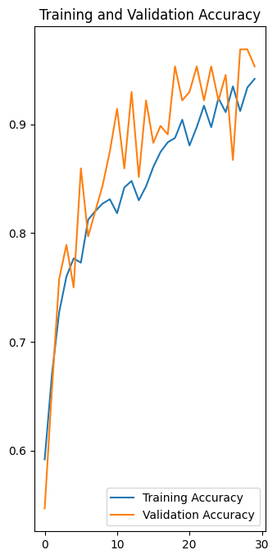
4
Training and Evaluation
#hyperparameter(IMAGE_SIZE, BATCH_SIZE,EPOCHS)
#The model was optimized utilizing the Adam optimizer, ensuring efficient convergence and robust performance. Comprehensive evaluations were conducted to validate the model's effectiveness and accuracy. These assessments confirmed the model's capability to meet the specified performance metrics.

Slide 18
1

Slide 19
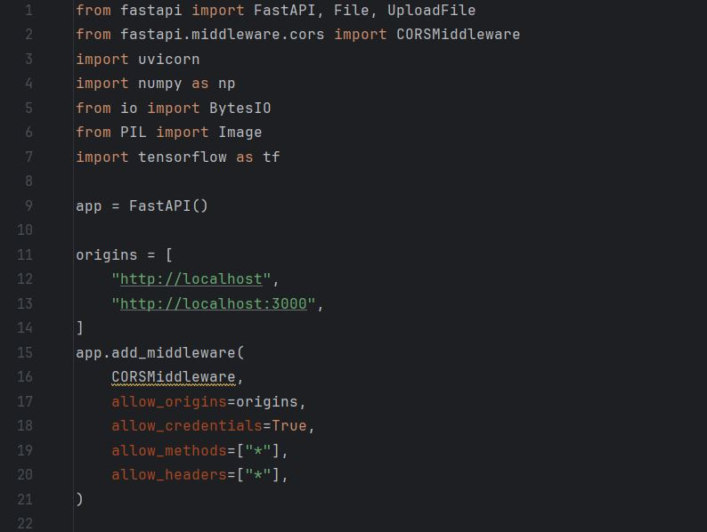
1
Setting up FastApi / CORS middleware
Setting up FastAPI is crucial for creating high-performance APIs that can handle requests
efficiently in deployment environments. Implementing CORS middleware ensues secure cross-origin
resource sharing, allowing your API to interact seamlessly with clients from different origins.
Together, they enable robust and secure API interactions,
essential for the successful deployment of machine learning models and applications.
.

Slide 20
2

Slide 21
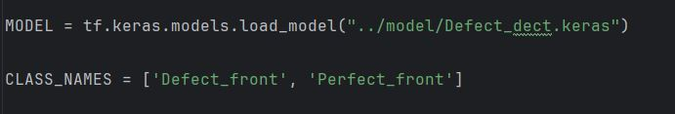
2
Loading the trained Keras model.
Loading the trained Keras model involves initializing the model architecture and weights,
ensuring it is prepared for deployment.
This process includes specifying the model file path and utilizing Keras load_model function for seamless integration.
Properly loading the model is crucial for maintaining performance consistency and reliability in production environments.

Slide 22
3

Slide 23
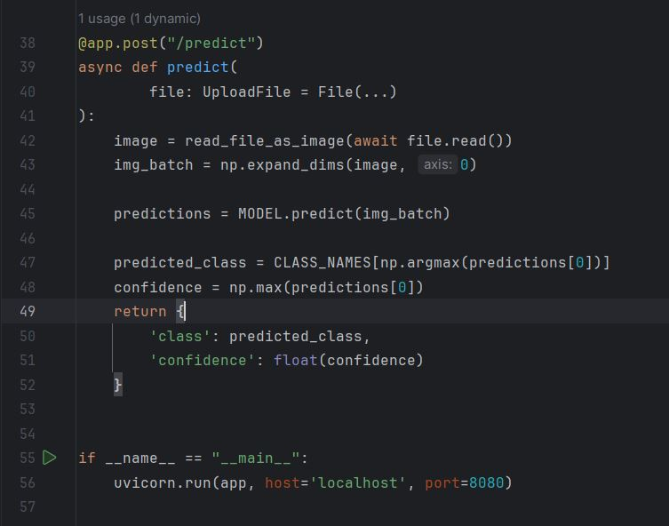
3
Server depolyment
#defines a FastAPI application for predicting image classes using a pre-trained Keras model.
#It includes an endpoint /predict that accepts image uploads, reads the image file, and converts it into a numpy array.
#The image is then preprocessed into a batch format and fed into the model for prediction.
#The model's output is used to determine the predicted class and its associated confidence level, which are returned in the response.
#The application is run on localhost at port 8080 using Uvicorn as the ASGI server.

Slide 24
4

Slide 25
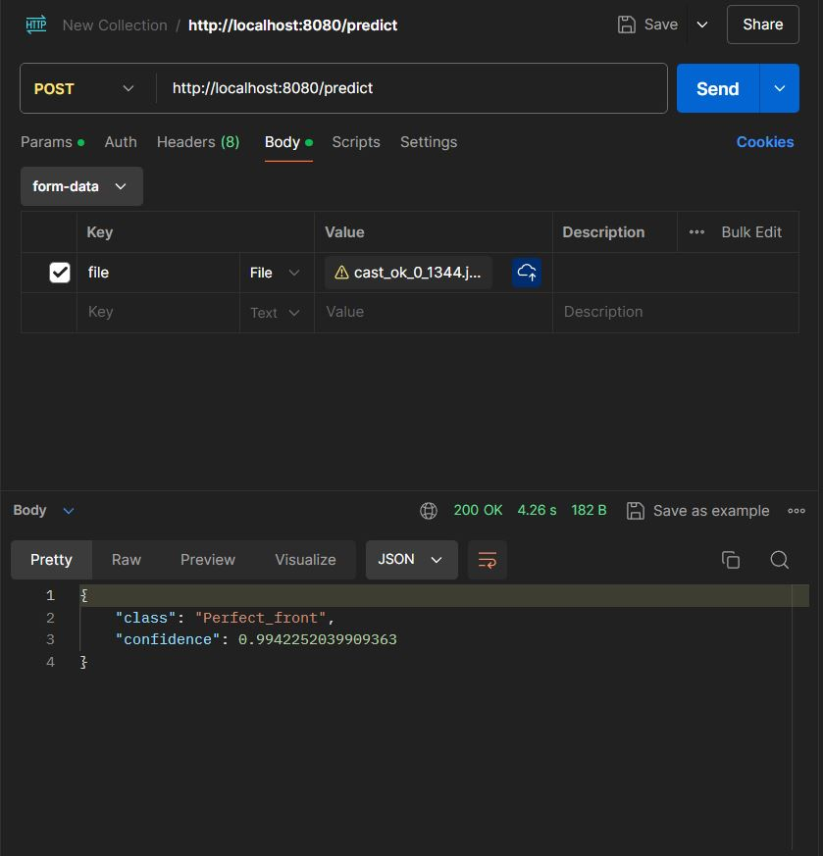
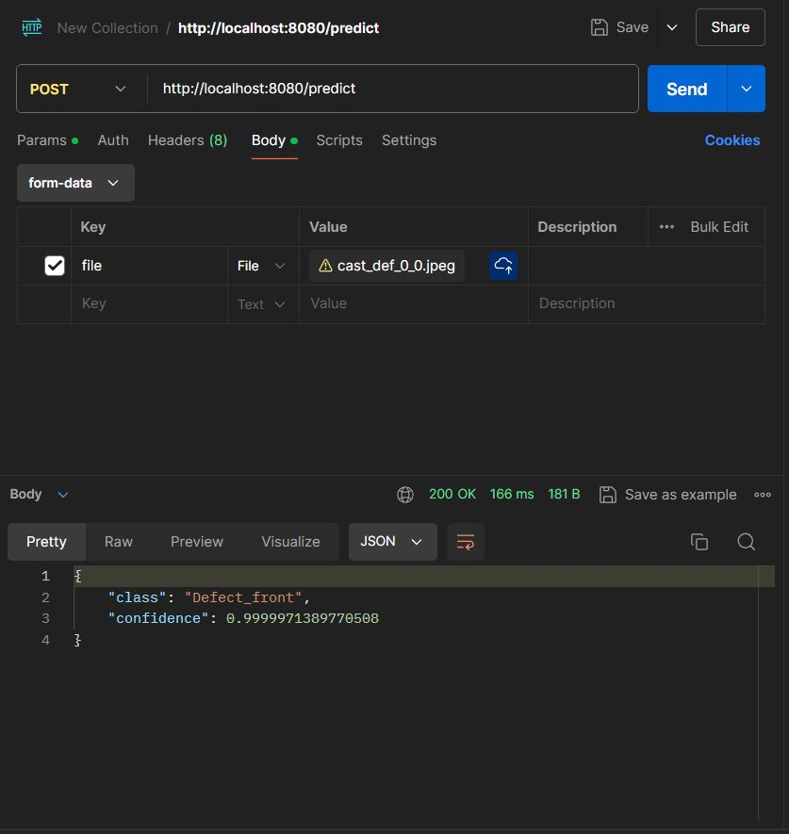
4
RESULTS
Using postman we could easy send requests to the server and verify the model accuracy

Slide 26
1

Slide 27

1
Building an website
To implement a Node.js framework for a local webpage, we developed a drag-and-drop interface for image uploads. Users can easily drop images onto the webpage, which then sends the images to our FastAPI server for prediction. This setup leverages the node.js library for the backend and integrates with FastAPI to handle model inference. The result is a seamless user experience for image-based predictions.

Slide 28
2

Slide 29
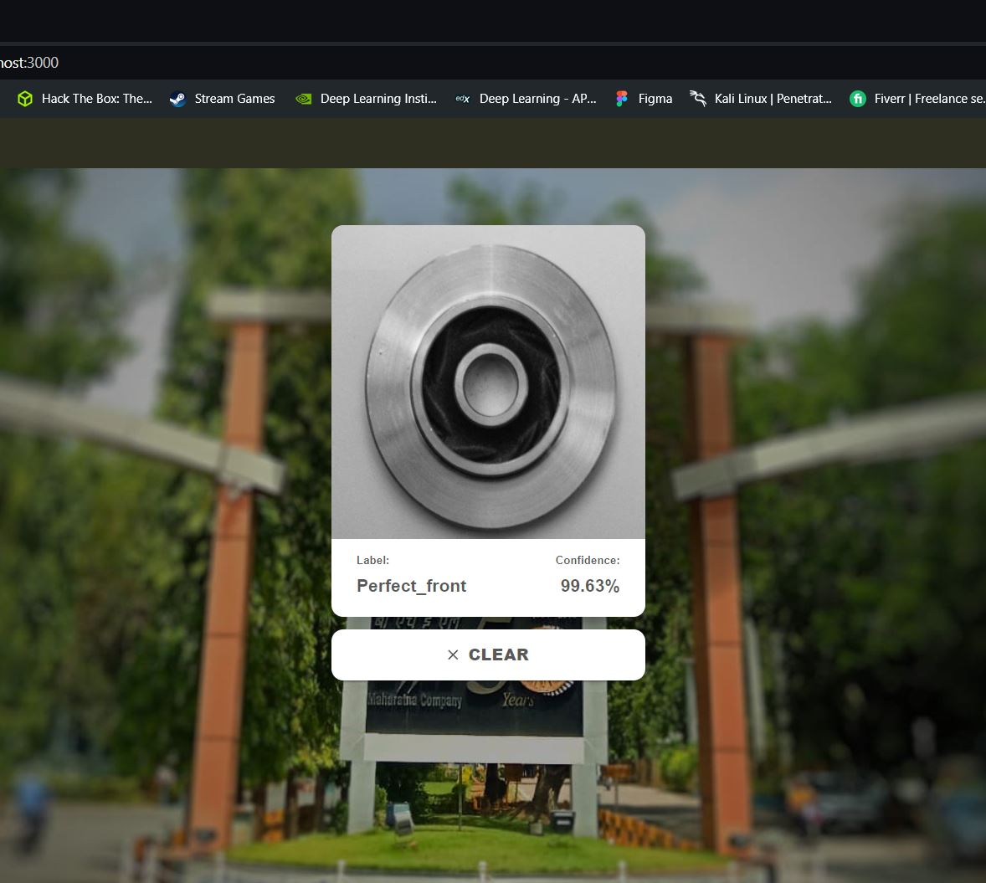
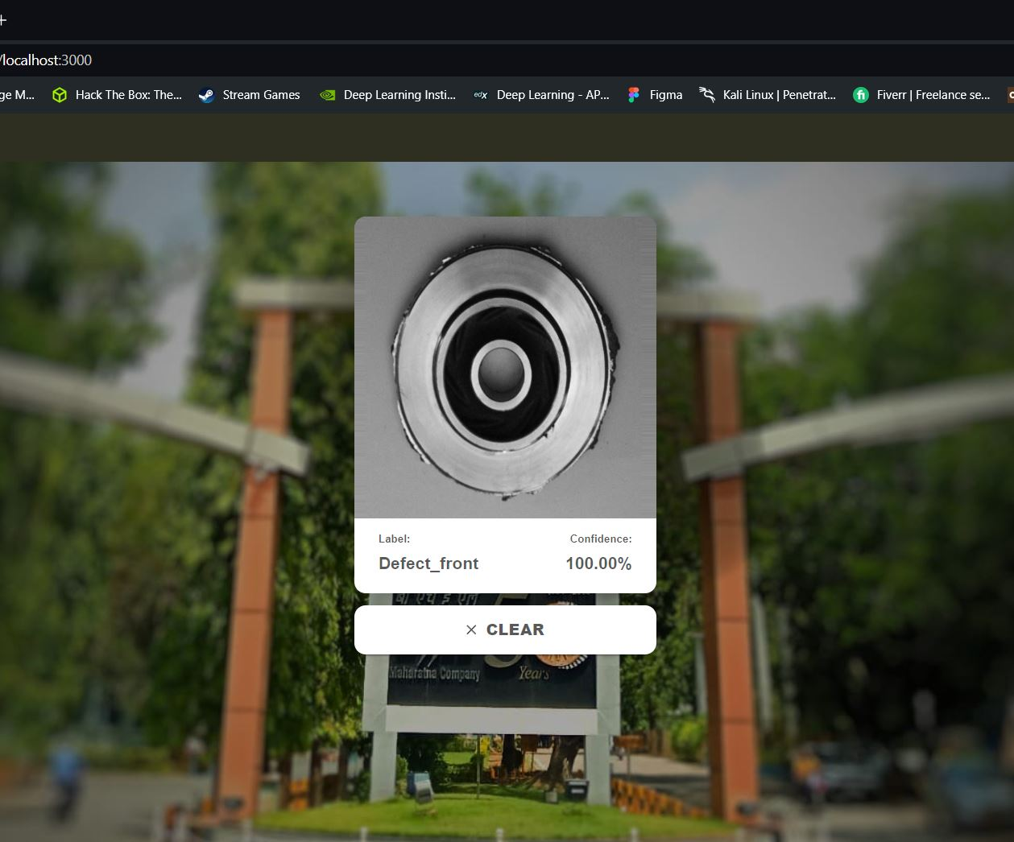
2
Results

Slide 30
1

Slide 31
1
Generative AI in Defect Detection
Introduction to Generative AI:
Uses advanced algorithms to generate new data similar to a given dataset.
In manufacturing, it can be employed to detect and classify defects in production images.
Phase 1 Implementation:
Defect Detection: Utilized CNN algorithms to identify whether an image from the production line is perfect or defective.
Improvement Metrics:
Increased detection accuracy by 93%.
Reduced false positives/negatives by 10%.
Phase 2 Goals:
Classifying Defects: Differentiate between reworkable and non-reworkable defects.
Process Integration: Streamline defect detection into the production workflow for real-time monitoring and intervention
Vendor Selection Based on Delivery Time

Slide 32
2

Slide 33
2
Impact on Production Efficiency
Improving Detection:
Generative AI can enhance the defect detection system by generating diverse and realistic defect samples, improving the model's ability to detect a wide range of defects in the manufacturing process.
Material Cost Reduction:
Accurate defect detection reduces material wastage by ensuring only defective products are flagged, leading to more efficient use of raw materials.
Manpower Optimization:
By reducing false positives, generative AI minimizes unnecessary inspections and rework, allowing manpower to focus on critical tasks.
Time of Delivery:
Efficient defect detection ensures timely identification and correction of defects, reducing delays in the production process and improving delivery times.
Vendor Selection:
Generative AI can simulate various defect scenarios associated with different vendors' materials, aiding in selecting vendors who provide the
best quality materials with minimal defects.
Classifying Defects: Differentiate between reworkable and non-reworkable defects.
Process Integration: Streamline defect detection into the production workflow for real-time monitoring and intervention.

Slide 34
3

Slide 35
3
Optimizing Procurement with Generative AI
Streamlining Procurement Practices in Manufacturing
Vendor Selection Based on Delivery Time:
Utilize generative AI to analyze historical data and predict vendor performance.
Select vendors with the best delivery times and reliability, reducing lead times.
Material Cost Analysis:
AI-driven insights into market trends and material costs.
Optimize procurement schedules and order quantities to minimize costs.
Manpower and Efficiency:
Automate procurement processes, reducing administrative overhead.
Enhance collaboration between procurement and production teams for better resource planning.
Benefits:
Improved supply chain reliability and responsiveness.
Reduction in procurement cycle time by ~47%

Slide 36
1

Slide 37
1
Conclusion of Phase 1 Implementation
The completion of Phase 1 marks a significant milestone in our project on defect detection within the manufacturing industry. This phase focused on developing a robust convolutional neural network (CNN) model, achieving an impressive accuracy rate of 93%.
Model Development and Data Augmentation: We began by designing and training a CNN model specifically tailored for defect detection. To enhance the model's performance and generalization capabilities, we incorporated data augmentation techniques directly within the model pipeline.
Model Export and Deployment: Upon reaching the desired accuracy, the trained model was exported in the .keras format, ensuring ease of integration and deployment. We then developed a backend server using FastAPI, a modern, fast (high-performance) web framework for building APIs with Python. The exported model was seamlessly loaded into the server, enabling real-time inference capabilities.
API Testing and Validation: To validate the server's functionality, we conducted comprehensive testing using the Postman application. By sending various requests to the FastAPI server, we confirmed that the model was accurately processing and classifying the input images, thereby ensuring the reliability and stability of the deployment
Front-End Development: In parallel with backend development, a user-friendly web interface was created using the Node.js framework. This website allows users to easily drag and drop images for defect detection. The interface provides immediate feedback, indicating whether the uploaded image is defective or perfect,

Slide 38
2

Slide 39
2
Conclusion on Phase 2 Implementation
The second phase of our project involved the strategic implementation of generative AI (Gen AI) alongside Convolutional Neural Networks (CNN) for defect detection and classification within the manufacturing industry. This phase emphasized the potential of Gen AI to revolutionize manufacturing processes by enhancing defect detection capabilities and optimizing procurement practices, particularly within BHEL's project-based manufacturing environment.
Integration of Gen AI and CNN
The integration of Gen AI with CNN has demonstrated significant improvements in defect detection accuracy and classification. By leveraging Gen AI's advanced data generation and pattern recognition capabilities, we achieved a higher precision in identifying and categorizing defects. This enhancement not only reduced the rate of false positives and negatives but also provided actionable insights into whether detected defects were reworkable or required immediate attention.
Gen AI Application in BHEL
In the context of BHEL, the application of Gen AI has proven to be transformative. BHEL's complex and large-scale
manufacturing operations benefit greatly from the enhanced defect detection and classification provided by Gen AI. The ability to accurately identify reworkable defects has led to significant reductions in material waste and rework time, thereby improving overall production efficiency.
Furthermore, Gen AI has streamlined procurement practices by predicting material requirements more accurately and selecting vendors based on their delivery performance. This predictive capability has enabled BHEL to optimize its procurement cycles, reduce lead times, and ensure timely delivery of materials, which is critical in a project-based manufacturing environment.
Impact on Procurement Practices
Gen AI's impact on procurement practices in project-based manufacturing environments has been profound. The predictive analytics capabilities of Gen AI allow for:
Enhanced Vendor Selection: By analyzing historical data on vendor performance, Gen AI helps in selecting vendors who consistently meet delivery schedules and quality standards.
Optimized Inventory Management: Predictive models forecast material needs more accurately, reducing overstock and stockouts.
Improved Supply Chain Efficiency: By anticipating material shortages and delivery delays, Gen AI enables proactive measures, thus minimizing production disruptions

