Slide 1

Project Title -Seasonal Agriculture Performance Analysis:
MADIPOJU SRIANJUN
VAAGDEVI ENGINEERING COLLEGE
AICTE STU ID: STU67f7d4b15a5481744295089

Slide 2

PROBLEM STATEMENT
(Agricultural activities are influenced by seasonal variations in environmental conditions, farming practices, resource availability and market conditions. As a result, agricultural performance may differ from one season to another. However, raw agricultural data does not clearly explain how agricultural performance changes across seasons or what patterns can be observed in different seasonal conditions. The problem is to analyze the given agricultural dataset and investigate seasonal differences in agricultural performance by identifying meaningful patterns, trends, relationships and variations within the available data.

Slide 3
Project Description
Seasonal Agriculture Performance Analysis:
Seasonal Agriculture Performance Analysis is a data analytics project that examines how agricultural performance varies across different seasons. The project analyzes factors such as crop yield, production, rainfall, temperature, soil conditions, fertilizer usage, irrigation, water efficiency, revenue, cost, profit, and disease/pest risk to identify meaningful seasonal patterns and relationships.
Using Python, Pandas, NumPy, Matplotlib, and Seaborn, the agricultural dataset is cleaned, explored, and visualized through statistical analysis and graphs. The analysis compares crops, seasons, regions, and farming practices to understand which conditions are associated with better productivity, resource efficiency, and profitability.
Key Objectives
Analyze seasonal variations in crop yield, production, revenue, and profit.
Identify relationships between environmental conditions, farming practices, and agricultural performance.
Compare crops, regions, and irrigation methods to determine better-performing combinations.
Generate actionable insights that can support improved resource management and future data-driven agricultural decision-making.

Slide 4

WHO ARE THE END USERS?
Crop & Season Insights – Identifies the best-performing crops and seasons based on yield and productivity.
Resource Optimization – Analyzes irrigation, rainfall, fertilizer usage, and water efficiency to support better resource management.
Profitability Analysis – Provides revenue, production cost, and profit insights to help users make financially informed farming decisions
Risk & Performance Monitoring – Highlights disease/pest risks and regional performance through easy-to-understand charts and analytics.

Slide 5

Technology Used
  Python: Core programming language used for the analysis
  Pandas: Used for data loading, cleaning, transformation, and grouping.
  NumPy: Used for numerical operations and calculations.
  Matplotlib: Base plotting library used for charts (histograms, scatter plots, bar charts).
  Seaborn: Used for statistical visualizations including the correlation heatmap.
  Google Colab / Jupyter Notebook: Cloud-based notebook environment used to run the full analysis.

Slide 6
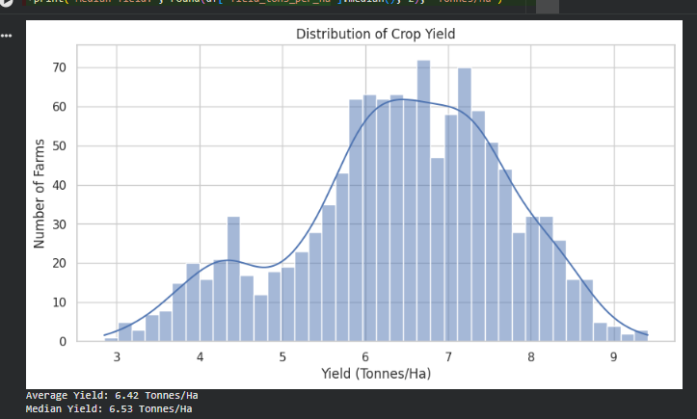
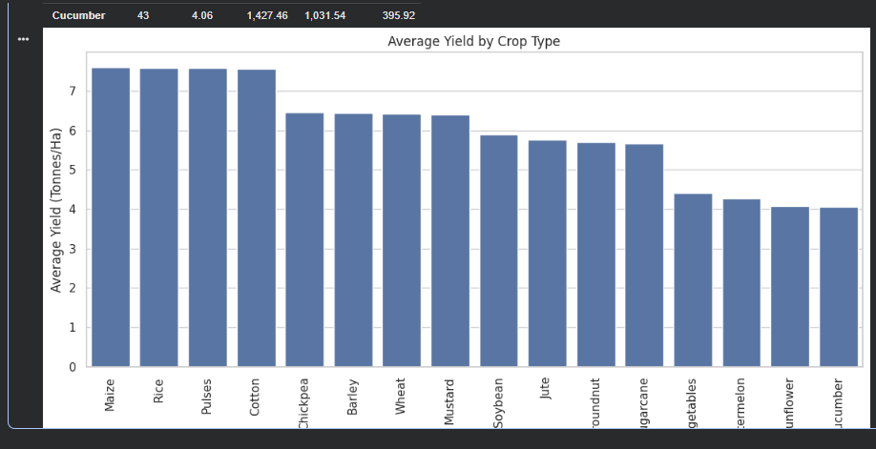
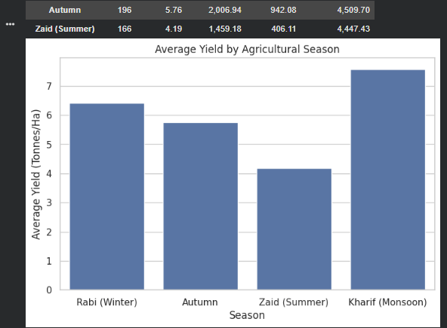
RESULTS

Slide 7
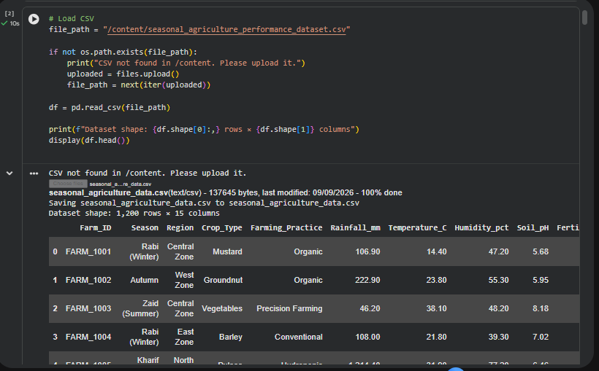
RESULTS

Slide 8
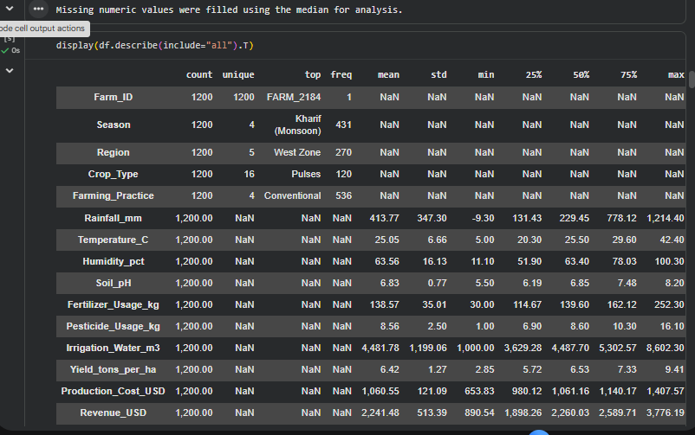
RESULTS

Slide 9
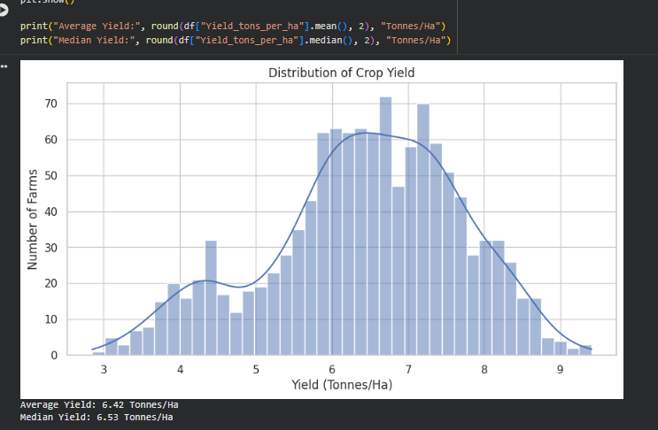
RESULTS

Slide 10
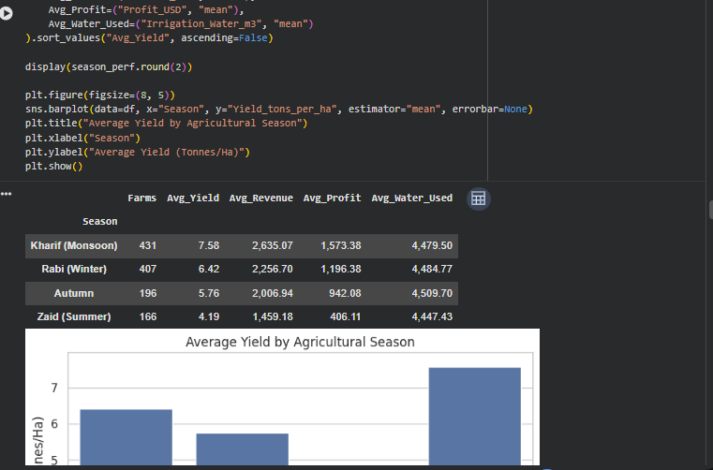
RESULTS

Slide 11
Future scope
AI-Based Yield Prediction – Develop machine-learning models to predict crop yield using soil, weather, irrigation, and fertilizer data.
Smart Crop Recommendation – Recommend the most suitable crop, season, and farming practices based on local environmental conditions.
Real-Time IoT Monitoring – Integrate IoT sensors to continuously monitor soil moisture, temperature, humidity, rainfall, and crop conditions.
Interactive Decision-Support Dashboard – Build a web/mobile application that provides real-time predictions, profit estimates, disease-risk alerts, and personalized recommendations to farmers.

Slide 12
GitHub Link
https://github.com/Srianjun26
Srianjun26 (Sri Anjun) · GitHub

Slide 13
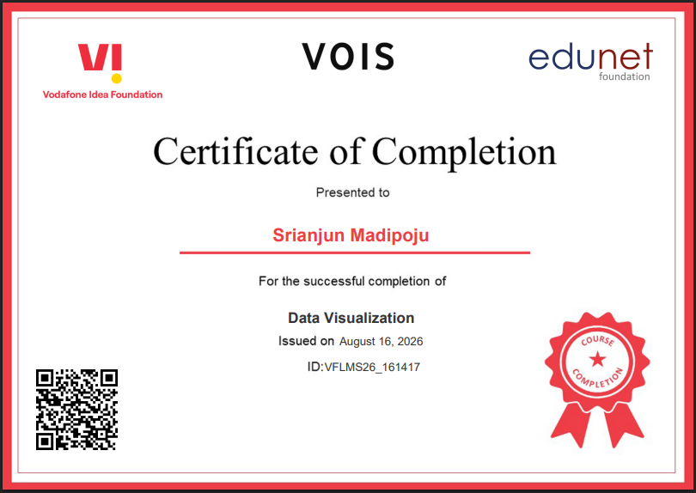
VOIS Course completion certificate -
Course name- Data Visualization

Slide 14
Thank you
.
.

