Slide 1
ONLINE VEHICLE PARKING RESERVATION SYSTEM
SCREEN SHOTS

Slide 2
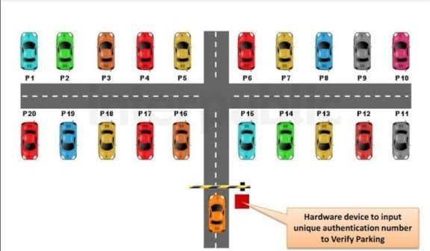
SCREENSHOT 1:Base View of Vehicle Reserved Parking

Slide 3
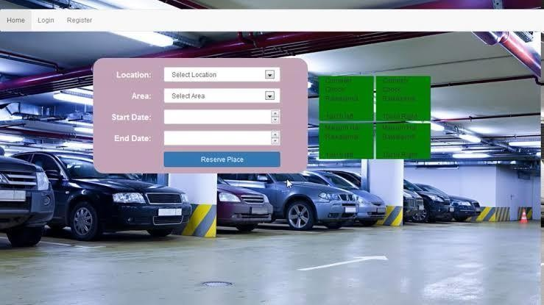
SCREENSHOT 2: Vehicle Parking Reservation Site

