Slide 1
Integrations as a Symphony: Harmonizing Your Business Ecosystem

Slide 2
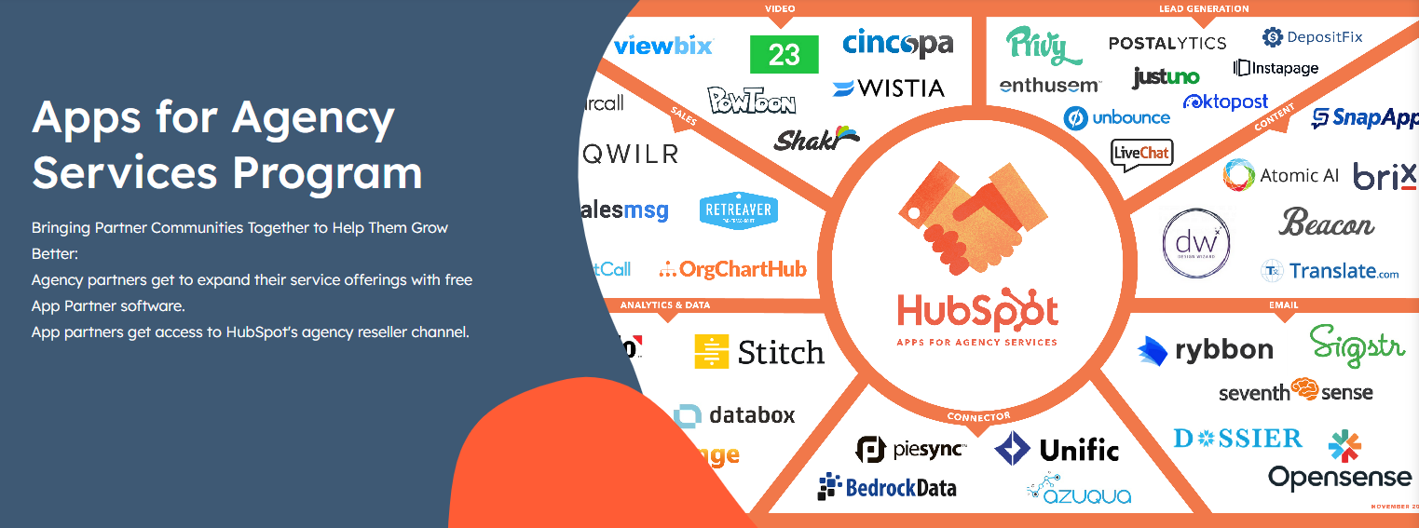
The Overture
Launched in May 2018, Apps for Agency sought to provide a new channel for integration solutions to resell their software.
The program was sunset as of September 2019 we can take a look at the data to gather important insights to further improve the program’s second life as the App Marketplace
Notes:
This new program is designed to help HubSpot’s vast digital marketing agency partner community differentiate their service offerings from the competition and help the company’s growing number of powerful integration solutions tap into a new channel to resell their software.

Slide 3
Setting the Stage
HubSpot set the stage for 63,737+ customers to utilize 6,972 integrations as instruments in creating business solutions worth of an encore
Aug.
Sep.
Oct.
Nov.
Dec.
Jan.
2018
2019
Apps for Agency
Launch
HB announces new
integration with Zoom
HB Blog post discussing
integrations how-to and the ability
To remedy data silos
Notes:
This new program is designed to help HubSpot’s vast digital marketing agency partner community differentiate their service offerings from the competition and help the company’s growing number of powerful integration solutions tap into a new channel to resell their software.
Active integrations = any integration with 1 or more installations

Slide 4
Setting the Stage
Active integrations increased by
43%
from the start of the review period
3430
4909
2018
2019
115k
While total installations increased by
84%
211k
Apps are the instruments for business harmony and our customers are fully
utilizing the experience.
Notes:
This new program is designed to help HubSpot’s vast digital marketing agency partner community differentiate their service offerings from the competition and help the company’s growing number of powerful integration solutions tap into a new channel to resell their software.
Active integrations = any integration with 1 or more installations

Slide 5
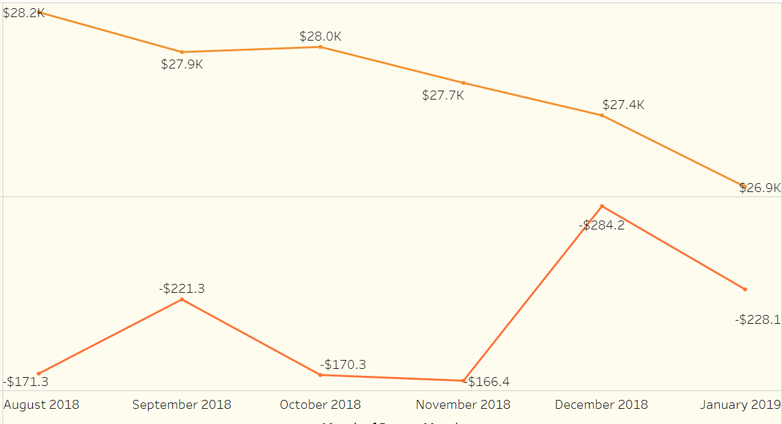
What events are causing spikes to the cancellation dollars in September and December 2018? These events may hold insight into how we might triage the emerging trend of increased cancellation $$ toward the tail end of the period
Average Monthly MRR (End-of-the month)
Total Cancellation Dollars

Slide 6
Integration Cohorts*
What can we learn from integration performance?
Not in Use 24% Zero Installations
One and Done 23% 10 or fewer with no MRR
One in the Number 45% 1 or more with positive MRR
Established & Moving the Needle 5% total revenue > $165,378*
Notes:
*3% percent are unclassified

Slide 7
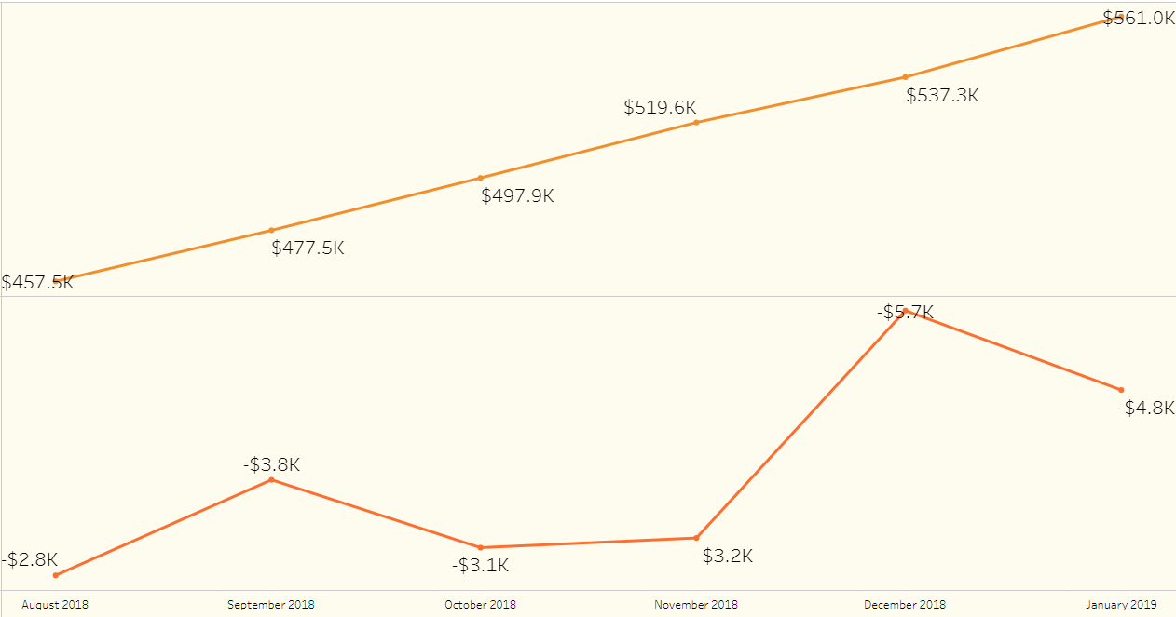
“Established and Earning” (lighthouse integretions) “The show must go on” We see the same spikes in September and Dec cancellation dollars but the average revenue isn’t shaken by these events.
Average Monthly MRR (End-of-the month)
Average Total Cancellation Dollars
Notes:
This new program is designed to help HubSpot’s vast digital marketing agency partner community differentiate their service offerings from the competition and help the company’s growing number of powerful integration solutions tap into a new channel to resell their software.

Slide 8
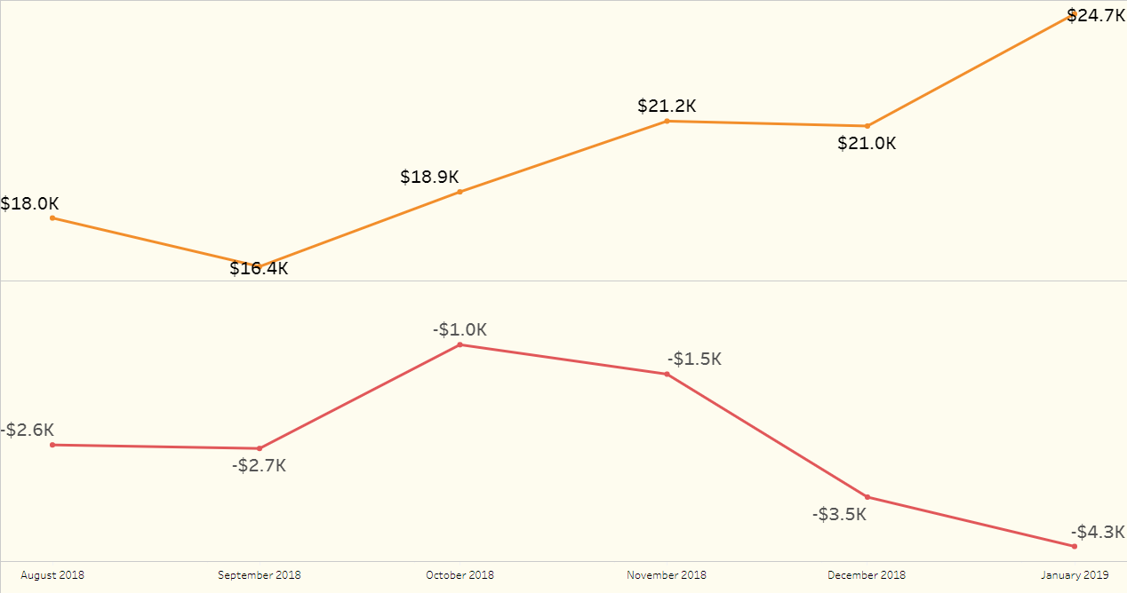
“Small-Scale” (integrations with 33 to 5000 and positive total revenue.) The small scale integrations remain resilient in the face of the increasing cancellations. Further examination could help identify emerging
Average Monthly MRR (End-of-the month)
Average Total Cancellation Dollars
Notes:
This cohort mirrors the trend we saw earlier.

Slide 9
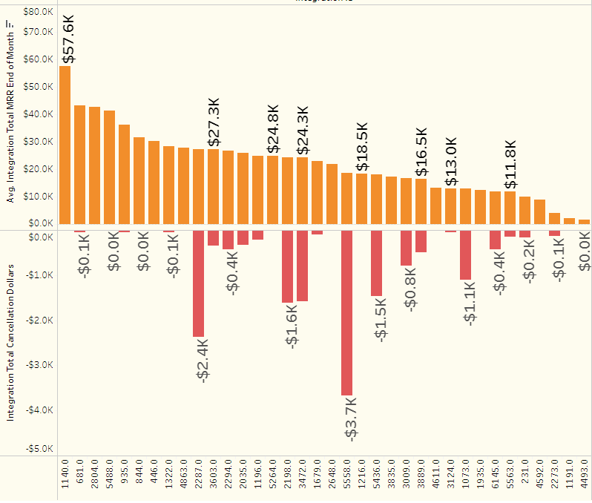
“Small-Scale” – Rouge Players
Notes:
This cohort mirrors the trend we saw earlier.

Slide 10
“What’s your worth?” There are rouge players within each cohort where the percent of their total MRR < the percent of the total cancellation dollars. While typically these integrations still yield an actual MRR dollar value greater than These are integrations to monitor:
Are other resources being used to mitigate larger spike in cancellation dollars?
Are these early indicators of an integration that does harmonize well with the chorus?
In the 20% of cases where the cancellation dollars outweigh the MRR, what steps can be taken to improve performance or sunset the integration altogether?

Slide 11
The Composer's Vision
In the world of business, customers are the composers of their own unique symphonies
They choose from a diverse array of applications and tools to orchestrate their desired experiences.
By seamlessly combining different systems, data, and services, they craft g a symphony of efficiency, innovation, and success.
Notes:
Product Screenshot Full MacBook

Slide 12
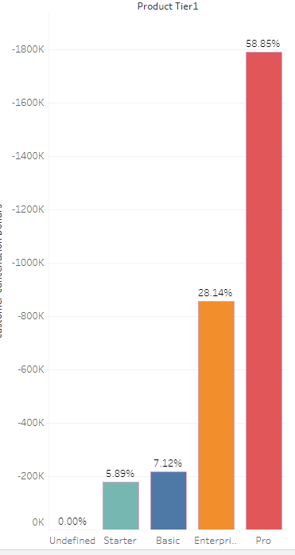
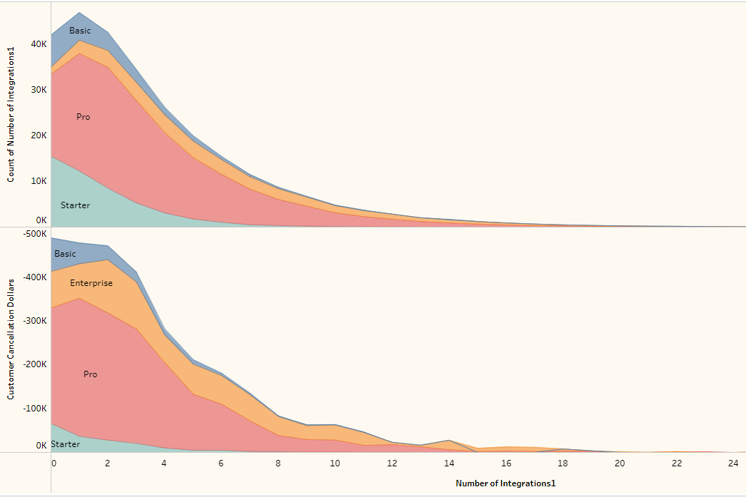
The Crescendo of Data Exchange

Slide 13
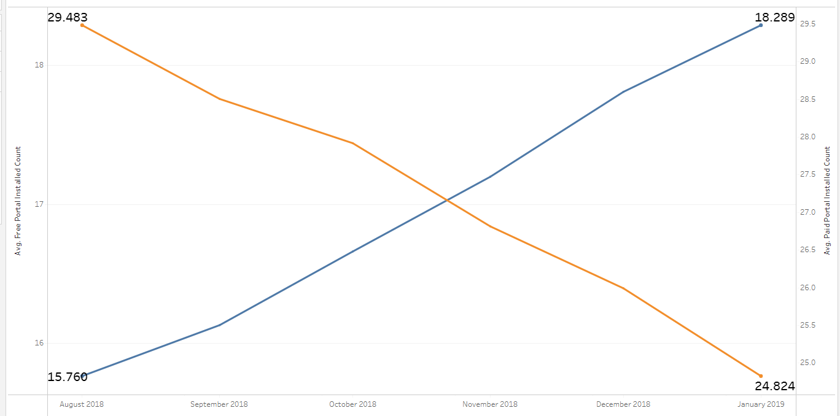
The Value Add As we look at the Apps for Agency journey free vs paid portal integration data shows us that as the program matures, value becomes more important for time invested
Paid
Free

Slide 14
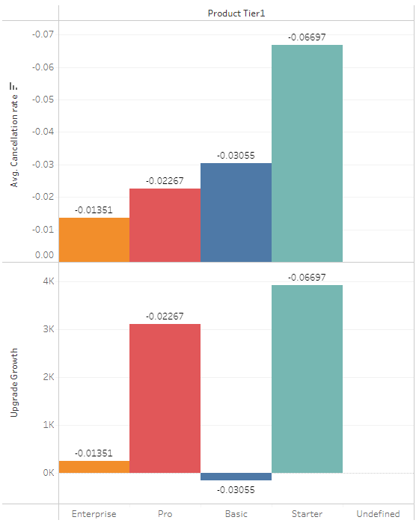
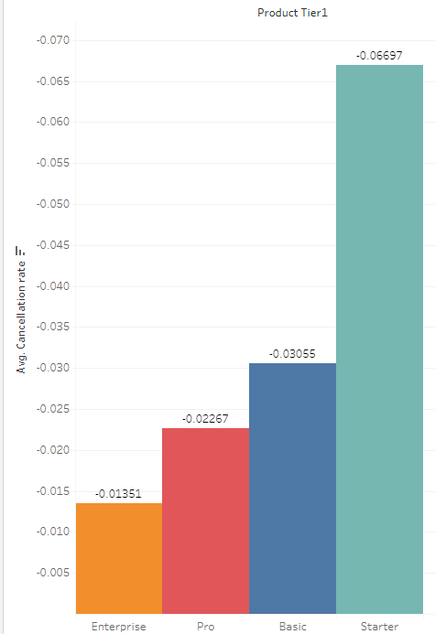
Customer Retention

Slide 15
The Final Score
Value is paramount. Integrations will only help retain customers if the use is evident and experienced early on in the customer journey.
Clear Objectives: In a symphony, every section knows its role and follows a conductor's lead. Likewise, in integration, having clear objectives helps in guiding your team and the integrations toward a harmonious performance. What do you aim to achieve, and how does integration contribute to your business goals?
Integration Maturity: At this stage, a business has achieved a level of integration maturity where various systems sources seamlessly work in concert. The result is greater efficiency and a streamlined workflow that allows customers to focus on value-added tasks rather than tedious data entry or reconciliation.

Slide 17
“ .”
Sam Balter | Sr. Marketing Manager of Podcasts | HubSpot

