Slide 1

Student Council 2024–25
This introduces the Student Council for the academic year 2024–25 at Symbiosis Institute of Technology, Hyderabad.
Each member has been elected or appointed to represent and support the student body, foster campus engagement, and contribute to academic and extracurricular development.

Slide 2
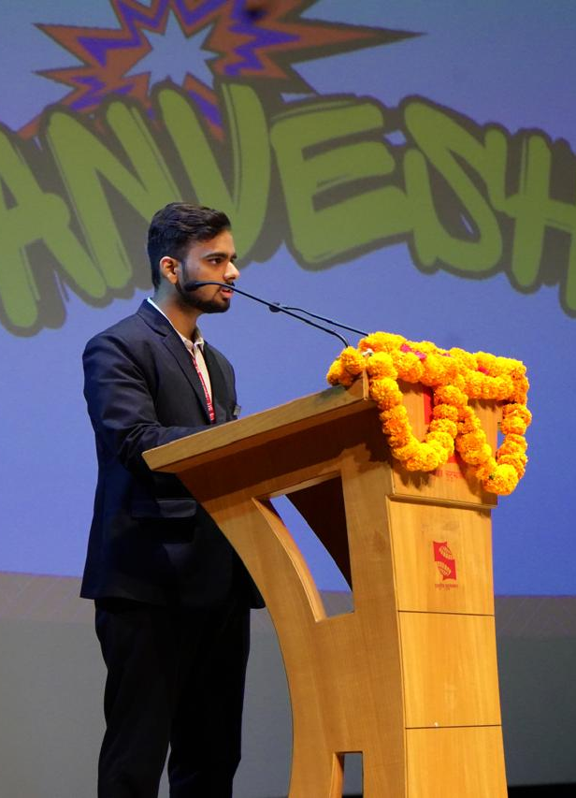
Anirudh Pratap Singh Yadav
President
Branch: AI & ML
Leads the Student Council, represents the student body, and ensures smooth coordination between students, faculty, and administration.

Slide 3
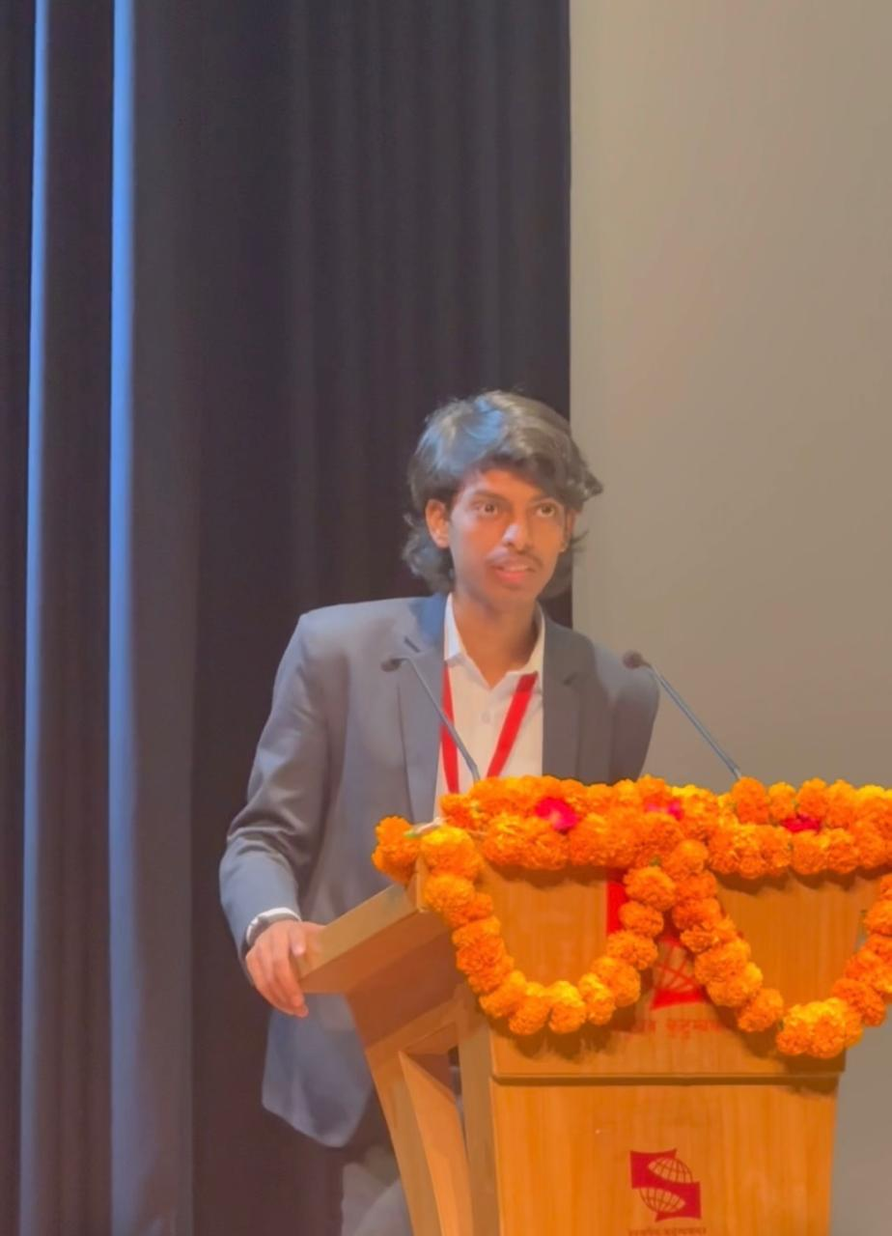
Harsh Anand
Vice-President
Branch: CST
Supports the President, steps in during their absence, and oversees the effective functioning of all committees.

Slide 4
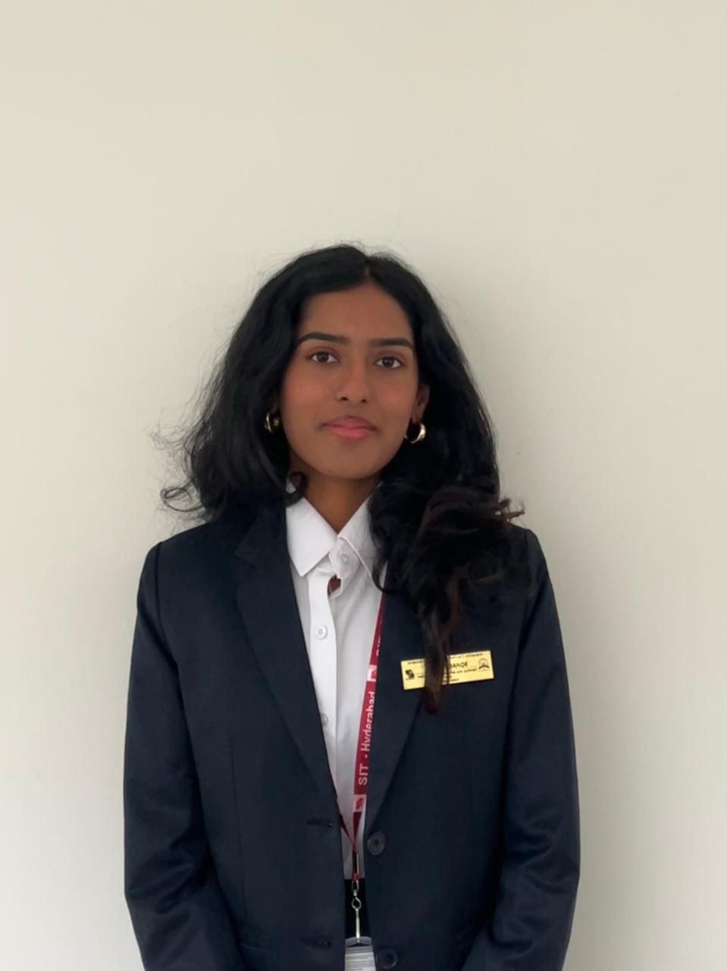
Saanvi Dande
Program Coordinator & Support Committee - Head
Branch: CSE
Plan, manage, and support academic and non-academic events while ensuring logistical support across campus activities.

Slide 5
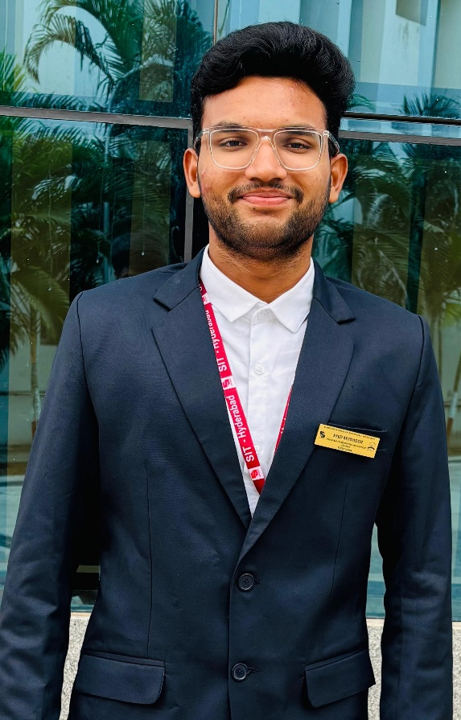
Syed Mudassir
Program Coordinator & Support Committee - Co-Head
Branch: CST

Slide 6
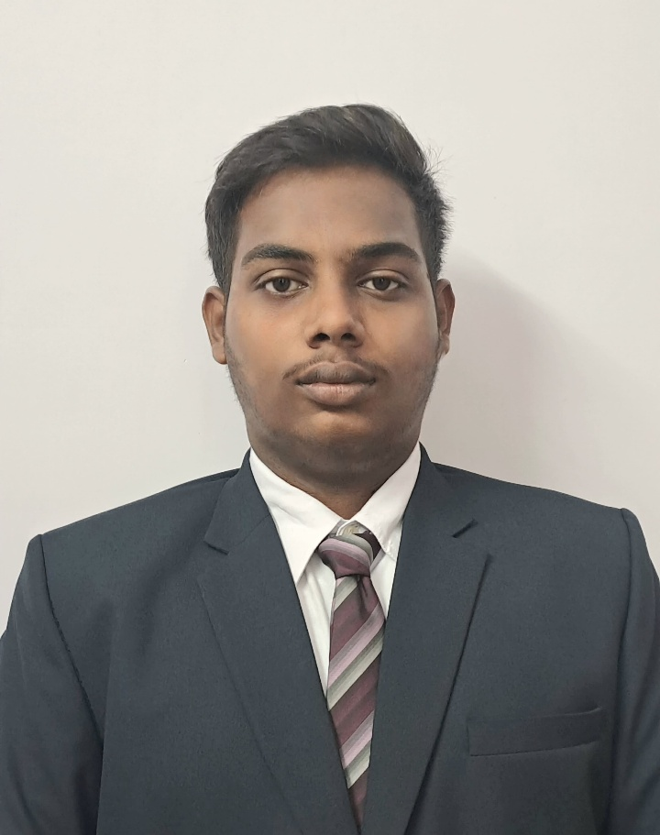
Dhruva Sai Phaneeswar
Academics & Research Committee - Head
Branch: CST
Work with faculty and peers to enhance academic life, promote research initiatives, and address student academic concerns.

Slide 7
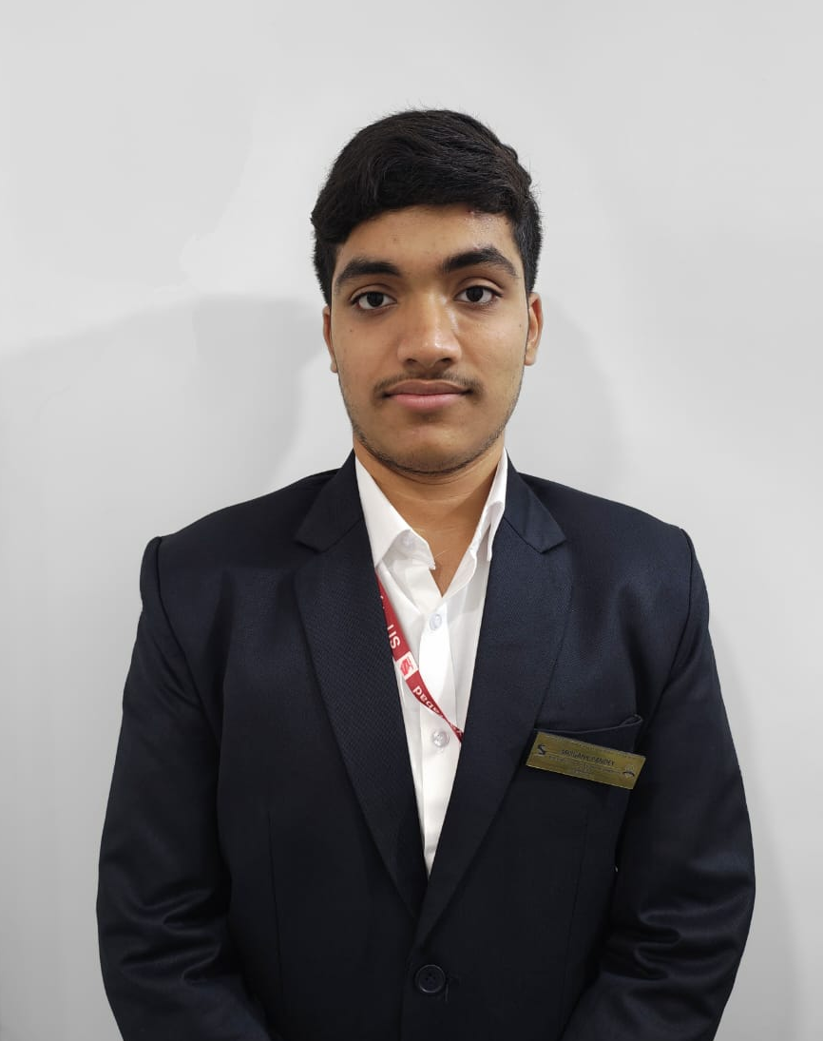
Mrigank Pandey
Academics & Research Committee - Co-Head
Branch: AI&ML

Slide 8
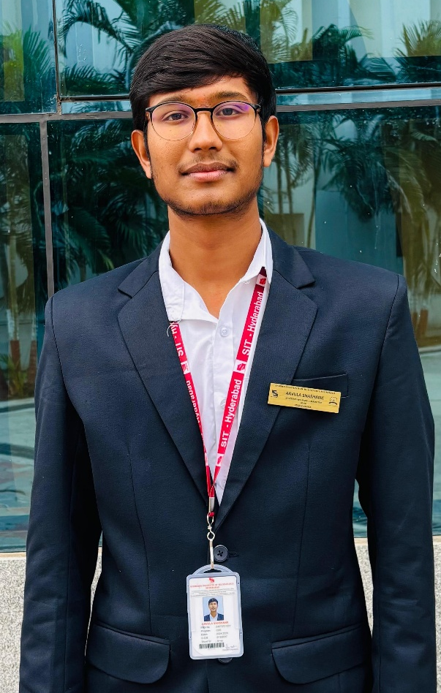
Aavula Shashank
Student Welfare Committee - Head
Branch: CSE
Focus on student well-being by addressing concerns related to mental health, inclusion, and campus life.

Slide 9
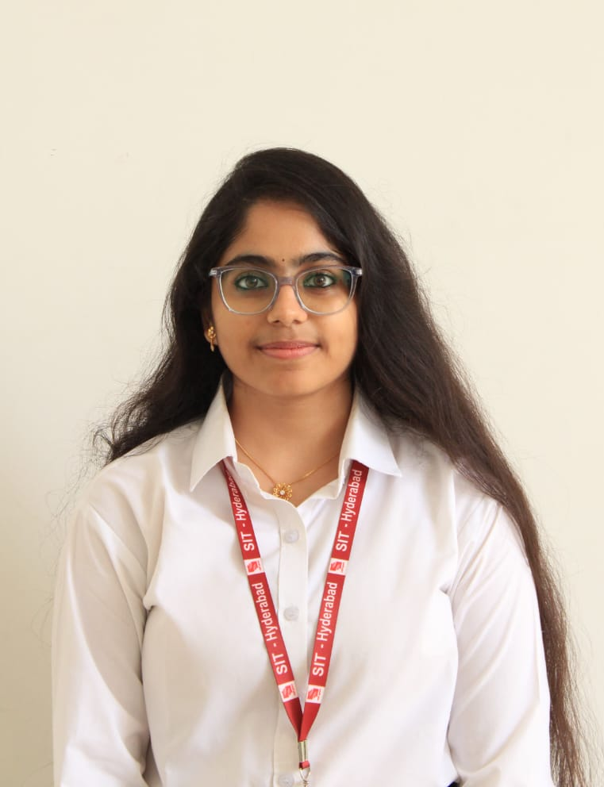
Kurikala Hasini
Student Welfare Committee - Co-Head
Branch: AI & ML

Slide 10
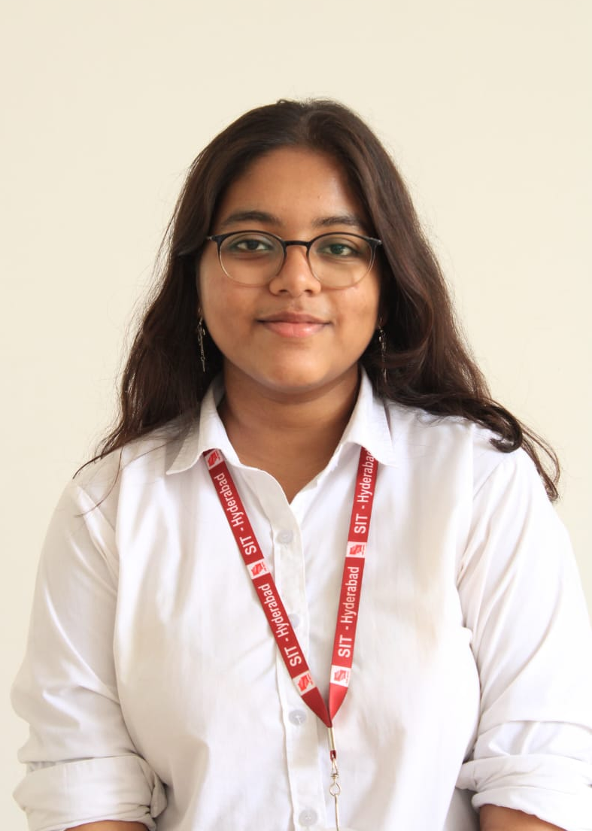
Riya Shastri
Media Committee - Head
Branch: CSE
Manage the Council's digital presence, event coverage, design content, and ensure effective communication with students.

Slide 11
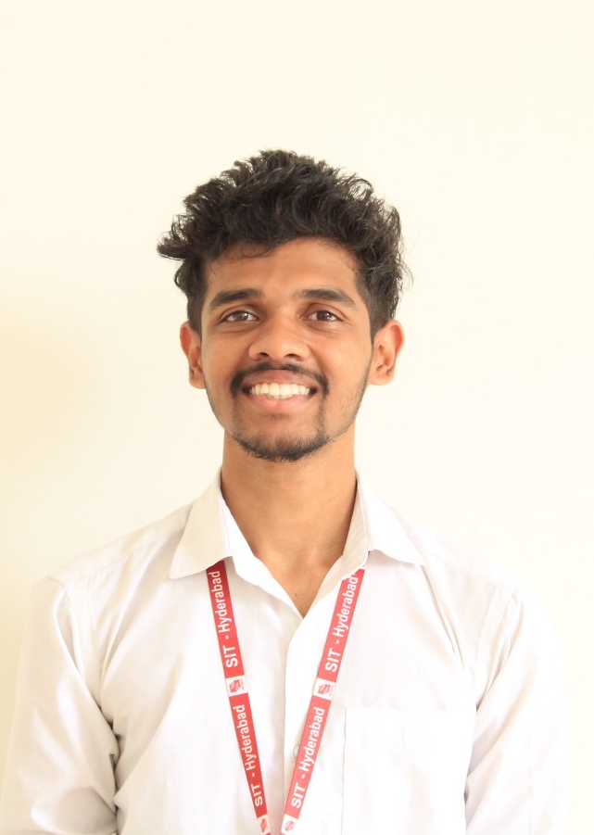
K U Parthiv
Media Committee - Co-Head
Branch: AI & ML

Slide 12
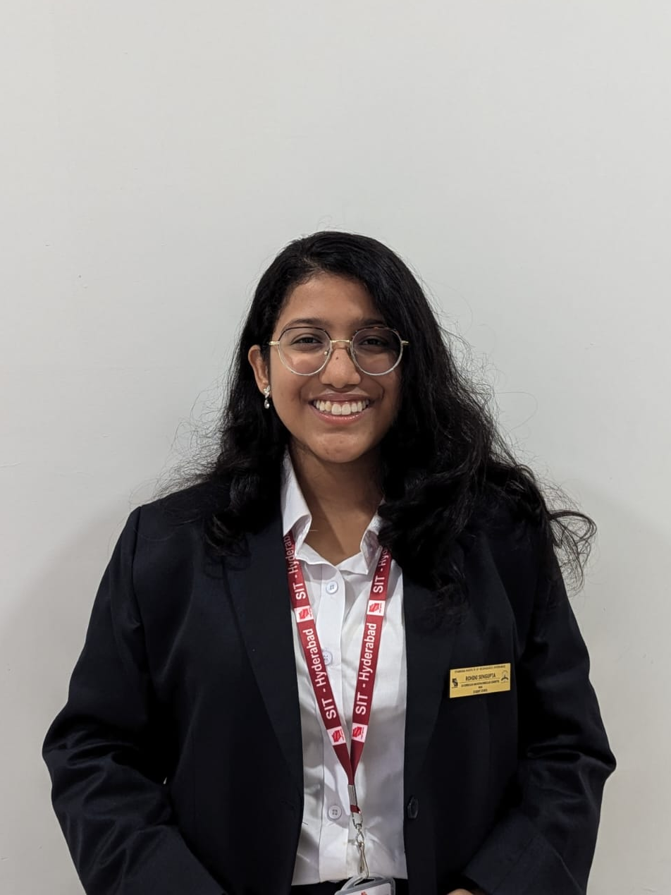
Rohini Sengupta
Co-curricular & Extra-curricular Committee - Head
Branch: CSE
Organize and promote cultural, technical, and sports events to encourage holistic student development.

Slide 13
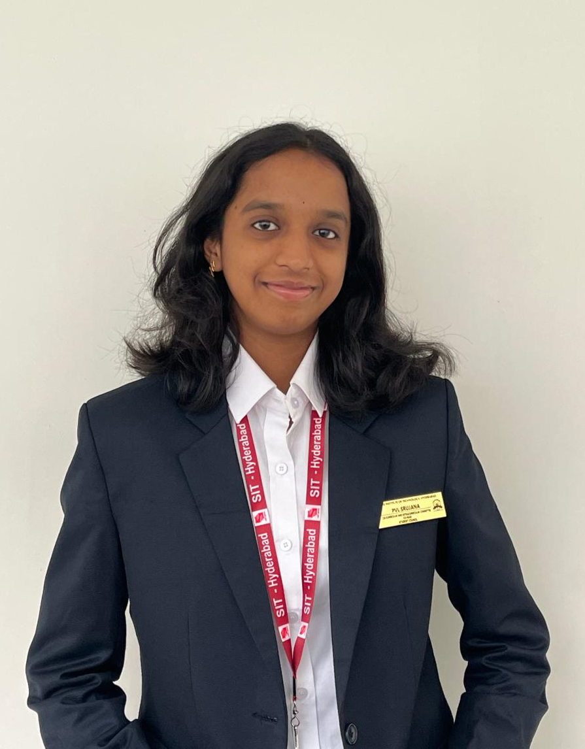
P V L Srujana
Co-curricular & Extra-curricular Committee - Co-Head
Branch: CSE

