Slide 1
fútFicianado ⚛️⚽💬 PLAYER PERFORMANCE ANALYSIS SYSTEM
Sathish Prasad VT - 185001137
Sreyas V - 185001162
Sricharan PP - 185001163

Slide 2
Problem statement
With technology getting involved in almost everything in life these days, sports have become an area for the technology to exploit. With so much data and information, available self-evaluation is very important. With football teams becoming more and more competitive these days, there is a pressing need for good performance analysis. With most teams analyzing on a team performance basis, it would be more helpful for both the management and the players if the analysis is done on a player-to-player basis about stats according to each player’s specific position/role.
We plan to design a client-server model to address the above-mentioned problem pertaining to both the team management and individual players. Our system would help the player to improve specific aspects of his game by viewing the statistical analysis provided based on his previous performances.

Slide 3
features
This system provides individual accounts to each staff member and all the players.
Breakdown of our advanced analysis onto the client side (the players) into simple statistics visualizations for their interpretation in an easy manner.
Among the player specific statistics, the system further curates specific numbers according to their position, which is essential for the players to improve in certain aspects.
Provide an efficient database management engine to smartly manage the details of all players, coaches and crunch the numbers for detailed analysis.
Easy handling of details with operations like adding, deleting, updating players/staff/stats.
Provision of a separate coaches corner for them to provide comments and assistance to every single player pertaining to their previous performances.
Chatroom for the team to have discussions

Slide 4

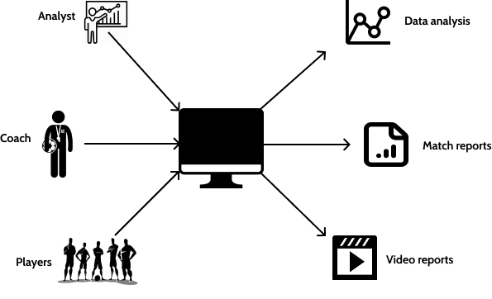
Overview of the
proposed system

Slide 5


Building blocks for interface
+
React JS – FrontEnd BackEnd integrated with Firebase
Firebase – Backend as a Service
(BaaS)

Slide 6

What’s special about the metrics we show ?
We have prepared dashboards using Tableau, one of the best software for data visualization. Our dashboards are dynamic and can include the details of all players/teams in a single dashboard.
Firstly, with a player logging in, we display options to view statistics of individual player, starting from his attributes (attacking , passing and defending) and which of his attributes are higher and lower than league average, the team stats (passing maps, counter attacks etc.) based on the match , and also the metrics of other teams in the league for the players to get and in depth view of how different everyone performs and what they have to improve.

